Slide 1
The Making of the West
SEVENTH EDITION
Chapter 20
Napoleon and the Revolutionary Legacy, 1800–1830
Lynn Hunt
University of California, Los Angeles
Thomas R. Martin
College of the Holy Cross
Barbara H. Rosenwein
Loyola University Chicago
Bonnie G. Smith
Rutgers University
Copyright © 2022 by Bedford/St. Martin’s. Distributed by Bedford/St. Martin’s/
Macmillan Learning strictly for use with its products. Not for redistribution.

Slide 2
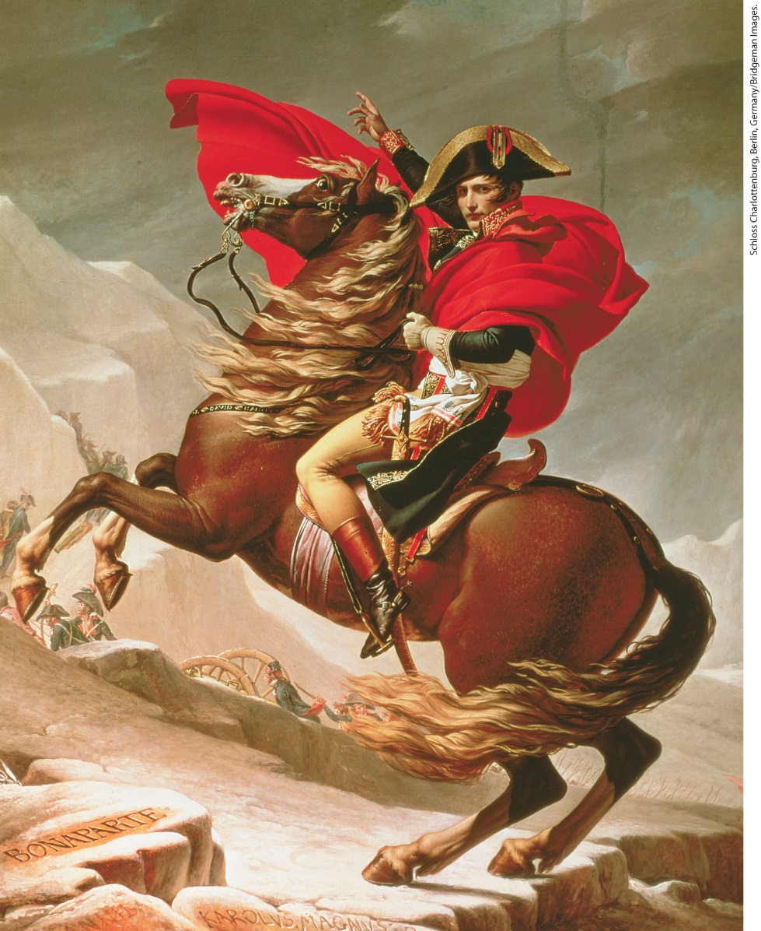
Napoleon as Military Hero

Slide 3
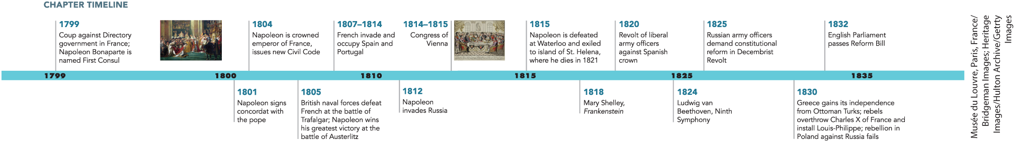
Chapter 20 Timeline

Slide 4
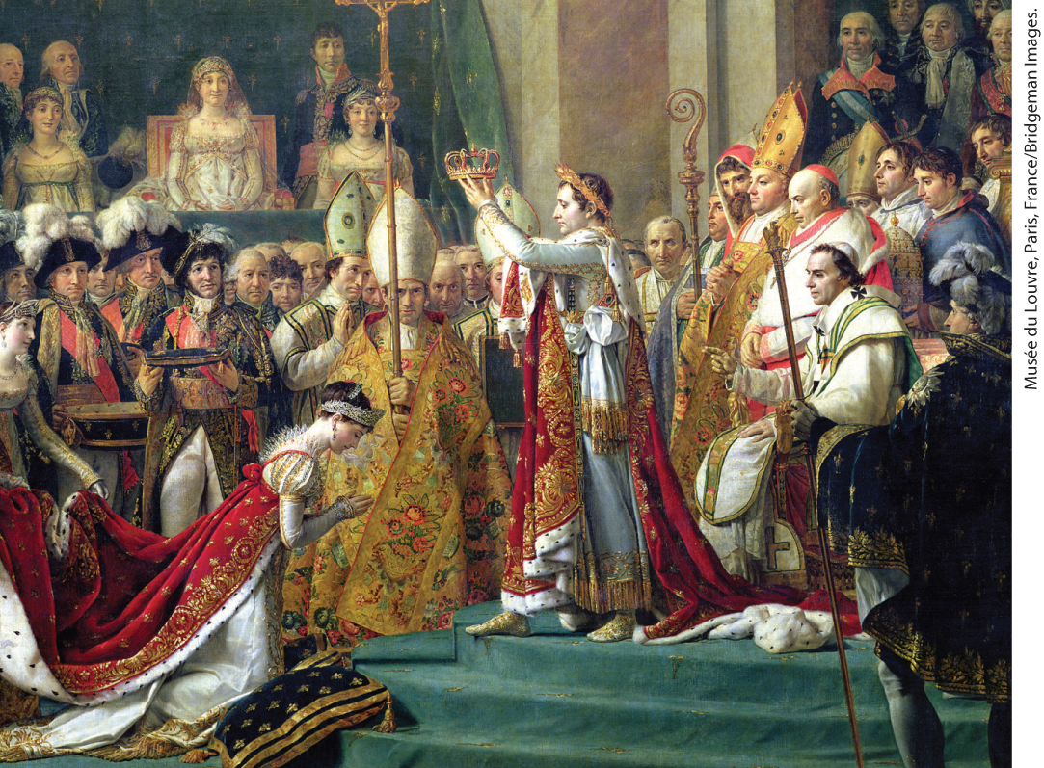
Napoleon’s Coronation as Emperor

Slide 5
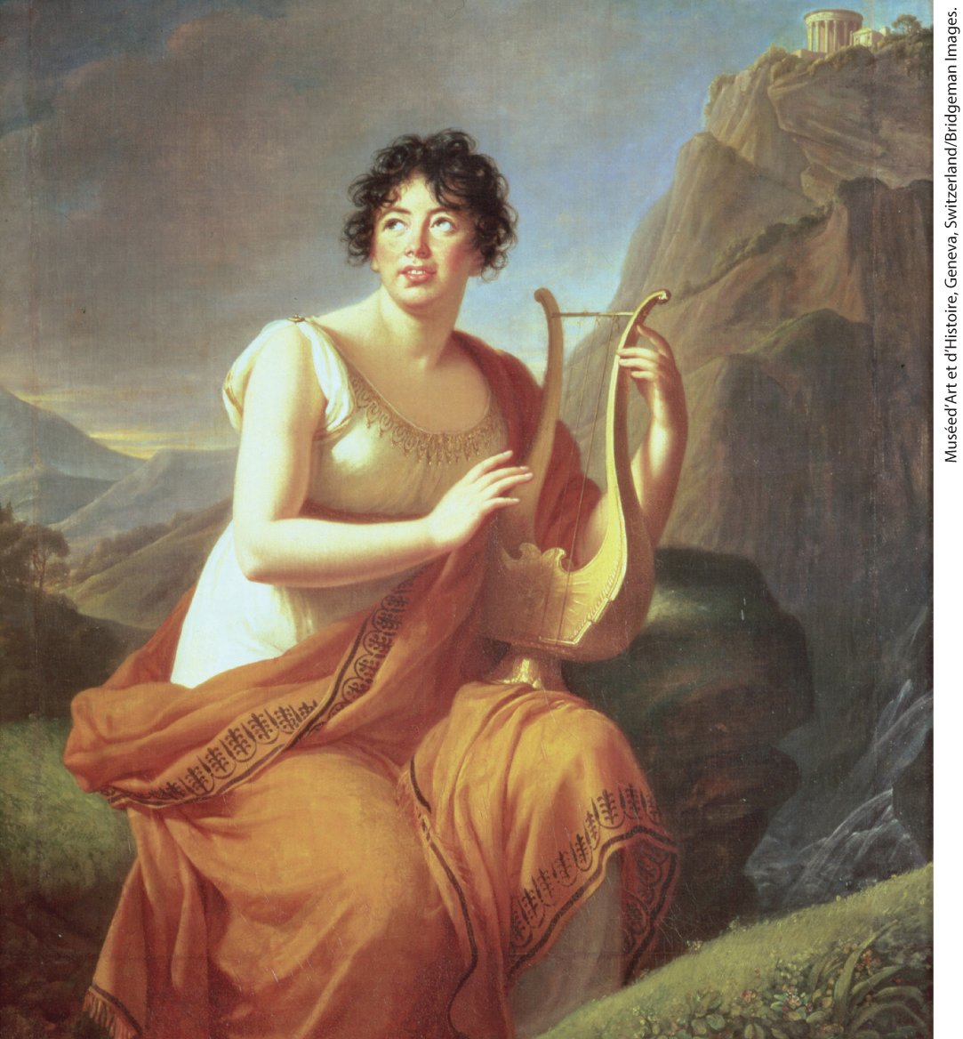
Germaine de Staël

Slide 6
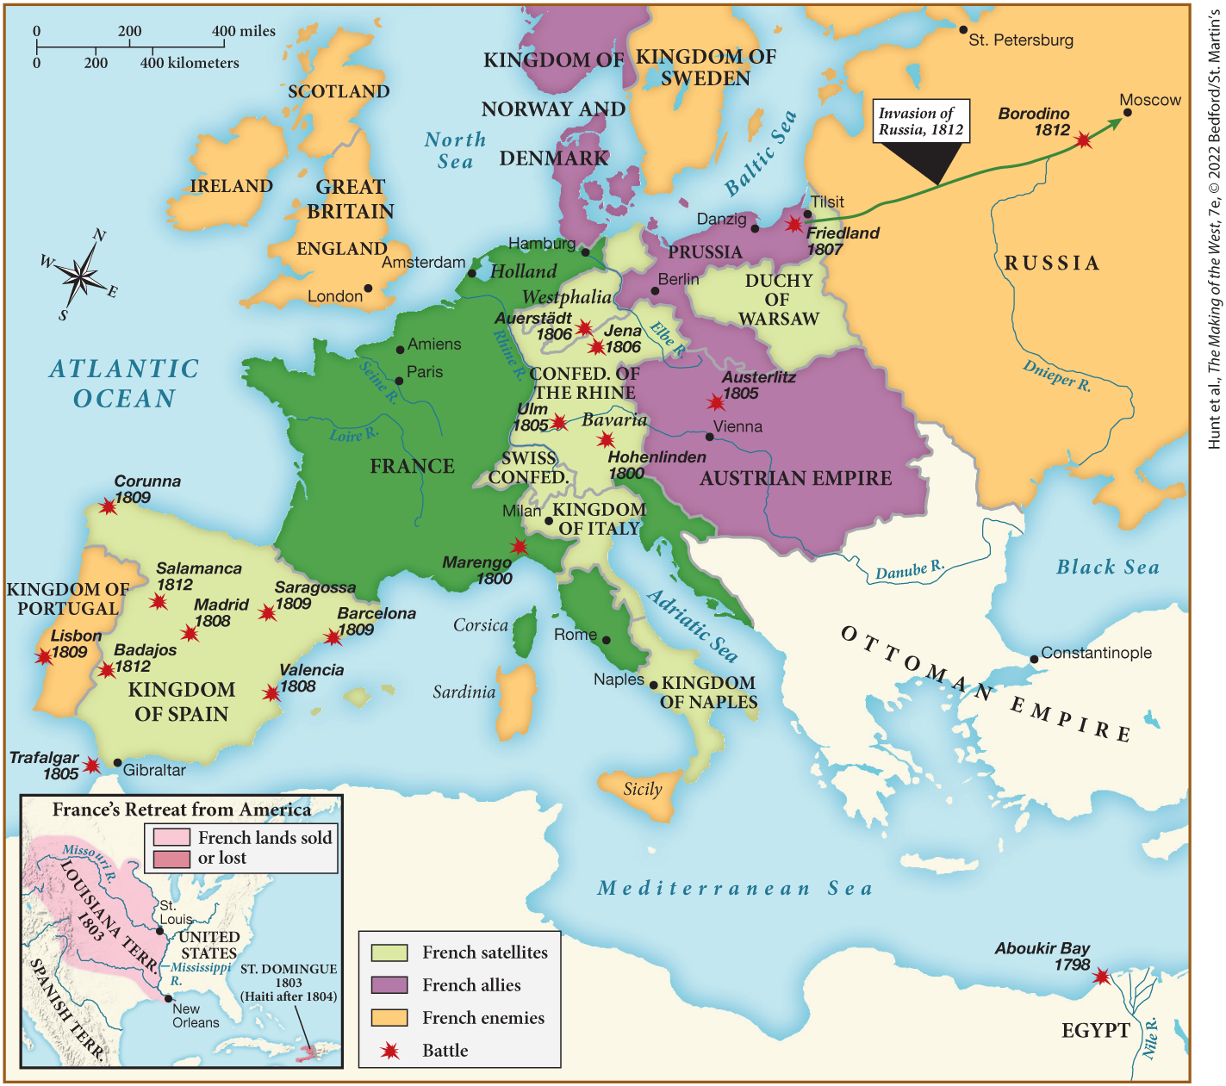
MAP 20.1 Napoleon’s Empire at Its Height, 1812

Slide 7
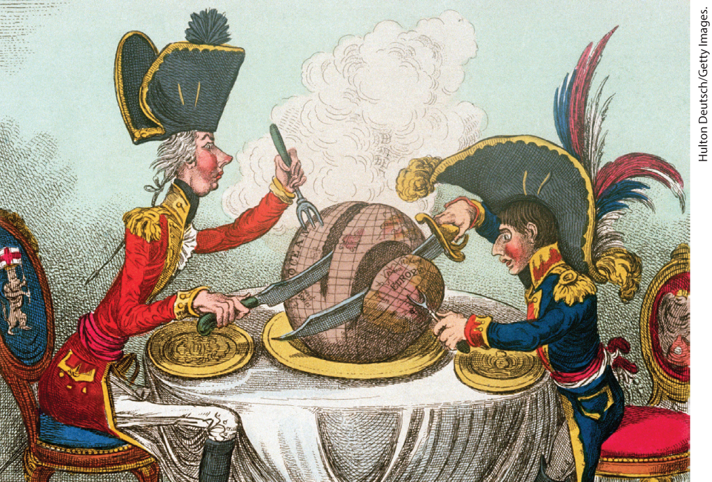
James Gillray, “The Plum-Pudding in Danger”

Slide 8
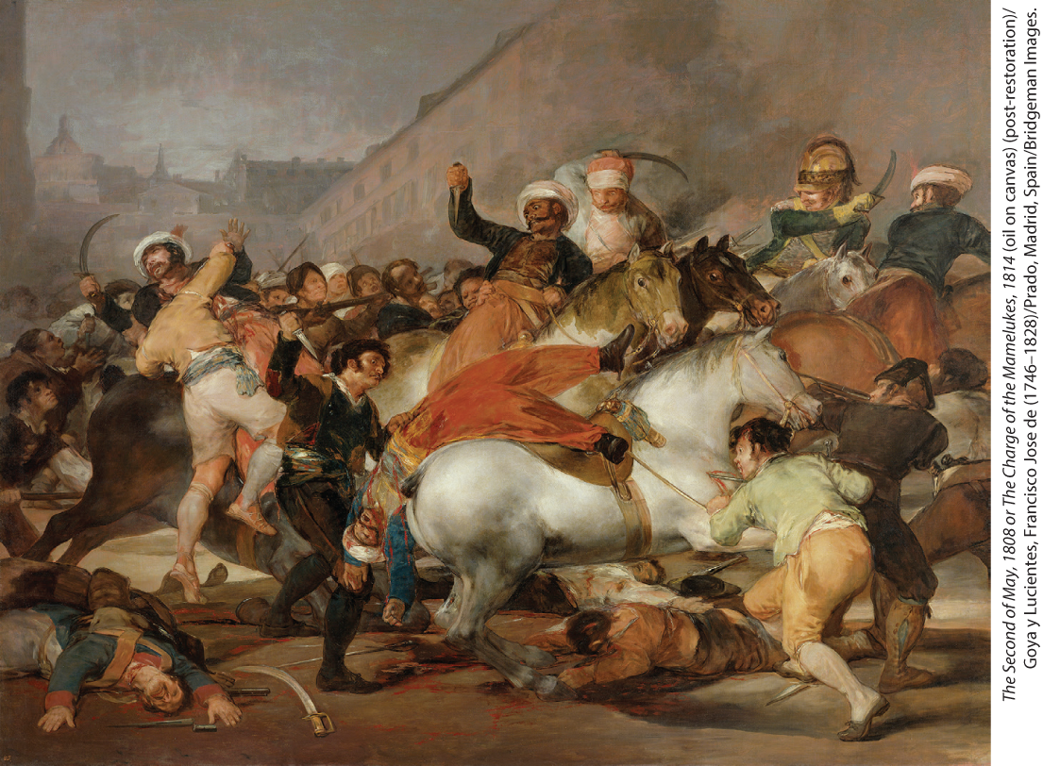
French Atrocities in Spain

Slide 9
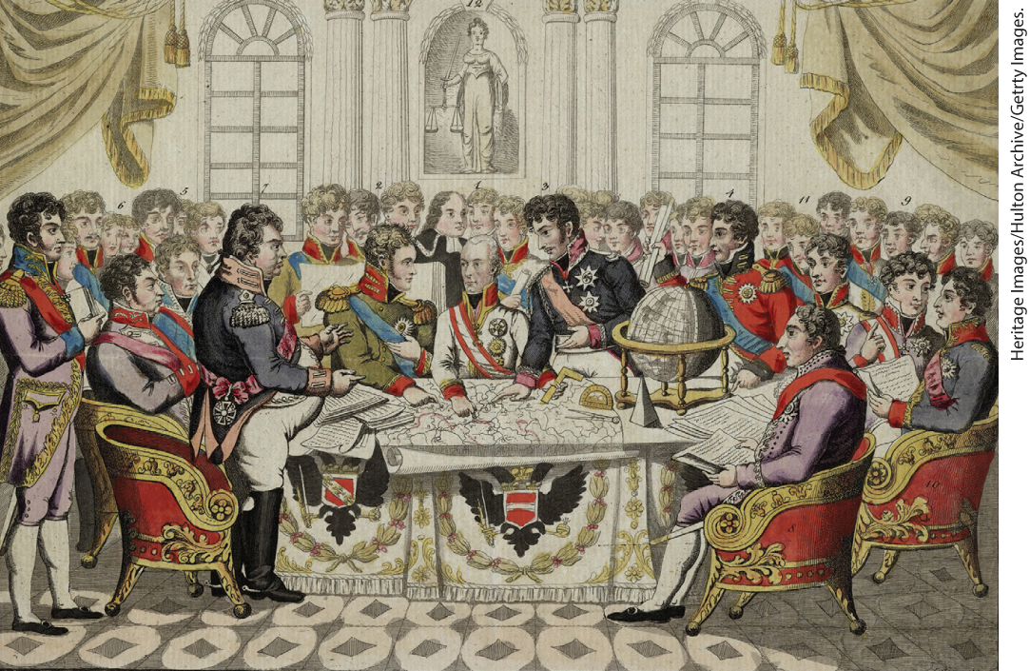
Congress of Vienna

Slide 10
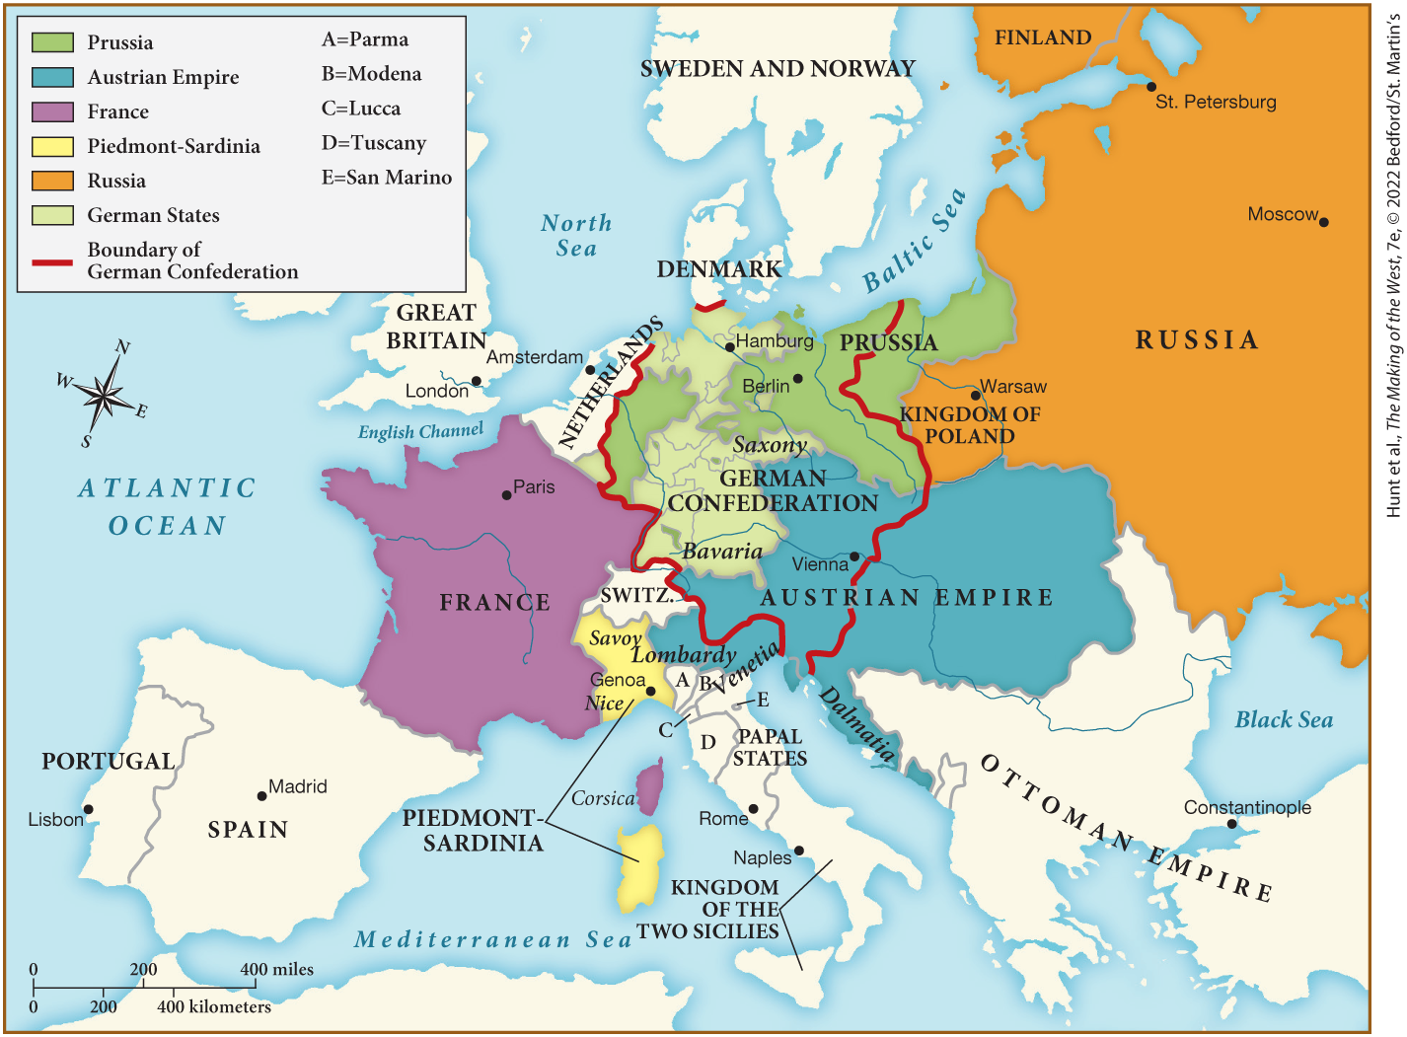
MAP 20.2 Europe after the Congress of Vienna, 1815

Slide 11

Environment Matters: Nature Tourism

Slide 12
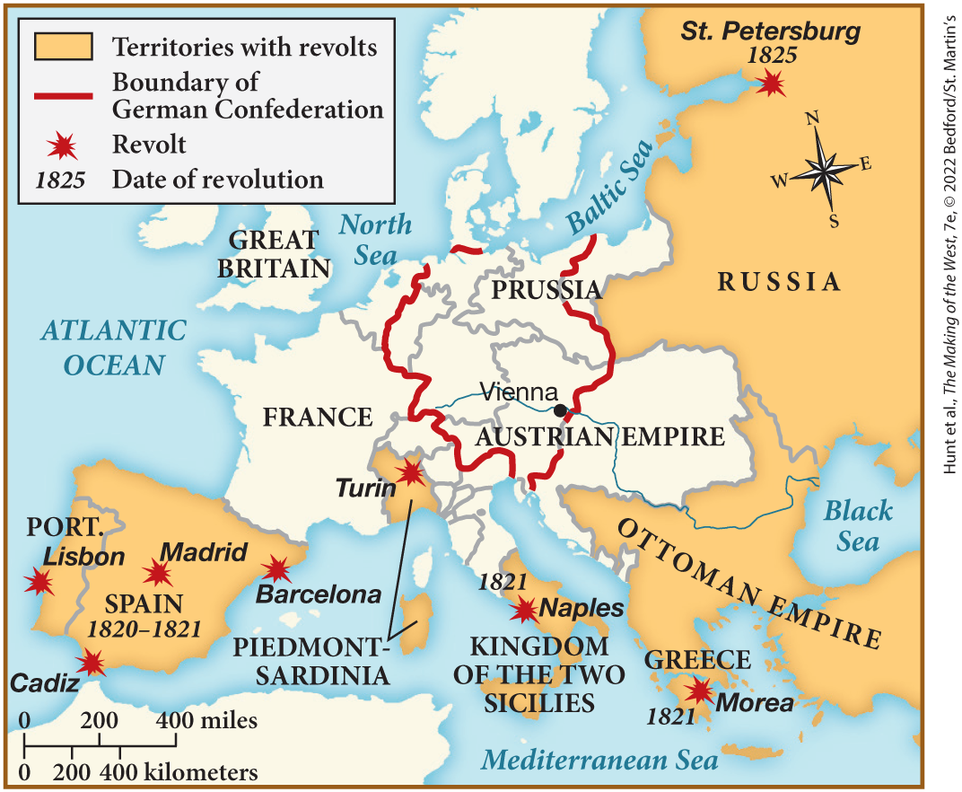
MAP 20.3 Revolutionary Movements of the 1820s

Slide 13
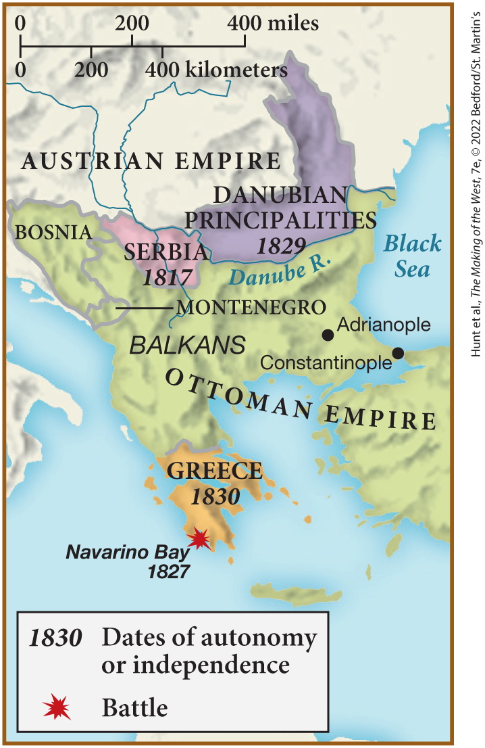
SPOT MAP 20.1 Nationalistic Movements in the Balkans, 1815–1830

Slide 14
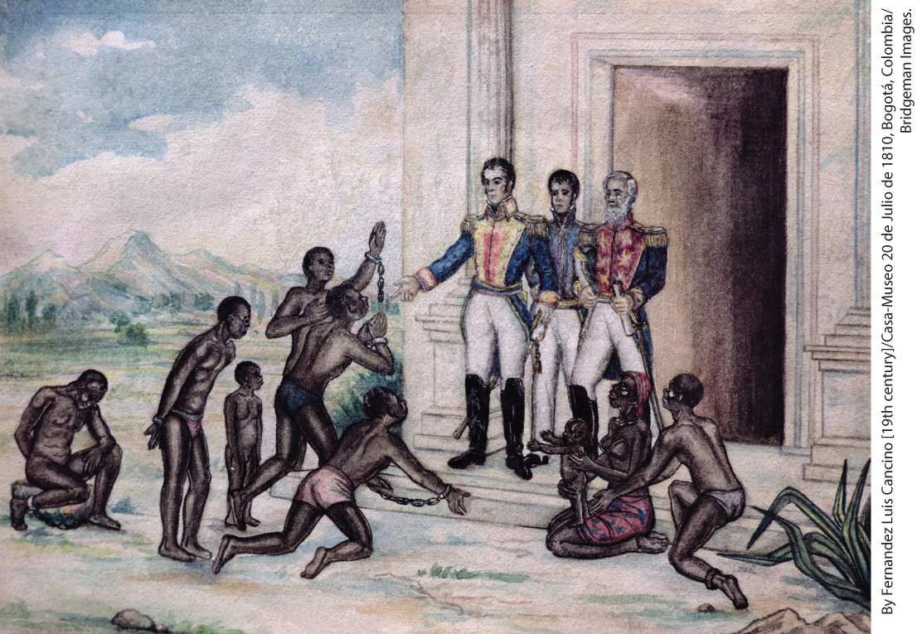
Simón Bolívar

Slide 15
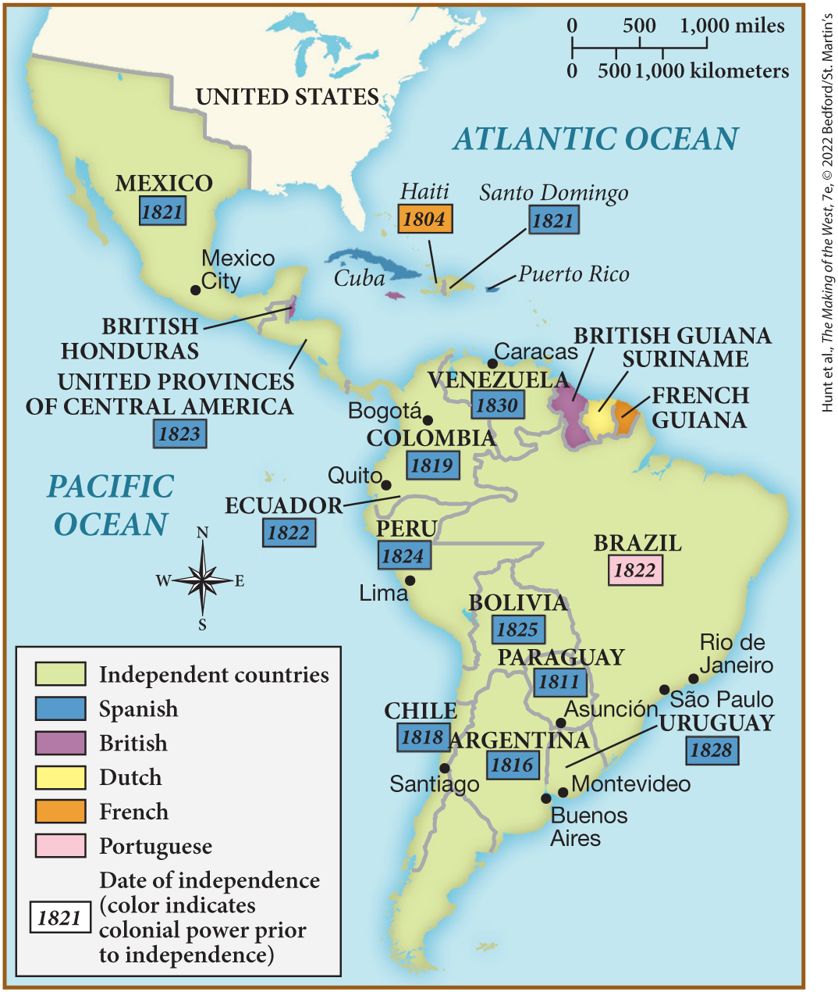
MAP 20.4 Latin American Independence, 1804–1830

Slide 16
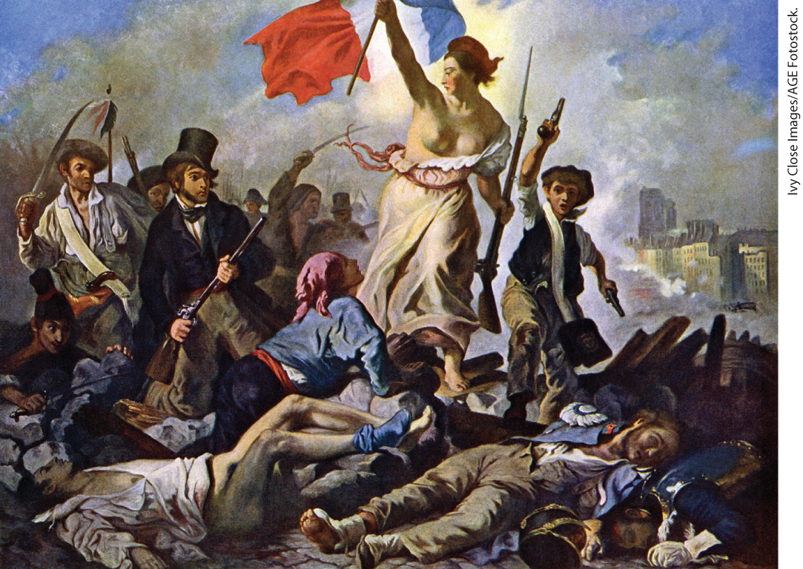
Eugène Delacroix, Liberty Leading the People (1830)

Slide 17
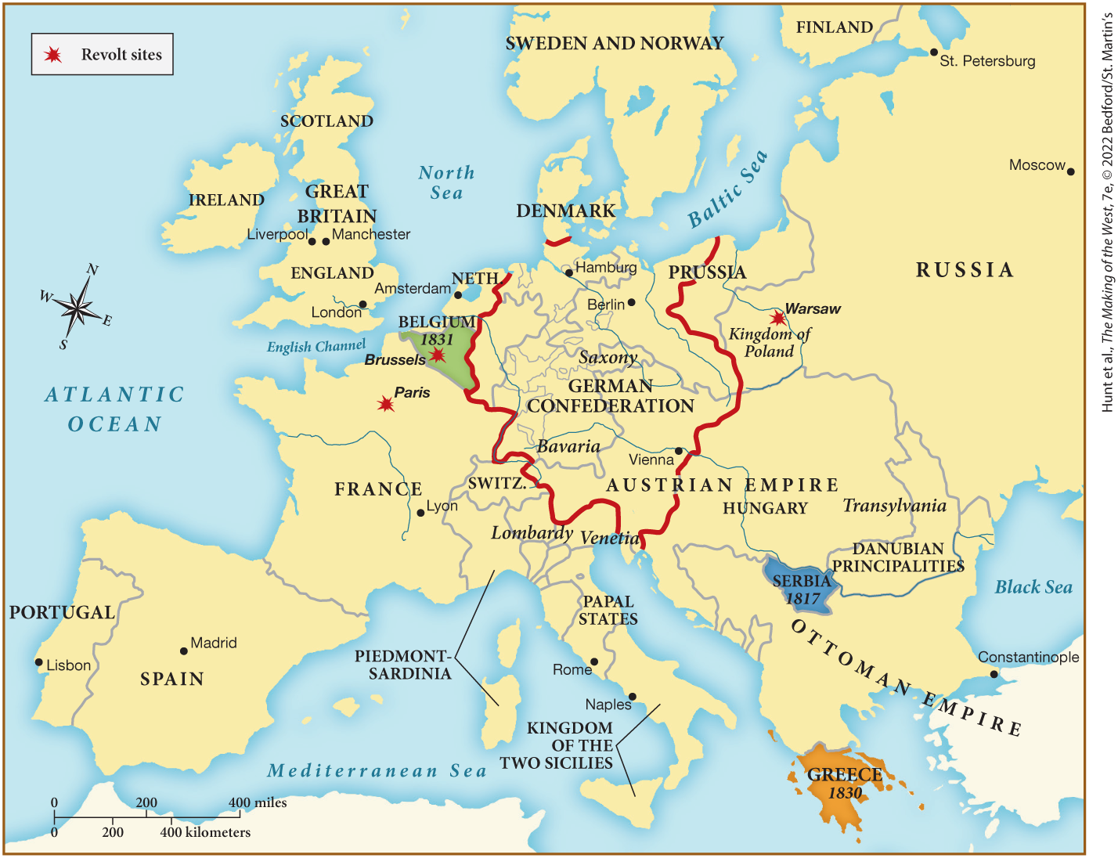
MAP 20.5 Mapping the West: Europe in 1830

