Slide 1
The Making of the West
Seventh Edition
Hunt • Martin • Rosenwein • Smith
CHAPTER 29
A New Globalism
1989 TO THE PRESENT
Copyright © 2022 by Bedford/St. Martin’s
Distributed by Bedford/St. Martin’s/Macmillan Learning strictly for use with its products. Not for redistribution.

Slide 2

Global Citizens

Slide 3
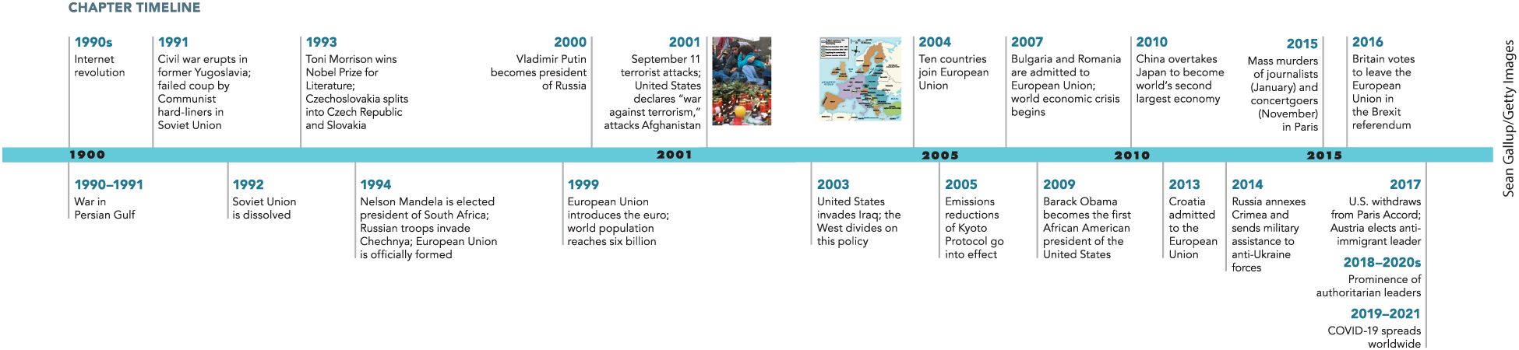
Chapter 29 Timeline

Slide 4
I. Collapse of the Soviet Union and Its Aftermath (1 of 5)
A. The Breakup of Yugoslavia (1 of 2)
  Tensions erupt in Yugoslavia when Serbian president Slobodan Milosevic begins to assert control of the Yugoslav federation
  Yugoslavia resists and calls for secession
  Slovenia and Croatia secede, Serb-dominated Yugoslav army invades Croatia
  Civil war breaks out in Bosnia-Herzegovina, Bosnian Serbs form a guerrilla army
  Tens of thousands die under Milosevic’s policy of genocide
Notes:
I. Collapse of the Soviet Union and Its Aftermath (1 of 5)
A. The Breakup of Yugoslavia (1 of 2)
Tensions erupted in Yugoslavia in 1990 when Slobodan Milosevic, the president of Serbia, began to assert Serbian control of the Yugoslav federation as a replacement for communism.
Other ethnic groups in Yugoslavia resisted Milosevic’s pro-Serb nationalism and called for secession.
In 1991, when Slovenia seceded followed by Croatia, the Serb-dominated Yugoslav army invaded Croatia.
An even worse civil war engulfed Bosnia-Herzegovina where the Muslim majority attempted to create a multiethnic state and Bosnian Serbs formed a guerrilla army supported by Milosevic.
Tens of thousands perished, and countless atrocities, including mass rape, were committed under Milosevic’s policy of genocide called ethnic cleansing.

Slide 5
I. Collapse of the Soviet Union and Its Aftermath (2 of 5)
A. The Breakup of Yugoslavia (2 of 2)
  Intervention by peacekeepers was ineffectual
  Campaign was followed by attack in Albanian region of Kosovo
  NATO bombs Serbia, and UN peacekeeping forces intervene
  Milosevic is captured and tried for crimes against humanity
Notes:
A. The Breakup of Yugoslavia (2 of 2)
Intervention by peacekeepers was ineffectual.
This campaign was followed by attacks in the Albanian region of Kosovo.
After several years of violence, NATO bombed Serbia, and UN peacekeeping forces intervened to enforce an interethnic truce.
Milosevic was captured and handed over to the International Court of Justice, or World Court, to be tried for crimes against humanity.

Slide 6
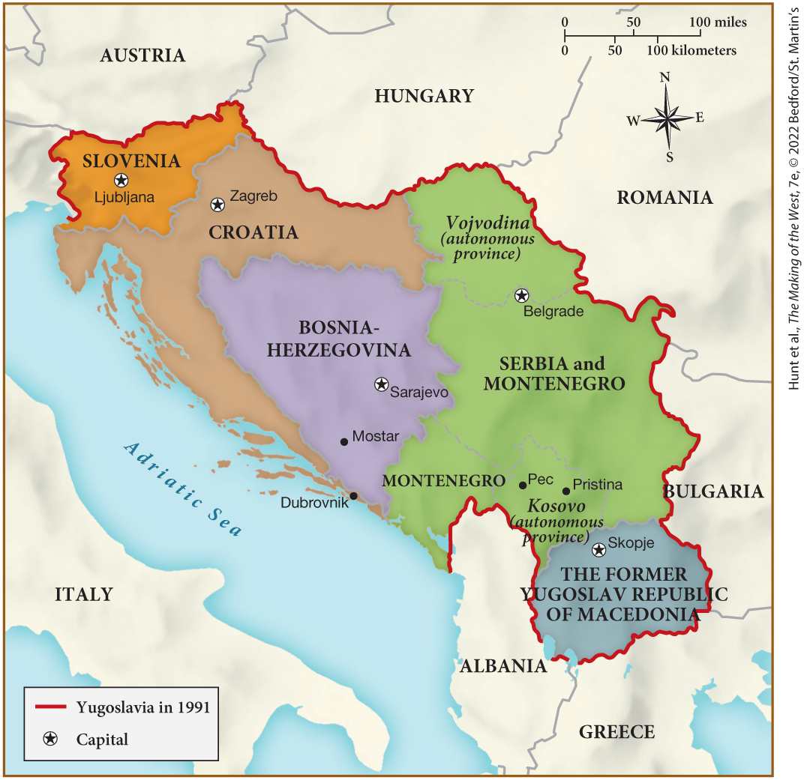
MAP 29.1 The Former Yugoslavia, c. 2000

Slide 7
I. Collapse of the Soviet Union and Its Aftermath (3 of 5)
B. The Soviet Union Comes Apart (1 of 2)
  Collapse of the Soviet Union launches a string of secessions
  Mikhail Gorbachev’s policies fail to revitalize the Soviet economy
  Boris Yeltsin is elected president of the Russian parliament
  In response, an unsuccessful coup launches
  The Soviet Union disintegrates after the failed coup as republics declared independence
  These secessions often led to ethnic violence
Notes:
B. The Soviet Union Comes Apart (1 of 2)
The total collapse of the Soviet Union (1992) launched a string of secessions with the potential for widespread regional, and perhaps even global, destabilization.
Mikhail Gorbachev’s policy of perestroika had, by 1990, failed to revitalize the Soviet economy.
In 1991, Boris Yeltsin was elected president of the Russian parliament over the Communist candidate.
In response, a group of hard-liners who opposed reform launched an unsuccessful coup that fell apart when civilians took to the streets in favor of reform, and military units defected to protect Yeltsin.
The Soviet Union disintegrated after the failed coup as one republic after another declared their independence.
These secessions were often followed by bloody, ethnic violence.

Slide 8
I. Collapse of the Soviet Union and Its Aftermath (4 of 5)
B. The Soviet Union Comes Apart (2 of 2)
  Gorbachev retires and Yeltsin accelerates the transition to a market economy
  Russian economy falls into further crisis as corruption spreads through the government
  Scandals involving Yeltsin force him to resign, his protégé Vladimir Putin becomes interim president
  Putin was a strong leader committed to democracy as the “dictatorship of law”
  Putin transfers Russia’s natural resources and assets to himself
Notes:
I. Collapse of the Soviet Union and Its Aftermath (4 of 5)
B. The Soviet Union Comes Apart (2 of 2)
Gorbachev retired from politics, and Yeltsin accelerated the transition to a market economy.
The Russian economy fell into further crisis as corrupt officials sold state property for personal profit, and Yeltsin’s own family was charged with corruption.
Political order, social disarray, and a corruption scandal involving Yeltsin and his family forced him to resign on December 31, 1999, and he appointed his protégé Vladimir Putin as interim president.
Although Putin was himself associated with the Yeltsin corruption scandal, he was a strong leader, committed to democracy as the “dictatorship of law,” and he drove corrupt politicians from office, restored strong government, and ended the influence of billionaires.
But, according to scholars knowledgeable in Russian politics and history, Putin was merely transferring Russia’s natural resources and assets to himself.

Slide 9
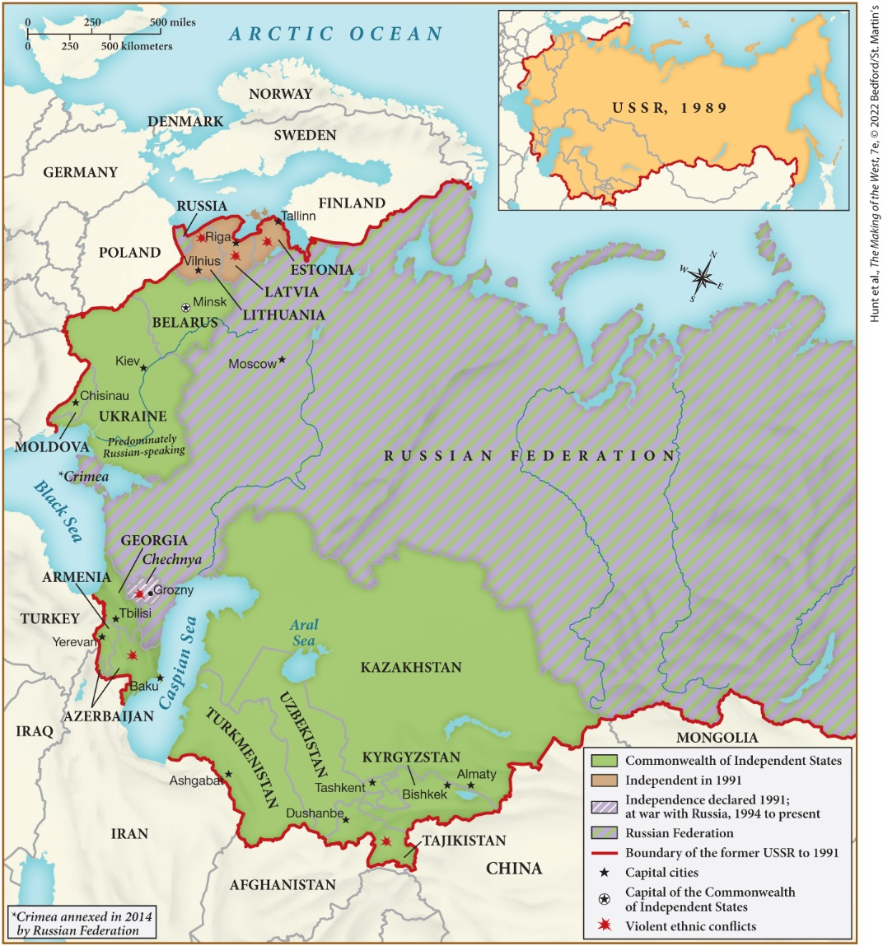
MAP 29.2 Countries of the Former Soviet Union, c. 2021

Slide 10
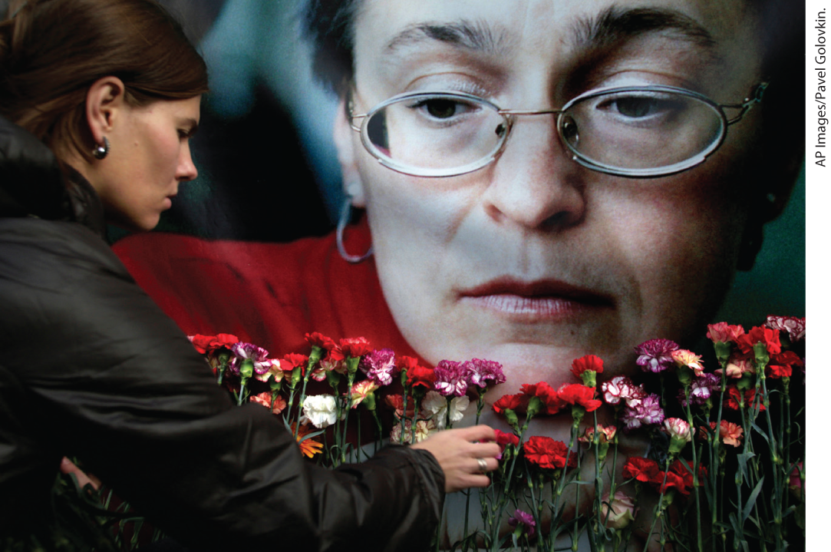
Assassination in Moscow

Slide 11
I. Collapse of the Soviet Union and Its Aftermath (5 of 5)
C. Toward a Market Economy
  Changes bring misery to Russia and the rest of eastern Europe
  Salaries are unpaid and many turn to desperate measures to survive
  Others flee to more prosperous parts of the world
  Many opposed Putin’s changes, farmers feared privatization of their land
  Countries such as Hungary and Poland emerge from the transition less strained, whereas political turmoil continues in other countries
  Former Soviet Union suffered from “brain drain” as talented workers emigrate
Notes:
I. Collapse of the Soviet Union and Its Aftermath (5 of 5)
C. Toward a Market Economy
The attempt to develop a free market and a republican government brought misery to Russia and the rest of eastern Europe.
As salaries went unpaid, particularly for the army and state employees, desperate measures to survive were sought, such as prostitution or selling household possessions.
Others, particularly the young and educated, chose permanent emigration to more prosperous parts of the world.
Many opposed the changes. Collective farmers feared privatization of their land would take away the only security they had ever known.
Countries such as Hungary and Poland, where administrators had earlier introduced elements of free trade, emerged from the transition less strained, whereas other countries continued to be mired in political corruption, tax evasion, and black markets.
The former Soviet Union also suffered from a “brain drain” because the newly opened borders permitted talented workers with marketable skills to emigrate in search of better opportunities and living conditions.

Slide 12
II. The Nation-State in a Global Age (1 of 5)
A. Europe Looks beyond the Nation-State (1 of 2)
  European Community opens the pathway to unified policy in economic matters, evolving into the European Union
  Twelve countries of the Common Market end nationalistic distinctions, ending passport controls at the borders
  Citizens of the European Community (EC) carried a common passport
  In 1994, the EC became the European Union (EU)
  The euro is developed and replaces the national currency of most EU members
  The EU parliament and subgroups negotiate cultural, economic, and social policies
  The EU takes a pacifist role, traditional enemies such as Greece and Turkey become supportive
Notes:
II. The Nation-State in a Global Age (1 of 5)
A. Europe Looks beyond the Nation-State (1 of 2)
The European Community opened the pathway to supranational, unified policy in economic matters, and its evolution into the European Union expanded cooperation into political and cultural matters.
In 1992, the twelve countries of the Common Market ended nationalistic distinctions in the spheres of business activity, border controls, and transportation, effectively ending passport controls at the borders between most Common Market countries.
Citizens of the European Community (EC) carried a common passport, and municipal governments agreed to treat all member nations’ firms the same.
In 1994, the EC became the European Union (EU) under the terms of the Maastricht Treaty.
In 1999, the euro came into being, and in 2002, it entirely replaced the national currency of most EU members.
The EU parliament convened regularly in Strasbourg, France; subgroups met to negotiate cultural, economic, and social policies.
One of the advantages of the EU was the pacifist role it played in Europe, as traditional enemies such as Greece and Turkey became supportive of each other.

Slide 13
II. The Nation-State in a Global Age (2 of 5)
A. Europe Looks beyond the Nation-State (2 of 2)
  Cooperation bolsters the economies of early members such as Greece
  The collapse of the Soviet Union brings eastern European nations closer to the West
  Lower wages and business costs in eastern Europe attracted foreign investment.
  Ten new members join the EU in 2004, and two more in 2007
  Standards of living improve, though discrepancies remain between thriving cities and ailing countryside
  Purchasing power of many Eastern countries grows
  Opportunities for well-educated eastern Europeans increased
Notes:
II. The Nation-State in a Global Age (2 of 5)
A. Europe Looks beyond the Nation-State (2 of 2)
The benefits of EU membership were made clear to nations in eastern Europe, as economic cooperation and the infusion of EU funds bolstered the economies of early members such as Greece.
The collapse of the Soviet Union had brought eastern European nations closer to the West, especially as industries became privatized and were purchased by Western firms.
Lower wages and business costs in eastern Europe attracted foreign investment.
Ten new members, mostly from central and eastern Europe, joined the EU in 2004, and two more in 2007.
Although the standards of living in many of these countries had risen in the late 1990s, there were large discrepancies between the thriving cities and the ailing countryside.
As the purchasing power of many Eastern countries grew, sales of consumer items — automobiles, computers, portable phones, and freezers — also rose.
Opportunities for well-educated eastern Europeans increased. Consumption assumed symbolic importance for many as a sign that isolation and Communist poverty had ended.

Slide 14
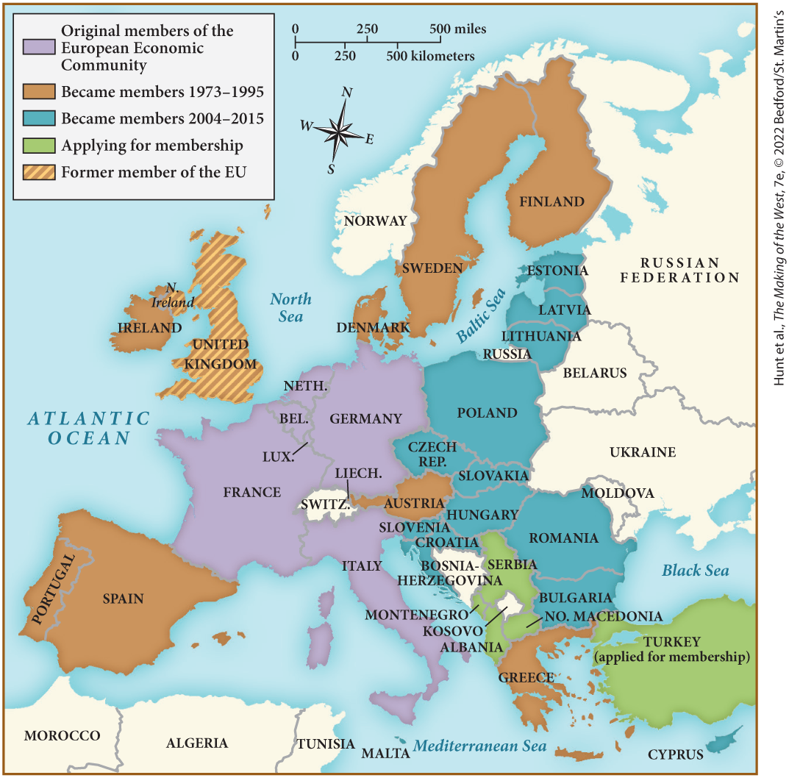
MAP 29.3 The European Union in 2021

Slide 15
II. The Nation-State in a Global Age (3 of 5)
B. Globalizing Cities and Fragmenting Nations (1 of 2)
  The West fragments into more nation-states and consolidated forms such as the global city
  Global cities are urban areas whose roles were overwhelmingly global rather than regional or national
  These cities contain organizations and enterprises that operate across local and national borders
  The cost of living in global cities becomes expensive, driving mid-level managers to suburbs and service providers into poor living conditions
Notes:
B. Globalizing Cities and Fragmenting Nations (1 of 2)
During this transitional period, the West fragmented into more nation-states and consolidated new forms, most notably the global city.
Global cities were urban areas whose institutions, functions, and visions were overwhelmingly global rather than regional or national.
These cities contained stock markets, legal firms, insurance companies, financial service organizations, and other enterprises that operated across local and national borders.
The high-powered and high-priced nature of such enterprises made the cost of living in global cities highly expensive, which drove mid-level managers to seek lower-priced housing in the suburbs and the lowest-paid service providers into poorer living conditions.

Slide 16
II. The Nation-State in a Global Age (4 of 5)
B. Globalizing Cities and Fragmenting Nations (2 of 2)
  Global cities become centers of migration, draw criticism as centers of concentrated wealth
  There were more nations in Europe in 2000 than there had been in 1945
  Czechoslovakia splits into the Czech Republic and Slovakia
  Activists in the some regions of France and Spain push for autonomy, at times resorting to terrorism
  There was also a push for the independence of northern Italy
Notes:
II. The Nation-State in a Global Age (4 of 5)
B. Globalizing Cities and Fragmenting Nations (2 of 2)
Global cities became centers of migration with the many opportunities they offered, although they also drew criticism as centers of concentrated wealth, which was often observed to be taken at the expense of poorer, southern countries.
There were more nations in Europe in 2000 than there had been in 1945, as individual nation-states fragmented under the rising tide of ethnicity.
In 1993, Czechoslovakia split into the Czech Republic and Slovakia.
Activists in the Breton and Corsican regions of France and the Basque region of Spain pushed for autonomy, at times resorting to terrorism.
There was also a push for the independence of northern Italy.

Slide 17
II. The Nation-State in a Global Age (5 of 5)
C. Global Organizations
  Globalization allows supranational organizations to regulate international politics, finance and social issues
  World Bank, International Monetary Fund (IMF), World Trade Organization raise deal with global economic issues
  The IMF grants loans to developing countries on the condition that they restructure their economies
  Other supranational organizations are charitable foundations
  Nongovernmental organizations (NGOs) control vast sums of money and international power
  After the fall of the USSR, NGOs shape economic and social policy
  Some groups such as Association for the Taxation of Financial Transactions and Aid to Citizens (ATTAC) oppose globalization
Notes:
II. The Nation-State in a Global Age (5 of 5)
C. Global Organizations
Globalization spawned the proliferation of supranational organizations to regulate international politics and address finance and social issues.
The World Bank, the International Monetary Fund (IMF), and the World Trade Organization raised money from national governments and dealt with global economic issues.
Raising money from individual governments, the IMF granted loans to developing countries on the condition that they restructure their economies according to neoliberal principles.
Other supranational organizations were charitable foundations, many of which were based in Europe and the United States.
Some of these nongovernmental organizations (NGOs) controlled vast sums of money and possessed considerable international power.
After the fall of the USSR, NGOs used their resources to shape economic and social policy and the course of political reform.
Not everyone supported globalization, such as the Association for the Taxation of Financial Transactions and Aid to Citizens (ATTAC), which worked to block the control of globalization by the forces of high finance.

Slide 18
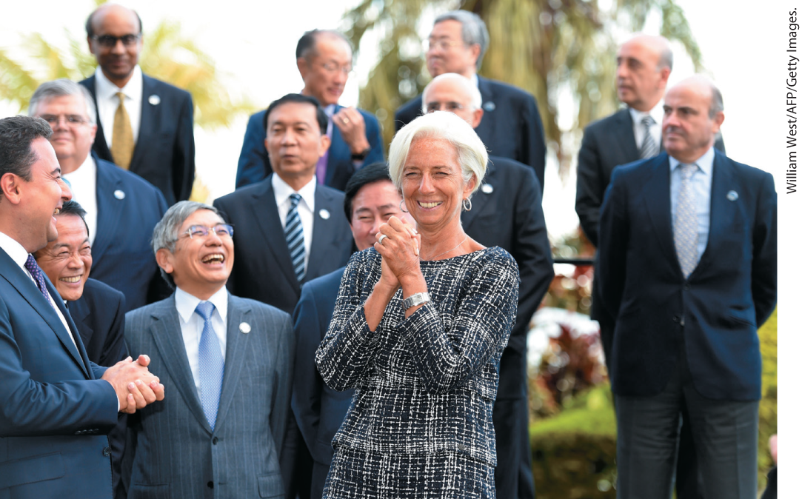
Christine Lagarde, Head of the European Central Bank

Slide 19
III. An Interconnected World’s Challenges (1 of 10)
A. The Earth and Its People Threatened (1 of 2)
  Rising globalization coincides with a number of challenges
  In 1986 Chernobyl explodes and spews radioactive dust into the atmosphere
  Thousands of locals perish from the effects of radiation
  Numerous bodies of water across Asia were filled with toxic wastes from nuclear testing and the dumping of nuclear, Japan experiences a tsunami that causes Fukushima nuclear operations to melt down
  Fossil-fuel pollutants produce acid rain, a poisonous brew that destroyed forests
  Clearing of forests for farming deplete the global oxygen supply and threatened the biological diversity of the entire planet
  The use of chlorofluorocarbons (CFCs) damage Earth’s atmosphere
Notes:
III. An Interconnected World’s Challenges (1 of 10)
A. The Earth and Its People Threatened (For a close look at one of the important environmental history topics in this chapter, see “Environment Matters: The German Reichstag: Reborn and Green.”) (1 of 2)
The rising tide of globalization coincided with a number of challenges, including the rise of criminal cartels, climate change, contagious diseases, and global inequality.
In 1986, the nuclear plant at Chernobyl in the Soviet Union exploded during a test of reactor No. 4 and spewed radioactive dust into the atmosphere, killing more than a dozen people instantly.
Thousands of locals perished over a period of time from the effects of radiation.
Numerous lakes, rivers, and seas across Asia were filled with toxic wastes from nuclear testing and the dumping of nuclear fuel, making them completely uninhabitable. In 2011, Japan experienced an earthquake and tsunami that caused its nuclear operations at Fukushima to melt down.
In industrial areas, fossil-fuel pollutants from natural gas, coal, and oil mixed with atmospheric moisture to produce acid rain, a poisonous brew that destroyed forests.
In less industrial areas, the clearing of forests for farming depleted the global oxygen supply and threatened the biological diversity of the entire planet.
The use of chlorofluorocarbons (CFCs), chemicals contained in or released by aerosols, refrigeration products, and automobile and industrial emissions, damaged Earth’s atmosphere.

Slide 20
III. An Interconnected World’s Challenges (2 of 10)
A. The Earth and Its People Threatened (2 of 2)
  Many worried that dramatic weather changes were the product of global warming
  Rising activity to protect the environment took decades to develop
  In West Germany, the Green Party is successful in promoting political awareness on environmental issues
  Europeans confront environmental problems on both the local and global level
  The Paris Climate Agreement, signed by 195 nations, dealt with reducing greenhouse gas emissions
  The withdrawal of the United States from this agreement made cooperation difficult
Notes:
III. An Interconnected World’s Challenges (2 of 10)
A. The Earth and Its People Threatened (For a close look at one of the important environmental history topics in this chapter, see “Environment Matters: The German Reichstag: Reborn and Green.”) (2 of 2)
Many worried that the ensuing dramatic weather changes were the product of the greenhouse effect and its consequence, global warming.
Rising activity to protect the environment took decades to develop.
In West Germany, the Green Party was founded in 1979 and was successful in promoting political awareness on environmental issues across Europe.
Europeans confronted environmental problems on both the local and global level, with many cities adopting more environmentally sound policies and many countries implementing alternatives to fossil fuel.
In 2015, the Paris Climate Agreement, signed by 195 nations, dealt with reducing greenhouse gas emissions, with countries setting specific individual reductions.
The withdrawal of the United States — the world’s second biggest polluter after China — from this agreement made cooperation on environmental protection a symbol of a potential fragmenting of the West.

Slide 21
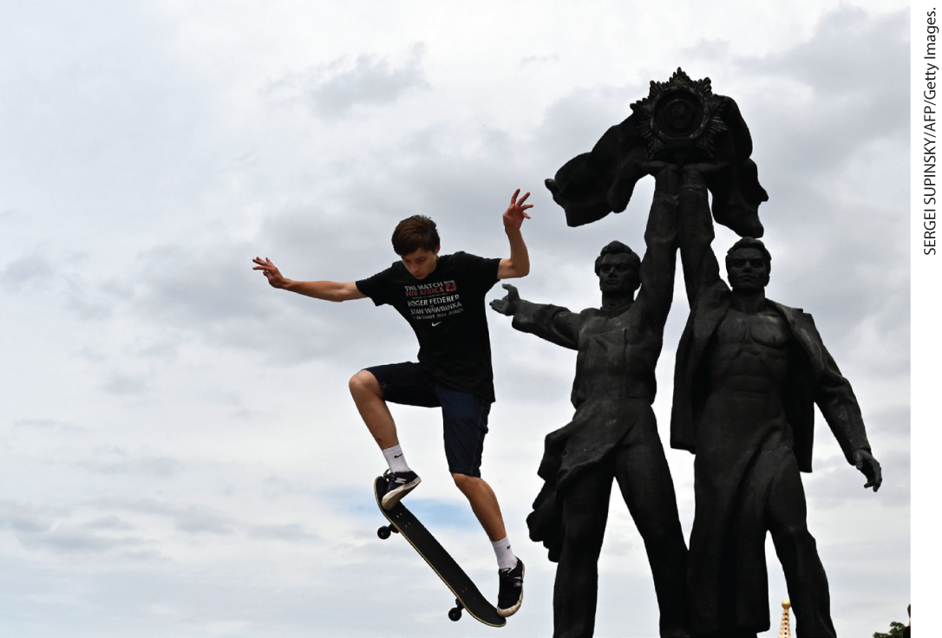
Skateboarder in Front of Soviet-Era Monument

Slide 22
III. An Interconnected World’s Challenges (3 of 10)
B. North versus South?
  With Australia and New Zealand as exceptions, people in the southern regions of the world generally suffered lower standard of living
  Governments in postcolonial southern regions struggled to provide services and education
  Latin American nations grapple with governmental corruption, debt, crime, and poverty
  Sub-Saharan Africa suffers from drought, famine, and civil war
  Rwanda, Somalia, Sudan, and Myanmar experience military rule and genocide
  As reforms were put in place, many parts of Africa and Latin America became targets for new investment
Notes:
III. An Interconnected World’s Challenges (3 of 10)
B. North versus South?
With Australians and New Zealanders as the exceptions, people in the southern regions of the world generally suffered lower living standards and measures of health.
Inexperienced governments in postcolonial southern regions struggled to provide welfare services and education. Aid money from northern countries and international institutions came with conditions, such as cutting government spending.
Latin American nations grappled with governmental corruption, multibillion-dollar debt, widespread crime, and poverty.
Sub-Saharan Africa suffered from drought, famine, and civil war.
Rwanda, Somalia, Sudan, and Myanmar experienced military rule and genocide in the 1990s and beyond. Millions of Africans died or were left starving and homeless as global economic advance was uneven on the continent.
As corruption became exposed, and reforms were put in place, many parts of Africa and Latin America became targets for new investment.

Slide 23
III. An Interconnected World’s Challenges (4 of 10)
C. Radical Islam Meets the West (1 of 2)
  In Iran, the government rejected Westernization
  Power in the Middle East remains fragmented
  Iraq president Saddam Hussein launches an attack on Iran
  No conclusive victory was attained by either side
  Iraq’s debt had risen greatly; in 1990, Hussein unsuccessfully annexes the oil-rich neighboring country of Kuwait
Notes:
III. An Interconnected World’s Challenges (4 of 10)
C. Radical Islam Meets the West (1 of 2)
In Iran, the government rejected Westernization and eliminated a range of rights such as free speech.
Despite the call for a pan-Islamic front, power in the Middle East remained fragmented.
In 1980, Iraq’s president Saddam Hussein, fearful that the Shiʿite minority in his country might be inspired by Shiʿite success in Iran, launched an attack on Iran.
After years of fighting, no conclusive victory was attained by either side.
At the end of the Iran war, Iraq’s debt had risen greatly; in 1990, Hussein decided to annex the oil-rich neighboring country of Kuwait, but he was unsuccessful.

Slide 24
III. An Interconnected World’s Challenges (5 of 10)
C. Radical Islam Meets the West (2 of 2)
  The Taliban takes over the government of Afghanistan
  Conflict between Palestinians and Israelis continues
  Muslim militants hijack several planes and fly them into the World Trade Center and the Pentagon on September 11, 2001
  Initial period of cooperation followed the attacks, but ended when the U.S. and other nations invade Iraq
Notes:
III. An Interconnected World’s Challenges (5 of 10)
C. Radical Islam Meets the West (2 of 2)
The Taliban, a radical Muslim group initially funded by the United States and others during the cold war, took over the government of Afghanistan in the late 1990s, imposing severe restrictions on women including the closure of girls’ schools and demanding that men adhere to its strict standards of Islamic dress.
To the west, conflict between Palestinians and Israelis continued. As Israeli settlers took more Palestinian land, Palestinian suicide bombers killed Israeli citizens and Israel killed Palestinian combatants and civilians in retaliation. In 2006, the Israeli government attacked Lebanon, sending missiles into the capital city of Beirut and killing hundreds of civilians.
Terrorism became one of the most frightening global challenges of the twenty-first century, particularly after a band of Muslim militants hijacked several planes and flew them into the World Trade Center in New York and the Pentagon in Washington, D.C., on September 11, 2001.
An initial period of cooperation followed the September 11 attacks, during which an international coalition rounded up suspected terrorists and conducted the first successful trials of them. However, the West ultimately fragmented when the United States and other nations invaded Iraq, claiming that Saddam Hussein was concealing weapons of mass destruction, and several European nations refused to support the invasion.

Slide 25
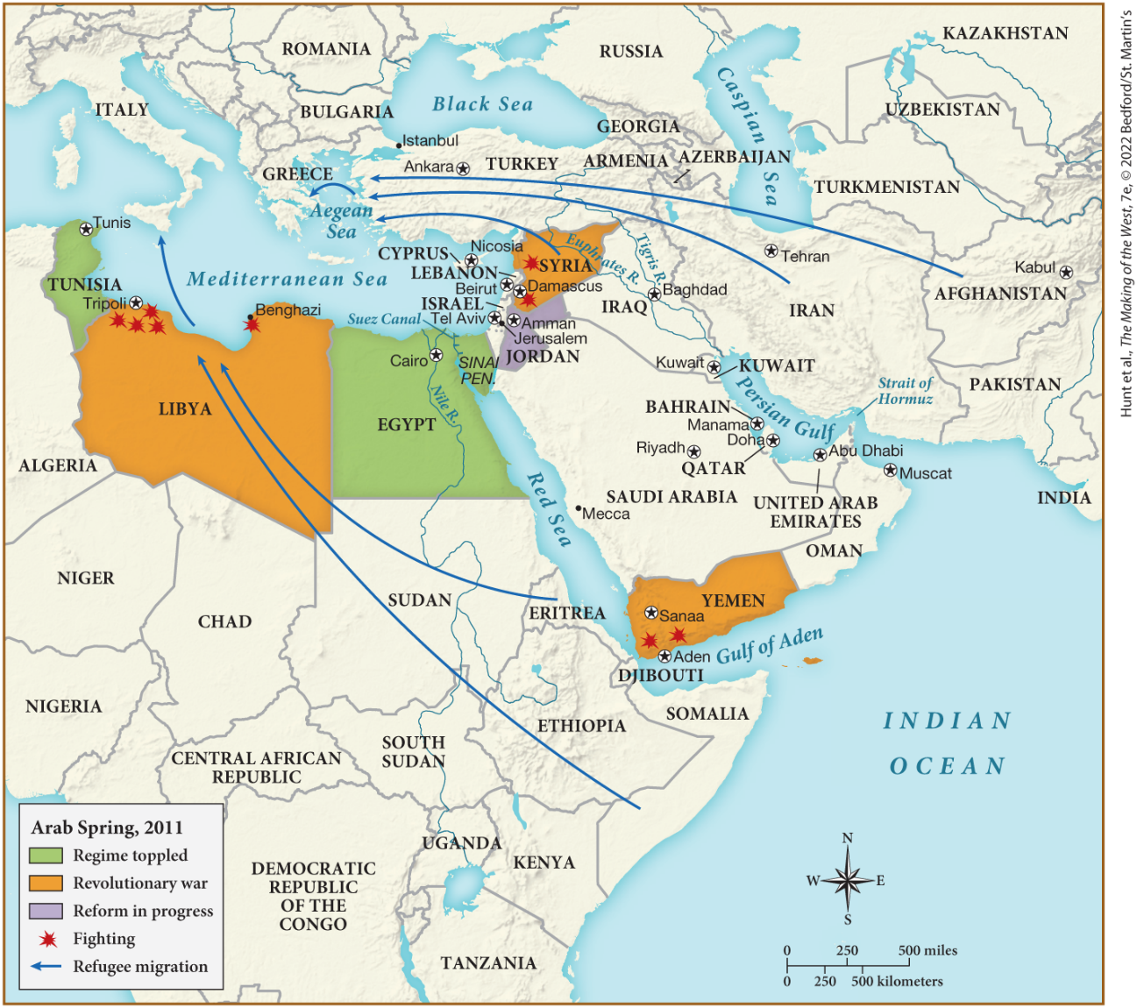
MAP 29.4 The Middle East in the Twenty-First Century

Slide 26
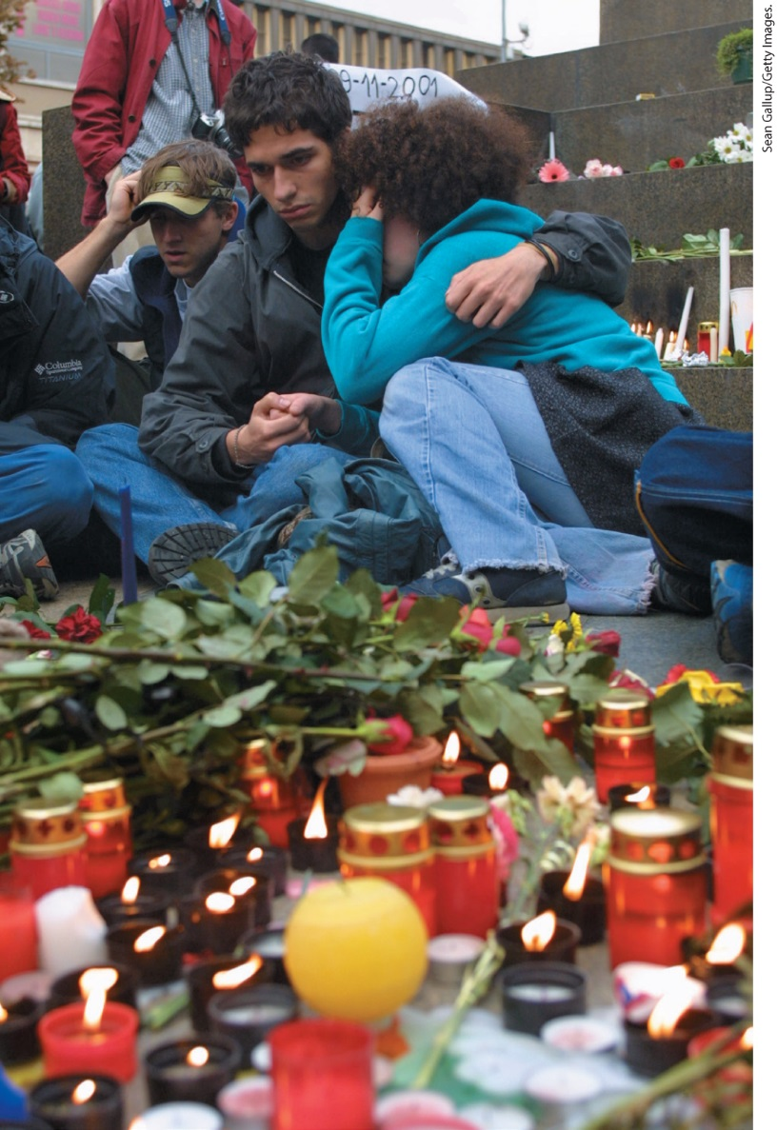
Europeans React to September 11 Terror Attacks

Slide 27
III. An Interconnected World’s Challenges (6 of 10)
D. Population, Health, and Disease (1 of 2)
  Nations struggle with surging populations, global public health establishment confronts spread of deadly diseases
  By 2020 Earth’s population reaches 7.8 billion
  Declining fertility across Europe leads to population declines
  Russian male life expectancy dropped from seventy in the mid-1970s to fifty-one at the beginning of the 2000s
  Western medicine expands into the less-developed world; however, many lack basic necessities, such as safe drinking water
Notes:
III. An Interconnected World’s Challenges (6 of 10)
D. Population, Health, and Disease (1 of 2)
Nations with less-developed economies struggled with the pressing problem of surging populations, while the global public health establishment confronted the spread of deadly diseases.
By 2020, Earth’s population reached 7.8 billion, in part because of the spread of Western medicine that enabled longer lifespans.
Declining fertility across Europe led to population declines, particularly in Italy and Spain.
The former eastern bloc was hit hard. Russian male life expectancy dropped from seventy in the mid-1970s to fifty-one at the beginning of the 2000s. It rebounded, however, to 72.57 in 2020. Russian women tended to live about ten years longer than men. The ten-year difference was attributed to increased drinking, smoking, drug use, poor diet, and general stress among men.
Western medicine and better health found their way into the less-developed world in the form of vaccines and pharmaceuticals to treat diseases such as malaria and smallpox; however, many individuals living in these regions still did not have access to basic necessities, such as safe drinking water.

Slide 28
III. An Interconnected World’s Challenges (7 of 10)
D. Population, Health, and Disease (2 of 2)
  Many criticize the disparity between health services supplied to the wealthy and limited care the poor receive
  Acquired immunodeficiency syndrome (AIDS) begins to spread globally in the 1980s
  AIDS spreads especially quickly in Africa and Asia, within a decade Washington, D.C., has infection rates as high as Africa
  Other deadly diseases spread through the world as health professionals worked to contain them
  In 2019, the catastrophic COVID-19 pandemic began, the United States had the highest rates of infection and death in 2020
Notes:
III. An Interconnected World’s Challenges (7 of 10)
D. Population, Health, and Disease (2 of 2)
Many critics pointed to the disparity between the extent of expensive, high-tech health services supplied to the wealthy in industrialized nations and the far more limited care the poor received even though they suffered more from chronic illnesses.
In the early 1980s, Western values and technological expertise were challenged by the global spread of acquired immunodeficiency syndrome (AIDS), which causes the body’s immune system to shut down.
AIDS spread especially quickly and widely among the heterosexual populations of Africa and Asia, passed mainly by men to and through women. Within a decade, Washington, D.C., had an infection rate as high as Africa’s.
In the twenty-first century, negative interconnectedness again became apparent when the deadly Ebola virus, severe acute respiratory syndrome (SARS), and swine flu traveled the world, even as health professionals worked to contain them.
In 2019, the catastrophic COVID-19 pandemic began and led to individual countries coming up with a variety of treatment and preventative strategies with mixed results. As a result of their strategies, the United States had the highest per capita rates of infection and death in 2020.

Slide 29
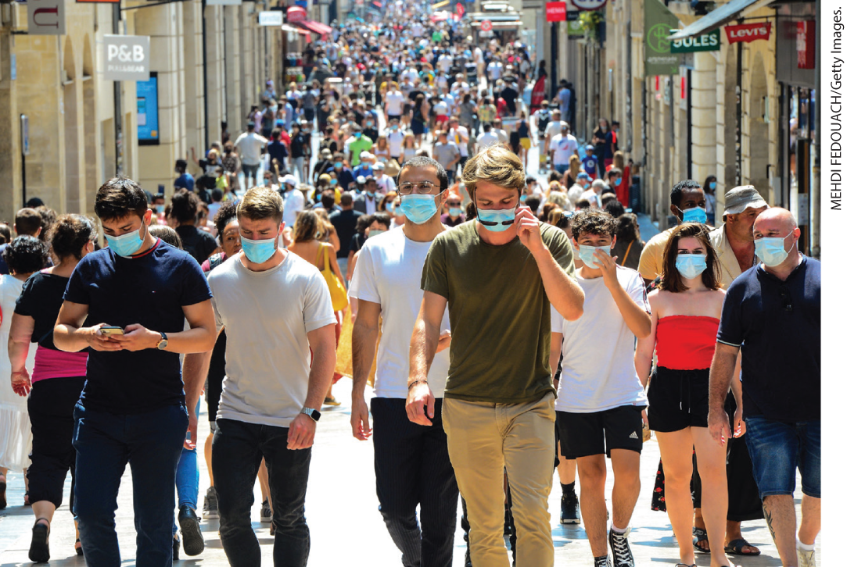
COVID-19 in Bordeaux, France

Slide 30
III. An Interconnected World’s Challenges (8 of 10)
F. The Promise and Problems of a World Economy (1 of 2)
  Emergence of powerful Asian economies begin to spread economic power from the Atlantic region to the Pacific
  South Korea, Taiwan, Singapore, Hong Kong, and China were called Pacific tigers
  By 2000, China becomes the United States’ largest creditor, taking over the U.S. role as champion of economic connectedness
  Working conditions in emerging Asian economies were often difficult
  Other emerging economies in the Southern Hemisphere continued to increase their share of the world’s gross domestic product (GDP)
Notes:
III. An Interconnected World’s Challenges (8 of 10)
F. The Promise and Problems of a World Economy (1 of 2)
Just as economic changes in the early modern period had redirected the European economy from the Mediterranean to the Atlantic, the emergence of powerful Asian economies in the 1980s and 1990s began to spread economic power from the Atlantic region to the Pacific.
South Korea, Taiwan, Singapore, Hong Kong, and China were called Pacific tigers because of the ferocity of their growth.
By 2000, China had become the United States’ largest creditor. As the United States withdrew from global partnership and championed isolation and protectionism between 2016 and 2020, China took over the U.S. role as champion of economic connectedness and global dynamism.
Working conditions in emerging Asian economies were often difficult.
Other emerging economies in the Southern Hemisphere continued to increase their share of the world’s gross domestic product (GDP). Newly democratic South Africa benefited, like Russia, Brazil, Iran, Saudi Arabia, Nigeria, and Chile, from growing demand for raw materials.

Slide 31
III. An Interconnected World’s Challenges (9 of 10)
F. The Promise and Problems of a World Economy (2 of 2)
  India’s economy soared in the early twenty-first century
  In 2008, the bursting of the housing bubble in the United States causes an enormous financial crisis
  The crisis becomes international as banks and companies became insolvent
  Prudent management enables Asian economies and Brazil to recover, European governments faced bankruptcy and high unemployment rates
  The crisis threatened the survival of the European Union
Notes:
III. An Interconnected World’s Challenges (9 of 10)
F. The Promise and Problems of a World Economy (1 of 2)
Despite political turmoil, India’s economy soared in the early twenty-first century, taking business from Western firms.
In 2008, the bursting of the housing bubble in the United States caused an enormous financial crisis.
The crisis became international as banks and companies became insolvent.
Prudent management enabled the Asian economies and Brazil to recover, but European governments faced bankruptcy and horrific unemployment rates.
The crisis threatened the survival of the European Union.

Slide 32
III. An Interconnected World’s Challenges (10 of 10)
G. International Politics and the New Russia
  The National Congress of the Chechen People took over the government of the oil-rich Chechen region from the USSR
  The Russian government invades with what it thought would be a small, victorious war
  The war dragged on, continuing under Putin
  The war compounded Russia’s economic and political problems
  Russia benefited from rising commodity prices but lost ground toward democracy under Putin
  Uncertainties in Russia slowed the economy, while Putin’s meddling in foreign elections led to disarray in the West
Notes:
III. An Interconnected World’s Challenges (10 of 10)
G. International Politics and the New Russia
In the fall of 1991, the National Congress of the Chechen People took over the government of the oil-rich Chechen region from the USSR in a move toward independence similar to that of other states within the Soviet Union.
In December 1994, the Russian government invaded, in part, to bolster Yeltsin’s sagging presidency with what it thought would be a small, victorious war.
The war dragged on, however, continuing under Putin, with high civilian casualties, many of which were retaliatory terrorist attacks committed by Chechens in Russian cities.
The war only compounded Russia’s problems of establishing a sound economy and a credible post-Communist government.
Russia under Putin benefited from rising commodity prices but lost ground toward democracy as critics were assassinated and the media was suppressed.
The uncertainties of the Russian political scene made a poor environment for innovation and the development of a diversified economy, while Putin’s meddling in foreign elections led to disarray in the West.

Slide 33
IV. Global Culture and Society in the Twenty-First Century (1 of 5)
A. Redefining the West: The Impact of Global Migration (1 of 2)
  Economic, political, and health uncertainty left tens of millions of people in search of better lives
  France, the Middle East, and the U.S. are all fundamentally changed as the result of immigration
  Genocide and war create millions more refugees, by 2020, there were an estimated 272 million migrants total worldwide
  Money sent back from immigrant workers contributed significantly to the economies of many countries
  Sometimes migration is coerced
Notes:
IV. Global Culture and Society in the Twenty-First Century (1 of 5)
A. Redefining the West: The Impact of Global Migration (1 of 2)
Uneven economic development, a global pandemic, political persecution, and war left tens of millions of people in search of opportunity and safety.
By 2020, France had become home to 6 million Muslims, the Middle East housed millions of workers from the west, and 14 percent of the U.S. population was foreign born.
Genocide in Africa and Myanmar along with the Iran-Iraq War created millions more refugees. Over 5.5 million Syrians were registered as external refugees after escaping attacks of the Syrian government and the Islamic State. By 2020, there were an estimated 272 million migrants total worldwide.
Money sent home from immigrant workers contributed significantly to the national economies of many countries.
Sometimes migration was coerced, as in the case of Asian and eastern European women sex workers, whose lives were controlled by international criminal gangs.

Slide 34
IV. Global Culture and Society in the Twenty-First Century (2 of 5)
A. Redefining the West: The Impact of Global Migration (2 of 2)
  Foreign workers were a convenient scapegoat
  In Europe, political parties with racist agendas attract support as unemployment rises
  In 2016, British citizens narrowly vote to leave the European Union
  White supremacist governments come to power in Hungary, Austria, and Poland
Notes:
IV. Global Culture and Society in the Twenty-First Century (2 of 5)
A. Redefining the West: The Impact of Global Migration (2 of 2)
Foreign workers were a convenient scapegoat in difficult economic times.
In Europe, political parties with racist agendas attracted support as unemployment rose.
Fear of foreigners had swelled so much that in 2016, 51 percent of British citizens voted to leave the European Union — which came to be known as Brexit.
Explicit white supremacist governments came to power in Hungary, Austria, and Poland, uniting citizens around anti-immigrant, anti-homosexual and trans, and anti-EU platforms in the name of fending off terrorists and job-stealing refugees.

Slide 35
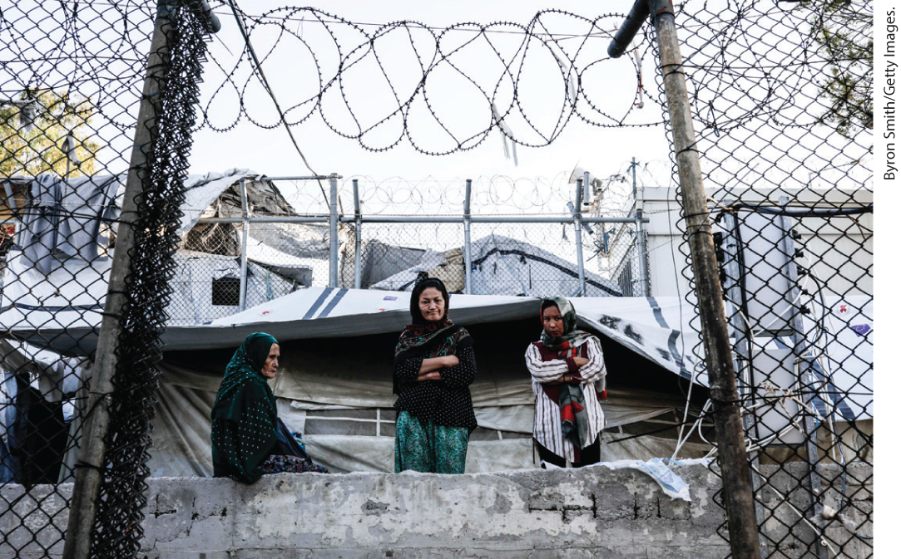
Refugee Women, September 2019

Slide 36
IV. Global Culture and Society in the Twenty-First Century (3 of 5)
B. Global Networks and Social Change
  Rapid technological changes made national borders permeable
  Conducting business and communicating via computer allow individuals to escape state regulations
  Enthusiasts claimed that the Internet would promote democracy, critics argue that those without computer skills or access are marginalized
  The Internet allowed for outsourcing of service work to countries with lower wage scales and business costs
  In 2003, the U.S. spent more in services from foreign countries than it sold to them
  Globalization redistributed jobs and reworked economic networks
  Digital medial also allows for widespread information sharing
Notes:
B. Global Networks and Social Change
Rapid technological changes — especially the development of the Internet — made national borders permeable.
Conducting business and communicating via computer allowed individuals to escape state regulations such as censorship, and a global marketplace in goods and services was also formed.
Enthusiasts claimed that the Internet would promote democracy, but critics argued that those without computer skills or the money to buy a computer were marginalized. Internet use was highest in the richer regions of the world.
The Internet allowed the outsourcing and subcontracting of service work, such as call centers and help desks, to countries with lower wage scales and business costs.
In 2003, the U.S. spent $77.38 billion in services from foreign countries and sold $131.01 billion to them, meaning that more in fact was insourced than outsourced.
Globalization thus redistributed jobs and reworked economic networks.
Digital medial also allowed for widespread information sharing and for individuals and organizations to spread awareness of problems such as population explosion, scarce resources, North-South inequities, global pollution, ethnic hatred, and global terrorism.

Slide 37
IV. Global Culture and Society in the Twenty-First Century (4 of 5)
C. Global Culture versus Nationalist Isolationism (1 of 2)
  New forms of transportation and communication facilitated cultural exchange
  Tourism soared, satellite-beamed telecasts transported movies and television shows worldwide
  Many countries absorb Western culture, but the West also continues to absorb material from other cultures
  Publishers marketed the written works of non-Western artists
  Zadie Smith’s White Teeth described postimperial Britain
  U.S. author Toni Morrison became the first African American to win the Nobel Prize for Literature
  The experiences of minorities living in the West drew increasing attention
Notes:
C. Global Culture versus Nationalist Isolationism (1 of 2)
In the postwar period, new forms of transportation and communication facilitated cultural exchange.
Tourism soared, and satellite-beamed telecasts transported movies and television shows worldwide.
Although many countries absorbed Western culture, the West in turn continued to absorb material from other cultures.
Publishers marketed the written works of non-Western artists and intellectuals.
Zadie Smith’s White Teeth described postimperial Britain through the experiences of an ethnically and culturally diverse array of characters.
U.S. author Toni Morrison (1931–2019) became the first African American to win the Nobel Prize for Literature. Her voice was both realistic and relentless as it described the pain inflicted by racism and the bravery necessary to survive it.
The experiences of minorities living in the West drew increasing attention, much to the chagrin of politicians who saw such multiculturalism as a sign of deterioration.

Slide 38
IV. Global Culture and Society in the Twenty-First Century (5 of 5)
C. Global Culture versus Nationalist Isolationism (2 of 2)
  Authors such as Olga Tokarczuk re-envisioned the past, while other authors tried to sort out the legacy of the past
  U.S. cultural dominance continued, particularly in the widespread use of English
  Some called such a mixing of influences postmodernism
  Postmodernism meant multiplicity without a unifying theme
  Architects designed buildings with aspects that did not traditionally go together
  Political postmodernism is defined as the demise of eighteenth-century ideals
  Postmodernism led to the questioning of science and the falsification of established narratives
Notes:
IV. Global Culture and Society in the Twenty-First Century (5 of 5)
C. Global Culture versus Nationalist Isolationism (2 of 2)
Authors such as Olga Tokarczuk re-envisioned the past, while other authors tried to sort out the legacy of communism and anti-Semitism.
U.S. cultural dominance continued, particularly in the widespread use of English (where the legacy of British imperialism was also a factor) and in film, even while American cultural tastes became more global and diverse.
Some called such a mixing of influences postmodernism.
By definition, postmodernism meant multiplicity without a unifying theme.
Architects designed buildings that mixed materials, forms, and perspectives that did not traditionally go together.
Postmodernism can also be defined in political terms as an outgrowth of the demise of eighteenth-century ideals of individuality, human rights, personal freedom, and the nation-state.
Postmodernism was part of a great enterprise of rethinking and questioning Enlightenment ideals, which led to the questioning of science and the falsification of established narratives.

Slide 39
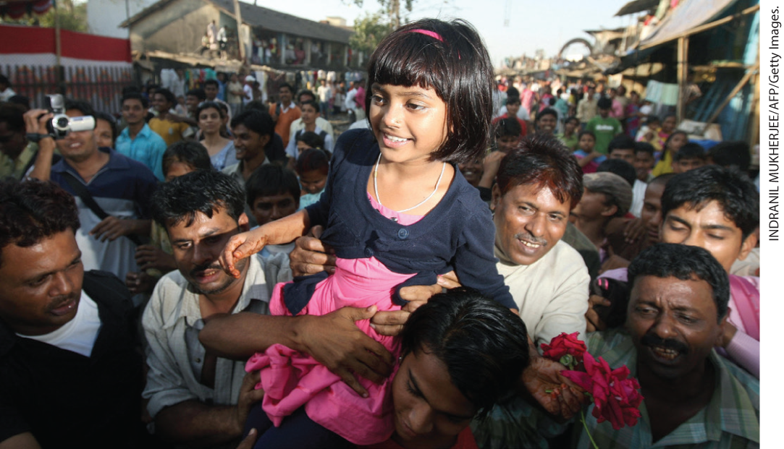
Slumdog Millionaire Star Returns Home from the Oscars

Slide 40
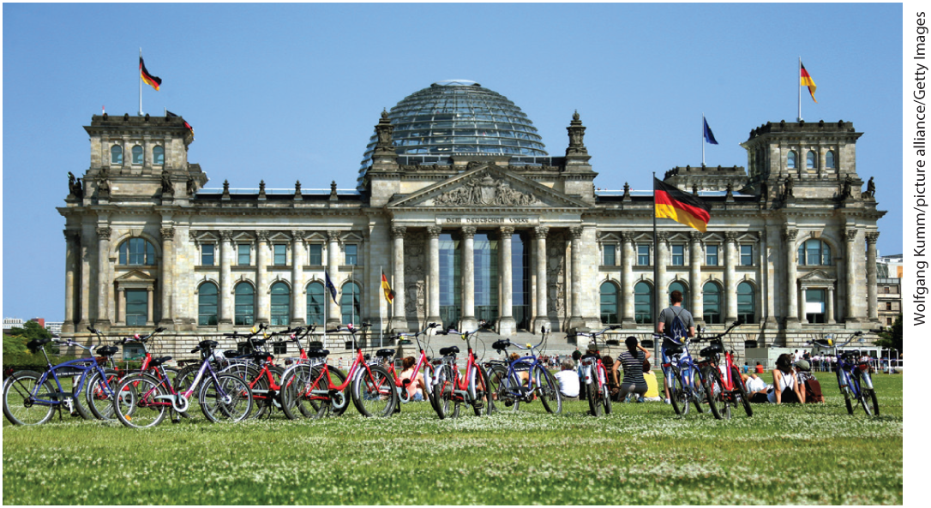
Environment Matters: The German Reichstag: Reborn and Green

Slide 41
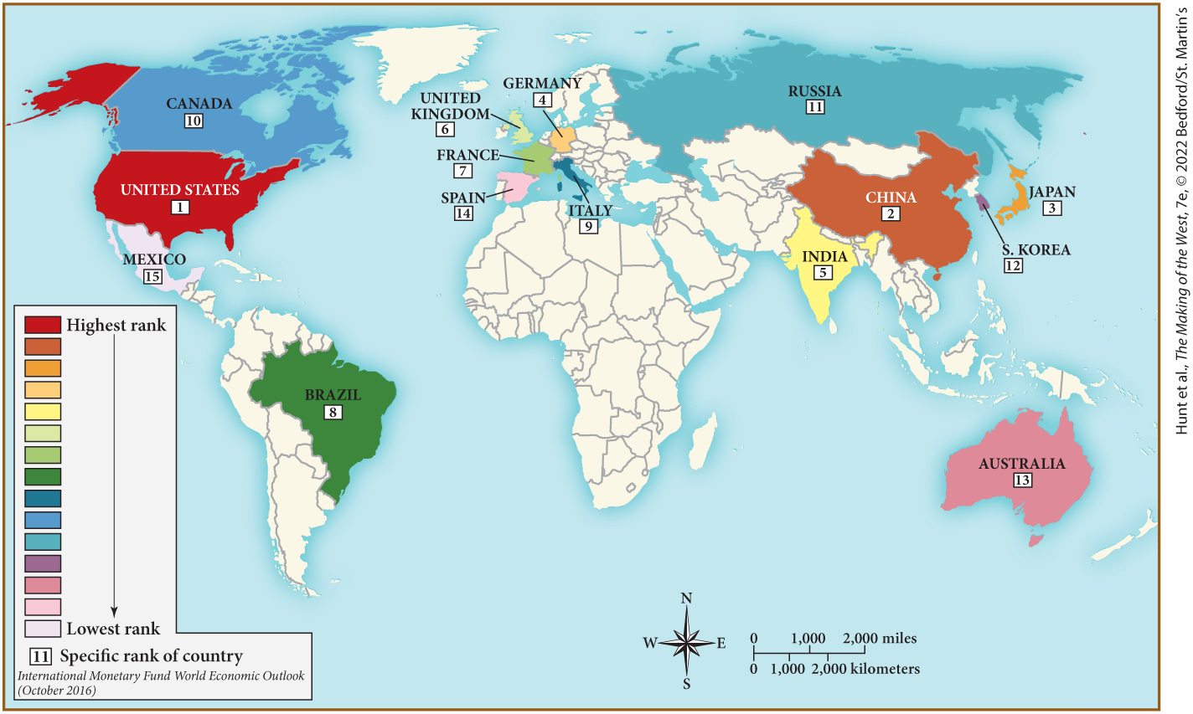
MAP 29.5 Mapping the West: The World’s Top Fifteen Economies as of 2021

