Slide 1
The Making of the West
Seventh Edition
Hunt • Martin • Rosenwein • Smith
CHAPTER 28
Postindustrial Society and the End of the Cold War Order
1960s –1989
Copyright © 2022 by Bedford/St. Martin’s
Distributed by Bedford/St. Martin’s/Macmillan Learning strictly for use with its products. Not for redistribution.

Slide 2
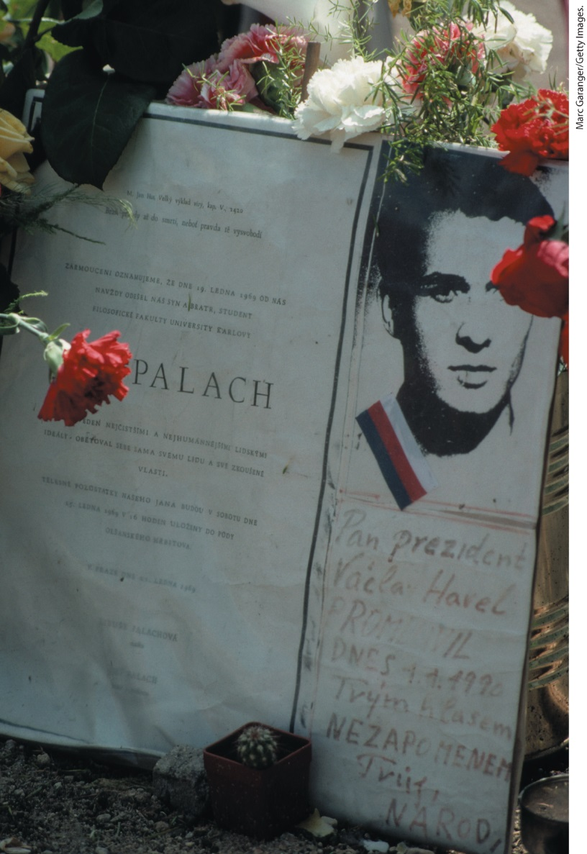
Shrine to Jan Palach

Slide 3
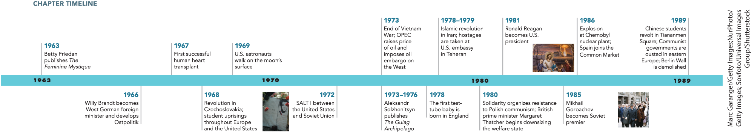
Chapter 28 Timeline

Slide 4
I. The Revolution in Technology (1 of 8)
A. The Information Age: Television and Computers (1 of 3)
  New technologies increased the speed for conveying knowledge
  New forms of media continued trend of forming a more homogeneous society
  Europeans rapidly adopted television in the middle of the century
  Audience for newspapers and theater decline as television becomes more popular
  European governments owned and controlled television stations
Notes:
I. The Revolution in Technology (1 of 8)
A. The Information Age: Television and Computers (1 of 3)
Information technology catalyzed social change, as television, computers, and telecommunications increased the speed and range for conveying knowledge, culture, and politics globally.
These new forms of media continued the trend begun by mass journalism, film, and radio of forming a more homogeneous society.
Between the mid-1950s and mid-1970s, Europeans rapidly adopted television.
As the audience for television increased, the audience for newspapers and theater declined.
As with radio, European governments owned and controlled television stations and their programming, which they funded with tax revenues.

Slide 5
I. The Revolution in Technology (2 of 8)
A. The Information Age: Television and Computers (2 of 3)
  Many believed television should enhance the humanist tradition and programming reflected this
  Communications satellites and video recorders introduced competition to state-sponsored television
  American media was dubbed into native languages and widely distributed
  News and educational programming were popular
  Heads of state often preempted regular programming
Notes:
I. The Revolution in Technology (2 of 8)
A. The Information Age: Television and Computers (2 of 3)
In the belief that this medium should be used to preserve and enhance the humanist tradition, programming featured drama, ballet, concerts, variety shows, and news.
The emergence of communications satellites and video recorders in the 1960s introduced competition to state-sponsored television because sports broadcasts could be diffused globally and television stations could purchase feature films on videocassette.
American television and feature films were dubbed into native languages and widely distributed.
News and educational programming were staples; travel shows were popular with an audience, such as that of the Soviet Union, for whom travel was either impossible or forbidden.
In both the East and West, heads of state could, and did, preempt regular programming.

Slide 6
I. The Revolution in Technology (3 of 8)
A. The Information Age: Television and Computers (3 of 3)
  Electoral success became dependent on creating a media image
  Computers were another important innovation
  The size and price of computers continued to improve, making them more widely adopted
  Computers and networks made it possible to work from home
  Rapid improvements in computer technology paved the way for postindustrialism
Notes:
I. The Revolution in Technology (3 of 8)
A. The Information Age: Television and Computers (3 of 3)
In the West, electoral success increasingly depended on cultivating a successful media image.
Computers were another important innovation.
From the size of a gymnasium in the 1940s, computers shrank to the size of a briefcase by the 1980s and changed the pace and procedures of work by speeding up and easing tasks. Prices declined and computers became commonplace.
Computers and public computer networks also made it possible for individuals to work from their homes.
While the technology of the Industrial Revolution added to muscle power, computer technology added to brainpower, paving the way for postindustrialism.

Slide 7
I. The Revolution in Technology (4 of 8)
B. The Space Age (1 of 2)
  The Soviet Union launched the world’s first satellite, Sputnik, beginning the “space race”
  A global audience watched on television as America put a man on the moon
  The space race influenced pop culture in the West, such as the film 2001: A Space Odyssey
  Polish writer Stanislaw Lem’s novel Solaris portrayed space-age individuals
Notes:
I. The Revolution in Technology (4 of 8)
B. The Space Age (1 of 2)
In 1957, the Soviet Union launched the world’s first satellite, Sputnik, into orbit, beginning a competition with the United States that was quickly labeled the “space race.”
In July 1969, a global audience watched on television as America put a man on the moon. Astronauts and cosmonauts were the era’s most admired heroes.
The space race spawned a new fantasy world in the West, influencing children’s toys and games, and popularizing science fiction novels and films such as 2001: A Space Odyssey (1968).
Similarly, Polish writer Stanislaw Lem’s novel Solaris (1961) portrayed space-age individuals engaged in personal quests.

Slide 8
I. The Revolution in Technology (5 of 8)
B. The Space Age (2 of 2)
  Space technology also powered destructive missiles
  An international consortium launches the first commercial communications satellite, Intelsat I
  Space exploration led to advancements in science
  New data reinforces the “big bang” theory posited by American astronomer Edwin Hubble
Notes:
I. The Revolution in Technology (5 of 8)
B. The Space Age (2 of 2)
Space technology was linked to the cold war, and rocket technology powered destructive missiles in the case of the Soviet-U.S. rivalry.
An international consortium headed by the United States launched the first commercial communications satellite, Intelsat I, in 1965, and by the 1970s, global satellite communication was a reality.
Space exploration advanced pure science, as data regarding cosmic radiation, magnetic fields, and infrared sources were gathered by unmanned spacecraft.
This information reinforced the “big bang” theory of the universe’s origins, first posited in the 1930s by American astronomer Edwin Hubble (1889–1953).

Slide 9
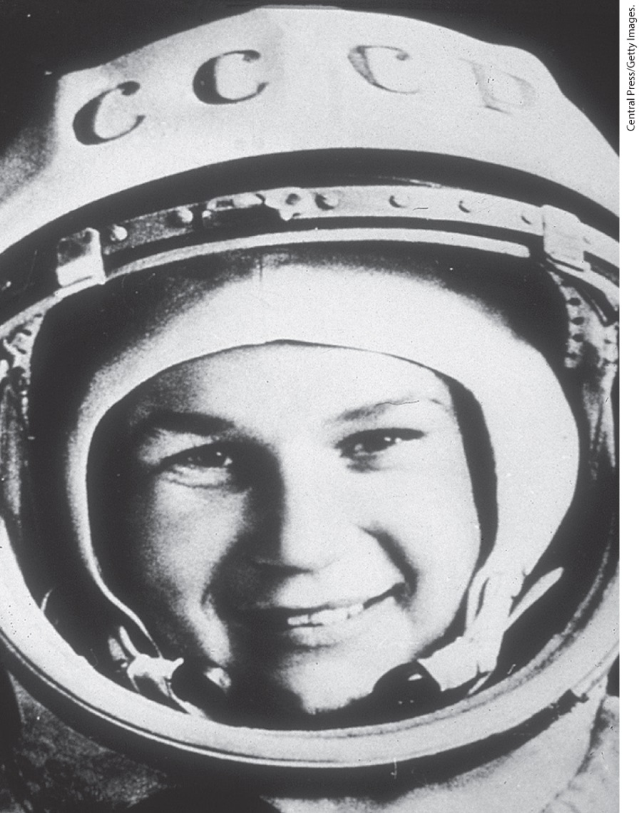
Valentina Tereshkova, Russian Cosmonaut

Slide 10
I. The Revolution in Technology (6 of 8)
C. The Nuclear Age
  Economic use of the atom boosts energy and economic expansion
  The first nuclear power plant is built in Obninsk in the USSR
  Nuclear power use multiplied rapidly
  A new function for the modern state was technological development
Notes:
I. The Revolution in Technology (6 of 8)
C. The Nuclear Age
The economic use of the atom in the form of nuclear power boosted available energy and dramatically boosted continued economic expansion.
The first nuclear power plant to produce electricity was built in Obninsk in the USSR in 1954. Britain and the United States followed.
Nuclear power for industrial, household, and military use multiplied a hundredfold during the 1960s and 1970s.
A new function for the modern state was technological development through the funding of projects such as nuclear reactors.

Slide 11
I. The Revolution in Technology (7 of 8)
D. Revolutions in Biology and Reproductive Technology (1 of 2)
  Scientists Francis Crick and James Watson discover the configuration of deoxyribonucleic acid (DNA)
  Genetics and molecular biology progress rapidly
  Understanding DNA allowed scientists to develop the “cloning” process
  Cloning and genetics research raises ethical questions for many
  Dr. Christiaan Barnard performs the first successful heart transplant; further innovations and controversy follow
Notes:
I. The Revolution in Technology (7 of 8)
D. Revolutions in Biology and Reproductive Technology (1 of 2)
In 1952, scientists Francis Crick and James Watson discovered the configuration of deoxyribonucleic acid (DNA), the material in a cell’s chromosomes that carries hereditary information.
Beginning in the 1960s, genetics and the new field of molecular biology progressed rapidly, and a broader understanding of nucleic acids and proteins made possible new vaccines to combat polio and other deadly diseases.
Understanding how DNA worked allowed scientists to bypass natural reproduction through a process called “cloning.”
Cloning and science’s growing ability to genetically alter or even create new species raised ethical questions for many.
In 1967, Dr. Christiaan Barnard performed the first successful heart transplant. Further innovations followed, causing some to wonder if the resources devoted to saving a few people would be better spent providing basic health care to many who lacked it.

Slide 12
I. The Revolution in Technology (8 of 8)
D. Revolutions in Biology and Reproductive Technology (2 of 2)
  Traditional constraints on sexuality begin to weaken
  Widespread distribution of new birth-control pills provides the most reliable means of preventing pregnancy
  Popular use of birth control led people to separate sexuality from reproduction
  Abortion moves from the hands of amateurs to those of medical professionals
  Medical procedures and equipment change pregnancy and childbirth as birth take place in hospitals
  New technologies improve chances of fertility
Notes:
I. The Revolution in Technology (8 of 8)
D. Revolutions in Biology and Reproductive Technology (2 of 2)
As Western societies industrialized and urbanized, traditional constraints on sexuality began to weaken.
By 1970, the widespread distribution of a new birth-control device, “the pill,” provided the most reliable, temporary means of preventing pregnancy.
Popular use of birth control led people to separate sexuality from reproduction; young people began sexual relations earlier with less risk of pregnancy.
Abortion moved from the hands of amateurs to those of medical professionals and, for the first time, became a safe medical procedure.
Pregnancy and childbirth were also transformed, as new medical procedures and equipment allowed closer monitoring of mother and child, and childbirth increasingly took place in hospitals, overseen by obstetricians rather than midwives.
New technologies, such as in vitro fertilization, also allowed couples who might otherwise be childless to reproduce.

Slide 13
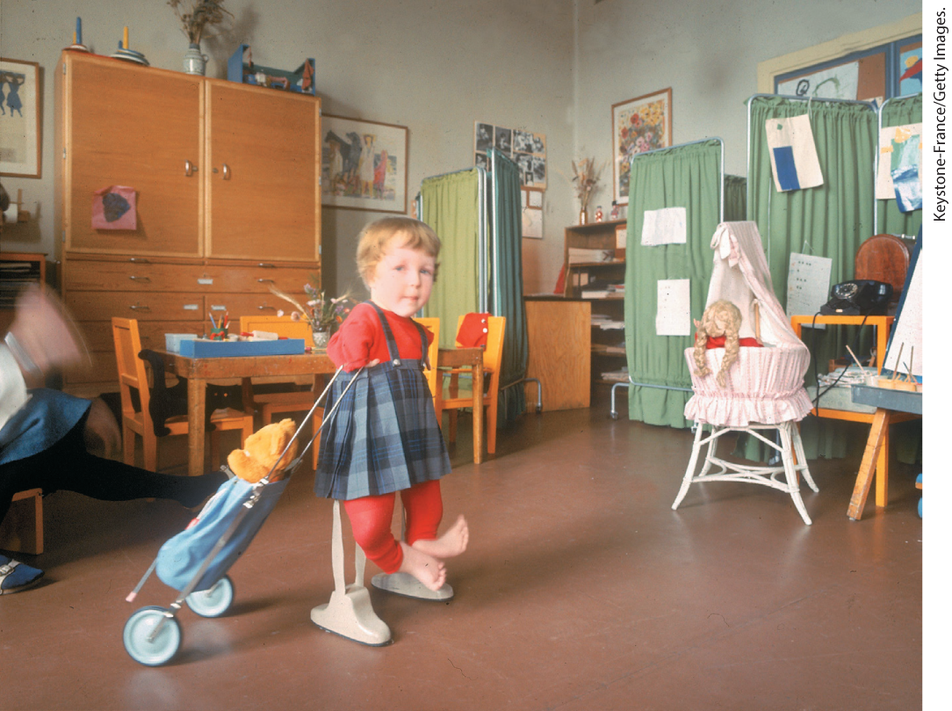
Thalidomide Children

Slide 14
II. Postindustrial Society and Culture (1 of 9)
A. Multinational Corporations (1 of 2)
  Postindustrial society paves the way for multinational corporations
  Companies produce for a global market and conduct business worldwide
  The U.S. leads the way in establishing these companies, Europe and Japan soon follow
  Some corporations have revenues greater than entire nations
Notes:
II. Postindustrial Society and Culture (1 of 9)
A. Multinational Corporations (1 of 2)
One aspect of the postindustrial society was the rise of multinational corporations.
These companies produced for a global market and conducted business worldwide, but unlike older international firms, they also established major factories in countries other than their home base.
The United States led the way in establishing such companies, but European and Japanese industries followed.
Some multinational corporations had revenues greater than entire nations, and their interests reached beyond a national or local outlook.

Slide 15
II. Postindustrial Society and Culture (2 of 9)
A. Multinational Corporations (2 of 2)
  To minimize labor costs and taxes, multinationals move operations to the emerging countries
  These corporations provide jobs local inhabitants, but profit mostly benefits foreign stockholders
  Critics denounced multinationals as new form of imperialism; some argue global expansion is competitively necessary
  Huge conglomerates contribute to Europe’s continuing economic growth
Notes:
II. Postindustrial Society and Culture (2 of 9)
A. Multinational Corporations (2 of 2)
In the 1960s, to minimize labor costs and taxes, multinationals repositioned more of their operations from Europe to the emerging economies of formerly colonized states or third world countries.
Although these corporations provided jobs to third world inhabitants, profits mostly enriched foreign stockholders. The companies had little concern for localities and nations where they
did business.
Critics initially denounced multinationals as a new form of imperialism; however, multinational firms believed global expansion was necessary to remain competitive.
In Europe, huge conglomerates were formed in sectors such as construction and airplane construction and contributed to Europe’s continuing economic growth.

Slide 16
II. Postindustrial Society and Culture (3 of 9)
B. The New Worker (1 of 2)
  Workplace conditions improve and union membership declines
  A new working class emerges in both eastern-bloc and Western countries
  Relationship of workers to bosses shifts
  Economic distinctions become blurred
  Service-sector workers become a majority in several industrial countries
Notes:
II. Postindustrial Society and Culture (3 of 9)
B. The New Worker (1 of 2)
The conditions of work changed in postwar Europe as work grew cleaner and less dangerous, and management entrusted groups of workers to set their own production quotas and compete with other teams. Union membership declined.
In both eastern-bloc and Western countries, a new working class emerged, consisting of white-collar, service personnel. Industrial labor and unions declined in numbers and influence.
The relationship of workers to their bosses shifted as workers adopted attitudes and gained responsibilities that had once been managerial prerogatives.
Economic distinctions based on the way one worked were also undermined.
By the 1970s, service-sector workers were a majority in several industrial countries.

Slide 17
II. Postindustrial Society and Culture (4 of 9)
B. The New Worker (2 of 2)
  In the eastern bloc huge differences remained between professional occupations and physical workers
  Gender shaped the workforce as women held lower-paying jobs than men in both the East and West, but the East considered physical labor “women’s work”
  Farm life was modernized and became “agribusiness”
  Technology and business knowledge were needed to run a modern farm
  Governments and planning agencies took over decision making for agriculture
Notes:
II. Postindustrial Society and Culture (4 of 9)
B. The New Worker (2 of 2)
In the eastern bloc in the 1960s, huge differences remained between professional occupations and those involving physical work because of less investment in advanced machinery and cleaner work processes.
In both the Western and eastern-bloc countries, gender shaped the workforce. Women held less prestigious, lower-paying jobs than men in both the East and West, but only in the East were jobs involving heavy physical labor, general medicine, and dentistry considered “women’s work.”
In the West, farm life was modernized and became “agribusiness.”
To run a modern farm, one needed the newest technology and chemical products, and producers tailored their crops to global markets.
Governments, farmers’ cooperatives, and planning agencies took over decision making from the individual farmer, setting production quotas and handling market transactions.

Slide 18
II. Postindustrial Society and Culture (5 of 9)
C. The Boom in Education and Research
  The United States made research a priority, spending more than 20 percent of its GNP on research
  In eastern-bloc countries, technological advancements were slowed by bureaucratic red tape
  New criteria for success fostered an unprecedented growth in education
  Great Britain and France focus on training the future workforce
  Institutions of higher learning added courses in business management and information technology
Notes:
II. Postindustrial Society and Culture (5 of 9)
C. The Boom in Education and Research
Because research was necessary to economic growth and military power, the United States funneled more than 20 percent of its gross national product (GNP) into research in the 1960s, siphoning off many of Europe’s leading intellectuals and technicians in what came to be known as the “brain drain.”
In eastern-bloc countries, on the other hand, having to navigate through enormous bureaucratic red tape often meant that scientific findings became obsolete before they received governmental approval and could be applied to technology.
In both the East and West, the new criteria for success fostered an unprecedented growth in education, especially in universities and scientific institutes.
Great Britain established a new network of technical universities to encourage technical research; France set up administrative schools to train future high-level bureaucrats.
Institutions of higher learning, in the West especially, added courses in business management and information technology to educate postindustrial workers.

Slide 19
II. Postindustrial Society and Culture (6 of 9)
D. Changing Family Life and the Generation Gap (1 of 2)
  The traditional family transforms greatly in the 1960s
  As the marriage rate fell, so did the birthrate
  Percentage of out-of-wedlock children soars
  Daily life changes as radio and television fill leisure time
  Household appliances also raised standards of cleanliness
  More women work outside the home more often
Notes:
II. Postindustrial Society and Culture (6 of 9)
D. Changing Family Life and the Generation Gap (1 of 2)
In the 1960s, the family appeared in many forms: single-parent households; “blended” households of two previously married persons, each with their own children; unmarried couples cohabitating; and traditionally married couples with fewer children. Households of same-sex partners became more common.
As the marriage rate was falling, by the mid-1960s, the birthrate was falling as well.
At the same time, however, the percentage of out-of-wedlock children soared.
Daily life within the family changed, as radio and television filled a family’s leisure time.
Household appliances made housework less taxing, but also raised standards of cleanliness.
More women worked outside the home, in part because children were going on to schools of higher education, which meant they stayed in school longer and therefore cost couples more money for their education.

Slide 20
II. Postindustrial Society and Culture (7 of 9)
D. Changing Family Life and the Generation Gap (2 of 2)
  Modern family life revolved around nurturing and educating children
  Social services offered aid in providing support, while television programs dealt with the tensions of modern life
  Young people stay in school longer, youth culture gives them alternative emotional focus
  Sex begins at younger ages, increased openness about sex
  Youth culture was characterized by rebelliousness expressed through the music
  Gender roles in youth culture did not change
  Cultural divide gives rise to a “generation gap”
Notes:
D. Changing Family Life and the Generation Gap (2 of 2)
Whereas the early modern family organized labor, taught craft skills, and monitored reproductive behavior, the modern family seemed to have a primarily psychological function: to nurture the child while he or she learned intellectual skills in school.
Psychologists, social workers, and social service agencies offered additional aid, if necessary, in providing this emotional support, while television programs about family life gave viewers the opportunity to observe how others — even fictitious others — dealt with the tensions of modern life.
Even though young people stayed in school longer and were thus more financially dependent upon their parents than before, the development of a youth culture gave them an alternative emotional focus.
Sex began at younger ages, and increased openness about sex led to talk of a “sexual revolution.”
Youth gained a new role as economic and cultural consumers. This youth culture was characterized by rebelliousness expressed through the music of heavily marketed and wildly successful bands such as the Beatles.
Gender roles in youth culture did not change.
The cultural divide between parents and their children gave rise to a “generation gap” during the 1960s.

Slide 21
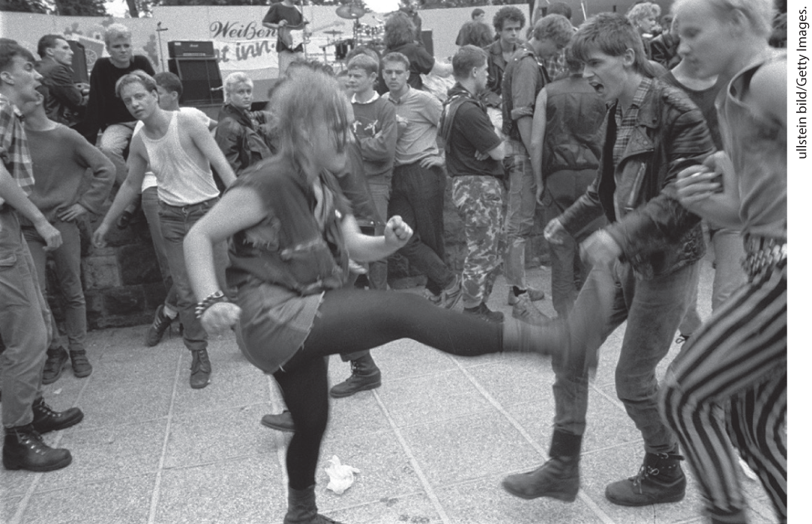
East German Punk Rockers

Slide 22
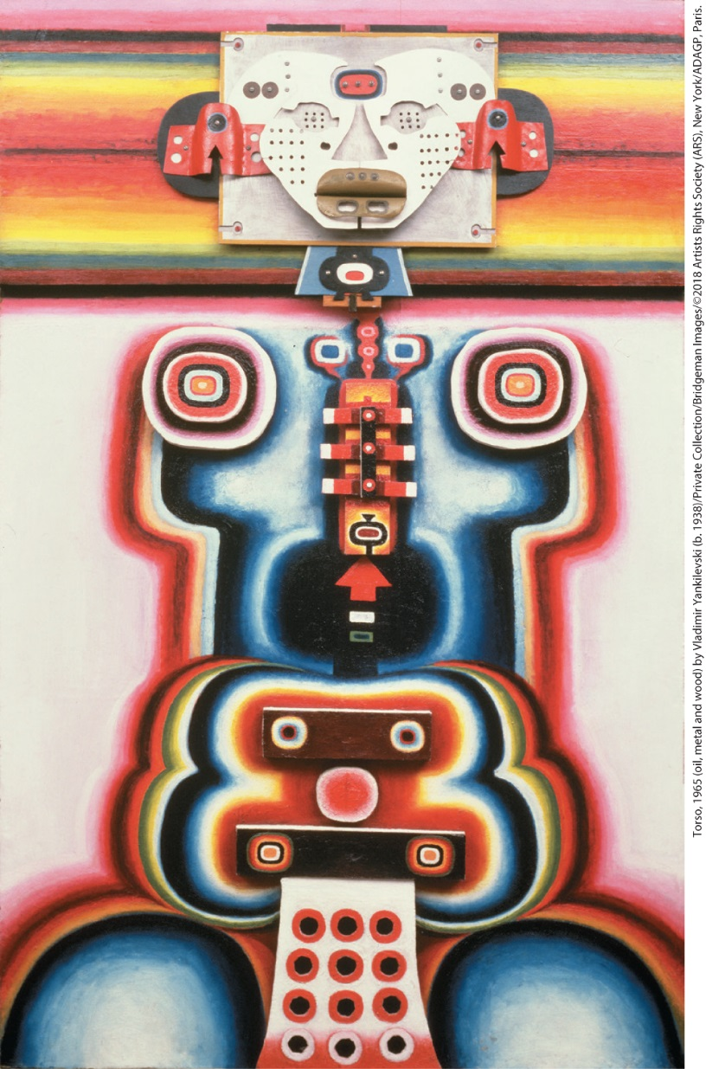
Dissident Art: Torso by Vladimir Yankilevski

Slide 23
II. Postindustrial Society and Culture (8 of 9)
E. Art, Ideas, and Religion in a Technocratic Society (1 of 2)
  New artistic movement, pop art, featured images from everyday life
  Art leadership passes from Europe to the United States
  Artists parodied modern commercialism as in artist Claes Oldenburg’s Giant Hamburger with Pickle Attached
  Artists draw on sources such as folk traditions of the Caribbean and Africa
  American composer John Cage adds sounds produced by everyday items to his music
  Minimalists simplify music by scoring repeated and sustained notes
Notes:
II. Postindustrial Society and Culture (8 of 9)
E. Art, Ideas, and Religion in a Technocratic Society (1 of 2)
A new artistic movement, pop art, featured images from everyday life and employed the glossy techniques and products of a mass-consumer society, what its practitioners called admass.
Art leadership passed from Europe to the United States.
Artists parodied modern commercialism and depicted grotesque aspects of ordinary consumer products, as in Swedish-born artist Claes Oldenburg’s (1929–) Giant Hamburger with Pickle Attached (1962).
Artists also drew on other sources such as folk traditions of the Caribbean and Africa for inspiration.
In music, American composer John Cage (1912–1992) added sounds produced by everyday items to his musical scores.
Other composers, called minimalists, simplified music by scoring repeated and sustained notes.

Slide 24
II. Postindustrial Society and Culture (9 of 9)
E. Art, Ideas, and Religion in a Technocratic Society (2 of 2)
  Social sciences reach peak of prestige
  Social sciences often undermine faith in ideal of individual agency and freedom
  The Catholic church rejects birth control, but also engages in a new global vision
  In the U.S., Protestant revivalism draws many people to join sects believing literal truth of the Scriptures
  In western Europe, churchgoing remained low
  Throughout the West, the religious landscape becomes more diverse as Muslims and Hindus emigrate.
Notes:
II. Postindustrial Society and Culture (9 of 9)
E. Art, Ideas, and Religion in a Technocratic Society (2 of 2)
The social sciences were at the peak of their prestige during these decades.
The social sciences often undermined faith in the Enlightenment ideal of individual agency and freedom. In anthropology, Claude Lévi-Strauss (1908–2009) developed structuralism, a theory that maintained that all societies functioned within controlling structures (such as kinship or exchange) that operated according to coercive rules.
Amidst rapid social change, the Catholic church rejected birth control and voiced concerns over the crisis of faith caused by affluence and secularism, but it also engaged in a new global vision implementing the ideals of Vatican II.
In the United States, Protestant revivalism drew many people to join sects that believed in the literal truth of the Scriptures.
In western Europe, churchgoing remained low.
Throughout the West, the religious landscape became more diverse as Muslims and Hindus emigrated in search of economic opportunity and an escape from the hardships of decolonization.

Slide 25
III. Protesting Cold War Conditions (1 of 8)
A. Cracks in the Cold War Order (1 of 2)
  Calls to soften the effects of the cold war emerge from countries independent from the superpowers
  European voters shift their allegiance from parties that support the U.S. to Socialist parties that favor bridging the divide
  Mayor of West Berlin Willy Brandt becomes foreign minister and pursues a policy of reconciliation and trade
  French President Charles de Gaulle steers a middle course between the United States and the Soviet Union
  Following de Gaulle’s lead, western Europe began to reassert itself
  Soviet Union reform continues under new leaders Leonid Brezhnev and Alexei Kosygin
  In East Berlin, Christa Wolf writes about a couple divided by the Berlin Wall in Divided Heaven
Notes:
III. Protesting Cold War Conditions (1 of 8)
A. Cracks in the Cold War Order (1 of 2)
Worldwide, calls came to soften the effects of the cold war, and many nations struck out on their own political course that was independent from the superpowers.
A significant minority of European voters shifted their allegiance from Christian Democratic parties that supported the United States to Socialist parties that favored bridging the cold war divide.
Willy Brandt (1913–1992), the Socialist mayor of West Berlin, became foreign minister (1966) and pursued a policy of reconciliation and trade with Communist East Germany known as Ostpolitik.
In France, President Charles de Gaulle (1890–1970) steered a middle course between the United States and the Soviet Union, pulling France out of NATO and signing trade agreements with Soviet-bloc countries, while protecting good relations with Germany.
Following de Gaulle’s lead, western Europe began to reassert itself.
In the Soviet Union, reform continued under new leaders Leonid Brezhnev (1909–1982) and Alexei Kosygin (1904–1980), who tried to reduce discontent by producing more consumer goods. Eastern European leaders such as Hungary’s János Kádár followed suit.
In East Berlin, Christa Wolf (1929–2011) wrote about a couple tragically divided by the Berlin Wall in Divided Heaven (1965).

Slide 26
III. Protesting Cold War Conditions (2 of 8)
A. Cracks in the Cold War Order (2 of 2)
  Repression returns, and visual artists begin holding secret exhibitions
  In the U.S., violent racism was a weak link in the American claim to moral superiority
  Lyndon B. Johnson pushed the Civil Rights Act through Congress in 1964
  This act outlawed segregation in public facilities and created the Equal Employment Opportunity Commission (EEOC)
  Johnson’s Great Society program attempted to improve the lives of the poorest Americans
  The United States becomes increasingly involved in Vietnam
  Seemingly endless conflict creates domestic tension and leads Johnson not to seek re-election
Notes:
III. Protesting Cold War Conditions (2 of 8)
A. Cracks in the Cold War Order (2 of 2)
Repression returned later in the 1960s, and visual artists began holding secret exhibitions while writers circulated uncensored publications by hand.
In the United States, violent racism was a weak link in the American claim to moral superiority in the cold war.
Lyndon B. Johnson (1908–1973; president 1963–1969), who became president when Kennedy was assassinated, steered the Civil Rights Act through Congress in 1964.
This legislation forbade segregation in public facilities and created the Equal Employment Opportunity Commission (EEOC) to fight job discrimination.
Johnson’s Great Society program attempted to improve the lives of the poorest Americans.
At the same time, the United States was becoming increasingly embroiled beyond its borders in Vietnam, where it supported non-Communist South Vietnamese leaders against a Communist uprising backed by the Soviet Union and China.
The seemingly endless conflict created domestic tension and led to Johnson’s decision in 1968 not to seek the presidency in the next election.

Slide 27
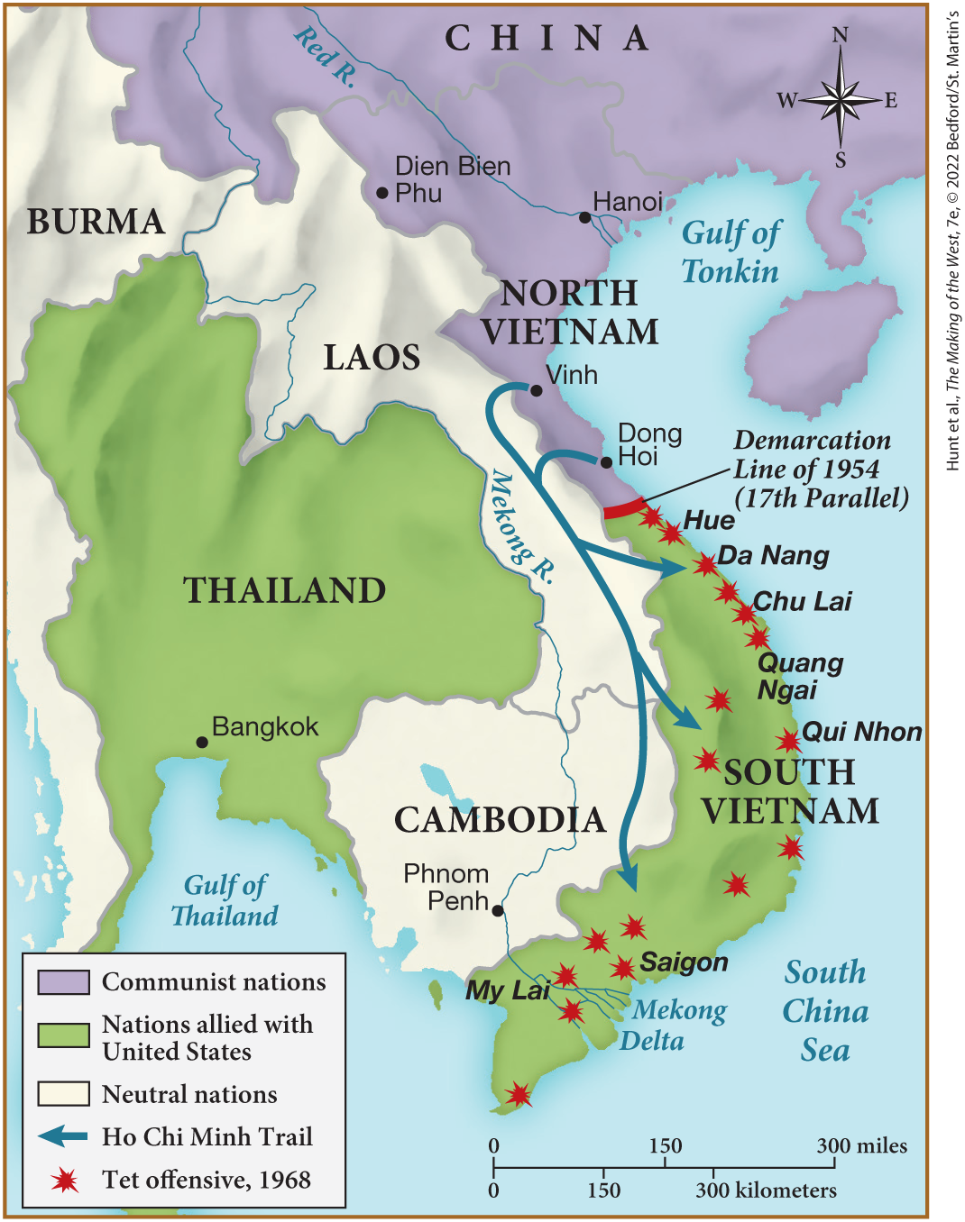
MAP 28.1 The Vietnam War, 1954–1975

Slide 28
III. Protesting Cold War Conditions (3 of 8)
B. The Growth of Citizen Activism (1 of 3)
  New social activism emerges in the West as a broad cross-section of Americans embraced the civil rights movement
  César Chávez leads Mexican American migrant workers in a strike for better wages and working conditions
  African American civil rights movement takes dramatic turn when riots erupt
  Some activists turn to militant affirmation of racial differences
  They argue that Black people should celebrate their blackness and work for “Black power”
  Homosexuals also began to openly assert their rights
Notes:
III. Protesting Cold War Conditions (3 of 8)
B. The Growth of Citizen Activism (1 of 3)
In the midst of continued conflict, a new social activism emerged in the West. A broad cross-section of Americans embraced the civil rights movement in the United States and transformed it.
In 1965, César Chávez (1927–1993) led Mexican American migrant workers in the California grape agribusiness in a strike for better wages and working conditions.
Meanwhile, the African American civil rights movement took a dramatic turn when riots erupted across the United States in 1965 and in subsequent summers.
Some activists transformed their struggle into a militant affirmation of racial differences.
They argued that Black people should celebrate their blackness and work for “Black power” by asserting and claiming the rights they were constitutionally entitled to instead of begging for them nonviolently.
Homosexuals also began to openly assert their rights. In June 1969, gay men in Greenwich Village, New York, rioted against the police. The gay movement spread around the world and involved women as well as men.

Slide 29
III. Protesting Cold War Conditions (4 of 8)
B. The Growth of Citizen Activism (2 of 3)
  White American university student find themselves excluded from leadership positions among Black activists
  Many protested against technological and social changes
  European youths also rebelled in Rome, Prague, and Poland
  Students attack the traditional university curriculum and turn defiant rebelliousness into a political activist style
  Students reject middle-class social values
  Businesses make billions of dollars catering to the counterculture
Notes:
III. Protesting Cold War Conditions (4 of 8)
B. The Growth of Citizen Activism (2 of 3)
As the emphasis shifted in the civil rights movement, white American university students who had participated in the early stages of the civil rights movement found themselves excluded from leadership positions among Black activists.
Many turned instead to the growing protest against technological change, consumerism, sexual repression, the educational establishment, and the Vietnam War.
European youths also rebelled in Rome, Prague, and Poland.
Students attacked the traditional university curriculum and turned the defiant rebelliousness of 1950s youth culture into a political activist style.
In their personal lives, students rejected middle-class values concerning fashion, personal hygiene, living arrangements, drug use, and sexuality.
Businesses made billions of dollars selling blue jeans, dolls dressed as hippies, natural foods, and drugs, as well as packaging and managing the superstars of the counterculture.

Slide 30
III. Protesting Cold War Conditions (5 of 8)
B. The Growth of Citizen Activism (3 of 3)
  Women’s activism gains more political traction
  Middle-class women respond positively to The Feminine Mystique written by American journalist Betty Friedan
  National Organization for Women (NOW) is formed to bring about female participation in society
  Activist women resent discrimination on the basis of sex, demand other rights
Notes:
III. Protesting Cold War Conditions (5 of 8)
B. The Growth of Citizen Activism (3 of 3)
Women’s activism exploded across the political spectrum.
Many middle-class women responded positively to the international best-seller The Feminine Mystique (1963), written by American journalist Betty Friedan (1921–2006).
In the United States, the National Organization for Women (NOW) was formed in 1966 to bring about full female participation in American society.
Activist women came to resent discrimination on the basis of sex within the civil rights and student movements, and some women demanded abortion rights or the decriminalization of homosexuality.

Slide 31
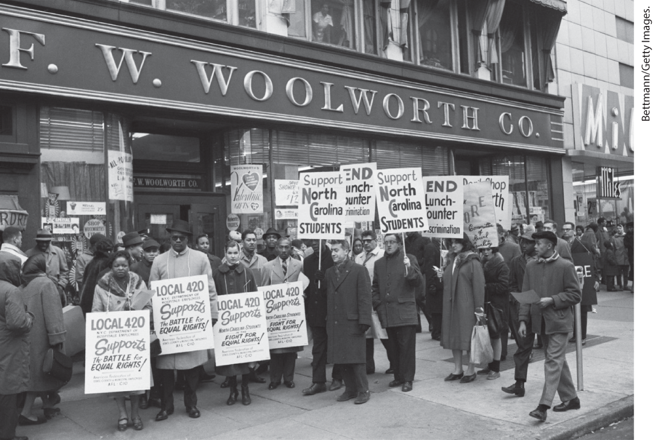
Civil Rights Protest in the United States, 1960

Slide 32
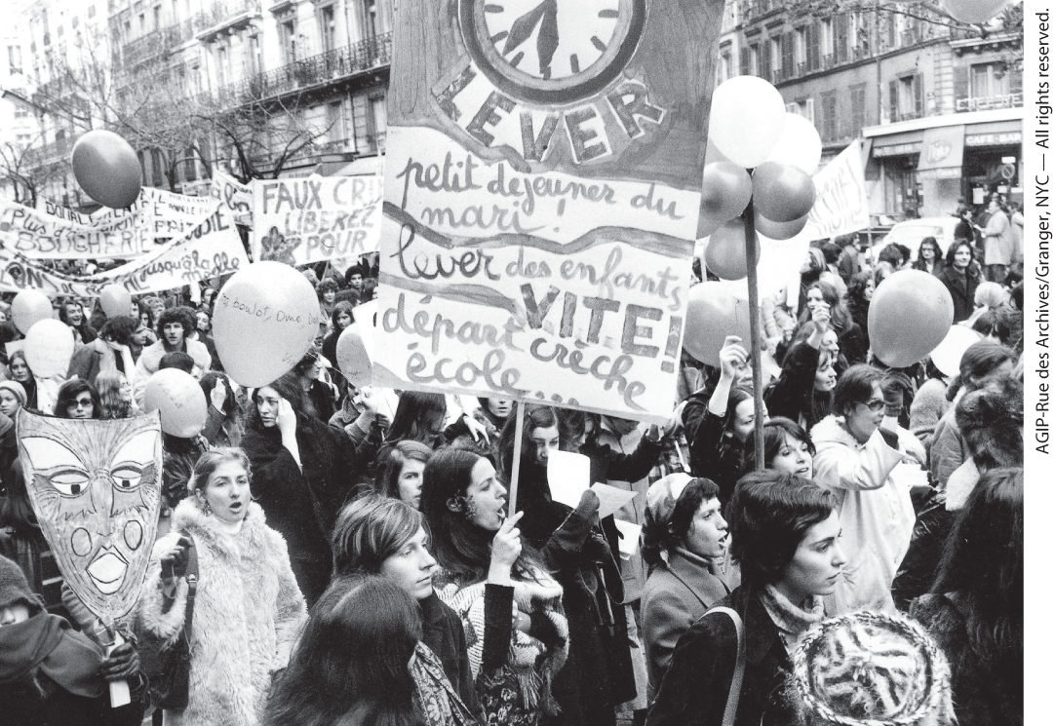
Second-Wave Feminists on the March

Slide 33
III. Protesting Cold War Conditions (6 of 8)
C. 1968: Year of Crisis (1 of 3)
  In January 1968 the Vietcong and the North Vietnamese attacked more than one hundred South Vietnamese towns and American bases
  The antiwar movement gains momentum, escalating protests
  Martin Luther King Jr. is assassinated and more than a hundred cities erupt in violence
  In France, students go on to protest education standards
  Police respond by assaulting and arresting student demonstrators
  Parisian middle classes are sympathetic to the students
  By May, protests become revolts and workers join
Notes:
III. Protesting Cold War Conditions (6 of 8)
C. 1968: Year of Crisis (1 of 3)
In January 1968, on the first day of the Vietnamese New Year, or Tet, the Vietcong and the North Vietnamese attacked more than one hundred South Vietnamese towns and American bases, inflicting heavy casualties and causing many Americans to conclude that the war might be unwinnable.
The antiwar movement gained crucial momentum, and protest escalated.
Adding to the unstable situation was the assassination of Martin Luther King Jr. on April 4, 1968. More than a hundred cities across the United States erupted in violence as a result.
In France, students at the university in Nanterre had gone on strike in January, protesting what they saw as a second-rate education.
Students at the Sorbonne showed solidarity, and the police responded by assaulting and arresting student demonstrators.
The Parisian middle classes were sympathetic to the students, as they shared the students’ resentment of bureaucracy, and were horrified by police violence.
By May, the protests had become outright revolt, and workers joined in.

Slide 34
III. Protesting Cold War Conditions (7 of 8)
C. 1968: Year of Crisis (2 of 3)
  President Charles de Gaulle announces pay raise for workers
  De Gaulle then sends tanks into Paris to stop student movement
  Protest erupt in Czechoslovakia as well, Alexander Dubček calls for more social and political openness
  Poland, East Germany, and the Soviet Union threatened Dubček’s government daily
  When Dubček fails to attend a meeting of Warsaw Pact leaders, Soviet threats intensify and Soviet tanks move into Prague
  Soviet determination to retain control was expressed in the Brezhnev Doctrine
  Repression of artists and intellectuals increases, author Alexander Solzhenitsyn expelled from the Soviet Union for his authorship of The Gulag Archipelago
Notes:
III. Protesting Cold War Conditions (7 of 8)
C. 1968: Year of Crisis (2 of 3)
In June, President Charles de Gaulle announced a pay raise for workers, and businesses offered them a stronger voice in decision making.
De Gaulle then sent tanks into Paris and shut down the student movement.
Protest erupted in Czechoslovakia as well. In autumn 1967, at a Czechoslovak Communist Party congress, Alexander Dubček (1921–1992), head of the Slovak branch of the party, called for more social and political openness, beginning the “Prague Spring.”
As the Czechs and Slovaks experimented with their newfound freedom of expression, Poland, East Germany, and the Soviet Union threatened Dubček’s government daily.
When Dubček failed to attend a meeting of Warsaw Pact leaders, Soviet threats intensified. In August 1968, Soviet tanks rolled into Prague and, despite Czech resistance, put an end to the reform movement.
Soviet determination to retain control over the eastern-bloc countries was expressed in the Brezhnev Doctrine, announced in November 1968, which made clear that further moves toward change would meet similar repression.
Repression of artists and intellectuals increased. Dissident author Alexander Solzhenitsyn was expelled from the Soviet Union in 1974 for his authorship of The Gulag Archipelago, a work that disillusioned many loyal Communists.

Slide 35
III. Protesting Cold War Conditions (8 of 8)
C. 1968: Year of Crisis (3 of 3)
  Anti-Semitism in Russia increases, Jews face severe repression
  Television was utilized by communist authorities to spread propaganda
  Repression increased flee of intellectuals from the East, helping erode any lingering support for communism
  In the U.S, President Richard Nixon orders the invasion of Cambodia, sparking further protests and resulting in the shooting of students at Kent State University
  The United States and North Vietnam continue to support hostilities until Vietnam is forcibly reunified
  The United States experiences a crisis of confidence
Notes:
III. Protesting Cold War Conditions (8 of 8)
C. 1968: Year of Crisis (3 of 3)
Anti-Semitism in Russia increased, and Jews were subject to educational restrictions, severe job discrimination, and constant assault on their religious practice. The government severely restricted Jewish emigration.
Television was enlisted by Communist authorities to calm the population. Czech soap operas lauded private life over political activism and portrayed the West as disillusioning.
Repression increased the “brain drain” from the East, and the presence of these exiles and escapees in the United States and western Europe helped erode any lingering support for communism.
In the United States, the newly elected president Richard Nixon (1913–1994; president, 1969–1974) ordered the invasion of Cambodia in the Vietnam War, which instigated further student protests and ultimately resulted in the shooting of students at Kent State University by the National Guard.
Despite agreeing to peace in 1973, the United States and North Vietnam continued to support hostilities until, in 1975, South Vietnam collapsed under a determined North Vietnamese offensive, and Vietnam was forcibly reunified.
In the aftermath of the war, the United States experienced a crisis of confidence, and many blamed protesters and activists rather than the government for the country’s perceived decline.

Slide 36
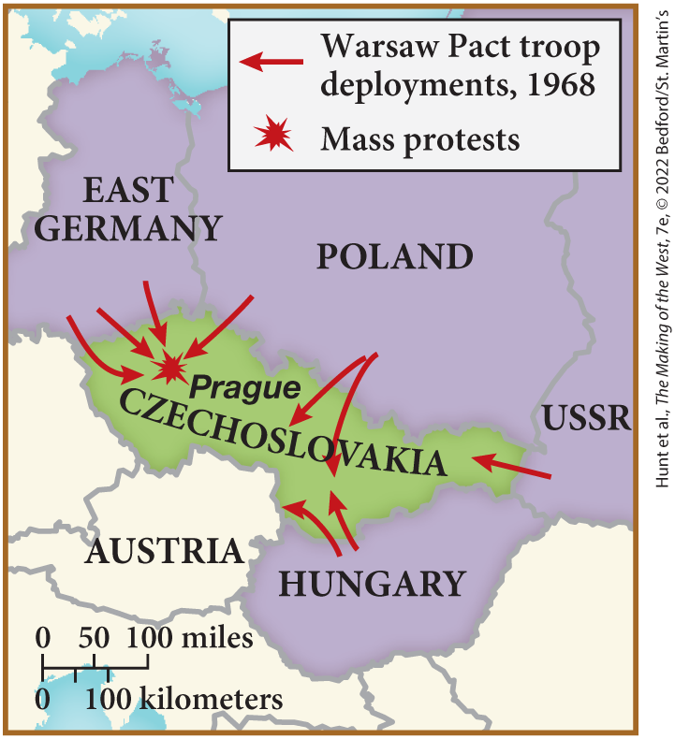
SPOT MAP 28.1 Prague Spring, 1968

Slide 37
IV. The Testing of Superpower Domination and the End of the Cold War (1 of 8)
A. A Changing Balance of World Power (1 of 3)
  After being tested at home, the great powers confront the world
  The United States opens relations with China
  The Soviet Union reacts by making political advances in the West
  The superpowers sign the Strategic Arms Limitation Treaty
  The Helsinki accords officially acknowledge Soviet territorial gains in exchange for the guarantee of basic human rights
Notes:
IV. The Testing of Superpower Domination and the End of the Cold War (1 of 8)
A. A Changing Balance of World Power (1 of 3)
After being tested by protest at home, the great powers confronted the world.
In 1972, the United States pulled off a foreign policy triumph over the USSR when it opened relations with China, the other Communist giant.
The Soviet Union reacted to this possible rapprochement between China and the United States by making overtures to the West.
In 1972, the superpowers signed the Strategic Arms Limitation Treaty (SALT I), which set a cap on the number of antimissile and antiballistic weapons each country could own and position.
In 1975, in the Helsinki accords on human rights, the western nations officially acknowledged Soviet territorial gains in World War II in exchange for the Soviet-bloc countries’ guarantee of basic human rights.

Slide 38
IV. The Testing of Superpower Domination and the End of the Cold War (2 of 8)
A. A Changing Balance of World Power (2 of 3)
  Rising purchases of military and imported goods make the United States a debtor to other countries
  U.S. president Richard Nixon’s administration resigns during the Watergate scandal
  Middle East challenges Western global dominance
  Israeli forces responds to hostility by seizing territory from Middle Eastern countries
  Egypt and Syria attack Israel on Yom Kippur, Israel successfully defends itself with the help of the U.S.
Notes:
IV. The Testing of Superpower Domination and the End of the Cold War (2 of 8)
A. A Changing Balance of World Power (2 of 3)
Despite these successes, rising purchases of military and imported goods made the United States a debtor nation that owed billions of U.S. dollars to other countries. The United States was forced to share leadership in the global economic system with the Common Market countries.
In the meantime, U.S. president Richard Nixon’s administration was rocked by the Watergate scandal, and he resigned in disgrace in the summer of 1974.
The Middle East provided a new challenge to Western global dominance.
In June 1967, Israeli forces responded to hostile moves including mobilization of the Egyptian army on Israel’s borders by seizing Gaza and the Sinai Peninsula from Egypt, the Golan Heights from Syria, and the West Bank from Jordan.
In 1973, Egypt and Syria attacked Israel on Yom Kippur, and with military assistance from the United States, Israel successfully turned back the invasion.

Slide 39
IV. The Testing of Superpower Domination and the End of the Cold War (3 of 8)
A. A Changing Balance of World Power (3 of 3)
  Arab nations in OPEC quadruple the price of oil and impose an embargo on oil exports
  The oil embargo causes unemployment to rise quickly in Europe and the United States
  The oil shortage creates a recession that was accompanied by inflation
  Simultaneous rise in prices and unemployment is dubbed “stagflation”
  Many in the Middle East call for reform, and an uprising in Iran overthrows the U.S.-backed government
Notes:
IV. The Testing of Superpower Domination and the End of the Cold War (3 of 8)
A. A Changing Balance of World Power (3 of 3)
After their defeat, the Arab nations in the Organization of Petroleum Exporting Countries (OPEC) quadrupled the price of oil and imposed an embargo on oil exports to the United States in retaliation for its support of Israel.
The oil embargo caused unemployment to rise by more than 50 percent in Europe and the United States.
Whereas previous recessions had brought falling prices because goods remained unsold, the oil shortage created a recession that was accompanied by inflation, while rising interest rates discouraged industrial investment and consumer buying.
The simultaneous rise in prices, unemployment, and declining commercial activity was dubbed “stagflation.”
Encouraged by OPEC’s successful stand against the West, many ordinary persons in the Middle East called for reform, and at the end of the 1970s, an uprising in Iran overthrew the U.S.-backed government and created an Islamic society.

Slide 40
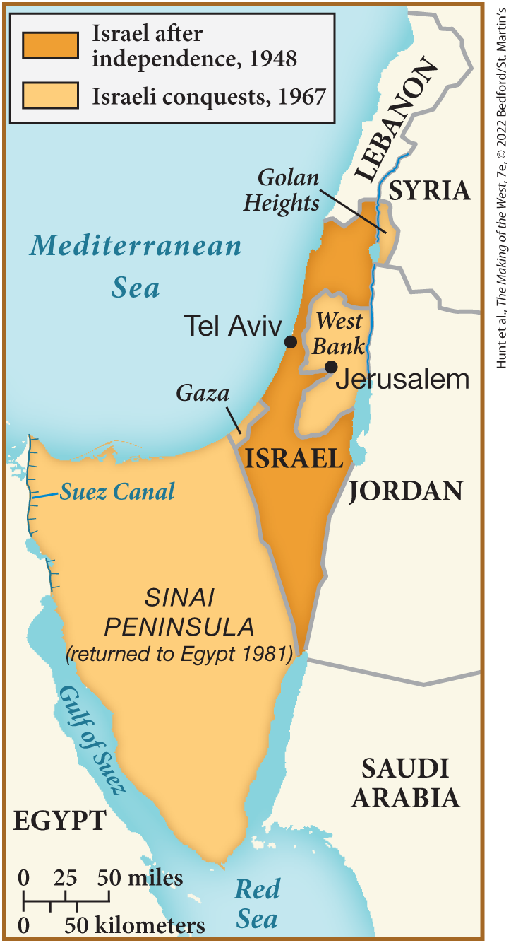
SPOT MAP 28.2 Israel after the Six-Day War, 1967

Slide 41
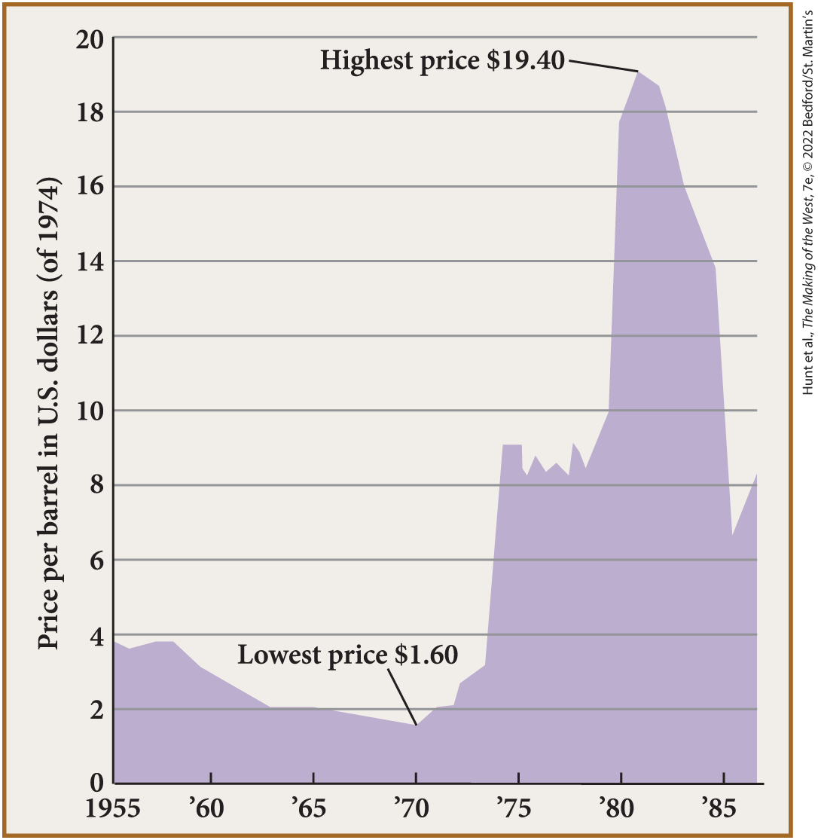
FIGURE 28.1 Fluctuating Oil Prices, 1955–1985

Slide 42
IV. The Testing of Superpower Domination and the End of the Cold War (4 of 8)
B. The Western Bloc Meets Challenges with Reform (1 of 2)
  In Europe, the restoration of political order is met with terrorism in West Germany and Italy
  In Ireland, nationalist and religious violence pitted Catholics against Protestants
  Portugal, Spain, and Greece all moved from authoritarian dictatorships to democracy
  Margaret Thatcher’s Conservative Party comes to power in Britain asserting the only solution to current problems was business-friendly policies and smaller government
  Thatcher’s policies came to be known as neoliberalism and shocked the British economy
  War against Argentina revived her popularity, and the economy strengthened
  Thatcher’s example was followed by Ronald Reagan in the U.S
Notes:
IV. The Testing of Superpower Domination and the End of the Cold War (4 of 8)
B. The Western Bloc Meets Challenges with Reform (1 of 2)
In Europe in the 1970s, the restoration of political order was met with terrorism as disaffected youths perpetrated kidnappings, bank robberies, bombings, and assassinations in West Germany and Italy.
In Ireland, nationalist and religious violence pitted Catholics against Protestants in the north.
There were some advances for democracy — Portugal, Spain, and Greece all moved from right-wing authoritarian dictatorships to democracy.
In Britain, Margaret Thatcher’s Conservative Party came to power amid stagflation and violence in Ireland and instituted a package of economic policies based on the monetarist, or supply-side, economic theory. This theory asserted that the only way to ensure prosperity was in a business-friendly environment with a reduced role for government and a dismantled welfare state.
Thatcher’s mix of income tax cuts, privatization, and budget cuts, that came to be known as neoliberalism, shocked the British economy and reduced her popularity.
War against Argentina in 1982 over the Falkland Islands revived her popularity, and the economy strengthened.
Thatcher’s example was followed by Ronald Reagan (1911–2004) in the United States, who served as president from 1981 to 1989.

Slide 43
IV. The Testing of Superpower Domination and the End of the Cold War (5 of 8)
B. The Western Bloc Meets Challenges with Reform (2 of 2)
  Reagan cut taxes and reduced government support for the welfare state
  Reagan increased military spending and budget deficits
  Helmut Kohl in West Germany also froze government spending and reduced taxes
  President François Mitterrand took a different approach, but his successor Jacques Chirac adopted neoliberal policies
  Smaller European countries thrived by investment in education and neoliberal economic policies
  Only Sweden maintained a full array of social programs for everyone
Notes:
IV. The Testing of Superpower Domination and the End of the Cold War (5 of 8)
B. The Western Bloc Meets Challenges with Reform (2 of 2)
Reagan vowed to promote the values of the “moral majority,” cutting taxes and reducing government support for the welfare state.
Reagan increased military spending and budget deficits, warning repeatedly of the Communist threat.
Helmut Kohl (1930–) in West Germany also froze government spending and reduced taxes.
In France, President François Mitterrand (1916–1996) took a different approach by increasing wages and social spending to stimulate the economy, although his successor Jacques Chirac (1932–) adopted neoliberal policies. The racist National Front Party grew more popular with promises to deport North African and Middle Eastern immigrants.
Some smaller European countries, such as Spain and Ireland, thrived by combining Common Market membership with investment in education and neoliberal economic policies.
Only Sweden maintained a full array of social programs for everyone, although high taxes and a huge influx of immigrants caused many to wonder whether the welfare state had become too extreme.

Slide 44
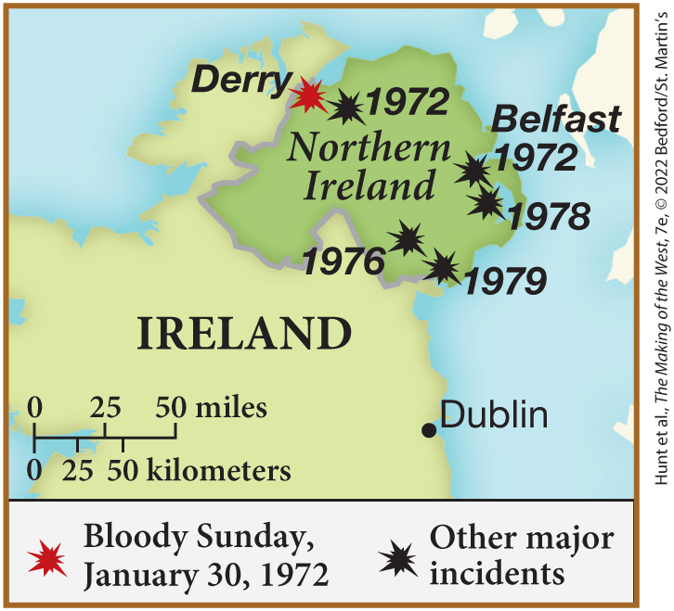
SPOT MAP 28.4 Nationalist Movements of the 1970s

Slide 45
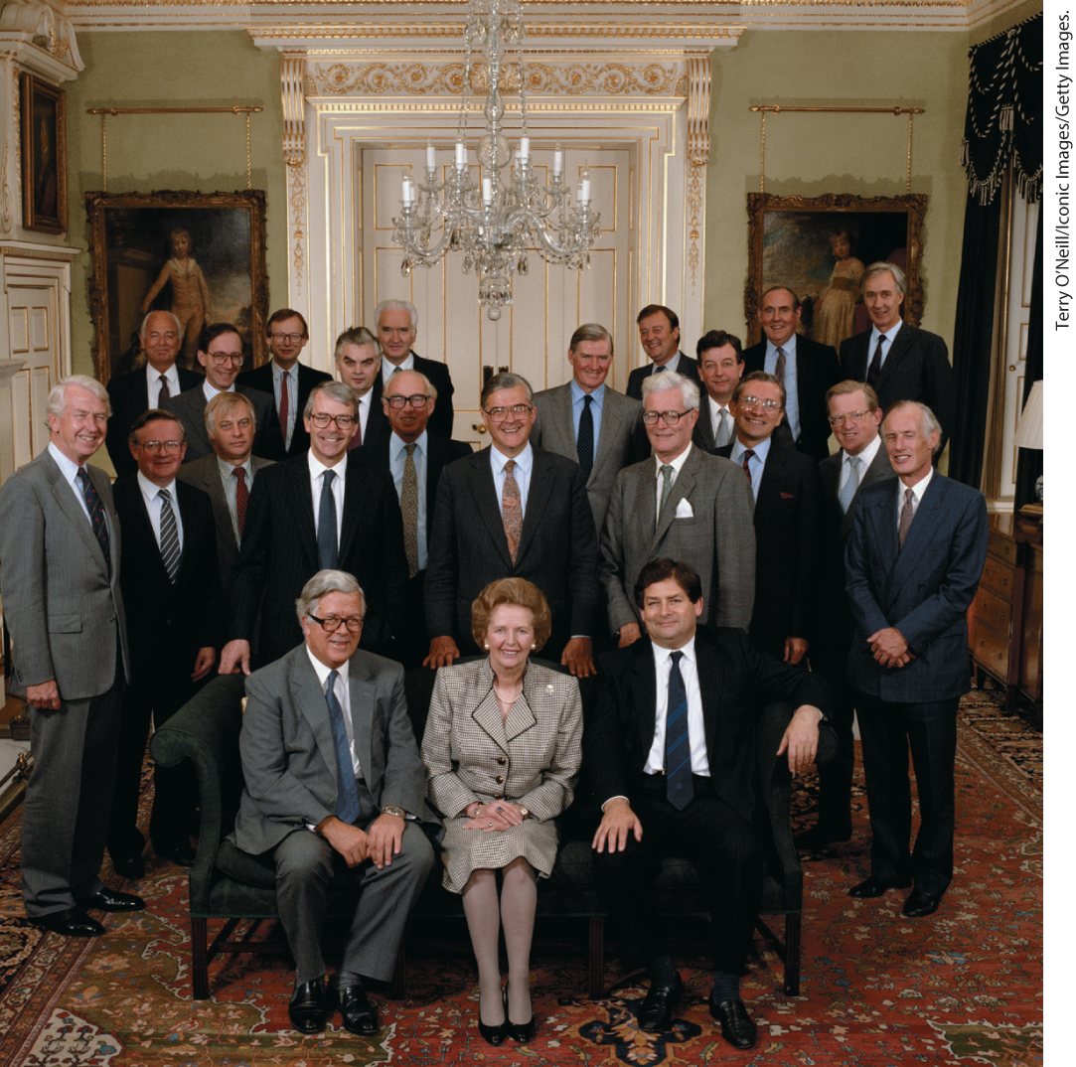
Margaret Thatcher and Her Cabinet, 1989

Slide 46
IV. The Testing of Superpower Domination and the End of the Cold War (6 of 8)
C. Collapse of Communism in the Soviet Bloc (1 of 3)
  Reform also begins in the Soviet Union, provoking rebellion and the eventual collapse of Communist rule
  Economic, political and social factors brought the need for reform to the forefront
  Mikhail Gorbachev opened an era of change with a program of economic reform
  Gorbachev instituted a policy of greater freedom of speech and openness in government
  Explosion of the nuclear reactor at Chernobyl highlighted the shortcomings of the system and increased criticism in the Soviet press
  Gorbachev ally, Boris Yeltsin, quits the government and demands more radical reform
Notes:
IV. The Testing of Superpower Domination and the End of the Cold War (6 of 8)
C. Collapse of Communism in the Soviet Bloc (1 of 3)
Reform was also begun in the Soviet Union but, instead of strengthening the economy, it provoked further rebellion and the eventual collapse of Communist rule in the USSR.
A deteriorating economy, a corrupt system of political and economic management, and a deteriorating standard of living with a rising level of alcoholism brought the need for reform to the forefront.
In 1985, Mikhail Gorbachev opened an era of change with a program of economic reform called perestroika, which aimed to reinvigorate the Soviet economy by introducing market mechanisms and achieving greater efficiency in manufacturing, agriculture, and services.
Gorbachev also instituted a policy of greater freedom of speech and openness in government called glasnost. Glasnost brought many of the Soviet Union’s social and economic problems into the public arena and fostered increasing dissent.
The explosion of the nuclear reactor at Chernobyl in 1986 highlighted the shortcomings of the system and increased criticism in the Soviet press. Even the Communist Party and Marxism-Leninism were subject to criticism. (For a close look at one of the important environmental history topics in this chapter, see “Environment Matters: Chernobyl.”)
In the fall of 1987, a Gorbachev ally, Boris Yeltsin, quit the government and demanded more radical reform. He inspired political opposition to the regime.

Slide 47
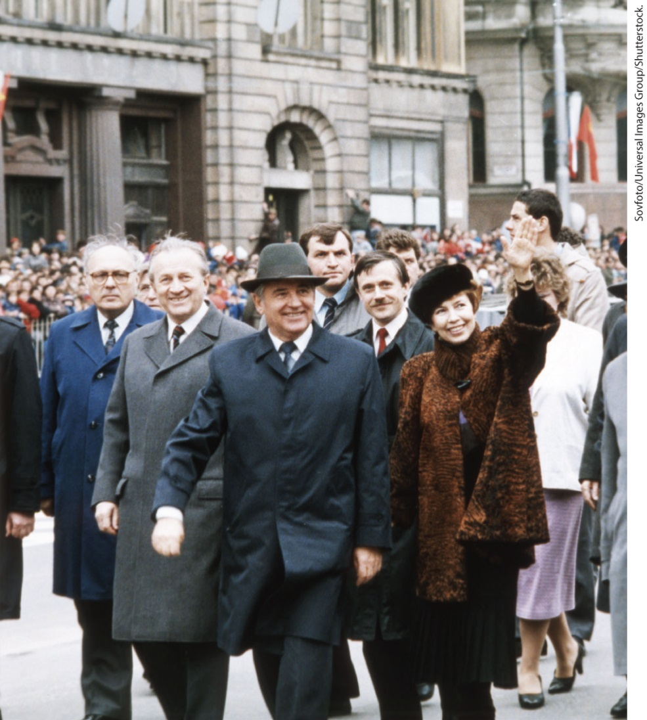
Mikhail and Raisa Gorbachev

Slide 48
IV. The Testing of Superpower Domination and the End of the Cold War (7 of 8)
C. Collapse of Communism in the Soviet Bloc (2 of 3)
  Gorbachev cuts Soviet military spending and reduces military action, winning over Ronald Reagan and defusing the cold war
  Lech Walesa and Anna Walentynowicz form the independent labor movement called Solidarity, which rivals the influence of the Polish Communist Party
  The Polish police outlaw Solidarity, but dissent remained alive in Poland
  Uprisings begin occurring in many parts of the world in the late 1980s
  Chinese Communists struggle to control dissident students, protest movement at Tiananmen Square crushed by military force
  Weakened Polish regime allows free elections which are won by Solidarity candidates
Notes:
IV. The Testing of Superpower Domination and the End of the Cold War (7 of 8)
C. Collapse of Communism in the Soviet Bloc (2 of 3)
Gorbachev cut Soviet military spending and withdrew Soviet troops from Afghanistan. His unilateral actions gradually won over Ronald Reagan, and the two leaders began defusing the cold war.
In 1980, two Polish workers, Lech Walesa and Anna Walentynowicz formed the independent labor movement called Solidarity, which rivaled the influence of the Polish Communist Party.
In 1981, the Polish police and military, with Soviet support, outlawed Solidarity. However, dissident culture remained alive in Poland.
Uprisings were occurring in many parts of the world in the late 1980s, including the Philippines, Chile, Haiti, South Africa, and China.
Chinese Communists struggled to control dissident students, whose inspirational protest movement at Tiananmen Square was crushed by military force.
In June 1989, the weakened Polish regime allowed free elections, won overwhelmingly by Solidarity candidates. Reversing the Brezhnev Doctrine, Gorbachev refused to interfere.

Slide 49
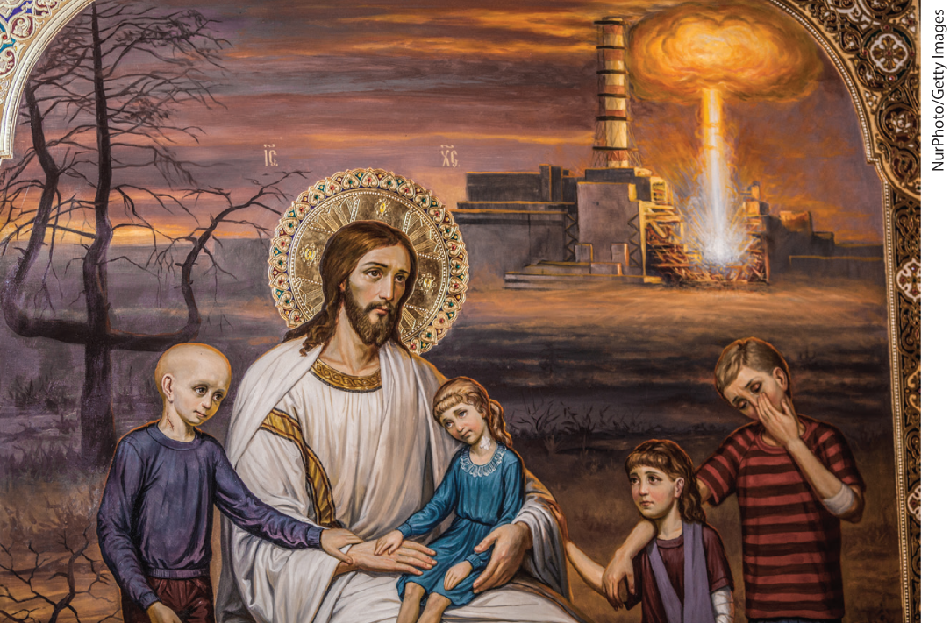
Environment Matters: Chernobyl

Slide 50
IV. The Testing of Superpower Domination and the End of the Cold War (8 of 8)
C. Collapse of Communism in the Soviet Bloc (3 of 3)
  Communism collapses in Hungary
  In the summer of 1989, the Berlin Wall falls
  In the “velvet revolution” of Czechoslovakia, dissident playwright Václav Havel is elected president
  In Romania, Communist dictator Nicolae Ceauşescu is tried and executed
  For many, his death signaled that the very worst of communism was over
Notes:
IV. The Testing of Superpower Domination and the End of the Cold War (8 of 8)
C. Collapse of Communism in the Soviet Bloc (3 of 3)
Communism next collapsed in Hungary.
In the summer of 1989, the Berlin Wall — the most potent and obvious symbol of a divided Europe — fell as crowds of East Germans flooded the borders of the crumbling Soviet bloc.
In the “velvet revolution” of Czechoslovakia, dissident playwright Václav Havel was elected to the presidency.
In Romania, the brutal and corrupt Communist dictator Nicolae Ceauşescu (1918–1989) was tried by a military court in 1989 and executed.
For many, his death signaled that the very worst of communism was over.

Slide 51
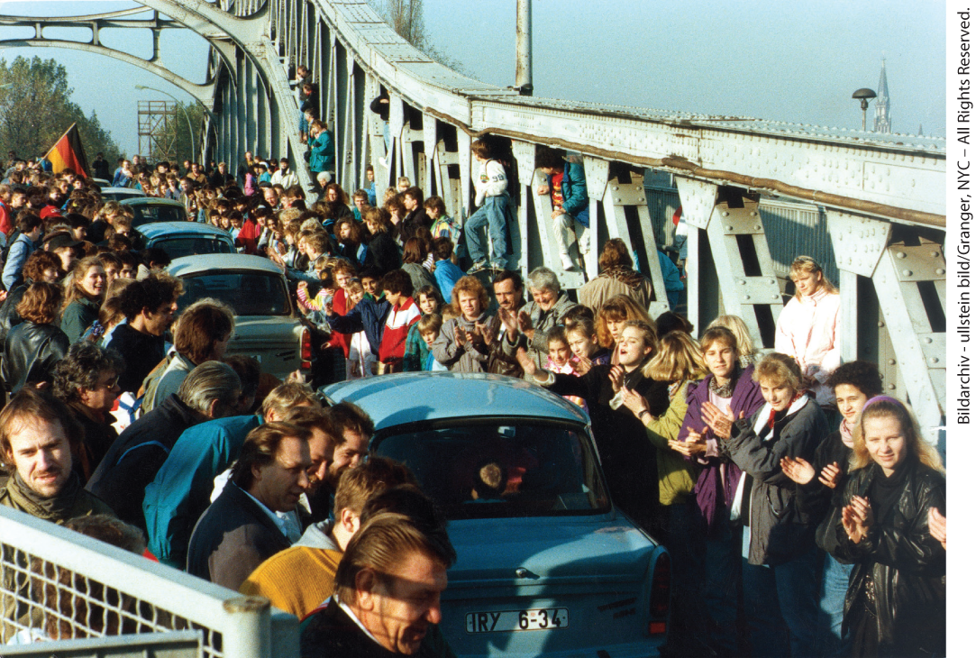
November 1989: East Germany Meets West Germany

Slide 52
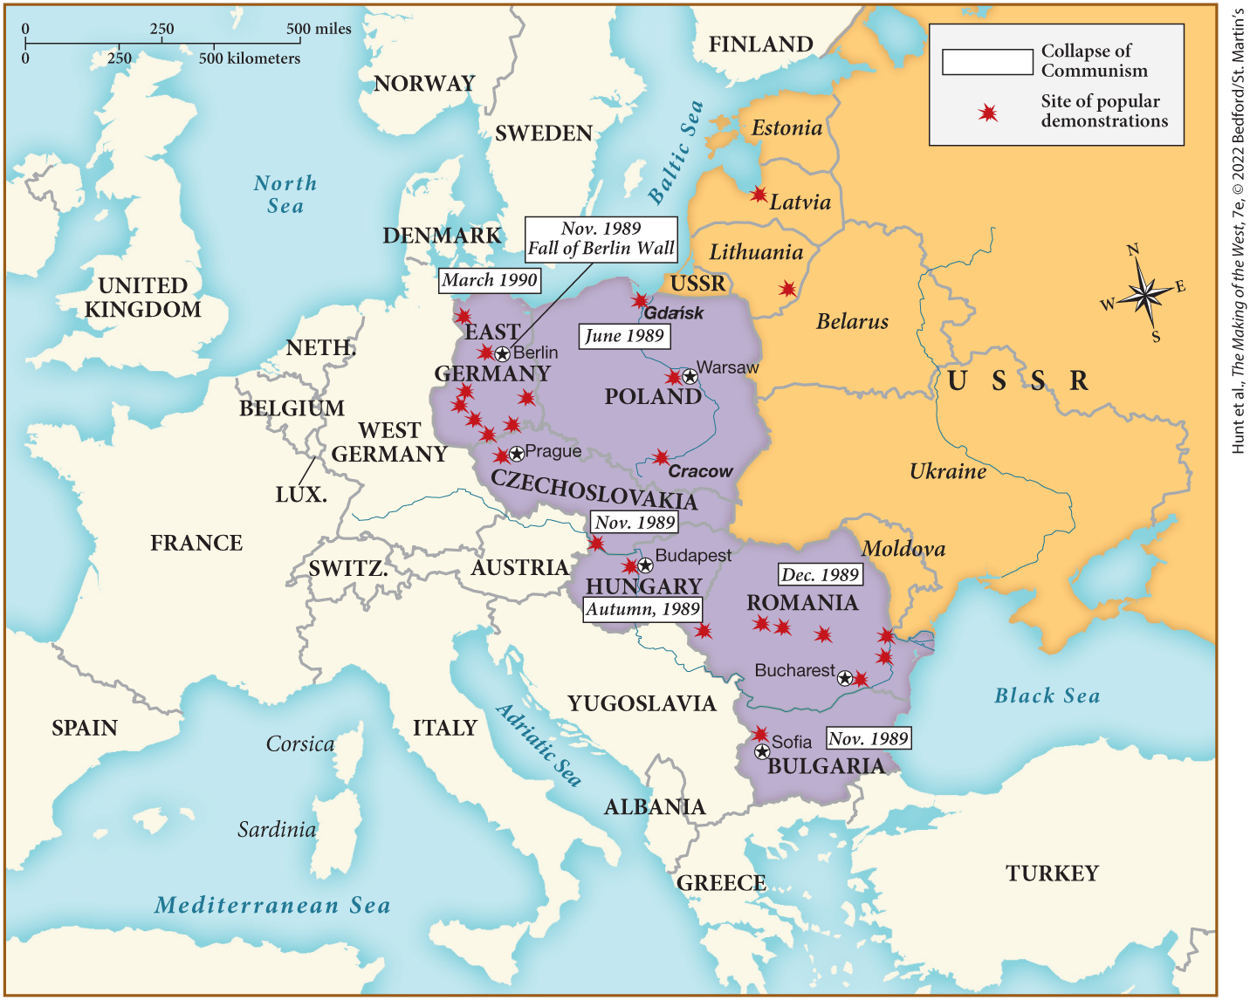
MAP 28.2 Mapping the West: The Collapse of Communism in Europe, 1989–1990

