Slide 1
The Making of the West
Seventh Edition
Hunt • Martin • Rosenwein • Smith
CHAPTER 27
The Cold War and the Remaking of Europe
1945 –1960s B.C.E.
Copyright © 2022 by Bedford/St. Martin’s
Distributed by Bedford/St. Martin’s/Macmillan Learning strictly for use with its products. Not for redistribution.

Slide 2
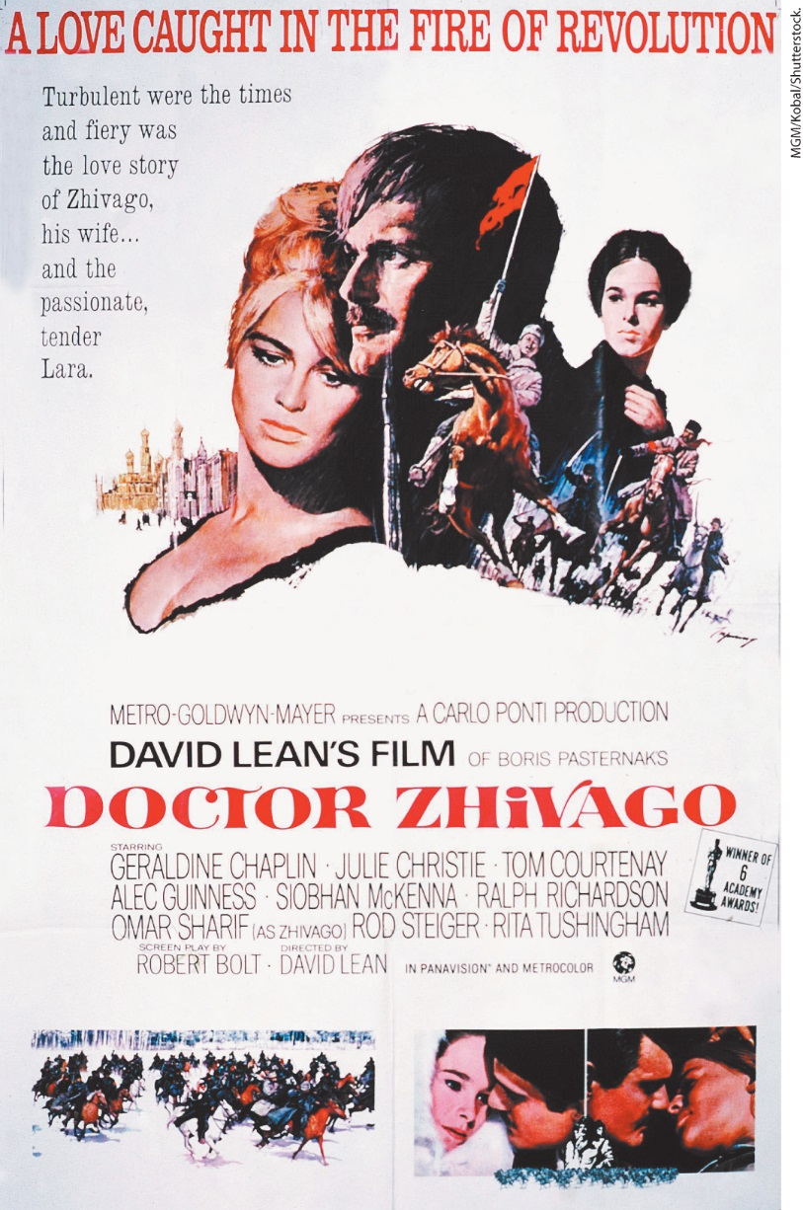
Doctor Zhivago Poster

Slide 3
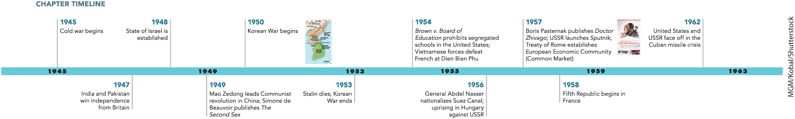
Chapter 27 Timeline

Slide 4
I. World Politics Transformed (1 of 7)
A. Chaos in Europe
  World War II left cities in rubble and millions of people suffering
  The German population suffered extreme mental distress, however were no mass uprisings
  Tens of millions of refugees suffered the most
  Many had escaped prisons and death camps, others forcibly expelled
  Survivors of concentration camps continued to suffer
  Many had nowhere to return as anti-Semitism continued in Europe
  Many Jews eventually went to Palestine
Notes:
I. World Politics Transformed (1 of 7)
A. Chaos in Europe
Unlike during World War I, armies in World War II fought a war that leveled thousands of square miles of territory, leaving cities in shambles and millions of people suffering and dying.
The German population as a whole was so traumatized and exhausted by the struggle for bare survival that people turned to faith healers and astrologists, and they claimed ghost sightings and witchcraft amid extreme mental distress. Unlike after World War I, however, there were no mass uprisings.
The tens of millions of refugees suffered the most.
Many had been inmates of prisons and death camps; others, especially ethnic Germans, had been forcibly expelled.
Survivors of the concentration camps continued to suffer after the war.
Many had no home to return to because property had been confiscated and entire communities destroyed. Anti-Semitism, sometimes violently expressed, continued in Europe.
Many Jews eventually went to Palestine.

Slide 5
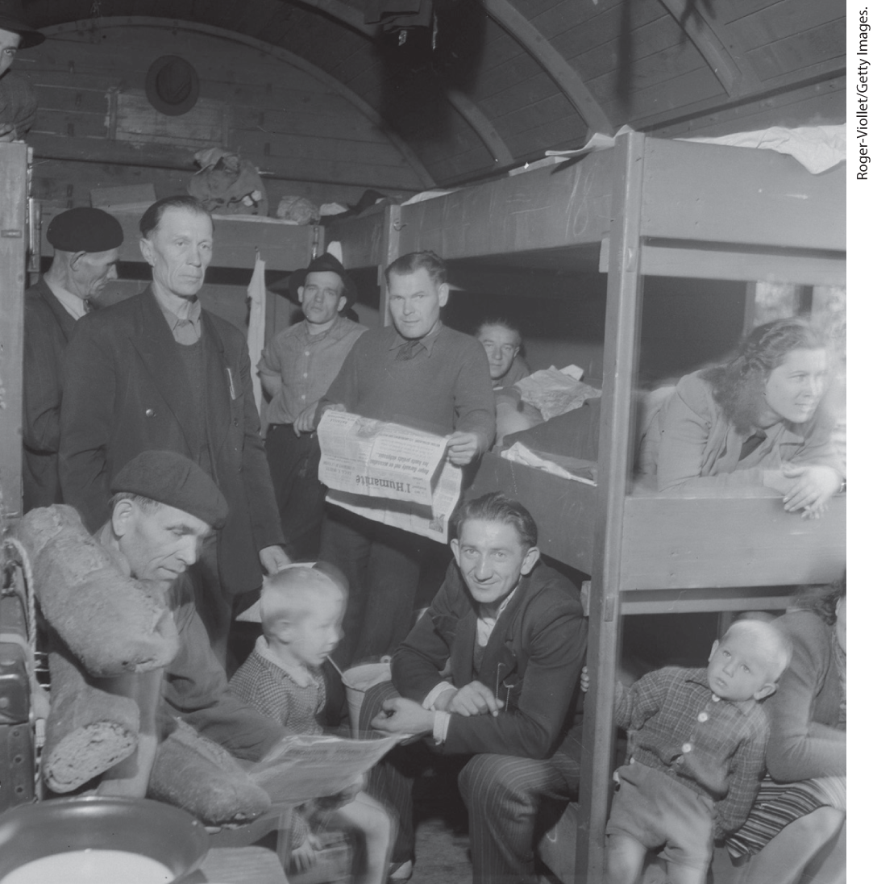
Polish Refugees after World War II

Slide 6
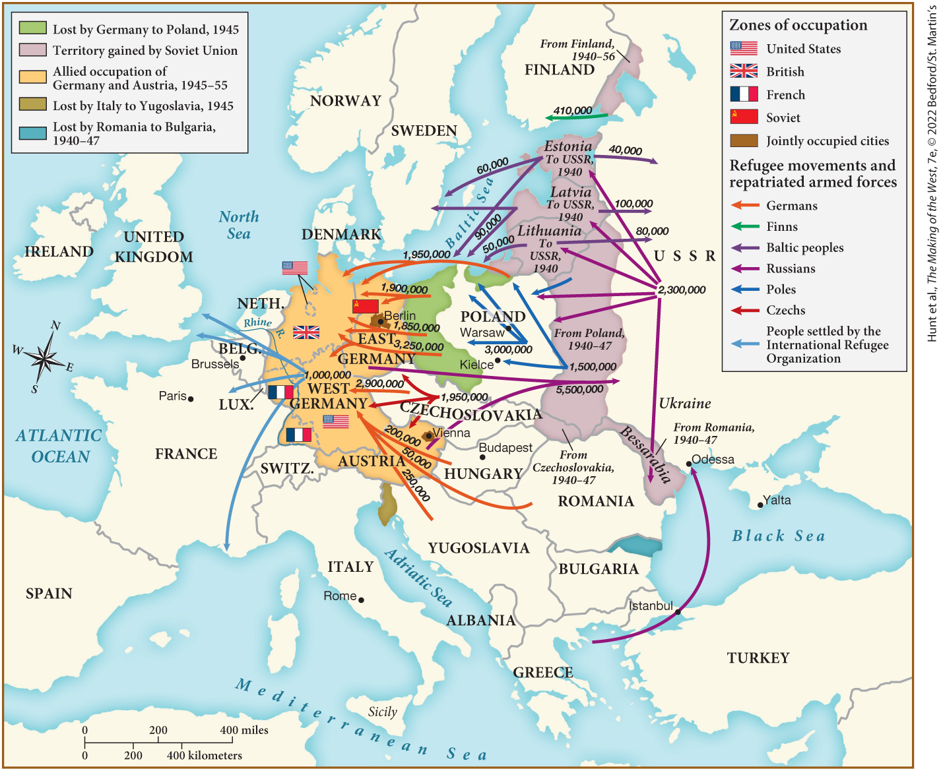
MAP 27.1 The Impact of World War II on Europe

Slide 7
I. World Politics Transformed (2 of 7)
B. New Superpowers: The United States and the Soviet Union (1 of 2)
  United States and the Soviet Union emerge as world powers
  United States becomes the richest country in the world
  Suburban housing developments and high consumer spending bolster the economy
  Internationalized Americans embraced their country’s position
  “Baby boom” causes surge in population
Notes:
I. World Politics Transformed (2 of 7)
B. New Superpowers: The United States and the Soviet Union (1 of 2)
Only two powerful countries remained in 1945: the United States and the Soviet Union.
The United States was now the richest country in the world, and a confident mood swept throughout the country.
A wave of suburban housing developments and high consumer spending kept the economy buoyant.
In a departure from U.S. isolationist attitudes before the war, internationalized Americans embraced their country’s position as a global leader.
Population soared with the “baby boom” that lasted from the late 1940s to the early 1960s.

Slide 8
I. World Politics Transformed (3 of 7)
B. New Superpowers: The United States and the Soviet Union (2 of 2)
  The Soviets expected equality in decision making with the United States
  Citizens expected hardships to end after meeting economic goals
  Stalin, however, increased repression to increase control
  Stalin announces a new five-year plan setting increased production goals
  Stalin intensifies propaganda to try and increase the birthrate
  Soviet citizens taught that enemies such as Jews threatened the state
Notes:
I. World Politics Transformed (3 of 7)
B. New Superpowers: The United States and the Soviet Union (2 of 2)
The Soviets also came out of the war with a sense of accomplishment, and, after their sacrifices in the war, expected equality in decision making with the United States rather than the imposed international isolation of the prewar period.
Citizens of the USSR expected hardship to end because they believed the defeat of Hitler proved that goals concerning industrialization and defense had been met.
Stalin, however, increased repression in order to increase his control; mobilization for total war had encouraged individual responsibility while relaxing Communist oversight.
Stalin announced a new five-year plan (1946) that set increased production goals and mandated stricter collectivization of agriculture.
To increase the birthrate, Stalin intensified propaganda emphasizing that working women should also fulfill their true nature by having many children.
Soviet citizens were taught that enemies threatened the state. Jews in particular were targeted in a growing atmosphere of fear.

Slide 9
I. World Politics Transformed (4 of 7)
C. Origins of the Cold War (1 of 2)
  Dangerous rivalry develops between U.S., British, and French against the Soviet Union
  Churchill sought to limit Soviet expansion, while Truman cut off aid as soon as the war ended
  Stalin sought a wall of Communist-ruled states to prevent aggression from western Europe
  The USSR repressed governments in central and eastern Europe
  Western leaders worried about further Communist expansion
Notes:
I. World Politics Transformed (4 of 7)
C. Origins of the Cold War (1 of 2)
Because no peace treaty officially ended the conflict with Germany to document mistaken policies, many historians point to a dangerous rivalry going back to at least to that time period of U.S., British, and French hostility toward the Soviet Communists’ abolition of private property and Russia’s withdrawal from World War I, along with Stalin’s aggressive policies.
After the war, Churchill sought to limit Soviet expansion and maintain Britain’s imperial power. Truman was tougher on the Soviets than Roosevelt and cut off aid to them as soon as the war ended.
Stalin wanted a buffer zone of friendly, Communist-ruled states to prevent what he perceived as aggression from western Europe.
To create this buffer zone, the USSR repressed democratic government in central and eastern Europe between 1945 and 1948, imposing Communist rule in Bulgaria, Romania, Hungary, Czechoslovakia, and Poland.
As Western leaders witnessed the Soviets intervening in eastern Europe, they worried about further Communist expansion in western Europe and Greece.

Slide 10
I. World Politics Transformed (5 of 7)
  C. Origins of the Cold War (2 of 2)
  Truman provided aid to regions threatened by communism
  The United States also announced the Marshall Plan, a program of massive economic aid to Europe
  Stalin was unable to supply similar economic aid to eastern Europe, choosing to suppress remaining democracies
  Yugoslavian leader Tito was the only exception to Soviet control
  Tito wanted Yugoslavia to develop independently of the Soviet Union
  Under Tito’s leadership, the various ethnic groups in the country remained at peace
Notes:
I. World Politics Transformed (5 of 7)
C. Origins of the Cold War (2 of 2)
In March 1947, Truman reacted to the threat by announcing economic and military aid to regions threatened by communism, a policy that came to be known as the Truman Doctrine.
Citing the deterioration of economic exchange during World War II as a threat to political stability, the United States also announced the Marshall Plan, a program of massive economic aid to Europe, under which the United States sent more than $12 billion in food, equipment, and services to Europe by the early 1950s.
Stalin considered the Marshall Plan a political ploy that found him unable to supply similar economic aid to eastern Europe, and his reaction was to suppress the remaining democracies in central and eastern Europe.
The only exception to the imposition of Soviet control came in Yugoslavia, ruled by the Communist leader Tito (Josip Broz, 1892–1980).
Tito wished to see Yugoslavia develop industrially independent of the Soviet Union.
Under Tito’s strong leadership, the various ethnic groups that made up Yugoslavia’s federation of six republics and two independent provinces remained at peace.

Slide 11
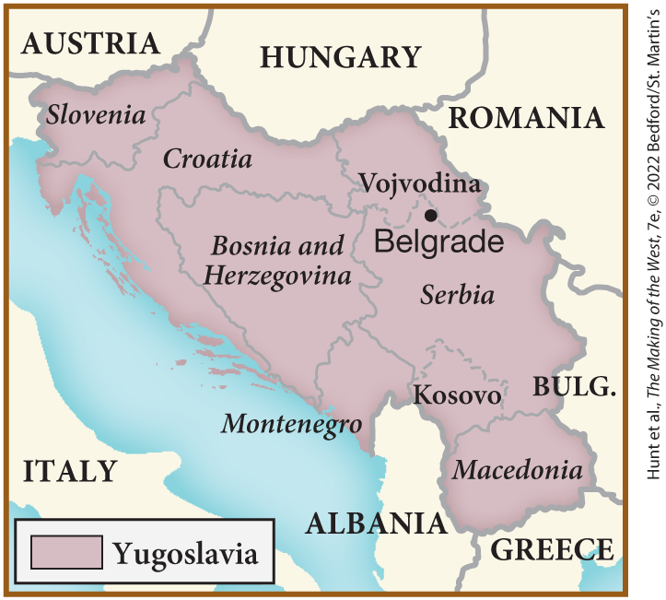
SPOT MAP 27.1 Yugoslavia after the Revolution

Slide 12
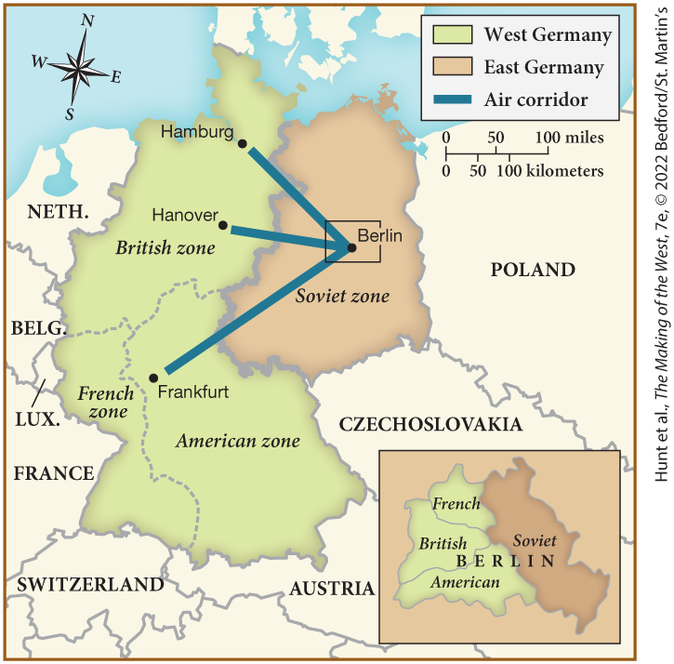
MAP 27.2 Divided Germany and the Berlin Airlift, 1946–1949

Slide 13
I. World Politics Transformed (6 of 7)
D. The Division of Germany (1 of 2)
  Agreements reached at Yalta split Germany into four zones, each controlled by one of the victors of the war
  Americans aimed to get rid of the Nazi legacy, Stalin redistributed the estates of wealthy Germans
  American leaders hoped for economic coordination among the four zones, the Soviets planned to use the output of their zone for their own purposes
  The three Western allies merged their zones into a West German state
  The United States began to make the western zone a buffer against the Soviets
  Stalin struck back, blockading Germany’s capital, Berlin
  Although the city was in Soviet territory, it had been divided into four zones
Notes:
I. World Politics Transformed (6 of 7)
D. The Division of Germany (1 of 2)
The agreements reached at Yalta provided for Germany’s occupation by troops divided into four zones, each of which was controlled by one of the four principal victors of the war: the United States, the Soviet Union, Great Britain, and France.
The Americans hoped to overthrow the Nazi legacy by controlling German media, while Stalin, believing that Nazism was an extreme form of capitalism, confiscated the estates of wealthy Germans and redistributed them to his supporters.
American leaders hoped for economic coordination among the four zones that would benefit the occupying countries and also support Germany, whereas the Soviets planned to use the economic output of their zone to help repair the Soviet economy.
Amid these tensions, the three Western allies agreed to merge their zones into a West German state instead of continuing to curtail German power as wartime agreements had stated.
The United States began an economic buildup under the Marshall Plan to make the western zone a buffer against the Soviets.
Stalin struck back at the Marshall Plan on July 24, 1948, when Soviet troops blockaded Germany’s capital, Berlin.
Although the city was deep in Soviet territory, it too had been divided into four occupation zones.

Slide 14
I. World Politics Transformed (7 of 7)
D. The Division of Germany (2 of 2)
  The Soviets refused to allow travel through their zone
  The United States responded by flying in supplies to Berlin during the winter of 1948–1949
  A divided Berlin becomes the symbol of the cold war
  The USSR creates an East German state
  The United States and their allies form the North Atlantic Treaty Organization (NATO)
  The Soviet Union establishes a military organization known as the Warsaw Pact in response
  Both nations increase their nuclear arsenals, overshadowing the European powers
Notes:
I. World Politics Transformed (7 of 7)
D. The Division of Germany (2 of 2)
The Soviets refused to allow vehicles from the west to travel through their zone.
The United States responded by flying in millions of tons of provisions to Berlin during the winter of 1948–1949, an operation known as the Berlin airlift.
By the time the Soviet blockade ended (May 12, 1949), a divided Berlin had become the symbol of the cold war; this conflict created competing military alliances.
A few months after the establishment of the West German state in 1948, the USSR created an East German state.
The United States, Canada, and their European allies formed the North Atlantic Treaty Organization (NATO).
The Soviet Union in turn established a military organization known as the Warsaw Pact, which included Albania, Bulgaria, Czechoslovakia, East Germany, Hungary, Poland, and Romania.
By this time, both nations had increasingly powerful nuclear weapons, and their might far outstripped that of the previously dominant European powers.

Slide 15
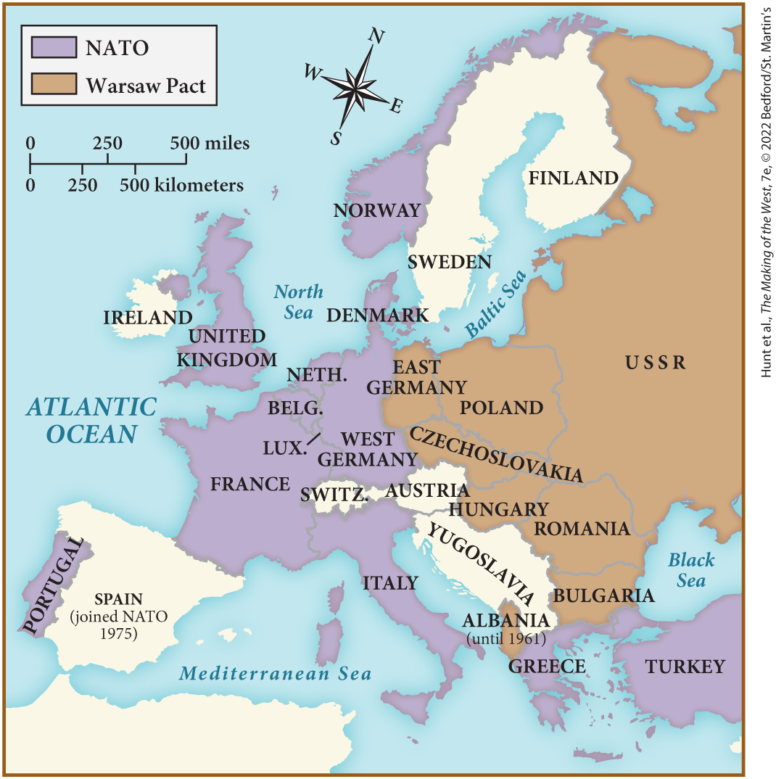
MAP 27.3 European NATO Members and the Warsaw Pact in the 1950s

Slide 16
II. Political and Economic Recovery in Europe (1 of 10)
A. Dealing with Nazism (1 of 2)
  Confusion reigned in Europe after the war as many lived under complex political systems
  Occupying armies often operated independently
  Some helped with food and clothing, others raped and robbed
  Desire for revenge against the Nazis grew as existence of death camps was discovered
  Civilians perpetrated vigilante justice against Nazi collaborators
  Members of the resistance executed Nazi officers and collaborators
  Government officials undertook a more systematic approach
Notes:
II. Political and Economic Recovery in Europe (1 of 10)
A. Dealing with Nazism (1 of 2)
Confusion reigned in May 1945 because Europeans were living under a complex system of political jurisdictions that included those of local resistance leaders, Allied armies of the occupation, international relief workers, and the remnants of bureaucracies, some of them Nazi sympathizers.
Occupying armies often operated independently of any law.
While some helped by distributing food and clothing, others — particularly the Soviet army — raped and robbed.
With the discovery of the death camps, desire for revenge against the Nazis grew.
Civilians perpetrated vigilante justice, shaving the heads of women suspected of collaborating or associating with Germans and making them parade naked through the streets.
Members of the resistance conducted on-the-spot executions of tens of thousands of Nazi officers and collaborators.
Government officials and Allied representatives undertook a more systematic “denazification.”

Slide 17
II. Political and Economic Recovery in Europe (2 of 10)
A. Dealing with Nazism (2 of 2)
  In the Nuremberg trials, Allies used Nazi documents to provide evidence of Nazi crimes
  Nuremberg set the precedent of international war crimes trials
  Not all Axis officials punished, some disappear
  Germans began to believe they were the main victims of the war
  Allied officials often relied on high-ranking Nazis for restoring government services
  West German government portrayed German prisoners still held by Soviets as the war’s real casualties
Notes:
II. Political and Economic Recovery in Europe (2 of 10)
A. Dealing with Nazism (2 of 2)
In the trials conducted at Nuremberg, Germany (fall of 1945), the Allies used Nazi documents to provide a horrifying image of Nazi crimes.
Nuremberg established the precedent of international war crimes trials for crimes against humanity.
Not all Axis officials were punished, and some disappeared and were not pursued.
As hardship continued in Germany, the Germans began to believe that they were the main victims of the war.
Allied officials themselves often relied on high-ranking Fascists and Nazis whose expertise was necessary for restoring government services.
The West German government portrayed German prisoners still held in Soviet prison camps as the war’s real casualties.

Slide 18
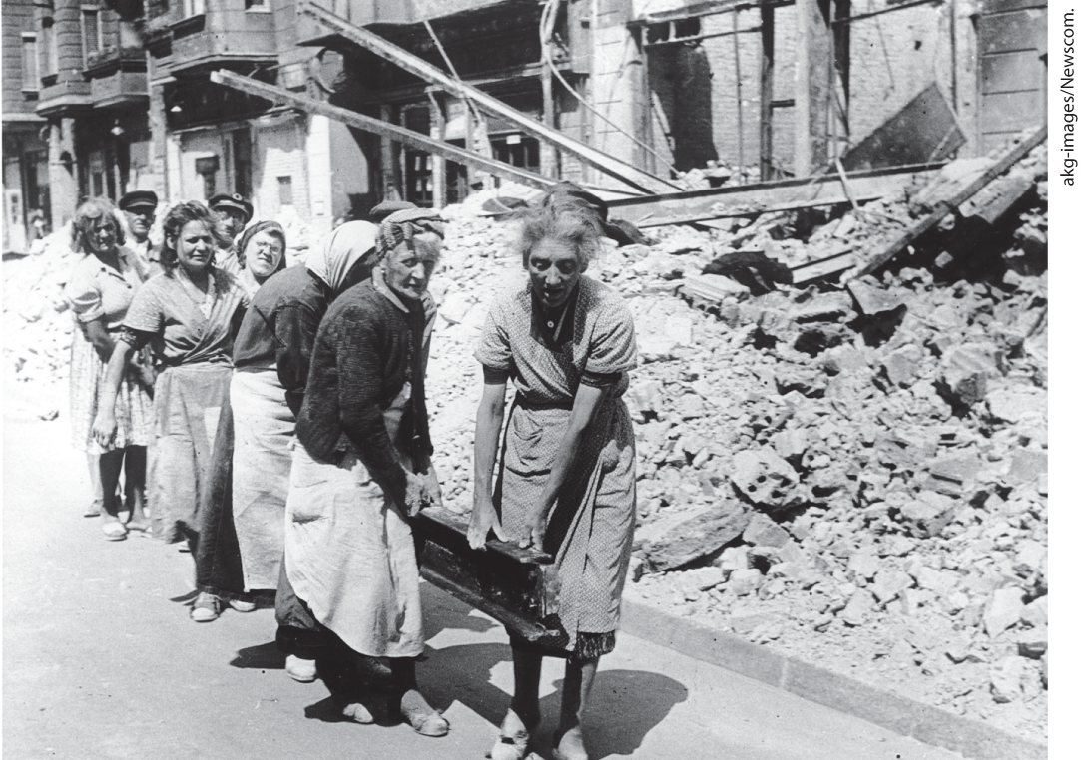
Women Clearing Berlin

Slide 19
II. Political and Economic Recovery in Europe (3 of 10)
B. Rebirth of the West (1 of 3)
  Resistance leaders make claims on political offices
  France approves a constitution, resistance leader Charles de Gaulle governs briefly
  Italy replaces its constitutional monarchy with a full parliamentary system
  The Communist Party attracts the loyalty of a large sector of the western European population
  Communists advocated for the welfare of the common man
  In Britain, the Labour government of Clement Attlee appeared the most likely to share wealth
  Communism did not appeal to those in West Germany
Notes:
II. Political and Economic Recovery in Europe (3 of 10)
B. Rebirth of the West (1 of 3)
Resistance leaders made the first claims on political office in postfascist western Europe.
The French approved a constitution in 1946 that established the Fourth Republic and finally granted women the vote. Resistance leader Charles de Gaulle governed briefly as head of state, but resigned when his wishes for a stronger executive were defeated.
Italy replaced its constitutional monarchy with a full parliamentary system that allowed women the vote for the first time as well.
Throughout western Europe, although Christian Democratic parties with leaders from the former resistance were influential, the Communist Party also attracted the vocal loyalty of a consistently large sector of the population.
People still remembered the common man’s plight in the 1930s, and the Communists advocated his welfare most forcefully.
In Britain, the non-Communist — but leftist — Labour government of Clement Attlee appeared the most likely to share wealth among the population.
In flourishing West Germany, however, communism had no appeal.

Slide 20
II. Political and Economic Recovery in Europe (4 of 10)
B. Rebirth of the West (2 of 3)
  Centrist politicians help create the German Federal Republic
  Anti-Communist Konrad Adenauer was its first chancellor, and guided Germany to economic recovery
  Democracy and individual freedom were threatened in the U.S.
  Senator Joseph McCarthy used anticommunism and fear as political tools
  Economic conditions across Europe required massive investment in infrastructure
  Marshall Plan funds had an impact on the European economy
  Postwar recovery also featured military spending and adaptation technology to consumer industry
Notes:
B. Rebirth of the West (2 of 3)
In 1949, centrist politicians helped create a new state: the German Federal Republic.
Its first chancellor was Catholic, anti-Communist Konrad Adenauer (1876–1967). Along with economist Ludwig Erhard, he guided Germany to economic recovery and the revival of democratic government.
In the United States, democracy and individual freedom were threatened after the war.
In 1949, fear caused by the detonation of a Soviet-built atomic bomb and a Communist revolution in China brought to the fore Joseph McCarthy (1908–1957), a senator from Wisconsin, who announced that Communists were infiltrating American institutions. Anticommunism, like anti-Semitism earlier, became a political tool.
Economic conditions across Europe after the war required massive investment in infrastructure and frustrated hardworking, hard-pressed ordinary people.
As Marshall Plan funds began to have an impact, food and consumer goods became more plentiful, and demand for automobiles, washing machines, and vacuum cleaners boosted economies.
The postwar recovery also featured continued military spending and the adaptation of wartime technology (such as improvements to airplanes) to consumer industry.

Slide 21
II. Political and Economic Recovery in Europe (5 of 10)
B. Rebirth of the West (3 of 3)
  West Germany becomes Europe’s economic leader
  The European Coal and Steel Community (ECSC) is formed in 1951
  This organization managed coal and steel prices to prevent war between France and Germany
  ECSC members sign the Treaty of Rome, creating the European Economic Community (EEC)
  The EEC led to increased cooperation and improved economies
  Britain initially refuses to join
  Government experts based decisions on expertise rather than political interest, while the Common Market disregarded self-interest of any one nation
Notes:
II. Political and Economic Recovery in Europe (5 of 10)
B. Rebirth of the West (3 of 3)
West Germany became Europe’s economic leader, and other European economies also revived, particularly in Scandinavia.
In 1951, Italy, France, Germany, Belgium, Luxembourg, and the Netherlands formed the European Coal and Steel Community (ECSC).
This organization would manage coal and steel production and prices, and, through creating common economic interests, prevent France and Germany from going to war.
In 1957, ECSC members signed the Treaty of Rome, which created a trading partnership called the European Economic Community (EEC), known as the Common Market.
The EEC reduced tariffs among its members that led to increased cooperation and produced great economic rewards.
Britain initially refused to join, fearing an end to trade arrangements with Commonwealth partners.
Government experts, called “technocrats” after 1945, based decisions regarding economic policy on expertise rather than political interest, while those working for the Common Market were to disregard the self-interest of any one nation.

Slide 22
II. Political and Economic Recovery in Europe (6 of 10)
C. The Welfare State: Common Ground East and West (1 of 2)
  Governments intervened to improve social conditions
  This policy became known as the welfare state
  The welfare state boosted population growth with direct financial aid to citizens
  Similar programs were also developed in the eastern bloc, but were less effective
  Most industrial nations fund medical insurance and subsidize medical care
Notes:
II. Political and Economic Recovery in Europe (6 of 10)
C. The Welfare State: Common Ground East and West (1 of 2)
On both sides of the cold war, governments intervened forcefully to ameliorate social conditions.
This policy of intervention became known as the welfare state, something that had been building gradually for almost a century.
The welfare state encouraged population growth with direct financial aid, imitating the Swedish programs of the 1930s by creating family allowances, health care and medical benefits, and programs for pregnant women and new mothers. Some policies, particularly in West Germany, were designed to keep women out of the workforce.
Similar programs were also developed in the eastern bloc, but they were less effective due to the greater poverty of these societies.
In most industrial nations except the United States, state-funded medical insurance and subsidized medical care covered health care needs.

Slide 23
II. Political and Economic Recovery in Europe (7 of 10)
C. The Welfare State: Common Ground East and West (2 of 2)
  Life expectancy improved and infant mortality rates lowered
  Vaccines for diseases made an enormous difference
  Other social initiatives helped to raise the standard of living
  Governments also sponsored a postwar housing boom
  New cities arose around the edges of major urban areas in both eastern and western Europe
Notes:
II. Political and Economic Recovery in Europe (7 of 10)
C. The Welfare State: Common Ground East and West (2 of 2)
The combination of better material conditions and state provision of health care dramatically extended life expectancy and lowered rates of infant mortality.
Vaccines for diseases such as tuberculosis, diphtheria, measles, and polio made an enormous difference.
State initiatives in other areas also helped to raise the standard of living. A network of nuclear power plants helped electrify much of eastern Europe, and governments legislated more leisure time and vacation days for workers.
Governments also sponsored a postwar housing boom; in western Europe, governments provided incentives to private builders as well as sponsored building projects.
As a result, new cities arose around the edges of major urban areas in both eastern and western Europe.

Slide 24
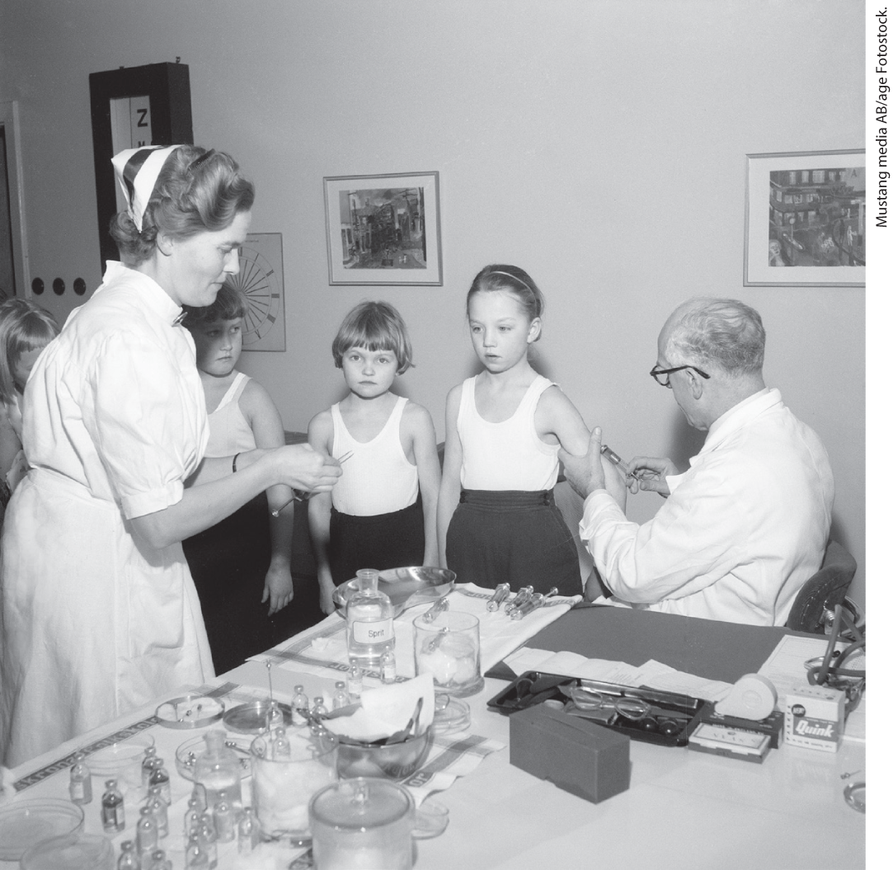
The Welfare State in Action, 1957

Slide 25
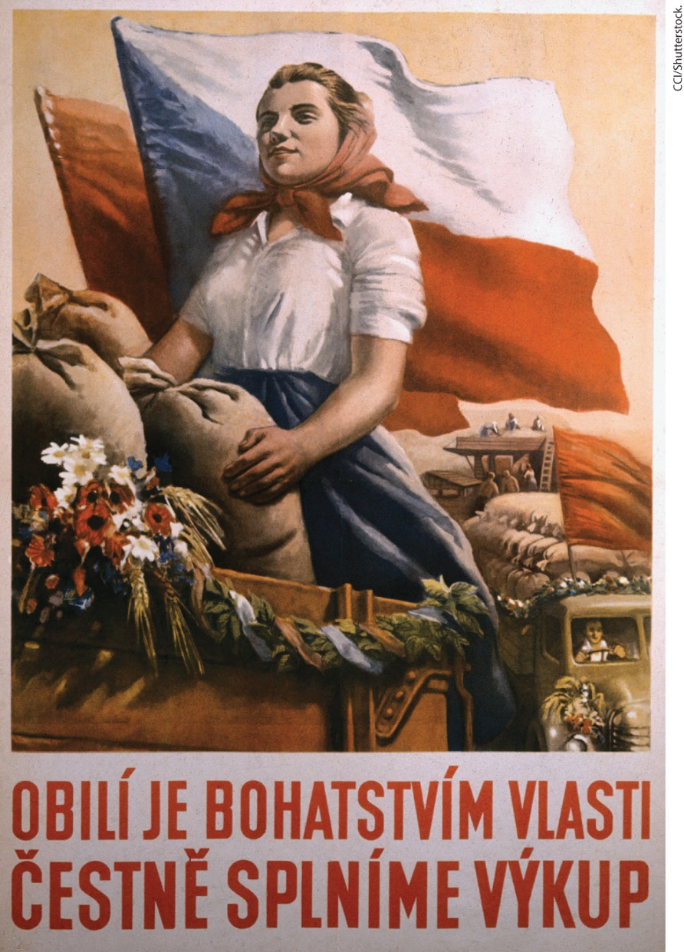
Propaganda for Collective Farming

Slide 26
II. Political and Economic Recovery in Europe (8 of 10)
D. Recovery in the East (1 of 3)
  Stalin collectivized agriculture and nationalized private property in eastern European countries
  The Soviet Union forms regional organizations to create the Council for Mutual Economic Assistance (COMECON).
  The terms of the COMECON slowed development in satellite states
  These states did, however, become oriented toward technology driven industrial economies
  People began to move to cities
Notes:
II. Political and Economic Recovery in Europe (8 of 10)
D. Recovery in the East (1 of 3)
As he had done in the Soviet Union before the war, Stalin collectivized agriculture and industrialized eastern European countries by nationalizing private property.
In an effort to make Communist economies rival U.S. productivity, the Soviet Union formed regional organizations, instituting the Council for Mutual Economic Assistance (COMECON) to coordinate economic relations among the satellite countries and Moscow.
The terms of the COMECON relationship thwarted development in the satellite states because the USSR was allowed to buy goods from its clients at bargain prices and reap profits by selling these goods at exorbitant prices.
These formerly peasant states did, however, become oriented toward technology and bureaucratically directed industrial economies.
People moved to cities where they received better education, health care, and jobs.

Slide 27
II. Political and Economic Recovery in Europe (9 of 10)
D. Recovery in the East (2 of 3)
  The Soviet Union dominates its alliances through physical coercion, repression against social elites
  Stalin’s death is followed by widespread worker strikes in East Germany, governments moved toward producing more consumer goods to calm protests
  Nikita Khrushchev emerges as undisputed leader of the Soviet Union
  Khrushchev denounces the “cult of personality” around Stalin
  Protest erupt in Poland and Hungary
Notes:
II. Political and Economic Recovery in Europe (9 of 10)
D. Recovery in the East (2 of 3)
Repression against religion and the social elites accompanied the drive for modernization, and the Soviet Union dominated its alliances through physical coercion along with state-instituted programs to build loyalty to the regime.
Stalin died in 1953. His death was followed by widespread worker strikes in East Germany. Soviet officials, despite enjoying the benefits of their positions, had also come to distrust Stalinism and now favored change. In order to calm protests across the Soviet bloc, governments moved toward producing more consumer goods in order to produce more food for ordinary people.
Nikita Khrushchev (1894–1971) emerged as the undisputed leader of the Soviet Union in 1955.
Khrushchev denounced the “cult of personality” with which Stalin had surrounded himself and announced that Stalinism did not equal communism. The greater openness of the Khrushchev period is referred to as the “thaw.”
In this climate of uncertainty, protest erupted in the summer of 1956, most notably in Poland and Hungary.

Slide 28
II. Political and Economic Recovery in Europe (10 of 10)
D. Recovery in the East (3 of 3)
  The United States refuses to intervene after the rebellions are suppressed, not willing to risk another world war
  Failure of eastern European uprisings overshadowed significant Soviet policy changes
  Khrushchev ends the Stalinist purges and makes several legal reforms
  The Soviets successfully launch the first satellite, Sputnik, and send Yuri Gagarin into orbit
  The Soviets’ advancements inspire the creation of the U.S. National Aeronautics and Space Administration (NASA)
  Despite more relaxed Soviet policies, the cold war advances
Notes:
II. Political and Economic Recovery in Europe (10 of 10)
D. Recovery in the East (3 of 3)
When these rebellions were brutally suppressed, the United States refused to intervene, demonstrating that it would not risk another world war by militarily challenging the Soviets in their sphere of influence.
The failure of eastern European uprisings overshadowed significant changes in Soviet policy.
Khrushchev ended the Stalinist purges, reformed the courts, and set a policy of more limited sentences for political offenders and criminals.
In 1957, the Soviets successfully launched the first artificial Earth satellite, Sputnik, and, in 1961, sent the first cosmonaut, Yuri Gagarin (1934–1968), into orbit around earth.
The Soviets’ edge in space technology shocked the western bloc and motivated the creation of the U.S. National Aeronautics and Space Administration (NASA).
Khrushchev’s policies toward domestic freedom were inconsistent, and despite the more relaxed nature of Soviet policy, the cold war advanced.

Slide 29

Environment Matters: The Green Revolution and Its Consequences

Slide 30
III. Decolonization in a Cold War Climate (1 of 9)
A. The End of Empire in Asia (1 of 2)
  Leaders in Asia begin to mobilize discontent
  The British had postponed Indian independence
  After the war, the British Labour government decided two countries should be created
  Violence erupts, Gandhi is assassinated, and the partition of India and Pakistan follows
  China experiences Communist takeover led by Mao Zedong
  Mao instituted social reforms, but also copied repressive Soviet tactics
Notes:
III. Decolonization in a Cold War Climate (1 of 9)
A. The End of Empire in Asia (1 of 2)
By the end of World War II, leaders in Asia had begun to mobilize the mass discontent that had intensified during the war.
The British had promised to grant India its independence in the 1930s, but postponed it when war broke out.
After the war, the British Labour government, presiding over the end of the British Empire in India, decreed that because distrust was so great between the Indian National Congress and the Muslim League, two countries should be created.
Hundreds of thousands died in violence, and Gandhi was assassinated in the partition of India and Pakistan that followed.
China experienced a Communist takeover (1949) led by Mao Zedong (1893–1976).
Mao instituted social reforms such as civil equality for women, but also copied Soviet collectivization, rapid industrialization, and the brutal repression of the privileged classes.

Slide 31
III. Decolonization in a Cold War Climate (2 of 9)
A. The End of Empire in Asia (2 of 2)
  Communist victory in China spurs increase of U.S. and USSR involvement in Asian politics
  North Koreans, supported by the Soviet Union, invade South Korea
  The UN Security Council approves “police action” against North Korea. but after two and a half years of fighting, the opposing sides agree to a settlement
  The conflict leads to the formation of the U.S.-backed Southeast Asia Treaty Organization
  The cold war spreads to Indochina, where nationalists oppose the renewal of French imperialism
  The French fight independence, but peasant guerrillas force them to withdraw
  The Geneva Convention carves out an independent Laos and divided Vietnam, free from French control
Notes:
A. The End of Empire in Asia (2 of 2)
The Communist victory in China spurred both the United States and the USSR to increase their involvement in Asian politics.
In 1950, the North Koreans, supported by the Soviet Union, invaded U.S.-backed South Korea.
The United States maneuvered the UN Security Council into approving a “police action” against North Korea but, after two and a half years of stalemate, the opposing sides agreed to a settlement (1953) that reestablished the border between North Korea and South Korea at the thirty-eighth parallel.
The conflict led to the formation in 1954 of the U.S.-backed Southeast Asia Treaty Organization, a huge increase in U.S. defense spending, and the industrialization of Japan to provide the United States with war supplies.
The cold war, via proxy wars, spread to Indochina, where nationalists had been struggling against the renewal of French imperialism.
The French fought all efforts at independence, but peasant guerrillas forced them to withdraw after the bloody battle of Dien Bien Phu (1954).
The Geneva Convention of 1954 carved out an independent Laos and divided Vietnam into North Vietnam and South Vietnam, each free from French control.

Slide 32
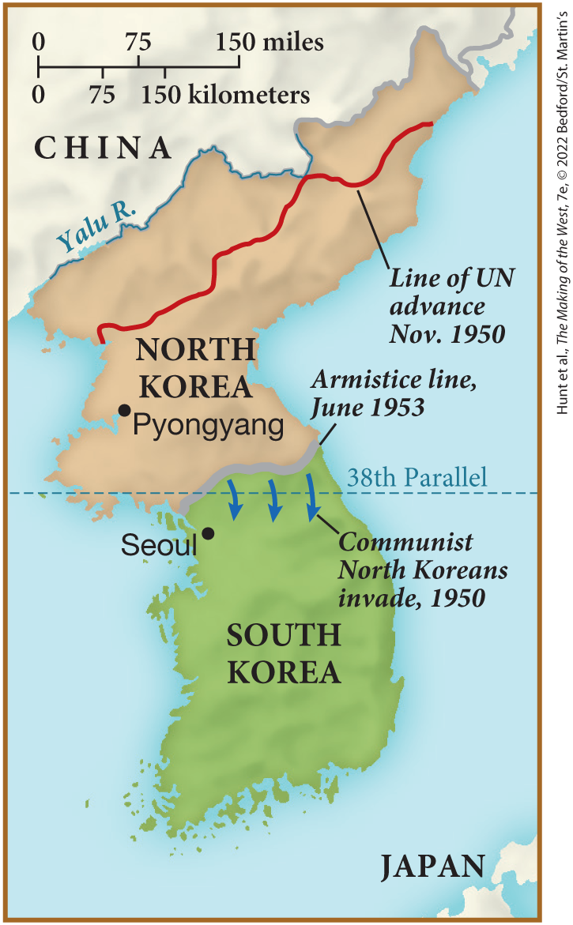
SPOT MAP 27.2 The Korean War, 1950–1953

Slide 33
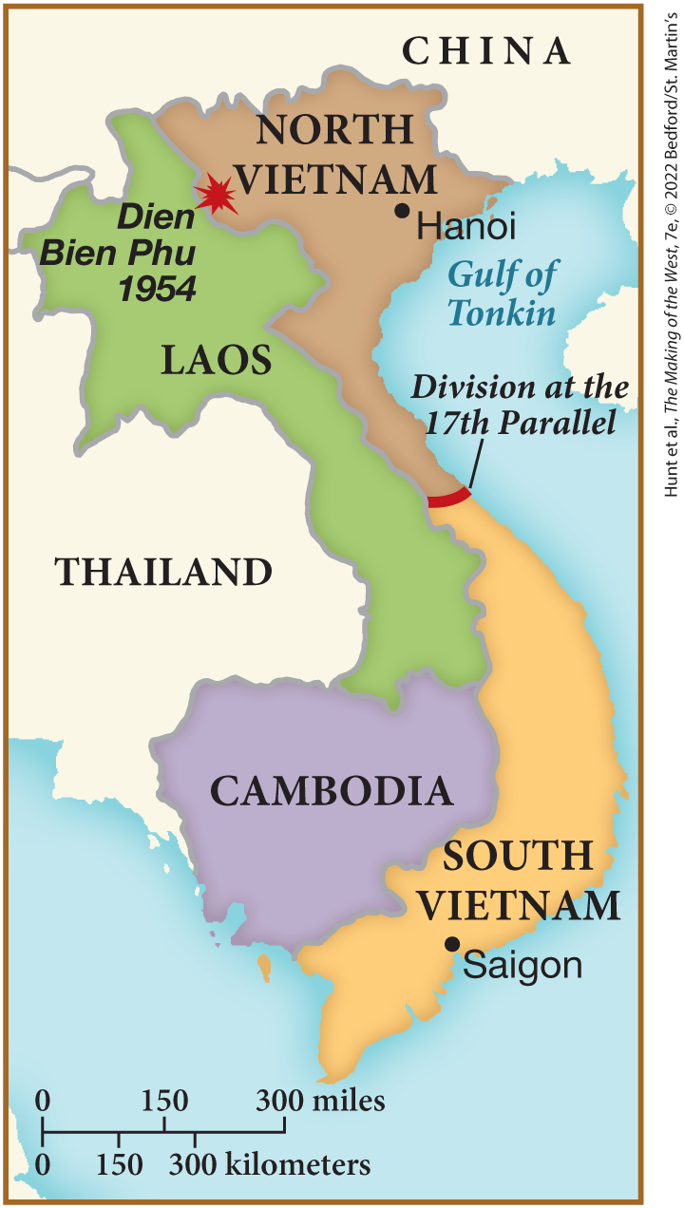
SPOT MAP 27.3 Indochina, 1954

Slide 34
III. Decolonization in a Cold War Climate (3 of 9)
B. The Struggle for Identity in the Middle East (1 of 2)
  Middle Eastern peoples renewed their commitment to independence
  The cold war gives Middle Eastern leaders an opening to bargain with the superpowers
  European corporations strip decolonizing nations of assets to avoid taxation and nationalization
  Western powers’ commit to secure a Jewish homeland, Arabs become determined to gain control of the region
  Great Britain cedes Palestine to the United Nations to work out a settlement
Notes:
III. Decolonization in a Cold War Climate (3 of 9)
B. The Struggle for Identity in the Middle East (1 of 2)
Middle Eastern peoples also renewed their commitment to independence and resisted attempts by the major powers to regain imperial control.
The cold war gave Middle Eastern leaders an opening to bargain with the superpowers, playing them off one another, especially over resources (such as oil) to repair war-torn economies.
Fearing loss of their funds, colonial officials, European settlers, and corporations stripped decolonizing nations of assets, sending them to new networks for “offshore” banking where they could escape taxation and possible nationalization.
The Western powers’ commitment to secure a Jewish homeland in the Middle East made Arabs more determined to regain economic and political control of the region.
Great Britain ceded Palestine to the United Nations in 1947 to work out a settlement between the Jews and the Arabs.

Slide 35
III. Decolonization in a Cold War Climate (4 of 9)
B. The Struggle for Identity in the Middle East (2 of 2)
  The United Nations votes to partition Palestine into an Arab region and a Jewish region
  Conflict leads to war, Jewish military forces prevailed, Israel is established
  Egypt gained independence from Britain at the end of the war
  However, Britain retained its control of the Suez Canal
  Colonel Gamal Abdel Nasser becomes Egypt’s president and nationalizes the canal
  Britain attempts to take the canal back, but is forced to back down by the U.S.
  Nasser’s triumph inspired confidence that Arab countries could confront the West
Notes:
III. Decolonization in a Cold War Climate (4 of 9)
B. The Struggle for Identity in the Middle East (2 of 2)
The United Nations voted to partition Palestine into an Arab region and a Jewish region.
Conflicting claims led to war, and the Jewish military forces prevailed; Israel was established on May 14, 1948.
Egypt had gained its independence from Britain at the end of the war.
However, Britain retained its control of the Suez Canal, which was owned by a British-run company.
In 1952, Colonel Gamal Abdel Nasser (1918–1970) became Egypt’s president, and in July 1956, he nationalized the canal.
In 1956, Britain, joined by France and Israel, attempted to take the canal back but was prevented when the United States forced it to back down.
Nasser’s triumph inspired confidence that the formerly colonized peoples could confront the West and win.

Slide 36
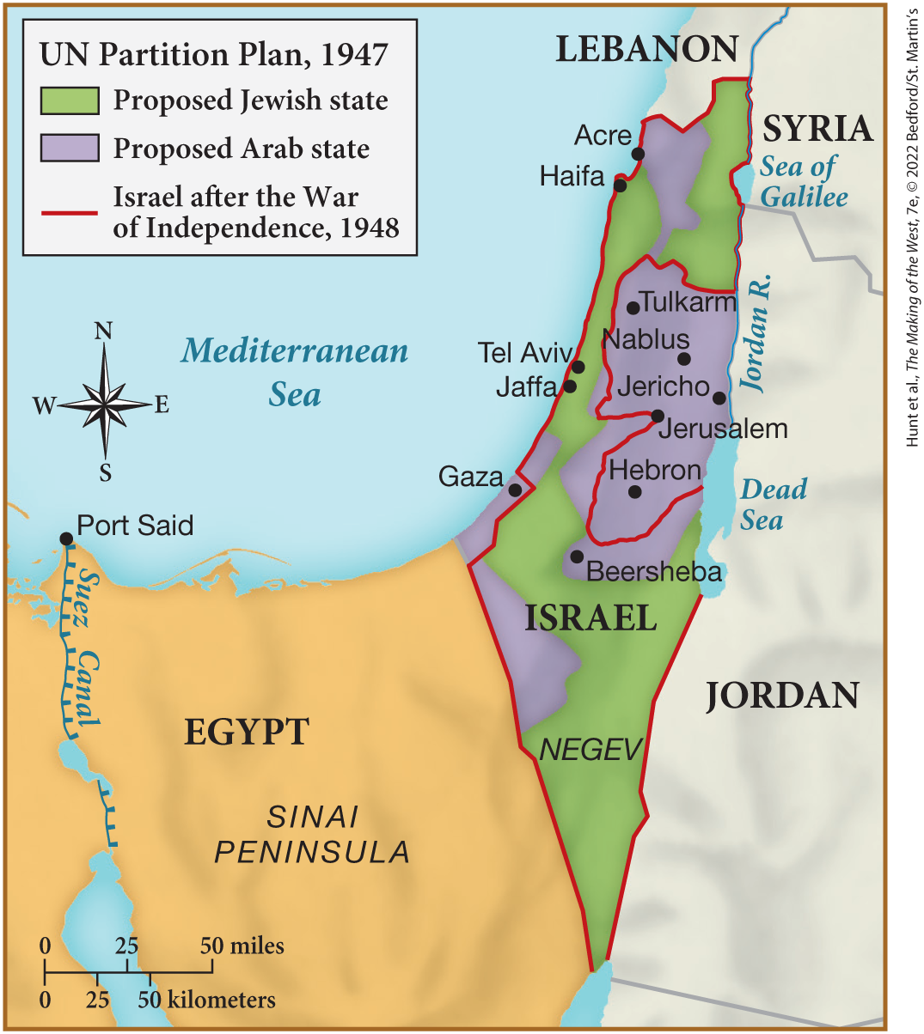
MAP 27.4 The Partition of Palestine and the Creation of Israel, 1947–1948

Slide 37
III. Decolonization in a Cold War Climate (5 of 9)
C. New Nations in Africa (1 of 3)
  Nationalist leaders in Sub-Saharan Africa challenge Europe’s increasing demands for resources and labor
  Kwame Nkrumah led the inhabitants of the British-controlled West African Gold Coast in passive resistance
  The British withdraw, allowing the creation of Ghana
  Nigeria becomes independent in 1960
  European settlers violently resist independence movements in other areas of Africa
  France grants independence for Tunisia, Morocco, and West Africa
Notes:
III. Decolonization in a Cold War Climate (5 of 9)
C. New Nations in Africa (1 of 3)
In sub-Saharan Africa, nationalist leaders roused their people to challenge Europe’s increasing demands for resources and labor, which resulted in poverty for African peoples.
Kwame Nkrumah (1909–1972) led the diverse inhabitants of the British-controlled West African Gold Coast in passive resistance and in Gandhi-inspired civil disobedience.
After years of such resistance, the British withdrew, allowing the state of Ghana to come into being in 1957.
Nigeria, the most populous African region, became independent in 1960.
The eastern coast and southern and central areas of Africa, particularly British East Africa, contained numerous European settlers who violently resisted independence movements.
France easily granted certain demands for independence, such as those of Tunisia, Morocco, and West Africa, where there were fewer settlers, more limited economic stakes, and less military involvement.

Slide 38
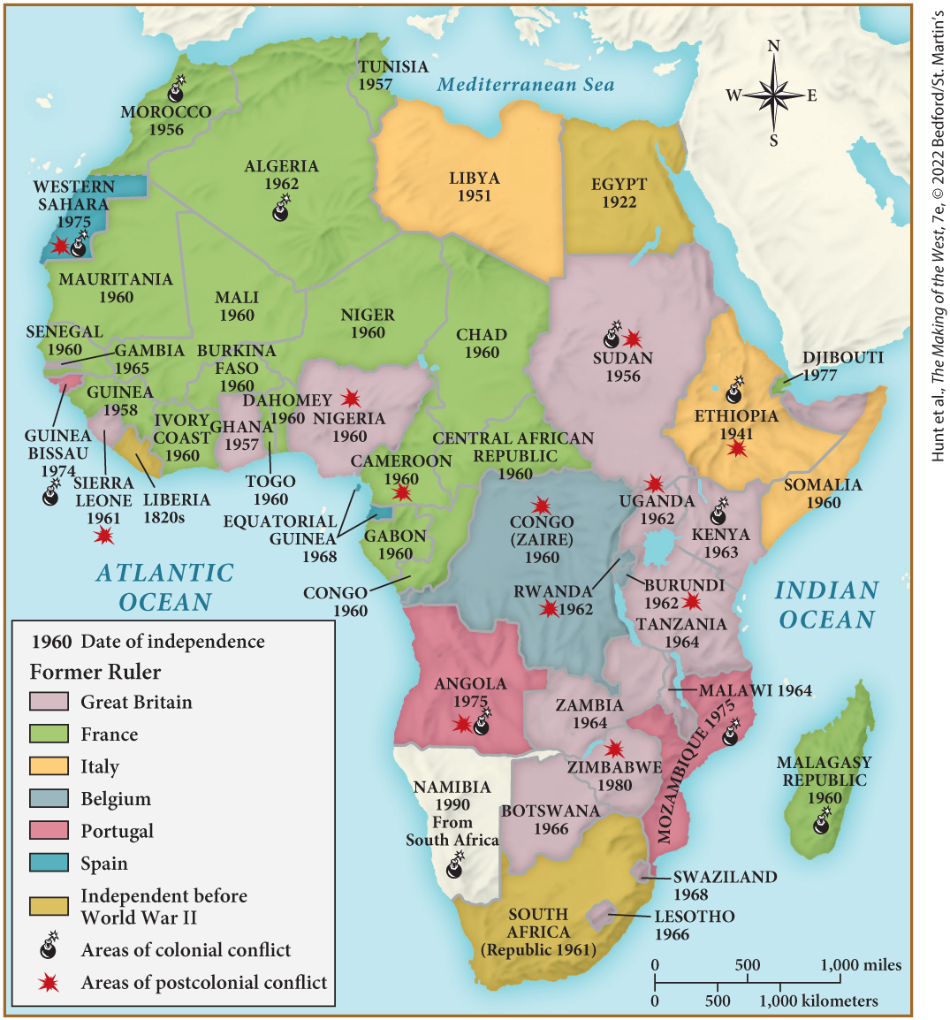
MAP 27.5 The Decolonization of Africa, 1951–1990

Slide 39
III. Decolonization in a Cold War Climate (6 of 9)
C. New Nations in Africa (2 of 3)
  Algerian nationalists rebel in the final days of World War II and are massacred by the French army
  The Algerian Front for National Liberation forms later and attacks European settlers
  The French send in more than 400,000 soldiers
  The Algerian war threatened French stability, the Fourth Republic collapses over the issue
  In 1958, Charles de Gaulle returns to power
  He demands creation of a new republican government with a strong president
Notes:
III. Decolonization in a Cold War Climate (6 of 9)
C. New Nations in Africa (2 of 3)
When Algerian nationalists rebelled against the restoration of French rule in the final days of World War II, the French army massacred tens of thousands of protesters.
The Algerian Front for National Liberation, formed in 1954, attacked European settlers and their Arab supporters.
The French fought back savagely, sending in more than 400,000 soldiers.
The Algerian war threatened French stability as protests in Paris greeted reports of the army’s barbarous practices, and the Fourth Republic eventually collapsed over the issue.
In 1958, Charles de Gaulle, supported by the army and approved by the Chamber of Deputies, returned to power.
In return for leading France out of its Algerian quagmire, de Gaulle demanded the creation of the Fifth Republic, a new republican government with a strong president who could exercise emergency power.

Slide 40
III. Decolonization in a Cold War Climate (7 of 9)
C. New Nations in Africa (3 of 3)
  De Gaulle negotiates Algerian independence, European settlers and Arab supporters flee to France
  The Dutch and Belgian empires also fall
  The United Nations was formed as a mechanism to promote international security
  Both the United States and the Soviet Union were active members
  The charter of the UN outlined a collective, global authority
  Indonesian leader Sukarno convenes the Bandung Convention of nonaligned nations
Notes:
III. Decolonization in a Cold War Climate (7 of 9)
C. New Nations in Africa (3 of 3)
By 1962, de Gaulle had negotiated Algerian independence, and hundreds of thousands of European settlers in Algeria, as well as their Arab supporters, fled to France.
The Dutch and Belgian empires also fell.
As these new nations emerged, the United Nations was formed as a mechanism to promote international security.
Both the United States and the Soviet Union were active members of the United Nations from its beginning.
The charter of the UN outlined a collective, global authority that would adjudicate conflicts, provide military protection, and oversee the fate of emerging states.
The Indonesian leader Sukarno convened the Bandung Convention of nonaligned nations in 1955, one of many for discussing the economic gaps that persisted between the developed world and the former colonies.

Slide 41
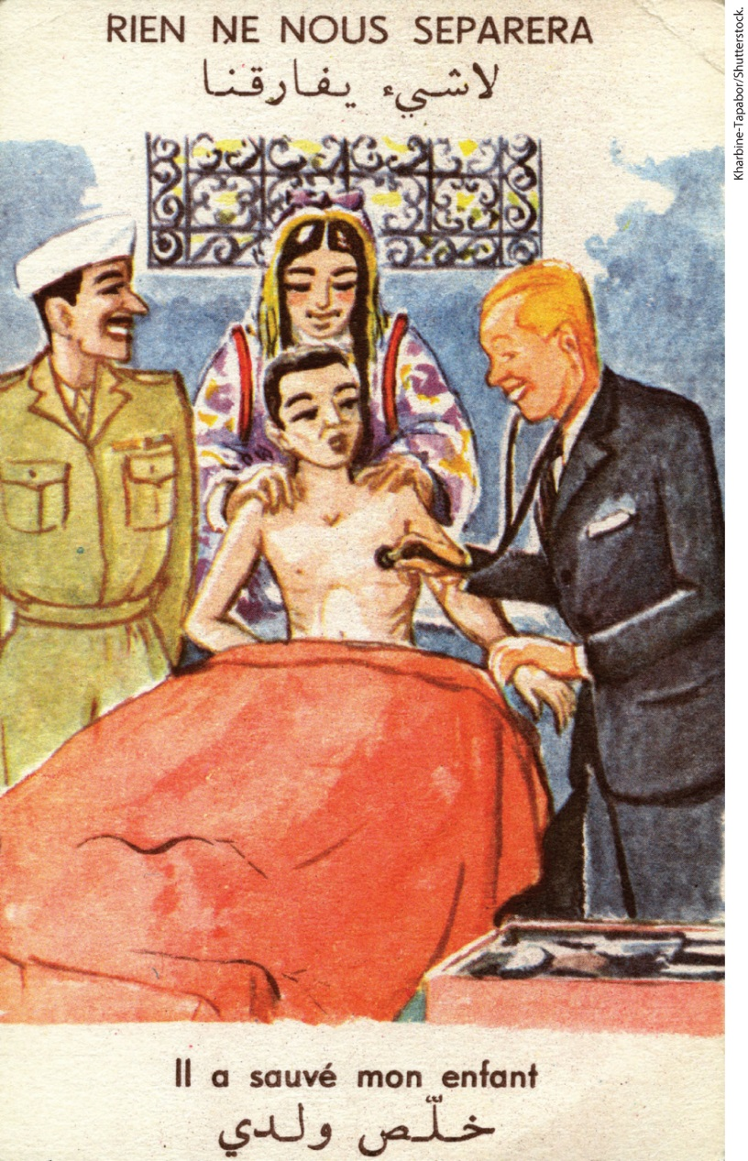
“We Cannot Be Separated, He Has Saved My Child” 1955

Slide 42
III. Decolonization in a Cold War Climate (8 of 9)
D. Newcomers Arrive in Europe (1 of 2)
  People from former colonies began immigrating to Europe after the war
  Immigrants were invited as temporary workers as a result of labor shortage
  By the 1980s, 8 percent of the European population was foreign-born
  Immigrant workers regarded as temporary residents
Notes:
III. Decolonization in a Cold War Climate (8 of 9)
D. Newcomers Arrive in Europe (1 of 2)
In a reversal of the nineteenth-century trend of emigration out of Europe, people from former colonies began immigrating to Europe after the war.
As European economies recovered, labor was in short supply, so immigrants were invited as temporary residents who would work in Europe as “guest workers” for a fixed period and then return home.
By the 1980s, 8 percent of the European population was foreign-born, compared to 6 percent of the U.S. population.
Immigrant workers were regarded as temporary residents.

Slide 43
III. Decolonization in a Cold War Climate (9 of 9)
D. Newcomers Arrive in Europe (2 of 2)
  Guest workers were welcomed because they did not require much government assistance
  Many worked in less desirable jobs
  Former colonials came to view Europe as a land of opportunity
  The composition of the European became more multicultural and diverse
Notes:
III. Decolonization in a Cold War Climate (9 of 9)
D. Newcomers Arrive in Europe (2 of 2)
These guest workers were welcomed because they availed themselves of few social services and, because they came as adults, did not even require public education.
Most worked in less desirable jobs such as collecting garbage, building roads, and cleaning homes.
Former colonials came to view Europe as a land of opportunity, and illegal immigration increased.
As empires collapsed, the composition of the European population in terms of race, religion, ethnicity, and social life began to change, becoming more multicultural and diverse than ever before in modern times.

Slide 44
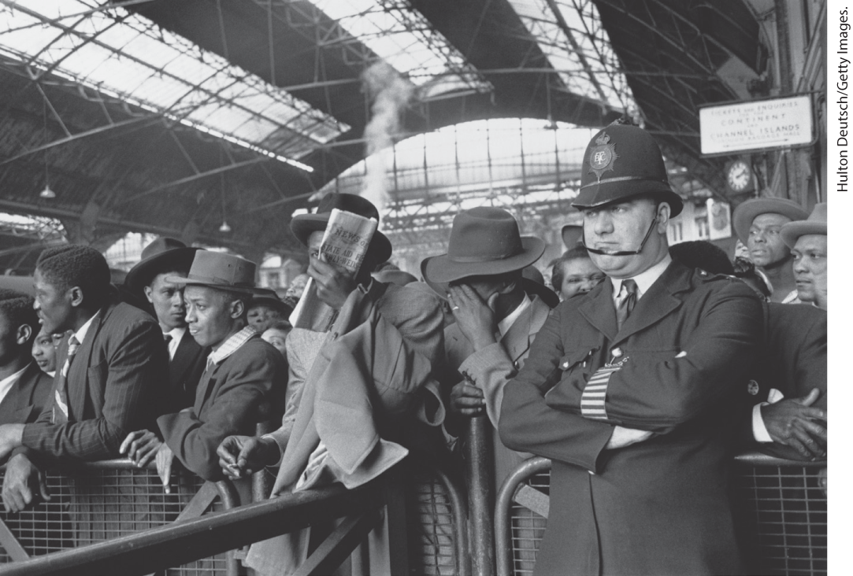
Newcomers to Europe

Slide 45
IV. Daily Life and Culture in the Shadow of Nuclear War (1 of 11)
A. Restoring “Western” Values (1 of 3)
  Cultural ideals in Europe and the United States reemphasized political choice
  The Catholic church, under the leadership of Pope John XXIII, undergoes reforms
  Despite this, trend toward more secular culture continued
  People emphasized Western culture
  Holocaust and resistance literature, such as Anne Frank’s Diary of a Young Girl, became popular
Notes:
IV. Daily Life and Culture in the Shadow of Nuclear War (1 of 11)
A. Restoring “Western” Values (1 of 3)
After the depravity and inhumanity of Nazism and fascism, cultural currents in Europe and the United States reemphasized universal values, spiritual renewal, and political choice.
Some saw the churches as central to the restoration of values, and the Catholic church in particular, under the leadership of Pope John XXIII, underwent reform and promoted cooperation between faiths after the Second Vatican Council.
Their success was only partial, however, as the trend toward a more secular culture continued.
Increasingly, people emphasized the triumph of a Western heritage, a Western civilization, and Western values over fascism.
Holocaust and resistance literature, such as Holocaust victim Anne Frank’s Diary of a Young Girl, became popular.

Slide 46
IV. Daily Life and Culture in the Shadow of Nuclear War (2 of 11)
A. Restoring “Western” Values (2 of 3)
  Governments and media venerated resisters and celebrated their role in winning the war
  Existential philosophy becomes popular among the cultural elite and students
  Existentialism explored the meaning of human existence and attempted to define “being” in the absence of God
  Simone de Beauvoir publishes The Second Sex, arguing most women fail to create an authentic “self”
  Frantz Fanon, a Black psychiatrist from the French colony of Martinique, begins analyzing liberation movements
Notes:
IV. Daily Life and Culture in the Shadow of Nuclear War (2 of 11)
A. Restoring “Western” Values (2 of 3)
Governments erected permanent plaques at locations where resisters had been killed; their biographies filled magazines and bookstalls; organizations of resisters commemorated their role in winning the war.
By the end of the 1940s, existential philosophy became the rage among the cultural elite and students.
Existentialism explored the meaning of human existence in a world where evil flourished, and attempted to define “being” in the absence of God and in the midst of the breakdown of morality.
In 1949, Simone de Beauvoir (1908–1986) published The Second Sex, in which she argued that most women fail to take the kind of action necessary to create an authentic “self” through considered action.
In the 1950s and 1960s, the immensely influential writings of Frantz Fanon (1925–1961), a Black psychiatrist from the French colony of Martinique, began analyzing liberation movements.

Slide 47
IV. Daily Life and Culture in the Shadow of Nuclear War (3 of 11)
A. Restoring “Western” Values (3 of 3)
  Fanon wrote that colonized people were traumatized by imposition of other cultures
  She predicted colonized people would decolonize through violence
  African Americans intensify their commitment to civil rights, advancing the cause of organizations such as the National Association for the Advancement of Colored People
  The U.S. Supreme Court declares segregated education to be unconstitutional
  Martin Luther King Jr. becomes foremost among the many talented leaders of the civil rights movement
Notes:
IV. Daily Life and Culture in the Shadow of Nuclear War (3 of 11)
A. Restoring “Western” Values (3 of 3)
Fanon wrote that the mental functioning of the colonized person was “traumatized” by the violence and the brutal imposition of another culture as the only standard of value.
Ruled by guns, the colonized person would decolonize through violence.
In the United States, African Americans, who had fought in the war to defeat the Nazi idea of white racial supremacy, intensified their commitment to the civil rights culture, advancing the cause of such long-standing organizations as the National Association for the Advancement of Colored People (NAACP, founded 1909).
In 1954, the U.S. Supreme Court declared segregated education to be unconstitutional in Brown v. Board of Education, a case initiated by the NAACP.
Foremost among the many talented leaders of civil rights groups that emerged was Martin Luther King Jr. (1929–1968), a pastor who, influenced by Gandhi, promoted nonviolent resistance to racism.

Slide 48
IV. Daily Life and Culture in the Shadow of Nuclear War (4 of 11)
B. Cold War Consumerism and Shifting Gender Norms (1 of 3)
  Government spending helped prevent social, political, and economic upheaval
  The war affected men’s roles and their sense of self
  Young men who had missed World War II adopted the violent style of soldiers
  Young men also took cues from pop culture
  American singer Elvis Presley and film star James Dean inspired American and European youth
  The American “beat” poets critiqued traditional ideals of the male achiever
Notes:
IV. Daily Life and Culture in the Shadow of Nuclear War (4 of 11)
B. Cold War Consumerism and Shifting Gender Norms (1 of 3)
Governmental spending on reconstruction, productivity, and welfare helped prevent the kind of social, political, and economic upheaval that had followed World War I.
Nonetheless, the war affected men’s roles and their sense of themselves.
Young men who had missed World War II adopted the violent style of soldiers.
Young men also took cues from pop culture.
The leader of rock-and-roll style and substance was the American singer Elvis Presley (1935–1977), while film star James Dean (1931–1955) in Rebel Without a Cause inspired American and European youths alike.
The American “beat” poets critiqued traditional ideals of the upright and rational male achiever.

Slide 49
IV. Daily Life and Culture in the Shadow of Nuclear War (5 of 11)
B. Cold War Consumerism and Shifting Gender Norms (2 of 3)
  Playboy magazine ushers in a changed male identity
  The new man was depicted as sexually aggressive and independent
  Men’s liberty had come to include not just political and economic rights, but also sexual expression
  Postwar women were made to symbolize a return to the domestic sphere
  Christian Dior launches a clothing style called the “new look”
  New look propaganda did not mesh with reality
Notes:
IV. Daily Life and Culture in the Shadow of Nuclear War (5 of 11)
B. Cold War Consumerism and Shifting Gender Norms (2 of 3)
In 1953, the inaugural issue of Playboy magazine ushered in a widely imitated depiction of a changed male identity.
The new man was depicted as sexually aggressive and independent of dull, domestic life — just as he had been during the war.
The notion of men’s liberty had come to include not just political and economic rights, but also freedom of sexual expression.
In contrast, postwar women were made to symbolize a return to normalcy by returning to the domestic sphere and no longer working outside the home.
In the late 1940s, the fashion house of Christian Dior (1905–1957) launched a clothing style called the “new look,” which was essentially a return to the nineteenth-century female silhouette.
New look propaganda did not, however, mesh with reality. Postwar poverty prevented widespread adoption of new look couture.

Slide 50
IV. Daily Life and Culture in the Shadow of Nuclear War (6 of 11)
B. Cold War Consumerism and Shifting Gender Norms (3 of 3)
  European women continued to work outside the home after the war
  Advertising business presided over creation of new cultural messaging
  Western Europeans imitated Americans
  Radio remained influential, but television also becomes an important consumer item
Notes:
IV. Daily Life and Culture in the Shadow of Nuclear War (6 of 11)
B. Cold War Consumerism and Shifting Gender Norms (3 of 3)
European women continued to work outside the home after the war
Advertising business presided over creation of new cultural messaging
Western Europeans imitated Americans
Radio remained influential, but television also becomes an important consumer item

Slide 51
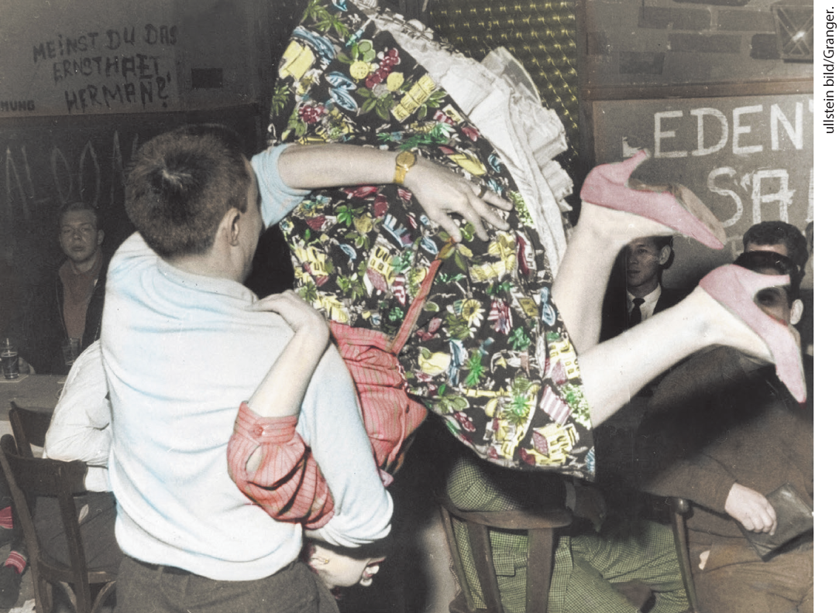
Rock and Roll

Slide 52
IV. Daily Life and Culture in the Shadow of Nuclear War (7 of 11)
C. The Culture of Cold War (1 of 2)
  Pop culture promoted the cold war at the same time that they conveyed antiwar messages; George Orwell’s 1984 was claimed by both sides
  Ray Bradbury’s Fahrenheit 451 condemned the cold war curtailment of intellectual freedom
  Spy stories such as the James Bond novels of British writer Ian Fleming, became popular
  People debated the “Americanization” they witnessed taking place in Europe
  Leadership of the art world passed to the United States
Notes:
IV. Daily Life and Culture in the Shadow of Nuclear War (7 of 11)
C. The Culture of Cold War (1 of 2)
Films, books, and other cultural productions promoted the cold war at the same time that they conveyed antiwar messages. George Orwell’s 1984 was claimed by both sides in the cold war.
Ray Bradbury’s popular Fahrenheit 451, whose title indicated the temperature at which books would burn, condemned the cold war curtailment of intellectual freedom.
Spy stories and espionage thrillers with a cold war setting, such as the James Bond novels of British writer Ian Fleming, became popular.
Consumer culture as a whole came under the cold war banner, as people debated the “Americanization” they witnessed taking place in Europe.
Leadership of the art world passed to the United States when art became part of the cold war, aided by secret U.S. government subsidies to artists and journalists.

Slide 53
IV. Daily Life and Culture in the Shadow of Nuclear War (8 of 11)
C. The Culture of Cold War (2 of 2)
  Abstract expressionists such as Jackson Pollock departed completely from realism
  Abstract expressionism spoke of self-discovery in the process of painting
  Canvases were said to exemplify Western “freedom”
  The Soviets denounced abstract expressionism
  In Italy, the neorealist technique was developed by filmmakers such as Roberto Rossellini and Vittorio De Sica
  Such works challenged Hollywood-style sets and costumes
Notes:
IV. Daily Life and Culture in the Shadow of Nuclear War (8 of 11)
C. The Culture of Cold War (2 of 2)
Abstract expressionism, practiced by American artists such as Jackson Pollock (1912–1956), departed completely from realism. Pollock appropriated elements of Native American art, with little to no credit.
Abstract expressionism spoke of the artist’s self-discovery, spiritual growth, and physical sensations in the process of painting.
Their canvases were said to exemplify Western “freedom.”
The Soviets denounced abstract expressionism as infantile.
In Italy, the neorealist technique was developed by filmmakers such as Roberto Rossellini (1906–1977) in Open City (1945) and Vittorio De Sica (1902–1974) in The Bicycle Thief (1948).
Such works challenged Hollywood-style sets and costumes by using ordinary characters living in devastated, impoverished cities.

Slide 54
IV. Daily Life and Culture in the Shadow of Nuclear War (9 of 11)
D. The Atomic Brink (1 of 3)
  Radio broadcasts were at the center of the cold war
  Voice of America, with its main studio in Washington, D.C., broadcasts all over the world
  Soviet counterpart broadcasts in Russian around the clock
  News reports also kept the cold war burning
  Children rehearsed for nuclear war in school, families build personal bomb shelters
  John Fitzgerald Kennedy becomes president of the United States
Notes:
IV. Daily Life and Culture in the Shadow of Nuclear War (9 of 11)
D. The Atomic Brink (1 of 3)
Radio broadcasts were at the center of the cold war.
During the late 1940s and early 1950s, the Voice of America, with its main studio in Washington, D.C., broadcast in thirty-eight languages from one hundred transmitters and provided an alternative source of news for peoples in eastern Europe.
The Soviet counterpart broadcast in Russian around the clock, although it initially spent much of its wattage jamming U.S. programming.
News reports also kept the cold war alive, featuring stories about nuclear testing, military buildups, and hostile diplomatic incidents.
In school, children rehearsed for nuclear war, and some families built personal bomb shelters.
John Fitzgerald Kennedy (1917–1963) became president of the United States in 1960.

Slide 55
IV. Daily Life and Culture in the Shadow of Nuclear War (10 of 11)
D. The Atomic Brink (2 of 3)
  Kennedy escalates the cold war
  A revolution in Cuba brought Fidel Castro to power, and he allies with the Soviet Union
  Kennedy launched an invasion of Cuba to overthrow Castro
  The invasion failed miserably
  Cold war rivalries continued to escalate over the continuing U.S. presence in Berlin
  East German workers begin construction of a wall on the city’s east–west border
Notes:
IV. Daily Life and Culture in the Shadow of Nuclear War (10 of 11)
D. The Atomic Brink (2 of 3)
A war hero and early fan of the fictional cold war spy James Bond, Kennedy intensified the arms race and escalated the cold war.
In 1959, a revolution in Cuba brought Fidel Castro (1926–2016) to power, and he allied his government with the Soviet Union.
In the spring of 1961, Kennedy, assured by the Central Intelligence Agency (CIA) of success, launched an invasion of Cuba at the Bay of Pigs to overthrow Castro.
The invasion failed miserably.
Cold war rivalries continued to escalate over the continuing U.S. presence in Berlin.
In the summer of 1961, East German workers, supervised by police, began construction of a wall on the city’s east–west border.

Slide 56
IV. Daily Life and Culture in the Shadow of Nuclear War (11 of 11)
D. The Atomic Brink (3 of 3)
  The wall blocked movement and increased tensions
  The CIA reported Soviets were installing medium-range missiles in Cuba
  Kennedy calls for a blockade, threatens nuclear war
  Leaders negotiate an end to the crisis before disaster
  Kennedy and Khrushchev work to improve nuclear diplomacy and sign a test-ban treaty
Notes:
IV. Daily Life and Culture in the Shadow of Nuclear War (11 of 11)
D. The Atomic Brink (3 of 3)
The wall blocked movement between east and west and increased superpower tensions.
The matter came to a head when the CIA reported, in October 1962, that the Soviets were installing medium-range missiles in Cuba.
Kennedy called for a blockade of ships headed for Cuba and threatened nuclear war.
After a few tense days, the two leaders negotiated an end to the crisis.
Following this scare, both Kennedy and Khrushchev worked to improve nuclear diplomacy. In the summer of 1963, the two nations signed a test-ban treaty outlawing the explosion of nuclear devices in the sea and atmosphere.

Slide 57
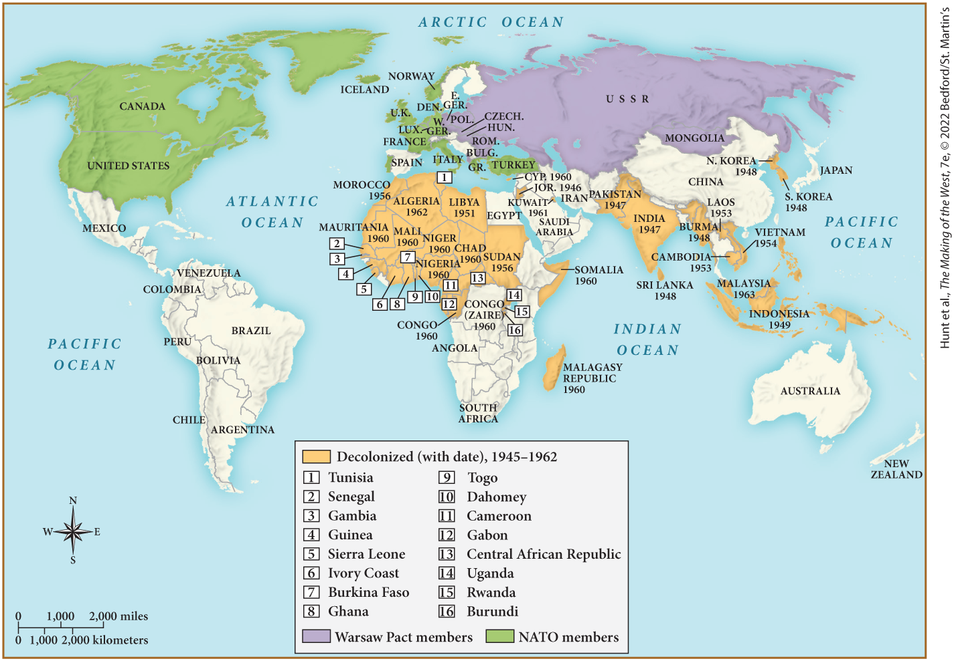
MAP 27.6 Mapping the West: The Cold War World, c. 1960

