Slide 1
The Making of the West
Seventh Edition
Hunt • Martin • Rosenwein • Smith
CHAPTER 26
The Great Depression and World War II
1929 –1945
Copyright © 2022 by Bedford/St. Martin’s
Distributed by Bedford/St. Martin’s/Macmillan Learning strictly for use with its products. Not for redistribution.

Slide 2
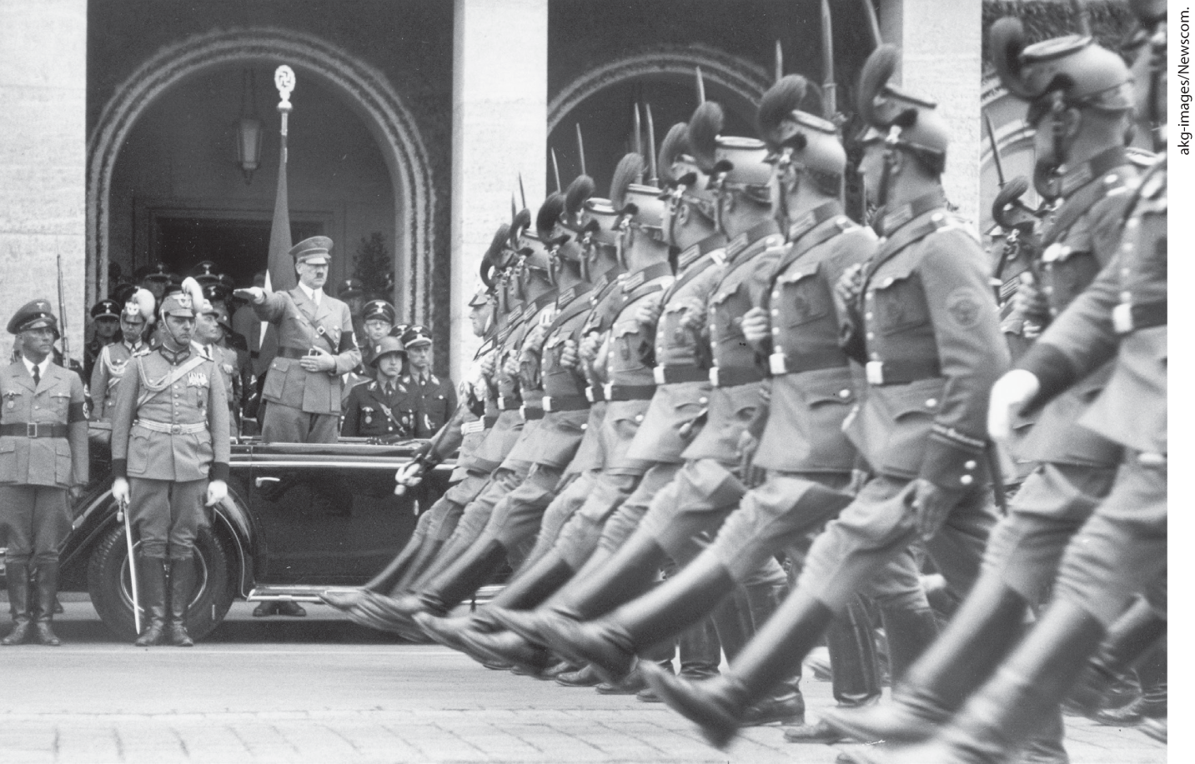
Nazis on Parade

Slide 3
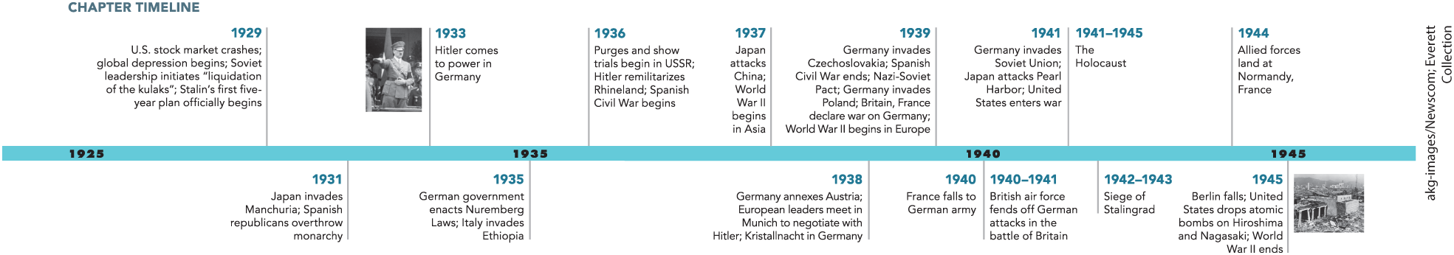
Chapter 26 Timeline

Slide 4
I. The Great Depression (1 of 5)
A. Economic Disaster Strikes
  In the 1920s many borrowed money to invest in the stock market
  As a result, the Federal Reserve Bank tightens the availability of credit, brokers demand clients immediately pay them back
  The stock market collapses as more stocks are sold to pay back debt
  The crisis in the United States has ripple effect causing a crisis in Europe
  Other factors worsen the international crisis
  Worldwide crisis called the Great Depression
Notes:
I. The Great Depression (1 of 5)
A. Economic Disaster Strikes
In the 1920s, U.S. corporations, banks, and millions of individuals borrowed money on margin to invest in the stock market, which had experienced a long, upward trend.
In order to stabilize the market, the nation’s central bank — the Federal Reserve Bank — tightened the availability of credit, forcing anxious brokerage firms to demand that clients immediately pay back the money they had borrowed to buy stock.
As more and more individuals and institutions sold their stocks to pay back their margin debts to brokers, the market collapsed between October and mid-November 1929.
In response to the crisis, the United States cut back on loans to Europe and called in short-term, international debts, which caused a financial crisis in Europe.
This worldwide crisis was worsened by rising unemployment, budget cuts, and tariff increases. Industry closed down, and agricultural price declines led to a rural debt crisis.
This worldwide economic crisis is called the Great Depression.

Slide 5
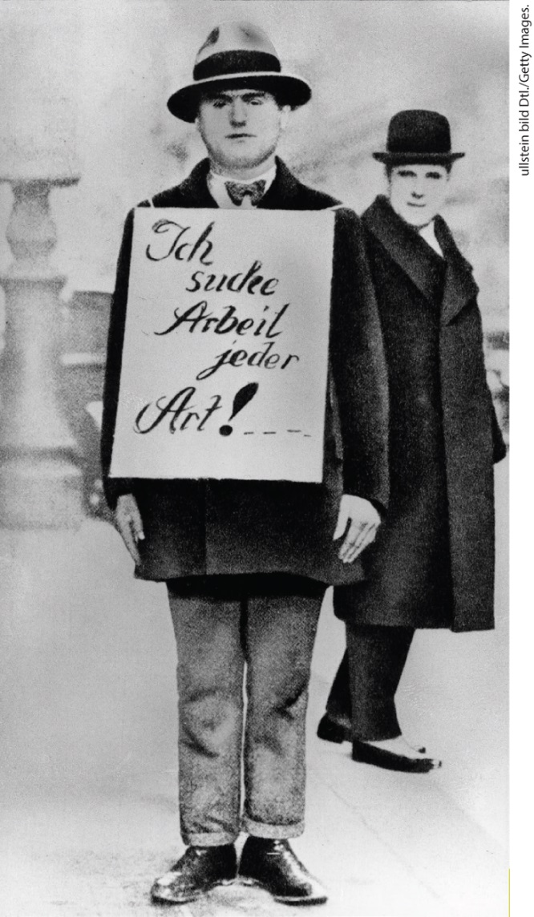
Unemployed in Germany (1932)

Slide 6
I. The Great Depression (2 of 5)
B. Social Effects of the Depression (1 of 2)
  Some countries avoided losses and continued modernization
  Governments continued public works projects, electricity and sewage pipes are installed in homes
  Unemployment high, but majority of Europeans and Americans still employed
  Many felt the threat of unemployment, creating anxiety
  Economic catastrophe had social impact
  Women began accepting low-paying jobs outside of the home
Notes:
I. The Great Depression (2 of 5)
B. Social Effects of the Depression (1 of 2)
The situation was not, however, uniformly bleak, and modernization proceeded during the 1930s in some industries and countries.
Municipal and national governments continued road construction and sanitation projects, and running water, electricity, and sewage pipes were installed in many homes for the first time.
Despite high rates of unemployment, the majority of Europeans and Americans were employed throughout the 1930s, and some even enjoyed considerable prosperity as prices declined.
Even those who held jobs, however, felt the threat of unemployment, which created a mood of fear and resentment throughout the West.
Economic catastrophe upset social life and strained gender relations.
Women accepted low-paying jobs, such as housecleaning or doing laundry, to make ends meet, and men often had to assume housekeeping chores at home.

Slide 7
I. The Great Depression (3 of 5)
B. Social Effects of the Depression (2 of 2)
  Begging became common, unemployed young men become more receptive to political radicalism
  Patriarchal authority continues to decline as number of farmer workers decreases
  Nazis and Fascists blame democracy, promise to create jobs
  Falling birthrate concerned politicians
  Economic hardship causes couples to have fewer children
  Lower birthrates reinvigorate racist rhetoric, Anti-Semitism used in critiques of the economic crisis
Notes:
I. The Great Depression (3 of 5)
B. Social Effects of the Depression (2 of 2)
Men could be observed on street corners begging while women worked to support their families. Young men in cities faced severe unemployment and were receptive to political radicalism.
As the number of farm workers decreased, patriarchal authority continued to decline in rural areas.
Demagogues blamed democracy for the economy’s failings. Nazi and Fascist politicians promised to create jobs.
The falling birthrate also concerned politicians.
Tough economic times led couples to have fewer children, and mandatory education caused parents extra expense and prevented children of working-class families from bringing in wages. Birth control was more acceptable and widely available.
The population crisis reinvigorated racist politics and rhetoric with the argument that, while “superior” peoples were failing to breed, “inferior” peoples were ready to take their place. Anti-Semitism was often featured in critiques of the economic crisis and relief efforts, particularly in eastern Europe.

Slide 8
I. The Great Depression (4 of 5)
C. The Great Depression beyond the West (1 of 2)
  Declining purchasing power leads to reduced demand for raw materials
  The price of food products falls, adversely affecting colonized countries
  Economic picture uneven in the colonies and different industries and trades
  Economic distress contributed to colonial independence movements
  Mohandas Gandhi emerges as the leader for Indian independence
Notes:
I. The Great Depression (4 of 5)
C. The Great Depression beyond the West (1 of 2)
The effects of declining purchasing power and unavailability of ready credit extended beyond the West, reducing the demand for copper, tin, and other raw materials and for the finished products manufactured in urban factories.
The depression also drove down the price of foodstuffs such as rice and coffee, which proved disastrous to those persons in colonized countries who had been forced to grow a single cash crop.
The economic picture was also uneven in the colonies; established industrial sectors of the Indian economy, such as textiles, gained strength, with India achieving virtual independence from British cloth.
Economic distress added to smoldering grievances and contributed to colonial independence movements.
In India, Mohandas (Mahatma or “great souled”) Gandhi (1869–1948) emerged as the charismatic leader for Indian independence by advocating civil disobedience: the peaceful but deliberate breaking of the law.

Slide 9
I. The Great Depression (5 of 5)
C. The Great Depression beyond the West (2 of 2)
  Mustafa Kemal founds independent Turkish republic
  Persia forces negotiation of oil contracts, changes name to Iran
  The French make fewer concessions as they increase trade in the colonies
  Ho Chi Minh founds the Indochinese Communist Party, leads a failed peasant uprising against the French
  Fascism spreads in Europe as British and French military forces are needed in their empires
Notes:
I. The Great Depression (5 of 5)
C. The Great Depression beyond the West (2 of 2)
In the Middle East, westernizer Mustafa Kemal (1881–1938) or Atatürk (“first among Turks”) took advantage of Europe’s vulnerability both after World War I and during the depression to found an independent Turkish republic (1923).
Persia also loosened Europe’s grip by forcing the negotiation of oil contracts and, in 1935, changed its name to Iran.
The French made fewer concessions because their trade with the colonies increased as trade with Europe lagged; they viewed the population growth in Africa and Asia in an optimistic light.
When, in 1930, Western-educated leader Ho Chi Minh (1890–1969), the founder of the Indochinese Communist Party, led a peasant uprising against French rule, the French brutally crushed it.
British and French military forces were needed in their empires to control resistance movements, leaving fascism to spread unchecked throughout Europe.

Slide 10
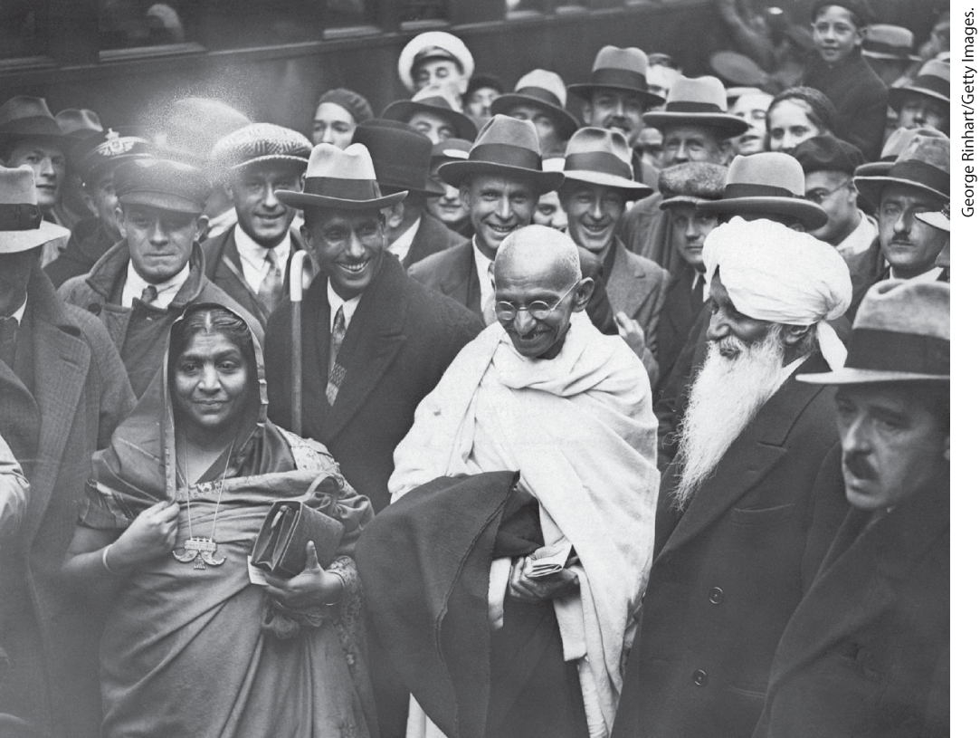
Gandhi Visits England, 1931

Slide 11
II. Totalitarian Triumph (1 of 7)
A. The Rise of Stalinism (1 of 3)
  Joseph Stalin ends Lenin’s New Economic Policy and announces his own plans for Soviet industrialization
  His first plan called for massive increases in the output of raw materials
  Central planning created new class of bureaucrats and managers, Soviet industry grows
  Industrial officials, skilled workers benefit, conditions harder for new and unskilled workers
  Workers often lacked experience, most falsify records to gain work
  Stalin demands more grain output from peasants
  Stalin calls for violence against peasants who resisted his demands
Notes:
II. Totalitarian Triumph (1 of 7)
A. The Rise of Stalinism (1 of 3)
When Joseph Stalin (1879–1953) took control of the Soviet Union, he ended Lenin’s New Economic Policy (NEP) and announced (spring of 1929) the first of several five-year plans to radically industrialize the Soviet economy.
This first plan called for massive increases in the output of coal, iron ore, steel, and industrial goods as an emergency measure to end Soviet backwardness and prevent the West from crushing communism.
Such central planning, which had its precedent in World War I, helped create a new elite of bureaucrats and industrial officials, especially managers who dominated the workers by limiting their ability to change jobs or move from place to place. Heavy industry grew some 500 percent from 1929 to 1935.
Industrial officials and, to a lesser extent, skilled workers benefited economically from these changes. Conditions were harder for new and unskilled workers, although some took pride in learning new skills.
Workers often lacked the technical education and the tools necessary to accomplish the goals set out in the five-year plan, so almost everyone falsified records to protect their jobs.
To feed this workforce, Stalin demanded more grain from peasants, grain that could also be exported to finance this forced industrialization.
When peasants resisted these demands by reducing production or withholding produce from the market, Stalin called for the “liquidation of the kulaks” (prosperous peasants).

Slide 12
II. Totalitarian Triumph (2 of 7)
A. The Rise of Stalinism (2 of 3)
  Kulaks face persecution, exile, murder
  Confiscated kulak land forms the basis of the kolkhoz
  Collectivization fails, Soviet citizens starve as the grain harvest declines
  Stalin blames the failure on anticommunist agitators
  Stalin begins to purge traitors, including leading Bolsheviks
  A purge of army commanders leaves the military lacking leadership
Notes:
II. Totalitarian Triumph (2 of 7)
A. The Rise of Stalinism (2 of 3)
Kulaks and their associates were denigrated, evicted, imprisoned, exiled, or murdered.
Confiscated kulak land formed the basis of the kolkhoz (“collective farm”).
Collectivization was a disaster, and Soviet citizens starved as the grain harvest declined and the remaining grain was sold to pay for foreign machinery and equipment.
Because work life was politicized, economic failure took on political meaning; Stalin blamed the failure on anticommunist “wreckers.”
He instituted purges — state violence in the form of widespread arrests, imprisonment in labor camps, show trials, and executions — to rid society of these traitors. Leading Bolsheviks were among the targets of the purges.
In 1937, there was a purge of the commanding ranks of the army, depriving it of leadership at a time when war with Germany threatened, but also ensuring that the USSR would not enter the war with an ossified officer corps unable to accommodate new ideas.

Slide 13
II. Totalitarian Triumph (3 of 7)
A. The Rise of Stalinism (3 of 3)
  Russian government develops system of prison camps known as the Gulag
  The purges have negative effects on cultural and social life
  Modernism was curtailed, falling birthrate leads to government restrictions and criminalization of homosexuality
  Propaganda referred to the family as a small Soviet state
  The purges opened up economic and political opportunities for rural women
  Experimentation in the arts ends under Stalin
Notes:
II. Totalitarian Triumph (3 of 7)
A. The Rise of Stalinism (3 of 3)
To accommodate detention of those caught in the purges, Stalin’s government developed an extensive system of brutal prison camps, known as the Gulag, that stretched from Moscow to Siberia. Some one million died in them annually from overwork, starvation, beatings, and murder.
In the midst of the anxiety caused by the purges, cultural and social life retreated from its earlier emphasis on experimentation.
Modernism in the arts and creativity in urban planning were curtailed; the falling birthrate led to a restriction of birth-control information, the encouragement of marriage, and the criminalization of homosexuality.
Propaganda now referred to the family unit as a “school for socialism” — a miniature Soviet state.
At the same time, women in rural areas made gains in literacy and received improved health care. The purges opened lower ranking positions in the party leadership to women, and some women began to enter the professions. Women industrial workers continued to perform all household and child-care tasks.
Avant-garde experimentation in the arts ended under Stalin. Artists were required to conform to “socialist realism” and contributed to the growing cult of Stalin.

Slide 14
II. Totalitarian Triumph (4 of 7)
B. Hitler’s Rise to Power
  The Nazi Party, led by Adolf Hitler, began to make political gains when the Great Depression hit Germany
  Nazi Party gains support of prominent businessmen and media tycoons
  Hitler’s followers make the government appear less effective by creating havoc in the streets
  The Nazis’ attack on the left won them approval of the middle class
  Young and idealistic become Hitler’s strongest supporters
  Nazis gain more power in elections of 1930 and 1932
  Effective propaganda garnered further support
Notes:
II. Totalitarian Triumph (4 of 7)
B. Hitler’s Rise to Power
When the Great Depression hit Germany, the National Socialist German Workers’ Party (Nazi Party), led by Adolf Hitler, began to outstrip its rivals in elections.
The Nazi Party gained the support of prominent businessmen and media tycoons who viewed it as a preferable alternative to communism, which also enjoyed widespread support.
As parliamentary government was virtually halted over its inability to reach an accord on economic measures, Hitler’s followers made the government appear even less effective by rampaging through the streets, wrecking stores owned by Jews, and beating up Social Democrats and Communists.
The Nazis’ attack on the left won them the approval of the middle classes who feared Russian-style revolution and the loss of their property.
Most of Hitler’s strongest supporters were young and idealistic, with the vast majority of Nazi Party members being under age forty, but the party also found support in every class.
In the elections of 1930 and 1932, the Nazis made huge gains.
Effective propaganda in the media garnered further support for Hitler.

Slide 15
II. Totalitarian Triumph (5 of 7)
C. The Nazification of German Politics (1 of 2)
  Hitler blames the destruction of the Reichstag building on Communists and suspends civil rights
  Delegates of the Reichstag intimidated into passing Enabling Act, suspending the constitution
  Nazis began suppressing individual rights, organizations such as Heinrich Himmler’s SS and Herman Goering’s Gestapo given vast powers
  The Nazis filled concentration camps with political enemies
  Hitler established himself as the one who settled internal disputes
  Hitler’s associate Ernst Roehm is killed along with others in the Night of the Long Knives
Notes:
II. Totalitarian Triumph (5 of 7)
C. The Nazification of German Politics (1 of 2)
When the Reichstag building was destroyed by fire in February 1933, Hitler blamed the Communists and suspended civil rights, declared censorship of the press, prohibited meetings of opposition writers and artists, and disrupted the work of other political parties.
Intimidated delegates of the Reichstag passed the Enabling Act the following March, which suspended the constitution for four years and allowed subsequent Nazi law to take effect without parliamentary approval.
The Nazis then began suppressing individual rights in the name of what they called a Volksgemeinschaft (“people’s community”) composed of like-minded, racially pure Germans (“Aryans,” in Nazi terminology), and organizations such as Heinrich Himmler’s SS and Herman Goering’s Gestapo were given vast powers to arrest, execute, or imprison people in the newly built concentration camps.
The Nazis filled these camps with Communists, homosexuals, Jews, and other so-called enemies of the community.
Hitler blurred authority in the regime to encourage division, positioning himself as the one who settled disputes.
On June 30, 1934, Hitler’s longtime associate Ernst Roehm, leader of the SA, was killed along with much of the SA leadership in the Night of the Long Knives. Roehm was a believer in a “second revolution” that would end the influence of the economic and military elite.

Slide 16
II. Totalitarian Triumph (6 of 7)
C. The Nazification of German Politics (2 of 2)
  Hitler stimulates the economy through government spending
  Hitler announces four-year plan in 1936, secretly prepares Germany for war
  Hitler believed war spoils would offset defense spending
  Hitler enacts laws increasing birthrates and reinforcing gender roles
  Social control characterized Nazi Germany, Hitler Youth encouraged to inform on parents
  Hitler credited for economic revival, but Nazi rule did not bring social harmony
Notes:
II. Totalitarian Triumph (6 of 7)
C. The Nazification of German Politics (2 of 2)
Needing to reduce the rate of unemployment, Hitler stimulated the economy through government spending on public works and the military.
Hitler also announced a four-year plan in 1936, with the secret aim of preparing Germany for war by 1940.
Defense spending created huge deficits. Hitler believed the spoils of future conquest would eliminate these.
Hitler also enacted legislation designed to increase the birthrate and reinforce traditional gender roles.
Censorship, book-burning, and social control through a system of informers characterized Nazi Germany. Youth were organized into the Hitler Youth and encouraged to inform on their parents.
Many Germans credited Hitler with economic revival, but for hundreds of thousands, if not millions, of Germans, Nazi rule did not bring harmony and community.

Slide 17
II. Totalitarian Triumph (7 of 7)
D. Nazi Racism
  Nazis defined Jews as an inferior “race” conspiring to destroy German race, held them responsible for most of Germany’s problems
  1935 Nuremberg Laws striped Jews of citizenship and rights
  Birth-control and abortions allowed for Jews, Slavs, Roma, and disabled
  Nazi doctors exterminate large numbers of elderly and handicapped
  Jews forced into slave labor, Nazis assault Germany’s remaining Jewish population in Kristallnacht, or Night of Broken Glass
  By the outbreak of World War II, 50 percent of Germany’s Jews had fled
Notes:
II. Totalitarian Triumph (7 of 7)
D. Nazi Racism
The Nazis defined Jews as an inferior “race” and held them responsible for most of Germany’s problems. Hitler appealed to what he declared the “greatest of scientific knowledge” — Mendel’s genetic studies — to pose false threats of those of Jewish ancestry taking over the human race. Jews were attacked both as rich businessmen and as working-class Bolsheviks who were part of a global conspiracy to annihilate the German race.
The 1935 Nuremberg Laws deprived Jews of citizenship, assigned “Jewishness” according to a person’s ancestry, and prohibited marriage between Jews and Aryan Germans.
Birth-control information and abortions were available for Jews, Slavs, Roma, and the mentally and physically disabled, but barred for healthy Aryans.
Nazi doctors helped organize the T4 project, which used carbon monoxide and other means to exterminate large numbers of elderly and handicapped persons.
Jews were forced into slave labor and harshly discriminated against. In 1938, when a Jewish teenager killed a German official, the Nazis reacted with a massive assault on Germany’s remaining Jewish population, smashing Jewish-owned stores and synagogues and imprisoning thousands of Jews, in what became known as Kristallnacht, or the Night of Broken Glass.
By the outbreak of World War II in 1939, more than 50 percent of Germany’s half a million Jews had emigrated, paying huge fees to the government for exit visas.

Slide 18
III. Democracies on the Defensive (1 of 6)
A. Confronting the Economic Crisis (1 of 3)
  Franklin Delano Roosevelt defeats Herbert Hoover in the 1932 presidential election
  Roosevelt creates legislation known as the “New Deal”
  Social Security Act of 1935 establishes a fund for retirement, unemployment, and other payments
  Roosevelt and his wife used mass media keep most Americans committed to democracy
  Sweden develops similar program for resolving economic and population problems
Notes:
III. Democracies on the Defensive (1 of 6)
A. Confronting the Economic Crisis (1 of 3)
As the rate of unemployment in the United States rose to fifteen million persons, Franklin Delano Roosevelt (1882–1945), promising relief and recovery, defeated Herbert Hoover (1874–1964) in the 1932 presidential election.
Roosevelt pushed through legislation known as the “New Deal.” It included relief for businesses and instructions for how firms could cooperate in stabilizing prices, price supports for farmers, and public works projects.
The Social Security Act of 1935 established a fund for retirement, unemployment, and payments to mothers with dependent children and the disabled.
Roosevelt and his wife, Eleanor, were experts at using mass media to promote democratic values, and although the depression remained severe and lynchings and other racial violence continued, the new programs and the media success kept most Americans committed to democracy.
Sweden likewise developed a coherent program for resolving economic and population problems.

Slide 19
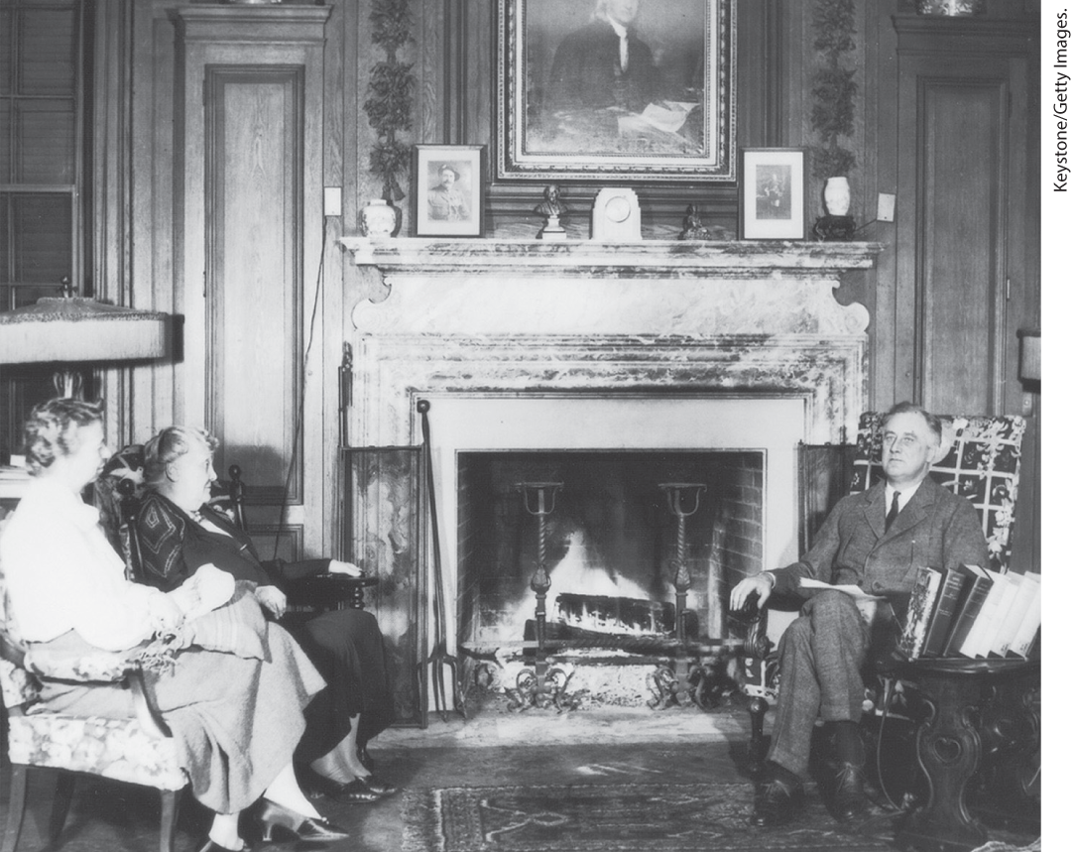
A Fireside Chat with FDR

Slide 20
III. Democracies on the Defensive (2 of 6)
A. Confronting the Economic Crisis (2 of 3)
  Sweden’s program takes central control economic and social welfare programs
  Sweden uses public works projects to maintain consumer spending and encourage modernization
  Britain and France also work to escape economic crisis
  British government starts slum clearance and new housing projects to provide jobs
  France endures the rise of violent right-wing paramilitary groups
Notes:
III. Democracies on the Defensive (2 of 6)
A. Confronting the Economic Crisis (2 of 3)
Under Sweden’s program, central planning of the economy and social welfare programs were instituted, and its currency was devalued to make exports appear more attractive to international buyers.
Sweden used pump-priming programs of public works to maintain consumer spending and encourage modernization. Support and subsidies for families without the racism and coercion of Nazism built widespread approval for the welfare state.
Britain and France also sought to escape economic crisis.
Declining government revenue forced cuts in unemployment insurance payments in Britain. In 1933, the British government took effective steps: a massive program of slum clearance and new housing projects provided employment and infused money into the economy.
France entered the depression later but endured public strife with the rise of violent right-wing paramilitary groups that rioted and threatened the lives of deputies.

Slide 21
III. Democracies on the Defensive (3 of 6)
A. Confronting the Economic Crisis (3 of 3)
  Spread of fascism prompts French politicians to establish a coalition, the Popular Front, Léon Blum as premier
  Blum extends welfare practices and appoints women to his government
  France guarantees workers several rights, including right to collective bargain
  Blum’s government was opposed by industrialists and fell when it failed to aid republican Spanish forces
  Fledgling democracies in central Europe were hard hit by the depression
Notes:
III. Democracies on the Defensive (3 of 6)
A. Confronting the Economic Crisis (3 of 3)
Shocked into action by the spread of fascism, French members of the Liberal, Socialist, and Communist parties rallied in support of democracy and established a coalition known as the Popular Front, which established Socialist leader Léon Blum (1872–1950) as premier.
Blum extended family subsidies, state services, and welfare benefits, and he appointed women to his government.
In June 1936, the government of France guaranteed workers two-week paid vacations, a forty-hour workweek, and the right to collective bargaining.
Blum’s government was politically weak, and investors, bankers, and industrialists undermined his policies. The government fell when it failed to aid republican Spanish forces in their struggle against fascism.
Fledgling democracies in central Europe created by the Peace of Paris, including Austria, Hungary, and Czechoslovakia, were hard hit by the depression, which led to simmering ethnic tensions and an increase in the appeal of fascism.

Slide 22
III. Democracies on the Defensive (4 of 6)
B. Cultural Visions in Hard Times (1 of 3)
  Artists of the 1930s responded to the depression, producing art that reflected the struggle
  French director René Clair’s À Nous la Liberté depicted prison life as an analogy to work in a factory
  Charlie Chaplin’s Modern Times showed his character as a worker in a modern factory
  Women were portrayed as either cause, or cure of problems
  German film The Blue Angel (1930) showed how a modern woman could destroy civilization
Notes:
III. Democracies on the Defensive (4 of 6)
B. Cultural Visions in Hard Times (1 of 3)
Instead of turning away from public life, writers, filmmakers, and artists of the 1930s responded vigorously to the depression, producing art that responded to everyday struggle.
In 1931, French director René Clair’s (1898–1981) À Nous la Liberté (Give Us Liberty) depicted prison life as an analogy to work on a factory assembly line.
Charlie Chaplin’s film Modern Times (1936) showed his character, the Little Tramp, as a worker in a modern factory, his job so ingrained that he assumed everything he could see needed mechanical adjustment.
Women were portrayed alternately as the cause of or as the cure for society’s problems.
The Blue Angel (1930), a German film starring Marlene Dietrich (1901–1992), showed how a modern woman could destroy civilization.

Slide 23
III. Democracies on the Defensive (5 of 6)
B. Cultural Visions in Hard Times (2 of 3)
  Women were portrayed positively in comedies and musicals
  Art became increasingly politicized; British writer George Orwell writes of his experiences in the Spanish Civil War
  German writer Thomas Mann goes into self-imposed exile when Hitler comes to power
  Virginia Woolf directly attacks social issues in Three Guineas
  Scientists turn away from certainties of science and technology
Notes:
III. Democracies on the Defensive (5 of 6)
B. Cultural Visions in Hard Times (2 of 3)
In comedies and musicals, however, women pulled men out of debt and set things right, smiling all the while.
Art became increasingly politicized because some writers found it crucial to reaffirm their belief in Western values such as rationalism, rights, and concern for the poor. British writer George Orwell wrote of his experiences among the poor and the atrocities committed by both sides in the Spanish Civil War.
German writer Thomas Mann (1875–1955) went into self-imposed exile when Hitler came to power and began a series of novels based on the Old Testament that commented on the struggle between humanist values and barbarism.
In her nonfiction work Three Guineas (1938), Virginia Woolf (1882–1941) also rejected experimental forms for a direct attack on militarism, poverty, and the oppression of women.
Scientists continued to point out limits to human understanding and turn away from the certainties that science and technology once boasted of.

Slide 24
III. Democracies on the Defensive (6 of 6)
B. Cultural Visions in Hard Times (3 of 3)
  Edwin Hubble determines the universe is an expanding entity
  Mathematician Kurt Gödel establishes mathematical systems contain undecidable propositions
  Physicist Werner Heisenberg develops the uncertainty principle in physics
  Swiss theologian Karl Barth encourages rebellion against Nazis
  Pope Pius XI condemns failure of modern societies to provide for their citizens
Notes:
III. Democracies on the Defensive (6 of 6)
B. Cultural Visions in Hard Times (3 of 3)
In California, astronomer Edwin Hubble (1889–1953) determined, in the early 1930s, that the universe is an expanding entity.
Czech mathematician Kurt Gödel established that any mathematical system will contain some propositions that are undecidable.
German physicist Werner Heisenberg (1901–1976) developed the uncertainty, or indeterminacy, principle in physics. Scientific observation of atomic behavior, according to this theory, actually disturbs the atom, thereby making precise formulations impossible.
The Swiss theologian Karl Barth (1886–1968) encouraged rebellion against the Nazis.
In his 1931 address to the world on social issues, Pope Pius XI (r. 1922–1939) condemned the failure of modern societies to provide their citizens with a decent life and supported governmental intervention to create better moral and material conditions.

Slide 25
IV. The Road to Global War (1 of 7)
A. A Surge in Global Imperialism (1 of 3)
  Ambitions of global imperialism leads to global war
  European Jews claim Palestine; pan-Arabism intensifies; countries compete for land and resources
  Japan’s military leaders seek greater control of Asia to grow their empire
  Japan invades Manchuria
  League of Nations condemns the invasion, does not sanction Japan
  Condemnation outrages the Japanese as they ally with Hitler and Mussolini
Notes:
IV. The Road to Global War (1 of 7)
A. A Surge in Global Imperialism (1 of 3)
Outsized ambitions of global imperialism in the 1930s led to another more lethal global war.
European Jews continued to go to Palestine and claim the area as theirs; pan-Arabism intensified; and Japan, Germany, and Italy entered into competition with other nations for land and resources.
Japan’s military leaders dominated the young Emperor Hirohito, sought greater control of Asia, and saw China, Russia, and other powers as obstacles to their empire’s prosperity and the fulfillment of its racial destiny.
In September 1931, Japan invaded Manchuria and set up a puppet government.
The League of Nations formally condemned the invasion but imposed no sanctions.
The condemnation nonetheless outraged the Japanese public and goaded the government into an alliance with Hitler and Mussolini.

Slide 26
IV. The Road to Global War (2 of 7)
A. A Surge in Global Imperialism (2 of 3)
  In 1937 Japan attacks China as first step to liberate East Asia from Western imperialism
  Hundreds of thousands of Chinese massacred in the Rape of Nanjing
  President Roosevelt takes action to put economic pressure on Japan
  Actions by Western powers and the Soviet Union did not slow Japan’s expansion
  Hitler and Mussolini demanded land and resources like those of other powers
  Hitler aimed to gain control over the Rhineland and break free of military restrictions
Notes:
IV. The Road to Global War (2 of 7)
A. A Surge in Global Imperialism (2 of 3)
In 1937, Japan again attacked China, justifying its offensive as the first step to liberate East Asia from Western imperialism.
Hundreds of thousands of Chinese were massacred in the Rape of Nanjing.
President Roosevelt immediately announced an embargo on the U.S. export of airplane parts to Japan and later enforced stringent economic sanctions on the crucial raw materials that drove Japanese industry.
However, the actions by Western powers and the Soviet Union did not effectively curtail Japan’s territorial expansion in Asia and the Pacific.
Hitler and Mussolini portrayed their countries as “have-not” nations demanding land and resources like those of other imperial powers.
Hitler’s agenda included reestablishing control over the Rhineland, breaking free from the Versailles Treaty’s military restrictions, and bringing Germans living in other nations into the Third Reich’s orbit.

Slide 27
IV. The Road to Global War (3 of 7)
A. A Surge in Global Imperialism (3 of 3)
  Hitler argued Aryans needed more land and planned to take it by force from “inferior” Slavic peoples and Bolsheviks
  Hitler rejects the Versailles Treaty
  Mussolini invades Ethiopia; League of Nations imposes sanctions with little effect
  Hitler moves troops into the demilitarized Rhineland
  The French protest to the League of Nations
  Hitler and Mussolini form powerful Rome–Berlin Axis
Notes:
IV. The Road to Global War (3 of 7)
A. A Surge in Global Imperialism (3 of 3)
Superior Aryans, Hitler believed, needed more Lebensraum (“living space”) to thrive, space that would be taken from “inferior” Slavic peoples and Bolsheviks.
In 1935, Hitler rejected the Versailles Treaty and began rearming.
In 1935, Mussolini invaded Ethiopia, one of the few remaining independent African states. Despite Ethiopian resistance, the Italians were successful. The League of Nations voted to impose sanctions, but, due to the urging of Britain and France, the sanctions lacked teeth.
In March 1936, Hitler ordered his troops into the demilitarized Rhineland.
Instead of countering with an invasion as they had in the Ruhr in 1923, the French protested to the League of Nations.
Hitler and Mussolini formed a Rome–Berlin Axis, which appeared powerful next to the seemingly timid democracies of France and Great Britain.

Slide 28
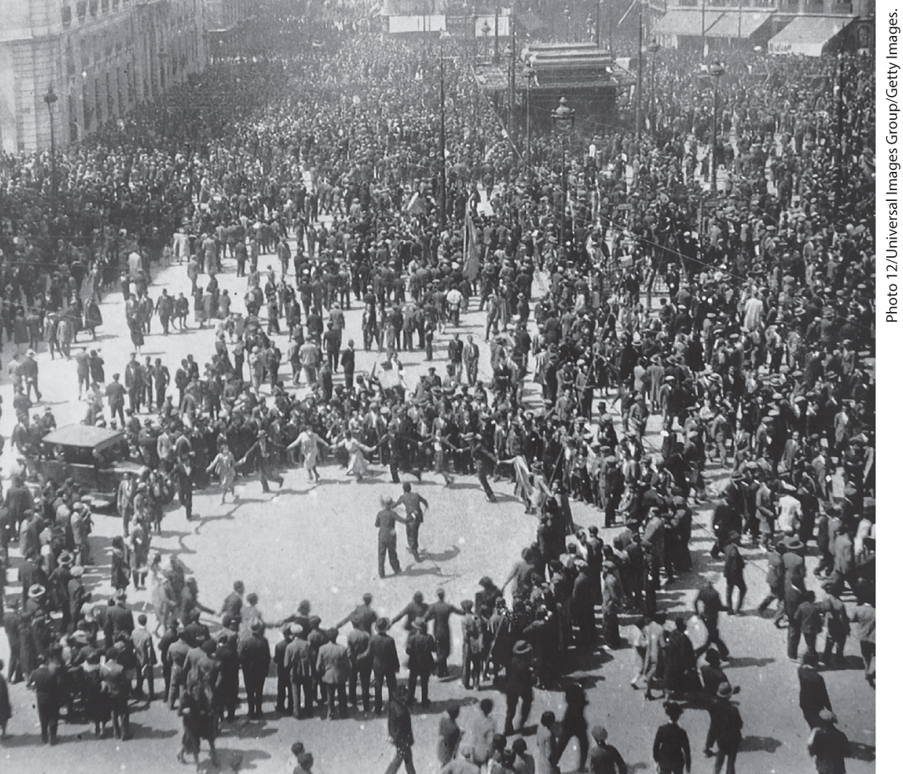
Declaration of the Spanish Republic 1931

Slide 29
IV. The Road to Global War (4 of 7)
B. The Spanish Civil War, 1936–1939 (1 of 2)
  Spanish republicans overthrow their king in 1931
  Republicans failed to build an effective political program
  Antimonarchist forces include an array of competing groups
  Pro-republican forces band together in a Popular Front coalition to win elections
  Right-wing revolts under the leadership of General Francisco Franco
  This military uprising led to the Spanish Civil War
Notes:
IV. The Road to Global War (4 of 7)
B. The Spanish Civil War, 1936–1939 (1 of 2)
In what seemed like an exception to the trend toward authoritarian government, Spanish republicans overthrew their king in 1931.
Although the republicans hoped to modernize Spain’s economy, they failed to build an effective political program or enact land redistribution, which would have won them popular endorsement and loyalty.
Antimonarchist forces included an array of competing and thus divided groups.
In 1936, pro-republican forces temporarily banded together in a Popular Front coalition to win elections and to prevent the republic from collapsing under the weight of growing monarchist opposition.
The right-wingers, however, including monarchists, big landowners, and the clergy, revolted under the leadership of General Francisco Franco (1892–1975).
This military uprising led to the Spanish Civil War, which pitted the republicans, or Loyalists, against the fascist Falangists and the authoritarian right.

Slide 30
IV. The Road to Global War (5 of 7)
B. The Spanish Civil War, 1936–1939 (2 of 2)
  The struggle becomes prelude to World War II when Hitler and Mussolini send military personnel in support of Franco
  The Spanish government seeks help, only Soviet Union answers
  Stalin sends troops and tanks but withdraws in 1938
  Britain and France refused to send aid
  Volunteers from several countries fight for the republic
  Franco defeats the republicans and establishes a dictatorship
Notes:
IV. The Road to Global War (5 of 7)
B. The Spanish Civil War, 1936–1939 (2 of 2)
The struggle became a rehearsal for World War II when Hitler and Mussolini sent military personnel in support of Franco, gaining the right to test new weapons and to practice new tactics, particularly terror bombing civilians.
The Spanish republican government appealed everywhere for assistance, but only the Soviet Union answered.
Stalin sent troops and tanks but withdrew in 1938 as the government’s ranks floundered.
Despite the outpouring of popular support for the cause of democracy, Britain and France refused to send aid.
Instead, a few thousand volunteers from several countries fought for the republic.
Franco defeated the republicans in 1939 and established a dictatorship, generating thousands of refugees.

Slide 31
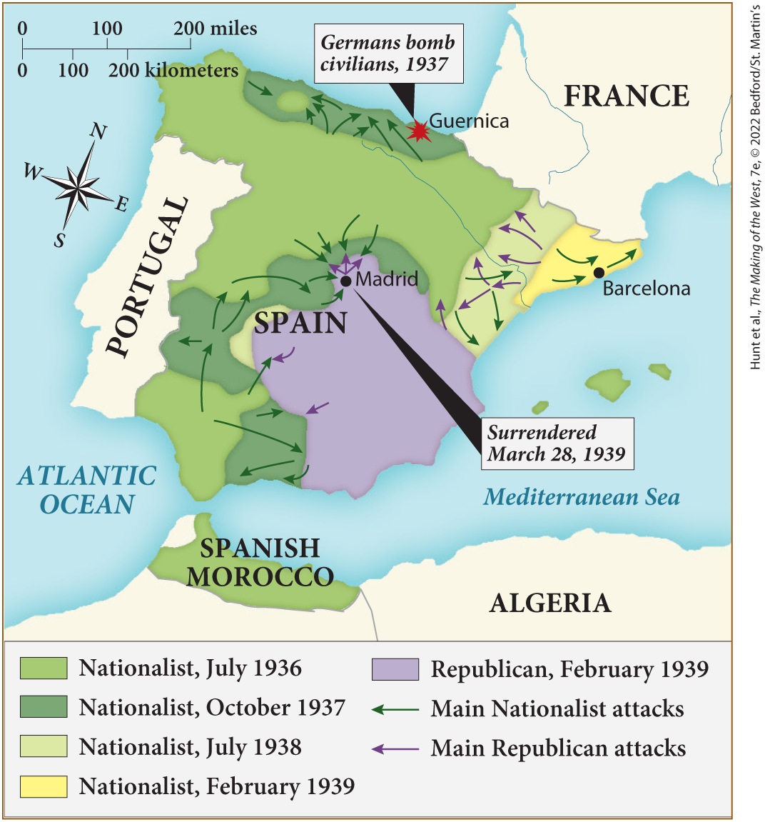
MAP 26.1 The Spanish Civil War, 1936–1939

Slide 32
IV. The Road to Global War (6 of 7)
C. Hitler’s Conquest of Central Europe, 1938–1939 (1 of 2)
  Hitler invades and annexes Austria
  This was the first step in plan to take over central and eastern Europe
  Hitler then turns focus toward Czechoslovakia
  Czechs are prepared to defend themselves
  Germany accuses Czechoslovakia of persecuting its German minority, demands autonomy for the Sudetenland
Notes:
IV. The Road to Global War (6 of 7)
C. Hitler’s Conquest of Central Europe, 1938–1939 (1 of 2)
In March 1938, Hitler ordered an invasion and annexed Austria.
This action, known as the Anschluss — a unification between Austria and Germany — was the first step in Germany’s plan to take over the resources of central and eastern Europe. Although brutal, the takeover was popular with many Austrians, particularly the unemployed who found work in the new factories built by the Nazis.
Hitler next turned his focus toward Czechoslovakia.
His task was more difficult here because Czechoslovakia had a large army, formidable border defenses, and armament factories, and most Czechs were prepared to defend their country.
German propaganda accused Czechoslovakia of persecuting its German minority and demanded that it grant autonomy to the German-populated region of the Sudetenland.

Slide 33
IV. The Road to Global War (7 of 7)
C. Hitler’s Conquest of Central Europe, 1938–1939 (2 of 2)
  British prime minister Neville Chamberlain and French premier Edouard Daladier agreed not to oppose Hitler claim to the Sudetenland
  Appeasement perceived as a positive act
  Hitler invades Czechoslovakia, Britain and France promise aid to other countries
  Germany and the USSR sign a nonaggression pact, Hitler prepares to attack Poland
Notes:
IV. The Road to Global War (7 of 7)
C. Hitler’s Conquest of Central Europe, 1938–1939 (2 of 2)
British prime minister Neville Chamberlain (1869–1940), French premier Edouard Daladier (1884–1970), and Mussolini met with Hitler in Munich and agreed not to oppose Hitler’s claim to the Sudetenland.
Appeasement, the strategy of preventing war by making concessions, was, at that time, perceived as a positive act.
Despite the decision made at the conference, Hitler, in March 1939, invaded Czechoslovakia anyway. Britain and France responded by promising to give aid to Poland, Romania, Turkey, and Greece in the event of a German invasion.
In August, to the shock of many, Germany and the USSR signed a nonaggression pact (the Nazi-Soviet Pact) with secret provisions to partition Poland and the Baltic States between them. Hitler prepared to attack Poland.

Slide 34
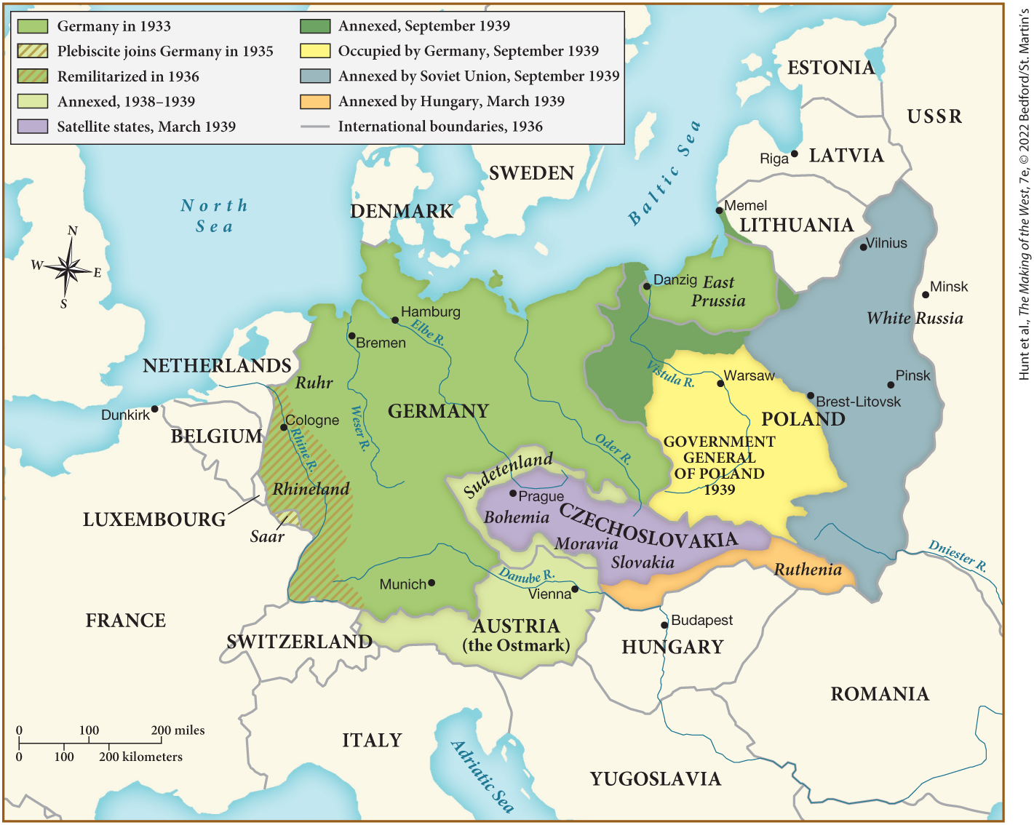
MAP 26.2 The Growth of Nazi Germany, 1933–1939

Slide 35
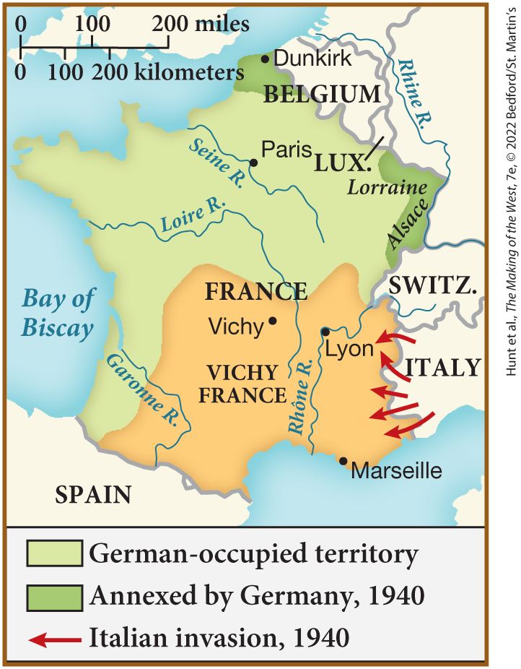
SPOT MAP 26.1 The Division of France, 1940

Slide 36
V. World War II, 1939–1945 (1 of 13)
A. The German Onslaught (1 of 2)
  Hitler’s Blitzkrieg tactics assure Germans that human costs would be light
  After successfully taking Poland, Denmark and Norway, the Germans attack Belgium, the Netherlands, and France
  The French surrender on June 22, 1940
  Henri Philippe Pétain allowed to govern Southern France
  Stalin uses diversion of war in the west to annex Baltic states
  Britain choses Winston Churchill as prime minister
Notes:
V. World War II, 1939–1945 (1 of 13)
A. The German Onslaught (1 of 2)
Hitler’s Blitzkrieg (“lightning war”) tactics in which airplanes, tanks, and motorized infantry encircled defenders, assured Germans that the human cost of conquest would be light.
After successfully using this tactic first in Poland (where the country was partitioned with the USSR as had been previously agreed), then in Denmark and Norway, the Germans attacked Belgium, the Netherlands, and France in May and June 1940.
When the French surrendered on June 22, 1940, Germany ruled the northern half of the country.
The southern part was named Vichy France, after the spa town where the government sat, and the aged World War I hero Henri Philippe Pétain (1856–1951) was allowed to govern.
Stalin used the diversion of war in the west to annex the Baltic states.
Britain, now alone in its fight against Hitler’s Germany, chose Winston Churchill (1874–1965) as prime minister.

Slide 37
V. World War II, 1939–1945 (2 of 13)
A. The German Onslaught (2 of 2)
  German air force begins bombing key British locations
  The British focus on defending themselves against aircraft
  German air losses forces Hitler to abandon plans for a naval invasion of England
  Hitler breaks the Nazi-Soviet Pact and begins invasion of the Soviet Union
  German inflict heavy casualties, but are by Hitler’s plan of attack
  German soldiers ill equipped for a long war during the Soviet winter
Notes:
V. World War II, 1939–1945 (2 of 13)
A. The German Onslaught (2 of 2)
In the battle of Britain, which the British called the Blitz, the German air force (Luftwaffe) bombed public buildings and monuments, harbors, weapons depots, military bases, and industry.
The British government poured its resources into antiaircraft weapons, its code-breaking group Ultra, and the development of radar.
By the fall of 1940, German air losses over England forced Hitler to abandon his plan for a naval invasion of that country.
In June 1941, Hitler began the invasion of the Soviet Union, breaking the Nazi-Soviet Pact.
Although German troops quickly penetrated Soviet territory and inflicted heavy casualties, they were slowed down by Hitler’s insistence on attacking several regions simultaneously.
In the winter, for which German soldiers were poorly equipped, the Soviets began to fight back, and Hitler’s ill-supplied troops succumbed to weather and disease.

Slide 38
V. World War II, 1939–1945 (3 of 13)
B. War Expands: The Pacific and Beyond
  Japan takes parts of the French Empire, attacks Indonesia, and invades parts of Indochina
  In December 1941, Japanese airplanes bomb American bases at Pearl Harbor
  The U.S. declares war on Japan
  By spring 1942 Japan had spread its control of the Pacific
  Hitler and Mussolini declare war on the United States
  Hitler’s enemies come together in the Grand Alliance
Notes:
V. World War II, 1939–1945 (3 of 13)
B. War Expands: The Pacific and Beyond
With the outbreak of war in Europe, Japan took control of parts of the French Empire, bullied the Dutch in Indonesia, and invaded parts of Indochina to procure raw materials for industrial production.
In December 1941, Japanese launched airplanes from aircraft carriers and bombed American naval and air bases at Pearl Harbor in Hawaii and then decimated a fleet of U.S. airplanes based in the Philippines.
The U.S. Congress declared war on Japan.
By spring 1942, as the United States prepared to intervene actively in the war, Japan had conquered Guam, the Philippines, Malaya, Burma, Indonesia, Singapore, and much of the southwestern Pacific.
Hitler declared war on the United States, which was unprepared for war, and Mussolini followed suit.
Hitler’s four enemies — Great Britain, the Free French, the Soviet Union, and the United States — came together in the Grand Alliance, and with a coalition that included twenty other countries, these Allies worked hard to subdue the Axis powers who were fanatically committed to global conquest.

Slide 39
V. World War II, 1939–1945 (4 of 13)
C. The War against Civilians (1 of 3)
  The war killed far more civilians than soldiers
  Both sides bombed cities, often inspiring defiance
  The German army slaughters civilians in eastern Europe in the name of “racial purity”
  Similar acts committed by the Soviets in the name of collectivization
  In Poland the SS murdered social leaders and sent citizens to forced labor camps
  The Japanese kill over thirty million in China
Notes:
V. World War II, 1939–1945 (4 of 13)
C. The War against Civilians (1 of 3)
Everyone was a target in World War II, and the war killed far more civilians than soldiers.
Both sides bombed cities to destroy the civilian will to resist; conversely, this tactic often seemed to inspire defiance.
As the German army moved through eastern Europe, it slaughtered hundreds of thousands in the name of “racial purity.”
Similar violence was inflicted by the Soviets in the name of collectivization.
In Poland, the SS (Hitler’s elite military force) murdered nobility, clergy, and intellectuals, and transported hundreds of thousands of Polish citizens to forced labor camps.
In China, the Japanese killed over thirty million, and millions more elsewhere.

Slide 40
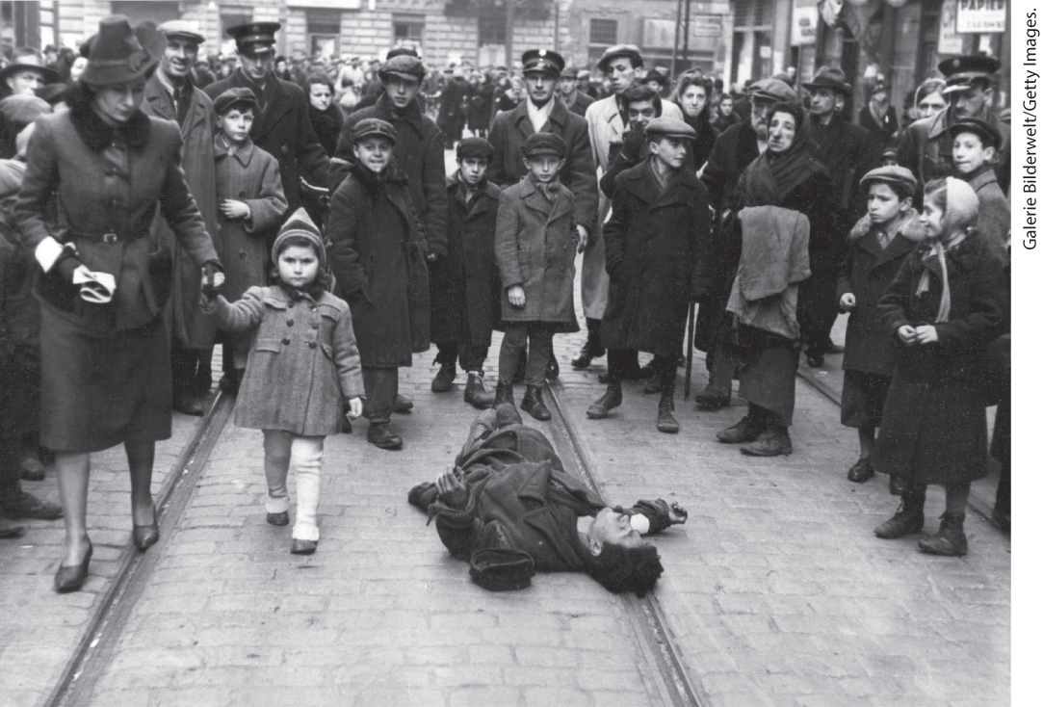
Life in Warsaw Ghetto

Slide 41
V. World War II, 1939–1945 (5 of 13)
C. The War against Civilians (2 of 3)
  Extermination of Jews became focus for the Nazis
  Jews throughout Europe were confined to ghettos or massacred
  System for rounding up Jews and sending them to extermination camps is formalized
  Six camps in Poland were developed for mass murder
  About 60 percent of arrivals were immediately murdered in Nazi gas chambers
  The rest for forced to work until they were murdered
Notes:
V. World War II, 1939–1945 (5 of 13)
C. The War against Civilians (2 of 3)
The extermination of Jews during the war became a special mission of the Nazis.
As German troops gained control of much of Europe, vast numbers of Jews were confined to ghettos or massacred en masse, sometimes by their neighbors rather than the Germans.
In addition to the massacres, a bureaucratically organized and efficient technological system for rounding up Jews and sending them to extermination camps had taken shape by the fall of 1941 and was formalized at a meeting at Wannsee, Germany, in 1942.
Six camps in Poland were developed specifically for the singular purpose of mass murder.
About 60 percent of new arrivals — particularly children, women, and the elderly — were directly selected to be mass murdered in Nazi gas chambers.
The remaining 40 percent labored until they, too, were sent to their deaths.

Slide 42
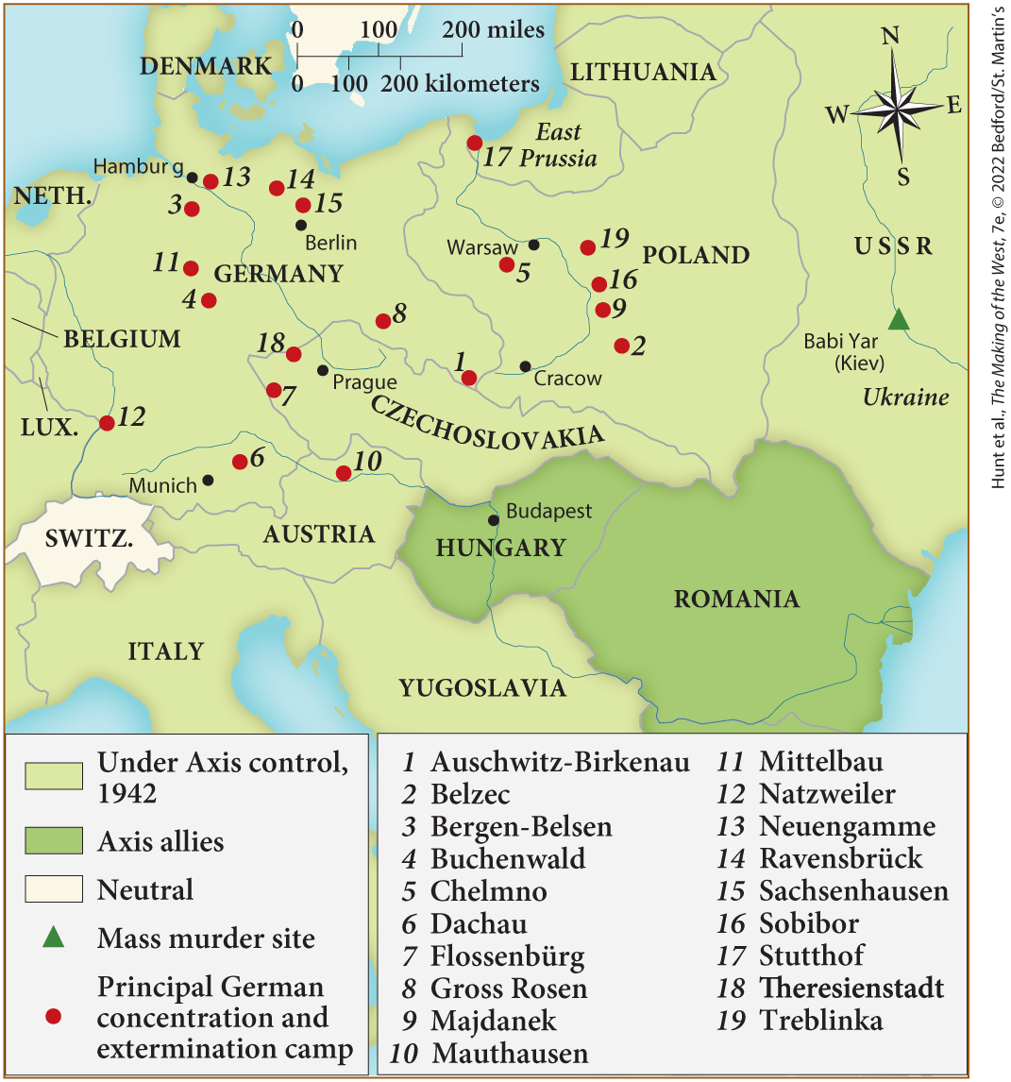
MAP 26.3 Concentration Camps and Extermination Sites in Europe

Slide 43
V. World War II, 1939–1945 (6 of 13)
C. The War against Civilians (3 of 3)
  Jewish resistance was nearly impossible due to poor living conditions
  Resistance meant certain death
  The Nazis took care to hide extermination camps from the outside world
  The Nazis projected a festive atmosphere when trains arrived at the camps
  Forced labor killed most of the internees who were not murdered more slowly
  Six million Jews along with an five to six million from other groups were murdered by the Nazis
Notes:
V. World War II, 1939–1945 (6 of 13)
C. The War against Civilians (3 of 3)
Effective resistance was nearly impossible; starvation and disease weakened Jews in the ghettos and, because men and young women had emigrated, ghettos were more likely to be populated by middle-aged women and the elderly.
Resistance, as in the uprising at the Warsaw ghetto in 1943, meant certain death.
The Nazis went to great lengths to hide what they were doing in the extermination camps.
They had bands playing when the trains arrived at the camps, and sometimes gave people cheery postcards to send home.
Those not immediately killed in the camps experienced harsh conditions of forced labor, which killed most of the internees more slowly.
By the end of the war, six million Jews — the vast majority from eastern Europe — along with an estimated five to six million gypsies, homosexuals, Slavs, and others were murdered by the Nazis.

Slide 44
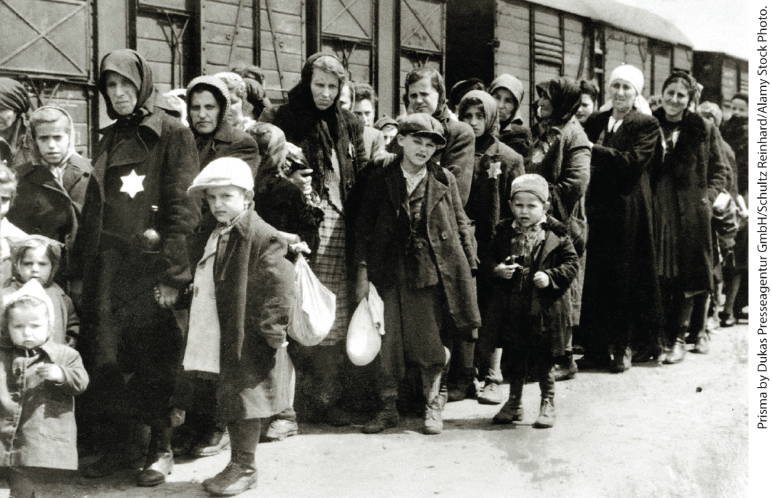
Families Arrive at Auschwitz-Birkenau Extermination and Concentration Camp, c. 1942

Slide 45
V. World War II, 1939–1945 (7 of 13)
D. Societies at War (1 of 2)
  World War II depended heavily on industrial productivity
  The Axis powers were outproduced by their enemies
  Japan and Germany underestimated their opponent’s resources
  Allied governments successfully generated civilian participation
  In Germany and Italy, women followed the fascist doctrine of separate spheres
Notes:
V. World War II, 1939–1945 (7 of 13)
D. Societies at War (1 of 2)
Even more than World War I, World War II depended on industrial productivity geared totally toward war and mass murder.
The Axis powers were at a serious disadvantage, as they were outproduced by their enemies. Even when the Germans occupied the Soviet industrial heartland, Soviet production increased.
Neither Japan nor Germany took the resources and morale of its enemies into full account.
Allied governments were overwhelmingly successful in generating civilian participation, especially among women.
In Germany and Italy, women followed the fascist doctrine of separate spheres, even though they were desperately needed in offices and factories.

Slide 46
V. World War II, 1939–1945 (8 of 13)
D. Societies at War (2 of 2)
  In the Soviet Union, women constituted more than half the workforce
  Stalin encouraged revival of Russian nationalism
  Propaganda used everywhere to boost morale
  Governments organized many aspects of civilian life during the war
  Racist sentiment was a hallmark of Nazi propaganda, Allied propaganda depicted Germans as sadists, Japanese as uncivilized
Notes:
V. World War II, 1939–1945 (8 of 13)
D. Societies at War (2 of 2)
In the Soviet Union, women constituted more than half the workforce by war’s end.
Stalin encouraged a revival of Russian nationalism and religion.
Propaganda was used everywhere to boost morale. People were glued to their radios for war news; and films, monitored by governmental agencies, depicted aviation heroes, infantry men, and the working women and wives left behind.
Governments organized many aspects of ordinary life during the war, and mass mobilization and the standardization of many items contributed to the development of mass society in which people lived and thought in identical ways.
Anti-Semitic, anti-Slav, and anti-gypsy sentiment was a hallmark of Nazi propaganda, whereas Allied propaganda depicted Germans as sadists and perverts and Japanese as uncivilized, insect-like fanatics.

Slide 47
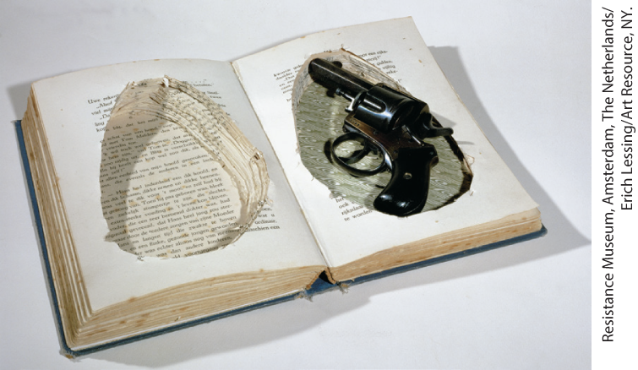
Hidden Revolver

Slide 48
V. World War II, 1939–1945 (9 of 13)
E. From Resistance to Allied Victory (1 of 3)
  The military eventually defeated the Axis, but civilian resistance contributed to victory
  Europeans from many walks of life took part in resistance against the Nazis
  Stalin’s successful defense of Stalingrad was a major turning point, allowing the Soviet army to drive to the West
  The British army and U.S. forces saw success in North Africa
  Germans take over the War in the Italian peninsula as Mussolini is killed by the Italian resistance
  The Soviets face the brunt of Germany’s forces, while Britain and France bomb German territory
  Allied forces under the command of U.S. General Dwight D. Eisenhower invade the Normandy coast of France
Notes:
V. World War II, 1939–1945 (9 of 13)
E. From Resistance to Allied Victory (1 of 3)
The combined efforts of the military ultimately defeated the Axis powers, but civilian resistance in Nazi-occupied areas also contributed to the Allied victory.
A broad spectrum of Europeans, from Communists to Catholic and Protestant clergy and women as well as men, took part in resistance activities. In July 1944, a conspiracy of German officers unsuccessfully attempted to kill Hitler — a plot that, if it had been successful, could have spared millions of lives.
A major turning point came for the Allied forces in August 1942, when the German army began its siege of Stalingrad, a Russian city that would provide access to Soviet oil. Stalin’s successful defense of Stalingrad marked the beginning of the Soviet’s drive westward.
Meanwhile, the British army in North Africa stood firm against the Germans in Egypt and Libya and, together with U.S. forces, invaded Morocco and Algeria in the autumn of 1942.
The invasion of Sicily in July 1943 was followed by a slow, grinding war up the Italian peninsula against Germans who had taken over the war effort from the Italians. Mussolini was caught by Italian resisters and killed.
The Soviets bore the brunt of the war against Germany, while Britain and France bombed German territory. Stalin wanted an Allied invasion of western Europe to relieve his forces.
On June 6, 1944, the combined Allied forces under the command of U.S. General Dwight D. Eisenhower (1890–1969) invaded the Normandy coast of France.

Slide 49
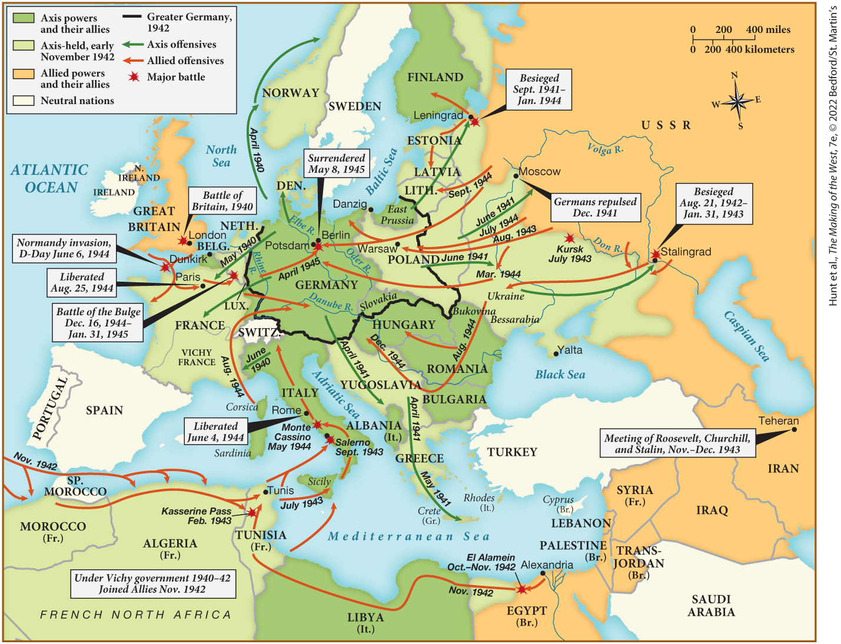
MAP 26.4 World War II in Europe and Africa

Slide 50
V. World War II, 1939–1945 (10 of 13)
E. From Resistance to Allied Victory (2 of 3)
  Allied forces break through German defenses, liberate Paris
  Allied forces fight eastward to join the Soviets
  Soviets continue to advance through Poland and the Baltic states
  Hitler commits suicide when the Soviet army takes Berlin
  Germany surrenders on May 8, 1945
  German surrender allows the Allies to shift their focus to Japan
  Allies turn the tide in battles at Midway Island and Guadalcanal
Notes:
V. World War II, 1939–1945 (10 of 13)
E. From Resistance to Allied Victory (2 of 3)
In late July, Allied forces broke through German defenses and, in August, helped liberate Paris.
British, Canadian, U.S., and other Allied forces then fought their way eastward to join the Soviets.
The Soviets continued to advance through Poland and the Baltic states, although when they paused for supplies in Warsaw, the Germans were able to put down an uprising in that city.
When the Soviet army entered and took the city of Berlin, Hitler and his wife, Eva Braun, committed suicide.
Germany surrendered on May 8, 1945.
The German surrender allowed the Allies to shift their focus to Japan.
In battles at Midway Island and Guadalcanal later that year, the Allies turned the tide, destroying some of Japan’s formidable naval power.

Slide 51
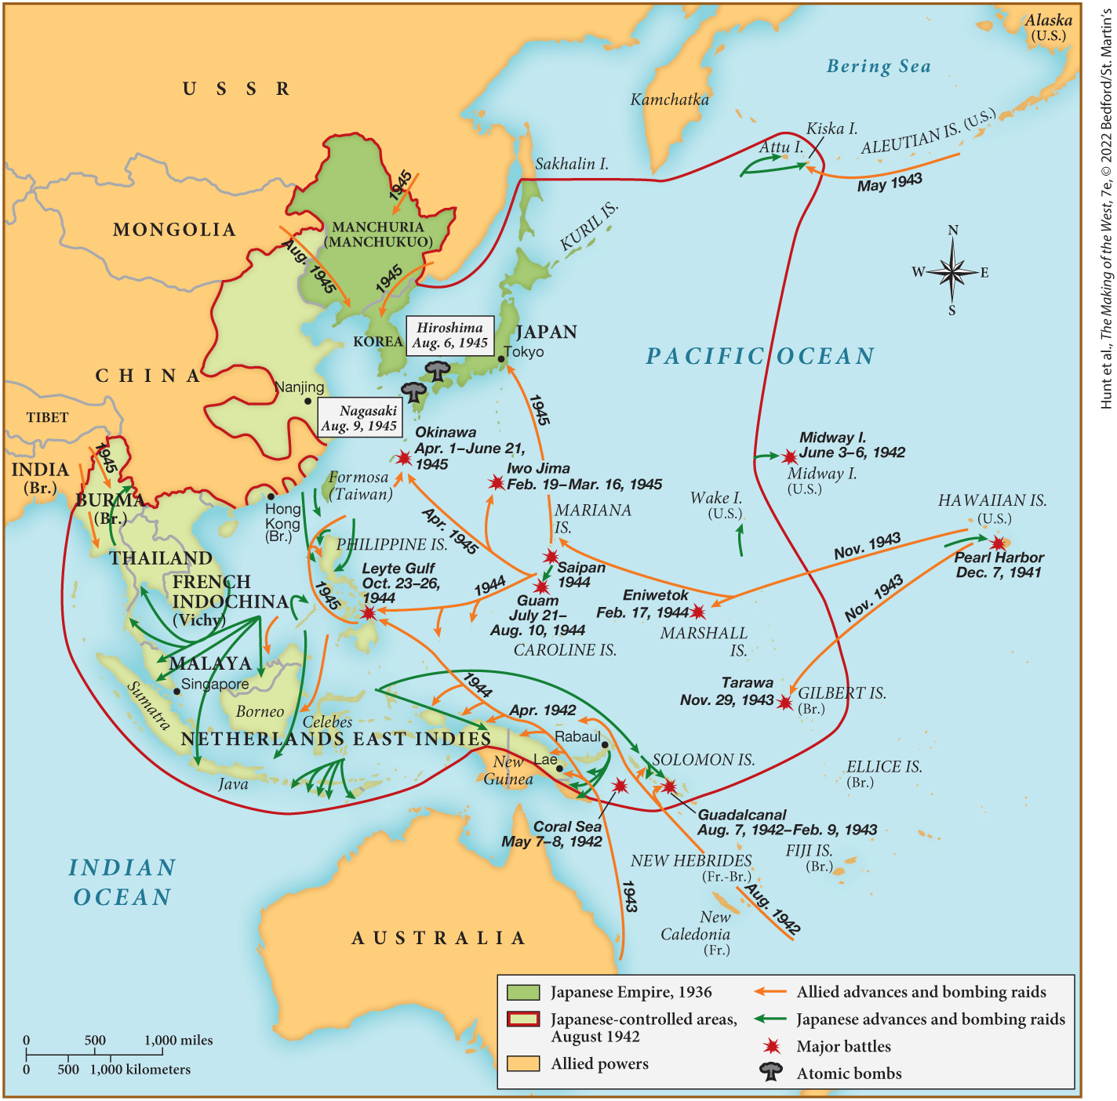
MAP 26.5 World War II in the Pacific

Slide 52
V. World War II, 1939–1945 (11 of 13)
E. From Resistance to Allied Victory (3 of 3)
  Japan had far less resources than the United States
  The Allies slowly took over Pacific islands, but the Japanese refused to surrender
  Japanese pilots adopt kamikaze tactics
  More than one hundred thousand scientists were working to develop the atomic bomb
  The United States drops atomic bombs on Hiroshima and Nagasaki
  One hundred forty thousand people were killed instantly; tens of thousands die later
  On August 14, 1945, Japan surrendered
Notes:
V. World War II, 1939–1945 (11 of 13)
E. From Resistance to Allied Victory (3 of 3)
Japan had far less resources and manpower than the United States alone.
The Allies, at great personnel loss, took one Pacific island after another, but the Japanese refused to surrender.
Instead, they adopted kamikaze tactics, in which pilots deliberately crashed their planes into American ships, killing themselves in the process.
Meanwhile, more than one hundred thousand scientists, technicians, and others were developing the atomic bomb.
Fearing that defeating Japan might take too long, cost too many lives, and allow the Soviet Union the opportunity to seize territory in the East, the United States dropped atomic bombs on Hiroshima and Nagasaki on August 6 and 9, 1945. (For a close look at one of the important environmental history topics in this chapter, see “Environment Matters: Hiroshima, 1945.”)
One hundred forty thousand people were killed instantly; tens of thousands died later of burns and wounds.
On August 14, 1945, Japan surrendered.

Slide 53
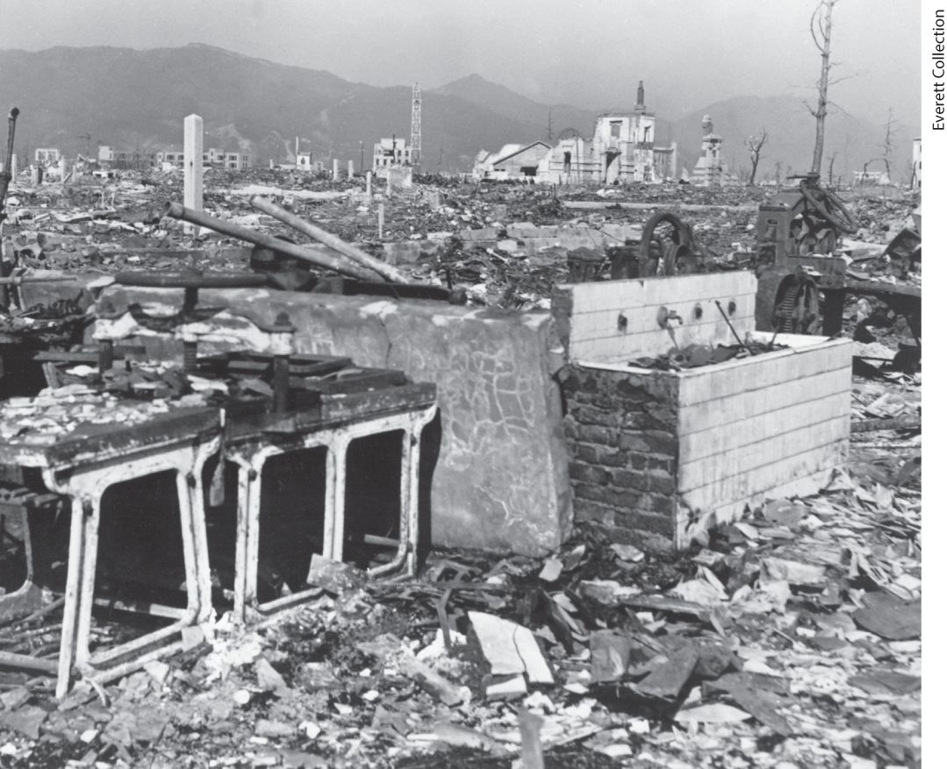
Environment Matters: Hiroshima, 1945

Slide 54
V. World War II, 1939–1945 (12 of 13)
F. An Uneasy Postwar Settlement (1 of 2)
  As the Grand Alliance was composed of nations with differing cultures, wartime agreements reflected these differences
  Roosevelt and Churchill forge the Atlantic Charter
  Churchill and Stalin plan the postwar distribution of territories
  Soviets would control Romania and Bulgaria, Britain would control Greece, both would oversee Hungary and Yugoslavia
  Roosevelt, Churchill, and Stalin meet in the Crimean town of Yalta for continued talks
Notes:
V. World War II, 1939–1945 (12 of 13)
F. An Uneasy Postwar Settlement (1 of 2)
The Grand Alliance was composed of nations with vastly different political and economic systems and agendas, and wartime agreements reflected continuing differences concerning the shape of postwar Europe.
In 1941, Roosevelt and Churchill forged the Atlantic Charter, which condemned aggression, reaffirmed the idea of collective security, and endorsed the right of all peoples to choose their governments.
In October 1944, Churchill and Stalin planned the postwar distribution and occupation of territories.
In an agreement that went against Roosevelt’s faith in collective security and threatened the principle of self-determination, Churchill and Stalin decided that the Soviets would control Romania and Bulgaria, while Britain would control Greece and, together, they would oversee Hungary and Yugoslavia.
Roosevelt, Churchill, and Stalin met in the Crimean town of Yalta in February 1945, where Roosevelt advocated the establishment of the United Nations and supported Soviet influence in Korea, Manchuria, and the Sakhalin and Kurile Islands in exchange for Stalin’s promise of help against any future Japanese aggression.

Slide 55
V. World War II, 1939–1945 (13 of 13)
F. An Uneasy Postwar Settlement (2 of 2)
  Final meeting in the summer of 1945 leads to four-way occupation of Germany
  The Second World War kills and displaces millions of people
  The spread of wartime values depressed many, including British writer George Orwell
  The Allies scrambled to outmaneuver each other after the war
Notes:
V. World War II, 1939–1945 (13 of 13)
F. An Uneasy Postwar Settlement (2 of 2)
At the final meeting in Potsdam, Germany, in the summer of 1945, the leaders of the Soviet Union and the Allied leaders agreed to give the Soviets control of eastern Poland, to cede a large stretch of eastern Germany to Poland, and to adopt a temporary four-way occupation of Germany that included France among the supervising nations.
The Second World War killed an estimated one hundred million people and left more than fifty million refugees. It ended non-European deference toward the West and weakened democracy.
The spread of wartime values, including deception and the use of euphemisms like battle fatigue for insanity, depressed many, including British writer George Orwell.
As victory unfolded, the Allies scrambled to outmaneuver each other in what became the cold war.

Slide 56
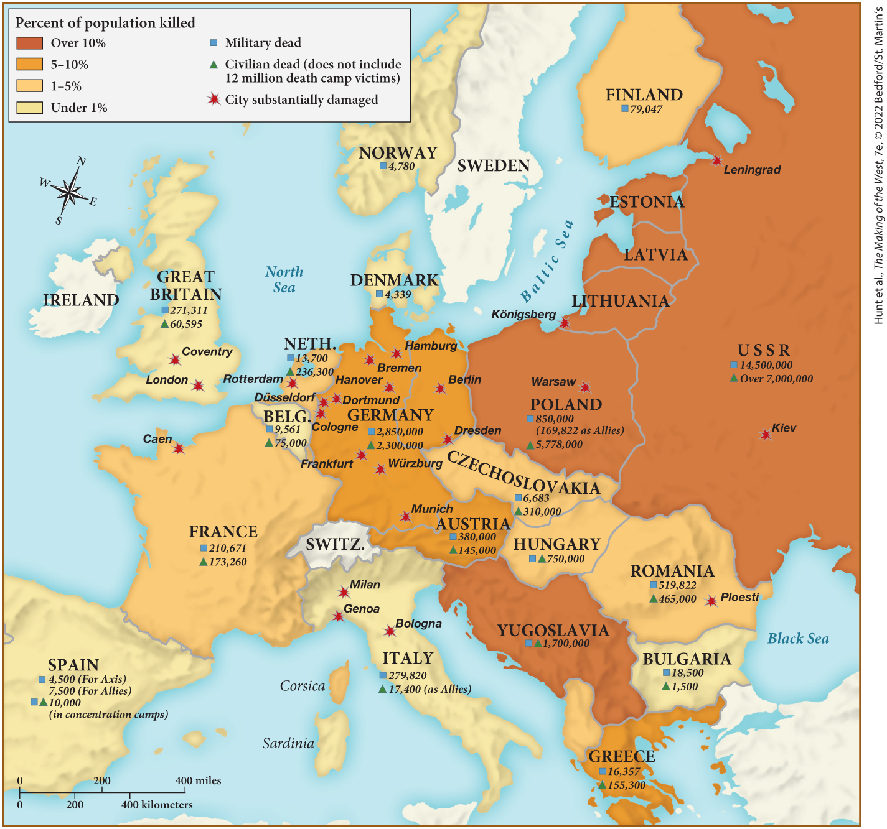
MAP 26.6 Mapping the West: Europe at War’s End, 1945

Slide 57
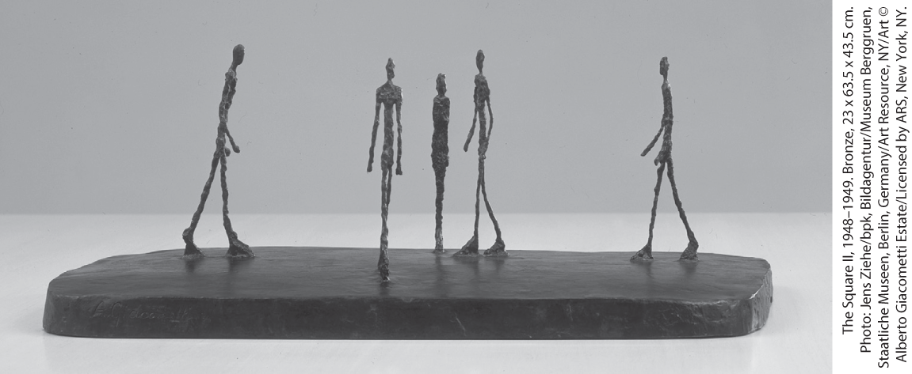
Alberto Giacometti, The Square II (1948–1949)

