Slide 1
The Making of the West
Seventh Edition
Hunt • Martin • Rosenwein • Smith
CHAPTER 25
World War I and Its Aftermath
1914 –1929
Copyright © 2022 by Bedford/St. Martin’s
Distributed by Bedford/St. Martin’s/Macmillan Learning strictly for use with its products. Not for redistribution.

Slide 2
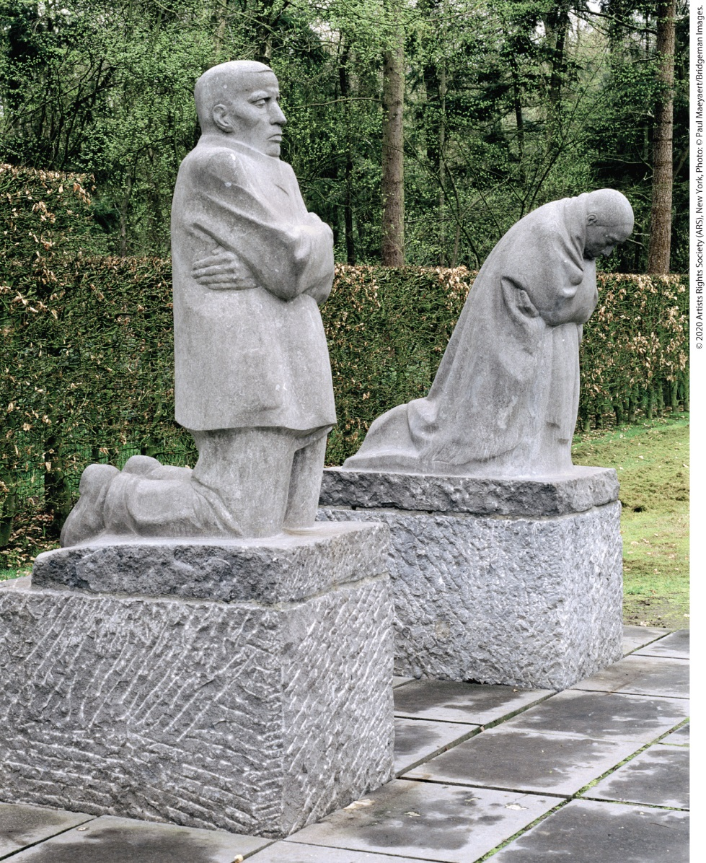
Grieving Parents

Slide 3
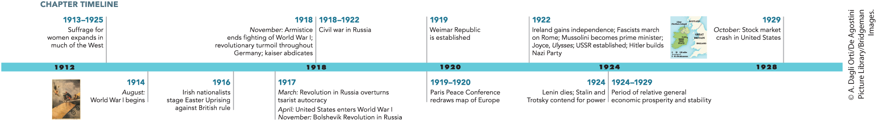
Chapter 25 Timeline

Slide 4
I. The Great War, 1914–1918 (1 of 10)
A. Blueprints for War (1 of 2)
  World War I pitted the Central Powers against the Allies
  In 1914, Japan joined the Allies and the Ottoman Empire joined the Central Powers
  Italy joined the Allies in 1915
  Germany’s goal was to create a central European empire
  Austria-Hungary and Russia both wanted to emerge as great powers
Notes:
I. The Great War, 1914–1918 (1 of 10)
A. Blueprints for War (1 of 2)
World War I pitted the Central Powers — Germany and Austria-Hungary — against the Allies — Great Britain, France, and Russia.
In late August 1914, Japan joined the Allies, and in the fall, the Ottoman Empire joined the Central Powers.
Italy joined the Allies in 1915 in exchange for a promise of territorial gains.
Germany’s goal was to create a central European empire by annexing Russian territory and parts of Belgium, France, and Luxembourg.
Austria-Hungary wanted to retain its great power status, whereas Russia wanted to reassert its status as a great power and as the protector of the Slavs by annexing a reunified Poland.

Slide 5
I. The Great War, 1914–1918 (2 of 10)
A. Blueprints for War (2 of 2)
  France wanted the return of Alsace and Lorraine, Britain wanted to fortify the routes to India
  Colonial powers enlisted soldiers, with fighting breaking out on multiple continents
  Machinery and technology influenced the war
  Old-fashioned weapons and tactics were used at the opening of the war, but lost millions of lives facing modern technology
Notes:
I. The Great War, 1914–1918 (2 of 10)
A. Blueprints for War (2 of 2)
The French wanted the return of Alsace and Lorraine, lost in the Franco-Prussian War, while the British wanted to cement their hold on Egypt, the Suez Canal, and the routes to India.
Colonial powers enlisted millions of soldiers to help fight the conflict, and the war was global, with fighting occurring in Africa, the Middle East, the Caucasus, and China. (For a close look at one of the important environmental history topics in this chapter, see “Environment Matters: War and East African Forests.”)
Machinery and technology influenced the war. Rail and motorized transportation were important. All the powers used new technologies and weapons: chlorine gas, bombs, and tanks.
At the opening of the war, old-fashioned weaponry, such as sabers and lances, and strategy seemed crucial to victory when used in spirited attacks. In the face of modern technology, such tactics cost millions of lives.

Slide 6
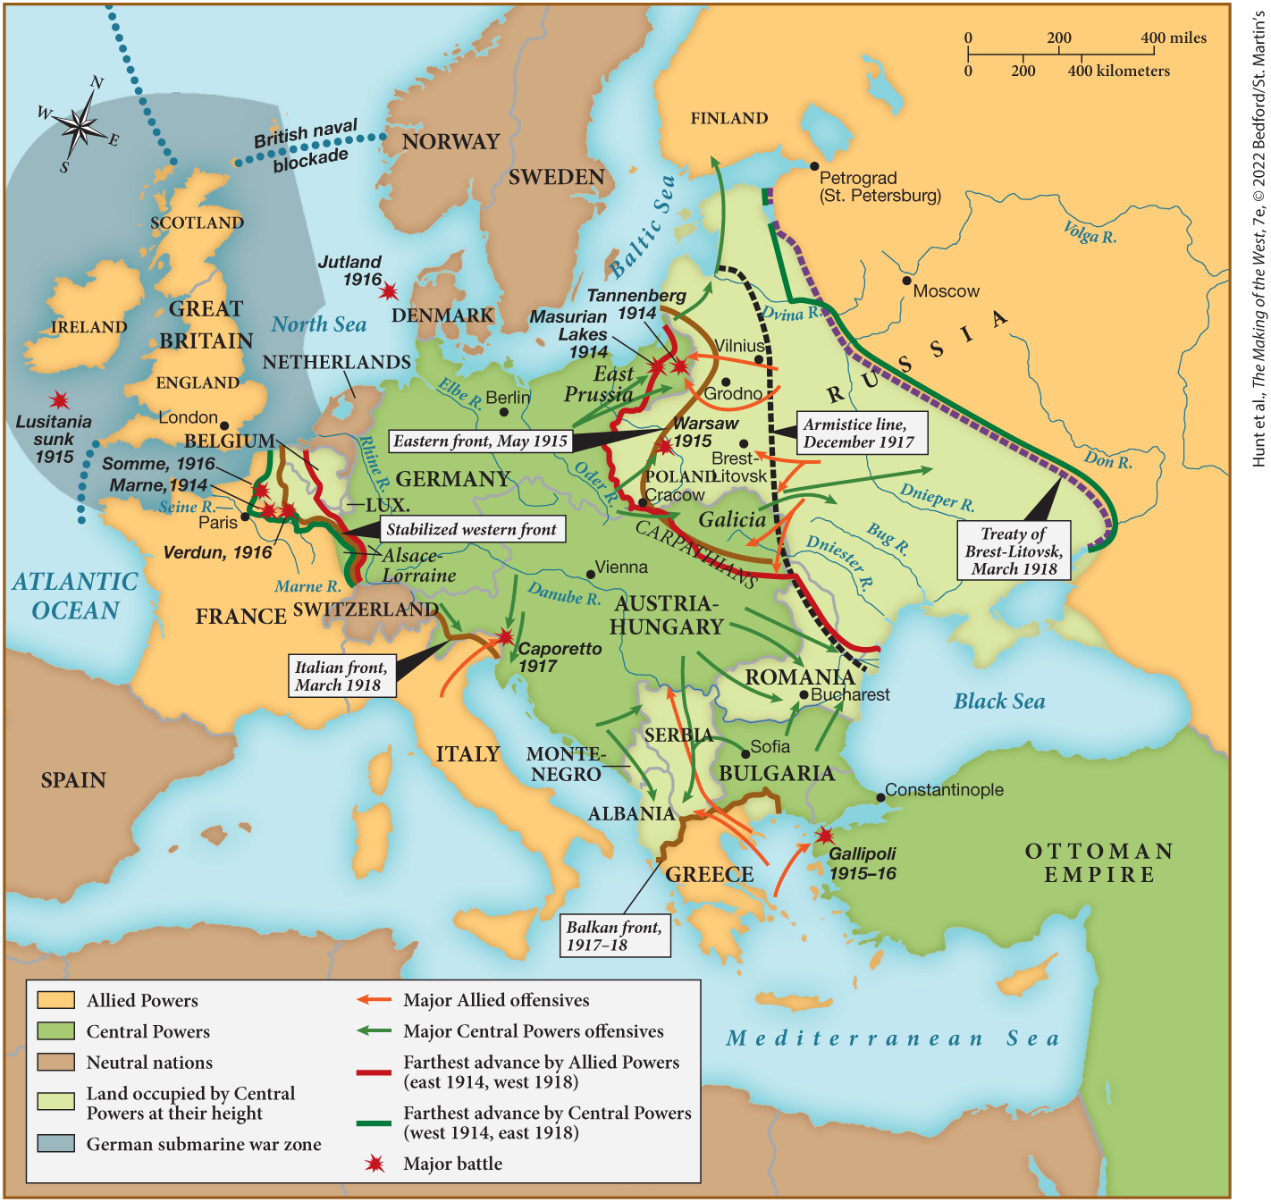
MAP 25.1 The Fronts of World War I, 1914–1918

Slide 7
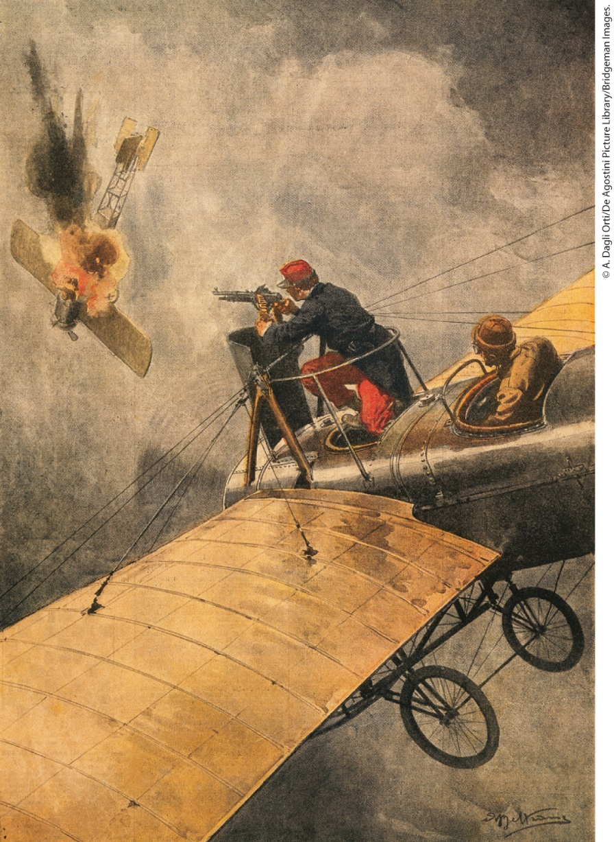
War in the Skies (1914)

Slide 8
I. The Great War, 1914–1918 (3 of 10)
B. The Battlefronts (1 of 4)
  Germany’s Schlieffen Plan required invasion of Belgium, rapid defeat of France, then a turn against Russia
  The Belgians slow the Germans, allowing British and French forces to engage the Germans
  Casualties were shocking; 1.5 million dead in the first 3 months
  The war turned to trench warfare for the following four years
  Russia advanced quickly, but were held off by Germany
Notes:
I. The Great War, 1914–1918 (3 of 10)
B. The Battlefronts (1 of 4)
The major armies mobilized rapidly and hoped for quick victory. Germany’s Schlieffen Plan required the invasion of Belgium and the rapid defeat of France, followed by a turn against Russia, which the Germans believed would mobilize more slowly.
The Belgians put up spirited resistance, affording British and French forces time to engage the Germans along the Marne River.
Casualties were shocking. In the first three months of the war, 1.5 million men fell on the western front alone.
During the following four years, both sides dug in and faced off along a deep trench line that stretched from the North Sea in Belgium and northern France to Switzerland.
The Russians advanced more quickly than expected, driving into East Prussia and parts of Austria-Hungary by mid-August, but Germany crushed the invading Russian forces. The fighting, however, diverted soldiers from the western front.

Slide 9
I. The Great War, 1914–1918 (4 of 10)
B. The Battlefronts (2 of 4)
  The Allies blockade entries to the Mediterranean and North Seas, blocking supplies to Germany
  William II retaliates with submarines
  The Germans sink the British ship Lusitania, among the dead are 124 Americans
  The Germans call off unrestricted submarine warfare to prevent American involvement
  The German and British navies clash in the battle of Jutland
Notes:
I. The Great War, 1914–1918 (4 of 10)
B. The Battlefronts (2 of 4)
War at sea proved equally indecisive. The Allies blockaded the entries to the Mediterranean and North Seas to prevent supplies from reaching Germany and Austria-Hungary.
William II retaliated with a massive U-boat (submarine) campaign against Allied and neutral shipping.
In May 1915, the Germans sank a British passenger ship, the Lusitania, killing 1,198 people, including 124 Americans.
Not wanting to provoke U.S. president Woodrow Wilson further, the Germans called off unrestricted submarine warfare.
In May 1916, the navies of Germany and Great Britain clashed in the battle of Jutland, which, although inconclusive, proved that the German fleet could not defeat the British.

Slide 10
I. The Great War, 1914–1918 (5 of 10)
B. The Battlefronts (3 of 4)
  The idea of a negotiated peace is rejected
  Attacks opened with an artillery barrage, followed by troops charging enemy trenches
  Germans assault the fortress of Verdun, but France holds despite heavy losses on both sides
  The British launch a failed offensive in the Somme region, 1.25 million are killed or wounded
  Russian advances are turned back by the Germans, including offensives into Austria
Notes:
I. The Great War, 1914–1918 (5 of 10)
B. The Battlefronts (3 of 4)
On both sides, governments rejected the idea of a negotiated peace.
Each attack opened with an artillery barrage, followed by troops going “over the top” to charge the enemy’s trenches, usually to be confronted with round upon round of machine-gun fire.
In 1916, the Germans assaulted the fortress of Verdun, hoping to crush French morale by its loss. Although French and German losses were close to a million men, the French held Verdun.
In June 1916, the British launched a failed offensive in the Somme region, and 1.25 million men were killed or wounded.
In 1915, Russian advances were turned back, and German forces pushed toward St. Petersburg. In 1916, Russian offensives into Austria were stopped by the Germans. The Germans took over Austrian military operations, weakening that state’s sovereignty.

Slide 11
I. The Great War, 1914–1918 (6 of 10)
B. The Battlefronts (4 of 4)
  Governments saw the war as “kill or be killed”, but sometimes troops agreed to avoid battle
  The camaraderie that developed as a result of war weakened class distinctions
  Colonized soldiers had a different experience from Europeans
  Colonials often placed in front ranks and faced unfamiliar surroundings
  Colonial troops gained a new perspective on Europeans
Notes:
I. The Great War, 1914–1918 (6 of 10)
B. The Battlefronts (4 of 4)
Whereas governments and officers saw the war as a “kill or be killed” situation, sometimes troops mutually agreed to avoid battle.
The male camaraderie that developed as a result of living, fighting, and dying together weakened traditional class distinctions and sometimes even racial barriers.
Most troops of colonized soldiers, however, experienced the front differently from their European comrades.
Colonials were often placed in the front ranks where the risks were greatest and endured unfamiliar climates and strange foods.
Apart from their suffering, colonial troops gained a new perspective on Europeans, whom they observed exhibiting completely “uncivilized” behavior.

Slide 12
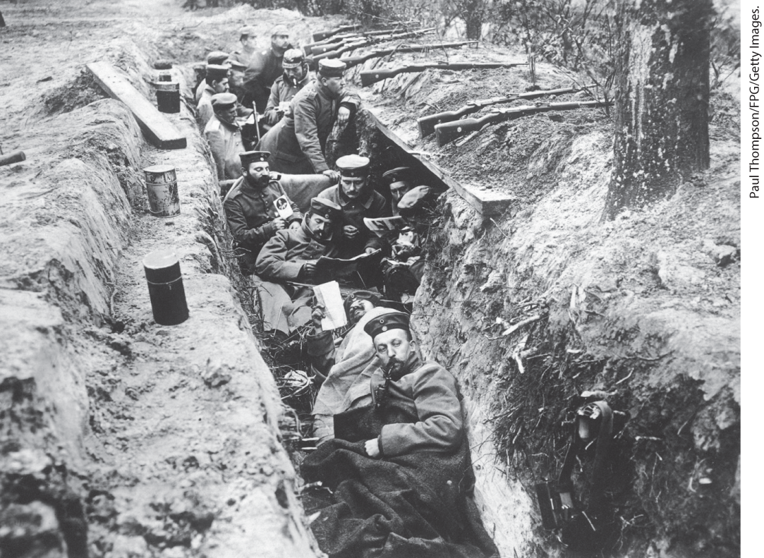
War in the Trenches

Slide 13
I. The Great War, 1914–1918 (7 of 10)
C. The Home Front (1 of 4)
  Civilian involvement was unavoidable as part of the war
  Civilians manufactured weapons, medical equipment, and coffins
  The effort depended on government direction
  Leaders urged population to put aside their differences
  Feminists were divided, but many participated in war efforts
  Governments had varying success in mobilizing the populace
Notes:
I. The Great War, 1914–1918 (7 of 10)
C. The Home Front (1 of 4)
World War I was a “total war.” Civilian involvement was indispensable to the war effort.
Civilians manufactured the weapons, as well as the crutches, wheelchairs, and coffins needed after an assault.
The war effort depended on extensive government direction.
When hostilities broke out in 1914, most of the population — including the socialists — put aside their differences to support the war. National leaders urged an end to political and social divisions.
Feminists were divided over whether to continue traditional pacifism, but many participated in war work and philanthropic efforts.
Governments mobilized the home front with varying degrees of success.

Slide 14
I. The Great War, 1914–1918 (8 of 10)
C. The Home Front (2 of 4)
  War ministries allocated labor and ensured steady supplies
  Industrialists were offered incentives for productivity, men and women were drafted for war work
  Local governments set up canteens and day-cares, but rural areas lacked these resources
  Governments deployed propaganda agencies to keep popular support
  Some stories of enemy atrocities were fabricated
  Armenians faced oppression in the Ottoman Empire, many died or were murdered
Notes:
I. The Great War, 1914–1918 (8 of 10)
C. The Home Front (2 of 4)
War ministries were established to allocate labor and ensure the steady production of armaments and other necessities.
Industrialists were offered incentives to encourage productivity, and in many countries, laws were passed allowing men and women to be drafted for war work.
Municipal governments set up canteens and day-care programs, but many rural areas had no such amenities.
Governments made it a crime to criticize official policies and created propaganda agencies that presented the war as a patriotic mission and demonized the enemy.
Some stories of enemy atrocities were fabricated.
In the Ottoman Empire, Armenians were accused of supporting the enemy and driven from their homes in Turkey, forced on long, genocidal marches or into concentration camps where they died or were murdered.

Slide 15
I. The Great War, 1914–1918 (9 of 10)
C. The Home Front (3 of 4)
  Activists in the international women’s movement meet in The Hague to oppose the war
  Local ethnic groups in Austria-Hungary hamper the war effort by calling for independence
  The Allies encourage independence movements
  Women took over jobs vacated by men
  The press praised women’s patriotism, but some were worried women would refuse to give up their jobs
  The poor suffered even more during wartime
Notes:
I. The Great War, 1914–1918 (9 of 10)
C. The Home Front (3 of 4)
Open opposition to the war did, however, exist. In 1915, activists in the international women’s movement met in The Hague, determined to end the war. They failed to inspire negotiations, yet their talking points ended up in President Woodrow Wilson’s Fourteen Points — his principles for negotiating peace.
Others indirectly hampered the war effort, such as local ethnic groups in Austria-Hungary, whose agitation for independence detracted from a focus on the war.
The Allies encouraged independence movements to help defeat the Habsburgs.
The war restructured the workforce: women took over higher-paying jobs vacated by men who left for the trenches.
The press praised women’s patriotism, but others were concerned that the war would destroy women’s femininity and that, once the war was over, women would refuse to give up their jobs to men.
Class conflict continued as the poor suffered even more under wartime conditions.

Slide 16
I. The Great War, 1914–1918 (10 of 10)
C. The Home Front (4 of 4)
  Rationing begins, but the wealthier classes able to obtain food luxuries through the black market
  Governments allow many businesses to reap high profits, shortages of staples like bread and meat worsen during brutal winter
  Some blamed Jews for the shortages
  Inhabitants of the colonies forced to work for the war effort, experienced increased taxes
  Civilian suffering pushed ordinary people to revolt
Notes:
I. The Great War, 1914–1918 (10 of 10)
C. The Home Front (4 of 4)
While workers endured longer hours on less food (because rationing had begun), the wealthier classes were able to afford food and fashionable clothing, paying large amounts of money for products only available on the black market that operated outside the official system of rationing.
Governments also allowed many businesses to reap high profits, bringing about increases in the cost of living as shortages of staples like bread and meat worsened during the brutal winter of 1916–1917.
Some blamed Jews for the shortages.
Inhabitants of the colonies were forced to work for the war effort at home or in Europe. Colonized peoples also experienced increased taxes and elevated prices.
Civilian suffering in Europe and the colonies laid the groundwork for ordinary people to revolt.

Slide 17
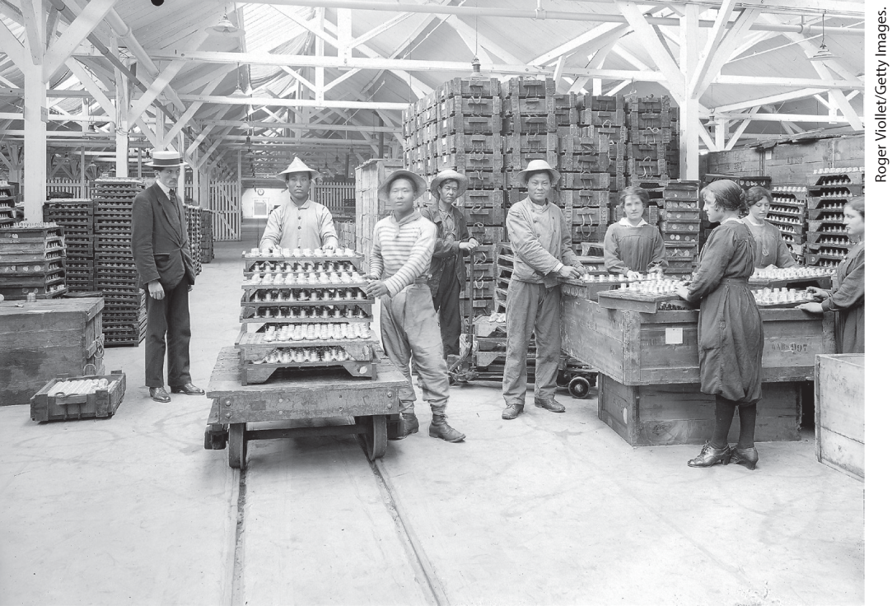
A New Workforce in Wartime

Slide 18
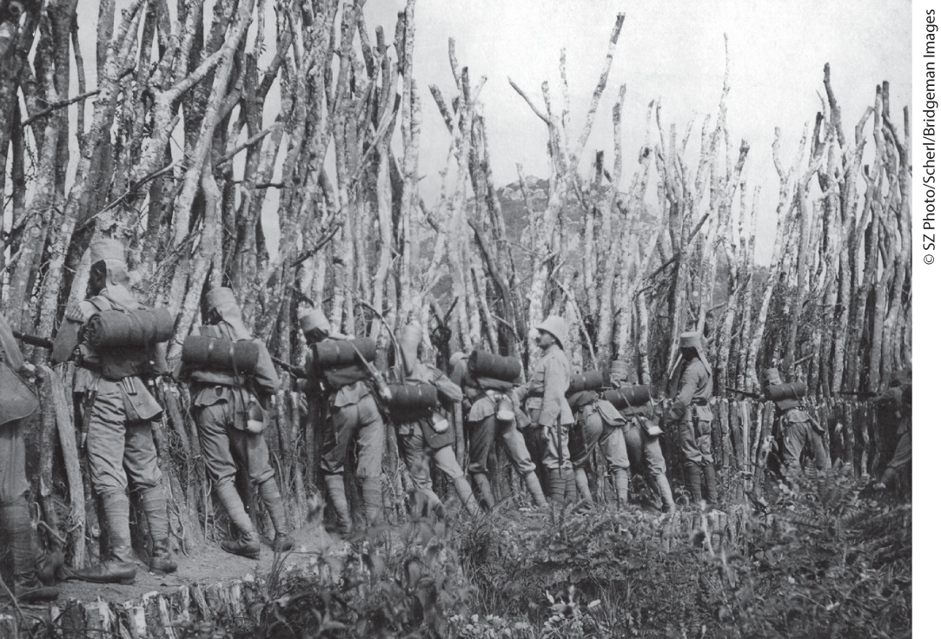
Environment Matters: War and East African Forests

Slide 19
II. Protest, Revolution, and War’s End, 1917–1918 (1 of 9)
A. War Protest (1 of 2)
  German government resumes full-scale submarine warfare in 1917
  British respond by mining harbors and utilizing shipping convoys
  Submarine warfare brings the United States into the war after Germans sink American ships
  War opposition turns to revolt, rebels try to seize power in Ireland
Notes:
II. Protest, Revolution, and War’s End, 1917–1918 (1 of 9)
A. War Protest (1 of 2)
On February 1, 1917, hard-pressed by public clamor over mounting casualties, the German government resumed full-scale submarine warfare. Military authorities promised this would end the war by cutting off food supplies to the British.
The British responded by mining harbors and developing the convoy system of shipping.
Unrestricted submarine warfare brought the United States into the war in April 1917 after the Germans had sunk several American ships.
As living conditions deteriorated, political opposition took the form of outright revolt. In Ireland, on Easter Monday 1916, republican rebels tried to seize power but were defeated.

Slide 20
II. Protest, Revolution, and War’s End, 1917–1918 (2 of 9)
A. War Protest (2 of 2)
  Food shortages in several countries provoke riots, worker strikes
  Austria-Hungary secretly asks Allies for peace
  German Reichstag announces desire for peace, American president Woodrow Wilson promises peace settlement
  French soldiers mutiny against further offensives
Notes:
II. Protest, Revolution, and War’s End, 1917–1918 (2 of 9)
A. War Protest (2 of 2)
Food shortages in Italy, Russia, Germany, and Austria-Hungary provoked women to riot, and as inflation mounted, tenants conducted rent strikes and workers went on strike.
Austria-Hungary secretly asked the Allies for a negotiated peace.
The German Reichstag also announced its desire for peace, and American president Woodrow Wilson issued his Fourteen Points in January 1918, promising a non-vindictive peace settlement.
French soldiers mutinied against further useless offensives.

Slide 21
II. Protest, Revolution, and War’s End, 1917–1918 (3 of 9)
B. Revolution in Russia (1 of 5)
  Russia sustained the greatest number of casualties: 7.5 million
  Eastern front drove many Russian peasants into the interior of the country
  Riots erupt in Petrograd
  Soldiers alienated from the government
  Russians suffer government incompetence
  Nicholas II resigns, a provisional government is formed
Notes:
II. Protest, Revolution, and War’s End, 1917–1918 (3 of 9)
B. Revolution in Russia (1 of 5)
Of all the warring nations, Russia sustained the greatest number of casualties: 7.5 million by 1917.
Slaughter on the eastern front drove many Russian peasants into the interior of the country, spreading hunger, homelessness, and disease.
Riots erupted in Petrograd in March 1917.
Soldiers were also alienated from the government.
Things were worse in Russia than elsewhere, due to governmental incompetence and the failure of Nicholas II.
Confronted with riots, Nicholas quickly resigned. Aristocratic and middle-class politicians from the Duma formed a provisional government.

Slide 22
II. Protest, Revolution, and War’s End, 1917–1918 (4 of 9)
B. Revolution in Russia (2 of 5)
  Workers and soldiers competed with the government for political support
  Peasantry begins to confiscate estates and withhold produce
  Germans provide safe transportation for Lenin and other Bolsheviks to return from exile
  Upon his return, Lenin issues the April Theses, calling for Russia to withdraw from the war and other demands
  Workers and soldiers call for replacement of Provisional Government
  Provisional Government leader Aleksandr Kerensky discredited by military defeats
Notes:
II. Protest, Revolution, and War’s End, 1917–1918 (4 of 9)
B. Revolution in Russia (2 of 5)
Spontaneously elected soviets — councils of workers and soldiers — competed with the government for political support and challenged its policies.
The peasantry began to confiscate the gentry’s estates and withheld produce from the market, which intensified urban food shortages.
In April 1917, the Germans provided safe rail transportation for Lenin and other prominent Bolsheviks to return from exile to Petrograd.
Upon his return, Lenin issued the April Theses, a radical document calling for Russia to withdraw from the war, for the soviets to seize power on behalf of workers and poor peasants, and for all private lands to be nationalized.
After another Russian defeat by the Austrians, groups of workers, soldiers, and sailors agitated for the soviets to replace the Provisional Government.
The Provisional Government led by Aleksandr Kerensky (1881–1970) was discredited by continued military defeats.

Slide 23
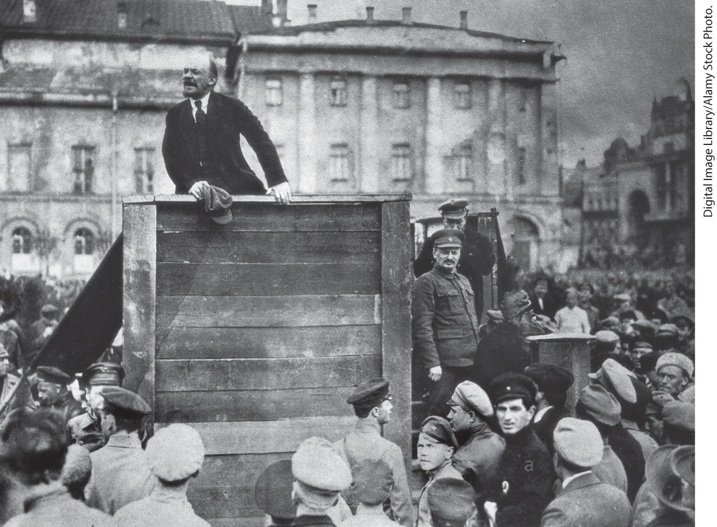
Lenin Addressing Soldiers

Slide 24
II. Protest, Revolution, and War’s End, 1917–1918 (5 of 9)
B. Revolution in Russia (3 of 5)
  Bolsheviks seize power in the Bolshevik Revolution
  Elections are held, but Bolsheviks forcibly seize control of government
  The Bolsheviks and Germany agree to peace with the Treaty of Brest-Litovsk
  Bolsheviks relocate the capital to Moscow
  Lenin believed the rest of Europe would soon overthrow the capitalist order
Notes:
II. Protest, Revolution, and War’s End, 1917–1918 (5 of 9)
B. Revolution in Russia (3 of 5)
In November 1917, the Bolshevik leadership, urged on by Lenin, staged an uprising, and the Bolsheviks seized power in the Bolshevik Revolution.
In January 1918, elections were finally held, and when the Bolsheviks did not fare well, they forcibly took control of the government. They abolished private property and nationalized production, limiting candidates in elections to members of the Communist Party.
The Bolsheviks sued Germany for peace. The resulting Treaty of Brest-Litovsk (March 1918) placed vast regions of the old Russian Empire under German occupation.
Because the loss of territory placed Petrograd at risk, the Bolsheviks relocated the capital to Moscow.
Lenin had agreed to this treaty because he had promised to bring peace, and he believed that the rest of Europe would soon rebel and overthrow the capitalist order.

Slide 25
II. Protest, Revolution, and War’s End, 1917–1918 (6 of 9)
B. Revolution in Russia (4 of 5)
  Resistance to Bolshevik policies turns into civil war
  Some fought to restore old government, others for independence
  Bolshevik commissar of war Leon Trotsky builds highly disciplined army by ending democratic procedures
  Lenin and Trotsky introduce war communism
  The Cheka (secret police) set up detention camps for political opponents
Notes:
II. Protest, Revolution, and War’s End, 1917–1918 (6 of 9)
B. Revolution in Russia (4 of 5)
Resistance to Bolshevik policies, especially those that nationalized private property, soon mushroomed into full-fledged civil war between the pro-Bolshevik “Reds” and antirevolutionary “Whites.” Many of Russia’s former allies landed troops to block German advances and fight the Bolsheviks.
Some fought to restore the old government, but others — especially non-Russian nationality groups — fought for independence. Without a common goal, the counterrevolutionaries could not win.
The civil war shaped communism; Leon Trotsky (1879–1940), Bolshevik commissar of war, built a highly disciplined army by ending democratic procedures that had originally attracted soldiers to Bolshevism.
Lenin and Trotsky also introduced war communism, whereby urban workers and troops confiscated grain from the peasantry.
The Cheka (secret police) set up detention camps for political opponents and black marketers and often shot them without trial.

Slide 26
II. Protest, Revolution, and War’s End, 1917–1918 (7 of 9)
B. Revolution in Russia (5 of 5)
  Bolsheviks found Third International, known as the Comintern
  The Red Army successfully consolidates Bolshevism in Russia and secured other areas
  Japanese withdraw from Siberia, ending the civil war in Central and East Asia
  Revolution removed the tsar and the aristocracy, but the Bolsheviks’ were not what socialists had hoped for
Notes:
II. Protest, Revolution, and War’s End, 1917–1918 (7 of 9)
B. Revolution in Russia (5 of 5)
The Bolsheviks also founded the Third International, known as the Comintern (Communist International) to distinguish it from its predecessors.
By mid-1921, the Red Army had successfully consolidated Bolshevism in Russia and secured the Crimea, the Caucasus, and the Muslim borderlands.
When the Japanese withdrew from Siberia in 1922, the civil war ended in Central and East Asia.
Although revolution removed the tsar and the privileged aristocracy, the Bolsheviks’ brutal political style greatly differed from what earlier socialists had hoped for.

Slide 27
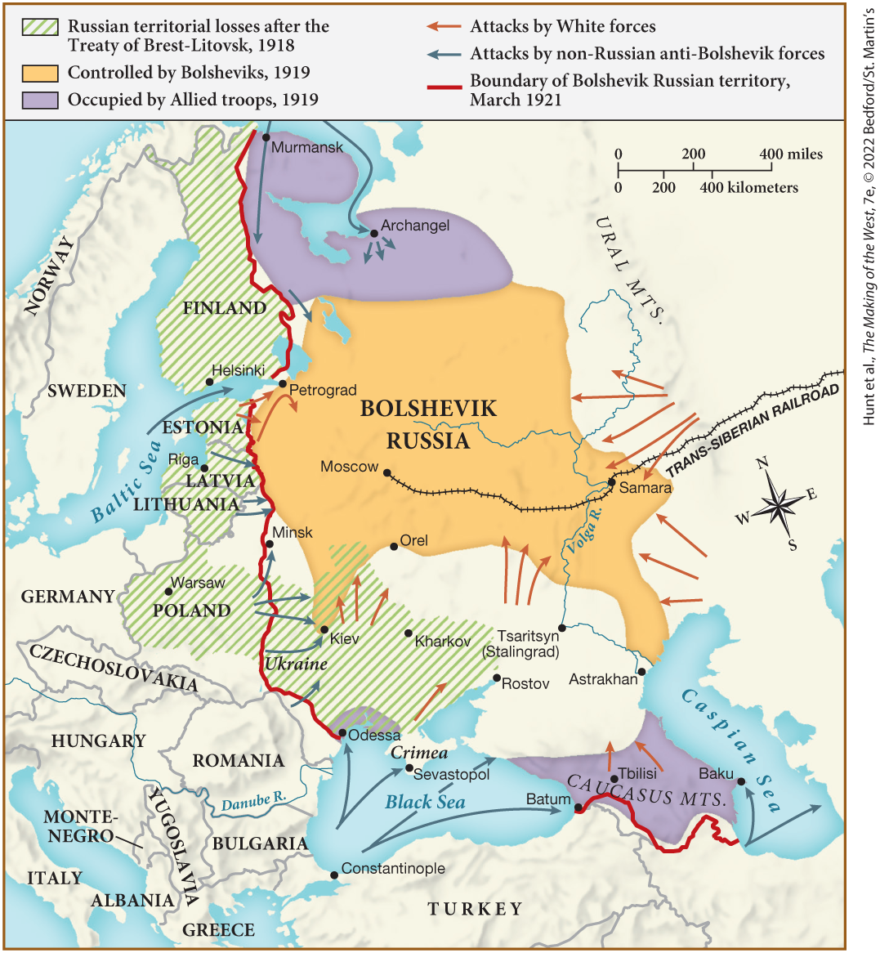
MAP 25.2 The Russian Civil War, 1917–1922

Slide 28
II. Protest, Revolution, and War’s End, 1917–1918 (8 of 9)
C. Ending the War, 1918 (1 of 2)
  In the spring of 1918 Germans make a final push, but the British and French had begun to use tanks and airplanes
  In the summer of 1918 the Allies push back the Germans on the western front
  German high command creates a new civilian government and blames it for defeat
  German sailors revolt, Social Democratic Party proclaims a German republic
  Czechs, Slovaks, and Croats declare independence
  Kaiser William II flees
Notes:
II. Protest, Revolution, and War’s End, 1917–1918 (8 of 9)
C. Ending the War, 1918 (1 of 2)
In the spring of 1918, using new tactics and troops from the eastern front, the Germans made a final attempt to smash through Allied lines, but the British and French had begun to make effective use of tanks supported by airplanes.
The fighting halted and, in the summer of 1918, the Allies — fortified with American troops — pushed back the Germans all along the western front and inflicted huge casualties.
By October 1918, the German high command helped create a new civilian government, saddling it with the responsibility for defeat; the military insisted that it was not losing the war and that, by suing for peace, the civilian government had “stabbed Germany in the back.”
German sailors, fearing a final, suicidal sea battle and resentful of the contrast between their own meager diets and the privileges of the officers, revolted. In an effort to prevent revolution, the Social Democratic Party proclaimed a German republic.
Czechs, Slovaks, and Croats declared independence.
On November 9, 1918, Kaiser William II fled.

Slide 29
II. Protest, Revolution, and War’s End, 1917–1918 (9 of 9)
C. Ending the War, 1918 (2 of 2)
  Armistice signed on November 11, 1918
  All told, ten million dead and thirty million wounded
  European agricultural and industrial production plumets
  Influenza epidemic kills at least one hundred million people
  Soldiers struggle to come to terms with their experiences
  Some maintained that the Great War was a heroic endeavor, others insisted it was meaningless
Notes:
II. Protest, Revolution, and War’s End, 1917–1918 (9 of 9)
C. Ending the War, 1918 (2 of 2)
Finally, on November 11, 1918, an armistice was signed.
Conservative figures put the battlefield toll at a minimum of ten million dead and thirty million wounded, some of whom would eventually die from their wounds.
European agricultural and industrial production had plummeted, with a worldwide impact.
From 1918 to 1919, an influenza epidemic killed at least one hundred million people across the world.
War provoked tremendous moral questioning, as soldiers published memoirs to come to terms with their experiences.
While some maintained that the Great War had been a heroic endeavor, others insisted that the fighting had been absolutely meaningless.

Slide 30
III. The Search for Peace in an Era of Revolution (1 of 8)
A. Europe in Turmoil (1 of 2)
  Many of newly independent people in eastern and central Europe supported socialist principles
  Germany was particularly unstable after defeat
  Demonstrators demanded aid for workers misery and back pay for veterans
  Some inspired by radical socialist faction the Spartacists, led by Karl Liebknecht and Rosa Luxemburg
  Social Democratic leader Friedrich Ebert headed the new government
  Ebert called on German army to suppress the demonstrators
Notes:
III. The Search for Peace in an Era of Revolution (1 of 8)
A. Europe in Turmoil (1 of 2)
Until 1921, the triumph of socialism seemed possible, particularly in urban areas as angry soldiers returned from the front. Many of the newly independent peoples of eastern and central Europe supported socialist principles, and workers and peasants in Germany were in a revolutionary frame of mind.
Germany was particularly unstable in November 1918, partly because of the shock of defeat.
Demonstrators demanded policies that would assuage workers’ misery and remit veterans’ back pay.
Some were inspired by one of the most radical socialist factions — the Spartacists — led by Karl Liebknecht (1871–1919) and Rosa Luxemburg (1870–1919).
Social Democratic leader Friedrich Ebert (1871–1925), who headed the new government, believed parliamentary politics would best realize his party’s objectives.
Ebert called on the German army and the Freikorps — a paramilitary band of students, demobilized soldiers, and others — to suppress the workers’ councils and demonstrators.

Slide 31
III. The Search for Peace in an Era of Revolution (2 of 8)
A. Europe in Turmoil (2 of 2)
  Freikorps hunt down and kill Luxemburg and Liebknecht
  Constituent assembly meets in Weimar, approves a constitution and founds new republic
  Ebert calls for a general strike when the military refuses to crush the coup
  Weimar Republic’s grip on power was tenuous
  Leftists proclaim republics in Bavaria and Hungary, but are overthrown
  Bolsheviks attempt to establish a Marxist regime in Poland, but the Poles resist
Notes:
III. The Search for Peace in an Era of Revolution (2 of 8)
A. Europe in Turmoil (2 of 2)
The Freikorps hunted down and killed Luxemburg and Liebknecht, showing that German Social Democrats were distancing themselves from Marxist Communists.
In February 1919, a constituent assembly met in the city of Weimar, where it approved a constitution and founded a parliamentary republic.
When the military command refused to crush the Freikorps’ coup, Ebert called for a general strike.
Although coups from the right and left failed, the Weimar Republic’s grip on power was tenuous, and it had set the precedent of relying on extra-parliamentary means to resolve political conflict.
In Bavaria and Hungary, leftists proclaimed soviet republics in late winter 1919, both of which were overthrown.
The Bolsheviks attempted to establish a Marxist regime in Poland, but the Poles resisted the advancing Red Army and the Allies rushed supplies and advisors to Warsaw.

Slide 32
III. The Search for Peace in an Era of Revolution (3 of 8)
B. The Paris Peace Conference, 1919–1920 (1 of 3)
  The Paris Peace Conference opens in January 1919
  French premier Georges Clemenceau needed to satisfy angry French citizens
  British prime minister David Lloyd George supported the harsh treatment of Germany, Italy wanted territory promised to it
  American president Woodrow Wilson hoped for a peace incorporating his Fourteen Points
  Germans refused to admit that their army had lost
  Wilson’s commitment to settlement attempted to balance the various European powers
Notes:
III. The Search for Peace in an Era of Revolution (3 of 8)
B. The Paris Peace Conference, 1919–1920 (1 of 3)
The Paris Peace Conference opened in January 1919, with fears of communism spreading westward. But the desperation of war-ravaged citizens, the status of Germany, and the reconstruction of a secure Europe topped the agenda.
French premier Georges Clemenceau (1841–1929) had to satisfy angry French citizens who demanded revenge, or at least compensation.
British prime minister David Lloyd George (1863–1945) also supported the harsh treatment of Germany, whereas Italy wanted the territory promised in the Treaty of London.
American president Woodrow Wilson (1856–1924) hoped for a conciliatory peace, one that would incorporate his Fourteen Points, which called for open diplomacy, arms reduction, and the self-determination of peoples.
However, while the Germans refused to admit that their army had lost, the European Allies campaigned to make Wilson appear naive and deluded.
In fact, Wilson’s commitment to settlement as opposed to surrender recognized the need to avoid humiliating Germany and balance the various European powers.

Slide 33
III. The Search for Peace in an Era of Revolution (4 of 8)
B. The Paris Peace Conference, 1919–1920 (2 of 3)
  The Peace of Paris was composed of a cluster of individual treaties
  The agreements in the treaties shocked the countries that had accepted them
  A series of small, weak states were created
  Poland was reconstructed from parts of Russia, Germany, and Austria-Hungary
  The Treaty of Versailles returned Alsace and Lorraine to France and forced Germany to pay reparations
  Several other restrictions were placed on Germany
Notes:
III. The Search for Peace in an Era of Revolution (4 of 8)
B. The Paris Peace Conference, 1919–1920 (2 of 3)
After six months, the statesmen produced the Peace of Paris, composed of a cluster of individual treaties.
The treaties shocked the countries that had to accept them. Austria and Hungary were separated, Hungary was enormously reduced, and the Ottoman Empire was broken up.
A series of small, weak states were created as a result: Czechoslovakia; Poland; and the Kingdom of the Serbs, Croats, and Slovenes, later renamed Yugoslavia.
Poland was reconstructed from parts of Russia, Germany, and Austria-Hungary, with one-third of its population ethnically non-Polish. The treaties also called for a Polish corridor that connected Poland to the Baltic Sea and separated East Prussia from the rest of Germany.
The Treaty of Versailles with Germany returned Alsace and Lorraine to France, which would also temporarily occupy the western bank of the Rhine and the coal-bearing Saar basin. Germany was to pay reparations set in 1921 in the amount of 132 billion gold marks.
Additionally, Germany was to reduce its army, almost eliminate its navy, cease manufacturing offensive weapons, deliver a large amount of free coal each year to Belgium and France, eliminate its air force, and give up its colonies.

Slide 34
III. The Search for Peace in an Era of Revolution (5 of 8)
B. The Paris Peace Conference, 1919–1920 (3 of 3)
  “War guilt” clause assigned responsibility to Germany
  League of Nations was created
  The effectiveness of the league was limited when the U.S. Senate failed to ratify the peace agreement, and Germany and Russia were initially excluded
  The league called for Germany and the Ottoman Empire’s former colonies to be ruled through a system of mandates.
  Colonized peoples began to challenge these claims
Notes:
III. The Search for Peace in an Era of Revolution (5 of 8)
B. The Paris Peace Conference, 1919–1920 (3 of 3)
The “war guilt” clause assigned responsibility for the war to Germany.
The Peace of Paris also set up a League of Nations, which was henceforth to be responsible for maintaining peace, a principle called “collective security.”
The effectiveness of the league was limited, however, when the U.S. Senate failed to ratify the peace settlement and refused to join. Further, Germany and Russia were initially excluded from the league.
The charter of the league called for Germany and the Ottoman Empire’s former colonies to be ruled through a system of mandates in which European powers would exercise political control over mandated territory, but local leaders would retain limited authority.
However, colonized peoples began to challenge the claims of their European masters.

Slide 35
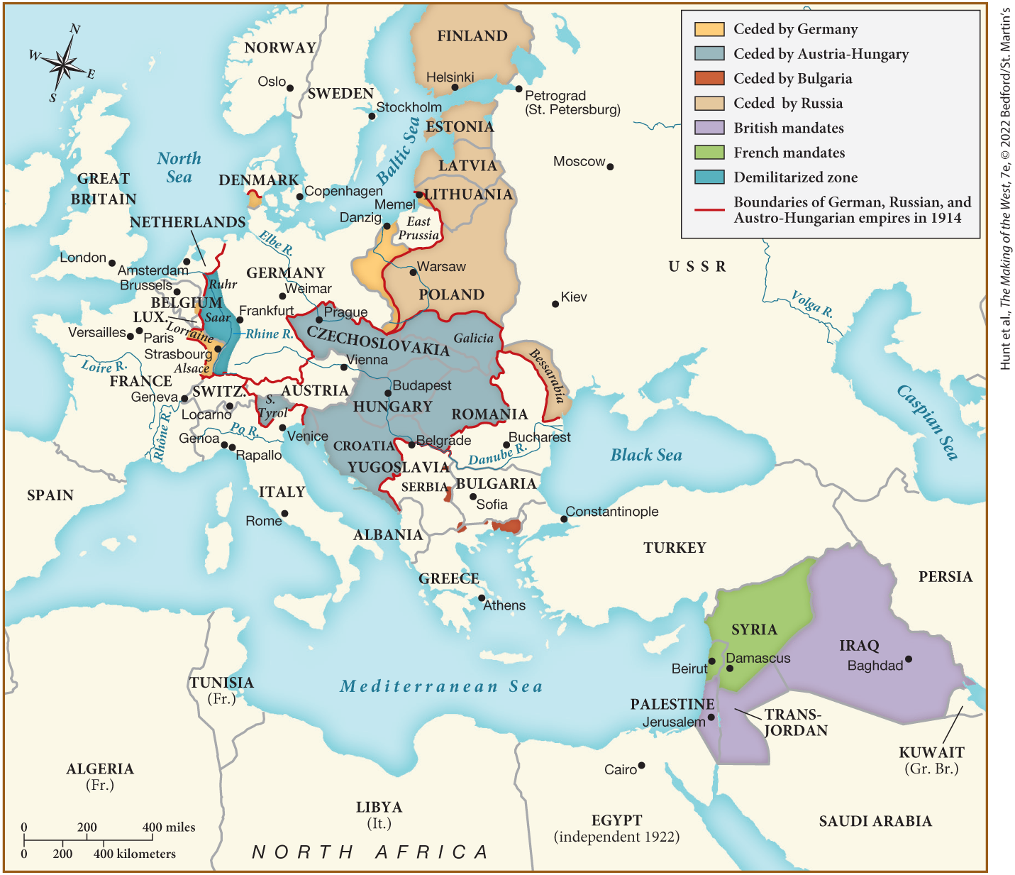
MAP 25.3 Europe and the Middle East after the Peace Settlements of 1919–1920

Slide 36
III. The Search for Peace in an Era of Revolution (6 of 8)
C. Economic and Diplomatic Consequences of the Peace (1 of 3)
  Western leaders concerned about economic recovery and enduring peace
  France was billions of dollars in debt to the United States
  The British worried wanted financial redress to pay war debts to the United States as well
  Germany claimed demand for reparations would further strain its politics
  Germany agrees to payment plan after France occupies parts of the Ruhr
  After Germany defaults on coal deliveries, the French and Belgians send in troops
Notes:
III. The Search for Peace in an Era of Revolution (6 of 8)
C. Economic and Diplomatic Consequences of the Peace (1 of 3)
In the aftermath of World War I, Western leaders were deeply concerned about economic recovery and an enduring peace.
France, the hardest hit by wartime destruction, was billions of dollars in debt to the United States and therefore in dire need of German reparations.
The British worried about maintaining their empire and restoring trade with Germany, but still wanted financial redress to pay war debts to the United States.
Germany claimed that the demand for reparations further strained its already unstable political system, although its dire situation could be traced to the Kaiser’s decision not to raise taxes during the war.
Only after France occupied parts of the Ruhr did Germany agree to a payment plan.
In 1923, after Germany defaulted on coal deliveries, the French and Belgians sent troops into the Ruhr basin.

Slide 37
III. The Search for Peace in an Era of Revolution (7 of 8)
C. Economic and Diplomatic Consequences of the Peace (2 of 3)
  Ruhr citizens refuse to work, German government issues trillions of worthless marks
  Germany suffers from staggering inflation
  The Dawes Plan and Young Plan restored stability by reducing reparation payments and balancing trade
  Inflation and unstable economy in Germany leads many to reject democratic institutions
  Statesmen concluded that lasting peace hinged on disarmament
  At the 1921 Washington Conference, several nations agree to reduce number of battleships
Notes:
III. The Search for Peace in an Era of Revolution (7 of 8)
C. Economic and Diplomatic Consequences of the Peace (2 of 3)
Ruhr citizens refused to work, and the German government issued trillions of worthless marks to support them.
Germany was soon suffering from a staggering inflation that wiped out people’s savings and ruined those individuals living on fixed incomes.
The Dawes Plan (1924) and Young Plan (1929) restored economic stability by reducing reparation payments, restoring the value of German currency, and balancing Germany’s trade between east and west.
Still, inflation and the difficulties of the postwar economy in Germany led many to reject democratic institutions.
Even before the economic question was settled, statesmen concluded that ensuring a lasting peace meant disarmament.
At the 1921 Washington Conference, the United States, Great Britain, Japan, France, and Italy agreed to reduce the number of their existing battleships and cease constructing new ones for ten years.

Slide 38
III. The Search for Peace in an Era of Revolution (8 of 8)
C. Economic and Diplomatic Consequences of the Peace (3 of 3)
  Meeting of the great powers provides Germany a seat in the League of Nations
  Czechoslovakia, Yugoslavia, and Romania form the Little Entente to prevent German expansion
  France becomes allied with the Little Entente and Poland
  Major European powers, Japan, and the United States sign the Kellogg-Briand Pact, condemning international violence
  New openness promised peace, but opened the negotiating process to nationalist demagogues
Notes:
III. The Search for Peace in an Era of Revolution (8 of 8)
C. Economic and Diplomatic Consequences of the Peace (3 of 3)
In 1925, a meeting of the great powers in Locarno, Switzerland, provided Germany a seat in the League of Nations (as of 1926) in return for a promise not to violate the borders of France and Belgium and to keep troops out of the Rhineland.
To prevent German expansion to the east, Czechoslovakia, Yugoslavia, and Romania formed the Little Entente in 1920–1921.
Between 1924 and 1927, France allied itself with the Little Entente and with Poland.
In 1928, the major European powers, Japan, and the United States signed the Kellogg-Briand Pact, which formally condemned international violence. The nations did not, however, commit themselves to concrete action to prevent its outbreak.
The new openness among the great powers suggested a diplomatic revolution and promised a peaceful age. However, open diplomacy also exposed the negotiating process to nationalist demagogues who could rekindle political hatreds.

Slide 39
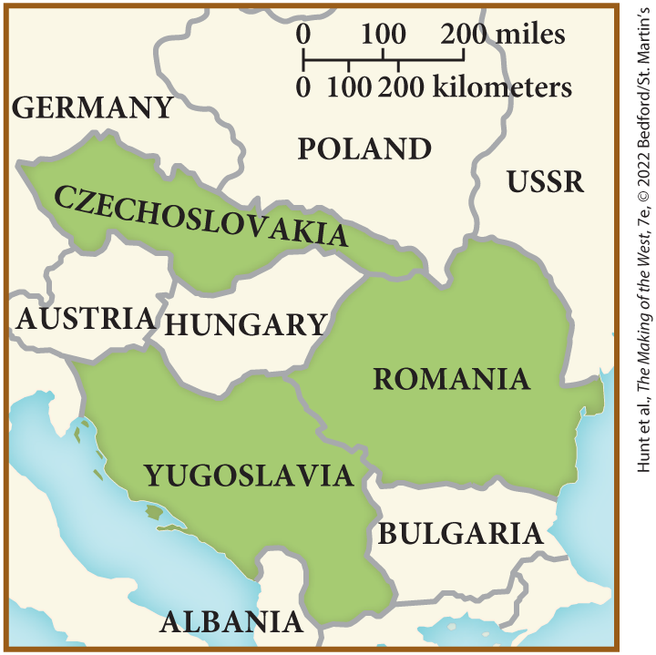
SPOT MAP 25.1 The Little Entente

Slide 40
IV. A Decade of Recovery: Europe in the 1920s (1 of 10)
A. Changes in the Political Landscape (1 of 5)
  Many governments extended the vote to women after the war
  Governments continue to build welfare states
  New governments believe economic equality would contribute to maintaining social stability
  Reemergence of boom and bust cycles make it difficult to move toward economic democracy
  Women lose many of the economic opportunities they had gained
  Unemployment leads some to question government policies
Notes:
IV. A Decade of Recovery: Europe in the 1920s (1 of 10)
A. Changes in the Political Landscape (1 of 5)
After the war, many governments (except France and Italy) extended the vote to women, claiming it was to reward them for their war work.
Governments also continued to build welfare states by expanding insurance programs for workers and payments to families with dependent children.
New governments believed that economic democracy — more evenly distributed wealth — would contribute to maintaining social stability.
The reemergence of cycles of boom and bust made it difficult to maintain the trend toward economic democracy. A short postwar boom gave way to a severe economic downturn in 1920.
Women in particular lost many of the economic opportunities they had gained by the mid-1920s.
Skyrocketing unemployment led some to question governmental policies.

Slide 41
IV. A Decade of Recovery: Europe in the 1920s (2 of 10)
A. Changes in the Political Landscape (2 of 5)
  Refugee and migration crises corrode the new republics of eastern Europe
  Poland reunification occurs without support from the Allies, forming a constitution that professed equal rights for all ethnic and religious groups
  Economic conditions make work difficult for Poland’s Sejm (parliament)
  Strikes and violence lead to a coup by former military leader Jozef Pilsudski
  Contempt for parliamentary politics becomes widespread in Germany, right-wing parties favor violence rather than consensus building
  Support for the far right comes from wealthy landowners, white-collar workers, and members of the lower and middle classes hurt by inflation
Notes:
IV. A Decade of Recovery: Europe in the 1920s (2 of 10)
A. Changes in the Political Landscape (2 of 5)
Hard times corroded the new republics of eastern Europe, especially because of refugee and migration crises and because none but Czechoslovakia had a mature industrial sector.
Poland exemplified the postwar political landscape in Eastern Europe. Polish reunification occurred without a common currency, political structure, or language, and with virtually no support from the Allies, economic or otherwise. Nevertheless, a government was formed under a constitution that professed equal rights for all ethnic and religious groups.
Economic conditions made it difficult for the Sejm (parliament) to redistribute large estates to the peasantry, and urban workers were worse off than other laborers across Europe.
Strikes and violence began in 1922, and the inability of coalition governments to bring about economic prosperity led to a coup (1926) by former military leader Jozef Pilsudski (1867–1935).
In Germany, although the economy had improved, political life remained precarious because so many people felt nostalgia for the empire and associated defeat with the new Weimar Republic. Contempt for parliamentary politics was widespread, and right-wing parties favored violence rather than consensus building.
Support for the far right came from wealthy landowners and businessmen, white-collar workers whose standard of living had declined during the war, and members of the lower and middle classes hurt by inflation.

Slide 42
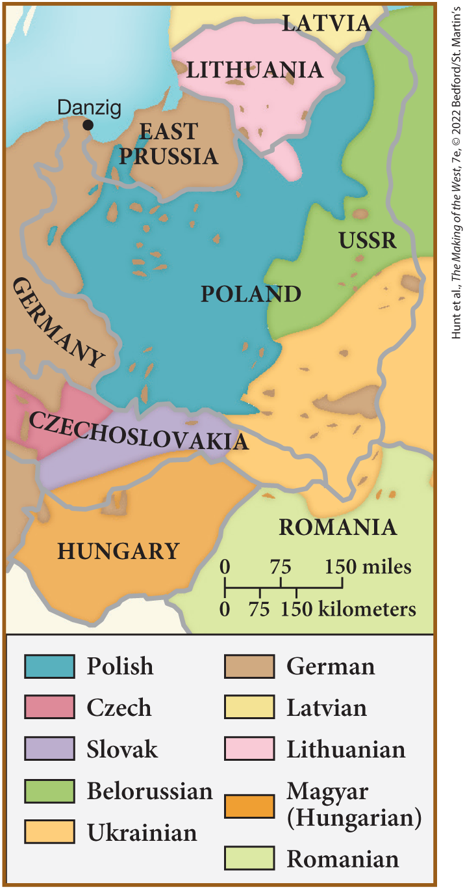
SPOT MAP 25.2 National Minorities in Postwar Poland

Slide 43
IV. A Decade of Recovery: Europe in the 1920s (3 of 10)
A. Changes in the Political Landscape (3 of 5)
  The Brown Shirts, led by Adolf Hitler, launch a failed coup in Munich
  Hitler spends less than a year in jail, co-conspirator Erich Ludendorff acquitted
  Right-wing parties have less influence in France and Britain
  Politicians form coalitions to rally support for reconstruction and the pursuit of reparations
  French parliament also focuses on increasing the birthrate
  In Britain, first Labour prime minister Ramsay MacDonald is elected
Notes:
IV. A Decade of Recovery: Europe in the 1920s (3 of 10)
A. Changes in the Political Landscape (3 of 5)
Bands of disaffected youths and veterans proliferated. One group, the Brown Shirts, led by Adolf Hitler (1889–1945), participated in a failed coup in Munich in 1923 (The Beer Hall Putsch).
Hitler spent less than a year in jail, while his co-conspirator, Erich Ludendorff (1865–1937), was acquitted. He became a national hero to many.
In France and Britain, right-wing parties had less of an effect because parliamentary politics were better established and the upper classes were not plotting to restore an authoritarian monarchy.
Politicians in France formed coalitions to rally support for reconstruction and the pursuit of reparations.
The French parliament also focused on increasing the birthrate, making the distribution of birth-control information illegal and abortion a severely punished crime.
In Britain, the election of the first Labour prime minister, Ramsay MacDonald, in 1924 was a sign of the growing political ambitions of the working class.

Slide 44
IV. A Decade of Recovery: Europe in the 1920s (4 of 10)
A. Changes in the Political Landscape (4 of 5)
  British workers conduct a nine-day general strike to protest poor conditions
  Middle-class resist the strike by joining up to replace workers
  Republican leaders announce Ireland’s independence from Britain and established a separate parliament, British refuse to recognize this
  Public outrage forces the British to negotiate a treaty with the Irish
  The settlement left a great deal of bitterness, violence in Ireland persisted
  European powers encounter rebellion in overseas colonies
Notes:
IV. A Decade of Recovery: Europe in the 1920s (4 of 10)
A. Changes in the Political Landscape (4 of 5)
Much of British industry was obsolete or in poor condition, as in the ailing coal industry. In May 1926, workers conducted a nine-day general strike against wage cuts and dangerous conditions in the mines.
The strike provoked unprecedented middle-class resistance, with individuals from all walks of life stepping in to drive trains, work on docks, and replace workers in other sorts of jobs.
Ireland also continued to be a problem. In January 1919, republican leaders announced Ireland’s independence from Britain and established a separate parliament. The British refused to recognize the parliament and sent in a volunteer army — the Black and Tans — who waged guerrilla warfare in Ireland.
By 1921, public outrage forced the British to negotiate. A treaty created the Irish Free State, a self-governing dominion owing an oath of allegiance to the British crown.
Ulster (Northern Ireland), a group of six northern counties, was self-governing but had representation in the British Parliament. The settlement left a great deal of bitterness, and violence in Ireland persisted.
European powers also encountered rebellion in overseas colonies, as colonized peoples who had served in the war expected increased rights, if not outright independence.

Slide 45
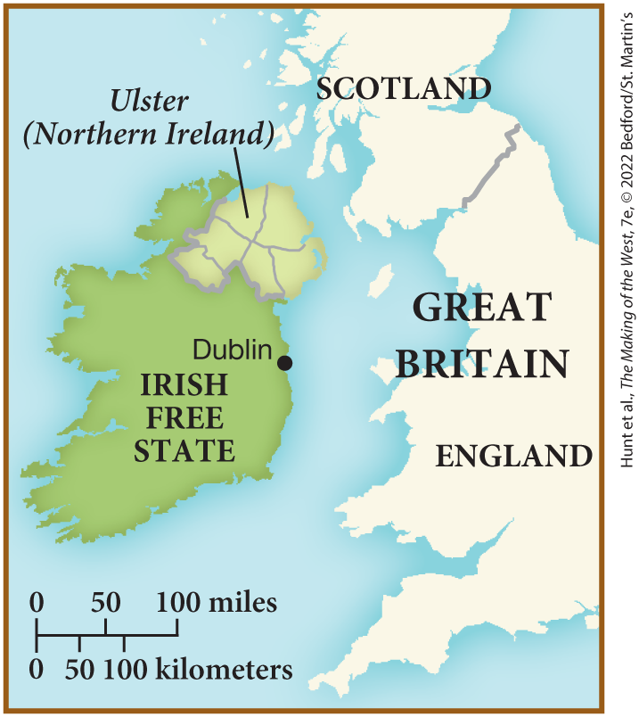
SPOT MAP 25.3 The Irish Free State and Ulster, 1921

Slide 46
IV. A Decade of Recovery: Europe in the 1920s (5 of 10)
A. Changes in the Political Landscape (5 of 5)
  The British massacre protesters at Amritsar, India, and put down revolts in Egypt and Iran
  The Dutch jail political leaders in Indonesia, while the French punished Indochinese nationalists
  Declining prestige abroad would feed antidemocratic forces at home for European powers
  In the 1920s, overseas enterprise was profitable, many colonial goods widely consumed
  Japanese power expanded postwar, but Japan resented its treatment in peace talks
Notes:
IV. A Decade of Recovery: Europe in the 1920s (5 of 10)
A. Changes in the Political Landscape (5 of 5)
The British massacred protesters at Amritsar, India, in 1919, and put down revolts against the mandate system in Egypt and Iran in the early 1920s.
The Dutch jailed political leaders in Indonesia, while the French punished Indochinese nationalists.
Europeans wanted to hold on to their empires because any hint of declining prestige abroad would feed antidemocratic forces at home.
Despite challenges, the 1920s was in many ways the high tide of European imperialism. Overseas enterprise was profitable, and many colonial goods became widely consumed in the West.
Japanese economic and imperial power expanded during and after the war, but Japan resented its treatment in the crafting of the peace and in postwar naval conferences.

Slide 47
IV. A Decade of Recovery: Europe in the 1920s (6 of 10)
B. Reconstructing the Economy (1 of 2)
  European economy lost many international markets to other countries, but the war forced efficient manufacturing
  Mergers and the formation of cartels continued after the war
  By the late 1920s, Europe was enjoying economic prosperity
  United States leads world in modernization
  Scientific management aimed to increase productivity by improving processes
Notes:
IV. A Decade of Recovery: Europe in the 1920s (6 of 10)
B. Reconstructing the Economy (1 of 2)
Although the European economy had lost many of its international markets to other countries, including the United States and Japan, the war forced manufacturing to become more efficient.
Mergers and the formation of cartels continued after the war, and owners of large manufacturing conglomerates wielded extensive financial and political power.
By the late 1920s, Europe was enjoying economic prosperity.
The United States was the trendsetter in modernization.
Scientific management also aimed to increase productivity by ridding the work process of superfluous movements.

Slide 48
IV. A Decade of Recovery: Europe in the 1920s (7 of 10)
B. Reconstructing the Economy (2 of 2)
  European industrialists balanced Frederick Taylor’s management methods with a belief in leisure time
  Many workers felt emphasis on efficiency turned them into automatons
  Power of management expanded during the war and continued to do so afterward
  Union bureaucracy also continued to expand its influence after the war
Notes:
IV. A Decade of Recovery: Europe in the 1920s (7 of 10)
B. Reconstructing the Economy (2 of 2)
European industrialists balanced this focus on Frederick Taylor’s management methods with a belief that workers also needed time for leisure.
However, many workers felt that the emphasis on efficiency turned them into human automatons.
Management expanded during the war and continued to do so afterward, but workers were perceived as uncreative and lacking in innovation, and women received lower wages to stem male competition.
Union bureaucracy also continued to expand after the war, with unions mobilizing masses of people and playing a key role in mass politics.

Slide 49
IV. A Decade of Recovery: Europe in the 1920s (8 of 10)
C. Restoring Society (1 of 3)
  Many returning veterans were hostile toward civilians
  Veterans returned to a world different from the one they left
  Some British suffragists began to embrace the idea of separate spheres for men and women
  Class distinctions become blurred during and after the war
  Returning veterans struggled with postwar life
Notes:
IV. A Decade of Recovery: Europe in the 1920s (8 of 10)
C. Restoring Society (1 of 3)
Many returning veterans were hostile toward civilians who, they believed, had complained about wartime conditions instead of patriotically and stoically enduring them.
Veterans returned to a world markedly different from the one they left to serve in the war.
Many women felt alienated from returning veterans, and some British suffragists began to embrace the idea of separate spheres for men and women.
The war blurred class distinctions, allowing many commoners to move into the aristocracy and leading to an emphasis on the equality of death in service.
Returning veterans sometimes had trouble getting jobs, and many found their wives and sweethearts had abandoned them.

Slide 50
IV. A Decade of Recovery: Europe in the 1920s (9 of 10)
C. Restoring Society (2 of 3)
  Governments worked to reintegrate veterans
  They created many social programs to stabilize veterans
  War dissolved many middle-class conventions, many became more open about sexuality
  Authors such as Theodor van de Velde discussed sexuality within the context of marriage
  Male sexual prowess examined by D. H. Lawrence and Ernest Hemingway
Notes:
IV. A Decade of Recovery: Europe in the 1920s (9 of 10)
C. Restoring Society (2 of 3)
Governments wanted to reintegrate veterans so as to avoid the spread of communism.
They created programs granting pension plans for veterans, stipends for war widows, benefits for unemployed men, and housing for veterans.
Despite governmental efforts to restore traditional family values, war had dissolved many middle-class conventions. Freer, more open discussions of sex and sexuality occurred, and unmarried men and women now socialized without chaperones.
Still, most discussions of sexuality placed it within the context of marriage, where greater attention to sexual pleasure was advocated by authors such as Theodor van de Velde (1873–1937) in his 1927 Ideal Marriage: Its Physiology and Technique.
Male sexual prowess was examined by D. H. Lawrence (1885–1930) in Women in Love (1920) and Ernest Hemingway (1899–1961) in The Sun Also Rises (1926).

Slide 51
IV. A Decade of Recovery: Europe in the 1920s (10 of 10)
C. Restoring Society (3 of 3)
  Greater attention was paid to physical appearance and hygiene
  Exercise becomes more important because of focus on health, need for a physically fit workforce
  People could buy more consumer goods as economy recovered
  Installment plans allowed for modern conveniences
  Housework became more mechanized, and family intimacy revolved around technology
Notes:
IV. A Decade of Recovery: Europe in the 1920s (10 of 10)
C. Restoring Society (3 of 3)
As images of men and women changed, greater attention was paid to physical appearance and hygiene. Ordinary women began “painting” their faces — something only prostitutes had done previously, and a multibillion-dollar cosmetics industry emerged.
Exercise also became more important because the consumer focus on personal health coincided with modern industry’s need for a physically fit workforce.
As prosperity returned, people could buy more consumer goods.
Modern conveniences became standard household items, sometimes purchased on the new installment plans that were popularized in the 1920s.
Housework became more mechanized, and family intimacy came to revolve around radios, phonographs, and automobiles.

Slide 52
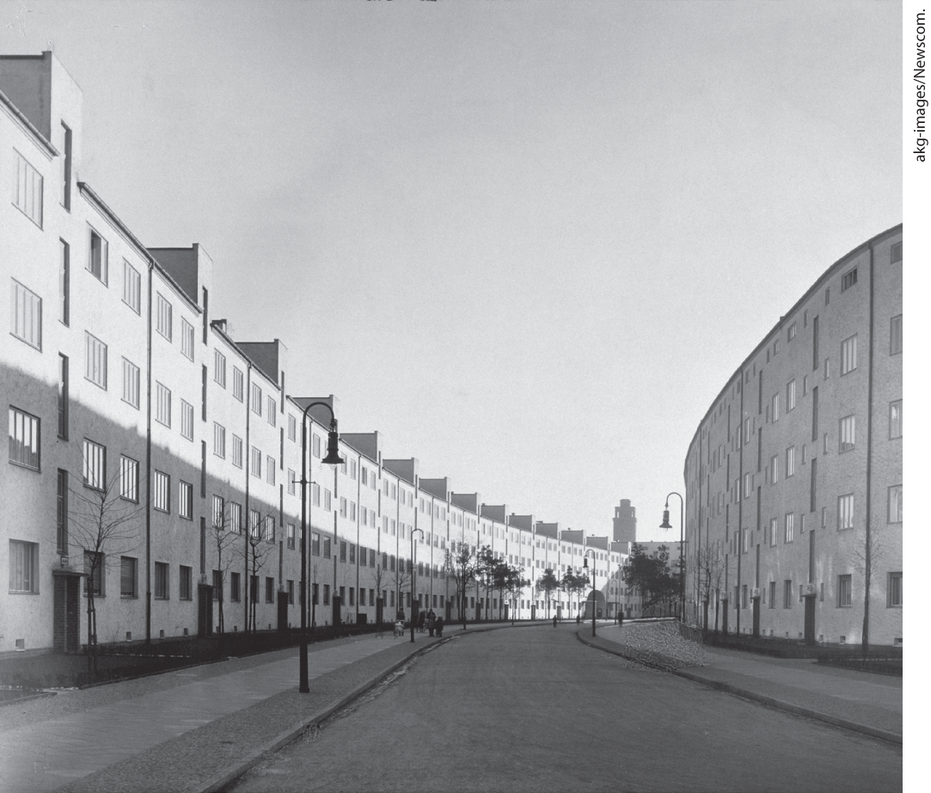
Modern Housing for the Berlin Working Class

Slide 53
V. Mass Culture and the Rise of Modern Dictators (1 of 10)
A. Culture for the Masses
  Radio, film, and newspapers expand the influence of technology
  Sales of practical nonfiction books soar
  The business of filmmaking creates international celebrities
  Films incorporate familiar elements from everyday life
  Movies attract millions of weekly viewers
  Filmmakers touched upon postwar fantasies and fears, such as the German film The Cabinet of Dr. Caligari
  Radio broadcasts gain in popularity and are used as a powerful tool for politicians
Notes:
V. Mass Culture and the Rise of Modern Dictators (1 of 10)
A. Culture for the Masses
The instruments of mass culture — primarily radio, film, and newspapers — expanded the influence of technology in the 1920s.
Bulletins from the battlefront had whetted the public’s appetite for new, real-life stories, and sales of practical nonfiction books soared.
In the 1920s, filmmaking became an international business, with a star system that turned film personalities into international celebrities. Films of literary works and historical events fostered a common consciousness and were sometimes sponsored by governments.
Films incorporated familiar elements from everyday life: the piano accompaniment for silent films was derived from music halls and familiar classical compositions, while comic characters, farcical plots, and slapstick humor had their origins in street or burlesque shows.
Movies attracted some one hundred million weekly viewers, the majority of them women, and crossed national borders easily.
Filmmakers touched upon postwar fantasies and fears. The German film The Cabinet of Dr. Caligari (1919) depicted events and inmates in an insane asylum as symbols of state power.
Radio broadcasts also gained in popularity. In the first half of the 1920s, mass audiences listened to radio broadcasts in public halls, but when radio receivers became inexpensive, people could listen to the broadcasts in their homes. By the 1930s, radio was used as a powerful tool for politicians.

Slide 54
V. Mass Culture and the Rise of Modern Dictators (2 of 10)
B. Cultural Debates over the Future (1 of 3)
  Many cultural leaders strived for a utopian future with little connection to the past
  German artists such as Käthe Kollwitz portrayed particularly bleak and violent subjects
  Some become interested in non-Western cultural forms
  The paintings of George Grosz paintings depict maimed soldiers and brutally murdered women
  Dadaists produced works punctuated by nonsense and expressions of alienation
  Portrayals of everyday life flourished in theaters and reinforced the veterans’ beliefs in civilian decadence
Notes:
V. Mass Culture and the Rise of Modern Dictators (2 of 10)
B. Cultural Debates over the Future (1 of 3)
Many cultural leaders were obsessed by the horrendous experiences of war or hoped for a utopian future with little connection to the past.
German artists were particularly bleak and violent. Käthe Kollwitz (1867–1945) portrayed heart-wrenching, antiwar images of bereaved parents and starving children.
Some became interested in non-Western cultural forms, such as Asian philosophies and religions.
George Grosz (1893–1959) joined Dada, an artistic and literary movement that had emerged during World War I. His paintings and political cartoons depicted maimed soldiers and brutally murdered women.
Dadaists produced works punctuated by nonsense, incongruity, and shrieking expressions of alienation.
Portrayals of seedy scenes from everyday life flourished in theaters and reinforced the veterans’ beliefs in civilian decadence.

Slide 55
V. Mass Culture and the Rise of Modern Dictators (3 of 10)
B. Cultural Debates over the Future (2 of 3)
  Popular writers such as Ernst Jünger in Germany glorified life in the trenches and called for the militarization of society
  Erich Maria Remarque’s All Quiet on the Western Front was a powerful antiwar statement
  Poets throughout Europe reflected on postwar conditions, dystopian fiction became a popular theme
  Franz Kafka depicted the world as an impersonal machine in novels such as The Trial and The Castle
  Writers such as James Joyce and Virginia Woolf focused on the power of memories and sensations
  Other artists looked to the future and technology
Notes:
V. Mass Culture and the Rise of Modern Dictators (3 of 10)
B. Cultural Debates over the Future (2 of 3)
A controversy erupted in postwar Germany over what the proper attitude should be toward the war, as popular writers such as Ernst Jünger (1895–1998) glorified life in the trenches and called for the militarization of society.
On other the side of the controversy, Erich Maria Remarque’s (1898–1970) All Quiet on the Western Front (1928) was a powerful antiwar statement.
Poets throughout Europe also reflected on postwar conditions, often using innovative styles. In the arts, dystopia, a utopian fantasy turned upside down, became an important theme.
Franz Kafka (1883–1924) depicted the world as a vast, impersonal machine in novels such as The Trial (1925) and The Castle (1926).
James Joyce (1882–1941) and Virginia Woolf (1882–1941) also focused on the interior life and the power of memories and sensations in Ulysses (1922) and Mrs. Dalloway (1925), respectively.
Other artists looked to the future and celebrated the promise of technology.

Slide 56
V. Mass Culture and the Rise of Modern Dictators (4 of 10)
B. Cultural Debates over the Future (3 of 3)
  Large collectives, such as the Bauhaus created streamlined office buildings and functional objects
  Russian artists created works about industry
  Artists were drawn to the modernity of United States
  African American performers such as Josephine Baker and Louis Armstrong became international sensations
Notes:
V. Mass Culture and the Rise of Modern Dictators (4 of 10)
B. Cultural Debates over the Future (3 of 3)
Many worked in large collectives, such as the Bauhaus. This group of German artists created streamlined office buildings and designed functional furniture, utensils, and decorative objects.
Russian artists optimistically wrote novels about cement factories and created ballets about steel.
Artists, fascinated by technology and machinery, were drawn to the United States, the most modern of all countries, and were especially attracted to jazz.
African American performers such as Josephine Baker (1906–1975) and Louis Armstrong (1901–1971) became international sensations.

Slide 57
V. Mass Culture and the Rise of Modern Dictators (5 of 10)
C. The Communist Utopia (1 of 3)
  Communism promised a utopia, but the rule of Bolsheviks became increasingly ruthless and authoritarian
  Peasant bands called Green Armies revolted against communism
  Industrial production stood at only 13 percent of its prior output
  Housing shortages affected all, refugees clogged cities and roamed the countryside
  Workers revolted, and though the Bolsheviks had many rebels shot, Lenin realized reform was needed
  Lenin institutes the New Economic Policy (NEP), which returned portions of the economy to the free market
Notes:
C. The Communist Utopia (1 of 3)
Communism promised a modern, technological culture and a shining future. But Bolsheviks encountered significant obstacles to consolidating their rule and became increasingly ruthless and authoritarian.
In the early 1920s, peasant bands called Green Armies revolted against war communism.
Further, industrial production stood at only 13 percent of its prewar output.
Housing shortages affected the entire population, and refugees clogged the cities and roamed the countryside.
In the early spring of 1921, workers in Petrograd and seamen at the naval base at Kronstadt revolted, calling for “soviets without Communists.” The Bolsheviks had many of the rebels shot, but the rebellion did force Lenin to realize that reform was needed.
He instituted the New Economic Policy (NEP), which returned portions of the economy to the free market; consumer goods and more food soon became available. This change led to the rise of “NEPmen” who lived in splendid homes and practiced conspicuous consumption.

Slide 58
V. Mass Culture and the Rise of Modern Dictators (6 of 10)
C. The Communist Utopia (2 of 3)
  Protest erupted among the Communists, Lenin responded by setting up procedures for purging dissidents
  Bolshevik leaders attempted to create a cultural revolution
  They also made birth control readily available, Aleksandra Kollontai promoted birth-control education and day-care programs
  Hygiene and efficiency became the focus of a swelling bureaucracy
  The Zhenotdel (Women’s Bureau) sought to educate the masses
  Officials promote the use of American methods to increase efficiency
Notes:
V. Mass Culture and the Rise of Modern Dictators (6 of 10)
C. The Communist Utopia (2 of 3)
Protest over this change erupted among the Communists, and Lenin responded by setting up procedures for purging dissidents.
Bolshevik leaders also attempted to create a cultural revolution, setting up classes in the countryside on various social and political subjects.
They also made birth control, abortion, and divorce readily available, and Aleksandra Kollontai (1872–1952) promoted birth-control education and day-care programs.
Hygiene and efficiency became the focus of a swelling bureaucracy.
The Zhenotdel (Women’s Bureau) sought to educate the masses about the changes taking place.
Officials promoted the use of American methods in the factories, the army, the arts, and everyday life to increase efficiency.

Slide 59
V. Mass Culture and the Rise of Modern Dictators (7 of 10)
C. The Communist Utopia (3 of 3)
  Government agency Proletkult aim to develop proletarian culture
  Russian artists experimented with blending high art and mass culture
  Many resisted the reshaping of culture as Bolshevik policies undermined traditional ways of life
  Lenin suffered a debilitating stroke and died two years later, prompting congress to declare the day of his death a permanent holiday
  General secretary of the Communist Party, Joseph Stalin, led the deification of Lenin
  Stalin also discredited Trotsky and expanded the Communist Party to achieve a dictatorship
Notes:
V. Mass Culture and the Rise of Modern Dictators (7 of 10)
C. The Communist Utopia (3 of 3)
The government agency Proletkult aimed at developing proletarian culture.
Russian artists experimented with blending high art, technology, and mass culture
Many resisted the reshaping of culture to “modern” or “Western” standards, as Bolshevik policies undermined traditional ways of life and belief systems and provoked resistance, particularly from peasants and in Islamic regions of central Asia.
Lenin suffered a debilitating stroke in 1922 and died in 1924. The party congress declared the day of his death a permanent holiday, his funeral was celebrated with elaborate pomp, and no one was allowed to criticize anything associated with his name.
The general secretary of the Communist Party, Joseph Stalin (1879–1953), led the deification of Lenin.
Despite Lenin’s misgivings about him, Stalin also discredited his chief rival, Trotsky, and expanded the Communist Party so as to achieve a virtually complete dictatorship by 1928–1929.

Slide 60
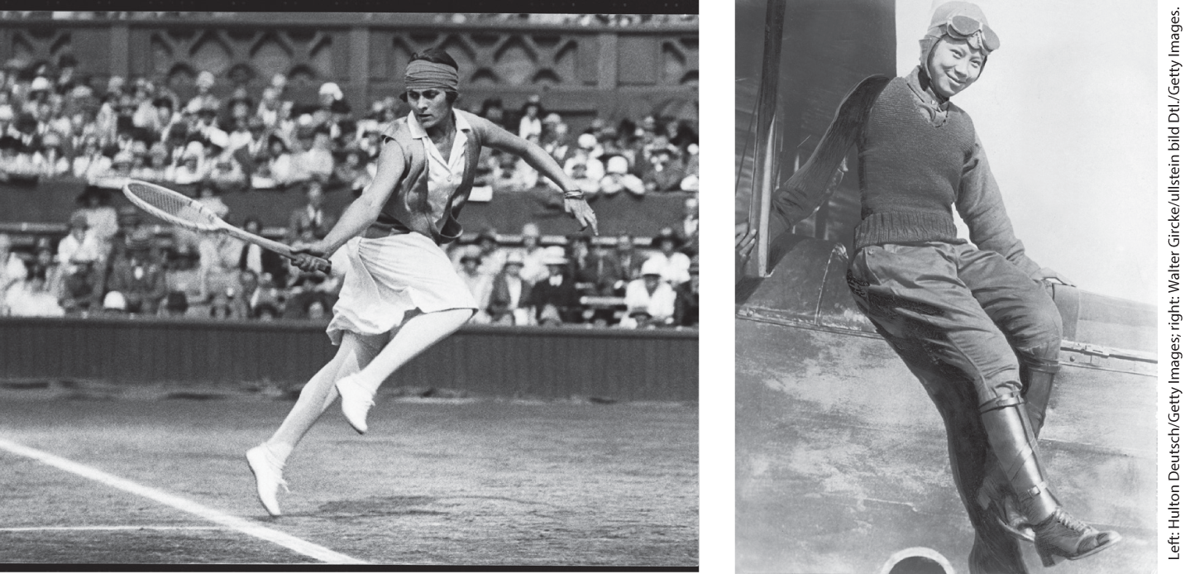
The “Modern Girl” aka the Flapper

Slide 61
V. Mass Culture and the Rise of Modern Dictators (8 of 10)
D. Fascism on the March in Italy (1 of 3)
  Discontent in Italy began when the Allies refused to honor their promises
  Peasants protested their serf-like status, workers seized factories
  Many Italians blamed parliament for their problems
  Benito Mussolini built a personal army of veterans and unemployed men called the “Black Shirts”
  Mussolini’s supporters staged a march to Rome and threatened a coup, King Victor Emmanuel III invites Mussolini to become prime minister
  Fascist movement attracts many who opposed socialism and parliament
Notes:
V. Mass Culture and the Rise of Modern Dictators (8 of 10)
D. Fascism on the March in Italy (1 of 3)
Postwar discontent in Italy began when the Allies refused to honor the promises made in the Treaty of London (1915).
To make matters worse, peasants, who had made great sacrifices during the war, protested their serf-like status, and workers seized factories to draw attention to their economic plight.
Many Italians blamed parliament for their problems.
In the midst of this chaos, Benito Mussolini (1883–1945), a socialist journalist who joined the radical right, built a personal army of veterans and unemployed men called the “Black Shirts,” which many Italians backed.
In 1922, Mussolini’s supporters, known as Fascists, staged a march to Rome and threatened a coup. To save his throne, King Victor Emmanuel III (r. 1900–1946) “invited” Mussolini to become prime minister.
The Fascist movement attracted many who opposed socialism and parliament and who felt cheated by the postwar settlement. Mussolini promised a restoration of men’s warrior status.

Slide 62
V. Mass Culture and the Rise of Modern Dictators (9 of 10)
D. Fascism on the March in Italy (2 of 3)
  Mussolini places himself at the head of governmental departments, uses force to silence opponents
  Despite this, many see Black Shirts as restorers of order
  Landowners and businessmen approve of the Fascists and support them financially
  Mussolini uses mass propaganda and the media to gain support
  Mussolini recognizes the importance of traditional values, signs the Lateran Agreement recognizing the Vatican as a state
Notes:
V. Mass Culture and the Rise of Modern Dictators (9 of 10)
D. Fascism on the March in Italy (2 of 3)
Mussolini placed himself at the head of governmental departments, made criticism of the state a criminal offense, and used force — even murder — to silence his opponents.
Despite this brutality, many saw his Black Shirts as restorers of order.
Large landowners and businessmen approved the tough tactics the Fascists had taken against socialists and supported them financially.
Mussolini used mass propaganda and the media to gain support, while hiring the unemployed to work for the state or on massive building projects.
Mussolini recognized the importance of maintaining traditional values, signing the Lateran Agreement with the Vatican (1929), which recognized the Vatican as a state under papal sovereignty and the church’s right to determine family doctrine and to assume a role in education.

Slide 63
V. Mass Culture and the Rise of Modern Dictators (10 of 10)
D. Fascism on the March in Italy (3 of 3)
  Mussolini also introduces the “corporatist” state that denied individual rights in favor of duty to the state.
  Mussolini gains favor by reducing women’s wages and barring them from certain professions
  Mussolini had many admirers, including Adolf Hitler, who had built the National Socialist German Workers’ Party
  During his brief imprisonment, Hitler writes his political plan, Mein Kampf
  The austere conditions that allowed Mussolini’s rise to power no longer existed in Germany by the late 1920s
Notes:
V. Mass Culture and the Rise of Modern Dictators (10 of 10)
D. Fascism on the March in Italy (3 of 3)
Mussolini also introduced the “corporatist” state that denied individual rights in favor of duty to the state, organizing employers, workers, and professionals into groups that could settle grievances through state-controlled channels.
Mussolini also gained favor by reducing women’s wages and barring them from certain professions.
Mussolini had many admirers, including Adolf Hitler, who had been occupied during the 1920s with building a paramilitary group and a political organization called the National Socialist German Workers’ Party (Nazis).
During his brief imprisonment, after a failed coup, Hitler wrote Mein Kampf (1925), a political plan calling for vicious anti-Semitism and political manipulation of the masses.
But, to Hitler’s chagrin, the austere conditions that had allowed Mussolini’s rise to power in 1922 no longer existed in Germany by the late 1920s. The Weimar government was actually functioning better as the decade wore on.

Slide 64
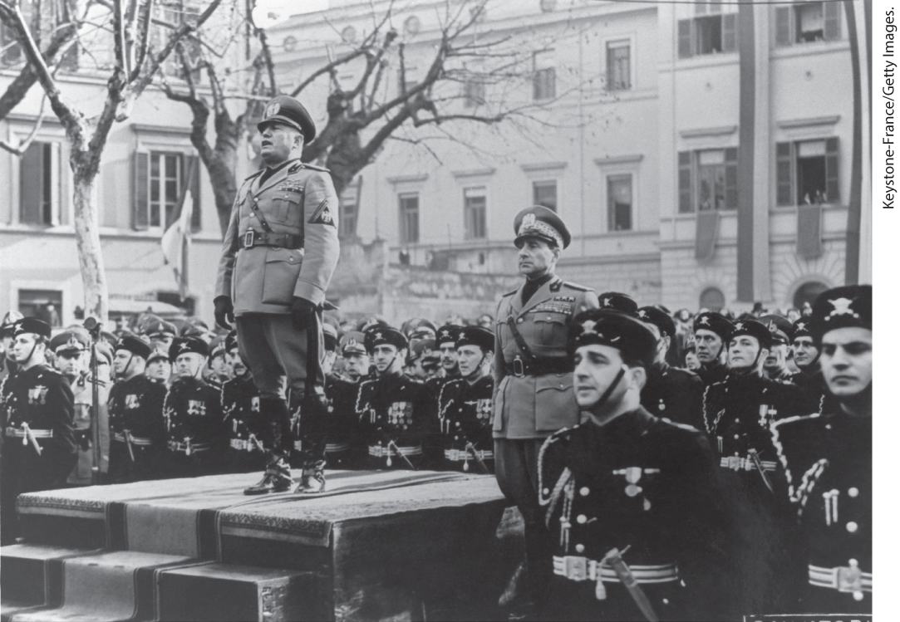
Mussolini and the Black Shirts

Slide 65
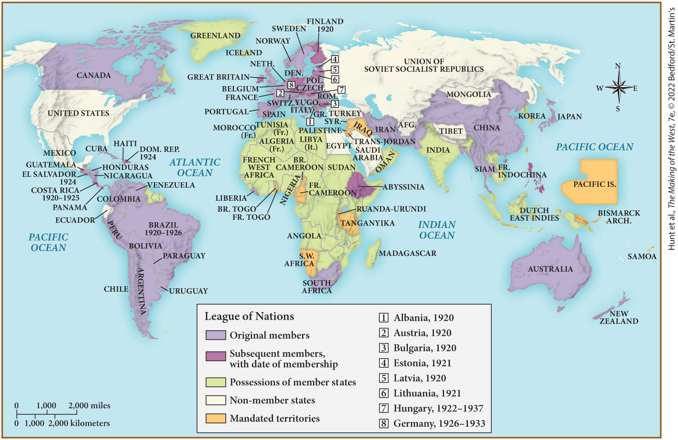
MAP 25.4 Mapping the West: Europe and the World in 1929

