Slide 1
The Making of the West
Seventh Edition
Hunt • Martin • Rosenwein • Smith
CHAPTER 24
Modernity and the Road to War
1890 –1914
Copyright © 2022 by Bedford/St. Martin’s
Distributed by Bedford/St. Martin’s/Macmillan Learning strictly for use with its products. Not for redistribution.

Slide 2

Edvard Munch, The Scream (1893)

Slide 3
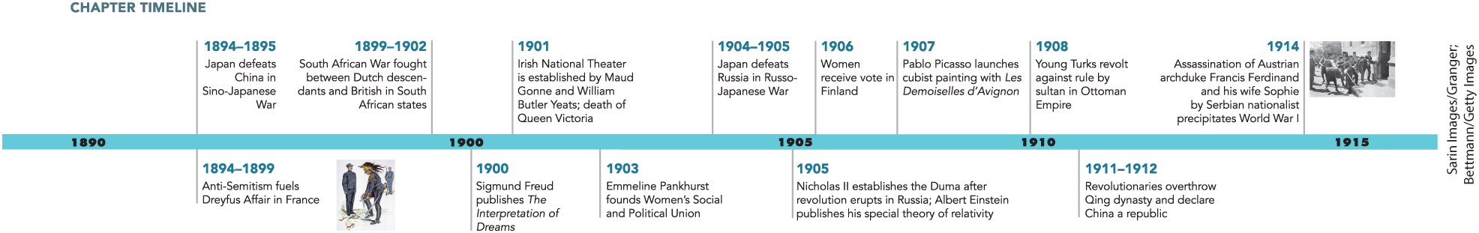
Chapter 24 Timeline

Slide 4
I. Public Debate over Private Life (1 of 7)
A. Population Pressure (1 of 2)
  Improvements in sanitation and public health cause population increase to continue
  Despite this, birthrate decreases in France, other countries
  People begin choosing to limit births on their own
  Diaphragms and condoms become reliable methods of birth control
Notes:
I. Public Debate over Private Life (1 of 7)
A. Population Pressure (1 of 2)
The staggering population increase of the eighteenth century continued through the nineteenth century due to improvements in sanitation and public health that extended longevity and reduced infant mortality.
However, despite an absolute rise in the population in much of the West, the birthrate (births per thousand people), which had been decreasing in France since the eighteenth century, began declining in other countries as well.
As society industrialized, individuals began making the decision to limit births on their own, often practicing coitus interruptus (the withdrawal method).
In the 1840s, the development of the vulcanization process for rubber made diaphragms and condoms fairly reliable methods of birth control.

Slide 5
I. Public Debate over Private Life (2 of 7)
A. Population Pressure (2 of 2)
  Abortion also common
  Government becomes concerned declining birthrates would reduce military power
  Some fear declining birthrate among middle and upper classes would lead to social decay
  Many fear European populations would be overrun by foreigners
Notes:
I. Public Debate over Private Life (2 of 7)
A. Population Pressure (2 of 2)
Abortion was also common.
Government officials and concerned citizens worried that declining birthrates would result in an inability to compete militarily with other European powers.
Activists and politicians feared that a declining birthrate among the middle and upper classes would lead to social decay as those from the “worst” classes would outnumber those from the “better” classes.
Nationalism and racism also played a role because many feared that the declining birthrate would cause western European populations to be overrun by foreigners such as Slavs and Jews.

Slide 6
I. Public Debate over Private Life (3 of 7)
B. Reforming Marriage (1 of 2)
  Eugenics grows in popularity
  Some call for marriage reform
  Many economic and legal reasons why women limited their fertility
  Women gain legal rights to wages, property in Europe
Notes:
I. Public Debate over Private Life (3 of 7)
B. Reforming Marriage (1 of 2)
Eugenics grew in popularity as eugenicists advocated increasing the fertility of the “fittest” and limiting the fertility of, or even sterilizing, “degenerates.”
Some believed that the answer to the population problem resided in marriage reform.
The inability of women to control their wages and property, the complications and costs of divorce where permitted, and women’s lack of legal control over their children were cited as reasons why women limited their fertility.
In response to such complaints, and the pressure for reform exerted by feminists, women gained legal rights to their wages and their property in much of Europe.

Slide 7
I. Public Debate over Private Life (4 of 7)
B. Reforming Marriage (2 of 2)
  Some countries legalize divorce
  Several countries pass laws providing assistance to lower class mothers
  Concern for population lays foundation for modern welfare state
  Reform more rapid in western Europe
Notes:
I. Public Debate over Private Life (4 of 7)
B. Reforming Marriage (2 of 2)
Some countries legalized divorce and made it easier and cheaper to obtain.
By the early twentieth century, several countries had passed legislation that provided government subsidies to assist mothers among the lower classes.
The concern for population laid the foundation for the modern welfare state that would be concerned not just with war and diplomacy, but also with the everyday life of its citizens.
The extent of change in women’s lives varied widely, but reform was more rapid in western Europe.

Slide 8
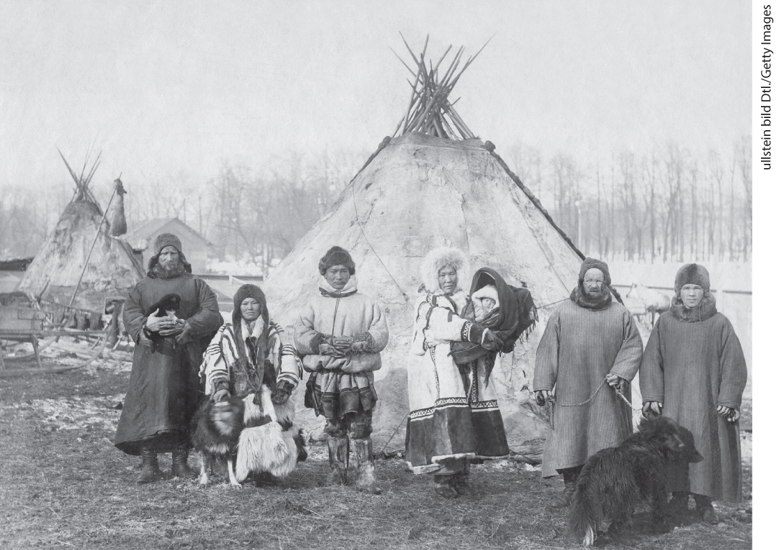
Environment Matters: Samoed Family of Russia

Slide 9
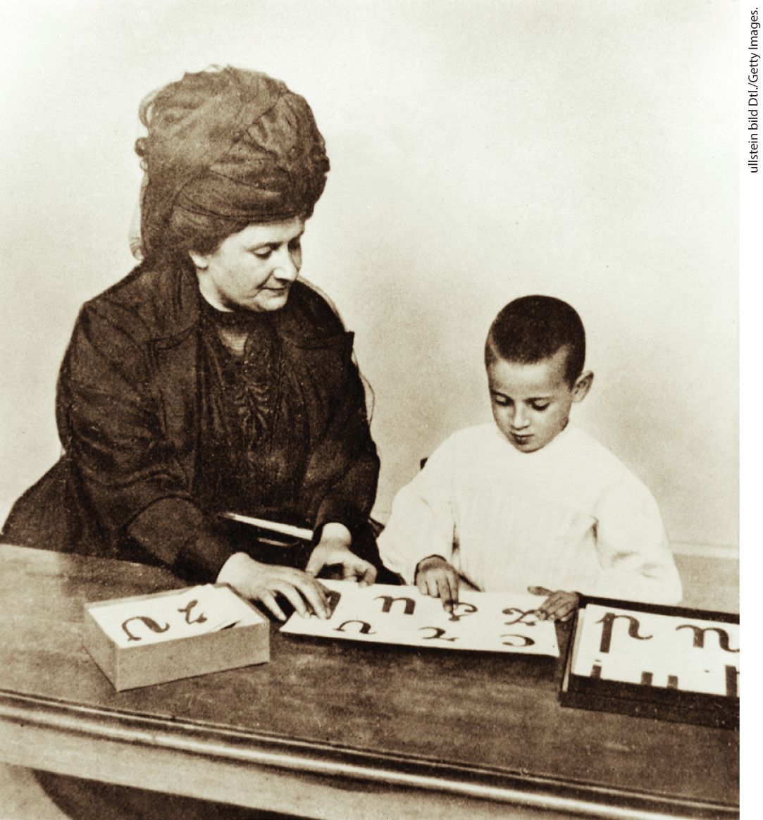
Maria Montessori

Slide 10
I. Public Debate over Private Life (5 of 7)
C. New Women, New Men, and the Politics of Sexual Identity
  Better job opportunities allow women to travel and live independently
  “New women” begin to push social, sexual boundaries
  “New women” attract criticism
  Sexual identity becomes topic of great discussion
  Havelock Ellis argues existence of “third sex” in his book Sexual Inversion
  Homosexuals call for recognition while the press reports on homosexual scandals
  Sexual identity and sexuality became part of political discourse
Notes:
I. Public Debate over Private Life (5 of 7)
C. New Women, New Men, and the Politics of Sexual Identity
The increasing availability of white-collar employment meant that more European women could travel and live independently.
These so-called new women dressed with fewer petticoats and looser corsets, biked and hiked, lived on their own in women’s clubs or apartments, supported themselves financially, and adopted new attitudes toward sexuality and reproduction.
The new woman attracted criticism.
Sexual identity was generally a topic of great discussion as the new field of sexology emerged.
Havelock Ellis (1859–1939), a British medical doctor who wanted to study sex scientifically, argued in his book Sexual Inversion (1896) for the existence of a new personality type: the homosexual, or “third sex.”
Self-identified homosexuals called for recognition, while the press reported on homosexual scandals such as the trial of British playwright Oscar Wilde (1854–1900) for indecency or the courts-martial of men in German Kaiser William II’s entourage for transvestitism and homosexuality.
In the context of concern over falling birthrates, sexual identity and sexuality came to be viewed through the light of nationalism, and patriotism and “private” sexual issues became weapons regularly employed in politics, even while the way was paved for growing sexual openness in the future.

Slide 11
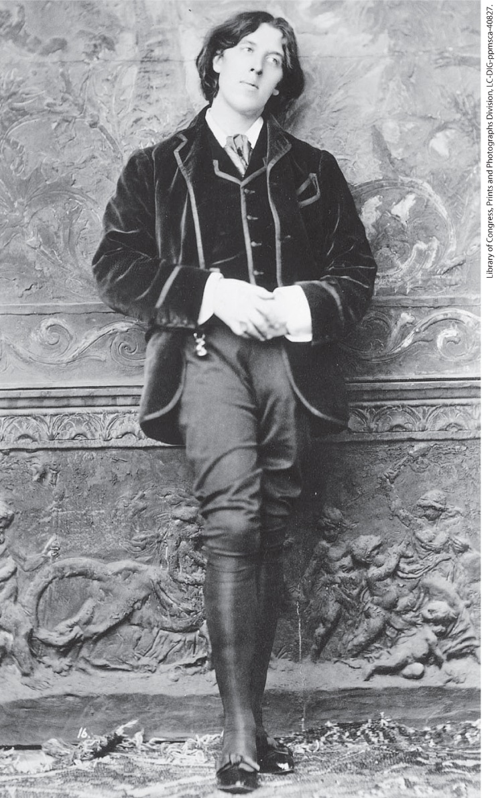
Oscar Wilde

Slide 12
I. Public Debate over Private Life (6 of 7)
D. Sciences of the Modern Self (1 of 2)
  Social Darwinists blame national decline on nervous illness
  Hungarian physician Max Nordau blames overstimulation for individual and national degeneration
  Social Darwinists offer solutions to overstimulation
  Sigmund Freud sought means to understand and treat nervous ailments
Notes:
I. Public Debate over Private Life (6 of 7)
D. Sciences of the Modern Self (1 of 2)
Social Darwinists believed that nervous illness was a cause of national decline.
In Degeneration, one of the most influential of the many books written on this subject in the 1890s, Hungarian-born physician Max Nordau (1849–1923) blamed overstimulation of the senses for individual and national degeneration in a world characterized by rapid change.
The cure for such overstimulation, Social Darwinists claimed, was imperial adventure, renewed virility, and increased childbearing.
The Viennese physician Sigmund Freud (1856–1939) sought a means to understand and remedy a variety of nervous ailments.

Slide 13
I. Public Debate over Private Life (7 of 7)
D. Sciences of the Modern Self (2 of 2)
  Freud argues that repressed personality parts are located in the “unconscious” and surface indirectly
  He also argues that the psyche is composed of three parts, challenging the belief in a unified, rational self
  Psychoanalysis has wide influence
  Freud believed humans beings were motivated by irrational drives toward death and destruction
Notes:
I. Public Debate over Private Life (7 of 7)
D. Sciences of the Modern Self (2 of 2)
In works such as The Interpretation of Dreams (1900), Freud argued that repressed parts of a person’s personality are located in the “unconscious” and surface only indirectly via dreams, symptoms of physical illness, and abnormal behavior.
He also argued that the psyche was composed of three parts — the id, the superego, and the ego — and that psychic development (or the creation of a healthy ego) entailed a constant attempt on the part of the superego (the conscience) to repress the sexual urges (seated in the id) that all children possess from birth. These ideas challenged the liberal belief in a unified, rational self. Freud demanded that sexual life be regarded objectively, free from moral and religious judgments. His insistence that women and girls had powerful sexual feelings contradicted existing beliefs of women as passionless.
Psychoanalysis had a wide cultural influence.
Freud, a meticulous scientist who believed in the rational examination of detailed evidence, believed that human beings were motivated by irrational drives toward death and destruction and that these drives shaped society’s collective mentality.

Slide 14
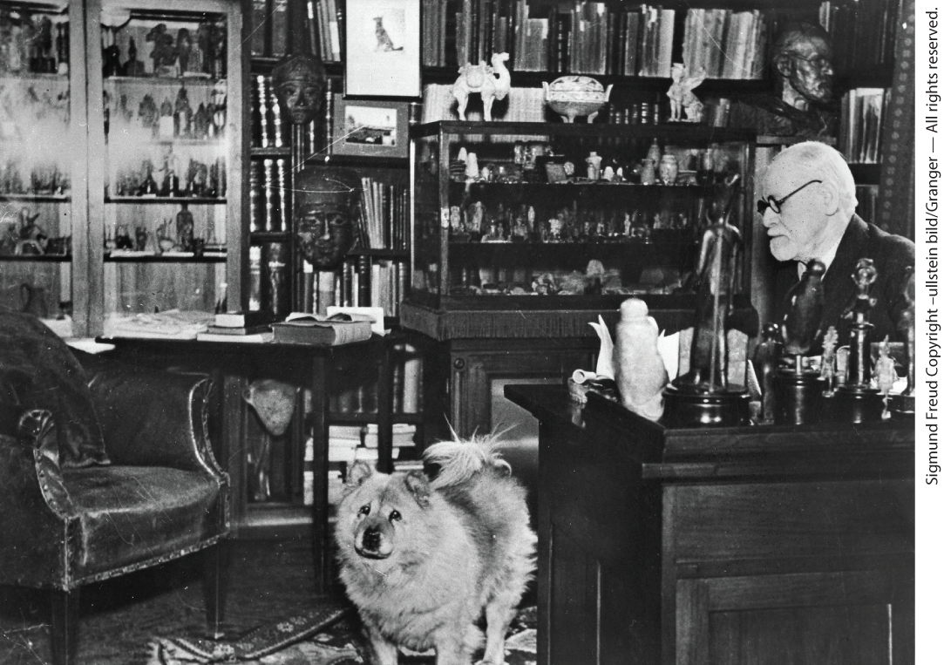
Freud’s Office and Collection

Slide 15
II. Modernity and the Revolt in Ideas (1 of 8)
A. The Opposition to Positivism (1 of 2)
  Many philosophers and social thinkers rejected positivism
  Relativists and pragmatists believed complexities of human life and society forced people to react to conditions at hand
  German sociologist Max Weber began to question effectiveness of bureaucracy
  Weber argued a charismatic leader might usurp power during crisis
Notes:
II. Modernity and the Revolt in Ideas (1 of 8)
A. The Opposition to Positivism (1 of 2)
Late in the nineteenth century, many philosophers and social thinkers rejected positivism — the belief that in science one could discover social laws based on rationally determined principles.
Critics of positivism, called relativists and pragmatists, declared instead that human life and society were ever changing and complex, forcing persons and society to react pragmatically to the immediate conditions at hand.
German sociologist and political theorist Max Weber (1864–1920) began to question the dependability of bureaucracy, maintaining that, as the numbers of persons involved in policymaking expanded, decisive action would become impossible, especially in times of crisis.
In this situation, Weber argued, a charismatic leader might usurp power.

Slide 16
II. Modernity and the Revolt in Ideas (2 of 8)
A. The Opposition to Positivism (2 of 2)
  Friedrich Nietzsche stated that scientific facts were illusions and that human existence was irrational
  Nietzsche wrote much of his work in aphorisms, stating ideas as individual perspectives
  Nietzsche believed individuals should resist dogmatic truths and become uninhibited “supermen”
  As Nietzsche’s mental health declined, his sister edited his works to appeal to German nationalists
Notes:
II. Modernity and the Revolt in Ideas (2 of 8)
A. The Opposition to Positivism (2 of 2)
German philosopher Friedrich Nietzsche (1844–1900) stated that all assertions of scientific fact and theory were illusions that people clung to because they could not face the primal, irrational side of human existence.
Nietzsche wrote much of his work in aphorisms — short, disconnected statements of truth or opinion — a form that broke with the logical rigor of traditional philosophy and that presented his ideas as statements of individual perspective and not as universal truths.
One aphorism declared, “God is dead, we have killed him,” meaning that dogmatic truth was on the decline, freeing people to search for new “poetries of life.” Nietzsche believed that individuals should cultivate their “will to power” and become uninhibited, dynamic “supermen.”
Nietzsche’s mental health deteriorated significantly the last eleven years of his life. The sister who cared for him subsequently edited his works to appeal to German nationalists, militarists, and anti-Semites, who Nietzsche had actually despised.

Slide 17
II. Modernity and the Revolt in Ideas (3 of 8)
B. The Revolution in Science (1 of 2)
  Scientific inquiry flourished, as did progress in public hygiene
  New scientific discoveries challenged accepted knowledge about universe
  Antoine Becquerel discoveres radioactivity
  French chemist Marie Curie and her husband Pierre isolated elements polonium and radium
  Scientists concluded that atoms were composed of subatomic particles
Notes:
II. Modernity and the Revolt in Ideas (3 of 8)
B. The Revolution in Science (1 of 2)
Scientific inquiry flourished and gained authority. Breakthroughs and progress in public hygiene earned science prestige.
New scientific discoveries challenged accepted knowledge about the nature of the universe, undermining the principles of time, space, matter, and energy.
In 1896, Antoine Becquerel (1852–1908) discovered radioactivity and suggested the mutability of elements by a rearrangement of their atoms.
French chemist Marie Curie (1867–1934) and her husband, Pierre (1859–1906), isolated the elements polonium and radium.
Building on these and other discoveries, scientists concluded that atoms were not solid but composed of subatomic particles rotating around a core.

Slide 18
II. Modernity and the Revolt in Ideas (4 of 8)
B. The Revolution in Science (2 of 2)
  German physicist Max Planck promotes quantum theory
  Albert Einstein publishes special theory of relativity
  Einstein transforms Planck’s quantum theory
  Einstein’s theory of general relativity proposes a fourth mathematical dimension
  These theories faced resistance initially, but eventually transform science
Notes:
II. Modernity and the Revolt in Ideas (4 of 8)
B. The Revolution in Science (2 of 2)
German physicist Max Planck (1858–1947) announced his quantum theory in 1900, which demonstrated that energy is emitted in irregular packets, not in a steady stream.
In 1905, physicist Albert Einstein (1879–1955) published his special theory of relativity, which argued that space and time are not absolutes, but rather vary according to the vantage point of the observer, and that only the speed of light is constant.
Einstein also transformed Planck’s quantum theory by suggesting that light travels in little packets and as waves.
Later, Einstein’s theory of general relativity proposed the blurring of mass and energy, expressed as E = mc², and postulated a fourth mathematical dimension to the universe.
These theories often faced resistance from the scientific community but eventually transformed the foundations of science.

Slide 19
II. Modernity and the Revolt in Ideas (5 of 8)
C. Modern Art (1 of 2)
  Conflicts between traditional values and new ideas raged in the arts as well
  Paul Cézanne adopts geometric vision in his paintings
  Spanish artist Pablo Picasso (1881–1973) develops cubism
  Picasso influenced by non-European art
  Picasso and French painter Georges Braque devised new kind of collage incorporating refuse
Notes:
II. Modernity and the Revolt in Ideas (5 of 8)
C. Modern Art (1 of 2)
The same conflicts between traditional values and new ideas raged in the arts, as artists distanced themselves still further from classical Western styles and from the conventions of polite society.
Paul Cézanne (1839–1906) adopted a geometric vision in his paintings, accentuating the lines and planes found in nature.
Spanish artist Pablo Picasso (1881–1973) followed in Cézanne’s footsteps and developed cubism — a style of painting in which a radical emphasis is placed on planes and surfaces that made people and objects almost unrecognizable.
Picasso was influenced by African, Asian, and South American art.
In 1912, he and French painter Georges Braque (1882–1963) devised a new kind of collage that incorporated newspaper clippings (which often described battles and murders), bits of string, and other artifacts, effectively creating a canvas covered in refuse.

Slide 20
II. Modernity and the Revolt in Ideas (6 of 8)
C. Modern Art (2 of 2)
  Many artists mixed political criticism with stylistic changes
  Expressionist works such as Edvard Munch’s The Scream breaks with middle-class optimism and emphasizes emotion
  Painters Hilma af Klint and Wassily Kandinsky pioneer abstract art
  Art trade becomes professionalized, complex
  Art nouveau style becomes commercial success
  Designers create things for the general public
Notes:
II. Modernity and the Revolt in Ideas (6 of 8)
C. Modern Art (2 of 2)
Many artists mixed political criticism with radical stylistic changes, opposing aspects of modern life.
Expressionism, another artistic style, broke with middle-class optimism, using geometric forms and striking colors to emphasize emotion, as is evident in Norwegian painter Edvard Munch’s (1863–1944) attempt to convey the horror of modern life in The Scream (1893).
The Swedish painter Hilma af Klint pioneered the first fully abstract paintings around 1909, and af Klint was followed by the Russian painter Wassily Kandinsky, who used geometric forms to produce abstract art prior to World War I.
Trade in art became increasingly professionalized, and the market more complex.
One innovative style that was a commercial success was art nouveau (“new art”).
Designers working in this new style created an array of beautiful things for the general public — from posters to street lamps to dishes — drawing inspiration from organic and natural elements and from Asian art.

Slide 21
II. Modernity and the Revolt in Ideas (7 of 8)
D. The Revolt in Music and Dance (1 of 2)
  Reaction to modern dance and music
  American dancer Isadora Duncan develops modern dance
  The Russian ballet experiments with bodily expression in performance of Igor Stravinsky’s The Rite of Spring
  French composers such as Claude Debussy influenced by non-European music
  Composers experiment with tonality
Notes:
II. Modernity and the Revolt in Ideas (7 of 8)
D. The Revolt in Music and Dance (1 of 2)
Modern dance and music shocked audiences.
Popular American dancer Isadora Duncan (1877–1927) developed the first performance of modern dance.
Like Duncan, the Russian ballet experimented with bodily expression in the 1913 performance of Igor Stravinsky’s (1882–1971) controversial The Rite of Spring.
French composers such as Claude Debussy (1862–1918) transformed their style to reflect the influence of non-European musical patterns and themes.
Composers also experimented with tonality, creating sounds that jarred the listeners.

Slide 22
II. Modernity and the Revolt in Ideas (8 of 8)
D. The Revolt in Music and Dance (2 of 2)
  Richard Strauss distorts familiar harmonic patterns
  Austrian composer Arnold Schoenberg proposes eliminating tonality
  Modernists in music shatter old norms
  New aesthetic distances artists from their audiences
Notes:
II. Modernity and the Revolt in Ideas (8 of 8)
D. The Revolt in Music and Dance (2 of 2)
Richard Strauss (1864–1949) used several keys simultaneously to distort familiar harmonic patterns.
Austrian composer Arnold Schoenberg (1874–1951) proposed eliminating tonality altogether.
Modernists in music, like those in the other arts, felt that they were shattering old norms and values.
But new aesthetic models distanced these artists from their audiences, separating high and low culture, and creating a distinction between the artistic elite and the social elite.

Slide 23
III. Growing Tensions in Mass Politics (1 of 9)
A. The Expanding Power of Labor (1 of 2)
  Working-class political power increased in the late nineteenth century
  Socialists gain seats in the national parliament of many countries
  Growing strength of the labor movement raises political tensions
  Second International debates the question of revisionism
  Russian socialists have little power
Notes:
III. Growing Tensions in Mass Politics (1 of 9)
A. The Expanding Power of Labor (1 of 2)
European leaders watched with dismay as working-class political power increased in the late nineteenth century.
In many countries such as Germany, England, and France, socialists gained seats in the national parliament.
The growing strength of the labor movement raised problems. Some socialists felt uncomfortable sitting in parliament with members of the upper classes, whereas others worried that electoral victories might compromise the goal of revolution.
Between 1900 and 1904, the Second International debated the question of revisionism, which argued whether socialists should work from within governments to achieve better conditions for laborers or push for a violent revolution to overthrow governments.
Russian socialists had little power, and most operated in exile.

Slide 24
III. Growing Tensions in Mass Politics (2 of 9)
A. The Expanding Power of Labor (2 of 2)
  Russian activist V. I. Lenin moves to western Europe and advances the idea that party elites could lead Russia to socialism
  Bolsheviks struggle against dominant Mensheviks
  Both group outnumbered by Socialist Revolutionaries, whose focus was on peasants
  Anarchists known as syndicalists commit terrorist acts and assassinations
  Upper and middle classes worry about the power of working people
Notes:
III. Growing Tensions in Mass Politics (2 of 9)
A. The Expanding Power of Labor (2 of 2)
Russian activist V. I. Lenin (1870–1924) moved to western Europe after serving a jail term in Siberia, where he had become involved with exiled Russian Marxists and advanced the theory that a highly disciplined party elite, rather than the working class as a whole, would lead a lightly industrialized Russia into socialism.
His faction of Bolsheviks constantly struggled with the dominant Mensheviks.
Neither group, however, had as large a constituency as the Socialist Revolutionaries, whose goal was to politicize peasants rather than workers.
During this period, anarchists and some trade union members, known as syndicalists, resorted to terrorist acts and assassinated prominent political figures.
The power of working people’s voices caused the upper and middle classes grave anxiety.

Slide 25
III. Growing Tensions in Mass Politics (3 of 9)
B. Rights for Women and the Battle for Suffrage (1 of 2)
  The women’s movement commits to gaining political rights for women
  Many activists conclude that the right to vote should be the primary goal
  Millicent Garrett Fawcett in England and Susan B. Anthony in the United States emerge as leaders
  Activist women were mostly white and from the middle class
Notes:
III. Growing Tensions in Mass Politics (3 of 9)
B. Rights for Women and the Battle for Suffrage (1 of 2)
The women’s movement was committed to gaining rights for women and had worked for various causes, including women’s education, the monitoring of the regulation of prostitution, and pacifism.
By the 1890s, however, many activists concluded that the right to vote should be the primary goal.
Influential women such as Millicent Garrett Fawcett (1847–1929) in England and Susan B. Anthony (1820–1906) in the United States emerged as leaders of the movement.
Activist women were mostly white and from the middle class, who had the time to engage in political activism and read works on feminist theory.

Slide 26
III. Growing Tensions in Mass Politics (4 of 9)
B. Rights for Women and the Battle for Suffrage (2 of 2)
  Working-class women along with Black and Native American activists support the suffrage movement, but also focus on other issues
  In 1906 women are granted the vote in Finland
  Failure elsewhere leads to more radical tactics
  Emmeline Pankhurst’s Women’s Social and Political Union began a campaign of violence
Notes:
III. Growing Tensions in Mass Politics (4 of 9)
B. Rights for Women and the Battle for Suffrage (2 of 2)
Although some working-class women distrusted middle-class women, and believed the vote less important than economic reform, many supported the suffrage movement. Black and Native American activists were also aware of other intersecting obstacles in their lives, such as race, gender, and economic discrimination.
In 1906, suffragists achieved their first major victory for European women when women were granted the vote in Finland.
But failure elsewhere prompted some women to more radical tactics.
The Women’s Social and Political Union founded in England by Emmeline Pankhurst (1858–1928) and her daughters began a campaign of violence, property destruction, and hunger strikes in 1909.

Slide 27
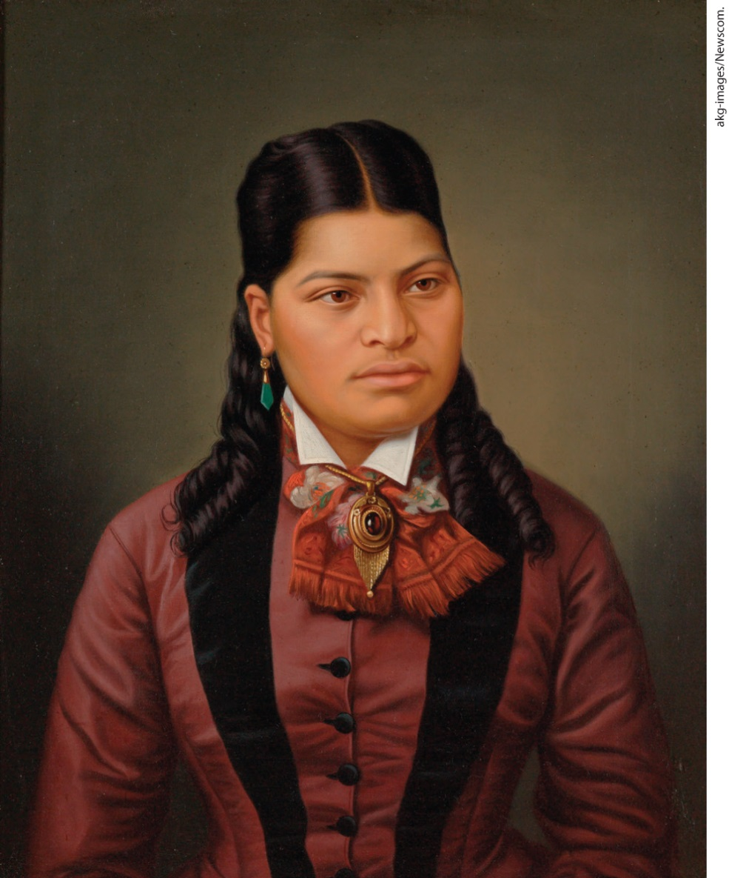
Maori and White Women get the Vote in New Zealand, 1893

Slide 28
III. Growing Tensions in Mass Politics (5 of 9)
C. Liberalism Tested (1 of 2)
  Liberals and Conservatives in British House of Commons clash over National Insurance Act of 1911
  As a result, House of Lords approves the Parliament Bill of 1911, eliminating their veto power
  Irish nationalists promote home rule and more radical demands for independence
  British Parliament approves home rule for Ireland
  World War I prevents legislation from taking effect
  Corruption plagues Italian monarchy
Notes:
III. Growing Tensions in Mass Politics (5 of 9)
C. Liberalism Tested (1 of 2)
In 1905, the British Liberal Party won a majority in the House of Commons and passed the National Insurance Act of 1911, which instituted a program of unemployment assistance. When Conservatives in the House of Lords resisted raising taxes to pay for this and other social programs, the Liberals threatened to demand the creation of more peers (lords) so as to dilute the power of the nobility.
Under this threat, the House of Lords approved the Parliament Bill of 1911, which eliminated their veto power.
Irish artists and nationalists promoted an “Irish way of life” revolving around language, culture, and Catholicism. Sinn Féin and other groups promoted home rule or more radical demands for complete independence, a goal that aligned with liberal values, but threatened the prestige of “liberal” Britain and the power of big landowners.
In 1913, the British Parliament approved home rule for Ireland.
The outbreak of World War I prevented this legislation from taking effect.
In Italy, corruption plagued the constitutional monarchy.

Slide 29
III. Growing Tensions in Mass Politics (6 of 9)
C. Liberalism Tested (2 of 2)
  Italian prime ministers attempt to forge national consensus by attempting to conquer Ethiopia
  Failure leads to riots and strikes that are repressed by armed government troops
  New prime minister, Giovanni Giolitti uses bribes and other benefits to localities to influence deputies in parliament
  Giolitti’s policies are met with unrest in Turin and Milan and in the south
  Urban and rural workers demanded change
  Giolitti appeases the protesters by instituting reforms
Notes:
III. Growing Tensions in Mass Politics (6 of 9)
C. Liberalism Tested (2 of 2)
In the 1890s, prime ministers used patriotic rhetoric, bribes to the press, and imperial adventure, which culminated in the failed attempt to conquer Ethiopia (1896), to forge a national consensus.
These policies failed and led to riots and strikes that were repressed by armed government troops.
A new prime minister, Giovanni Giolitti (1842–1928), followed a policy known as trasformismo (Italian for “transform”), using bribes, public works programs, and other benefits to localities to influence their deputies in parliament in the absence of well-developed political parties.
Giolitti’s policies met with unrest in the rapidly industrializing cities of Turin and Milan and in the depressed agrarian south.
Urban and rural workers demanded change, especially a widening of suffrage.
Giolitti appeased the protesters by instituting social welfare programs and, in 1912, virtually complete male suffrage.

Slide 30
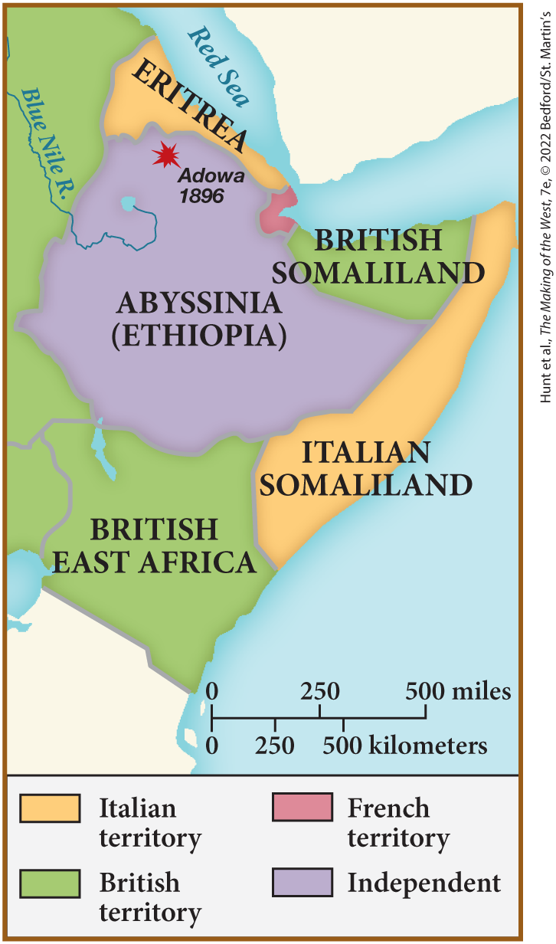
SPOT MAP 24.1 The Struggle for Ethiopia, 1896

Slide 31
III. Growing Tensions in Mass Politics (7 of 9)
D. Anti-Semitism, Nationalism, and Zionism in Mass Politics (1 of 3)
  Politicians use anti-Semitism and nationalism to their advantage
  Russian tsar Nicholas II supported anti-Semitic social values, and blamed Jews for government failures
  In France, prejudice against Jews was exploited to weaken the republican government
  Jewish army officer, Alfred Dreyfus convicted of spying for Germany
  Novelist Émile Zola accuses officials of lies and cover-ups, Dreyfus eventually pardoned
  In Germany, ruling elites used anti-Semitism as a political weapon as well
  These elites based their power and wealth on agriculture
Notes:
III. Growing Tensions in Mass Politics (7 of 9)
D. Anti-Semitism, Nationalism, and Zionism in Mass Politics (1 of 3)
Anti-Semitism and nationalism offered pat answers to complex questions, and leaders invoked these concepts in order to maintain interest-group support, to direct hostility away from themselves, and to win elections.
Russian tsar Nicholas II supported the Russian orthodox religion, autocratic politics, and anti-Semitic social values. Jews were blamed for any failure in Russian policy. Nicholas II increasingly limited where Russian Jews could live and how they could earn a living, and he made pogroms a regular occurrence in their lives.
In France, widespread prejudice against Jews was exploited to weaken the republican government they were said to control.
A Jewish army officer, Alfred Dreyfus (1859–1935), was convicted of spying for Germany in 1894.
As evidence came to light regarding his innocence, novelist Émile Zola (1840–1902) accused governmental officials of a list of lies and cover-ups in the affair, and Dreyfus was eventually pardoned in 1899.
In Germany, ruling elites used anti-Semitism as a political weapon to gain support from those who feared the consequences of Germany’s rapid industrialization.
These elites based their power and wealth on agriculture.

Slide 32
III. Growing Tensions in Mass Politics (8 of 9)
D. Anti-Semitism, Nationalism, and Zionism in Mass Politics (2 of 3)
  Elites came to loathe industry and the working class
  Anti-Semitism, attacks on socialists and feminists, become powerful political weapons
  Nationalism and anti-Semitism were also used politically in Austria-Hungary
  Hungarians demanded autonomy for themselves, but forcibly imposed their own culture on smaller ethnic groups
  Unrest in Hungary fuels unrest elsewhere in the empire
  Central government grants the Czechs more privileges
  Increase in Czech influence outrages ethnic Germans like Karl Lueger who linked grievances with the Jews
Notes:
III. Growing Tensions in Mass Politics (8 of 9)
D. Anti-Semitism, Nationalism, and Zionism in Mass Politics (2 of 3)
As agriculture came to comprise a smaller percentage of the gross national product, these elites came to loathe industry and the working class.
Anti-Semitism was a powerful weapon in their political armory, along with attacks on socialists and new women.
In Austria-Hungary, nationalism and anti-Semitism were also used to win votes, but the presence of many ethnic groups and competing nationalisms made the politics of hate more complex.
While Hungarians demanded more autonomy for themselves, they forcibly imposed their own language and culture on other, smaller ethnic groups (a policy called Magyarization).
Unrest in Hungary fueled unrest elsewhere in the empire, as Croats, Serbs, and other Slavic groups in the south called for equality with the Hungarians.
The central government granted the Czechs more privileges because the heightened development of industry in their region gave them more influence.
This increase in Czech influence outraged ethnic Germans in the Czech regions and politicians in Vienna, like mayor Karl Lueger (1844–1910), who linked the growing power of Hungarian and Czech politicians with the Jews.

Slide 33
III. Growing Tensions in Mass Politics (9 of 9)
D. Anti-Semitism, Nationalism, and Zionism in Mass Politics (3 of 3)
  Rise of nationalism and anti-Semitism destabilizes politics in the Dual Monarchy
  Jews in western Europe assimilate with Christian culture and values
  Jews in Russia and Romania singled out for persecution and forced to live in ghettos
  Ukrainian physician Leon Pinsker argues for creation of a Jewish state
  Theodor Herzl publishes The Jewish State
  Herzl organizes the first International Zionist Congress, endorses settlement in Palestine
  By 1914, eighty-five thousand Jews resettle in Palestine
Notes:
III. Growing Tensions in Mass Politics (9 of 9)
D. Anti-Semitism, Nationalism, and Zionism in Mass Politics (3 of 3)
The rise of nationalism and anti-Semitism further destabilized politics in the Dual Monarchy.
Jews in western Europe had responded to legal emancipation with assimilation, adopting liberal political and cultural values, intermarrying with Christians, and sometimes converting to Christianity.
By contrast, Jews in Russia and Romania were increasingly singled out for persecution, legally disadvantaged, and forced to live in ghettos.
A spirit of Jewish nationalism arose. In the 1880s, Ukrainian physician Leon Pinsker (1821–1891) argued that the Jewish people needed to create a safe and established Jewish state. (Although he did not necessarily believe that Palestine should be that state.)
In 1896, Hungarian journalist Theodor Herzl (1860–1904) published The Jewish State, which called for the creation of a Jewish nation-state.
With the support of poor eastern European Jews, Herzl succeeded in calling the first International Zionist Congress in 1897, which endorsed settlement in Palestine.
By 1914, some eighty-five thousand Jews had resettled in Palestine.

Slide 34
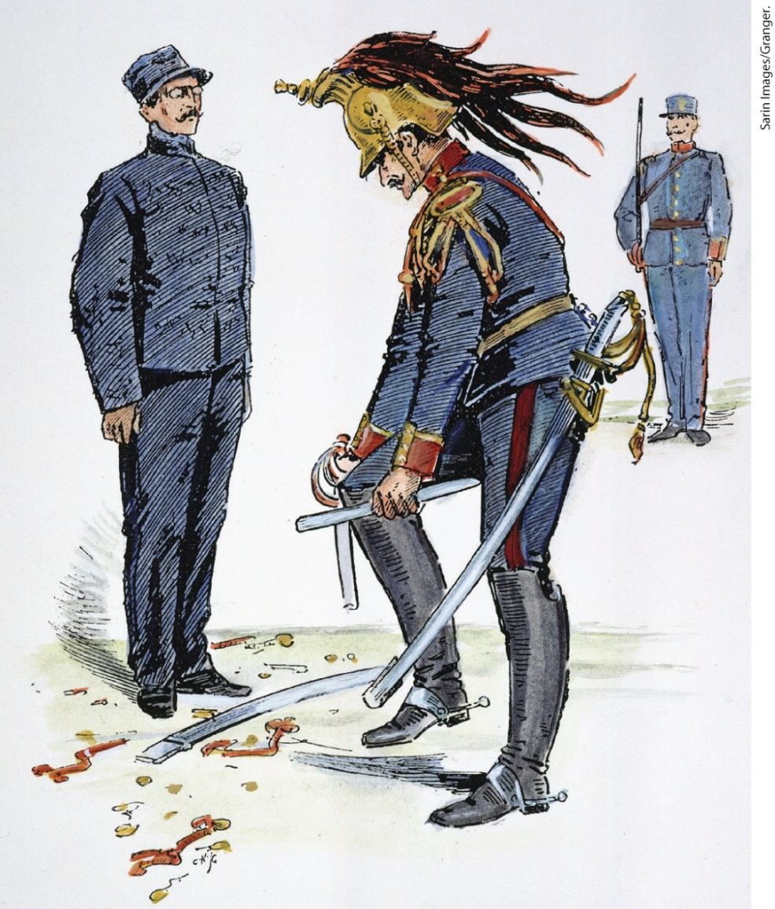
The Humiliation of Alfred Dreyfus

Slide 35
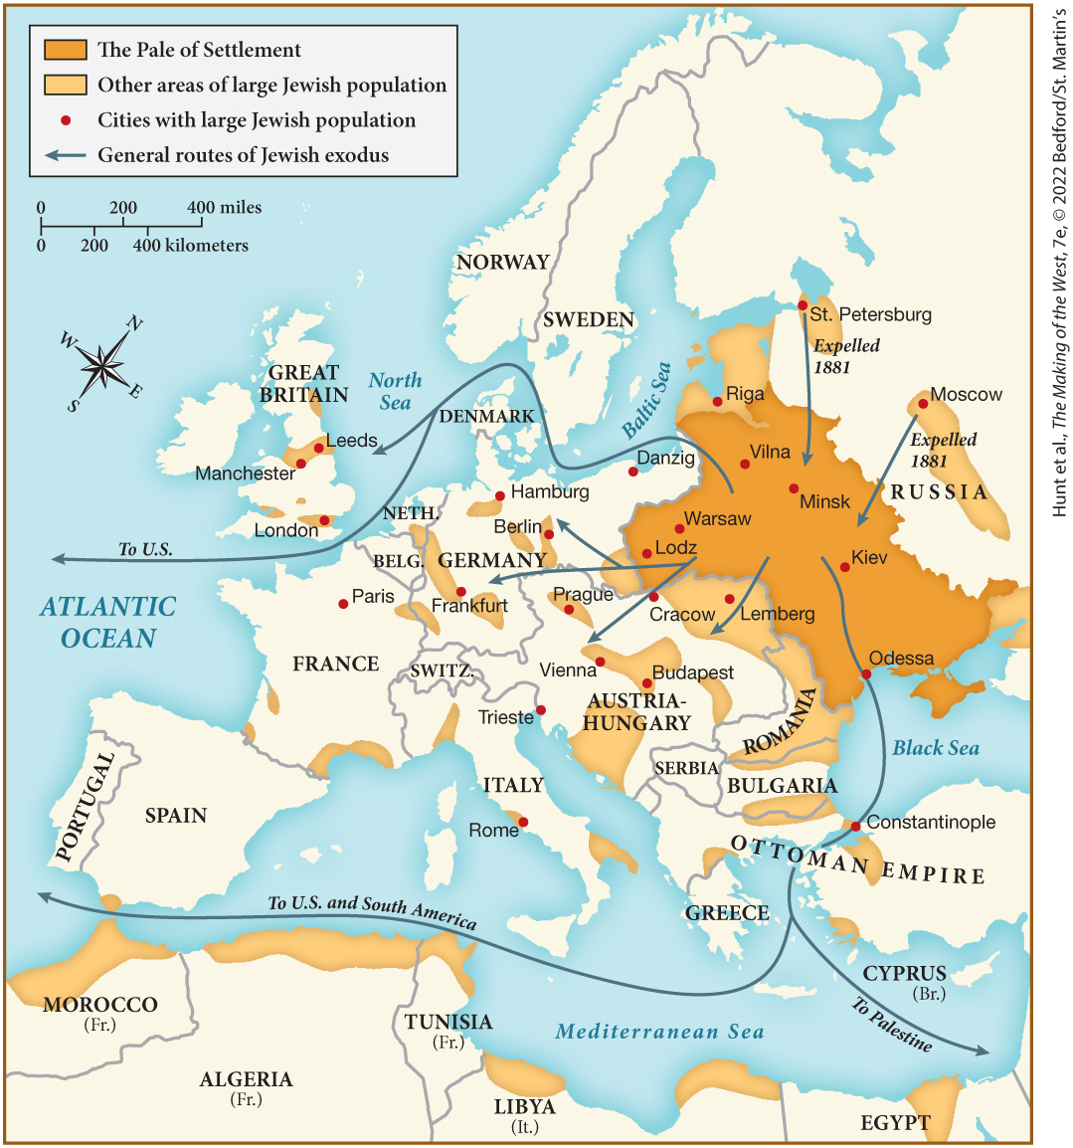
MAP 24.1 Jewish Migrations in the Late Nineteenth Century

Slide 36
IV. European Imperialism Challenged (1 of 6)
A. The Trials of Empire (1 of 2)
  Britain and France grow as imperial powers, while Italy and Germany struggle to do so
  Southern African Cape Colony prime minister Cecil Rhodes unsuccessfully attempts to raid Boer territory
  Britain goes to war with the Boers, annexes the Transvaal and the Orange Free State
  Settlers proceeded to seize the land of Black people and start a repressive system named Apartheid
  Brutality of the war causes many to criticize imperialism
  Spain loses control of Caribbean colonies as a result of defeat in the Spanish-American War
  United States annexes Hawaii and wages war against the Filipinos who were demanding independence
Notes:
IV. European Imperialism Challenged (1 of 6)
A. The Trials of Empire (1 of 2)
As the twentieth century opened, imperial adventure soured for Britain and France, while Italy and Germany found it difficult to establish themselves as imperial powers.
In 1896, the British experienced a bloody defeat when Cecil Rhodes (1853–1902), prime minister of the Cape Colony in southern Africa, ordered an unsuccessful raid into Boer territory.
Not willing to accept defeat, Britain went to war with the Boers and succeeded in annexing the Transvaal and the Orange Free State in 1902.
White settlers proceeded to seize the land of Black people, confining them to ever smaller amounts of territory — a repressive system ultimately named Apartheid.
The brutality of the war horrified Britons, and many more people began to criticize imperialism.
At almost the same time, Spain lost Cuba, Puerto Rico, and the Philippines as a result of rebellions and the defeat in the Spanish-American War of 1898.
The United States annexed Hawaii in 1898 and subsequently waged a bloody war against the Filipinos who were demanding independence, further disillusioning the European public about the “civilizing” aspect of imperialism.

Slide 37
IV. European Imperialism Challenged (2 of 6)
A. The Trials of Empire (2 of 2)
  Italy and Germany still remain interested in imperial expansion
  Germany establishes colonies in Africa but run into resistance from natives, Britain, and France
  Japan emerges as an imperial power
  Japan starts Sino-Japanese War, forces China to end its domination of Korea
  As Russia expands into Asia, the Japanese attack Russian forces
  Russia’s Baltic Fleet is destroyed in the battle of Tsushima Strait
  Japan annexes Korea and target other areas for expansion
Notes:
IV. European Imperialism Challenged (2 of 6)
A. The Trials of Empire (2 of 2)
Italy and Germany still remained interested in imperial expansion. An Italian attempt to conquer Ethiopia was defeated in 1896, but it annexed Libya from the Ottoman Empire later.
Germany had several colonies in Africa but ran into both native resistance and rivalry with Britain and France.
European confidence fell further as Japan emerged as an imperial power.
In 1894, Japan sparked the Sino-Japanese War, which forced China to end its domination of Korea.
As Russia expanded east and south into Asia, the Japanese became anxious and attacked Russian forces (1904).
The complete destruction of Russia’s ineptly led Baltic Fleet in the battle of Tsushima Strait (1905) caused Western imperialists to worry about the rise of Asia.
Japan annexed Korea and targeted other areas for further expansion.

Slide 38
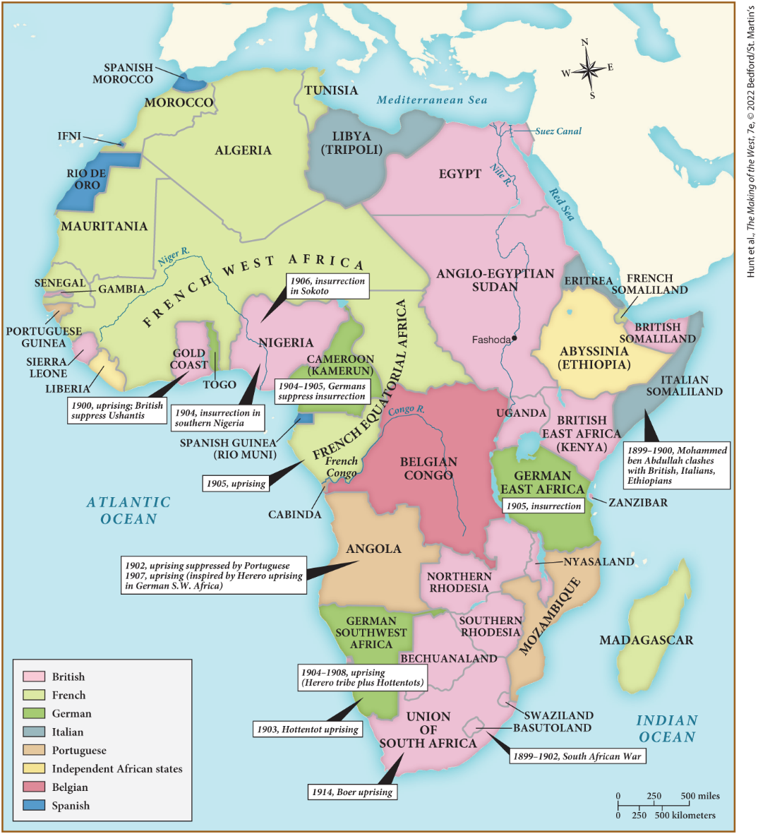
MAP 24.2 Africa in 1914

Slide 39
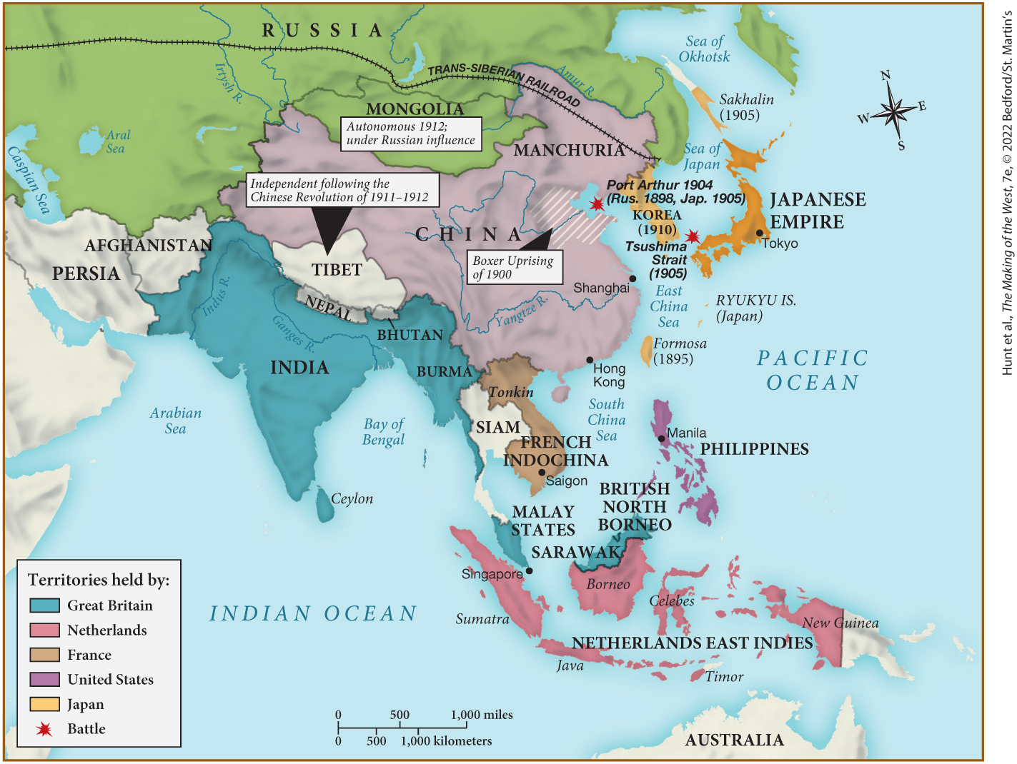
MAP 24.3 Imperialism in Asia, 1894–1914

Slide 40
IV. European Imperialism Challenged (3 of 6)
B. The Russian Empire Threatened (1 of 2)
  Japanese defeat of the Russians causes further internal problems
  A crowd gathers outside the tsar’s palace to make Nicholas II aware of brutal working conditions
  Soldiers fire on the crowd, an event that came to be known as Bloody Sunday
  The event spurs other rebellions
  Workers demand political representation
  Nicholas II creates a representative body, the Duma, as a response
  Revolutionary activity slows after the Duma is convened
Notes:
IV. European Imperialism Challenged (3 of 6)
B. The Russian Empire Threatened (1 of 2)
Although the Russian Empire had expanded during the nineteenth century, internally the threat of revolution was constant. The military humiliation of the Russians by the Japanese caused further problems for the regime.
In January 1905, a crowd gathered outside the tsar’s palace in St. Petersburg to make Nicholas II aware of industry’s brutal working conditions.
Soldiers fired on the crowd, killing hundreds and wounding thousands, an event that came to be known as Bloody Sunday.
The quashing of this demonstration spurred other workers to rebel.
During the following year, workers struck over wages, hours, and working conditions and demanded political representation. Liberals and intellectuals joined the struggle, hoping for political reform.
In response to the continuing violence, Nicholas II created a representative body: the Duma.
The Duma convened in 1907, and revolutionary activity abated.

Slide 41
IV. European Imperialism Challenged (4 of 6)
B. The Russian Empire Threatened (2 of 2)
  The Duma, along with political debate, liberalized government
  The tsar disagrees with the Duma’s recommendations and disbands it
  Prime Minister Pyotr Stolypin enacts changes to eliminate discontent among the peasants
  These reforms allow people to move to the cities
  Stolypin clamps down on revolutionary organizations and increased Russification efforts
  Rebels, however, continue to assassinate officials, including Stolypin
  Reforms create larger industrial workforce, more assertive peasantry
Notes:
IV. European Imperialism Challenged (4 of 6)
B. The Russian Empire Threatened (2 of 2)
Although very few citizens had voting privileges, the Duma’s existence, coupled with the right of public political debate, liberalized government.
However, when the tsar disliked its recommendations, he disbanded the Duma.
Prime Minister Pyotr Stolypin (1863–1911) resolved to eliminate sources of discontent by ending the mir system, canceling land redemption payments, and making governmental loans available to peasants.
These reforms allowed more people to move to the cities and created a larger group of independent peasants.
At the same time, Stolypin clamped down on revolutionary organizations and stepped up Russification — the forced assimilation of non-Russians to Russian culture.
Despite these measures, rebels continued to assassinate government officials, including Stolypin himself, who was killed in 1911.
Without curbing unrest, the reforms created a larger industrial workforce and a more assertive peasantry.

Slide 42
IV. European Imperialism Challenged (5 of 6)
C. Growing Resistance to Colonial Domination (1 of 2)
  China’s ruling Qing dynasty forced to grant economic concessions to Western powers
  Peasants organize into secret societies to restore Chinese integrity
  Society of the Righteous and Harmonious Fists (or Boxers) rebel, killing missionaries and Chinese Christians
  The Qing dynasty is overthrown, China declared a republic
  Sun Yat-Sen, the leader of the revolutionaries, uses Western concepts to promote Chinese values
  Indian politicians begin to take radical measures
  Hindu leader, B. G. Tilak preaches complete noncooperation with the British, inspiring violent rebellion
Notes:
IV. European Imperialism Challenged (5 of 6)
C. Growing Resistance to Colonial Domination (1 of 2)
China’s 1895 defeat by Japan forced the ruling Qing dynasty to grant economic concessions to the Western powers.
Consequently, peasants organized into secret societies to restore Chinese integrity.
One such group, the Society of the Righteous and Harmonious Fists (or Boxers) rebelled in 1900, killing missionaries and Chinese Christians. Colonial powers, after putting down the rebellion, forced the Chinese government to pay a huge indemnity and to allow more extensive foreign military occupation.
In 1911, the Qing dynasty was overthrown, and the following year China was declared a republic.
Sun Yat-Sen (1866–1925), the leader of the revolutionaries, used Western concepts to promote Chinese values while pursuing a cluster of Western programs.
In India, the Japanese victory over Russia and the Russian Revolution of 1905 stimulated politicians to take a more radical course than that offered by the Indian National Congress.
A Hindu leader, B. G. Tilak (1856–1920), preached complete noncooperation with the British and promoted Hindu customs, while inspiring violent rebellion in his followers.

Slide 43
IV. European Imperialism Challenged (6 of 6)
C. Growing Resistance to Colonial Domination (2 of 2)
  The British sponsor the Muslim League, a rival nationalist group
  Nationalism also weakens the Ottoman Empire
  Sultan Abdul Hamid II provokes Turkish nationalism in Constantinople
  Turkish nationalists emphasizes their culture
  Group of nationalists called the Young Turks take control of Constantinople
  Their victory motivates other groups in the Middle East and the Balkans to assert their independence from the Ottomans
  Germany and France also face nationalist rebellions in their colonies
Notes:
C. Growing Resistance to Colonial Domination (2 of 2)
In an attempt to stop Tilak, the British sponsored the Muslim League, a rival nationalist group, but also conceded some political power to Indian elites.
Nationalism was also weakening the Ottoman Empire.
When Sultan Abdul Hamid II (r. 1876–1909) attempted to promote a pan-Islamic solution to nationalist discontent, he provoked Turkish nationalism in Constantinople.
Turkish nationalists emphasized their distinct history, culture, and language.
In 1908, a group of nationalists, called the Young Turks, took control of Constantinople.
Their victory motivated other groups in the Middle East and the Balkans to assert their independence from the Ottomans and economic dependence on the West. The Young Turks repressed nationalist uprisings by non-Turkish minorities in the Middle East and the Balkans.
In German East Africa, colonial forces responded to native rebellion with a scorched-earth policy, while in Indochina the French closed the University of Hanoi, executed Indo-Chinese intellectuals, and deported thousands of suspected nationalists.

Slide 44
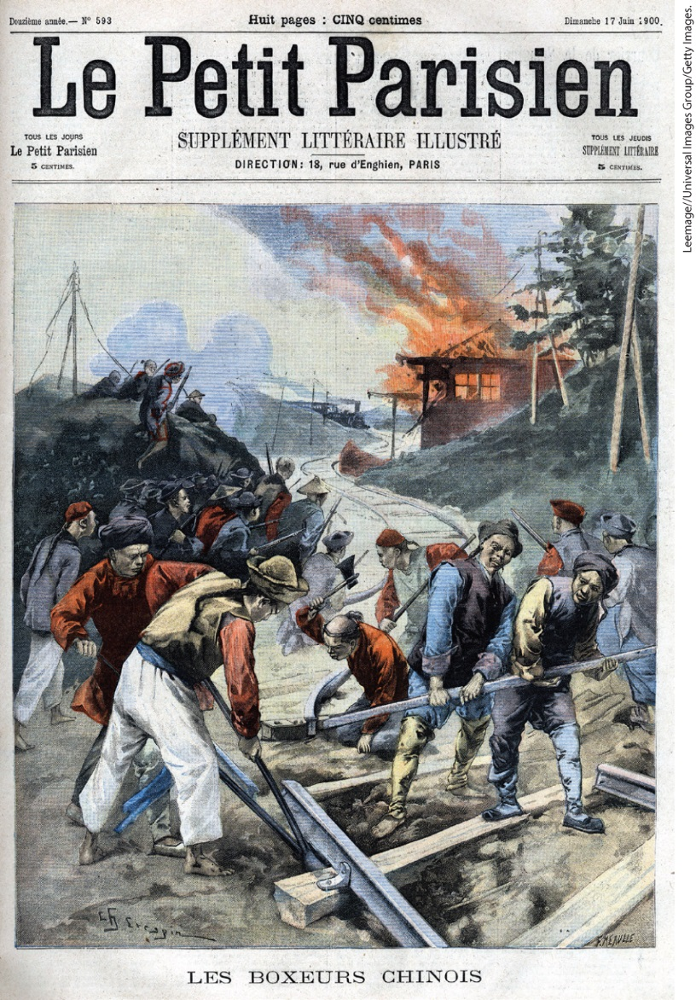
Boxer Siege of the Foreigner Settlement at Tientsin

Slide 45
V. Roads to War (1 of 6)
A. Competing Alliances and Clashing Ambitions (1 of 2)
  Triple Alliance between Germany, Austria-Hungary, and Italy is opposed by the alliance forged by France and Russia
  French and British armies confront each other in the Fashoda incident in Sudan, however, France withdraws
  Agreements between the two becomes an alliance called the Entente Cordiale
  Germany unwittingly strengthens this alliance in challenges to French dominance in Morocco
  Germany disappointed in expectations for more colonial power
  Germany turns eye towards central Europe, the Balkans, and Turkey
Notes:
V. Roads to War (1 of 6)
A. Competing Alliances and Clashing Ambitions (1 of 2)
At the beginning of the twentieth century, the Triple Alliance between Germany, Austria-Hungary, and Italy faced the alliance forged by France and Russia in the 1890s.
The Fashoda incident in 1898 — named after a town in Sudan where French and British armies confronted each other — led France and Great Britain to the brink of war. However, France withdrew. France and Great Britain also strengthened ties with a series of secret agreements concerning French claims in Morocco and British claims in Egypt.
These agreements became a British-French alliance called the Entente Cordiale.
Germany unwittingly strengthened this alliance in a series of challenges to French predominance in Morocco in 1905 and 1911, known respectively as the First and Second Moroccan Crises.
However, they were disappointed in their expectations for more colonial power.
Frustrated in the colonies, German statesmen turned their hopes to the creation of a Mitteleuropa that would include central Europe, the Balkans, and Turkey.

Slide 46
V. Roads to War (2 of 6)
A. Competing Alliances and Clashing Ambitions (2 of 2)
  The Habsburgs aimed to expand into the Balkans
  Russia is outraged at Austria-Hungary’s annexation of Bosnia-Hungary
  Several Balkan states sought to incorporate territories in Austria-Hungary and the Ottoman Empire
  The First Balkan War breaks out
  Balkan states join forces to take Macedonia and Albania from the Ottomans
  In a second war, Greece, Serbia, and Montenegro win a victory over Bulgaria
  Strategists began to think these wars could resolve tension in the Balkans
Notes:
V. Roads to War (2 of 6)
A. Competing Alliances and Clashing Ambitions (2 of 2)
The Habsburgs, backed by Germany, wished to expand into the Balkans, believing the resulting addition of more ethnic groups would weaken those already present in the Dual Monarchy.
Promoting itself as protector of the Slavs, Russia was outraged at Austria-Hungary’s 1908 annexation of Bosnia-Hungary, where many Serbian Slavs resided.
Among the Balkan states themselves, Greece, Serbia, Bulgaria, Romania, and Montenegro all wanted to incorporate territories in Austria-Hungary and the Ottoman Empire in which members of their ethnic groups lived.
In 1912, the First Balkan War broke out.
Greece, Serbia, Bulgaria, and Montenegro joined forces to take Macedonia and Albania from the Ottomans.
In a second war in 1913, Greece, Serbia, and Montenegro won a quick victory over Bulgaria.
Strategists began to think that a quick war in the Balkans could resolve the multiple tensions that existed.

Slide 47
V. Roads to War (3 of 6)
B. The Race to Arms (1 of 2)
  Constant readiness for war seemed necessary
  Governments begin to draft citizens in large standing armies
  Rates of conscription and military expenditure rise
  Impact of modernization of weaponry
  Alfred Nobel patents dynamite and develops a new type of gunpowder
Notes:
V. Roads to War (3 of 6)
B. The Race to Arms (1 of 2)
Rivalries, territorial ambitions, and aspirations for greatness made constant readiness for war seem increasingly necessary.
During the nineteenth century, governments began to draft ordinary citizens for periods of two to six years in large standing armies.
Between 1890 and 1914, as competition in the colonies and in Europe increased the threat of war, the rates of conscription and military expenditure rose.
At the same time, the modernization of weaponry had a huge impact.
Swedish arms manufacturer Alfred Nobel (1833–1896) patented dynamite and developed a type of gunpowder that improved the accuracy of firearms.

Slide 48
V. Roads to War (4 of 6)
B. The Race to Arms (2 of 2)
  Military leaders begin to devise strategies to protect armies
  Arms manufacturers increase production, governments stockpile weapons
  Battleships began to be constructed out of metal rather than wood
  German naval ambitions cause France and Great Britain to increase naval spending
  Military buildup added to economic and social stability by creating jobs
  Public relations campaigns created support for an arms race
Notes:
V. Roads to War (4 of 6)
B. The Race to Arms (2 of 2)
Military leaders began to devise strategies to protect their armies, such as the trenches used by Russia during the Russo-Japanese War.
Arms manufacturers throughout Europe increased production as governments stockpiled weapons.
The modernization of weaponry also affected navies; battleships began to be constructed out of metal rather than wood.
German naval ambitions caused France and Great Britain to increase naval spending and to draw even closer together in the Entente Cordiale.
Military buildup was a response to a possible threat of war; however, it also added to economic and social stability by creating jobs.
Public relations campaigns created support for an arms race that had external and internal benefits.

Slide 49
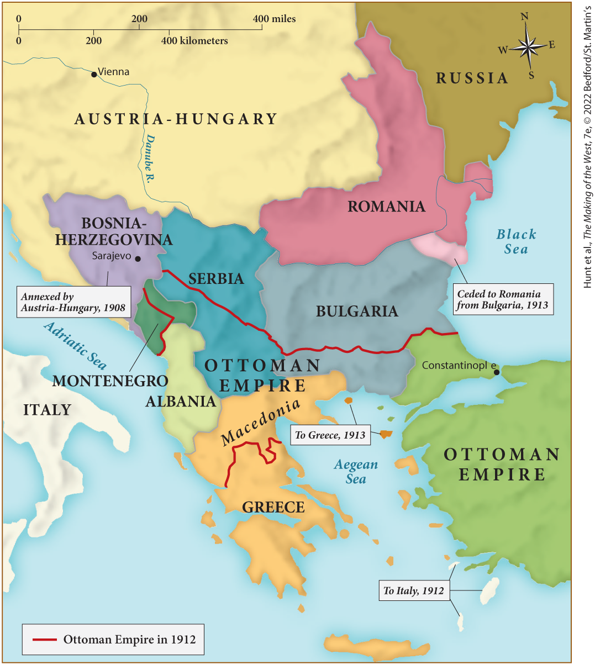
MAP 24.4 The Balkans, 1908–1914

Slide 50
V. Roads to War (5 of 6)
C. 1914: War Erupts (1 of 2)
  Bosnian nationalist Gavrilo Princip assassinates Archduke Francis Ferdinand in Bosnia
  Princip received arms and information from Serbian officials
  Austria presents Serbia with a harsh ultimatum
  Serbia refuses Austrian participation in the investigation and Austria-Hungary, confident of Germany’s support, declares war on Serbia
  Germany and Russia asked the other to avoid war
  Germany, however, was fixed on fighting a short war to gain territory in the Balkans
Notes:
V. Roads to War (5 of 6)
C. 1914: War Erupts (1 of 2)
On June 28, 1914, Bosnian nationalist Gavrilo Princip (1895–1918) assassinated Archduke Francis Ferdinand (1863–1914), heir to the Habsburg throne, and his wife, Sophie, when they were on a state visit to Bosnia.
Evidence showed that Princip had received arms and information from Serbian officials who hoped, like Princip, to join Bosnia to Serbia.
Austria, backed by Germany, presented Serbia with a harsh ultimatum.
Serbia agreed to every condition except Austrian participation in the investigation. Austria-Hungary, confident of Germany’s backing, declared war on Serbia on July 28.
As the tsar and the kaiser corresponded, each asked the other to avoid starting a European war; the British foreign secretary unsuccessfully proposed an international conference.
The German military leadership was fixed on fighting a short war that could provide territorial gains leading toward the goal of Mitteleuropa and hoped that martial law would justify arresting the leaders of the Social Democratic Party.

Slide 51
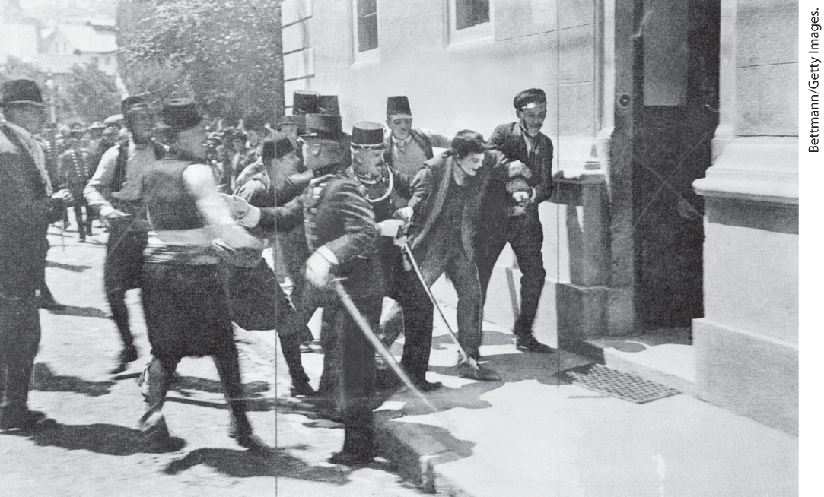
Arrest of the Assassin

Slide 52
V. Roads to War (6 of 6)
C. 1914: War Erupts (2 of 2)
  Military leaders prepare for an attack
  Austria mobilizes troops
  In response, Nicholas II orders Russian mobilization to aid Serbia
  The Germans mobilize, France declares war on Germany
  Germany violates Belgian neutrality, triggering British war declaration
  Celebrations erupt throughout Europe as war begins
  Europeans believed the conflict would resolve long-growing tensions
Notes:
V. Roads to War (6 of 6)
C. 1914: War Erupts (2 of 2)
While the press fanned war fever, military leaders prepared for an attack.
The Austrians mobilized on July 31.
In response, Nicholas II ordered Russian mobilization to aid her ally, Serbia.
The Germans mobilized on August 1, and France declared war on Germany.
Germany violated Belgian neutrality on its way to invade France, triggering a British war declaration.
As war broke out, celebrations erupted throughout Europe.
Europeans believed the conflict would be short and that it would resolve tensions ranging from the rise of the working class to imperial competition.

Slide 53
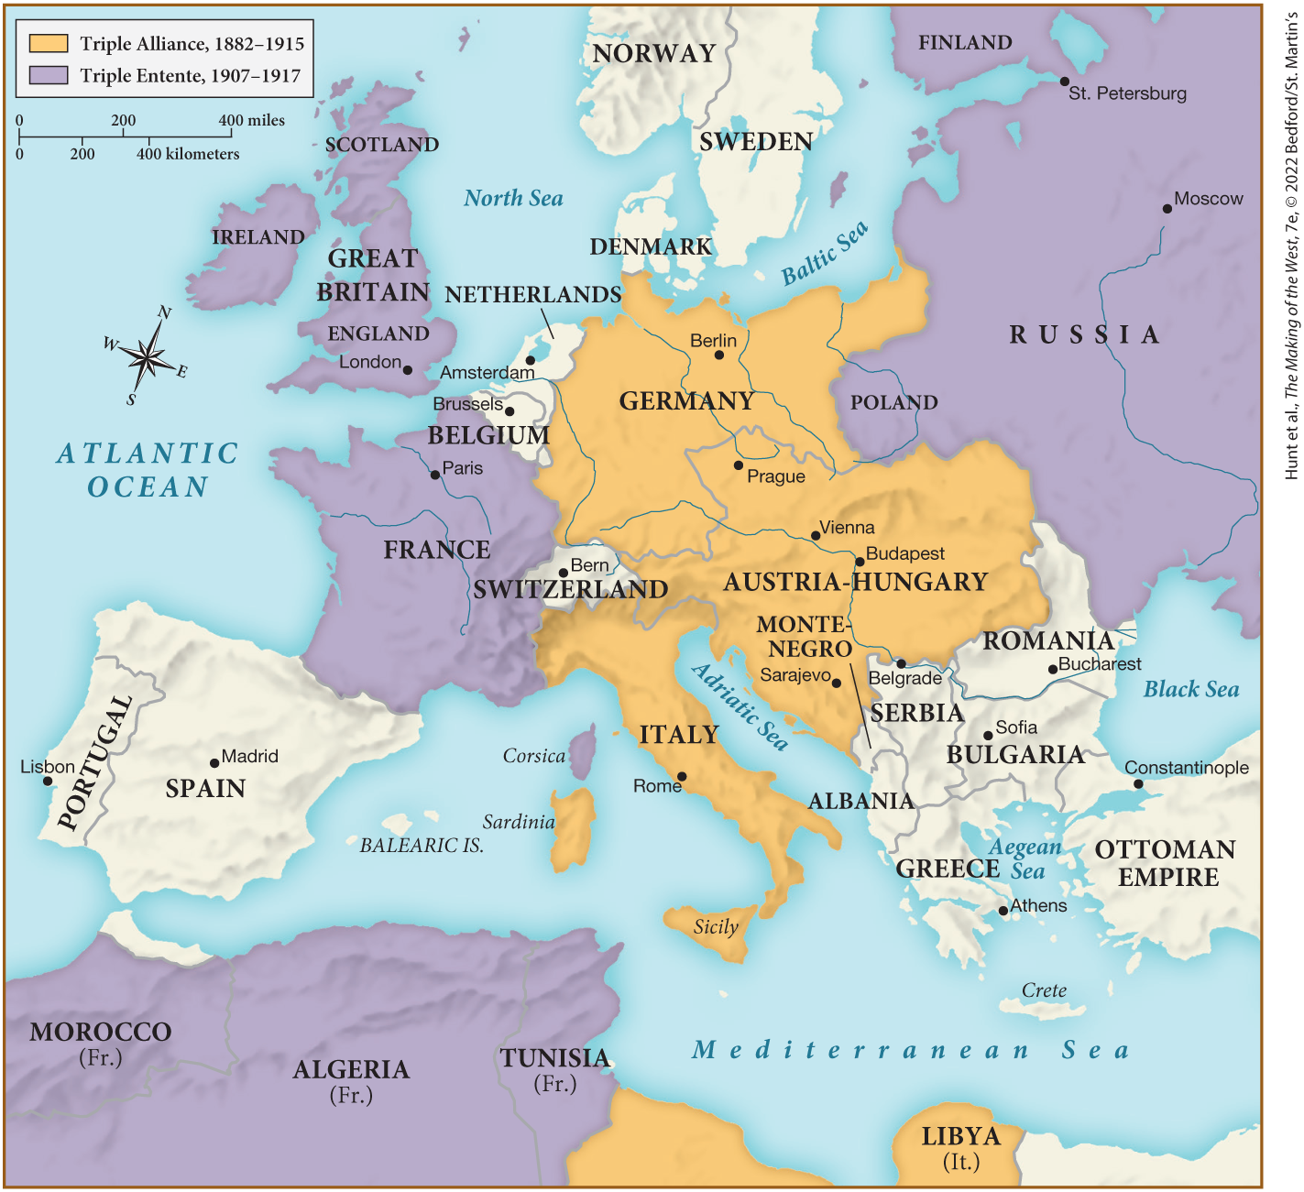
MAP 24.5 Mapping the West: Europe at the Outbreak of World War I, August 1914

