Slide 1
The Making of the West
Seventh Edition
Hunt • Martin • Rosenwein • Smith
CHAPTER 23
Empire, Industry, and Everyday Life
1870 –1890
Copyright © 2022 by Bedford/St. Martin’s
Distributed by Bedford/St. Martin’s/Macmillan Learning strictly for use with its products. Not for redistribution.

Slide 2
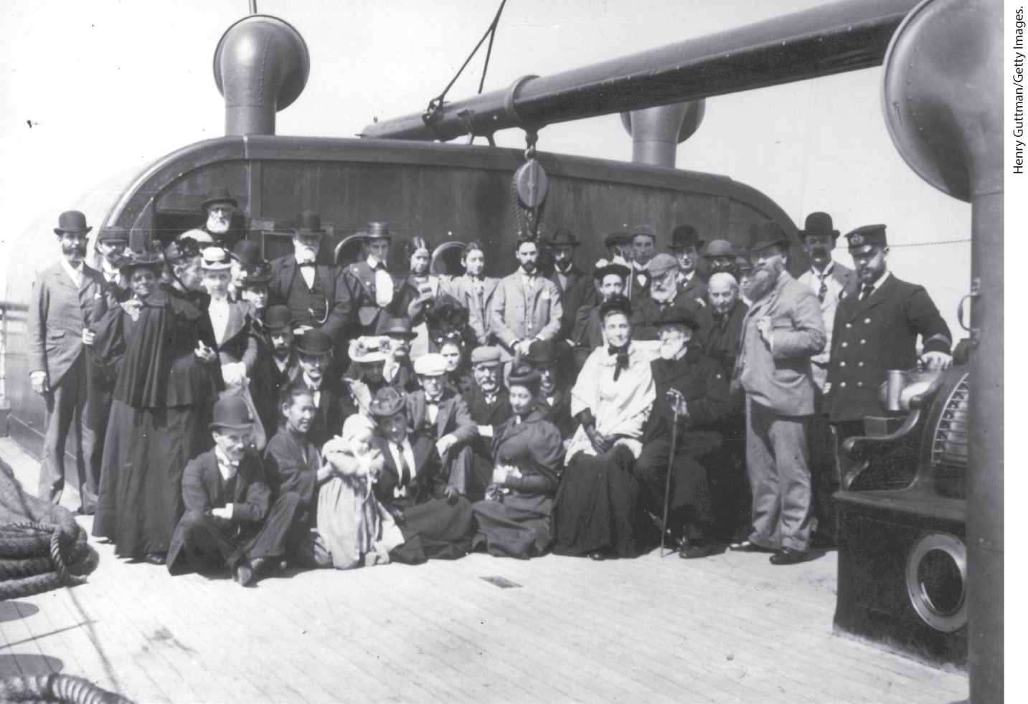
European Migrants aboard Ship

Slide 3
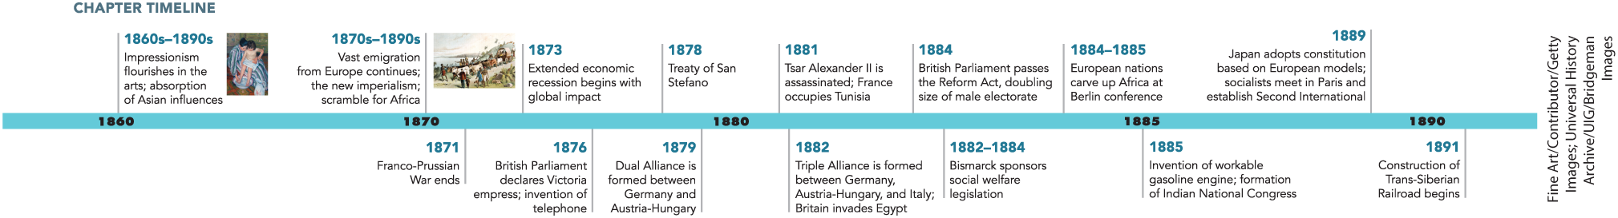
Chapter 23 Timeline

Slide 4
I. The New Imperialism (1 of 7)
A. The Scramble for Africa — North and South (1 of 3)
  European countries turn their attention to African and Asian shores of the Mediterranean
  Europeans invest heavily in Egyptian development and infrastructure modernization
  French and British take over Egyptian treasury, Britain invades Egypt
  British begin to run Egyptian government
  British officials limited agricultural production to crops destined for export
  France occupies Tunisia
Notes:
I. The New Imperialism (1 of 7)
A. The Scramble for Africa — North and South (1 of 3)
The European countries eyed the African and Asian shores of the Mediterranean for the chance to profit from trade and deal-making.
Europeans invested heavily in Egyptian development and infrastructure modernization, including the building of the Suez Canal, and lent money at exorbitant rates of interest to Egyptian rulers. Tens of thousands of local people actually did much of the physical and brain work to create this infrastructure.
In 1879, the French and British took over the Egyptian treasury to secure their investments, and Britain used the nationalist resistance that ensued as an excuse to invade Egypt in 1882.
The British began to run the government, reshaping the Egyptian economy to meet British needs.
In place of a diversified and self-sufficient agricultural system, for example, British officials, working with local landowners and moneylenders, limited agricultural production to a few crops destined for export.
In Algeria, the French continued to extend their presence and occupied neighboring Tunisia in 1881.

Slide 5
I. The New Imperialism (2 of 7)
A. The Scramble for Africa — North and South (2 of 3)
  Businessmen from Europe flood Asia Minor with cheap goods, force locals into low-paying work
  European employers discriminate on the basis of ethnicity and religion
  Europeans become more involved in trade in sub-Saharan Africa
  African territories fall to the European economic powers
  Competition raises European tensions; after Belgian King Leopold II takes over the Congo, German chancellor Otto von Bismarck calls a conference
  European powers agree on terms to divide Africa
Notes:
I. The New Imperialism (2 of 7)
A. The Scramble for Africa — North and South (2 of 3)
Businessmen from Britain, France, and Germany flooded Asia Minor with cheap goods, driving out artisans from their trades and into low-paying work building railroads or processing tobacco.
European employers discriminated on the basis of ethnicity and religion, paying Muslims less than Christians and Arabs less than other ethnic groups.
After the British takeover of the Egyptian government, Europeans became more involved in sub-Saharan Africa, seeking to expand trade in raw materials such as palm oil, rubber, and diamonds, and to use coastal areas as stopover ports on the route to Asia.
In the 1880s, one African territory after another fell to the British, French, Belgians, Portuguese, Italians, and Germans.
The competition raised European tensions and prompted Belgian King Leopold II to violently and cruelly claim the Congo region of central Africa, and German chancellor Otto von Bismarck to call a conference in Berlin. (For a close look at one of the important environmental history topics in this chapter, see “Environment Matters: The Violence of Colonization.”)
During a series of meetings in 1884 and 1885, the European powers agreed that settlements along the African coast guaranteed rights to internal territory, an agreement that divided Africa into territories along straight lines that cut across indigenous boundaries.

Slide 6
I. The New Imperialism (3 of 7)
A. The Scramble for Africa — North and South (3 of 3)
  European descendants take resources from native peoples
  British businessman Cecil Rhodes corners the diamond market
  Europeans use Social Darwinism to justify conquest of Africa
  Europeans destroy African economic and political systems
  Europeans look down on Africans, see them as source of manual labor
  Traditional African agriculture replaced with focus on cash-crops
Notes:
I. The New Imperialism (3 of 7)
A. The Scramble for Africa — North and South (3 of 3)
In southern Africa, farmers of European descent wrested farmland and mineral resources from native peoples.
British businessman Cecil Rhodes cornered the diamond market in southern Africa and claimed immense lands for Britain.
Social Darwinism reshaped racism to justify conquest of African lands as the right of “superior” people.
Europeans destroyed African economic and political systems to ensure their own profit and domination.
Ignoring evidence to the contrary, most Europeans considered Africans barely civilized, unlike the Chinese and Indians, whom Europeans credited with a scientific and artistic heritage, deeming Africans good only for manual labor.
Traditional African agriculture, aimed at providing food for the family, was replaced with cash-crop agriculture.

Slide 7
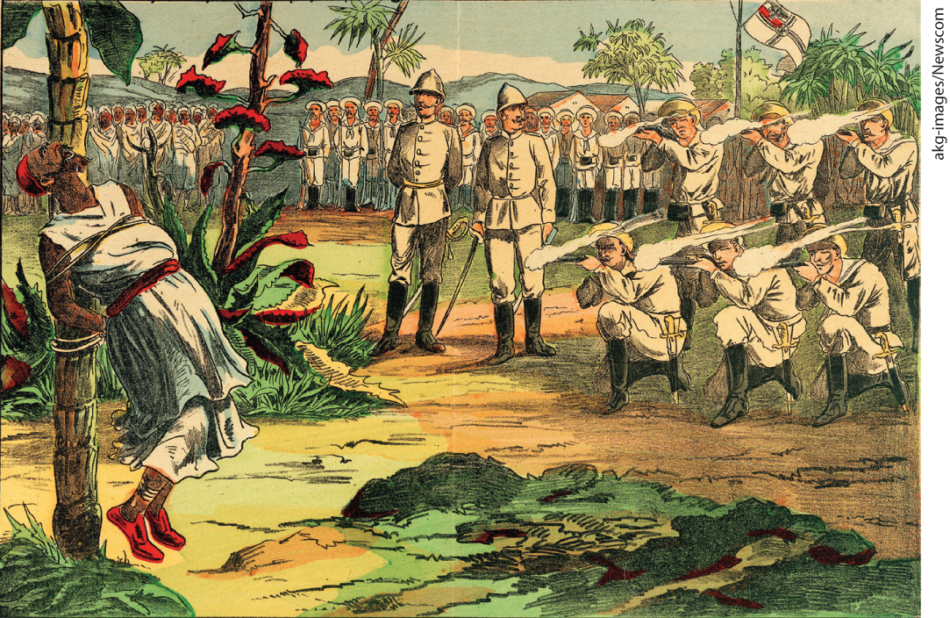
Environment Matters: The Violence of Colonization

Slide 8
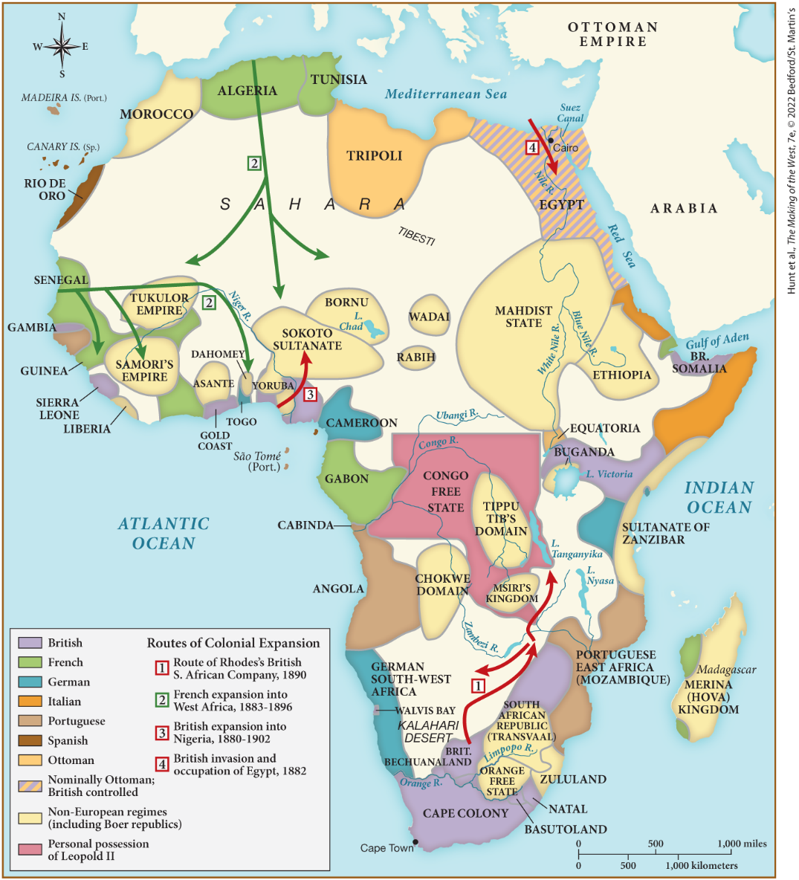
MAP 23.1 Africa, c. 1890

Slide 9
I. The New Imperialism (4 of 7)
B. Imperializing Asia
  Asia integrated into European empires
  Indians found Indian National Congress to challenge Britain’s right to rule
  Britain takes control of territories that provide resources and trade routes to China
  Russians expand into Asia and build the Trans-Siberian railroad
  France creates the Union of Indochina
Notes:
I. The New Imperialism (4 of 7)
B. Imperializing Asia
European expansion was occurring around the world. Much of Asia was integrated into European empires.
Discrimination drove educated elite Indians to found the Indian National Congress in 1885, which, while it accepted aspects of liberalism, challenged Britain’s right to rule.
To the east, Britain took control of the Malay Peninsula in 1874 and the interior of Burma in 1885, territories that provided natural resources and a trade route to China.
The British viewed with mistrust Russian annexations in central Asia. The Russians penetrated Persia and China as well as the Ottoman Empire and built the Trans-Siberian railroad, which opened up Siberia to large-scale settlement.
In 1887 France threatened military action to create the Union of Indochina from Cambodia, Tonkin, Annam, and Cochin China. (Laos was added in 1893.)

Slide 10
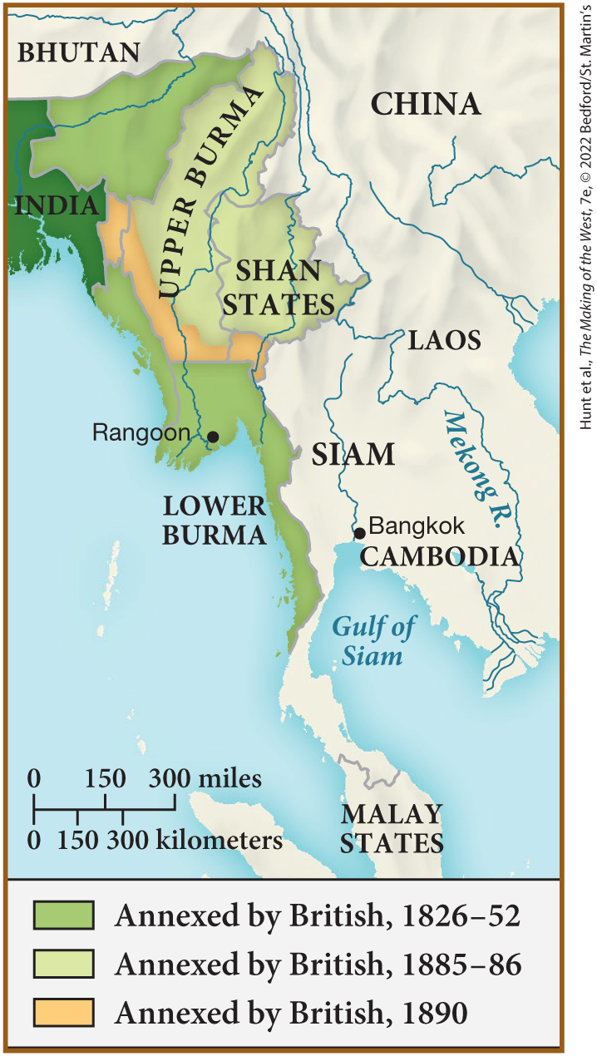
SPOT MAP 23.1 British Colonialism in the Malay Peninsula and Burma, 1826-1890

Slide 11
I. The New Imperialism (5 of 7)
C. Japan’s Imperial Agenda
  Japanese embrace foreign ideas
  Japanese government focuses on heavy industry
  Japanese scholars draft constitution that emphasizes state power
  Japan adopts imperialist mentality, conquers Okinawa, intervenes in Korea
Notes:
I. The New Imperialism (5 of 7)
C. Japan’s Imperial Agenda
Under the Meiji Restoration, the Japanese embraced foreign trade, imperialism, and industry.
The Japanese government directed the development of heavy industry.
In 1889, legal scholars drafted a constitution on the German model that emphasized state power rather than individual rights.
Japan also adopted the imperialist mentality of the West and conquered Okinawa, as well as beginning to intervene in Korea.

Slide 12
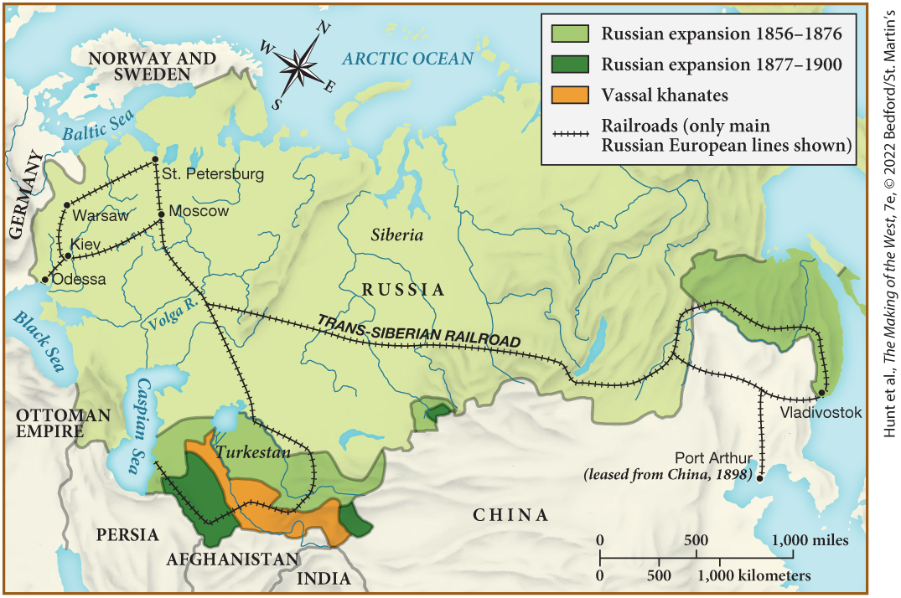
MAP 23.2 Expansion of Russia in Asia, 1865–1895

Slide 13
I. The New Imperialism (6 of 7)
D. The Paradoxes of Imperialism (1 of 2)
  International distrust grows as countries vied for influence
  Politicians question the value of colonies
  Colonies provide markets for certain businesses
  Colonies provide jobs for people in port cities, but all taxpayers share the costs
  Imperialists argued that Europeans had a “civilizing mission”
Notes:
I. The New Imperialism (6 of 7)
D. The Paradoxes of Imperialism (1 of 2)
Although imperialism was intended to stabilize great-power status, international distrust intensified as countries vied for world influence.
Politicians began to question the value of colonies whose costs exceeded their profits.
Yet, for certain businesses, such as French soap making and metallurgy, colonies provided crucial markets.
Colonies also provided jobs for people in European port cities, but all taxpayers shared the burden of paying for colonial armies and administration.
To those worried about the costs, imperial advocates argued that Europeans had a “civilizing mission” to bring their superior culture to the rest of the world.

Slide 14
I. The New Imperialism (7 of 7)
D. The Paradoxes of Imperialism (2 of 2)
  Conflicting ideas of civilizing mission vs violent imposition
  Europeans learn about other cultures, but believe their own superiority
  Missionaries view indigenous religion as inferior
  Some Europeans believe conquered peoples were superior
  Europeans continued to take pride in imperialism
Notes:
I. The New Imperialism (7 of 7)
D. The Paradoxes of Imperialism (2 of 2)
The idea of the civilizing mission sometimes conflicted with the violence used to establish and impose imperial rule.
Europeans took the opportunities provided by imperialism to learn more about other cultures but continued to believe in their own superiority.
Missionaries viewed indigenous religion as inferior and sometimes supported military action to spread Christianity.
A few Europeans believed that conquered peoples were superior in that they were not corrupted by “civilization.”
Despite the paradoxes of imperialism, Europeans continued to take pride in the imperial accomplishments of their own nations.

Slide 15
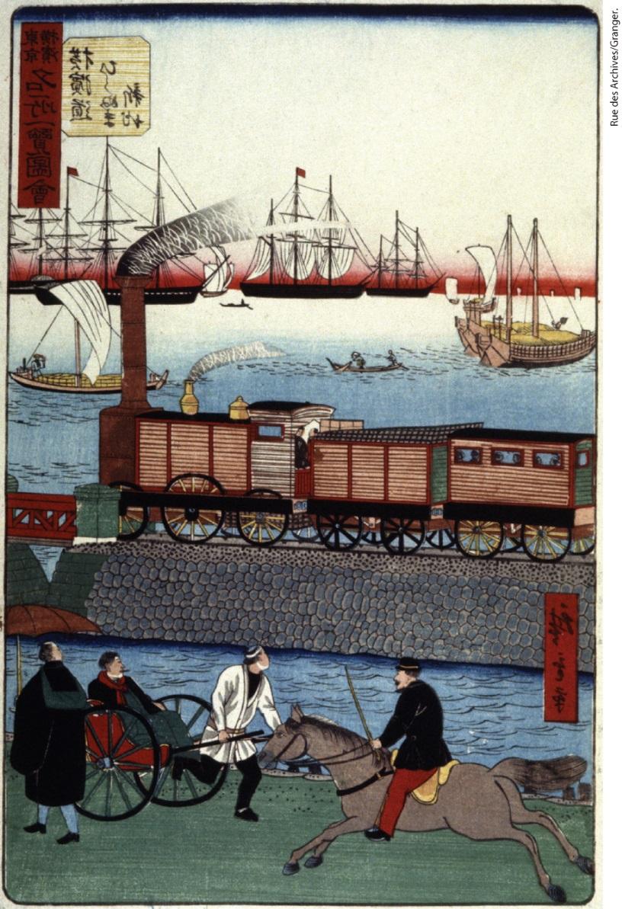
Modernization in Japan

Slide 16
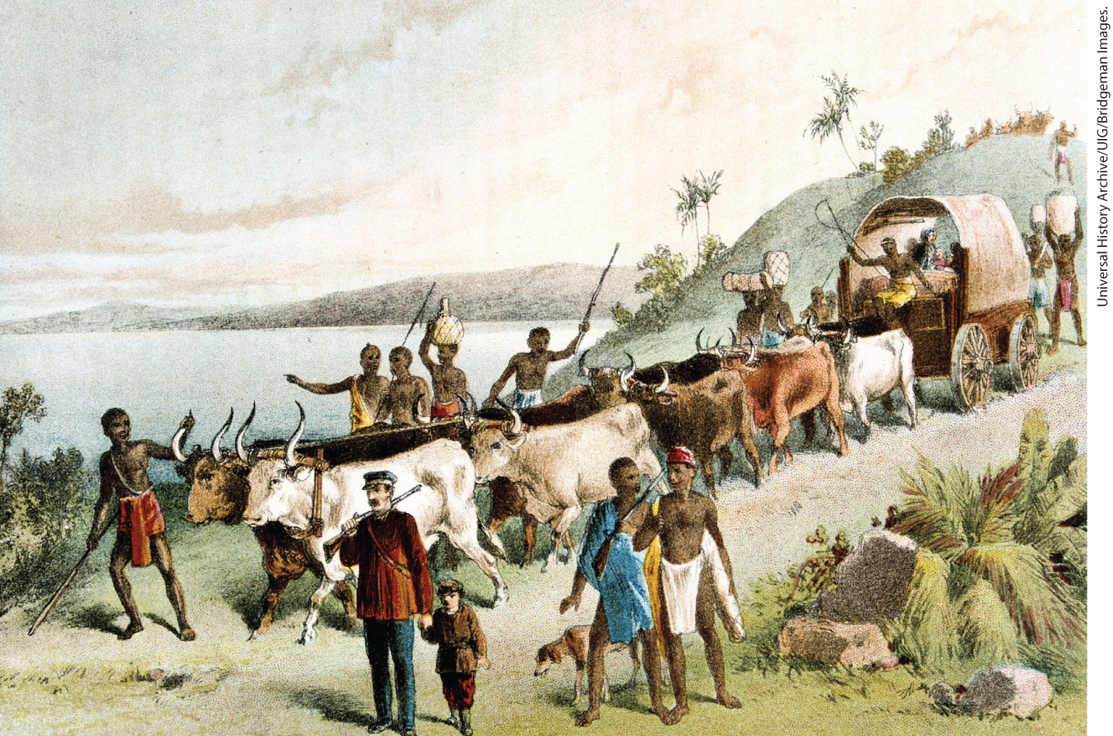
Scottish Explorer David Livingstone

Slide 17
II. The Industry of Empire (1 of 7)
A. Industrial Innovation (1 of 3)
  Innovation characterized the late nineteenth century
  Progress creates new products, electricity comes into common use
  Industrial nations mine massive quantities of coal and iron to produce steel
  Second Industrial Revolution develops in Great Britain
  The two industrial revolutions arrive simultaneously in many countries
  Outwork persists in some industries
Notes:
II. The Industry of Empire (1 of 7)
A. Industrial Innovation (1 of 3)
Industrial, technological, and commercial innovation characterized the late nineteenth century.
New products — from the telephone to the internal combustion engine — provided proof of industrial progress. After 1880, electricity came into common use.
Leading industrial nations mined massive quantities of coal and iron and produced steel during the 1870s and 1880s, all necessary for the growth of industry.
For Great Britain, a second Industrial Revolution developed, founded this time not on steam and textiles but on heavy industrial products like iron and steel.
On the continent, the two industrial revolutions arrived simultaneously in many countries.
Outwork persisted in some industries such as garment making.

Slide 18
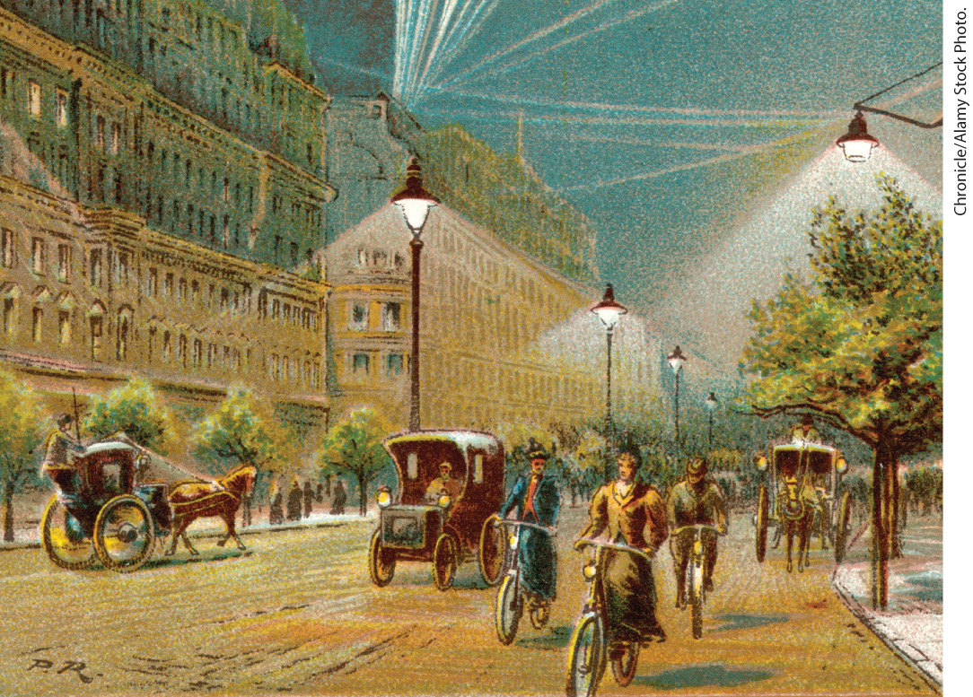
The Invention of Electric Lighting

Slide 19
II. The Industry of Empire (2 of 7)
A. Industrial Innovation (2 of 3)
  Industrialization transformed agriculture in the late nineteenth century
  Development of refrigeration allows transport of fruit and meat, importation of tin leads to canned foods
  European technological superiority contributes to success of imperialism
  Great Britain begins to lose its industrial dominance to Germany and the United States
  German industrialization facilitated by the conquest of Alsace and Lorraine
  American industry drew on rich natural resources
Notes:
II. The Industry of Empire (2 of 7)
A. Industrial Innovation (2 of 3)
Industrialization transformed agriculture in the late nineteenth century, as chemical fertilizers boosted crop yields and reapers and threshers mechanized harvesting.
The development of refrigeration accommodated the transport of fruit and meat, diversifying and increasing the urban food supply, while the importation of tin from the colonies facilitated the large-scale commercial canning of foods.
European technological superiority, manifested in railroads, steamships, medicines, and guns, contributed to the success of imperialism.
Great Britain began to lose its industrial predominance to Germany and the United States, both of which rapidly industrialized during this period and came to exceed Britain in both research and innovation.
German industrialization was facilitated by the conquest of the resource-rich and technically advanced provinces of Alsace and Lorraine.
American industry drew on America’s rich natural resources and was more driven by entrepreneurs than state-driven German industrialization.

Slide 20
II. The Industry of Empire (3 of 7)
A. Industrial Innovation (3 of 3)
  French industry grows but remains smaller than other countries
  Industry mainly develops in cities in Spain, Austria-Hungary, and Italy
  Electricity allows Scandinavian countries to industrialize
  Russian industrialization lags behind
  Russian peasants only work in industry when not needed for farm work
  Russian workers and peasants remain poor
Notes:
II. The Industry of Empire (3 of 7)
A. Industrial Innovation (3 of 3)
French industry grew, but French business establishments remained smaller than those in Germany and the United States.
In Spain, Austria-Hungary, and Italy, industry developed in highly concentrated areas, but the rest of these countries remained tied to nonmechanized agriculture.
Electricity allowed the coal-poor Scandinavian countries to industrialize, and Sweden and Norway became leaders in the use of hydroelectric power and the development of electrical products.
Russian industrialization continued to lag behind.
Russian peasants, still tied to the mir, only worked in small numbers in industry when they were not needed to work the land.
Russian workers and peasants could not afford to buy the goods they produced.

Slide 21
II. The Industry of Empire (4 of 7)
B. Facing Economic Crisis (1 of 2)
  Before 1850, economic crises were tied to agricultural crisis
  In 1873, crisis of industry and finance develop on its own
  Industry had become too capital intensive
  Distribution and consumption of goods were inadequate for sustained growth
  Governments responded with new laws to increase investor confidence
Notes:
II. The Industry of Empire (4 of 7)
B. Facing Economic Crisis (1 of 2)
Before 1850, economic crises were usually caused by an agricultural crisis.
In 1873, however, a crisis of industry and finance developed on its own because entrepreneurs were facing more and more obstacles. The crisis spread from Europe to the rest of the world, evidence of how economies were increasingly tied together globally.
First, industry had become capital intensive because entrepreneurs had to invest heavily in expensive machinery to start a business.
Second, the distribution and consumption of goods were both inadequate to sustain growth because workers were paid too little to consume many industrial products. Slumps became common.
Governments responded to this crisis with new laws that limited personal liability in cases of bankruptcy, thereby increasing investor confidence.

Slide 22
II. The Industry of Empire (5 of 7)
B. Facing Economic Crisis (2 of 2)
  Stock markets began raising money from larger pools of capital, London Stock Exchange becomes center of economy
  Businesses band together into cartels and trusts
  Trusts and cartels also vertically integrated companies
  Trusts, cartels, and governments restrict the free market
Notes:
II. The Industry of Empire (5 of 7)
B. Facing Economic Crisis (2 of 2)
Stock markets trading in a wide variety of securities raised money from larger, more international pools of capital. At the center of the international economy was the London Stock Exchange.
Businesses began to band together into cartels (favored in Germany) and trusts (predominant in the United States) in order to control prices and competition.
Trusts and cartels also vertically integrated companies, thereby enabling them to control the entire process of manufacturing from raw material to finished product.
Trusts and cartels restricted the free market. Governments also restricted the market by raising tariffs in response to recessions and trade deficits. All countries except Belgium, Britain, and the Netherlands ended free trade by the 1890s.

Slide 23
II. The Industry of Empire (6 of 7)
C. Revolution in Business Practices (1 of 2)
  Owners hire specialized managers to run operations
  White-collar service sector emerges
  Women fill majority of these jobs
  Employers save money by designating certain jobs as “female”
  Boost in consumption led to the development of merchandising
Notes:
II. The Industry of Empire (6 of 7)
C. Revolution in Business Practices (1 of 2)
To minimize the effects of the economic crises, industrialists revolutionized the everyday conduct of their businesses by hiring specialized managers to run their complex operations, improving manufacturing, marketing, and worker productivity.
A white-collar service sector emerged simultaneously, consisting of office workers employed as secretaries, file clerks, typists, and bank tellers, all educated in state-run primary schools.
Women, including middle-class women, filled the majority of service-sector jobs, despite the strength of the domestic ideal that discouraged them from working.
Employers saved money by designating certain types of jobs as “female” and then paying women lower wages than they would have had to pay men, a practice that continues.
The drive to boost consumption led to the development of merchandising.

Slide 24
II. The Industry of Empire (7 of 7)
C. Revolution in Business Practices (2 of 2)
  The department store is developed
  Stores bring women out of the home
  Mail-order catalogs give rural populations new access to variety of goods
  New industrial goods and products became more widespread
Notes:
II. The Industry of Empire (7 of 7)
C. Revolution in Business Practices (2 of 2)
The department store, developed after midcentury, sought to stimulate consumer desires, especially among female shoppers.
Such stores brought women out of the domestic sphere into the public, either as shoppers or as salesgirls.
Mail-order catalogs and the extension of the railroad system gave rural populations access to the variety of goods department stores had to offer, many of which (coffee, tea, or soap made from palm oil) were imported from the colonies.
Consumerism was shaped by empire and industry. New industrial goods and products from the colonies became more widespread and shaped ordinary life.

Slide 25
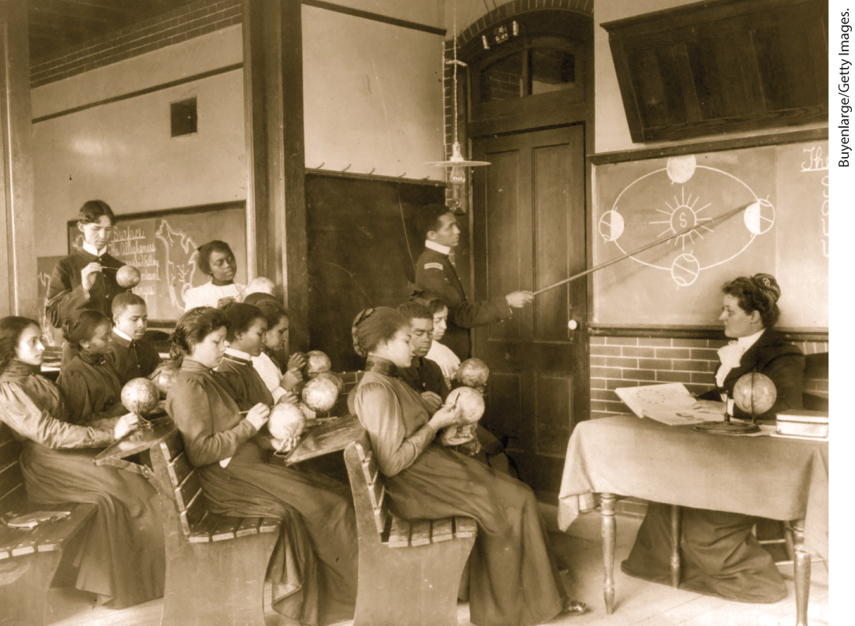
Hampton Institute, 1890s

Slide 26
III. Imperial Society and Culture (1 of 9)
A. The “Best Circles” and the Expanding Middle Class (1 of 2)
  Profits add new members to the upper classes
  Best circles often formed from aristocracy, but new millionaires begin to join
  Ranks of aristocrats and rich bourgeois become increasingly blurred
  Poorer aristocrats marry into rich bourgeois families
  Upper-class men popularize big-game hunting
Notes:
III. Imperial Society and Culture (1 of 9)
A. The “Best Circles” and the Expanding Middle Class (1 of 2)
The profits from industry and empire building added new members to the upper classes, or “best circles,” as they were called.
Persons in these circles often came from the aristocracy, but new millionaires from the ranks of the bourgeoisie joined, and some intermarried.
The ranks of aristocrats and rich bourgeois became increasingly blurred, and millionaires without aristocratic connections made conspicuous displays of wealth and segregated themselves in suburbs or new urban areas away from the bourgeois and the indigent.
Rich aristocrats financed global business ventures, while poorer aristocrats married into rich bourgeois families.
Upper-class men popularized big-game hunting expeditions in Asia and Africa, which replaced the more modest fox and bird hunting as the fashionable masculine sport of the highest class.

Slide 27
III. Imperial Society and Culture (2 of 9)
A. The “Best Circles” and the Expanding Middle Class (2 of 2)
  Members of best circles control children’s social lives, marriages.
  Double standard endorsed promiscuity for upper-class men while seeing it as immoral for women
  Upper-class women devoted to having children, maintaining social standards
  Middle class expanded in western and central Europe
  Most households employed at least one servant
  Middle class homes maintained cleanliness and polish
Notes:
III. Imperial Society and Culture (2 of 9)
A. The “Best Circles” and the Expanding Middle Class (2 of 2)
Members of the best circles maintained exclusivity by controlling their children’s social and sexual lives, especially their marriages.
Many upper-class men seduced lower-class women, as a double standard endorsed promiscuity for men as normal while seeing it as immoral for women.
Once married, upper-class women devoted themselves to having children, directing staffs of servants, and maintaining standards of etiquette and social conduct. They also consumed and displayed a wide range of luxury goods, many from the colonized world.
A solid middle class was expanding in western and central Europe.
The lives of these businessmen and professionals remained modest; however, most households employed at least one servant.
In place of the conspicuous consumption of the very rich, the middle class proudly maintained a high level of cleanliness and polish.

Slide 28
III. Imperial Society and Culture (3 of 9)
B. Working People’s Strategies (1 of 3)
  Empire and industry powerful factors in migration
  Parts of Europe could not provide enough employment, hundreds of thousands leave to find work elsewhere
  Rural eastern minorities leave for economic reasons
  Russian Jews fled due to violence
  Most immigrated to the Americas and Australia
Notes:
III. Imperial Society and Culture (3 of 9)
B. Working People’s Strategies (1 of 3)
Empire and industry were powerful factors in migration.
Parts of Europe simply could not produce enough or provide enough employment to support a growing population, so hundreds of thousands left their native lands to find work elsewhere in Europe or the United States.
Millions of rural eastern European Jews, Swedes, and Sicilian and Irish peasants left for economic reasons.
Russian Jews fled in the face of violent pogroms that destroyed Jewish homes, businesses, and lives.
Most immigrated to North and South America, Australia, and New Zealand to seek out new opportunities.

Slide 29
III. Imperial Society and Culture (4 of 9)
B. Working People’s Strategies (2 of 3)
  Railroads and steamships improve travel
  Immigrants frequently send money home
  Immigrants learn new languages, customs to find work
  Immigrant women often insulated, preserve traditional culture
  Urbanization accelerates throughout Europe
Notes:
III. Imperial Society and Culture (4 of 9)
B. Working People’s Strategies (2 of 3)
The development of railroads and steamships made the trip faster, cheaper, and more comfortable.
Once established in their new countries, immigrants frequently sent money home.
Male immigrants had to learn new languages and new civic practices in order to obtain employment, as did some female immigrants.
Immigrant women who stayed at home were insulated from their new environments and often preserved traditional ways and languages.
Within Europe, urbanization accelerated, although most still resided in rural areas; many urban dwellers returned to rural areas at harvest time.

Slide 30
III. Imperial Society and Culture (5 of 9)
B. Working People’s Strategies (3 of 3)
  In cities, workers had to adapt to fluctuating job markets
  More physical exertion demanded, wages not increased accordingly
  Managers resented, women often sexually harassed
  Many workers paid low wages, forced to work long hours
  Urban working class still grows more informed
Notes:
III. Imperial Society and Culture (5 of 9)
B. Working People’s Strategies (3 of 3)
In cities, changes in technology and management meant that workers had to adapt to an insecure job market and changing work conditions.
Stepped-up productivity demanded more physical exertion, but wages were not increased accordingly.
Men and women resented managers, and women were often sexually harassed.
Many workers, especially women, worked at home doing outwork for which they were paid extremely low wages, forcing them to work long hours to make ends meet.
By and large, however, the urban working classes grew more informed, more visible, and more connected to the progress of industry and empire.

Slide 31
III. Imperial Society and Culture (6 of 9)
C. National Fitness: Reform, Sports, and Leisure (1 of 2)
  Reform organizations and charities formed by the middle and upper classes to address economic instability
  Various groups intervene in workers’ lives and improve lives of children
  Working-class mothers expected to conform to middle-class standards
  Dutch physician Aletta Jacobs begins to make birth control available
  Knowledge of birth control spreads spurring opposition from Churches and reformers
  Governments sponsor laws that bar women from certain jobs
Notes:
III. Imperial Society and Culture (6 of 9)
C. National Fitness: Reform, Sports, and Leisure (1 of 2)
The social problems caused by economic instability, the uneven prosperity of industrialization, and the upheaval of migration were addressed through reform organizations and charities formed by the middle and upper classes.
Philanthropists, industrialists, schools, and governmental agencies, influenced by Social Darwinism, intervened in workers’ lives to teach mothers child-care techniques and to provide health care for children.
They expected working-class mothers to conform to middle-class standards of housekeeping and childrearing.
Dutch physician Aletta Jacobs began to make birth control available.
Working-class women sought out these clinics, and knowledge of birth control spread by word of mouth among workers. Churches and many reformers opposed the spread of birth control.
Governments sponsored laws that barred women from “unhealthy” night work and from trades such as pottery that were considered dangerous, despite evidence that women in strenuous jobs got sick less often than men.

Slide 32
III. Imperial Society and Culture (7 of 9)
C. National Fitness: Reform, Sports, and Leisure (2 of 2)
  Laws limited women’s access to higher-paying jobs
  Organized team sports replace village games
  Newspapers report the results of sporting events such as the Tour de France
  Schools for girls introduce gymnastics and exercise, team sports for women emerge but individual sports considered more feminine
  Middle class believes in benefits of leisure pursuits
  Working-class people adopt middle-class leisure habits
  Healthy recreation affords individuals greater sense of individual freedom
Notes:
III. Imperial Society and Culture (7 of 9)
C. National Fitness: Reform, Sports, and Leisure (2 of 2)
Laws also limited women’s access to higher-paying jobs.
Organized team sports replaced village games, integrating immigrants as well as the lower and higher classes in a common pastime.
Newspapers reported the results of sporting contests such as the Tour de France, and competitive sports began to be viewed as a sign of national strength and spirit.
Demonstrating the increased belief in physical health and strength for both sexes, schools for girls introduced gymnastics and exercise. Team sports for women emerged, such as soccer, field hockey, and rowing; but individual sports, such as horseback riding, were considered more feminine.
The middle classes believed that leisure pursuits should strengthen the mind and fortify the body.
Working-class persons adopted middle-class habits by joining clubs for pursuits such as bicycling, touring, and hiking.
The new emphasis on healthy recreation afforded individuals a greater sense of individual freedom and power and thereby contributed to a developing sense of citizenship based less on constitutions and rights than on an individual nation’s exercise of raw power.

Slide 33
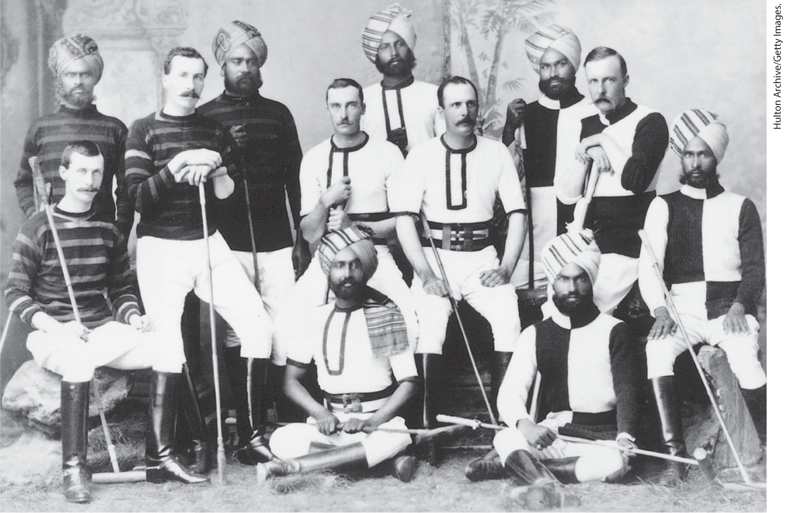
Anglo-Indian Polo Team

Slide 34
III. Imperial Society and Culture (8 of 9)
D. Artistic Responses to Empire and Industry (1 of 2)
  Darwin believed civilizations that failed to embrace change would perish
  Émile Zola produced novels that described the effects of industrial society on individuals
  Norwegian playwright Henrik Ibsen commented critically on women’s roles
  Rural people designed “traditional” costumes and created ceremonies
  These “traditions” attracted attention
Notes:
III. Imperial Society and Culture (8 of 9)
D. Artistic Responses to Empire and Industry (1 of 2)
Darwin had theorized that strong civilizations that failed to keep up with changing conditions would perish, an idea that influenced many writers.
Émile Zola (1840–1902) produced a series of novels that described the effects of industrial society on individuals through the portrayal of a family plagued by alcoholism and madness.
Like Zola, Norwegian playwright Henrik Ibsen (1828–1906) commented critically on women’s roles.
Country people used mass-produced textiles to design “traditional” costumes and concocted ceremonies based on a mythical past.
Thought to be old and authentic, these quaint “traditions” attracted tourists and caught the eye of architects and industrial designers, who turned to rural styles for models.

Slide 35
III. Imperial Society and Culture (9 of 9)
D. Artistic Responses to Empire and Industry (2 of 2)
  English designers William Morris and his daughter Mary Morris create household items in traditional Persian and Indian motifs
  Photographers’ work became accessible to a wider public
  Painters altered their styles to distinguish their art from photographs
  Artists such as Claude Monet, Vincent Van Gogh, and Georges Seurat experimented with impressionism.
  Many impressionists like American Mary Cassatt were influenced by Japanese art
Notes:
III. Imperial Society and Culture (9 of 9)
D. Artistic Responses to Empire and Industry (2 of 2)
English designers William Morris (1834–1896) and his daughter Mary Morris (1862–1938) designed fabrics, wallpaper, and household items in traditional Persian and Indian motifs, such as the silhouettes of plants.
New photographers’ depictions of places and people were accessible to a wider public.
In response, painters altered their styles, employing new and varying techniques to distinguish their art from the photographic realism of the camera.
Artists, trying to capture a fleeting moment by focusing on the ever-changing light and color of everyday vision, experimented with a new style labeled impressionism. Impressionists Claude Monet (1840–1926) and Vincent Van Gogh (1853–1890) experimented with color and brush strokes. Georges Seurat (1859–1891) depicted white-collar workers at leisure in newly created parks.
Many impressionists, like the American expatriate Mary Cassatt (1845–1926), were influenced by Japanese art.

Slide 36
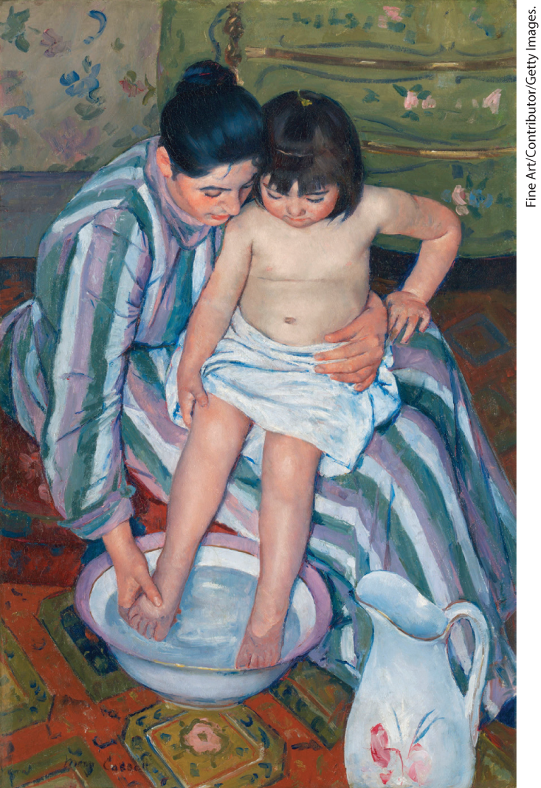
Mary Cassatt, The Child’s Bath, 1893

Slide 37
IV. The Birth of Mass Politics (1 of 9)
A. Workers, Politics, and Protest (1 of 3)
  Workers form unions to exert pressure on governments and businesses
  Some industrialists find unions appealing
  Pace of collective bargaining increases, as do strikes
  Housewives carry out protests against high food prices
  Governments increasingly respond to strikes with force
Notes:
IV. The Birth of Mass Politics (1 of 9)
A. Workers, Politics, and Protest (1 of 3)
Struggling for a political voice, workers came together in unions to exert pressure on governments and businesses, marking the beginning of mass politics.
Despite fears of revolution, some industrialists found unions appealing because they made strikes more predictable (or even preventable) and also provided a liaison for labor-management relations.
From the 1880s on, the pace of collective action for more pay, lower prices, and better working conditions accelerated, and the number of strikes increased.
Housewives carried out their own protests against high food prices, confiscating merchants’ goods and selling them at what they considered a just price.
Although most strikes were not revolutionary, governments increasingly responded with force.

Slide 38
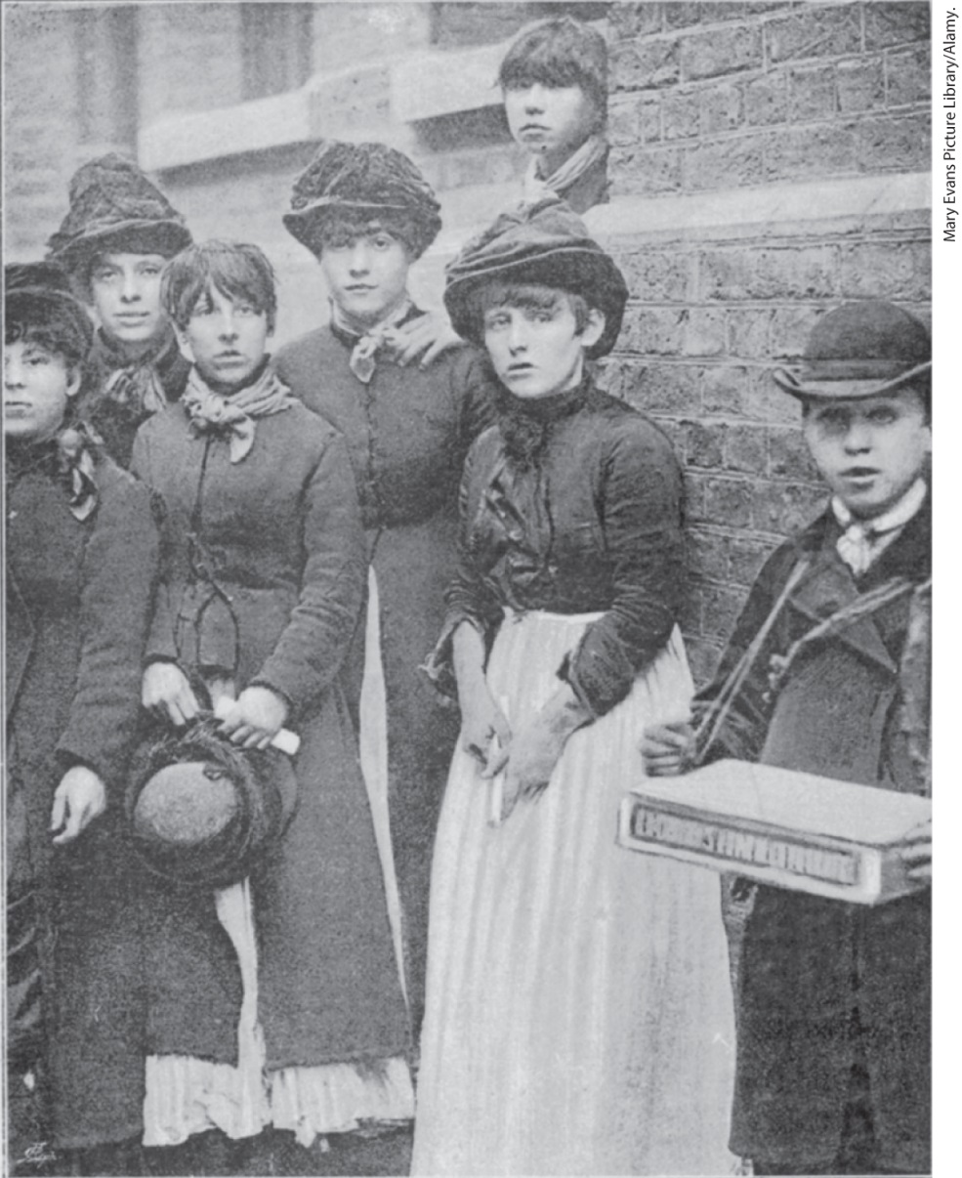
Match Makers’ Union

Slide 39
IV. The Birth of Mass Politics (2 of 9)
A. Workers, Politics, and Protest (2 of 3)
  Unions begin to form for different types of workers
  New nationwide unions could plan massive strikes affecting a number of trades
  Unions increasingly influenced business practices and society
  Political parties such as the Labour Party address working-class issues
  Socialists from across Europe form the Second International, a federation of working-class organizations
Notes:
IV. The Birth of Mass Politics (2 of 9)
A. Workers, Politics, and Protest (2 of 3)
Unions continued to attract skilled artisans, but a new unionism also attracted transport workers, miners, matchgirls, and dockworkers.
These new unions were nationwide groups that could plan massive general strikes affecting a number of trades simultaneously.
Like cartels and trusts, these unions increasingly influenced business practices and society’s views of workers.
New political parties, such as the Labour Party in England, most of which were inspired by Marxist theories, also addressed working-class issues.
In 1889, some four hundred socialists from across Europe formed the Second International, a federation of working-class organizations and political parties that replaced the First International founded by Marx.

Slide 40
IV. The Birth of Mass Politics (3 of 9)
A. Workers, Politics, and Protest (3 of 3)
  This organization adopted Marxist revolutionary program
  Members wanted to rid the organization of anarchists
  Anarchists had bombed various buildings
  Women join working-class parties, but these groups pay little attention to women’s issues
  Politics incorporated informally into everyday life through leisure activities
Notes:
IV. The Birth of Mass Politics (3 of 9)
A. Workers, Politics, and Protest (3 of 3)
This organization adopted a Marxist revolutionary program but also advocated suffrage.
Members wanted to rid the organization of anarchists for whom Marxist ideology was not applicable and who flourished in less industrial parts of Europe, notably Italy, Spain, and Russia.
During the 1880s, anarchists had bombed stock exchanges, parliaments, and businesses.
Some women joined working-class parties, but since they could not vote, they had little time for party activities, and their presence was rejected by many working-class men; working-class parties paid little attention to women’s issues.
Politics were also incorporated more informally into everyday life through a range of organizations designed to forge worker solidarity through leisure activities — gymnastic and choral societies, for example.

Slide 41
IV. The Birth of Mass Politics (4 of 9)
B. Expanding Political Participation in Western Europe (1 of 2)
  Western European nations moved toward mass politics faster than countries to the east
  Mass journalism gives Europeans information about politics and world events
  Journalism creates informed citizens, but elites complain about predilection for the sensational
  William Gladstone used journalism to his advantage to campaign for a seat in British Parliament
  British Ballot Act of 1872 makes voting secret
  Reform Act of 1884 doubles electorate enfranchising many urban citizens
  Liberals and Conservatives established political clubs to gain party loyalty
Notes:
IV. The Birth of Mass Politics (4 of 9)
B. Expanding Political Participation in Western Europe (1 of 2)
Western European nations moved toward mass politics more rapidly than did countries to the east.
The rise of mass journalism after 1880 gave Europeans access to information about politics and world events.
Journalism created a national community of up-to-date citizens, but elites grumbled about its predilection for the sensational and the scandalous.
William Gladstone (1809–1898) used journalism to his advantage when he waged a campaign for a seat in the British Parliament in 1879; newspapers reported his tour of northern England and Scotland, highlighting his speeches to thousands of working men and women.
This campaign exemplified the trend toward expanded participation in Britain’s political life, a process continued with the Ballot Act of 1872, which made voting secret.
Then, with the Reform Act of 1884, the electorate was doubled, enfranchising many urban workers and artisans.
As many British men entered politics for the first time, both Liberals and Conservatives established political clubs to gain party loyalty.

Slide 42
IV. The Birth of Mass Politics (5 of 9)
B. Expanding Political Participation in Western Europe (2 of 2)
  Under the leadership of Charles Stewart Parnell, the Irish demand their own Parliament
  Parnell’s campaign fails after the revelation of an affair
  The Third Republic in France destabilized due to scandal and political struggles
  A new constitution strengthened the elected Chamber of Deputies at the expense of the presidency
  Newspaper coverage of financial scandals involving the Chamber of Deputies eroded confidence in the government
  Republican leaders sought to create a free public education system
  Spain and Belgium established universal male suffrage, whereas other countries limited voting
Notes:
IV. The Birth of Mass Politics (5 of 9)
B. Expanding Political Participation in Western Europe (2 of 2)
British political reforms weakened the control of the landed aristocracy, a change that was especially revolutionary in Ireland, where Irish tenant farmers gained the right to vote and could use that vote against absentee landlords. Under the leadership of Charles Stewart Parnell (1846–1891), the Irish demanded their own Parliament (home rule).
Parnell’s campaign failed, and he died in disgrace after the revelation of his affair with a married woman.
In France, the Third Republic (established in 1874) was unstable, due to scandal and political struggle among competing factions.
An alliance of businessmen, shopkeepers, professionals, and rural property owners successfully supported the republic, and in 1875, when a new constitution was created, it strengthened the elected Chamber of Deputies at the expense of the presidency.
However, newspaper stories of financial scandals involving members of the Chamber of Deputies eroded confidence in the government and contributed to anti-Semitism as many blamed Jewish bankers.
Republican leaders sought to create national unity by instituting a system of compulsory and free public education in the 1880s.
Spain and Belgium established universal manhood suffrage in 1890 and 1893, respectively, whereas Denmark, Sweden, Italy, and the Netherlands continued to limit political participation.

Slide 43
IV. The Birth of Mass Politics (6 of 9)
C. Power Politics in Central and Eastern Europe (1 of 4)
  In Germany, Austria-Hungary, and Russia, political forces remained powerful
  Bismarck sought stability after uniting the German states
  Bismarck forges an alliance called the Three Emperors’ League with Austria-Hungary and Russia
  Bismarck creates financial institutions to further German commerce and industry
  Austria-Hungary enacts free-trade, but remains monarchist and authoritarian
  Austria-Hungary increasingly threatened by Slavic nationalism
Notes:
IV. The Birth of Mass Politics (6 of 9)
C. Power Politics in Central and Eastern Europe (1 of 4)
In Germany, Austria-Hungary, and Russia, agrarian political forces remained powerful, often working to block political, social, and economic change.
Once Bismarck succeeded in uniting the German states, he sought stability and a respite from war.
In 1873, he forged an alliance called the Three Emperors’ League with Austria-Hungary and Russia, both of which shared Germany’s commitment to maintain the political status quo.
Bismarck joined with liberals at home to create financial institutions destined to further German commerce and industry such as a central bank. He also opposed the growth of socialist political parties and organizations and sided with conservatives in establishing agricultural tariffs.
In Austria-Hungary, the liberals held power for a time in the 1870s, and the government enacted free-trade provisions, but the country remained monarchist and authoritarian.
Despite some concessions, Austria-Hungary was increasingly threatened by Slavic nationalism.

Slide 44
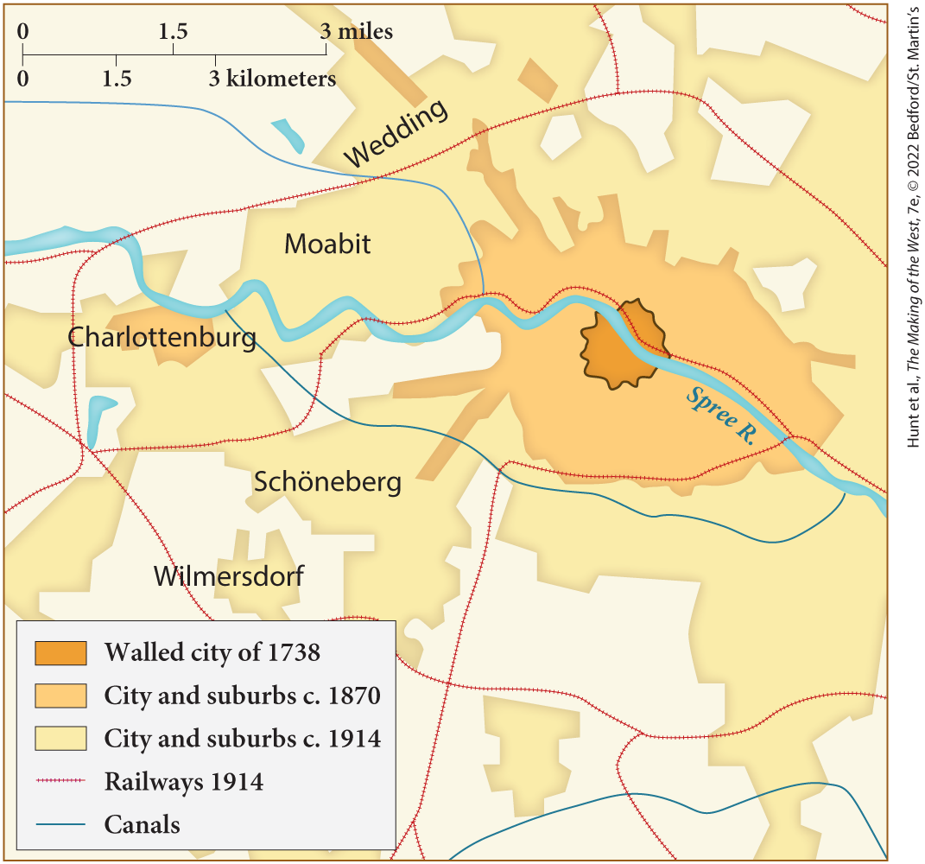
MAP 23.3 Expansion of Berlin to 1914

Slide 45
IV. The Birth of Mass Politics (7 of 9)
C. Power Politics in Central and Eastern Europe (2 of 4)
  Slavs in the Balkans rebel against Ottoman control
  Russian Pan-Slavic organizations send relief, Russia declares war on Turkey
  Treaty of San Stefano creates a large, pro-Russian Bulgaria
  Austria-Hungary and Great Britain feared Bulgaria would become a Russian satellite
  An international congress held in Berlin partitions Bulgaria
  Following the Congress of Berlin, European powers attempted to ensure stability
Notes:
IV. The Birth of Mass Politics (7 of 9)
C. Power Politics in Central and Eastern Europe (2 of 4)
In the Balkans, Slavs of Bulgaria and Bosnia-Herzegovina rebelled against Ottoman control in 1876; after brutal Ottoman countermeasures, they were followed by Serbia and Montenegro.
Russian Pan-Slavic organizations sent relief to the rebels, and Russia declared war on Turkey in 1877.
The 1878 Treaty of San Stefano created a large, pro-Russian Bulgaria.
Austria-Hungary and Great Britain feared that an enlarged Bulgaria would become a Russian satellite, enabling the tsar to dominate the Balkans.
An international congress held in Berlin staved off the threat of war and rolled back the Russian victory by partitioning Bulgaria.
Following the Congress of Berlin, the European powers attempted to ensure stability through a series of alliances and treaties.

Slide 46
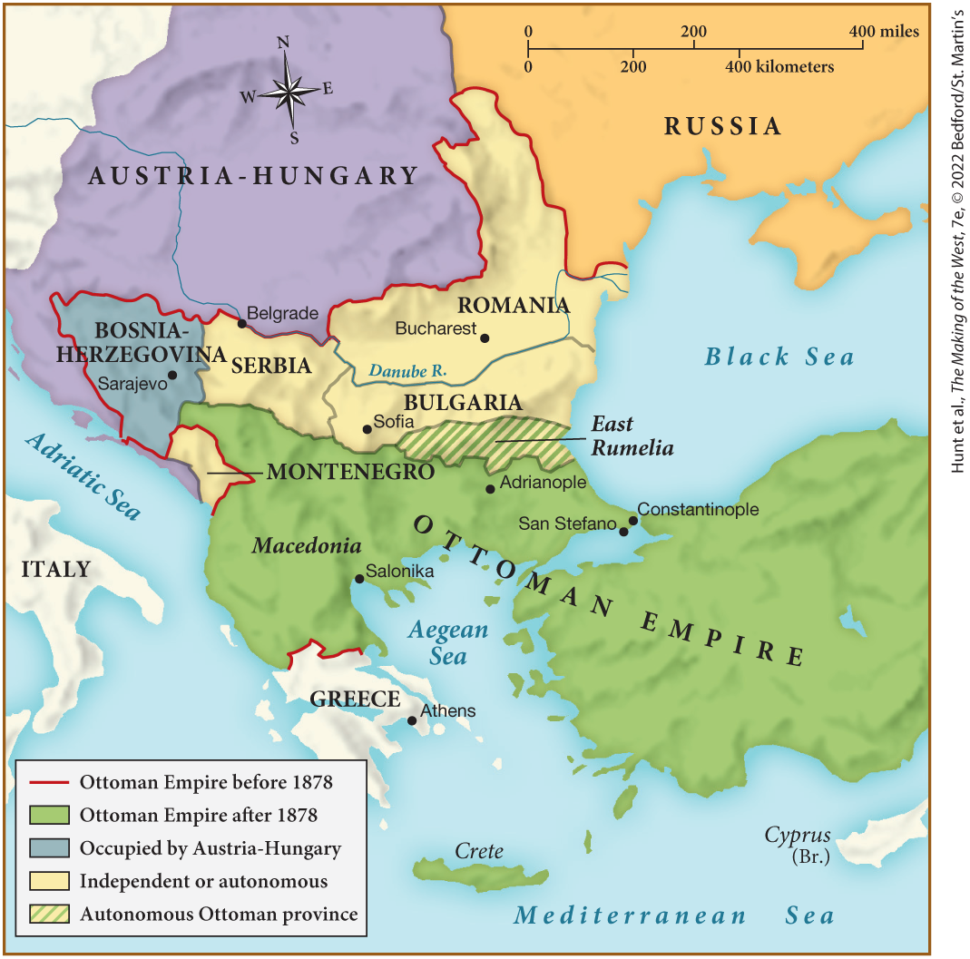
MAP 23.4 The Balkans, c. 1878

Slide 47
IV. The Birth of Mass Politics (8 of 9)
C. Power Politics in Central and Eastern Europe (3 of 4)
  Germany and Austria-Hungary form a defensive alliance against Russia
  Italy joins, turning the Dual Alliance into the Triple Alliance
  The Three Emperors’ League replaced by a Reinsurance Treaty between Germany and Russia
  Russia faces internal strife from revolutionary groups
  Russia’s secret police round up radicals, many are executed
  Russian writers Leo Tolstoy and Fyodor Dostoevsky both opposed revolution
Notes:
IV. The Birth of Mass Politics (8 of 9)
C. Power Politics in Central and Eastern Europe (3 of 4)
Germany and Austria-Hungary formed a defensive alliance in 1879 against Russia.
In 1882, Italy joined, turning the Dual Alliance into the Triple Alliance.
The Three Emperors’ League was replaced in 1887 by a Reinsurance Treaty between Germany and Russia, designed to prevent the breakout of a war between Russia and Austria-Hungary.
Russia’s internal affairs were in disarray. A dissatisfied, reform-minded youth increasingly turned to revolutionary groups such as the Populists for solutions to political and social problems.
Russia’s formidable secret police rounded up hundreds of radicals, many of whom were executed.
Writers participated in the debate over Russia’s future. Leo Tolstoy and Fyodor Dostoevsky both opposed revolution, believing that Russia required spiritual regeneration.

Slide 48
IV. The Birth of Mass Politics (9 of 9)
C. Power Politics in Central and Eastern Europe (4 of 4)
  Radical revolutionary groups argue for need for violent action
  One of these groups — the People’s Will — murder Tsar Alexander II
  In response, Alexander III rejected any calls for further reform and began a campaign of intense Russification
  Five million Jews were confined to the Pale of Settlement and suffered oppression
  New German kaiser William II dismisses Bismarck and allows the alliance with Russia to lapse
  International politics grow more dangerous and unpredictable
Notes:
IV. The Birth of Mass Politics (9 of 9)
C. Power Politics in Central and Eastern Europe (4 of 4)
The more radical revolutionary groups, however, saw a need for violent action.
In 1881, one of these groups — the People’s Will — murdered Tsar Alexander II in a bomb attack.
In response, Alexander III (r. 1881–1894) rejected any calls for further reform, gave the secret police virtually unchecked power, and embarked on a campaign of intense Russification, denigrating minority groups in the Russian Empire.
The five million Jews who were confined to the Pale of Settlement, an area to which they had been restricted since the eighteenth century, suffered especially severe oppression in the form of government-instigated pogroms.
As Russia’s internal politics became more chaotic and repressive, its international alliances were altered by the decision of the new German kaiser William II (r. 1888–1918) to dismiss Bismarck and allow the alliance with Russia to lapse in favor of closer ties with Austria-Hungary.
The international scene was growing ever more dangerous and unpredictable.

Slide 49
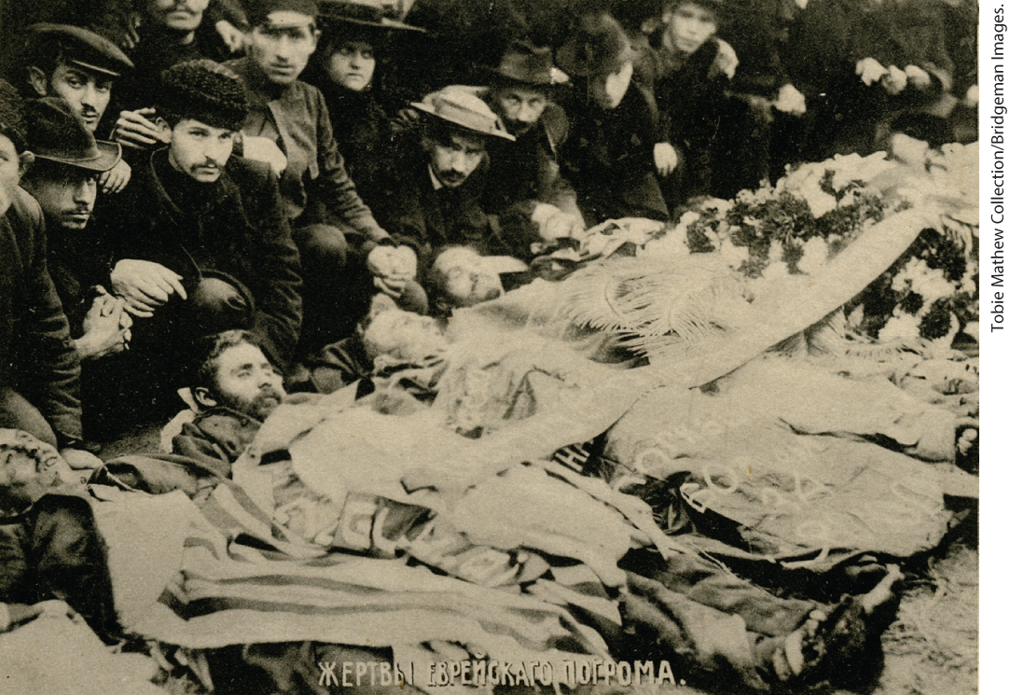
Pogrom Victims

Slide 50
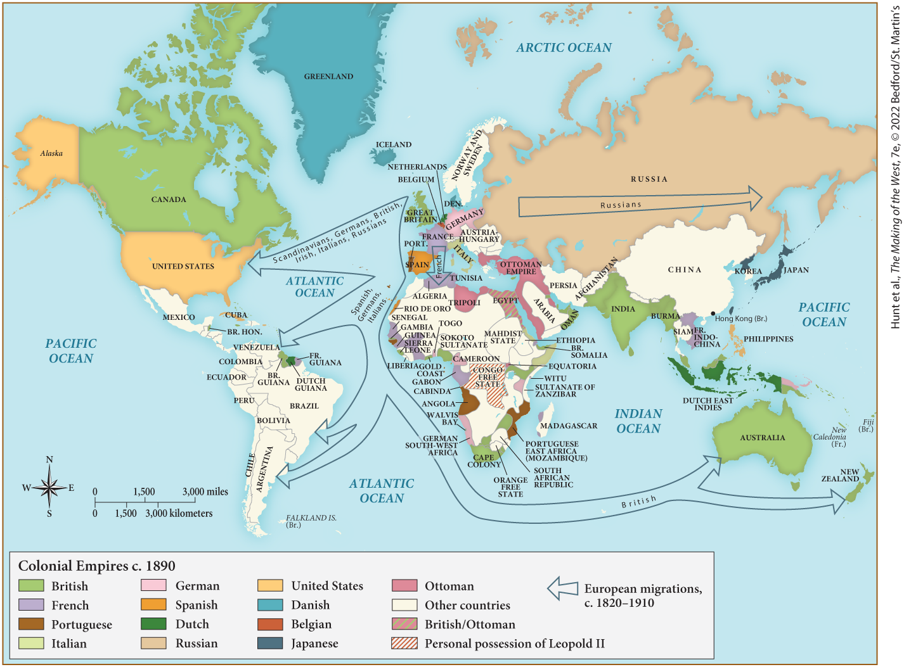
MAP 23.5 Mapping the West: The West and the World, c. 1890

