Slide 1
The Making of the West
Seventh Edition
Hunt • Martin • Rosenwein • Smith
CHAPTER 22
Politics and Culture of the Nation-State
1850 –1870
Copyright © 2022 by Bedford/St. Martin’s
Distributed by Bedford/St. Martin’s/Macmillan Learning strictly for use with its products. Not for redistribution.

Slide 2

Aïda Poster

Slide 3
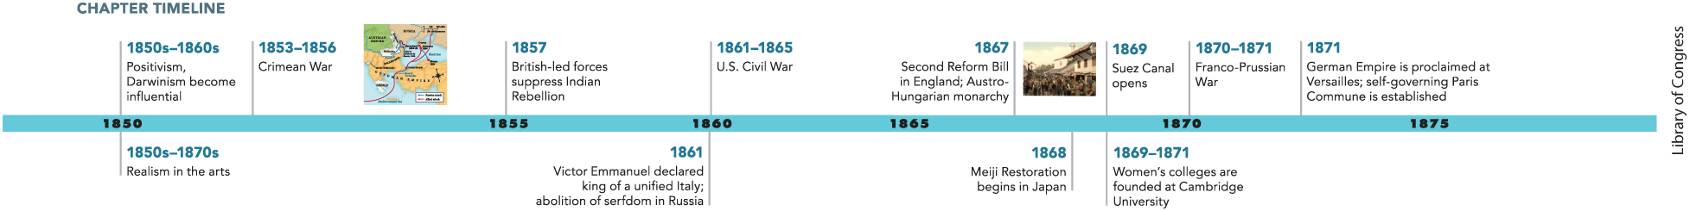
Chapter 22 Timeline

Slide 4
I. The End of the Concert of Europe (1 of 6)
A. Napoleon III and the Quest for French Glory
  Louis-Napoleon encouraged French grandeur and the cult of his uncle
  Napoleon III maintained a masculine image while his wife, the Empress Eugénie, fulfilled the role of mother
  Napoleon III supported modernization and promoting economic reforms
  Napoleon III allowed working-class organizations after economic downturn
  Napoleon III realigned foreign powers and engaged in foreign wars
  He also attempted to extend French influence outside of Europe
  Napoleon III’s foreign policy broke down diplomacy established by the Congress of Vienna
Notes:
I. The End of the Concert of Europe (1 of 6)
A. Napoleon III and the Quest for French Glory
In France, Louis-Napoleon encouraged French grandeur and the cult of his famous uncle as part of nation building.
As emperor, Napoleon III combined economic liberalism with authoritarian rule, maintaining a lavish court and cultivating a masculine image by wearing military uniforms and openly displaying mistresses while his wife, the Empress Eugénie, fulfilled the role of devoted mother and philanthropist.
Napoleon III also supported modernization, sponsoring the rebuilding of Paris and artistic exhibitions, while promoting free trade with Britain, economic growth, railroad construction, and innovative investment banking.
Following an economic downturn in the late 1850s, Napoleon III sought broader support by allowing working-class organizations and some democratic reforms.
Napoleon III broke the Congress of Vienna’s containment of France by realigning foreign powers and engaging Russia, Austria, and Prussia in a series of wars.
Outside Europe he enforced French rule in Algeria and southeast Asia and attempted to install Habsburg Maximilian as ruler of Mexico, a plan that ended in rebellion and Maximilian’s execution in 1867. He also encouraged such projects as the Suez Canal, which connected the Mediterranean and Red Seas.
Overall, Napoleon III’s foreign policy broke down the international system of peaceful diplomacy established by the Congress of Vienna.

Slide 5
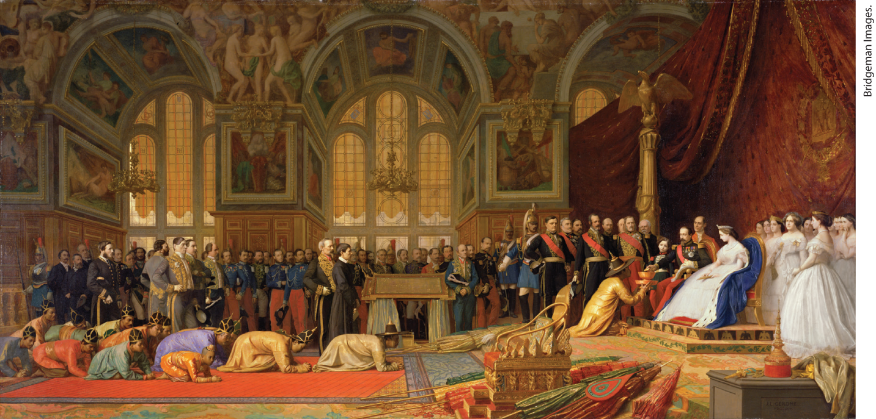
Napoleon III and Eugénie Receive the Siamese Ambassadors, 1864

Slide 6
I. The End of the Concert of Europe (2 of 6)
B. The Crimean War, 1853–1856: Turning Point in European Affairs (1 of 2)
  Russian tsar Nicholas aimed to absorb the ailing Ottoman Empire
  The conflict between Russia and the Ottoman Empire upsets the European balance of power
  Austria remains neutral, ends Russian-Austrian alliance
  Russians dominate the Ottomans, but British ally with France to declare war on Russia
  British and French besiege Russian naval base at Sevastopol in the Crimea on the Black Sea
  A million men die during the conflict
Notes:
I. The End of the Concert of Europe (2 of 6)
B. The Crimean War, 1853–1856: Turning Point in European Affairs (1 of 2)
Russian tsar Nicholas I had wanted to absorb as much of the ailing Ottoman Empire as possible, and Napoleon III encouraged his aggressiveness.
The conflict between Russia and the Ottoman Empire that broke out in 1853 upset the European balance of power that had been set by the Congress of Vienna.
The Austrians, who still harbored resentment over Russia helping to put down a Hungarian revolt in 1849, remained neutral — again with encouragement from Napoleon III — ending the Russian-Austrian alliance that had checked French power.
The Russians dominated the Ottomans militarily, but since the British were concerned by the Russian threat to Britain’s Mediterranean links with Asia, they allied with their former enemy France to declare war on Russia in 1854.
The British and French besieged the Russian naval base at Sevastopol in the Crimea on the Black Sea for a year; both sides suffered high casualties.
Lacking adequate sanitation and medical care, and led by incompetent generals on both sides, a million men died, more than two-thirds of them from disease and starvation, showing the nation-state’s incomplete evolution.

Slide 7
I. The End of the Concert of Europe (3 of 6)
B. The Crimean War, 1853–1856: Turning Point in European Affairs (2 of 2)
  Alexander II becomes tsar after his father’s death
  Peace of Paris deprives Russia of key naval bases
  Moldavia and Walachia became autonomous Turkish provinces
  Crimean War introduces new technologies into warfare
  Increased press coverage brought forth extensive public scrutiny
  Florence Nightingale of Britain pioneered professional nursing and promoted sanitation
  The war accomplishes Napoleon III’s goal of ending alliance of Austria and Russia
Notes:
I. The End of the Concert of Europe (3 of 6)
B. The Crimean War, 1853–1856: Turning Point in European Affairs (2 of 2)
Upon his father’s death, Alexander II (r. 1855–1881) became tsar and asked for peace.
The 1856 Peace of Paris deprived Russia of its naval bases in the Dardanelles Straits and the Black Sea.
Moldavia and Walachia (which soon merged to form Romania) became autonomous Turkish provinces, reducing Russian influence.
The Crimean War introduced new technologies into war such as the railroad, the shell-firing cannon, the breech-loading rifle, the telegraph, and the steam-powered ship.
It was also the first war to be subjected to extensive public scrutiny, as increased press coverage, the use of the telegraph, and the advent of photography brought the war home to Europeans in a way never before possible. Many were outraged by the way the war was conducted.
Florence Nightingale of Britain went to the front lines and organized a group of nurses, pioneering professional nursing and promoting sanitation.
The war accomplished Napoleon III’s goal of severing the conservative alliance of Austria and Russia. This opened up space for liberalism and nationalism in Europe.

Slide 8
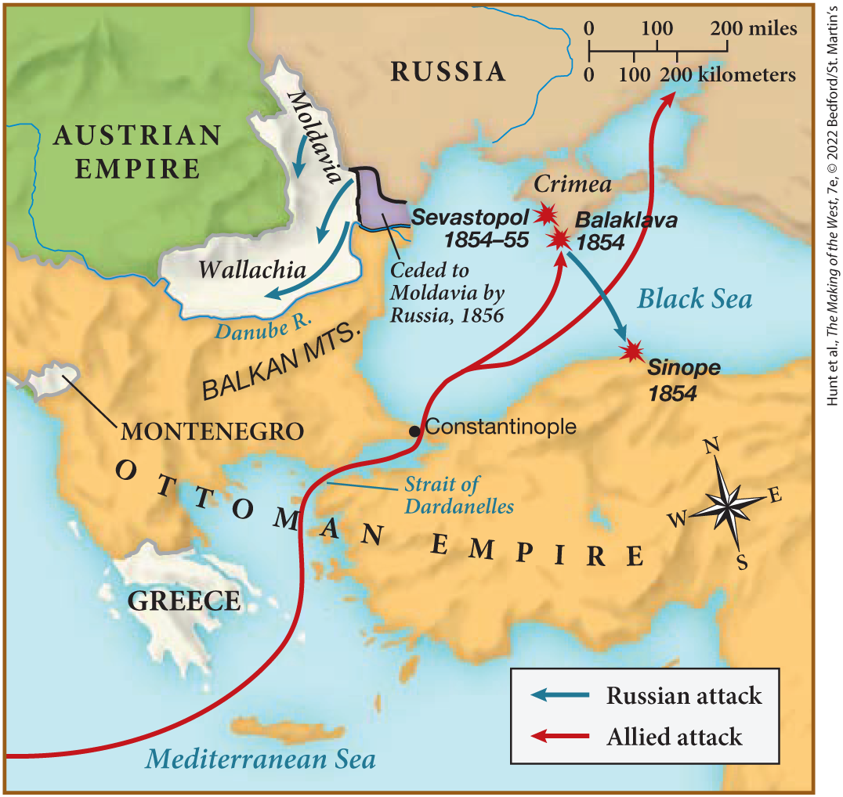
MAP 22.1 The Crimean War, 1853–1856

Slide 9
I. The End of the Concert of Europe (4 of 6)
C. Reform in Russia (1 of 3)
  Peasant insurrection was common in Russia prior to the war
  Writers such as Ivan Turgenev denounces serfdom
  Tsar Alexander II launches a series of Great Reforms
  Former serfs were given land, but not as private owners
  The land was organized into a community controlled by elders
  Although no individual peasants actually owned land, all were required to repay the original landowners
Notes:
I. The End of the Concert of Europe (4 of 6)
C. Reform in Russia (1 of 3)
In the decade preceding the Crimean War, peasant insurrection was common in Russia.
Writers such as Ivan Turgenev denounced serfdom. Defeat in the war confronted the educated public with the poor performance of serf conscripted armies and the intolerable liability of serf labor.
To avoid revolution, Tsar Alexander II launched a series of Great Reforms, beginning with the emancipation of nearly fifty million serfs.
The former serfs were given land, but not as private landowners.
Rather, they and the land they farmed were organized into a community (mir) controlled by male village elders.
Although no individual peasants actually owned land, all were required to repay the original landowners via payments to the government.

Slide 10
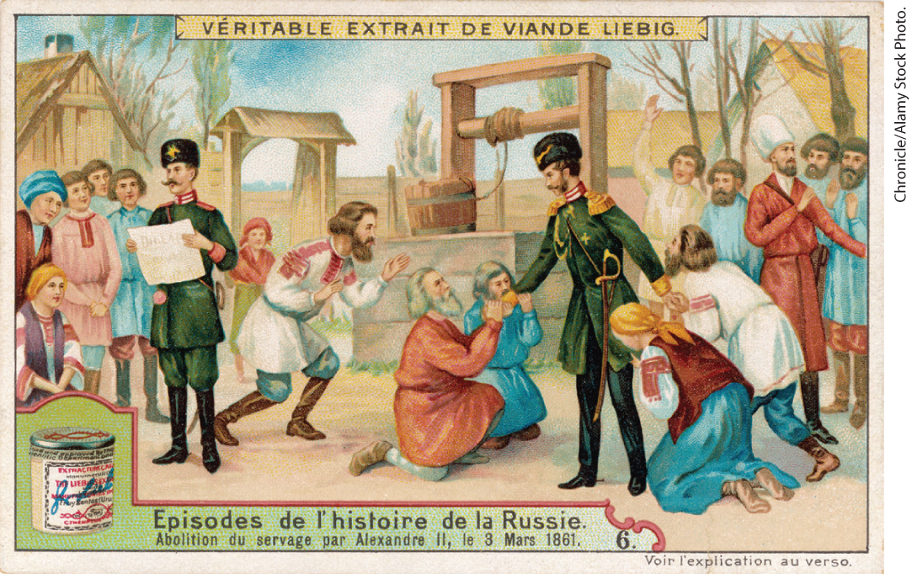
Emancipation of the Russian Serfs

Slide 11
I. The End of the Concert of Europe (5 of 6)
C. Reform in Russia (2 of 3)
  Serfs still could not form pool of free labor
  Russia also reforms local administration, setting regional councils dominated by nobility
  Travel restrictions lifted
  Military reform replaced the twenty-five-year period of conscription with six-year term
  Reforms aimed to create a Russian army more competitive with other European forces
  Reaction to the reforms differed among generations
Notes:
I. The End of the Concert of Europe (5 of 6)
C. Reform in Russia (2 of 3)
Emancipated but chained to enormous debts and particular plots of land, the serfs still could not form the pool of free labor Russia needed.
The state also reformed local administration, setting up zemstvos, regional councils dominated by the nobility, and the judiciary by giving all Russians access to modern civil courts.
Travel restrictions were lifted, allowing Russians to see how the rest of Europe was governed.
Military reform followed in 1874 when the government replaced the twenty-five-year period of conscription with a six-year term.
It was believed that attention to education, efficiency, and humane treatment of recruits would create a Russian army more competitive with other European forces.
Reaction to the reforms often differed along generational lines. Older aristocrats resented the weakening of their personal authority. Younger aristocrats emphasized the importance of practical activity over leisure and identified with workers and peasants, and younger aristocratic women sought greater independence.

Slide 12
I. The End of the Concert of Europe (6 of 6)
C. Reform in Russia (3 of 3)
  Traditionalists label young people as “nihilists”
  Reforms spark resistance in Russian-dominated nations
  Russian government responds to unrest in Poland with military force, campaign of Russification
  Alexander II only partially develops other nation-states
  Control still held by the tsar and his inner circle
  Russia lacks national identity felt elsewhere
Notes:
I. The End of the Concert of Europe (6 of 6)
C. Reform in Russia (3 of 3)
Traditionalists pessimistically labeled these radical young people “nihilists,” implying a lack of belief in any values.
The reforms also sparked resistance in Russian-dominated nations, including Poland, which sought full independence in 1863. Polish peasants were promised reforms in return for helping the Russians.
As in the past, the Russian government responded to unrest in Poland and elsewhere with military force, but also with a policy of Russification — an intense campaign to force minorities to adopt Russian language and culture.
Despite the Great Reforms, Alexander II only partially developed the institutions that buttressed other nation-states.
The reins of government were still tightly held by the tsar and his inner circle.
The persistence of autocracy and the abuse of large population groups suffocated the shared national identity felt so strongly elsewhere.

Slide 13
II. War and Nation Building (1 of 10)
A. Cavour, Garibaldi, and the Process of Italian Unification (1 of 2)
  Idea of political unification had not disappeared in Italy
  Risorgimento (“rebirth”) begins in Piedmont-Sardinia
  Its prime minister, Camillo di Cavour, attempts to liberate Austrian-held regions
  In exchange for military aid, France promised the city of Nice and the province of Savoy
  Cavour provokes Austrians to invade northern Italy
  Forces of Piedmont-Sardinia win stunning victories over Austria
Notes:
II. War and Nation Building (1 of 10)
A. Cavour, Garibaldi, and the Process of Italian Unification (1 of 2)
Despite failed revolutions in 1848, the idea of political unification had not disappeared in Italy.
The obvious leader for this Risorgimento (“rebirth”) was Piedmont-Sardinia, the most economically and militarily advanced of the Italian states, with a liberal political climate.
Its prime minister, Camillo di Cavour (1810–1861) attempted to liberate Austrian-held regions by encouraging economic development and allying with Napoleon III.
In exchange for military aid, France was promised the city of Nice and the province of Savoy.
Cavour provoked the Austrians to invade northern Italy in April 1859, which united nationalist Italians in support of Piedmont.
With the help of the French and the newly built Piedmontese railroad, the forces of Piedmont-Sardinia won stunning victories over Austria.

Slide 14
II. War and Nation Building (2 of 10)
A. Cavour, Garibaldi, and the Process of Italian Unification (2 of 2)
  Napoleon III signs treaty granting Lombardy to Piedmont-Sardinia, but leaving Venetia with Austria
  Piedmontese victories create a groundswell of nationalism, other northern Italian states join Piedmont-Sardinia.
  Guerrilla fighter Giuseppe Garibaldi raises volunteer army and liberates Sicily from corrupt government
  Cavour sends his troops to meet Garibaldi, who supports Piedmontese monarchy; the kingdom of Italy is proclaimed
  Cavour dies, and divisions keep Italy relatively weak
  Legend of Garibaldi becomes more important to Italian national pride than the work of Cavour
Notes:
II. War and Nation Building (2 of 10)
A. Cavour, Garibaldi, and the Process of Italian Unification (2 of 2)
To Cavour’s dismay, Napoleon III then signed a treaty granting Lombardy to Piedmont-Sardinia, but leaving Venetia in Austrian hands.
Nevertheless, the Piedmontese victories had created a groundswell of nationalism, and other northern Italian states (except Rome, which was occupied by French troops) elected to join Piedmont-Sardinia.
In May 1860, Giuseppe Garibaldi (1807–1882), a committed republican and inspired guerrilla fighter, raised a volunteer army (the Red Shirts), liberated Sicily from overbearing landlords and a corrupt government, and then crossed to the mainland and headed north.
Cavour sent his troops south, and when the two armies met in Naples in the autumn of 1860, Garibaldi threw his support to the Piedmontese monarchy, and in 1861, the kingdom of Italy was proclaimed, with former Piedmont-Sardinian king Victor Emmanuel at its head.
Cavour died shortly thereafter, and divisions among successive political leaders and differences between the wealthy commercial north and the impoverished agricultural south kept Italy relatively weak. Venice and Rome remained outside the new Italian state’s control.
The legend of the daring Garibaldi became more important to evolving Italian national pride than the economic and military Realpolitik of Cavour.

Slide 15
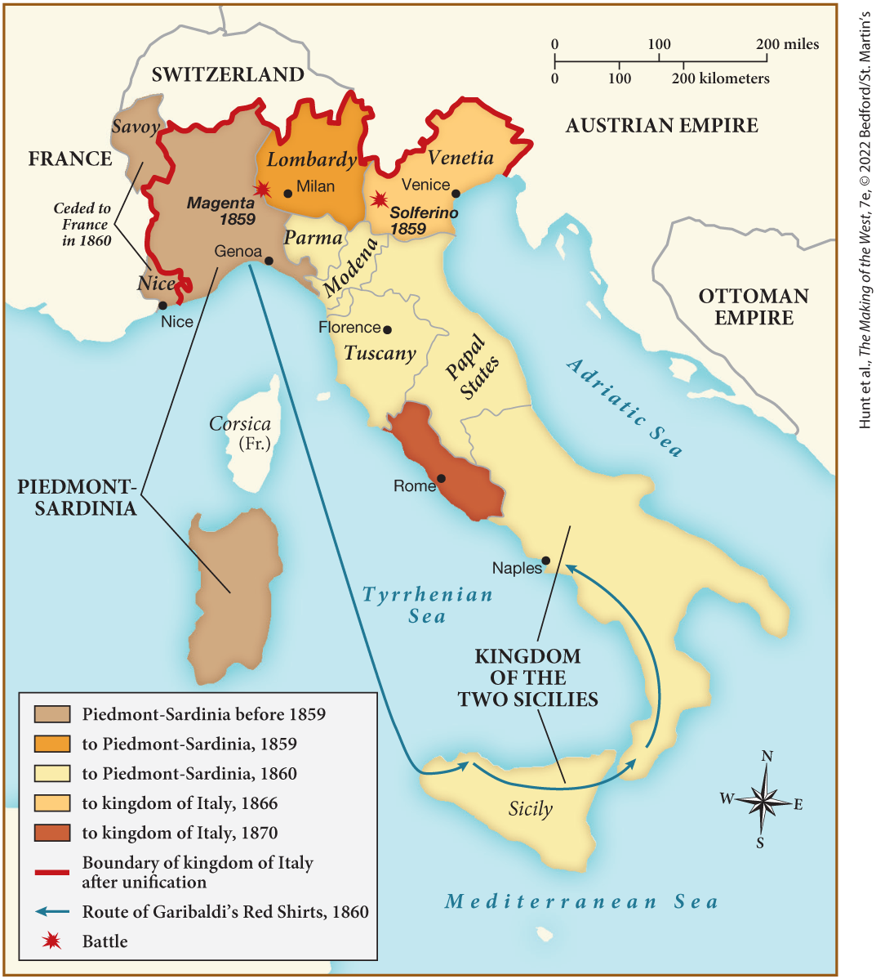
MAP 22.2 Unification of Italy, 1859–1870

Slide 16
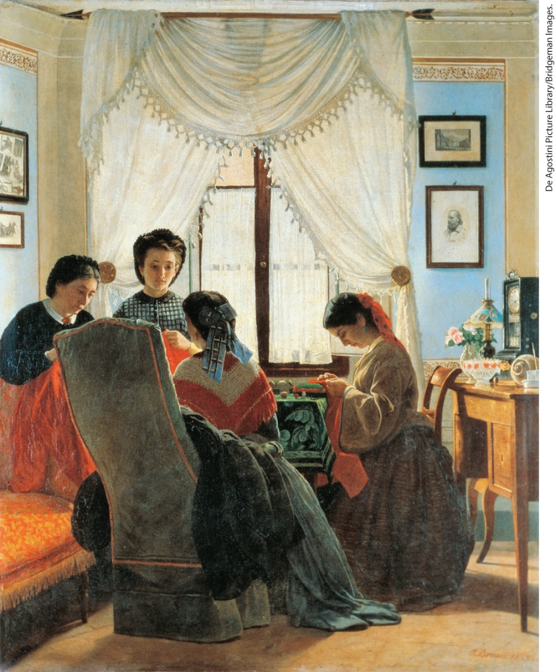
Seamstresses of the Red Shirts

Slide 17
II. War and Nation Building (3 of 10)
B. Bismarck and the Realpolitik of German Unification (1 of 3)
  Creation of a united Germany is momentous act for the future of Europe
  Otto von Bismarck appointed prime minister by William I of Prussia, quickly builds up army
  He embarks on a series of wars
  Bismarck unites the smaller German states behind Prussia rather than Austria
  Prussia and Austria win provinces of Schleswig and Holstein in the Danish war of 1864
Notes:
II. War and Nation Building (3 of 10)
B. Bismarck and the Realpolitik of German Unification (1 of 3)
The creation of a united Germany in 1871 was the most momentous act of nation building for the future of Europe and the world.
The architect of a united Germany was Otto von Bismarck (1815–1898). Appointed by William I of Prussia (r. 1861–1888) to the position of prime minister in 1862, Bismarck overrode liberals in parliament and rammed through programs to build up the army.
He then embarked on a series of wars: with Denmark in 1864, Austria in 1866, and France in 1870.
In the course of these wars, Bismarck united the smaller German states behind Prussia rather than Austria, thus excluding that great power from German unification.
In the Danish war of 1864, Prussia and Austria together won the provinces of Schleswig and Holstein, which had a heavy German population, from Denmark.

Slide 18
II. War and Nation Building (4 of 10)
B. Bismarck and the Realpolitik of German Unification (2 of 3)
  Austria provoked by Bismarck into declaring war on Prussia
  Modernized and mobile Prussian military wins a decisive victory, creates a North German Confederation
  Bismarck goads France into declaring war
  France falls the Prussian forces, ending Napoleon III’s Second Empire
  Germans crown King William of Prussia kaiser of the new German Reich
Notes:
II. War and Nation Building (4 of 10)
B. Bismarck and the Realpolitik of German Unification (2 of 3)
An overconfident Austria, laden with debt and plagued by its restless national minorities, was provoked by Bismarck into declaring war on Prussia over the administration of the provinces of Schleswig and Holstein.
Within seven weeks, the modernized and mobile Prussian military won a decisive victory. Prussia created a North German Confederation, excluding Austria.
To bring in the remaining German holdouts, Bismarck goaded France into declaring war over the choice of a new king for Spain, in part by provoking French public opinion.
France quickly fell to the Prussian forces, ending Napoleon III’s Second Empire, on September 4, 1870.
As the crowning blow, the Germans crowned King William of Prussia kaiser of the new German Reich (“empire”) at the Palace of Versailles in January 1871.

Slide 19
II. War and Nation Building (5 of 10)
B. Bismarck and the Realpolitik of German Unification (3 of 3)
  France gave Alsace and Lorraine to Germany as a result
  The kaiser retains his title as the king of Prussia
  The kaiser controls the military and appoints Bismarck chancellor of the empire
  Population of the states elect representatives to a new assembly, the Reichstag
  Votes from the upper classes count more than lower classes
  Liberals support Bismarck
Notes:
II. War and Nation Building (5 of 10)
B. Bismarck and the Realpolitik of German Unification (3 of 3)
France had to give Alsace and Lorraine to Germany and pay an indemnity.
The kaiser retained his title as the king of Prussia, and henceforth Prussia became a state of the new empire.
The kaiser controlled the military and appointed Bismarck chancellor of the empire.
The adult male population of all the states elected representatives to a new assembly, the Reichstag, which ratified budgets but had little power to initiate legislation.
To maintain the social hierarchy, votes from the upper classes counted more than those from the lower classes.
The liberals, giddy with military success, supported Bismarck’s blend of economic progress, constitutionalism, and militaristic nationalism.

Slide 20
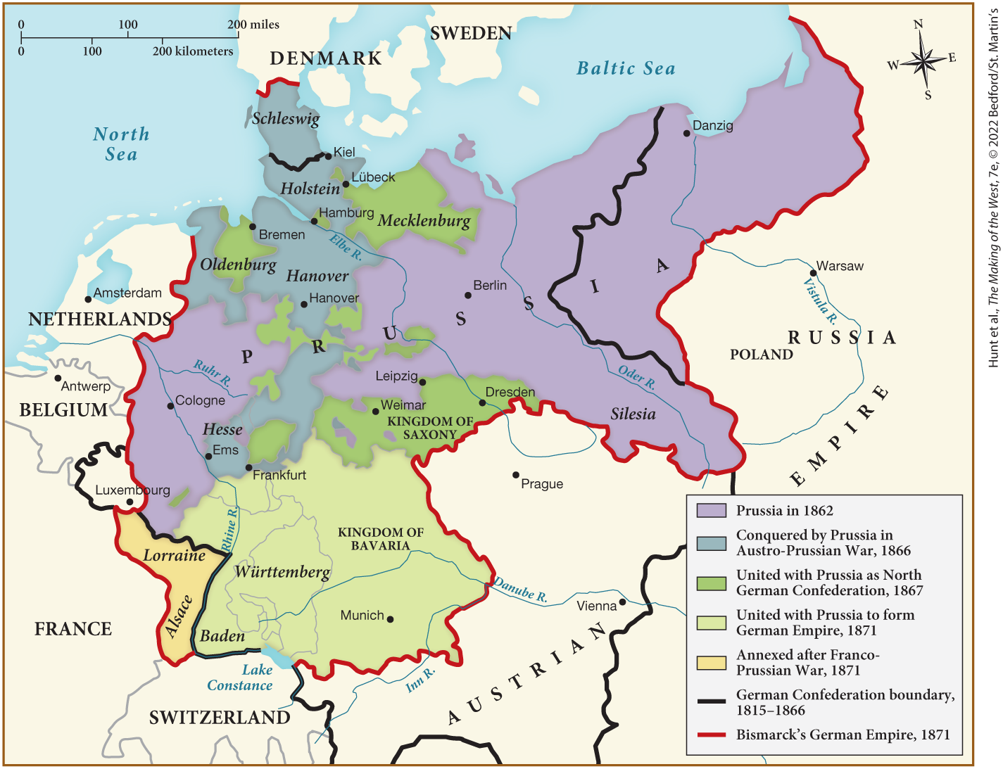
MAP 22.3 Unification of Germany, 1862–1871

Slide 21
II. War and Nation Building (6 of 10)
C. Francis Joseph and the Creation of the Austro-Hungarian Monarchy (1 of 2)
  Confrontations Cavour and Bismarck force Austria to make changes
  Emperor Francis Joseph attempts to enhance his authority through court ceremony
  Standards improve in the government, the state promotes local education, rights of minorities
  Internal barriers abolished, boom in private railway construction and foreign investment
  Vienna undergoes renovation, more jobs created as industrialization progresses
Notes:
II. War and Nation Building (6 of 10)
C. Francis Joseph and the Creation of the Austro-Hungarian Monarchy (1 of 2)
Confrontations with Cavour and Bismarck confronted Austria with the need to make some changes.
Hardworking Emperor Francis Joseph (r. 1848–1916) attempted to enhance his authority through elaborate and formal court ceremony, but he resisted change.
Nonetheless, in the 1850s and 1860s, standards of honesty and efficiency improved within the government, and the state promoted local education and respected the rights of minorities to be educated, and to communicate with officials, in their native language.
Most internal customs barriers were abolished, and there was a boom in private railway construction and foreign investment.
Eventually, Vienna underwent extensive renovation, and more jobs opened up as industrialization progressed.

Slide 22
II. War and Nation Building (7 of 10)
C. Francis Joseph and the Creation of the Austro-Hungarian Monarchy (2 of 2)
  Francis Joseph forced to modify policy as Germany imposes financial constraints
  Hungarian elites request Magyar home rule, creating a “dual monarchy”
  Although Francis Joseph was king, Hungary largely rules itself through restored parliament
  Other ethnic groups within the empire increased demands for self-rule
  Some turn to Russia, hoping to form a Pan-Slavism movement
  Loyalty to the Habsburgs remained, but imperial subjects had difficulty relating to one another
Notes:
II. War and Nation Building (7 of 10)
C. Francis Joseph and the Creation of the Austro-Hungarian Monarchy (2 of 2)
Francis Joseph was forced to modify his absolutism as German liberals imposed financial constraints on the military and blocked other measures that would strengthen the government.
In 1866, the Hungarian agrarian elites requested Magyar home rule, which was granted, creating a “dual monarchy.”
Although Francis Joseph was crowned king of Hungary and was in charge of coordinating Austro-Hungarian foreign policy, Hungary largely ruled itself after 1867 through the restored Hungarian parliament.
Following the establishment of this dual monarchy, other ethnic groups within the empire increased their demands for self-rule.
Some turned to Russia, hoping to form a Pan-Slavism movement (a transnational alliance of all Slavic peoples) that would allow them to break away from Austria’s influence.
Loyalty to the Habsburgs remained, but imperial subjects had increasing difficulty relating to one another as members of a single nation.

Slide 23
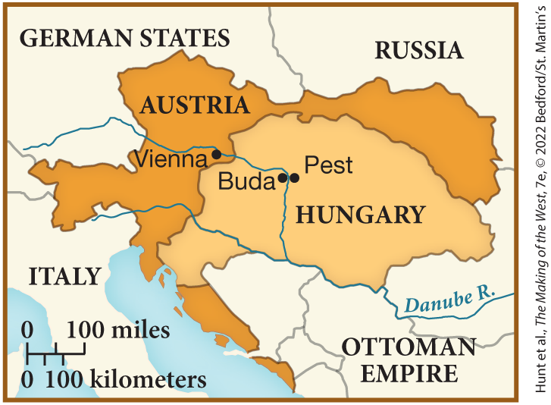
SPOT MAP 22.1 The Austro-Hungarian Monarchy, 1867

Slide 24
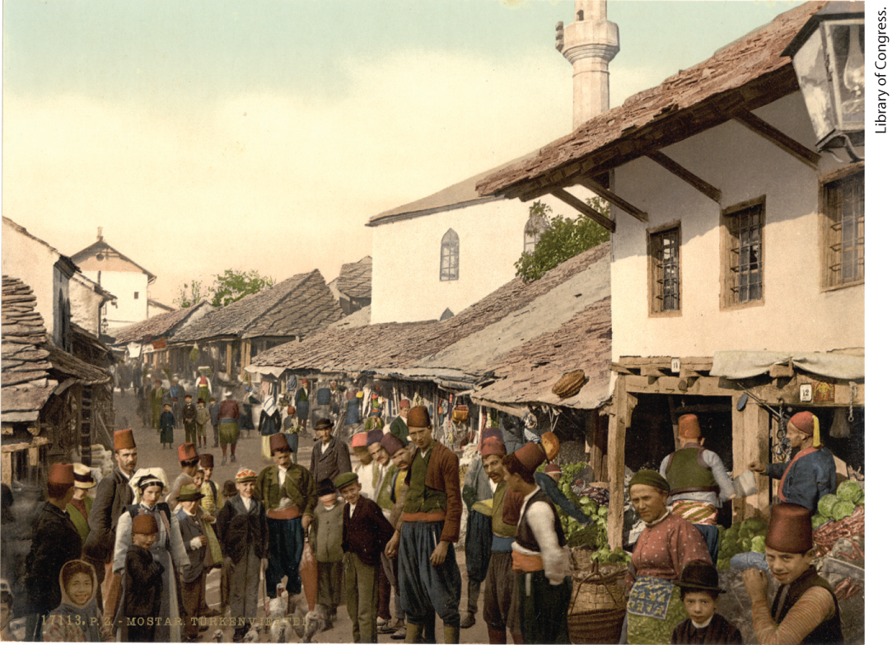
Mostar Marketplace

Slide 25
II. War and Nation Building (8 of 10)
D. Political Stability through Gradual Reform in Great Britain
  Great Britain, ruled by Queen Victoria with the aid of her husband Prince Albert, saw relative peace at home
  Parliament enjoyed smooth decision making and progress
  Conservative party, led by Benjamin Disraeli, passed the Second Reform Bill, which granted new voting rights
  Interest groups pressured both parties to support reform
  Government passes Matrimonial Causes Act of 1857, and the Married Women’s Property Act of 1870
  Royal ceremonies united citizens of different classes while masking social issues
  Britain’s politicians used violence to expand overseas empire and to control Ireland and Irish immigrants, but maintained a positive image
Notes:
II. War and Nation Building (8 of 10)
D. Political Stability through Gradual Reform in Great Britain
In contrast to the upheaval in continental Europe, Great Britain, ruled by Queen Victoria (r. 1837–1901) with the aid of her husband Prince Albert, basked in domestic tranquility, morality, and middle-class virtues.
Parliament, dominated by the Conservatives (formerly the Tory party) and the Liberals (formerly the Whigs), enjoyed smooth decision making and liberal progress.
In 1867, the Conservative party, led by Benjamin Disraeli (1804–1881), passed the Second Reform Bill, which enfranchised a million new male voters.
Interest groups pressured both parties to support reform.
Under pressure from women’s groups, the government addressed family and marital issues, passing the Matrimonial Causes Act of 1857, which facilitated divorce, and the Married Women’s Property Act of 1870, which allowed married women to own property and keep the wages they earned. Mass demonstrations led to passage of the Second Reform Bill.
Plush royal ceremonies united citizens of different classes while masking social conflict. The monarchy promoted respectability and the family. The term “Victorian” came to refer to anything from manners to political institutions during Victoria’s reign.
All was not peaceful, however. Britain’s politicians were as devoted to Realpolitik as Bismarck and used violence to expand their overseas empire and to control Ireland and Irish immigrants, who were denigrated. Removed from the violence occurring in distant colonies, Britons maintained a positive image as calm, peace-loving, and rational.

Slide 26
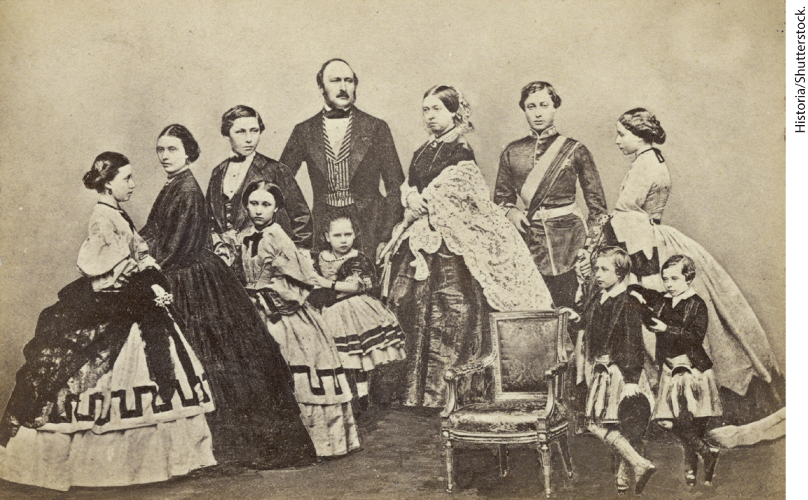
Portrait of Queen Victoria, Prince Albert, and Their Nine Children

Slide 27
II. War and Nation Building (9 of 10)
E. Nation Building in North America (1 of 2)
  More democratic culture existed in the United States
  United States continues to expand westward with victory over Mexico
  Politicians and citizens disagree over slavery, new Republican Party opposes slavery
  Election of Republican Abraham Lincoln led most slaveholding states to secede to form the Confederate States of America
  Lincoln issues the Emancipation Proclamation, which freed slaves in the Confederacy
Notes:
II. War and Nation Building (9 of 10)
E. Nation Building in North America (1 of 2)
The United States had a more democratic political culture, including near-universal male suffrage, an independent press, and combative mass political parties that believed that sovereignty derived from the people, no matter how exclusively “the people” was defined.
The United States continued to expand westward, and an 1848 victory over Mexico brought in California, Texas, and large portions of the Southwest.
Although politicians and citizens agreed that native Americans should be banned from these lands, they disagreed over whether slavery should be allowed. A new party, the Republican Party, opposed slavery and ran on a platform of “free soil, free labor, free men.”
As the issue came to polarize the country, the 1860 election of the Republican Abraham Lincoln led most of the slaveholding states to secede to form the Confederate States of America.
Although he initially fought to maintain the Union, in January 1863, Lincoln issued the Emancipation Proclamation, which freed slaves in the Confederacy, as a wartime measure.

Slide 28
II. War and Nation Building (10 of 10)
E. Nation Building in North America (2 of 2)
  North prevails despite assassination of Lincoln
  Slavery abolished, but full political rights to African American men nullified
  Union’s victory opened path to stronger national government and economic advance
  United States threatens annexation of Canada
  Great Britain grants Canada status of self-governing dominion
Notes:
II. War and Nation Building (10 of 10)
E. Nation Building in North America (2 of 2)
By April 1865, despite the assassination of Lincoln, the North, stronger economically and militarily, had prevailed.
Slavery was abolished, but the constitutional guarantee of full political rights to African American men was effectively nullified once southern whites regained control of state politics after 1877.
The Union’s victory opened the way to a stronger national government and economic advance not tied to the slave economy.
In retribution for Great Britain’s partiality to the Confederacy, the United States threatened the annexation of Canada.
To avoid this, Great Britain granted Canada the status of self-governing dominion.

Slide 29
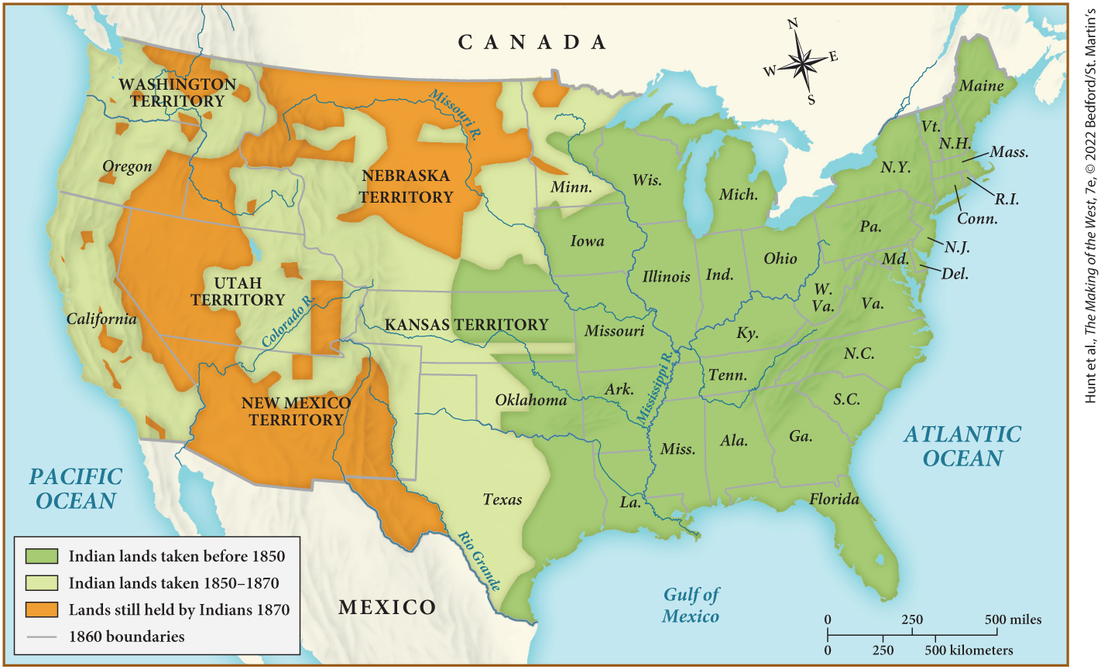
MAP 22.4 U.S. Expansion, 1850–1870

Slide 30
III. Nation Building through Social Order (1 of 13)
A. Bringing Order to the Cities (1 of 2)
  Efforts to improve sanitation and beautify European cities revitalized the state’s credit
  Austrian emperor Francis Joseph destroys Vienna’s medieval city walls, and replaces them with public buildings
  Other cities follow and build broad boulevards
  Renovated cities highlighted class differences as boulevards separate rich from poor
  Renovation replaces slums with large commercial streets
Notes:
III. Nation Building through Social Order (1 of 13)
A. Bringing Order to the Cities (1 of 2)
European cities became the backdrop for displays of state power and national solidarity; thus efforts to improve sanitation and beautify cities revitalized the state’s credit.
In 1857, Austrian emperor Francis Joseph ordered the destruction of Vienna’s medieval city walls and replaced them with boulevards lined with public buildings such as the opera house and government buildings.
Other cities built broad boulevards that enabled crowds to observe royal pageantry and allowed troops faster access to the city and its inhabitants.
These renovated cities highlighted class differences: poor neighborhoods were razed, and boulevards separated the rich from the poor.
In London, renovation replaced slums and lower-class neighborhoods with large commercial streets, all designed to foster civic pride and stabilize the state.

Slide 31
III. Nation Building through Social Order (2 of 13)
A. Bringing Order to the Cities (2 of 2)
  Disease still remained a problem, improving sanitation became a government priority
  French scientist Louis Pasteur discovers that bacteria and parasites could be killed with heat
  English surgeon Joseph Lister applies Pasteur’s discovery to medical care
  Governments improve drainage and water supplies
  In Paris, Georges-Eugene Haussmann devises a system to pipe in water from less-contaminated sources
  Middle and lower classes aware of the importance of hygiene
Notes:
III. Nation Building through Social Order (2 of 13)
A. Bringing Order to the Cities (2 of 2)
Despite such renovation, disease still remained a problem. Poor sanitation contributed to epidemic diseases such as cholera and typhoid along with disorder, and improving sanitation became a government priority.
Scientific research was increasingly conducted in government-financed universities and hospitals. French scientist Louis Pasteur discovered that bacteria and parasites were responsible for many illnesses, and he demonstrated that heating foods such as wine and milk — pasteurization — could kill these organisms.
English surgeon Joseph Lister applied Pasteur’s discovery to medical care and developed antiseptics for treating wounds.
At the same time, governments improved drainage and water supplies.
In Paris, urban prefect Georges-Eugene Haussmann devised a system to pipe in water from less-contaminated sources in the countryside, a system imitated throughout Europe. (For a close look at one of the important environmental history topics in this chapter, see “Environment Matters: Straightening the Rhine.”)
On the lookout for disease and sanitary dangers, people became more aware of foul odors and air that had been an accepted part of life for thousands of years. Now aware of the importance of hygiene, the middle and lower classes began to bathe more often, a refinement in harmony with government concern for order.

Slide 32
III. Nation Building through Social Order (3 of 13)
B. Expanding Government Bureaucracy
  New social programs expand state bureaucracies
  Census taking expands government authority into everyday life
  Data used to set quotas for military conscription, predict need for prisons
  Reformers believed quantitative information allowed government decisions based on facts
  Increase in government regulation of prostitution
  New government departments and agencies established
Notes:
III. Nation Building through Social Order (3 of 13)
B. Expanding Government Bureaucracy
Enacting new programs to build social order and safety and to enhance the nation expanded state bureaucracies.
Government authority reached further into the realm of everyday life, in part through regular census taking.
Details of people’s lives — their ages, occupations, and marital status, for example — could be used to set quotas for military conscription or to predict the need for new prisons.
Reformers such as Florence Nightingale believed that the gathering of quantitative information made government less susceptible to corruption and inefficiency. Decisions would be based on facts rather than influence-peddling or ill-informed guesses.
Another “intrusion” was the increase in government regulation of prostitution, designed to limit the spread of venereal disease.
As government increased such functions, new departments and agencies were established.

Slide 33
III. Nation Building through Social Order (4 of 13)
C. Schooling and Professionalizing Society (1 of 3)
  Certain professions begin to influence state policy
  Civil service jobs become merit-based
  Countries require these positions to be earned through competitive examinations
  Professions exclude persons who lack credentials
  Major improvements in education
Notes:
III. Nation Building through Social Order (4 of 13)
C. Schooling and Professionalizing Society (1 of 3)
Increased requirements for empirical knowledge and objective standards of evaluation elevated and altered certain professions; doctors, lawyers, managers, professors, and journalists began to influence state policy and regulate admission to their fields.
The middle classes successfully lobbied to make civil service jobs merit-based rather than rewards for political loyalty or high birth.
Britain and other countries passed legislation requiring that these positions be earned through competitive examinations.
The professions sought to exclude persons who lacked credentials, such as midwives.
Nation building required major improvements in education.

Slide 34
III. Nation Building through Social Order (5 of 13)
C. Schooling and Professionalizing Society (2 of 3)
  Governments introduce compulsory schooling
  Religious influence of schools decreases, states introduce secular and scientific instruction
  Over time education becomes valued by poor and working class
  Secondary education remain elite luxuries, Russians suspicious of advanced studies
  Colleges for women founded at British universities of Oxford and Cambridge
Notes:
III. Nation Building through Social Order (5 of 13)
C. Schooling and Professionalizing Society (2 of 3)
Governments introduced compulsory schooling to inculcate nationalism, reduce illiteracy, and educate their growing electorates.
Traditionally, primary education had been religious, but after the 1850s, states increasingly introduced secular and scientific instruction.
The economic importance of children made it difficult to enforce school attendance, but over time, among the working poor and the middle classes, education became a shared value and made traveling lecturers, public forums, reading groups, and debating societies popular.
Secondary and university education remained elite luxuries, but now secondary education developed along different tracks. In authoritarian countries such as Russia, advanced studies were viewed with suspicion as they might encourage young people to think for themselves.
Reformers pushed for more advanced and complex courses for young women than they had been offered in the past. Colleges for women were founded at the British universities of Oxford and Cambridge and had the effect of raising standards at the lax men’s colleges as well.

Slide 35
III. Nation Building through Social Order (6 of 13)
C. Schooling and Professionalizing Society (3 of 3)
  Secondary education expands professional opportunities for women
  Young women take advantage of opportunities in medicine
  Women sought to bring feminine values to health care
  Women enter teaching in large numbers
  Changes to women’s roles cause controversy
Notes:
III. Nation Building through Social Order (6 of 13)
C. Schooling and Professionalizing Society (3 of 3)
Secondary and university-level courses for women, especially in Paris and Zurich, opened professional doors for them.
Some young women took advantage of new opportunities in medicine.
These women saw the need to protect the modesty of female patients and to bring feminine values to health care.
Women also entered teaching in large numbers, as primary education expanded.
Yet, because this work took them outside the domestic sphere, it raised a storm of controversy.

Slide 36
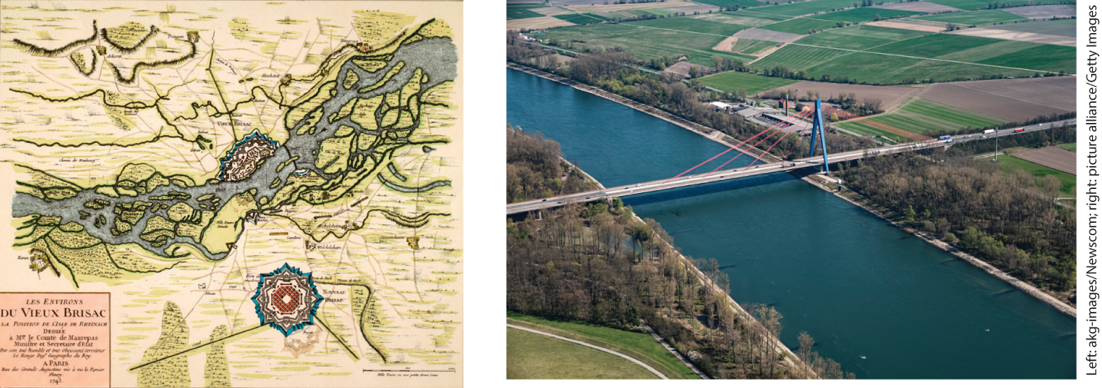
Environment Matters: Straightening the Rhine

Slide 37
III. Nation Building through Social Order (7 of 13)
D. Spreading National Power and Order beyond the West (1 of 4)
  Colonies take on new political focus in industrial age
  Great Britain, France, and Russia institute direct rule over colonies
  British institutions and power spreads through India
  Hindu and Muslim troops rebel to protect religious beliefs
  Revolt in Jhansi sparked when East India Company attempts to seize control
Notes:
III. Nation Building through Social Order (7 of 13)
D. Spreading National Power and Order beyond the West (1 of 4)
In an age of nation building and industrial development, colonies took on a new political dimension.
After mid-century, Great Britain, France, and Russia revised their colonial policy by instituting direct rule, expanding colonial bureaucracies, and providing a wide array of social and cultural services.
Although British colonialism in the first half of the century had been laissez-faire, British institutions and power nonetheless gradually spread through India.
In 1857, Hindu and Muslim troops rebelled against regulations that violated their religious beliefs.
This Indian mutiny coincided with a revolt in Jhansi, sparked when the East India Company tried to seize the kingdom from rani (queen) Lakshmibai (widow of Jhansi’s previous ruler).

Slide 38
III. Nation Building through Social Order (8 of 13)
D. Spreading National Power and Order beyond the West (2 of 4)
  British government takes direct control, names Queen Victoria “empress of India”
  Britain shapes the Indian economy to serve British needs
  French government expands control over Cochin China and occupies Algeria
  Economic benefits of Southeast Asian colonies go to the French rather than indigenous inhabitants
  Louis Napoleon, France construct Suez Canal
Notes:
III. Nation Building through Social Order (8 of 13)
D. Spreading National Power and Order beyond the West (2 of 4)
After brutally crushing the revolt, the British government took direct control with the 1858 Government of India Act. In 1876 Queen Victoria was named “empress of India.”
Britain shaped the Indian economy to serve British, not Indian, needs. However, some Indians found some British values and ideas attractive.
The French government pushed its dominion over Cochin China (in modern Vietnam) in the 1860s and occupied all of Algeria by 1870.
The French brought some infrastructure improvement to its new Southeast Asian colonies, but the economic benefits went chiefly to the French rather than the indigenous inhabitants.
Louis Napoleon, aware of the importance of the Mediterranean, ensured France took the lead in the construction of the Suez Canal. Once the Suez Canal was opened in 1869, it offered a shorter trade route to Asia and led to a European fascination with Egypt and its culture.

Slide 39
III. Nation Building through Social Order (9 of 13)
D. Spreading National Power and Order beyond the West (3 of 4)
  Algerians resist French occupation, leading to dramatic population decline
  Christian missionaries disturb Chinese society
  Contact with the West inspires Taiping (Heavenly Kingdom) movement in China
  Taiping gains control of half of China
  Civil war breaks out between Taiping followers and the Qing regime
Notes:
III. Nation Building through Social Order (9 of 13)
D. Spreading National Power and Order beyond the West (3 of 4)
The French occupied all of Algeria by 1870. Local leaders in Algeria were attracted to services such as schools and to French goods, technology, and institutions, and thus cooperated in building railroads and borrowing money from French banks. Many inhabitants resisted French rule, and the French takeover led to a dramatic population decline.
China had eluded complete takeover, but Christian missionaries and traders disturbed a society that was already unsteady from exploding population, defeat in the Opium Wars, and other trade pressures from Europe.
Contact with the West touched off the Taiping (Heavenly Kingdom) movement, which attracted millions of followers who wanted the end of the ruling Qing dynasty, reform, and the expulsion of foreigners.
By the mid-1850s, the Taiping controlled half of China.
A bloody civil war broke out between Taiping followers and the Qing regime, and the Qing turned to the British and French for aid in defeating the Taiping.

Slide 40
III. Nation Building through Social Order (10 of 13)
D. Spreading National Power and Order beyond the West (4 of 4)
  Europeans gain access to China after end of civil war
  Japan escapes European domination
  Japanese agree to open the country to foreign trade
  Japanese reformers pressured shogun to abdicate and restore the emperor to full power
  Goal of reformers was to establish Japan as a independent power free from Western control
Notes:
III. Nation Building through Social Order (10 of 13)
D. Spreading National Power and Order beyond the West (4 of 4)
When peace finally came, the Europeans had profited, gaining virtually unlimited access to the country.
Japan alone was able to escape domination.
By 1854, when the Japanese agreed to open the country to foreign trade, Dutch traders at Nagasaki had already made the Japanese keenly aware of Western industrial, military, and commercial innovations.
In 1867, Japanese reformers, after a brief civil war, pressured the ruling shogun to abdicate and then restored the emperor to full power in 1868.
The goal of this Meiji Restoration (the word “Meiji” referred to the “enlightened rule” of the new emperor) was to establish Japan as a modern, technologically powerful state free from Western control.

Slide 41
III. Nation Building through Social Order (11 of 13)
E. Contesting the Nation-State’s Order at Home (1 of 3)
  Unchecked growth of the state leads to tensions in European society
  New theories explain political and economic changes
  French socialist Pierre-Joseph Proudhon argues private ownership robbed those without property their share of benefits
  Russian nobleman Mikhail Bakunin championed individual freedom
  His ideas formed the basis of anarchism
Notes:
III. Nation Building through Social Order (11 of 13)
E. Contesting the Nation-State’s Order at Home (1 of 3)
By the close of the 1860s, the unchecked growth of the state and the ongoing process of economic change had led to palpable tensions in European society.
New theories of work life and politics appeared to explain political and economic changes.
Among the new theorists was French printer and utopian socialist Pierre-Joseph Proudhon (1809–1865), who argued that the private ownership of property robbed those without property of their share of the planet’s benefits; he advocated the organization of artisans into mutualist social organizations that would bring about the end of government.
Russian nobleman Mikhail Bakunin (1814–1876) argued that the state should not in any way infringe upon individual freedom.
His ideas formed the basis of anarchism, a doctrine that advocated the destruction of all state power.

Slide 42
III. Nation Building through Social Order (12 of 13)
E. Contesting the Nation-State’s Order at Home (2 of 3)
  Karl Marx publishes The Communist Manifesto and Das Kapital
  Karl Marx rejected the liberal focus on individual rights and argued for class-based social revolution
  Parisians demand local government action to deal with food shortage
  Parisians declare themselves a self-governing commune
  Paris Commune lasts for two months
Notes:
III. Nation Building through Social Order (12 of 13)
E. Contesting the Nation-State’s Order at Home (2 of 3)
Particularly influential was Karl Marx (1818–1883), the author of The Communist Manifesto (written with Friedrich Engels in 1848) and Das Kapital.
From the 1870s onward, Karl Marx offered Realpolitik for the working classes, arguing that social organization was derived from the relationships of classes to productive processes. This idea, materialism, rejected the liberal focus on individual rights and pointed toward an inevitable, class-based social revolution that would be won by the modern industrial working class. Marx believed that capitalism would give way to socialism and that a proletariat revolution would eradicate private ownership and bring about a classless society.
Marx and others saw the future in contemporary events, such as the Paris Commune. In the winter of 1870–1871, Paris was suffering from a harsh winter and the Prussian siege that deprived them of food. Parisians demanded a locally elected government to deal with the crisis.
In March 1871, Parisians declared themselves a self-governing commune, an act that was imitated by other French cities.
The Paris Commune lasted for two months; during that time, Parisians set up political clubs, local ceremonies, and cooperative workshops.

Slide 43
III. Nation Building through Social Order (13 of 13)
E. Contesting the Nation-State’s Order at Home (3 of 3)
  Communards inspired by mutualist and socialist ideas
  They could not agree on a cohesive path to change society
  Provisional government stamps out communes in other cities
  The French army enters Paris and violently disbands the commune, arresting citizens and punishing them
  French establishment saw Parisians as traitors, but gradually created a new narrative blaming women
  The French struggle to recover from civil war
Notes:
III. Nation Building through Social Order (13 of 13)
E. Contesting the Nation-State’s Order at Home (3 of 3)
The Communards (members of the commune) were inspired by mutualist and socialist ideas and agreed to bring about a social revolution, one that would include women.
But they frequently disagreed on the path to a changed society; mutualism, anticlericalism, feminism, international socialism, and anarchism were proposed.
Meanwhile, the provisional government at Versailles quickly stamped out communes in other cities.
On May 21, 1871, the army entered the capital. In a week of fighting, both the Communards and the army executed hostages and set fire to the city. The commune was put down, and the army shot down tens of thousands of citizens in the streets. Many more were arrested and either executed or sent to penal colonies.
The French establishment saw all Parisians as traitors, but gradually a new “history” of the commune was promulgated: it was the fault of women — a case of women run mad, crowding the streets in a frenzy of destruction and wanton sexuality.
The French state struggled to recover from defeat and civil war. Conservatives saw the commune as a symptom of collapsing social order and gender relations; for Marx it represented a class rebellion, an attack on property, and a government determined to protect the wealthy.

Slide 44
IV. The Culture of Social Order (1 of 8)
A. The Arts Confront Social Reality (1 of 3)
  Readers begin to prefer biographies of political leaders, exhibitions become popular in the general public
  Realism dominates the novel
  Works of Charles Dickens become hugely popular
  His relatable characters draw attention to the impact of industrialization on society
  Novels of George Eliot explore contemporary personal problems
  French writer Gustave Flaubert scandalizes French society with Madame Bovary
Notes:
IV. The Culture of Social Order (1 of 8)
A. The Arts Confront Social Reality (1 of 3)
The reading public devoured biographies of political leaders, and the general public attended an increasing number of artistic, scientific, and natural history exhibitions.
Realism dominated the novel.
The hugely popular novels of Charles Dickens (1812–1870) appeared in serial form in magazines and periodicals.
His characters came from contemporary English society and ranged from starving orphans to ruthless opportunists who drew attention to the impact of industrialization and civil law on society.
The widely read novels of George Eliot (Mary Ann Evans, 1819–1880) explored contemporary personal problems.
French writer Gustave Flaubert (1821–1880) scandalized French society with Madame Bovary (1857), the tale of an unhappy wife whose longing for possessions she could ill afford and illicit affairs ultimately led her to commit suicide.

Slide 45
IV. The Culture of Social Order (2 of 8)
A. The Arts Confront Social Reality (2 of 3)
  Poet Charles-Pierre Baudelaire writes explicitly about sex and drug use in Les Fleurs du mal
  Russian writers debate if Western European values are harming their culture
  Ivan Turgenev captures generational conflict in Fathers and Sons
  Fyodor Dostoevsky creates antiheroes in Notes from Underground and Crime and Punishment
  Painters turn away from idealized portraits and adopted realist style
  French painter Gustave Courbet depicts reality of physical labor
Notes:
IV. The Culture of Social Order (2 of 8)
A. The Arts Confront Social Reality (2 of 3)
The poet Charles-Pierre Baudelaire (1821–1867) also shocked the public by writing explicitly about sex, as well as drug- and wine-induced fantasies, in Les Fleurs du mal (Flowers of Evil, 1857). Both Baudelaire and Flaubert were charged with obscenity by French authorities.
Russian writers during the era of Great Reforms debated whether Western European values were harming Russian culture.
Ivan Turgenev (1818–1883) captured generational conflict in Fathers and Sons (1862), a story of nihilistic children rejecting the older generation’s romantic spiritual values.
Fyodor Dostoevsky (1821–1881) created antiheroes in works such as Notes from Underground (1864) and Crime and Punishment (1866).
After 1848, despite their dependency on elite audiences and patronage, painters turned away from idealized portraits of workers and peasants and adopted the realist style.
French painter Gustave Courbet (1819–1877) depicted how backbreaking physical labor could be.

Slide 46
IV. The Culture of Social Order (3 of 8)
A. The Arts Confront Social Reality (3 of 3)
  Édouard Manet abandons romanticism in paintings such as Olympia and Universal Exhibition
  Opera becomes accessible to most of society
  Giuseppe Verdi explores noble ideals, social issues in Opera
  Richard revolutionizes opera by fusing music and drama
  His The Ring of the Nibelungen explores destructiveness of materialism
  Creative artists help create unified culture
Notes:
IV. The Culture of Social Order (3 of 8)
A. The Arts Confront Social Reality (3 of 3)
Édouard Manet (1823–1883) abandoned romanticism in his portrayals of women and sexuality in paintings such as Olympia (1865) and Universal Exhibition (1867).
Opera was a commercially profitable enterprise and accessible to most classes of society.
Giuseppe Verdi (1813–1901) used the genre to contrast the noble ideals of honor, love, and patriotism with the corrosive effects of power; he explored social issues as well.
Richard Wagner (1813–1883), the era’s most flamboyant and musically innovative composer, revolutionized opera by fusing music and drama to arouse an audience’s fear, awe, and engagement with his vision.
His cycle of four operas — The Ring of the Nibelungen — exploring the destructiveness of materialism and the pursuit of power concluded that only unselfish love could redeem society.
Although often controversial, writers, visual artists, and composers helped create a unified cultural community.

Slide 47
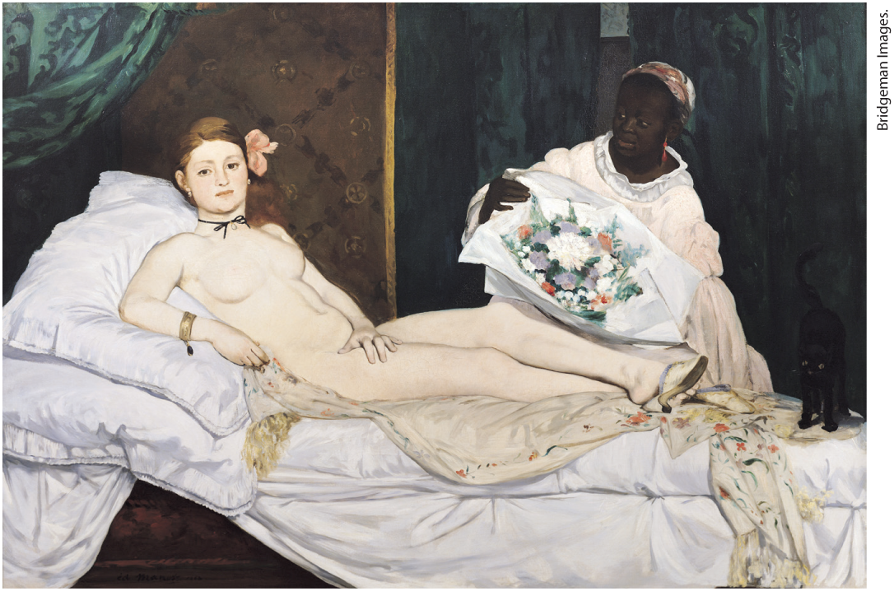
A Realist View of the Nude

Slide 48
IV. The Culture of Social Order (4 of 8)
B. Religion and National Order (1 of 3)
  Liberals and nationalists came to reject a religious worldview
  Anti-Catholicism in England sparks hatred for Irish Catholics
  Bismarck launches culture war against Catholicism in Germany
  Catholic church resists nationalism and rationalism
  Pope Pius IX issues The Syllabus of Errors
Notes:
IV. The Culture of Social Order (4 of 8)
B. Religion and National Order (1 of 3)
Although organized religion provided a source of stability after 1848, some liberals and nationalists came to reject a religious worldview, as it was based on faith, not reason, and slowed the growth of nationalist sentiment.
In England, violent anti-Catholicism helped build national unity around hatred for an out-group — Irish Catholics.
In Germany, Bismarck launched a full blown Kulturkampf (“culture war”) against Catholicism, viewing it as contrary to the national interest. The pope, the German bishops, and many Catholics and conservatives resisted repression of religion.
The Catholic church resisted growing nationalism and rationalism, which it saw as attempts to replace religious faith and loyalty.
In 1864, Pope Pius IX (r. 1846–1878) issued The Syllabus of Errors, which put the church explicitly at odds with aspects of liberalism, progress, and modern civilization.

Slide 49
IV. The Culture of Social Order (5 of 8)
B. Religion and National Order (2 of 3)
  New pope, Leo XIII, encourages the church accept modern ideas
  Religion remains a powerful influence, but practices change
  Pope’s declaration of “Immaculate Conception” encourages religious fervor among women
  Bernadette Soubirous begins having visions of the Virgin Mary in southern France
  Railroad lines created enable pilgrims to visit the shrine at the location
Notes:
IV. The Culture of Social Order (5 of 8)
B. Religion and National Order (2 of 3)
In 1878, a new pope, Leo XIII, encouraged the church to modernize by accepting aspects of democracy and encouraging Catholic universities to be open to up-to-date scholarship. It became easier for faithful Catholics to be patriotic citizens.
Religion remained a powerful influence, but religious practice changed. Church attendance declined among workers and artisans, although many in the upper and middle classes and most of the peasantry remained faithful. A religious gender gap developed, with women being more pious than men.
The pope’s declaration of the “Immaculate Conception” — the dogma that Mary, alone among humans, had been born without original sin — was followed by an outburst of religious fervor, among women in particular.
In 1858, a peasant girl in Lourdes in southern France, Bernadette Soubirous (1844–1879), began having visions of the Virgin Mary.
Less than ten years later, railroad track had to be laid to Lourdes to enable millions of pilgrims to visit the shrine. This showed that the Catholic church could combine some modern aspects with traditional institutions.

Slide 50
IV. The Culture of Social Order (6 of 8)
B. Religion and National Order (3 of 3)
  Charles Darwin publishes On the Origin of Species
  Darwin argued survival of the fittest
  Darwin’s theories challenged biblical creation story
  Gregor Mendel discovers the law of genetics, German scientists research the female reproductive cycle
  Social Darwinism promoted by men such as Herbert Spencer and Darwin himself
Notes:
IV. The Culture of Social Order (6 of 8)
B. Religion and National Order (3 of 3)
At the same time, Charles Darwin (1809–1882) published On the Origin of Species (1859), in which he stated that life had evolved over the course of millions of years.
Darwin argued that only the strongest or best adapted to the environment would find sexual partners and reproduce.
Darwin’s theories challenged the biblical creation story and the Enlightenment view that nature was noble and humans essentially rational.
Other discoveries included Gregor Mendel’s discovery of the law of genetics, and German scientists researched the female reproductive cycle, using their findings to argue that men’s sexual aggression and women’s sexual passivity were rooted in nature.
Social Darwinism, promoted by men such as Herbert Spencer, used its version of evolutionary theory to argue against Christian charity as a source of weakness to modern nation-states. Darwin argued that the dominance of men over women and of Europeans over other peoples was rooted in biological differences.

Slide 51
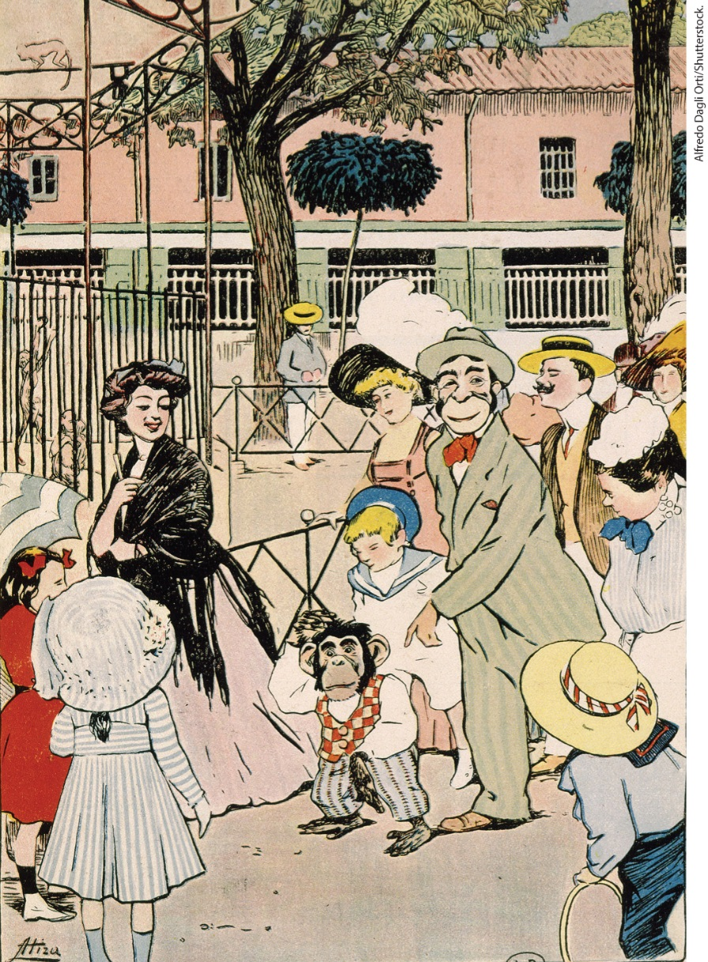
“Gentlemen, We Are Descended from Monkeys,” Spain, Late Nineteenth Century

Slide 52
IV. The Culture of Social Order (7 of 8)
C. From the Natural Sciences to Social Science (1 of 2)
  Darwin’s theories accelerate search for alternatives to religious explanations
  Auguste Comte originates social science of positivism
  Comte’s ideas open the fields of the social sciences to women
  English philosopher John Stuart Mill argues for education, enfranchisement of women
Notes:
IV. The Culture of Social Order (7 of 8)
C. From the Natural Sciences to Social Science (1 of 2)
Darwin’s theories accelerated the search for alternatives to the religious explanation of social order.
Auguste Comte (1798–1857) originated the ideas for positivism, a social science that called for the careful study of facts so as to generate accurate or “positive” laws of society.
Because Comte promoted women’s participation in reform, his ideas opened the fields of the social sciences to them.
English philosopher John Stuart Mill (1806–1873) was initially an enthusiastic supporter of Comte and argued for mass education and the complete enfranchisement of women.

Slide 53
IV. The Culture of Social Order (8 of 8)
C. From the Natural Sciences to Social Science (2 of 2)
  On Liberty argues for individual liberty protected from the state
  Mill’s promotion of women’s rights inspire him to write The Subjection of Women
  Progressive side of Mill’s work lost in flood of Social Darwinism
  Policymaking increasingly influenced by statistics and fact-gathering
Notes:
IV. The Culture of Social Order (8 of 8)
C. From the Natural Sciences to Social Science (2 of 2)
His treatise On Liberty (1859) argued for individual liberty protected from state intrusion.
Mill’s promotion of women’s rights — an argument he developed with the help of his wife, Harriet Taylor Mill (1808–1858) — inspired him to write The Subjection of Women (1869), in which he stated that a woman’s assigned role of love and obedience in marriage masked gross marital inequality.
The progressive side of Mill’s social thought, however, was submerged in a flood of Social Darwinism.
Policymaking was increasingly influenced by statistics and fact-gathering with the goal of producing strong, healthy nations.

Slide 54
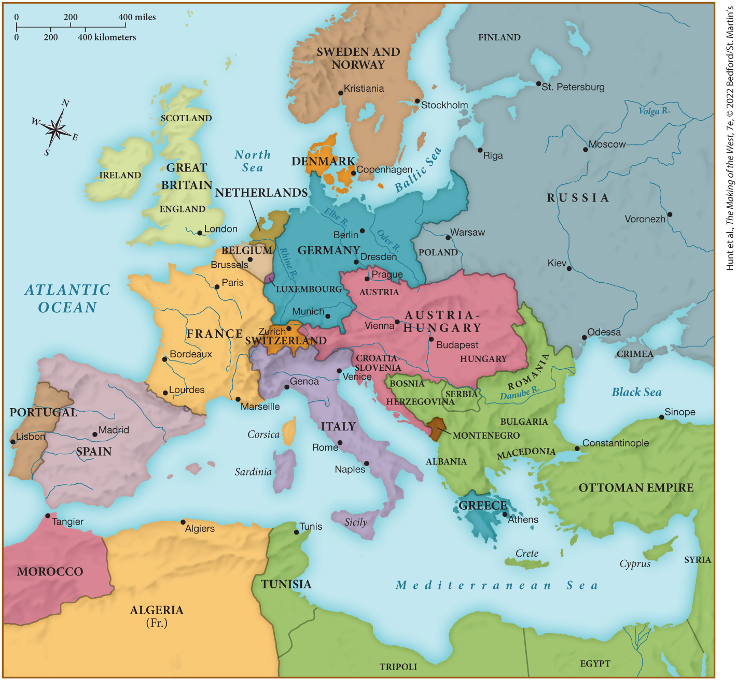
MAP 22.5 Mapping the West: Europe and the Mediterranean, 1871

