Slide 1
The Making of the West
Seventh Edition
Hunt • Martin • Rosenwein • Smith
CHAPTER 21
Industrialization and Social Ferment
1830 –1850
Copyright © 2022 by Bedford/St. Martin’s
Distributed by Bedford/St. Martin’s/Macmillan Learning strictly for use with its products. Not for redistribution.

Slide 2
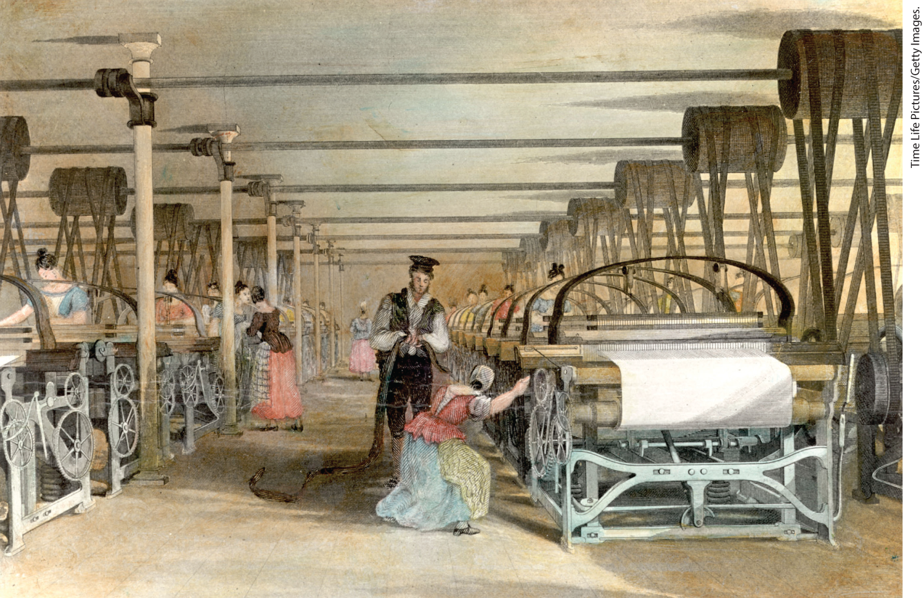
Workers at an English Cotton Factory, 1830s

Slide 3
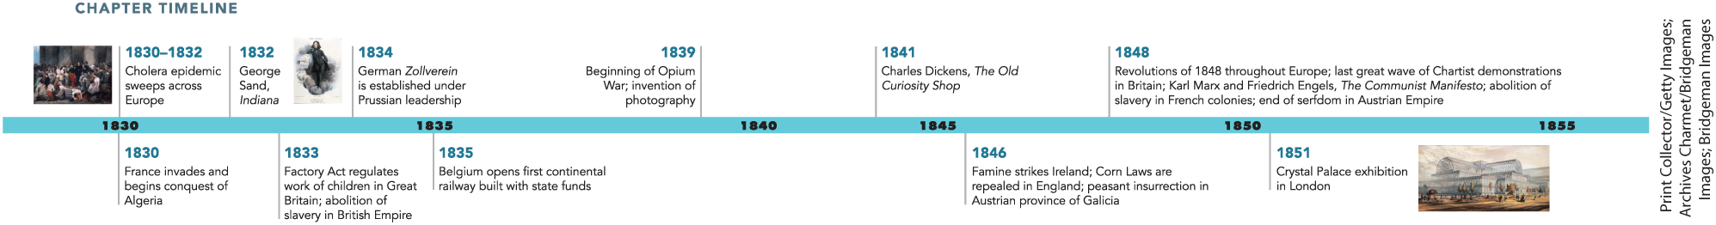
Chapter 21 Timeline

Slide 4
I. The Industrial Revolution (1 of 8)
A. Roots of Industrialization
  James Watt adapts steam engines to make them more efficient and adaptable
  New power machinery replaced skilled weavers with semiskilled workers
  Contributing factors to early industrialization in England
  Cotton industry in England grows rapidly, Britain begins buying cotton from the slave states of the American South
  Domestic manufacturing throughout Europe helps pave the way for full-scale Industrial Revolution
  Workers in the industrial and textile production industry face instability, weavers resist introduction of technology
Notes:
I. The Industrial Revolution (1 of 8)
A. Roots of Industrialization
A key breakthrough in the Industrial Revolution occurred in 1776 when James Watt adapted existing steam engines to make them more efficient and adaptable to power textile looms and railroad locomotives.
Combined with John Kay’s flying shuttle developed in the 1730s and the spinning jenny and mechanized loom of the 1780s, new power machinery was assembled in factories that replaced skilled weavers with semiskilled men, women, and children.
Factors contributing to early industrialization in England included a rapidly growing population, available capital, and access to slave-produced cotton, coal, and iron. The opportunity for social mobility and access to scientific education, as well as a plentiful supply of labor, partially caused by the increase in agricultural efficiency, also contributed.
The cotton industry in England was growing rapidly. Cotton cloth became England’s major export, and British cotton cloth exports destroyed the native cloth production industry in India. After the abolition of slavery in the British Empire in 1833, Britain bought cotton from the slave states of the American South.
Domestic manufacture throughout Europe grew dramatically in the eighteenth century. Also referred to as the “putting-out” system, domestic manufacture involved manufacturers supplying raw materials to families working under contract. The spread of the putting-out system of manufacture is sometimes called “proto-industrialization,” as it helped pave the way for full-scale Industrial Revolution.
Workers in the industrial and domestic textile production industry enjoyed few protections from frequent marketplace fluctuations and resulting economic instability. Weavers, sometimes violently, resisted the introduction of technology that would force them out of work.

Slide 5
I. The Industrial Revolution (2 of 8)
B. Engines of Change (1 of 3)
  English engineer George Stephenson develops steam engine powerful enough to pull train cars
  Industrialization begins to spread in Europe as major countries build railroads
  Railroad construction grows rapidly in Britain and the United States
  Railroad construction pushes further industrial development
  Steam-powered engines make Britain world leader in manufacturing
  By 1850, continental Europe still lagged behind British development
Notes:
I. The Industrial Revolution (2 of 8)
B. Engines of Change (1 of 3)
The English engineer George Stephenson developed a steam engine powerful enough to pull train cars in the 1820s, leading to railroads as an effective means of transportation.
In the 1830s and 1840s, industrialization began to spread throughout continental Europe, as major countries built railroad systems.
Railroad construction and investment grew rapidly in the 1840s, particularly in Britain and the United States.
Governments and private investors backed railroads, as states realized that railroad construction with its demand for iron and coal pushed further industrial development.
Steam-powered engines made Britain the world leader in manufacturing. Other powers such as Germany tried to keep up.
Industrialization by British engineers and exported machinery spread slowly from key areas. By 1850, continental Europe still lagged some twenty years behind British industrial development.

Slide 6
I. The Industrial Revolution (3 of 8)
B. Engines of Change (2 of 3)
  British engineers bring knowledge to rest of Europe
  Industrialization spreads slowly in central Europe, while Eastern Europe lags further behind, especially Russia
  Factory workers remain small minority
  Peasants alternate seasonally between manufacturing and agriculture
  Industrial workers come from rural areas, family wages and a twelve- to seventeen-hour workday typical
  Workers come to constitute a new socioeconomic class
Notes:
I. The Industrial Revolution (3 of 8)
B. Engines of Change (2 of 3)
British engineers brought industrial know-how to much of continental Europe. Between 1830 and 1844, the fastest-industrializing country on the European continent was Belgium.
Industrialization spread slowly in central Europe from centers in Saxony, Prussia, and Bohemia. Eastern Europe lagged further behind, especially Russia, largely due to the persistence of serfdom, which hindered labor mobility and tied up investment capital.
Although they attracted much attention, factory workers were a small minority, even in England.
Many peasants continued to alternate seasonally between manufacturing and agriculture. Workers also continued putting-out work.
Industrial workers came from rural areas as an increasing birthrate in Britain fed workers into the factory system. Family wages and a grueling twelve- to seventeen-hour workday were typical.
As urban factories grew, workers came to constitute a new socioeconomic class holding common interests.

Slide 7
I. The Industrial Revolution (4 of 8)
B. Engines of Change (3 of 3)
  New working class organizes societies for mutual aid, become first labor unions
  Factories draw criticism for pollution, working conditions
  Governments collect information about workers’ health
  Inquiries lead to several reforms regarding working conditions of woman and children
  Continental countries followed British lead, but enforcement was lax
Notes:
I. The Industrial Revolution (4 of 8)
B. Engines of Change (3 of 3)
This new working class organized societies for mutual aid and political reform, from which would come the first labor unions.
Factories drew criticism for the pollution they created and for the pitiful working conditions.
As industrialism and its consequences grew, local and national governments collected information about workers’ health, their living conditions, and their families.
Government inquiries often focused on women and children, and in Great Britain, inquiries led to the Factory Act of 1833, which responded to horrific reports of child labor in factories and mines, and in 1842, the British Parliament prohibited the employment of women and girls underground. In 1847, Parliament limited the workday of women and children to ten hours.
The continental countries eventually followed the British lead, but most did not insist on inspection, so enforcement was therefore lax.

Slide 8
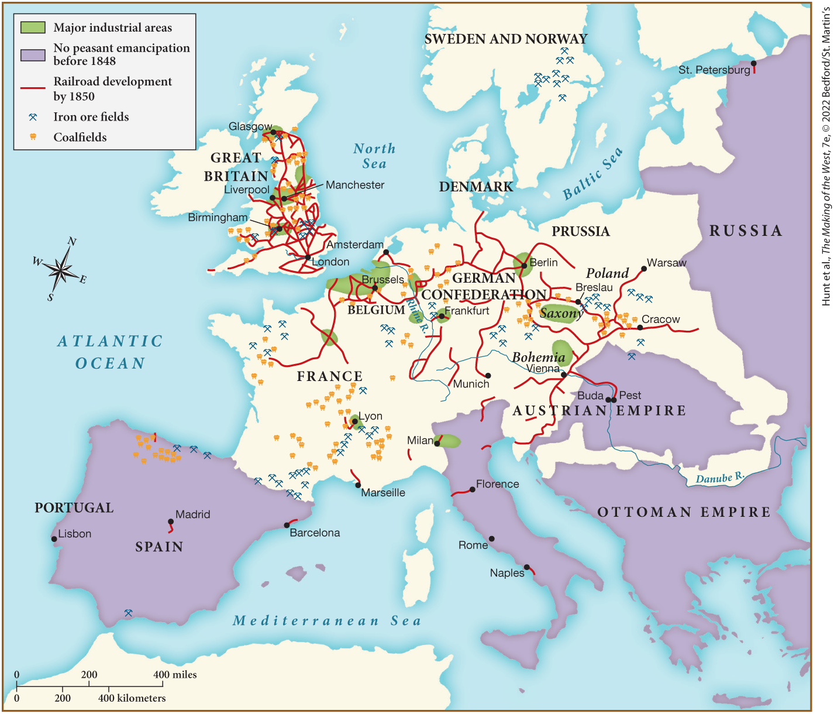
MAP 21.1 Industrialization in Europe, c. 1850

Slide 9
I. The Industrial Revolution (5 of 8)
C. Urbanization and Its Consequences (1 of 2)
  Industrialization linked with urban growth
  By 1850, half of England and Wales lived in towns
  Urban populations soar all over Europe
  Agricultural improvements reduce rural employment, factories and urban life attract the rural poor
  Cities dismantled medieval walls for public improvements
Notes:
I. The Industrial Revolution (5 of 8)
C. Urbanization and Its Consequences (1 of 2)
Industrialization was linked with rapid urban growth.
Great Britain was the leader in this as well; by 1850, half the population of England and Wales lived in towns.
Urban populations soared all over Europe because of massive migrations out of rural areas.
Agricultural improvements had increased the food supply and therefore the rural population, reducing opportunities for employment. Factories and urban life attracted the rural poor.
As the cities grew, they dismantled their medieval walls and incorporated parks, zoos, cemeteries, and greenways.

Slide 10
I. The Industrial Revolution (6 of 8)
C. Urbanization and Its Consequences (2 of 2)
  Housing expanded slowly, overcrowding fostered disease
  Pollution fills streets, skies, and water
  Unsanitary conditions lead to cholera epidemics and tuberculosis deaths
  Middle-class lived in cleaner neighborhoods
  Middle-class reformers sought to improve living conditions of the poor
  Widening separation between rich and poor
Notes:
I. The Industrial Revolution (6 of 8)
C. Urbanization and Its Consequences (2 of 2)
Housing expanded more slowly than the urban population, and severe overcrowding fostered disease.
Garbage and refuse littered the streets, smog and smoke obscured the atmosphere, and water was scarce and unclean.
Unsanitary conditions led to cholera. From 1830 to 1832, and again from 1847 to 1851, cholera epidemics killed hundreds of thousands. Tuberculosis killed even more, but since it killed one by one, rather than in epidemics, it had less impact on social relations.
Middle-class persons lived in more spacious and cleaner neighborhoods, but the nearby poor were a source of anxiety.
Middle-class reformers, pointing to the living conditions of the poor as a cause of moral degeneracy, collected statistics on illegitimacy and infanticide. Reformers also addressed prostitution, alcoholism, and crime.
Contemporary observers saw the widening separation between rich and poor and the growing hostility between the classes as a threat.

Slide 11
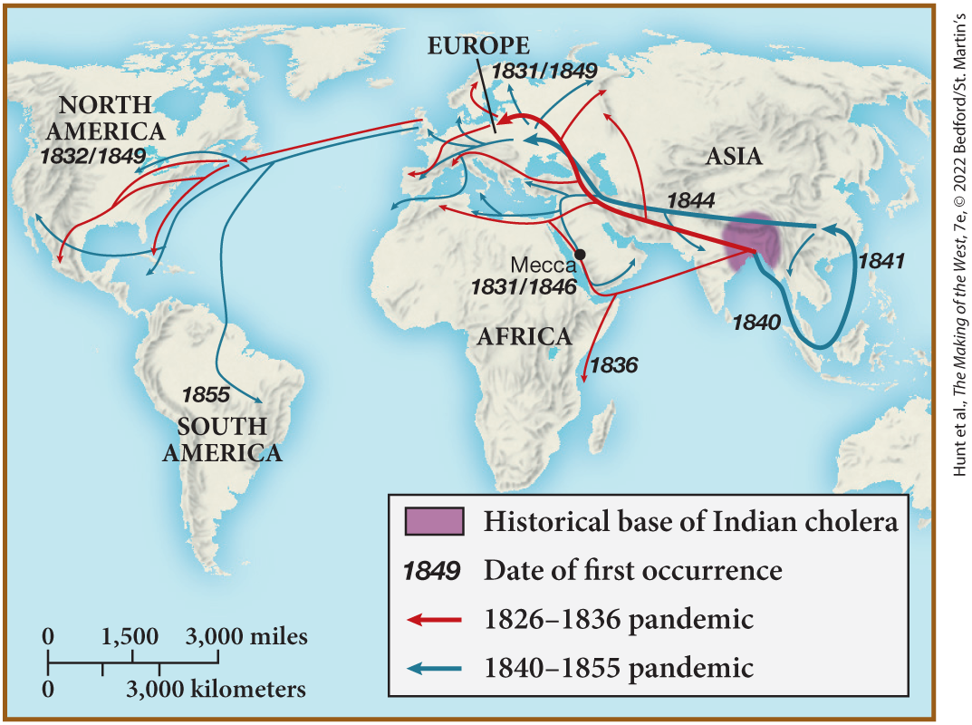
MAP 21.2 The Spread of Cholera, 1826–1855

Slide 12
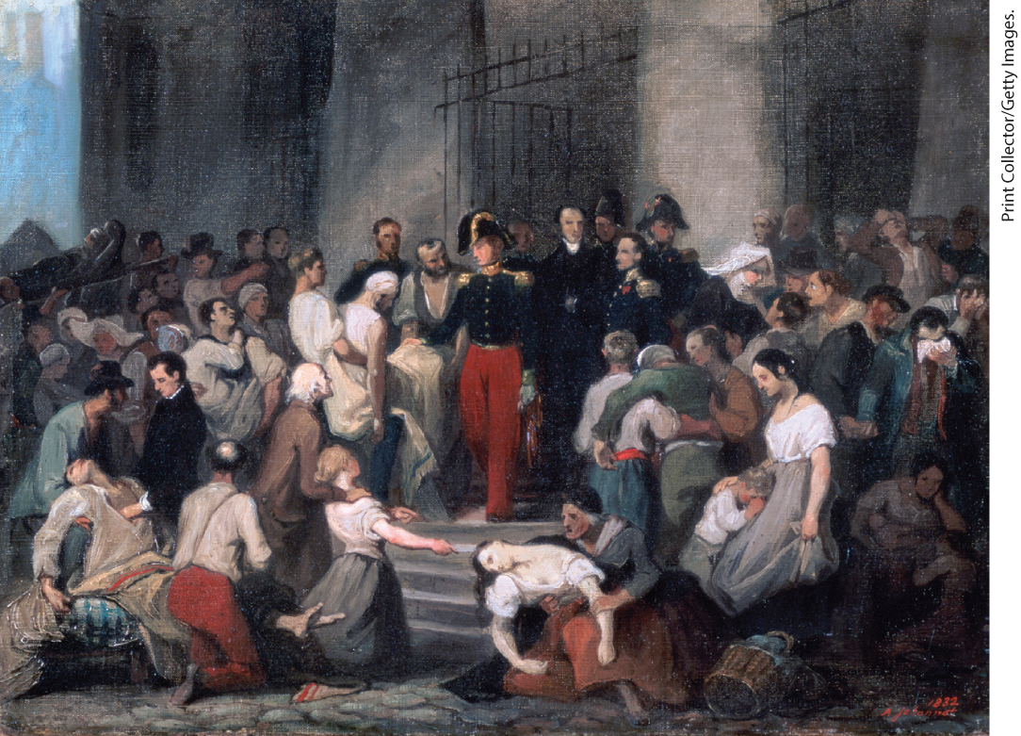
Alfred Johannot, The Duke of Orleans Visiting the Sick at l’Hôtel-Dieu During the Cholera Epidemic in 1832

Slide 13
I. The Industrial Revolution (7 of 8)
D. Agricultural Perils and Prosperity (1 of 2)
  Growing populations created rising demands for food
  Peasants and farmers continued working, but population grew faster than food production
  Railroads and canals improved distribution, but much of Europe remained vulnerable to local famines
  Upper classes still dominated rural society
  In France, millions of peasants tended their own properties
Notes:
I. The Industrial Revolution (7 of 8)
D. Agricultural Perils and Prosperity (1 of 2)
Burgeoning populations created rising demands for food and spurred changes in rural life.
Peasants and farmers planted fallow land, chopped down forests, and drained marshes, but population grew faster than food production in the first half of the nineteenth century.
Railroads and canals improved food distribution, but much of Europe remained isolated from markets and thus vulnerable to local famines.
Most people still lived on the land, and the upper classes still dominated rural society, although businessmen and peasants were sometimes able to buy land.
In France, almost two million independent peasants tended their own small properties.

Slide 14
I. The Industrial Revolution (8 of 8)
D. Agricultural Perils and Prosperity (2 of 2)
  Landowners expanded their estates in other parts of Europe
  Survival of independent peasant families threatened
  Europeans became more aware of birth control methods
  Population pressure causes emigration, often to the United States
  In Europe, political power remains in the hands of traditional elites
  Troops easily suppress serf rebellions in Russia
Notes:
I. The Industrial Revolution (8 of 8)
D. Agricultural Perils and Prosperity (2 of 2)
But in England, southern Italy, Prussia, and eastern Europe, large landowners expanded their estates.
The survival of independent peasant families was threatened as men often migrated seasonally to earn cash in factories while women stayed behind to tend the crops.
As child mortality declined outside the industrial cities and people without property began marrying earlier, Europeans became more aware of birth control methods.
Population pressure also caused people to emigrate from their homelands, often to the United States. Between 1816 and 1850, five million Europeans left their home countries and traveled overseas.
In Europe, political power remained in the hands of traditional elites. The biggest property owners controlled political assemblies and often personally selected clergy and local officials.
The old rural order seemed most impregnable in Russia, where troops easily suppressed serf rebellions in 1831 and 1842.

Slide 15
II. Reforming the Social Order (1 of 7)
A. Cultural Responses to the Social Question (1 of 2)
  Social question reflected concern about changes arising from industrialization and urbanization
  Romanticism glorified nature and deplored industrial and urban growth
  English poet Elizabeth Barrett Browning decried child labor
  Romantic painters glorify natural landscape, but some landscapes reflected the power of new technologies
  Attention to social problems reached audiences via the novel
  Novels tend to portray individuals in the context of social life
Notes:
II. Reforming the Social Order (1 of 7)
A. Cultural Responses to the Social Question (1 of 2)
The social question reflected concern about social changes arising from industrialization and urbanization — a concern that pervaded all forms of art and literature.
The dominant artistic movement of the time, romanticism, tended to glorify nature and deplore industrial and urban growth. (For a close look at one of the important environmental history topics in this chapter, see “Environment Matters: Joseph M. W. Turner, The Fighting “Téméraire” Tugged to Her Last Berth to Be Broken Up (1838).”)
The English poet Elizabeth Barrett Browning decried child labor, and architects used the Gothic style, reminiscent of the Middle Ages, to glorify the preindustrial world.
Although romantic painters glorified the landscape as a way of calling attention to the wonders of nature, some painted landscapes reflected the power of new technologies.
Attention to social problems reached its greatest audience via the novel, thanks to increasing literacy, the spread of reading rooms and lending libraries, and serials published in newspapers and journals.
Unlike the novels of the eighteenth century, which focused on individual personalities, the great novels of the 1830s and 1840s tended to portray individuals in the context of social life.

Slide 16
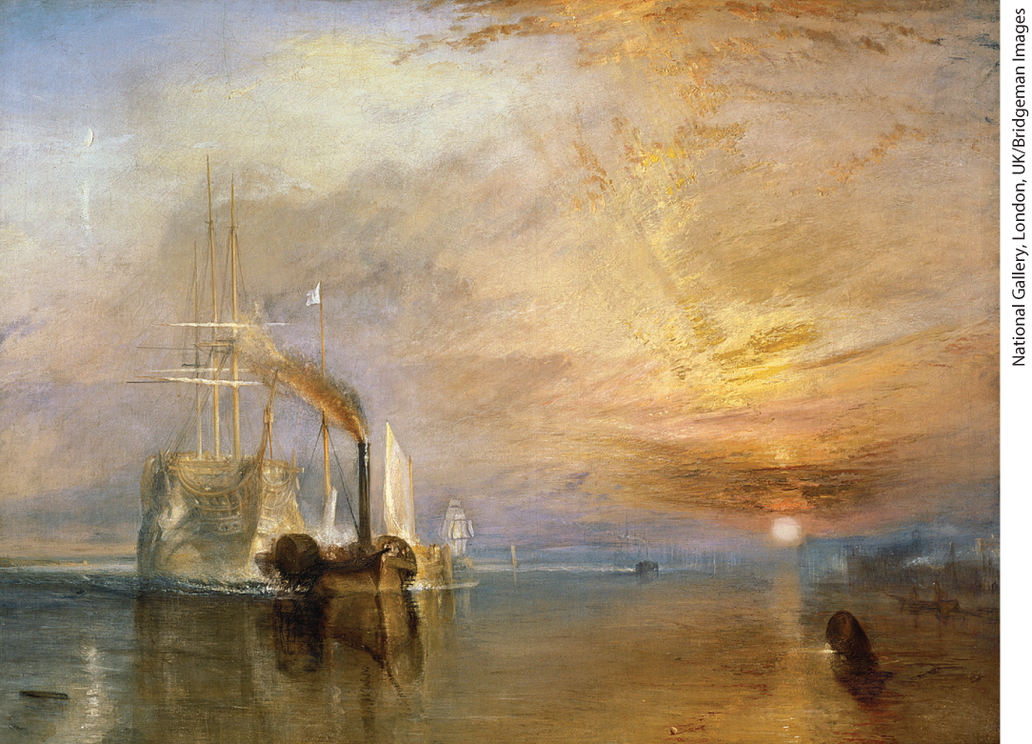
Environment Matters: Joseph M. W. Turner, The Fighting “Téméraire” Tugged to Her Last Berth to Be Broken Up (1838)

Slide 17
II. Reforming the Social Order (2 of 7)
A. Cultural Responses to the Social Question (2 of 2)
  French novelist Honoré de Balzac cataloged French society, English writer Charles Dickens drew attention to the negative effects of industrialization
  Novels by women reveal bleaker side of women’s lives
  Charlotte Brontë explored the difficulties that unmarried middle-class women faced
  French novelist George Sand scandalized Europe
  Popular theaters, museums drew large crowds of lower- and middle-class
  Photography emerges as a medium for expression
  Number of artists and writers grow rapidly, competition grows
Notes:
II. Reforming the Social Order (2 of 7)
A. Cultural Responses to the Social Question (2 of 2)
French novelist Honoré de Balzac (1799–1850) cataloged the social types of French society, whereas English writer Charles Dickens (1812–1870) drew attention to the negative effects of industrialization and urbanization.
Novels by women (usually published under a male pseudonym) often revealed the bleaker side of women’s situations.
In Jane Eyre (1847), Charlotte Brontë (1816–1855) explored the difficulties that unmarried middle-class women faced when trying to earn a living.
French novelist George Sand (Amandine-Aurore-Lucile Dupin Dudevant, 1804–1876) scandalized Europe with her love affairs, her masculine dress, her novels, and her socialist political activity.
Just as an audience for novels grew, so too did the public interest in cultural events. Popular theaters drew large crowds of lower- and middle-class spectators, museums opened to the public, and middle-class persons began to collect art.
In 1839, photography offered artists a new medium for expression.
The number of artists and writers grew rapidly, and in the fiercely competitive world of art, many went hungry, increasing their sympathy with the new working class.

Slide 18
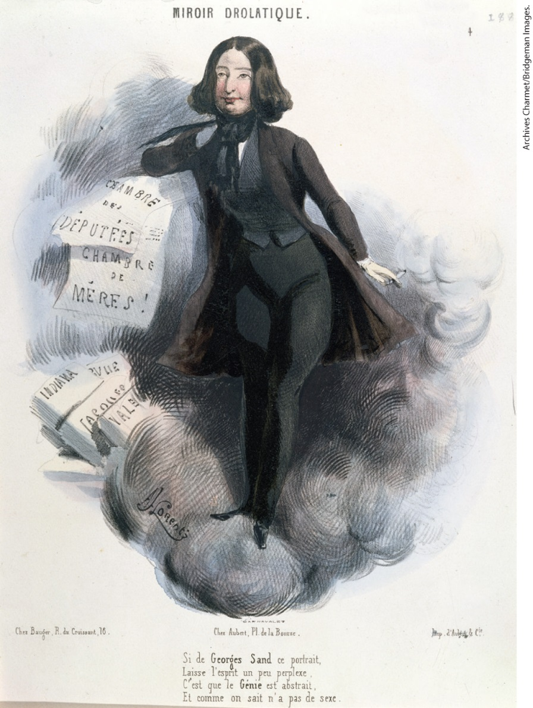
George Sand

Slide 19
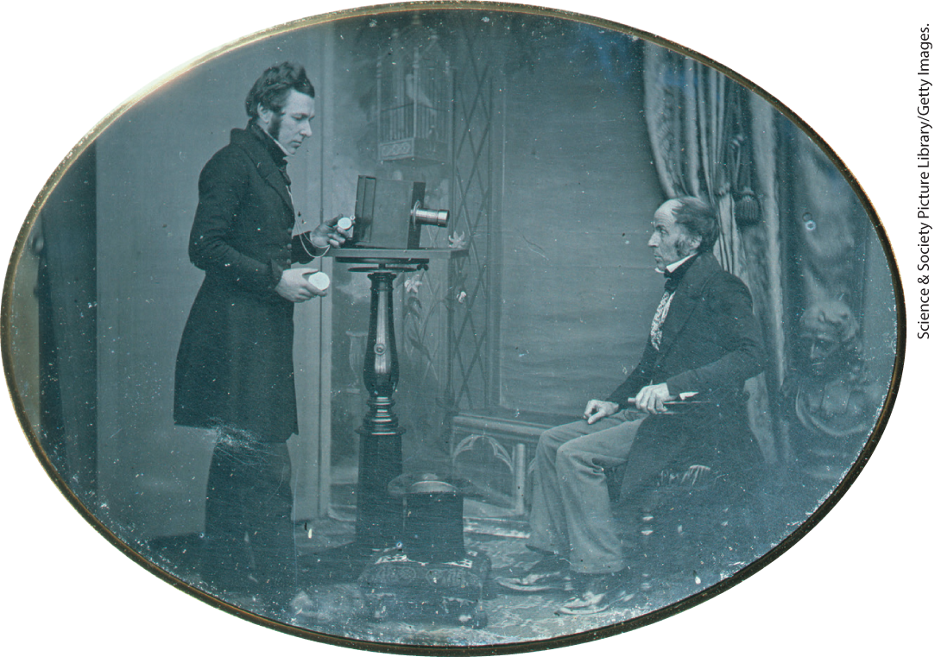
Daguerreotype

Slide 20
II. Reforming the Social Order (3 of 7)
B. The Varieties of Social Reform (1 of 3)
  Clergy and religious groups attempt to raise interest in religion
  Great Britain, Sunday school movement taught working-class children to read
  Women assumed a prominent role in religious charitable works
  Both Catholics and Protestants promoted temperance
  Social reformers stressed education for the poor and working classes
Notes:
II. Reforming the Social Order (3 of 7)
B. The Varieties of Social Reform (1 of 3)
Religious convictions inspired many reformers, as many clergy and religious groups tried to raise working-class people’s low level of interest in religion.
In Great Britain, the Sunday school movement taught working-class children to read at a time when few could attend school.
Women assumed a prominent role in charitable works. Catholic religious orders enrolled women to run schools, hospitals, leper colonies, insane asylums, and old-age homes, while Protestant women established Bible, missionary, and reform societies. One chief concern was prostitution.
Both Catholics and Protestants promoted temperance. Temperance advocates viewed drunkenness as immoral and a threat to social order.
Social reformers stressed education for the poor and working classes. British churches organized to promote education, and in 1833, the French government passed a law that required every town to maintain a primary school, pay a teacher, and provide free education to poor boys.

Slide 21
II. Reforming the Social Order (4 of 7)
B. The Varieties of Social Reform (2 of 3)
  In France, girls’ schools were optional; only one in thirty children went to school
  Protestant Prussia had 75 percent of its children in primary school
  Russian tsar Nicholas I excluded peasants from primary schools
  Elite seek to impose discipline and order on working people
  Governments often intervene when private charities fail to meet the needs of the poor
Notes:
II. Reforming the Social Order (4 of 7)
B. The Varieties of Social Reform (2 of 3)
In France, girls’ schools were optional, but hundreds of women taught at the primary level. Overall only one in thirty children went to school in France.
Protestant Prussia had 75 percent of its children in primary school by 1835.
By contrast, Russian tsar Nicholas I (r. 1825–1855) blamed the Decembrist Revolt on education and thus excluded peasants from primary schools.
The elite sought to impose discipline and order on working people. In Great Britain, the Society for the Prevention of Cruelty to Animals attempted to eliminate lower-class sports such as cockfighting and bearbaiting.
Governments often intervened when private charities failed to meet the needs of the poor.

Slide 22
II. Reforming the Social Order (5 of 7)
B. The Varieties of Social Reform (3 of 3)
  Britain enacts the Starvation Act of 1834, prompting protests from anti–poor law societies
  Many women see public charity work as an extension of domestic roles and moral influence
  Practice of separate spheres for women and men left women economically dependent
  Gender distinctions were most noticeable in the elite classes
  Scientists and intellectuals support male domination
  Lower-class women had to work to support their families
Notes:
II. Reforming the Social Order (5 of 7)
B. The Varieties of Social Reform (3 of 3)
In Britain, attempts to control the costs of public welfare included the so-called Starvation Act of 1834, which required all those receiving relief to be housed together in workhouses with husbands separated from wives and children separated from parents. Intended to be unpleasant in order to encourage poor people to improve their situations as fast as possible, this system prompted protests from anti–poor law societies.
Many women saw public charity work as an extension of their domestic role and moral influence. According to the ideals of domesticity, women were to devote their lives to home and family.
Many believed that men and women had to act according to distinct roles in order to ensure social order. The notion of separate spheres for women and men left most women economically dependent, preventing them from pursuing higher education, careers, or politics.
Gender distinctions were most noticeable in the elite classes where boys attended school while girls lived at home, and men wore practical clothing while women dressed for decorative effect.
Scientists and intellectuals supported male domination and the idea that women were unfit for public life, although some middle-class women protested their situation.
Lower-class women may have considered domesticity an ideal; however, because they had to work to support their families, staying at home was rarely a reality.

Slide 23
II. Reforming the Social Order (6 of 7)
C. Abuses and Reforms Overseas (1 of 2)
  Colonialism becomes imperialism as direct rule shifts to indirect rule
  Decline of the slave trade
  British and French end slave trade and abolish slavery
  Spain and Portugal continue slave trading, Brazil, Cuba, and the United States continue practicing slavery
  France invades and takes control of Algeria
Notes:
II. Reforming the Social Order (6 of 7)
C. Abuses and Reforms Overseas (1 of 2)
In the first half of the nineteenth century, colonialism became imperialism. Direct rule shifted to indirect rule by European nations, and focus shifted from the Caribbean to Asia and Africa and toward more indirect forms of economic exploitation.
One sign of the decline of colonialism was the decline of the slave trade.
British religious groups took the lead in establishing abolitionist organizations and pressuring Parliament for reforms. The British withdrew from the slave trade in 1807 and abolished slavery in 1833, whereas the French government suppressed the clandestine slave trade in the 1830s and abolished slavery in its colonies in 1848.
Spain and Portugal continued slave trading. Brazil, Cuba, and the United States continued slavery, and the slave trade in those countries reached its peak in the early 1840s.
In 1830, France invaded Algeria, taking control by 1850.

Slide 24
II. Reforming the Social Order (7 of 7)
C. Abuses and Reforms Overseas (2 of 2)
  France also takes over Tahiti
  Britain grants Canada greater self-control, annexes Singapore and New Zealand
  British extend control over India via the East India Company
  East India Company pushes opium trade with China
  Chinese try to expel British merchants, British bombard Chinese coastal cities and impose the Treaty of Nanking
Notes:
II. Reforming the Social Order (7 of 7)
C. Abuses and Reforms Overseas (2 of 2)
France also took over Tahiti.
The British granted Canada greater self-determination in 1839 but annexed Singapore in 1819 and New Zealand in 1840.
In addition, the British extended their control over India via the East India Company and educated a native elite to be colonial administrators.
The East India Company pushed opium trade with China, which the Chinese government attempted to keep out.
When the Chinese tried to expel British merchants for importing the drug in 1839, the British bombarded Chinese coastal cities and imposed the Treaty of Nanking in 1842, which forced the Chinese to open four more ports to Europeans and to cede to the British the island of Hong Kong with the guarantee that British merchants could continue the opium trade.

Slide 25
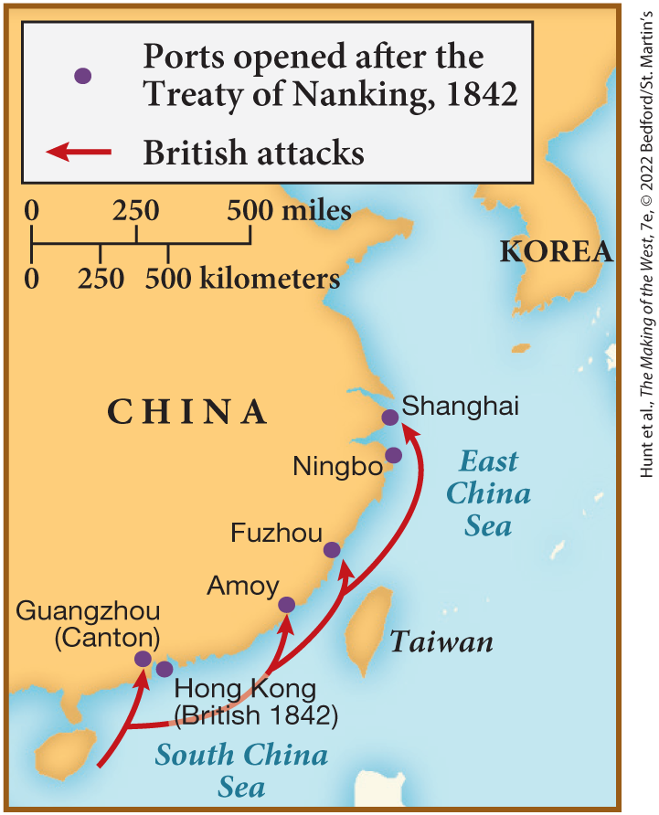
SPOT MAP 21.1 The Opium War, 1839-1842

Slide 26
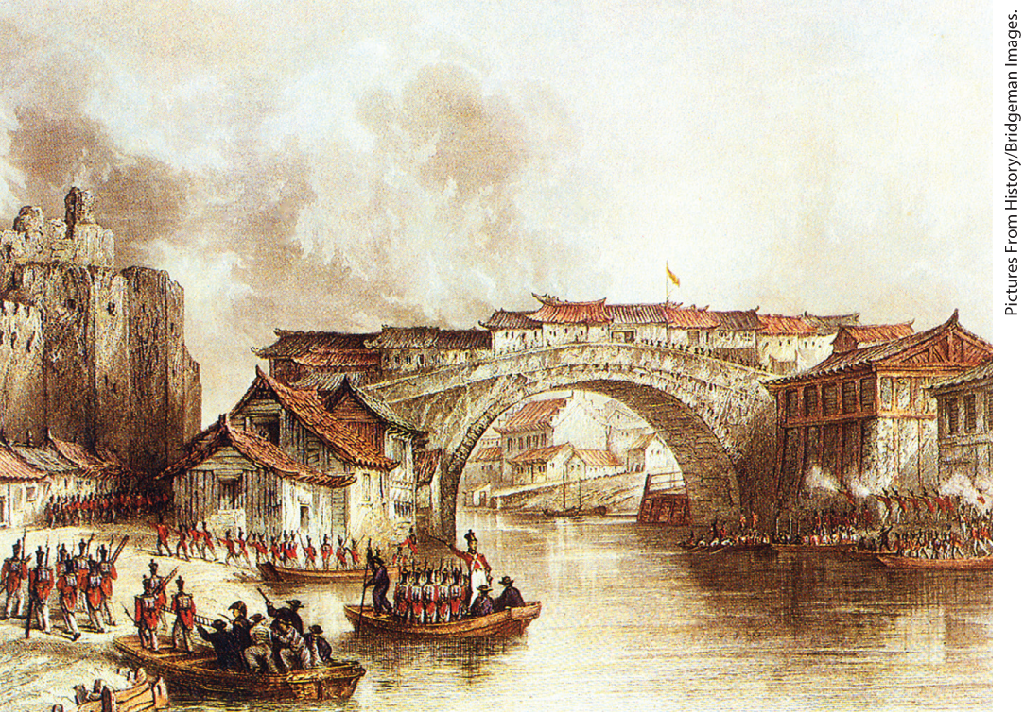
First Opium War

Slide 27
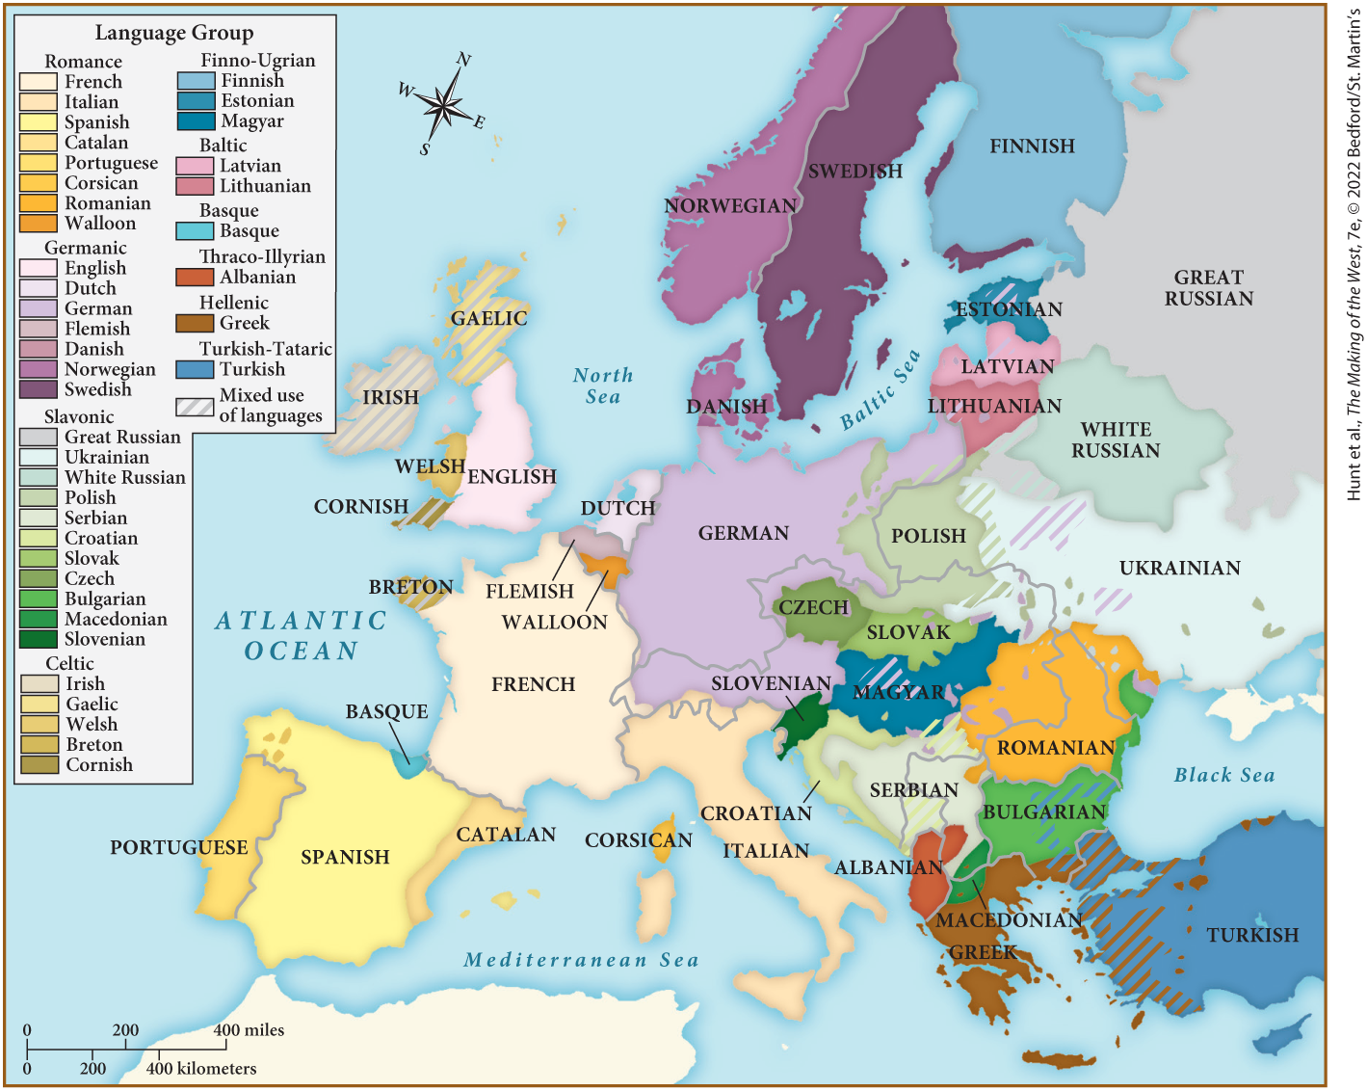
MAP 21.3 Languages of Nineteenth-Century Europe

Slide 28
III. Ideologies and Political Movements (1 of 7)
A. The Spell of Nationalism (1 of 2)
  Nationalism insisted that all peoples derived their identity from their nations
  Nationalism makes Austrian Empire especially volatile
  In opposition efforts to stifle nationalism in the Italian parts of Austrian empire, Giuseppe Mazzini founds Young Italy
  German states move toward economic unification by creating a customs union, the Zollverein
  German nationalists desire political union as well
Notes:
III. Ideologies and Political Movements (1 of 7)
A. The Spell of Nationalism (1 of 2)
The doctrine of nationalism insisted that all peoples derived their identity from nations, which are defined by common language, cultural traditions, and sometimes religion. When such nations do not coincide with state boundaries, nationalism can produce violence and warfare as different national groups compete for control.
Nationalism made the Austrian Empire especially volatile because it included so many ethnic groups.
In opposition to Metternich’s efforts to stifle nationalism in the Italian parts of the Austrian empire, Giuseppe Mazzini (1805–1872) founded Young Italy, a secret society dedicated to an Italian-led, European-wide revolution.
Under Metternich, Austria opposed German unification. In 1834, the German states moved toward economic unification by creating, under Prussian leadership, a customs union, the Zollverein, to help Germans compete economically with the rest of Europe.
German nationalists desired political union as well, but the question of whether to include both Prussia and Austria was difficult to resolve.

Slide 29
III. Ideologies and Political Movements (2 of 7)
A. The Spell of Nationalism (2 of 2)
  Thousands of Poles flee after failed revolt against the Russians
  Adam Mickiewicz portrays Polish exiles as martyrs and forms a Polish Legion to fight for restoration of Poland
  Plans for an uprising collapse when peasants slaughter not the Austrians but their Polish masters
  Russian nationalism defines itself as opposition to Western ideas
  Irish nationalists develop strong organizations aimed to recover history and preserve language
  Irish representative Daniel O’Connell attracts huge crowds with his call to repeal the Act of Union
Notes:
III. Ideologies and Political Movements (2 of 7)
A. The Spell of Nationalism (2 of 2)
After the failed revolt against the Russians in 1830, ten thousand Poles fled Poland, primarily to western Europe.
The poet Adam Mickiewicz (1798–1855) became a hero by portraying Polish exiles as martyrs and by forming a Polish Legion to fight for restoration of Poland, but conflicts among the nationalists prevented action until 1846.
Plans for an uprising in the Polish province of Galicia in the Austrian Empire collapsed when peasants slaughtered not the Austrians but their Polish masters.
Russian nationalism defined itself as opposition to Western ideas. Russian nationalists or Slavophiles (lovers of the Slavs) argued that only a return to non-Westernized religious traditions and historical principles could protect the country against the corrosive effects of rationalization and materialism.
Irish nationalists developed strong organizations in the 1840s. The Young Ireland movement, formed in 1842, aimed to recover history and preserve the Gaelic language.
Irish landowner and representative to Parliament Daniel O’Connell attracted huge crowds with his call to repeal the 1801 Act of Union, which had made Ireland part of Great Britain. O’Connell was arrested and convicted of conspiracy.

Slide 30
III. Ideologies and Political Movements (3 of 7)
B. Liberalism in Economics and Politics (1 of 2)
  Liberalism sought social improvement and supported social and economic changes produced by the Industrial Revolution
  Jeremy Bentham argued that government should promote “the greatest good for the greatest number”
  British liberals advocated free markets and limited government role in economics
  Liberals sought to repeal tariffs such as the Corn Laws
  When their efforts to lower grain tariffs were thwarted, liberals establish an Anti–Corn Law League, which lead to a repeal of the laws
Notes:
III. Ideologies and Political Movements (3 of 7)
B. Liberalism in Economics and Politics (1 of 2)
Liberalism, with its origins in the writings of John Locke, favored Enlightenment principles of personal liberty and free trade. Liberalism sought social improvement and generally applauded the social and economic changes produced by the Industrial Revolution. Liberalism was strongest among the middle class.
Jeremy Bentham (1748–1832) argued that government was most useful when it promoted “the greatest good for the greatest number” — a clear rejection of policies that favored the aristocratic minority.
British liberals advocated free markets, arguing that governments should limit their economic role to maintaining the currency, enforcing contracts, and financing major enterprises like the military and the railroads.
Liberals sought to repeal tariffs such as the Corn Laws, which kept the price of grain artificially high to the benefit of landowners and the detriment of the poor.
When their efforts to lower grain tariffs were thwarted by landowners, liberals established an Anti–Corn Law League, which published newspapers and journals, campaigned in elections, and eventually won the support of the Tory prime minister Sir Robert Peel, whose government repealed the Corn Laws in 1846.

Slide 31
III. Ideologies and Political Movements (4 of 7)
B. Liberalism in Economics and Politics (2 of 2)
  Continental industries needed protection against British dominance
  Liberals on the continent focused more on constitutional reform.
  In France and elsewhere, governments used repression and censorship
  Reform organizations emerge where industrialization most developed
  Hungarian nationalist Lajos Kossuth advocates a boycott of all non-Hungarian goods
  Reformers in Russia discuss Western ideas in informal groups
  Nicholas I bans all Western liberal writings and exiles political activists to Siberia
Notes:
III. Ideologies and Political Movements (4 of 7)
B. Liberalism in Economics and Politics (2 of 2)
On the continent, free trade had less appeal because continental industries needed protection against British industrial dominance.
As a result, liberals on the continent focused more on constitutional reform.
In France and elsewhere, governments used repression and censorship to stifle the reformers.
Reform organizations emerged where industrialization was most developed, as industrialists called for greater political clout.
In Hungary, the nationalist Lajos Kossuth (1802–1894) publicized American democracy and British political liberalism, and advocated a boycott of all non-Hungarian (and especially Austrian) goods.
Despite state opposition, reformers emerged even in Russia, where they lamented Russia’s backwardness and discussed Western ideas in informal “circles.”
Nicholas I banned all Western liberal writings and all books about the United States and exiled tens of thousands of political activists to Siberia.

Slide 32
III. Ideologies and Political Movements (5 of 7)
C. Socialism and the Early Labor Movement (1 of 3)
  Socialists considered liberalism inadequate to deal with the class inequalities
  Socialists believed that industrialism divided society into two classes
  Socialists advocated total reorganization of society.
  Socialist Robert Owen, establishes a model factory town in New Lanark, Scotland
  Claude Henri de Saint-Simon and Charles Fourier become influential socialist thinkers in France
  Saint-Simon believed work should be controlled by scientists, artists, engineers, and industrialists
  Fourier also advocated the creation of utopian communities
Notes:
III. Ideologies and Political Movements (5 of 7)
C. Socialism and the Early Labor Movement (1 of 3)
Socialism had many variants in the 1830s and 1840s, but all socialists considered liberalism inadequate to deal with the class inequalities caused and perpetuated by industrialization.
Socialists believed that industrialism had divided society into two classes: the middle-class factory owners, or capitalists, and the downtrodden working class.
Socialists advocated the total reorganization of society.
Socialist Robert Owen, a Welsh-born manufacturer, established a model factory town in New Lanark, Scotland, where working hours were curtailed and children were sent to school rather than the factory.
In France, Claude Henri de Saint-Simon (1760–1825) and Charles Fourier (1772–1837) were the most influential early socialist thinkers.
Saint-Simon believed that work was the central element in the new society and that it should be controlled by scientists, artists, engineers, and industrialists (a term he coined, along with industrialism).
Fourier also advocated the creation of utopian communities in which jobs would be rotated to maximize happiness and in which women would be emancipated.

Slide 33
III. Ideologies and Political Movements (6 of 7)
C. Socialism and the Early Labor Movement (2 of 3)
  Followers of Fourier and Saint-Simon advocated for liberation of women
  Many women join Robert Owen’s movement
  French activist Flora Tristan sought to reconcile the interests of male and female workers
  French socialists Louis Blanc and Pierre-Joseph Proudhon shape the French labor movement
  Socialists such as Étienne Cabet began to call themselves communists
  Karl Marx and Friedrich Engels develop the most influential form of socialism
  Marx establishes the Communist League and, with Engels, publishes The Communist Manifesto
Notes:
III. Ideologies and Political Movements (6 of 7)
C. Socialism and the Early Labor Movement (2 of 3)
Many followers of Fourier and Saint-Simon argued that the liberation of women would lead to the liberation of workers.
In Great Britain, many women joined Robert Owen’s movement and helped to form cooperative societies and trade unions. Women’s influence turned Owenism toward community experimentation and to issues of religious thought, women’s rights, marriage reform, and popular education.
French activist Flora Tristan (1801–1844) sought to reconcile the interests of male and female workers, but most socialist groups did not welcome women.
French socialists Louis Blanc (1811–1882) and Pierre-Joseph Proudhon (1809–1865) both argued for the importance of working-class associations; their arguments shaped the French labor movement.
After 1840, some socialists, such as Étienne Cabet (1788–1856), began to call themselves communists to indicate their plan to replace private property with communal ownership.
Karl Marx (1818–1883) and Friedrich Engels (1820–1895) developed the most influential form of socialism.
In Paris, Marx established the Communist League and, with Engels, published The Communist Manifesto (1848).

Slide 34
III. Ideologies and Political Movements (7 of 7)
C. Socialism and the Early Labor Movement (3 of 3)
  Marx and Engels embrace industrialization
  Socialist doctrines led to working-class organizations, worrying the middle class
  Workers increasingly become involved in politics
  Leaders fear that advocating women’s suffrage would alienate potential supporters
  Chartists organize massive petition campaigns, presenting the House of Commons with the People’s Charter
  Chartists ally with working-class movements and distance themselves from women workers
  Trade unions and strikes were illegal on the continent
Notes:
III. Ideologies and Political Movements (7 of 7)
C. Socialism and the Early Labor Movement (3 of 3)
Marx and Engels embraced industrialization, believing it would bring about the inevitable proletarian revolution and thus the abolition of exploitation, private property, and social class.
Socialist doctrines led to working-class organizations: cooperative societies, local trade unions, and societies for mutual aid, all of which worried the middle class.
Workers increasingly became involved in politics as well. In Great Britain, workers joined the Chartist movement, which called for universal manhood suffrage, vote by secret ballot, equal electoral districts, and the payment of stipends to members of Parliament, and would essentially transform Britain into a democracy.
Although many women took part in the movement, leaders feared that advocating women’s suffrage would alienate potential supporters.
The Chartists organized massive petition campaigns in 1838 and 1839, presenting the House of Commons with the People’s Charter (as their list of demands was called), signed by more than a million people.
Because the House of Commons repeatedly refused to act, Chartists allied themselves with working-class strike movements and distanced themselves from women workers.
Trade unions and strikes were illegal on the continent, so workers there were less organized.

Slide 35
IV. The Revolutions of 1848 (1 of 8)
A. The Hungry Forties
  Crop failures send food prices soaring
  Blight destroys the potato crop
  As much as one-eighth of the Irish population dies of starvation and disease
  Hundreds of thousands emigrate from Ireland
  Famine destroys social peace
  High prices hurt manufacturing, workers’ wages decline
  Unemployment and higher costs make workers’ lives even more difficult
Notes:
IV. The Revolutions of 1848 (1 of 8)
A. The Hungry Forties
Beginning in 1845, crop failures sent food prices soaring.
A blight destroyed the potato crop, a staple of peasant diets, especially in Ireland.
In Ireland alone, as much as one-eighth of the population died horribly of starvation and disease.
Hundreds of thousands emigrated from Ireland to England, the United States, and Canada.
Famine destroyed social peace, as workers protested high prices, often attacking bakeries and markets.
High prices also hurt manufacturing, and workers’ wages declined relative to the cost of living.
In the cities, unemployment and higher costs of living rendered workers’ lives even more difficult.

Slide 36
IV. The Revolutions of 1848 (2 of 8)
B. Another French Revolution (1 of 2)
  Hunger gave rise to criticism of the government
  Reform demonstrations begin in Paris, fighting breaks out between the crowds and soldiers, King Louis-Philippe flees to England
  New republic leaders issued liberal reforms, including the abolition of slavery
  New government sets up national workshops to provide construction work for unemployed men
  Many supported the reforms and the workshops enthusiastically
Notes:
IV. The Revolutions of 1848 (2 of 8)
B. Another French Revolution (1 of 2)
Everywhere, hunger gave rise to criticism of the government.
Reform demonstrations began in Paris, and students, workers, and the unemployed began to build barricades. Fighting broke out between the crowds and soldiers, and on February 24, 1848, King Louis-Philippe abdicated and fled to England.
The leaders of the new republic issued liberal reforms, including the abolition of slavery in the colonies, and promised to establish the right to vote for all adult men.
The new government set up national workshops to provide construction work for minimal wages to unemployed men (and later women). To pay for the workshops, the government levied a surtax on property taxes, which alienated peasants and landowners.
Simultaneously, many supported the reforms and the workshops enthusiastically. Newspapers praised the republic, and political clubs sought to give men and women an opportunity to debate political issues.

Slide 37
IV. The Revolutions of 1848 (3 of 8)
B. Another French Revolution (2 of 2)
  Activism alarms middle-class, government enlists unemployed youths in a mobile guard
  Largely conservative National Assembly closes national workshops, workers take to the streets
  Army, the National Guard, and the mobile guard joined by provincial volunteers to put down the uprising
  National Assembly adopts new constitution calling for a presidential election, Louis-Napoleon Bonaparte, nephew of the dead emperor, wins the presidential election
Notes:
IV. The Revolutions of 1848 (3 of 8)
B. Another French Revolution (2 of 2)
This outburst of activism alarmed middle-class liberals and conservatives and prompted the government to enlist unemployed youths in a mobile guard.
Concern about demonstrations led by radicals resulted in the election of a largely conservative National Assembly in April 1848, which closed the national workshops. In response to the closure of the workshops, workers took to the streets on June 23 by the tens of thousands.
During the June Days, as the following week came to be called, the army, the National Guard, and the mobile guard were joined by provincial volunteers to put down the uprising. More than ten thousand demonstrators were killed and twelve thousand were arrested.
The National Assembly adopted a new constitution calling for a presidential election in which all men could vote. Louis-Napoleon Bonaparte, nephew of the dead emperor, won the presidential election. In 1852, he declared himself Emperor Napoleon III.

Slide 38
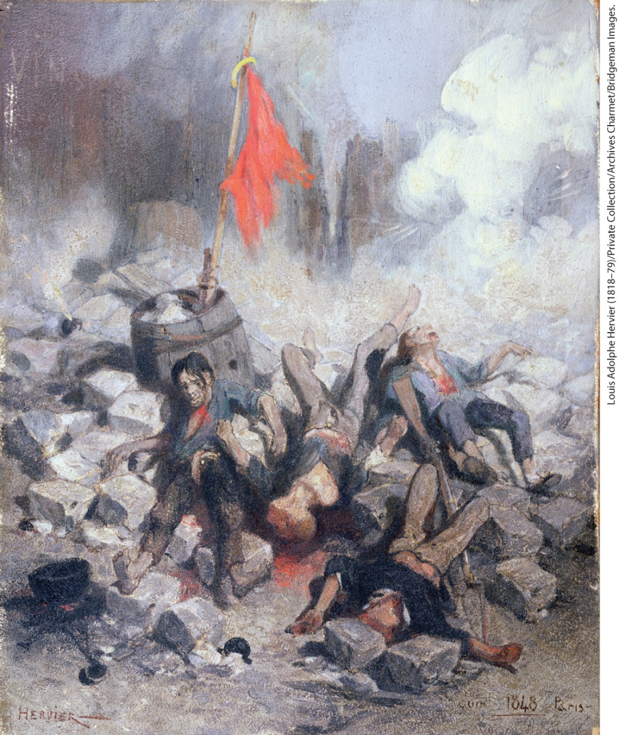
The Violence of Revolution

Slide 39
IV. The Revolutions of 1848 (4 of 8)
C. Nationalist Revolution in Italy
  Revolt against the Bourbons breaks out in Palermo, Sicily
  Mass demonstrations take place throughout the Italian peninsula in support
  In central Italy, peasants and artisans turn against local rulers
  Property owners and business leaders support a conservative government, workers want a social democracy
  Charles Albert, king of Piedmont-Sardinia, leads a failed military campaign against Austria
  Romans drive the pope from the city and declare a republic, but Louis-Napoleon Bonaparte intervenes
  Republican leaders Mazzini and Garibaldi flee; ending the revolution in Italy
Notes:
IV. The Revolutions of 1848 (4 of 8)
C. Nationalist Revolution in Italy
In January 1848, a revolt against the Bourbons broke out in Palermo, Sicily.
When news of the revolution in Paris arrived, mass demonstrations took place throughout the Italian peninsula. Nationalists hoped to unite the diverse territories of Italy, but class divisions and regional differences barred the way; nationalists found themselves in conflict with the Bourbon rulers in the south, as well as the pope and the Austrian emperor.
In central Italy, peasants and artisans turned against local rulers, demanding land reform and higher wages.
Property owners and business leaders supported liberal reforms and a conservative government, while workers and intellectuals envisioned a social democracy.
Charles Albert, king of Piedmont-Sardinia, the most powerful Italian state, led a military campaign against Austria that failed largely because of disagreements over tactics and goals. Austria defeated the rebels in the north during the summer of 1848.
In the fall, the Romans drove the pope from the city and declared a republic, but Louis-Napoleon Bonaparte intervened to restore Pius IX to the papal throne.
Republican leaders Mazzini and Garibaldi fled; the revolution was over in Italy.

Slide 40
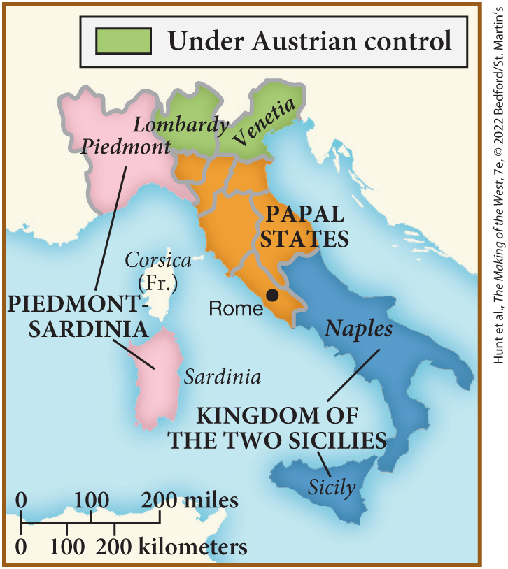
SPOT MAP 21.2 The Divisions of Italy, 1848

Slide 41
IV. The Revolutions of 1848 (5 of 8)
D. Revolt and Reaction in Central Europe (1 of 2)
  Demonstrations pop up in Austria, Prussia, and the many German states
  After violence in Berlin, the Prussian king agrees to call an assembly to draft a constitution
  German states agree to a federal parliament at Frankfurt to attempt to unite Germany, disturbances and attacks on property and Jewish moneylenders persist
  Prussian king Frederick William IV crushes the revolution in Berlin
  Frankfurt parliament offers Frederick William position of Emperor, he refuses
  Metternich forced to flee Austria after rioting in Vienna
Notes:
IV. The Revolutions of 1848 (5 of 8)
D. Revolt and Reaction in Central Europe (1 of 2)
As in Italy, news of the revolt in Paris touched off demonstrations in Austria, Prussia, and the many German states of central Europe.
After violence in Berlin, the Prussian king agreed to call an assembly to draft a constitution, but the goal of German unification soon took precedence over social and political reform among the rebels.
Most of the German states agreed to elect delegates to a federal parliament at Frankfurt that would attempt to unite Germany, but the delegates had little political experience and no access to an army and feared demands for social reforms made by the lower classes. Disturbances and attacks on property and Jewish moneylenders persisted.
The Prussian king Frederick William IV (r. 1840–1860) soon recovered his confidence and crushed the revolution in Berlin in the fall of 1848. His troops then intervened to put down revolts in other German states during the spring of 1849.
When the Frankfurt parliament offered Frederick William the position of Emperor of a united, constitutional Germany, he refused.
In Austria, Metternich was forced to flee the country in disguise after rioting in Vienna in March 1848. The empire seemed in a state of collapse in the summer of 1848.

Slide 42
IV. The Revolutions of 1848 (6 of 8)
D. Revolt and Reaction in Central Europe (2 of 2)
  Austrians faced Magyar nationalists who demanded autonomy for Hungary
  Austrians granted Hungary home rule, but the Magyar revolutionaries alienate Hungarian landowners by abolishing serfdom
  Social conflicts and ethnic divisions doom the nationalist revolutionaries within the Austrian Empire
  Austrians take advantage of divisions and abolish all remaining peasant obligations to nobility
  Fragmentation of revolutionary groups enabled military forces to begin a counteroffensive
  Eighteen-year-old Francis Joseph ascends to the throne as the new Habsburg ruler
  Hungarian revolution defeated
Notes:
IV. The Revolutions of 1848 (6 of 8)
D. Revolt and Reaction in Central Europe (2 of 2)
In addition to the revolts in Italy, the Austrians faced Magyar nationalists who demanded autonomy for Hungary, and revolution for political reform in Vienna itself.
The beleaguered Austrians granted Hungary home rule, but the Magyar revolutionaries alienated Hungarian landowners by abolishing serfdom. They also alienated other ethnic groups by imposing the Magyar language on them.
Social conflicts and ethnic divisions like these would doom the diverse nationalist revolutionaries within the Austrian Empire.
The Austrians took advantage of these divisions and abolished all remaining peasant obligations to the nobility in order to put an end to peasant discontent.
The continued fragmentation of revolutionary groups enabled military forces, in June 1848, to begin a counteroffensive, crushing the revolt in Prague, then Vienna, and eventually Hungary, which was placed under martial law.
Eighteen-year-old Francis Joseph (r. 1848–1916) ascended to the throne as the new Habsburg ruler.
In conjunction with a large Russian army, the Hungarian revolution was finally defeated in the spring of 1849.

Slide 43
IV. The Revolutions of 1848 (7 of 8)
E. Aftermath to 1848: Reimposing Authority (1 of 2)
  Revolutions have major impact on Europe
  France’s short-lived republic prepares the French for another republic after 1870
  In Italy and Germany, calls for national unity came to be seen as a practical reality
  Political awareness, organization, and activity increased
  Almost all the German states had a constitution and a parliament after 1850
  No revolution occurred in Great Britain
Notes:
IV. The Revolutions of 1848 (7 of 8)
E. Aftermath to 1848: Reimposing Authority (1 of 2)
The revolutionaries of 1848 failed to achieve most of their goals, but the revolutions did have an impact on Europe.
The experience of France’s short-lived republic prepared the French for another republic after 1870.
In Italy and Germany, calls for national unity had been given widespread publicity and came to be seen as a practical reality, not just an ideal.
Political awareness, organization, and activity increased.
Almost all the German states had a constitution and a parliament after 1850.
No revolution occurred in Great Britain, despite massive demonstrations organized by the Chartists.

Slide 44
IV. The Revolutions of 1848 (8 of 8)
E. Aftermath to 1848: Reimposing Authority (2 of 2)
  British middle classes did not support revolution, working classes were satisfied by Parliamentary reforms
  Russia also escaped revolution
  Aristocracy remained the dominant power in most countries
  Women’s participation led to a conservative reaction
  Feminist movement in France disintegrates after the conservative government disbanded groups and arrested leaders
  Many socialists, communists, and nationalists fled into exile
Notes:
IV. The Revolutions of 1848 (8 of 8)
E. Aftermath to 1848: Reimposing Authority (2 of 2)
The British middle classes, encouraged by the 1832 Reform Bill, did not support revolution as they had in other countries, and working classes were satisfied by Parliamentary reforms that regulated women’s and children’s work.
Russia, where Nicholas I kept a tight grip through police surveillance and censorship of education and the expression of ideas, also escaped revolution.
Almost everywhere, the aristocracy remained the dominant power.
Women’s participation in revolutionary activity led to a conservative reaction against women’s public roles.
The feminist movement in France, the most advanced in Europe, disintegrated after the conservative republican government forbade women to form political clubs and arrested feminist leaders.
Many socialists, communists, and nationalists fled into exile to wait for another opportunity to voice their demands.

Slide 45
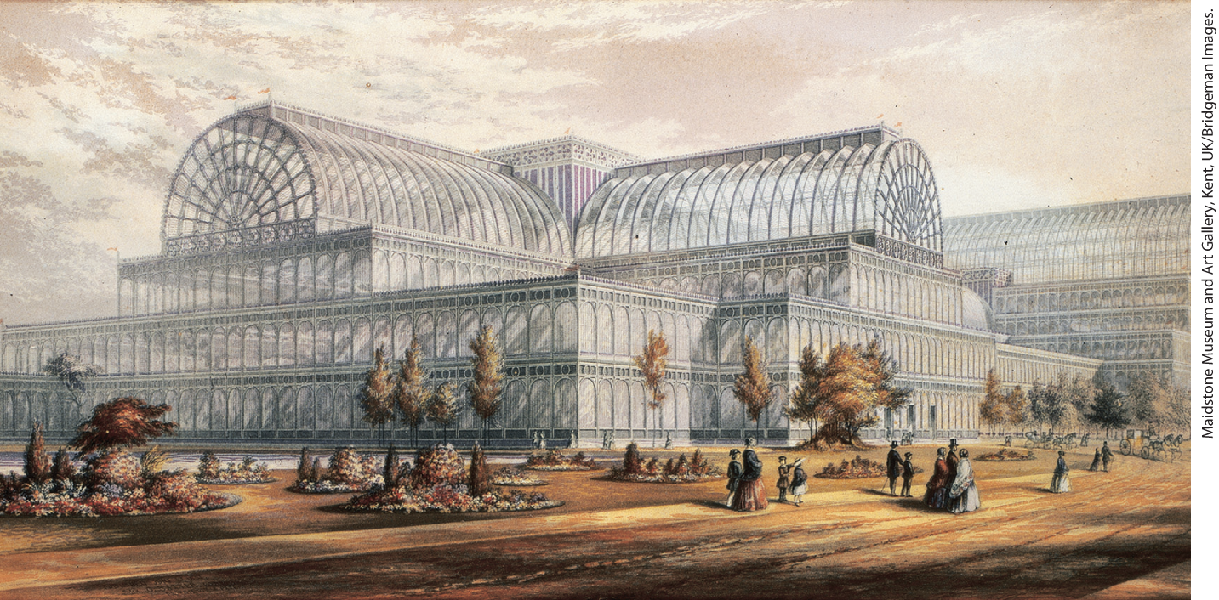
The Crystal Palace, 1851

Slide 46
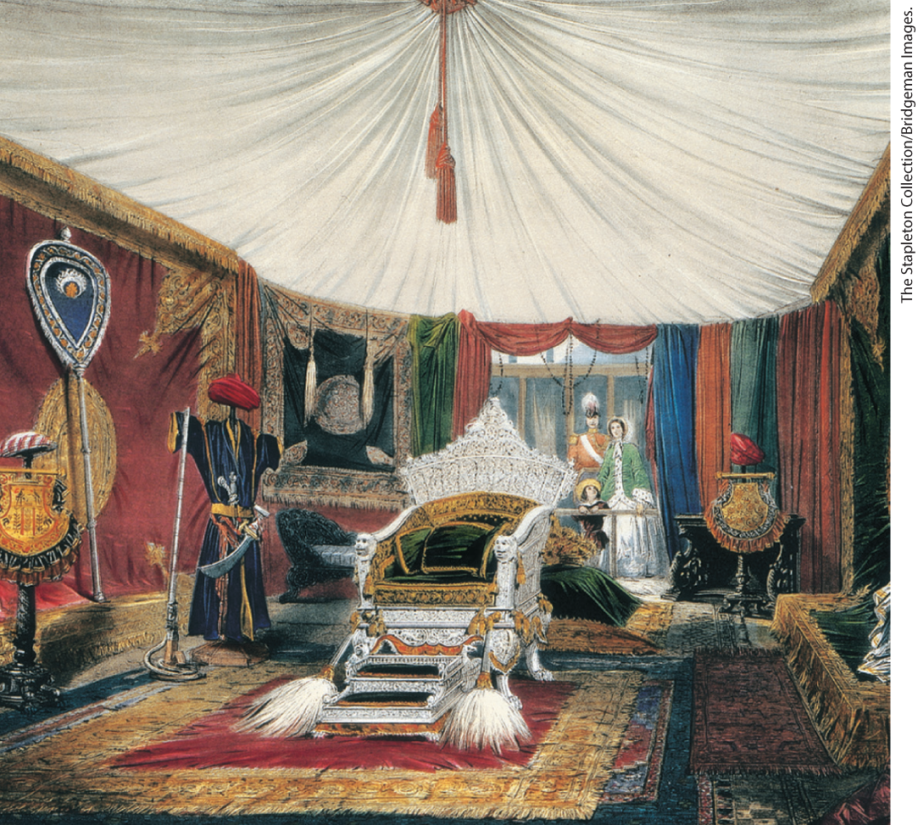
The Crystal Palace, 1851

Slide 47
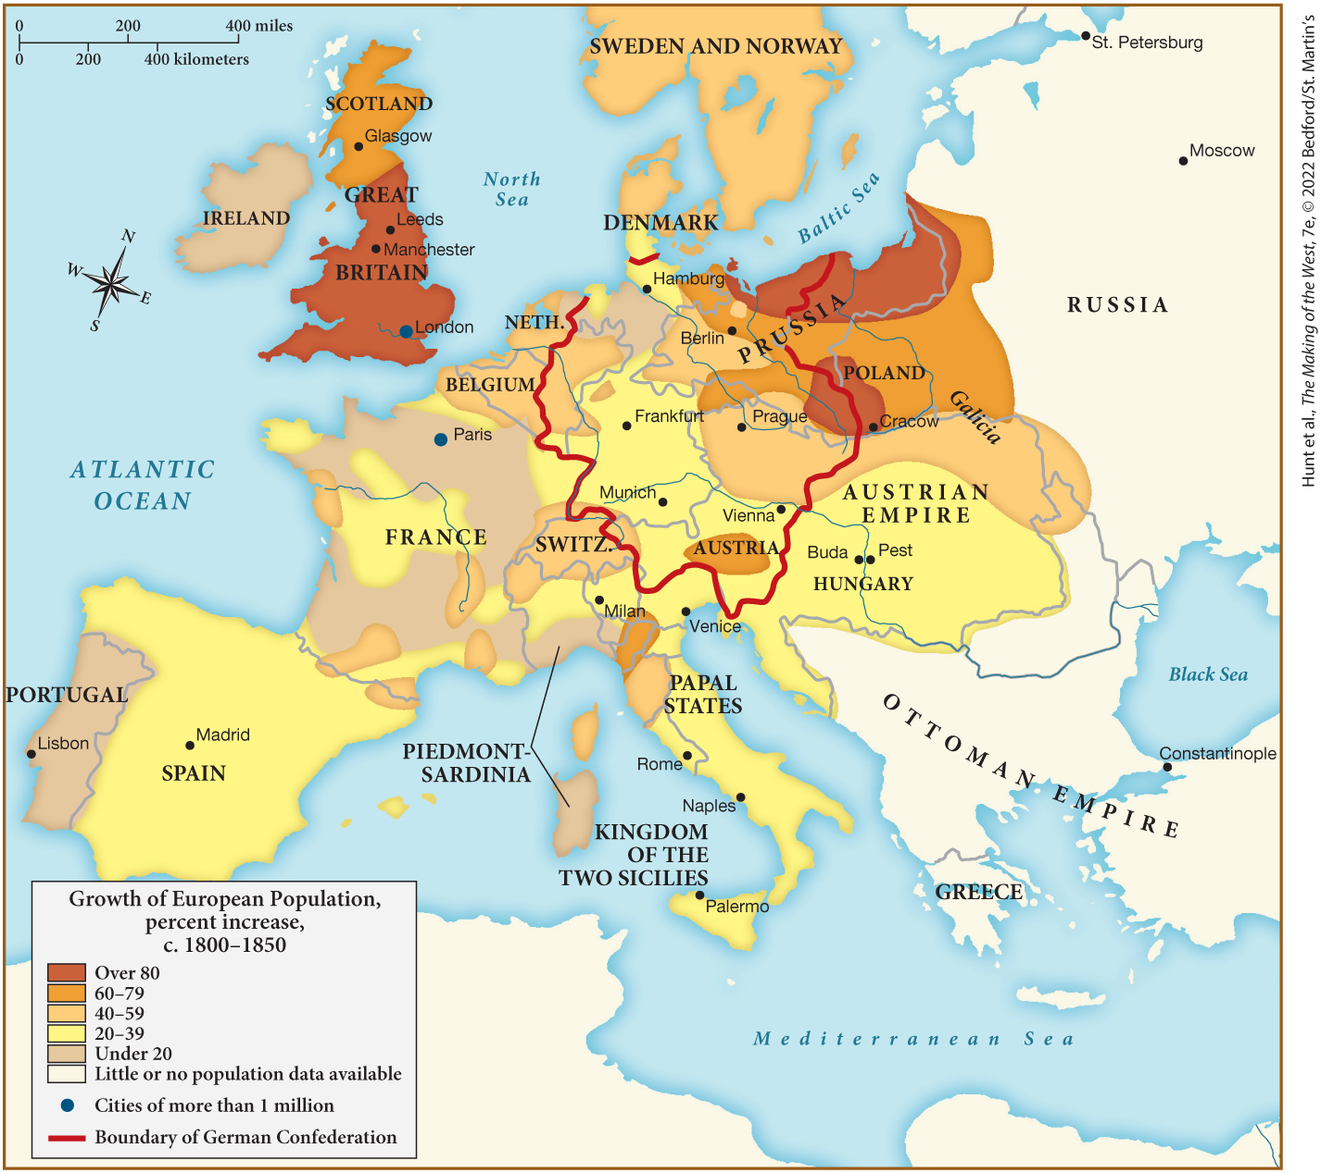
MAP 21.4 Mapping the West: Europe in 1850

