Slide 1
The Making of the West
Seventh Edition
Hunt • Martin • Rosenwein • Smith
CHAPTER 20
Napoleon and the Revolutionary Legacy
1800 –1830
Copyright © 2022 by Bedford/St. Martin’s
Distributed by Bedford/St. Martin’s/Macmillan Learning strictly for use with its products. Not for redistribution.

Slide 2
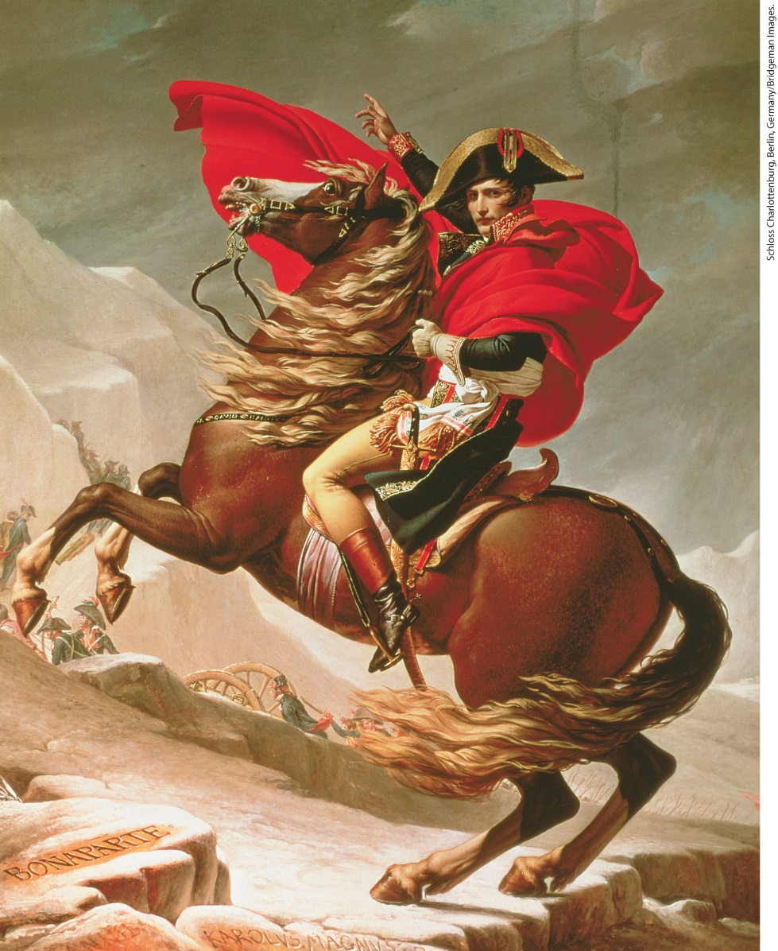
Napoleon as Military Hero

Slide 3
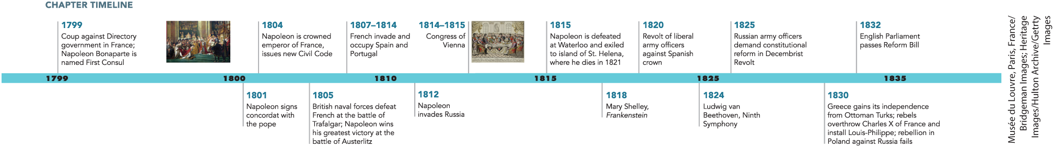
Chapter 20 Timeline

Slide 4
I. The Rise of Napoleon Bonaparte (1 of 8)
A. A General Takes Over (1 of 2)
  Napoleon Bonaparte rose from artillery officer to supreme ruler of France in four years
  After military successes in Italian campaigns, Napoleon defeats the Piedmontese and the Austrians.
  He establishes client republics dependent upon him
  Napoleon quiets discontent by sending confiscated Italian art back to France
  He is given command of an Egyptian invasion force sent to cut British trade route to India, but invasion fails
Notes:
I. The Rise of Napoleon Bonaparte (1 of 8)
A. A General Takes Over (1 of 2)
Napoleon Bonaparte (1769–1821) rose from penniless, imprisoned artillery officer to supreme ruler of France in four years.
After his astounding military successes in the Italian campaigns of 1796–1797, Napoleon defeated the Piedmontese and the Austrians.
He established client republics that were dependent upon him by negotiating directly with the Austrians, while paying his army with the cash he received as tribute to ensure its loyalty.
Napoleon quieted any discontent in the Directory by sending confiscated Italian art back to France.
In 1798, he was given command of an Egyptian invasion force sent to cut the British trade route to India. Despite French victory over the Egyptian army, British naval activity caused the invasion to fail.

Slide 5
I. The Rise of Napoleon Bonaparte (2 of 8)
A. A General Takes Over (2 of 2)
  Introduces Enlightenment legal reform to Egypt, uncovers the Rosetta Stone
  Bonaparte returns to France in the midst of crises
  Anti-Directory conspirators overthrow the legislature, abolish the Directory and establish the consulate
  New constitution written and submitted to the public for a vote
Notes:
I. The Rise of Napoleon Bonaparte (2 of 8)
A. A General Takes Over (2 of 2)
Napoleon did introduce Enlightenment legal reform to Egypt, and his forces uncovered the Rosetta Stone, a slab of black basalt dating back to 196 B.C.E. that was inscribed with Egyptian hieroglyphics, Demotic, and Greek, allowing linguists to decipher hieroglyphs for the first time.
Bonaparte returned to France in October 1799, when France was in the midst of a series of crises. Powerful generals, supported by their troops, had become virtually independent.
Anti-Directory conspirators, including Bonaparte’s brother, arranged for the overthrow of the legislature, allowing a rump assembly to abolish the Directory and establish the consulate, a three-man executive that included Napoleon as First Consul.
A new constitution — without a declaration of rights — was written and submitted to the apathetic public for a vote, the results of which were falsified to show more support for the new government.

Slide 6
I. The Rise of Napoleon Bonaparte (3 of 8)
B. From Republic to Empire (1 of 2)
  Constitution of 1799 installs Napoleon Bonaparte as First Consul
  Council eliminates direct elections for deputies and denies independent powers to the legislature
  Napoleon signs concordat with Pope Pius VII to reconcile Catholics to the regime
  Napoleon creates the Bank of France, uses government censorship to limit opposition
  Hundreds of Jacobins arrested after failed attempt to assassinate Napoleon
  Napoleon kidnaps, executes the duke d’Enghien, a relative of the French royal family
Notes:
I. The Rise of Napoleon Bonaparte (3 of 8)
B. From Republic to Empire (1 of 2)
The constitution of 1799 installed Napoleon Bonaparte as First Consul with the right to choose the Council of State, which drew up all the laws.
The Council eliminated direct elections for deputies and denied independent powers to the three houses of the legislature.
Although he was not religious, Napoleon signed a concordat (agreement) with Pope Pius VII (r. 1800–1823) in 1801 to reconcile Catholics to the regime. Catholicism was recognized as the religion of “the great majority of French citizens,” and the pope validated the sale of church lands that had occurred during the Revolution. Catholic priests and Protestant pastors were paid by the state.
Napoleon continued to centralize state power by creating the Bank of France and appointing prefects who supervised local affairs in each department in the country. He reestablished order in France, in part by using government censors and the police to limit opposition and by censoring newspapers, operas, and plays.
When royalists attempted to assassinate Napoleon with a bomb in 1800, his minister of police, Joseph Fouché, used the incident to arrest hundreds of Jacobins.
Napoleon also struck at royalists; in 1804, his agents kidnapped the duke d’Enghien, a relative of the French royal family, from Germany on false charges of having plotted against Napoleon. After a quick trial, d’Enghien was executed.

Slide 7
I. The Rise of Napoleon Bonaparte (4 of 8)
B. From Republic to Empire (2 of 2)
  Napoleon names himself First Consul for life, and later crowns himself emperor
  Napoleon works to establish authority and cultivate his image
  Building projects included the Arc de Triomphe and the Stock Exchange
  Effective bureaucracy based on a patron-client relationship
  Reinstituted social hierarchy, created an aristocracy, and installed relatives in positions of power
  Divorces his wife Josephine and marries Austrian princess, designating their son the king of Rome
Notes:
I. The Rise of Napoleon Bonaparte (4 of 8)
B. From Republic to Empire (2 of 2)
In 1802, Napoleon named himself First Consul for life, and in December 1804, he crowned himself emperor. His actions were approved by plebiscites.
Napoleon worked hard to establish his authority and to cultivate his image, which was reproduced on coins, on public monuments, and in paintings.
His ostentatious building projects, most of which were in the neoclassical style, included the Arc de Triomphe and the Stock Exchange.
Napoleon’s most trusted officials from past military campaigns helped him rule, and his effective bureaucracy was based on a patron-client relationship.
He reinstituted a social hierarchy that rewarded merit and talent regardless of birth. He also created an aristocracy based in part on wealth and installed his relatives in positions of power and influence.
In 1810, to establish a new dynasty, he divorced his childless wife Josephine and married an Austrian princess. He designated their son the king of Rome.

Slide 8
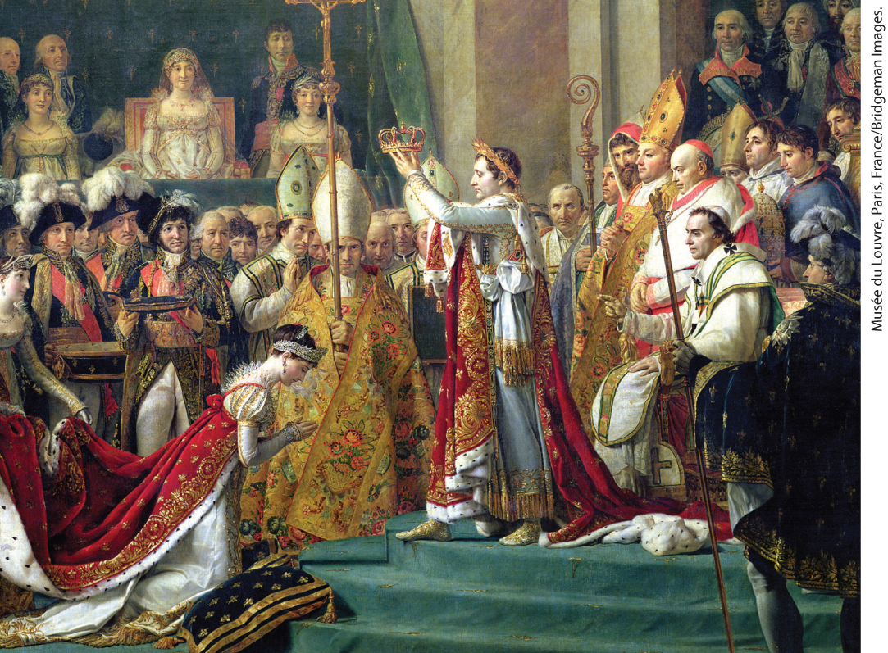
Napoleon’s Coronation as Emperor

Slide 9
I. The Rise of Napoleon Bonaparte (5 of 8)
C. The New Paternalism: The Civil Code (1 of 2)
  Creation of the Civil Code, or Napoleonic Code
  Civil Code reasserted the Old Regime’s system of male domination over women
  The code severely curtails women’s rights
  The code is adopted in many European and Latin American countries, as well as Louisiana
Notes:
I. The Rise of Napoleon Bonaparte (5 of 8)
C. The New Paternalism: The Civil Code (1 of 2)
One of Napoleon’s first acts as emperor was the creation of the Civil Code, or Napoleonic Code: the first unified system of law for France.
Napoleon’s familial model of power placed men firmly in charge. The Civil Code reasserted the Old Regime’s system of male domination over women and insisted on a father’s control over, and responsibility for, his children.
The code severely curtailed women’s rights, making women responsible for private virtue because Napoleon believed a woman’s place was in the home.
The code was adopted in many European and Latin American countries, as well as in the French colony of Louisiana.

Slide 10
I. The Rise of Napoleon Bonaparte (6 of 8)
C. The New Paternalism: The Civil Code (2 of 2)
  The government educated boys but took little interest in girls
  All workers required to attest to good conduct, workers’ organizations prohibited
  Arbitration boards established to settle labor disputes, but required representation by foremen and shop superintendents.
  Limitations on workers’ rights won support of French business
Notes:
I. The Rise of Napoleon Bonaparte (6 of 8)
C. The New Paternalism: The Civil Code (2 of 2)
The government managed military-style education at the new lycées for boys but took little interest in educating girls.
All workers were required to carry a card attesting to their good conduct, and workers’ organizations were prohibited.
Arbitration boards were established in 1806 to settle labor disputes, but they treated workers as minors and demanded that they be represented by foremen and shop superintendents.
Limitations on workers’ rights won Napoleon the support of French business.

Slide 11
I. The Rise of Napoleon Bonaparte (7 of 8)
D. Patronage of Science and Intellectual Life (1 of 2)
  Napoleon promoted scientific inquiry
  Developments in physics, evolutionary science and medicine during his reign
  Napoleon encouraged scientists, considered most writers useless or dangerous
  Writer Madame de Staël forced to live in exile
  Her novel Corinne criticized the regime
Notes:
I. The Rise of Napoleon Bonaparte (7 of 8)
D. Patronage of Science and Intellectual Life (1 of 2)
Napoleon promoted scientific inquiry, especially if it served practical purposes.
During his reign, experiments with balloons led to the discovery of laws about the expansion of gases, research on fossil shells prepared the way for new theories of evolutionary change later in the century, and new techniques of amputation and medical care were developed.
While he encouraged scientists, Napoleon considered most writers useless or dangerous.
Madame de Staël (1766–1817), like many of the country’s talented writers, had to live in exile.
Her novel Corinne (1807) criticized the regime by focusing on a brilliant woman thwarted by a patriarchal system.

Slide 12
I. The Rise of Napoleon Bonaparte (8 of 8)
D. Patronage of Science and Intellectual Life (2 of 2)
  Even though Napoleon restored the authority of religion, many Catholics and royalists criticized him
  François-René de Chateaubriand believed that Napoleon had saved France, but still preferred monarchy
  In his Genius of Christianity, Chateaubriand argued that Napoleon did not understand the power of faith
Notes:
I. The Rise of Napoleon Bonaparte (8 of 8)
D. Patronage of Science and Intellectual Life (2 of 2)
Even though Napoleon restored the authority of the state and of religion, many Catholics and royalists criticized him as a usurper.
François-René de Chateaubriand (1768–1848) believed that Napoleon had “saved [France] from the abyss” but he still preferred monarchy and did not believe that Napoleon had done enough to defend Christian values against the Enlightenment’s emphasis on reason.
In his Genius of Christianity (1802), Chateaubriand argued that Napoleon did not understand the mystical power of faith.

Slide 13
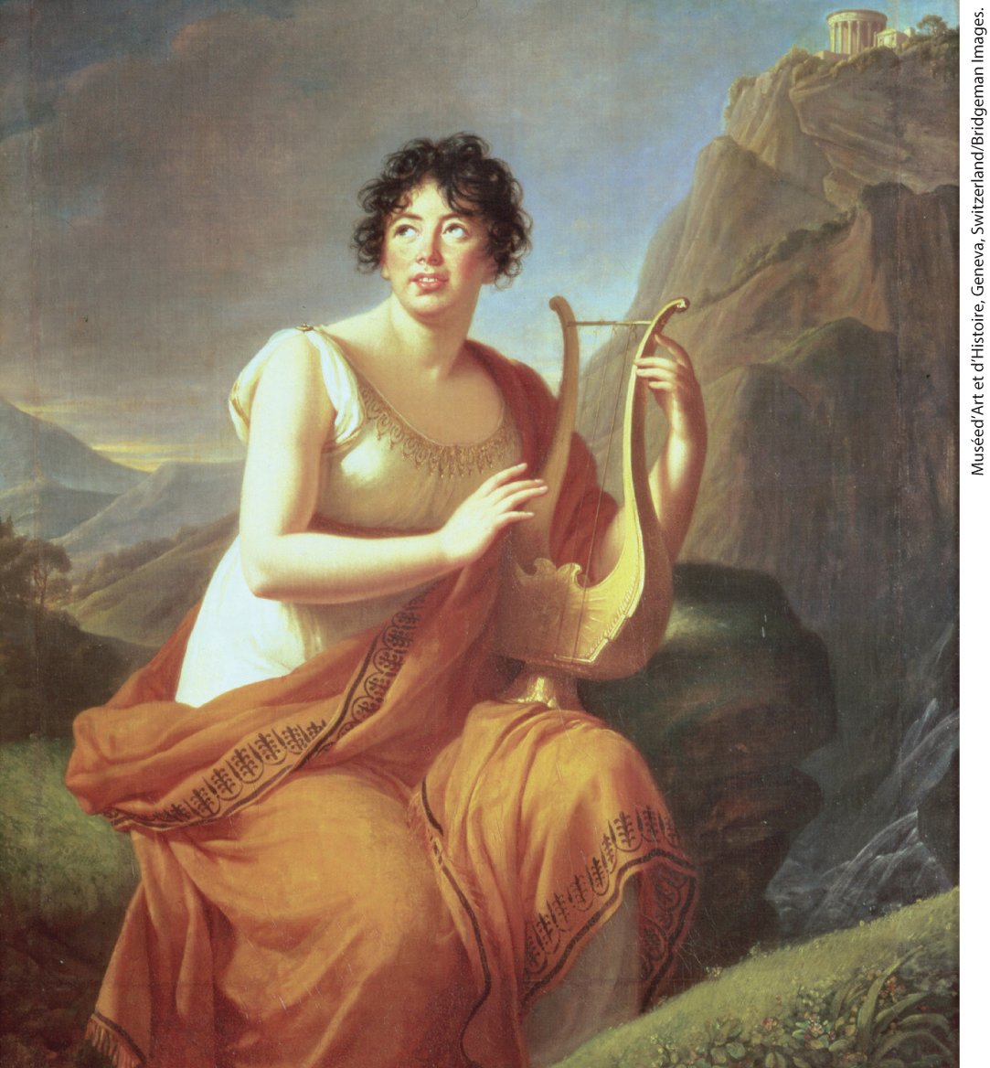
Germaine de Staël

Slide 14
II. “Europe Was at My Feet”: Napoleon’s Conquests (1 of 9)
A. The Grand Army and Its Victories, 1800–1807 (1 of 3)
  Conscription provided Napoleon with a large army, which had higher morale than other armies
  Napoleon ends fighting among generals, unites all French forces into a single Grand Army
  Napoleon inspires personal loyalty, fights alongside troops in battles
  Napoleon’s favorite tactic was to attack the main army with large forces, follow up with relentless pursuit
  Napoleon failed to train independent subordinates, so supply was a constant problem
Notes:
II. “Europe Was at My Feet”: Napoleon’s Conquests (1 of 9)
A. The Grand Army and Its Victories, 1800–1807 (1 of 3)
Conscription provided Napoleon with a large army, and the army also offered social mobility and appealed to French patriotism. Officers who rose through the ranks were young, ambitious, and experienced, and the French military had higher morale than the armies of other powers.
Napoleon ended the squabbling among generals that characterized the Directory by uniting all French forces into a single Grand Army under his personal command.
Despite the difficult conditions under which soldiers fought, Napoleon inspired an almost fanatical personal loyalty, fighting alongside his troops in some sixty battles.
Napoleon’s favorite tactic was to attack the main body of the opposing army in a lightning strike with the largest force possible and to follow up decisive victories with relentless pursuit.
He served as his own operations officer, but he failed to train independent subordinates. Supply was a constant problem.

Slide 15
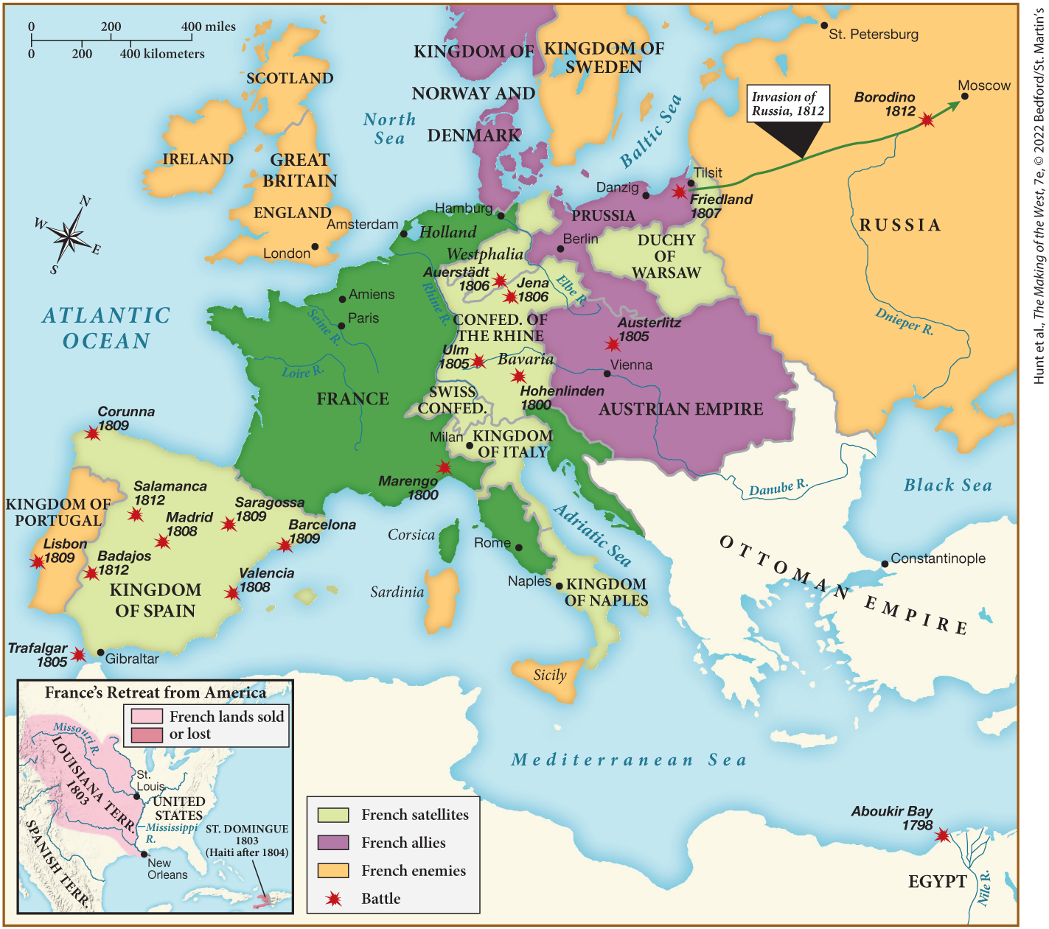
MAP 20.1 Napoleon’s Empire at Its Height, 1812

Slide 16
II. “Europe Was at My Feet”: Napoleon’s Conquests (2 of 9)
A. The Grand Army and Its Victories, 1800–1807 (2 of 3)
  Lack of coordination among enemies was a great advantage
  Napoleon’s victories in the battles of Marengo and Hohenlinden force Austrians to agree to peace
  Success was followed by the Treaty of Amiens with the British
  Napoleon sends forces to St. Domingue, withdraws due to organized resistance, yellow fever
  Napoleon sells Louisiana to the United States
Notes:
II. “Europe Was at My Feet”: Napoleon’s Conquests (2 of 9)
A. The Grand Army and Its Victories, 1800–1807 (2 of 3)
A lack of coordination among his enemies’ armies was one of his greatest advantages; he therefore maneuvered diplomatically and militarily to face them one at a time.
Napoleon’s victories in the battles of Marengo and Hohenlinden in 1800 forced the Austrians to agree to peace.
This success was followed in 1802 by the Treaty of Amiens with the British, which lasted only until 1803.
During this temporary truce, Napoleon sent forces to St. Domingue to retake the colony but was forced to withdraw because of the organized resistance by the Black population and an epidemic of yellow fever.
As part of his retreat from the Western Hemisphere and because of his especial need for funds, Napoleon sold Louisiana to the United States in 1803.

Slide 17
II. “Europe Was at My Feet”: Napoleon’s Conquests (3 of 9)
A. The Grand Army and Its Victories, 1800–1807 (3 of 3)
  British navy defeats the French and Spanish allies in the battle of Trafalgar
  Napoleon defeats Austrians at Ulm, and the Austrians and Russians at Austerlitz
  Prussia enters the war and is promptly defeated
  Napoleon again defeats the Russians at Friedland
  Ensuing treaties of Tilsit result a significant loss of territory for Prussia
Notes:
II. “Europe Was at My Feet”: Napoleon’s Conquests (3 of 9)
A. The Grand Army and Its Victories, 1800–1807 (3 of 3)
When war resumed, the British navy defeated the French and their Spanish allies in the battle of Trafalgar (1805).
That same year, Napoleon defeated the Austrians at Ulm, and the Austrians and Russians at Austerlitz.
Prussia entered the war and was promptly defeated at Jena and Auerstädt in 1806.
In 1807, Napoleon again defeated the Russians at Friedland.
The ensuing treaties of Tilsit — negotiated between Napoleon and Russian tsar Alexander I (r. 1801–1825) — resulted in Prussia’s suffering a significant loss of territory.

Slide 18
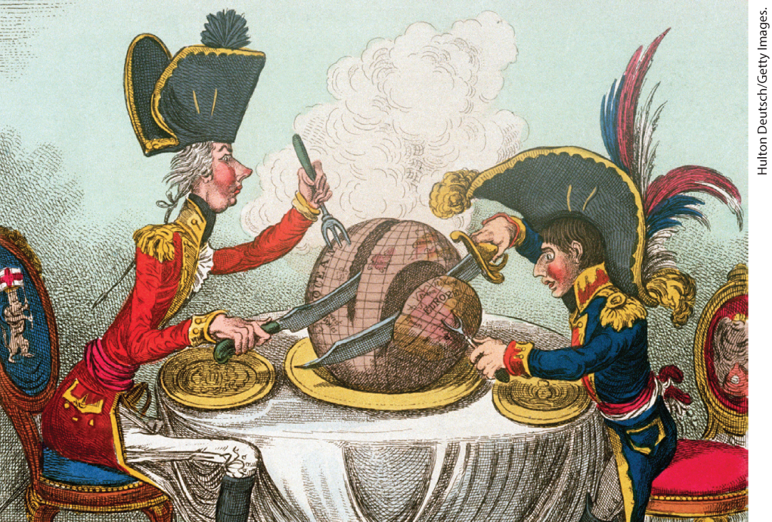
James Gillray, “The Plum-Pudding in Danger”

Slide 19
II. “Europe Was at My Feet”: Napoleon’s Conquests (4 of 9)
B. The Impact of French Victories (1 of 3)
  Napoleon attempts to colonize much of Europe
  Unites the German and Italian states, established the Confederation of the Rhine, Holy Roman Emperor resigns his title
  Napoleon consolidates Italy, establishes kingdoms of Italy and Naples.
  Annexes territories and rules directly from France, satellite kingdoms subject to French laws
  Napoleon abolishes serfdom and enacts several religious reforms
Notes:
II. “Europe Was at My Feet”: Napoleon’s Conquests (4 of 9)
B. The Impact of French Victories (1 of 3)
By annexing some territories and setting up others as satellite kingdoms with little autonomy, Napoleon attempted to colonize much of Europe.
He united the disparate German and Italian states to rule them more effectively, and in 1806 he established the Confederation of the Rhine, which included almost all the German states except Austria and Prussia. The Holy Roman Emperor resigned his title and became simply emperor of Austria.
Napoleon consolidated Italy by annexing the territories next to France and establishing the kingdoms of Italy and Naples.
Annexed territories, ruled directly from France, and satellite kingdoms, usually ruled by one of Napoleon’s relatives, were subject to French laws and French-style reforms.
Napoleon abolished serfdom, eliminated seigneurial dues, introduced the Napoleonic Code, suppressed monasteries, subordinated church to state, and extended civil rights to Jews and other religious minorities.

Slide 20
II. “Europe Was at My Feet”: Napoleon’s Conquests (5 of 9)
B. The Impact of French Victories (2 of 3)
  Reactions to Napoleon’s innovations were mixed
  Conflicts arise, Napoleon annexes Holland when his brother Louis becomes sympathetic to the Dutch
  Napoleon’s success puts pressure on defeated rulers, in Prussia, Frederick William III abolishes serfdom
  Tsar Alexander I founds new universities, urges nobles to free serfs
  Great Britain remains one power standing between Napoleon and total domination
Notes:
II. “Europe Was at My Feet”: Napoleon’s Conquests (5 of 9)
B. The Impact of French Victories (2 of 3)
Reactions to these innovations were mixed: real improvements in roads, public works, law codes, education, and the economy were achieved, but increased taxes and conscription to support conquests and occupations aggravated dissent.
Conflicts arose when Napoleon’s desire to standardize and unify came up against local insistence on old customs and traditions. Such resistance led Napoleon to annex the satellite kingdom of Holland in 1810 when his brother Louis became too sympathetic to Dutch interests.
Napoleon’s success put pressure on defeated rulers to rethink political and cultural assumptions. In Prussia, Frederick William III abolished serfdom, expanded the liberties of peasants, and reformed the army along French lines in order to compete.
Tsar Alexander I made a few efforts at reform in Russia, including the founding of new universities and urging nobles to free their serfs, but these reforms had little impact on Russian life.
The one power standing between Napoleon and total domination of Europe was Great Britain.

Slide 21
II. “Europe Was at My Feet”: Napoleon’s Conquests (6 of 9)
B. The Impact of French Victories (3 of 3)
  Napoleon establishes Continental System prohibiting trade between Great Britain and France
  System hurts British trade at first, but British industrial growth continued
  Resistance to French encouraged nationalism in other countries
  In southern Italy, the carbonari harassed French army and local officials
  Resistance greatest in Spain and Portugal
  Portuguese and Spanish rebels engage Napoleon in a six-year war for national independence
Notes:
II. “Europe Was at My Feet”: Napoleon’s Conquests (6 of 9)
B. The Impact of French Victories (3 of 3)
In 1806, Napoleon established the Continental System, which prohibited trade between Great Britain and France, its dependent states, and its allies.
The system at first harmed Britain’s trade, but because smuggling was rampant, British industrial growth continued.
Resistance to the French encouraged the development of nationalism in other countries.
In southern Italy, gangs of bandits and a network of secret societies, the carbonari, harassed the French army and local officials.
Resistance was greatest in Spain and Portugal: the nobles feared revolutionary reforms, the Catholic church spread anti-French propaganda, and the peasants fought to defend their priests and resented French requisitions of food.
Assisted by the British, Portuguese and Spanish rebels engaged Napoleon in a six-year war for national independence. The war was marked by brutal atrocities committed by both sides.

Slide 22
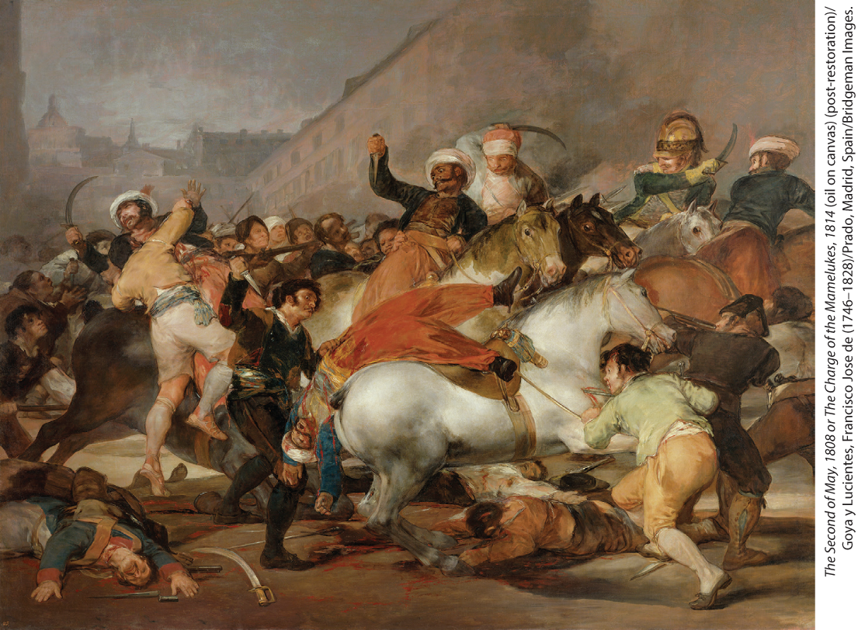
French Atrocities in Spain

Slide 23
II. “Europe Was at My Feet”: Napoleon’s Conquests (7 of 9)
C. From Russian Winter to Final Defeat, 1812–1815 (1 of 3)
  Only Great Britain and Russia remain independent of Napoleon
  Great Britain sends aid to Portuguese and Spanish rebels, Tsar Alexander I makes peace with the Ottoman Empire
  Napoleon invades Russia, engaging the main Russian force at Borodino
  Napoleon takes Moscow, departing Russians set city on fire, tsar refuses to negotiate
  Napoleon begins retreat in October with supplies running low
Notes:
II. “Europe Was at My Feet”: Napoleon’s Conquests (7 of 9)
C. From Russian Winter to Final Defeat, 1812–1815 (1 of 3)
By 1812, only Great Britain and Russia remained independent of Napoleon.
Great Britain sent aid to the Portuguese and Spanish rebels, while Tsar Alexander I made peace with the Ottoman Empire and allied himself with Great Britain and Sweden.
In 1812, Napoleon invaded Russia with an enormous army, engaging the main Russian force at Borodino in September, which resulted in heavy casualties on both sides.
Napoleon took Moscow, but the departing Russians had set the city on fire, and the tsar refused to negotiate.
With supplies running low, Napoleon began his retreat in October; in November, the bitter Russian winter began.

Slide 24
II. “Europe Was at My Feet”: Napoleon’s Conquests (8 of 9)
C. From Russian Winter to Final Defeat, 1812–1815 (2 of 3)
  By December, only one-sixth of Napoleon’s troops return
  Napoleon’s difficulties caused by two front war, many soldiers in Spain and Portugal
  Napoleon replenishes his armies but a coalition of armies backed by British finances defeat him at the Battle of the Nations
  French Senate deposes and exiles Napoleon to the island of Elba
  Louis XVIII restored to the throne
Notes:
II. “Europe Was at My Feet”: Napoleon’s Conquests (8 of 9)
C. From Russian Winter to Final Defeat, 1812–1815 (2 of 3)
By December, only one-sixth of Napoleon’s original troops had returned to France.
Many of Napoleon’s difficulties were caused by the fact that he was fighting on two fronts, and many French soldiers were tied down in Spain and Portugal during the Russian campaign.
Napoleon replenished his armies by the spring of 1813, but a coalition of Russian, Austrian, Prussian, and Swedish armies — backed by British financial support — defeated him at the Battle of the Nations, as satellite provinces revolted and joined the coalition.
In March 1814, the French Senate deposed and exiled Napoleon to the island of Elba off the coast of Italy.
Louis XVIII (r. 1814–1824) was restored to the throne.

Slide 25
II. “Europe Was at My Feet”: Napoleon’s Conquests (9 of 9)
C. From Russian Winter to Final Defeat, 1812–1815 (3 of 3)
  New king caught between returning nobles, and those who had benefited from the Revolution
  Chaos gives Napoleon opportunity to escape and return to France
  Louis XVIII flees, Napoleon reconstitutes army with former soldiers still loyal to him
  Napoleon once again defeated by coalition of European powers at Waterloo
  He abdicates and enters permanent exile on the island of St. Helena where he dies
  Napoleon’s wars killed hundreds of thousands, but his legacy sets the agenda for modern European history
Notes:
II. “Europe Was at My Feet”: Napoleon’s Conquests (9 of 9)
C. From Russian Winter to Final Defeat, 1812–1815 (3 of 3)
The new king was caught between returning émigré nobles, who demanded restoration of their lands and powers, and those who had benefited from the Revolution or from Napoleon’s reign.
This chaos gave Napoleon the opportunity to escape exile and return to France, which he did during the so-called Hundred Days.
Louis XVIII fled, and Napoleon reconstituted his army with former soldiers still loyal to him.
Napoleon was once again defeated by a coalition of European powers at the decisive battle of Waterloo on June 18, 1815.
He abdicated and entered permanent exile on the island of St. Helena off the coast of West Africa, a British colony, where he died in 1821.
Napoleon’s wars killed 750,000 French soldiers and 400,000 soldiers from territories he controlled, but his unification of Europe, his spread of French reforms, and the national sentiment generated by resistance to him all set the agenda for modern European history.

Slide 26
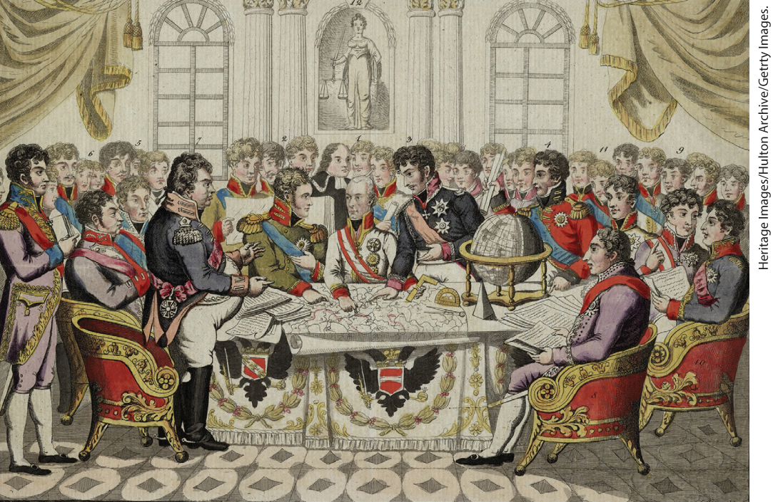
Congress of Vienna

Slide 27
III. The “Restoration” of Europe (1 of 6)
A. The Congress of Vienna, 1814–1815 (1 of 2)
  Congress of Vienna balances post-Napoleonic Europe
  Boundaries settled by representatives of the five major powers: Austria, Russia, Prussia, Britain, and France
  Austrian prince Klemens von Metternich takes the lead in negotiations
  He works with British statesman Robert Castlereagh to check French aggression while preserving its power
  Prince Charles Maurice de Talleyrand represents France, which is deprived of all territory conquered since 1790
  Congress restores traditional rulers where possible
  Rearranges territorial boundaries elsewhere to balance interests of the great powers
Notes:
III. The “Restoration” of Europe (1 of 6)
A. The Congress of Vienna, 1814–1815 (1 of 2)
The Congress of Vienna balanced post-Napoleonic Europe by relying on the major powers to cooperate while guaranteeing the status of smaller states.
Boundaries were settled by representatives of the five major powers: Austria, Russia, Prussia, Britain, and France. The Congress of Vienna provided a model for the twentieth-century League of Nations and United Nations.
The Austrian prince Klemens von Metternich (1773–1859) took the lead in the negotiations.
He worked with the ambitious British statesman Robert Castlereagh (1769–1822) to check French aggression while preserving it as a great power to counter the ambitions of Prussia and Russia.
Prince Charles Maurice de Talleyrand (1754–1838) represented France. After the Hundred Days, France was deprived of all territory conquered since 1790.
Where possible, the congress restored traditional rulers.
Elsewhere, it rearranged territorial boundaries to balance the competing interests of the great powers; the duchy of Warsaw thus became the kingdom of Poland ruled by the Russian tsar.

Slide 28
III. The “Restoration” of Europe (2 of 6)
A. The Congress of Vienna, 1814–1815 (2 of 2)
  Dutch Republic and Austrian Netherlands unite as kingdom of the Netherlands
  Austria takes charge of German Confederation, which replaces Holy Roman Empire
  Sardinia given Piedmont, Genoa, Nice, and part of Savoy
  Sweden acquires Norway and accepts Russian control of Finland
  Congress condemns slave trade, but does not ban it
  Alexander I of Russia proposes Holy Alliance, Prussia and Austria agrees, Great Britain declines
  Legitimacy of states depend on treaty system, not divine right
Notes:
III. The “Restoration” of Europe (2 of 6)
A. The Congress of Vienna, 1814–1815 (2 of 2)
The Dutch Republic and Austrian Netherlands united as the new kingdom of the Netherlands under the restored stadholder.
Austria took charge of the German Confederation, which replaced the Holy Roman Empire.
Sardinia was given Piedmont, Genoa, Nice, and part of Savoy.
Sweden acquired Norway and accepted Russian control of Finland.
The congress also condemned the slave trade in principle but did not ban it.
Alexander I of Russia proposed a Holy Alliance to ensure divine assistance in upholding religion, peace, and justice; Prussia and Austria agreed, but Great Britain declined.
From that point on, the legitimacy of states depended on a treaty system, not divine right.

Slide 29
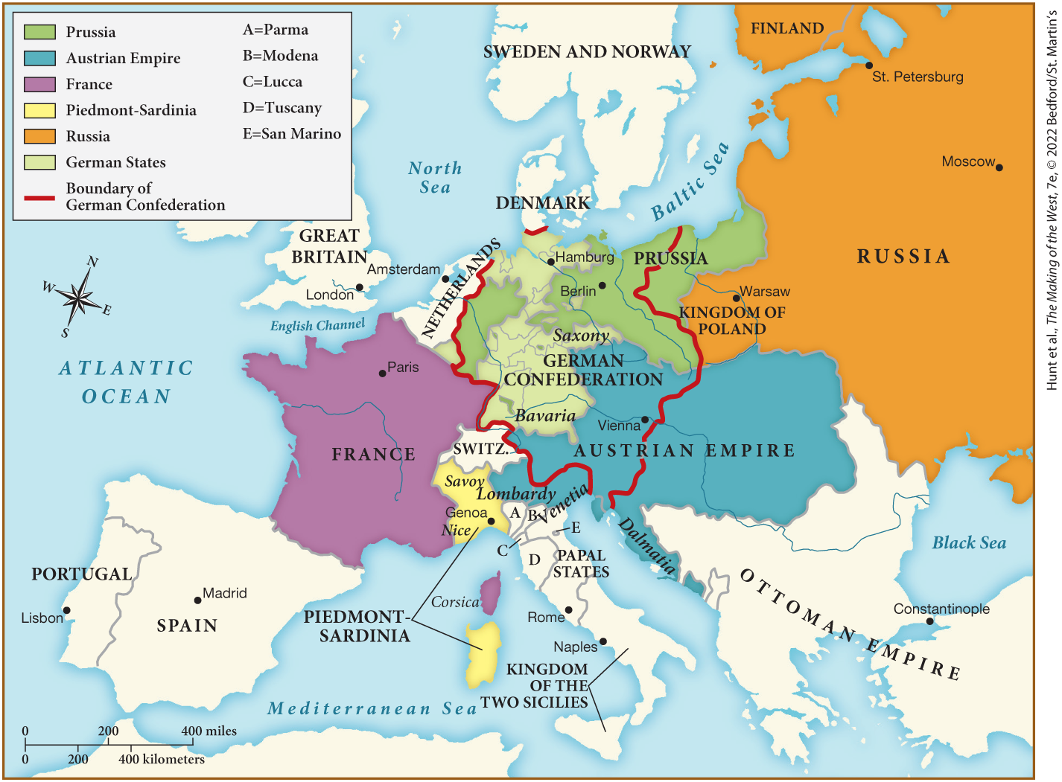
MAP 20.2 Europe after the Congress of Vienna, 1815

Slide 30
III. The “Restoration” of Europe (3 of 6)
B. The Emergence of Conservatism (1 of 2)
  French Revolution and Napoleon’s domination proved old order of society subject to sudden change
  Conservatism justified belief in restored governments
  Conservatives believed Enlightenment led to the French Revolution
  British Conservative Edmund Burke believed that change should be gradual, respect traditions
  Conservatives argue the “rights of man” must be balanced by the rights of the community
Notes:
III. The “Restoration” of Europe (3 of 6)
B. The Emergence of Conservatism (1 of 2)
The French Revolution and Napoleon’s domination of Europe had proved that the old order of society was subject to sudden change and disruption.
People needed justification to believe in restored governments, and conservatism provided that justification.
Conservatives believed that the Enlightenment had led to the French Revolution, which produced both the Terror and the authoritarian Napoleon.
The most influential spokesman of conservatism was Britain’s Edmund Burke (1729–1799), who believed that any change in government should be gradual and must respect national and historical traditions.
Conservatives defended hereditary monarchy and the authority of the church, arguing that the “rights of man” must be balanced by the rights of the community, and that faith, sentiment, history, and tradition must fill the vacuum left by the failure of reason and the excessive belief in individual rights.

Slide 31
III. The “Restoration” of Europe (4 of 6)
B. The Emergence of Conservatism (2 of 2)
  Ascension of Louis XVIII tested conservative beliefs in France
  Louis XVIII maintained some of the past reforms
  Ultraroyalists push for complete repudiation of the revolutionary past
  Ultras insist on abolishing divorce, set up special courts to punish opponents
Notes:
III. The “Restoration” of Europe (4 of 6)
B. The Emergence of Conservatism (2 of 2)
Not surprisingly, conservatism had its strongest appeal in ruling circles: the ascension of Louis XVIII tested conservative beliefs in France.
Louis XVIII maintained the Civil Code, guaranteed rights of ownership to church lands sold during the Revolution, and created a parliament based on restricted suffrage.
While the king tried to follow a moderate course of compromise, the Ultras (ultraroyalists) pushed for complete repudiation of the revolutionary past.
In 1816, the Ultras insisted on abolishing divorce and set up special courts to punish opponents of the regime.

Slide 32
III. The “Restoration” of Europe (5 of 6)
C. The Revival of Religion (1 of 2)
  Many renewed their religious faith
  Catholic church holds ceremonies to express sorrow over Revolution, Jesuit order reestablished
  Revivalist movements challenge the status quo
  Methodists, or Wesleyans, attract thousands to large-scale revival meetings
  Methodists hostility to rigid doctrine promoted community and rudimentary sexual equality
Notes:
III. The “Restoration” of Europe (5 of 6)
C. The Revival of Religion (1 of 2)
Once peace returned to Europe, many renewed their religious faith.
In France, the Catholic church held ceremonies to express sorrow over the Revolution. The papacy reestablished the Jesuit order, banned during the Enlightenment.
Revivalist movements, which had begun in Great Britain and Germany in the eighteenth century, sometimes challenged the status quo.
In England, the Methodists, or Wesleyans, attracted thousands of shopkeepers, artisans, agricultural laborers, and workers in cottage industry, often to large-scale revival meetings that went on for days.
Although Methodism stressed obedience to the government, the group’s hostility to rigid doctrine and encouragement of popular preaching promoted a sense of democratic community and even a rudimentary sexual equality.

Slide 33
III. The “Restoration” of Europe (6 of 6)
C. The Revival of Religion (2 of 2)
  Women preachers travel to preach to public, Sunday schools teach poor children to read and write
  Second Great Awakening in the United States
  Protestant sects begin missionary activity in other parts of the world
  British missionaries succeeded in getting the practice of sati abolished in India
  Missionary activity would become one of the arms of European imperialism in later years
Notes:
III. The “Restoration” of Europe (6 of 6)
C. The Revival of Religion (2 of 2)
Women preachers traveled to sermonize in barns, town halls, and textile dye houses; and Sunday schools taught thousands of poor children to read and write.
In the United States, the second Great Awakening began around 1790, bringing together thousands of worshippers in huge camp meetings.
Protestant sects began missionary activity in other parts of the world in the late eighteenth century as well.
In India, British missionaries succeeded in getting the practice of sati — the burning alive of widows on the funeral pyres of their husbands — abolished in 1829.
Missionary activity by both Protestants and Catholics would become one of the arms of European imperialism and cultural influence later in the nineteenth century.

Slide 34
IV. Challenges to the Conservative Order (1 of 9)
A. Romanticism (1 of 2)
  Romanticism glorified nature, emotion, genius, and imagination
  Poet George Gordon, Lord Byron, celebrated emotion and creative imagination
  William Wordsworth elevated the wonders of nature
  Mary Shelley explored the nightmarish side of human genius
  Johann Wolfgang von Goethe elaborated on the destructive potential of human nature
  Romanticism idealized nature and the individual in painting
Notes:
IV. Challenges to the Conservative Order (1 of 9)
A. Romanticism (1 of 2)
Romanticism was an artistic movement that glorified nature, emotion, genius, and imagination as antidotes to the Enlightenment’s emphasis on reason and classicism’s emphasis on symmetry and ordered geometric space. (For a close look at one of the important environmental history topics in this chapter, see “Environment Matters: Nature Tourism.”)
One of the most influential of the romantic poets, George Gordon, Lord Byron (1788–1824), celebrated emotion and creative imagination, comparing the poet to Prometheus bringing fire from the Greek gods to humanity.
William Wordsworth (1770–1850) elevated the wonders of nature to a transcendent height.
Mary Shelley (1797–1851) explored the nightmarish side of human genius in Frankenstein (1818).
In the same mode as Shelley, Johann Wolfgang von Goethe (1749–1832) elaborated on the destructive potential of human nature in Faust (1832).
In painting, romanticism idealized nature and the individual of deep feelings. It also often expressed anxiety about industrial changes.

Slide 35
IV. Challenges to the Conservative Order (2 of 9)
A. Romanticism (2 of 2)
  Caspar David Friedrich depicted overpowering nature and the nature of faith
  Joseph M. W. Turner blurred outlines in misty seascapes
  French painter Eugène Delacroix emphasized light and color
  German composer Ludwig van Beethoven transforms the symphony
  Support of nationalist aspirations in romanticism
  Manzoni’s The Betrothed served as a manifesto of Italian nationalism
  Novels of the Scottish novelist Sir Walter Scott infused with romantic nationalism
Notes:
IV. Challenges to the Conservative Order (2 of 9)
A. Romanticism (2 of 2)
Caspar David Friedrich (1774–1840) depicted individual figures overwhelmed by an overpowering nature and the steadfast nature of faith.
Joseph M. W. Turner (1775–1851) anticipated later artists by blurring the outlines of objects in his misty seascapes.
Like other romantics, French painter Eugène Delacroix (1798–1863) experimented with new techniques, emphasizing light and color in medieval and contemporary scenes.
The German composer Ludwig van Beethoven (1770–1827) helped set the direction for romanticism in music when he transformed the symphony into a connected work with recurring and evolving musical themes, conveying the impression of organic growth.
If any common political thread existed among the romantics, it was the support of nationalist aspirations — especially through the search for the historical origins of national identity.
In Italy, Manzoni’s The Betrothed, a novel set in the seventeenth century, served as a manifesto of Italian nationalism.
The enormously influential novels of the Scottish novelist Sir Walter Scott (1771–1832) were infused with romantic nationalism.

Slide 36

Environment Matters: Nature Tourism

Slide 37
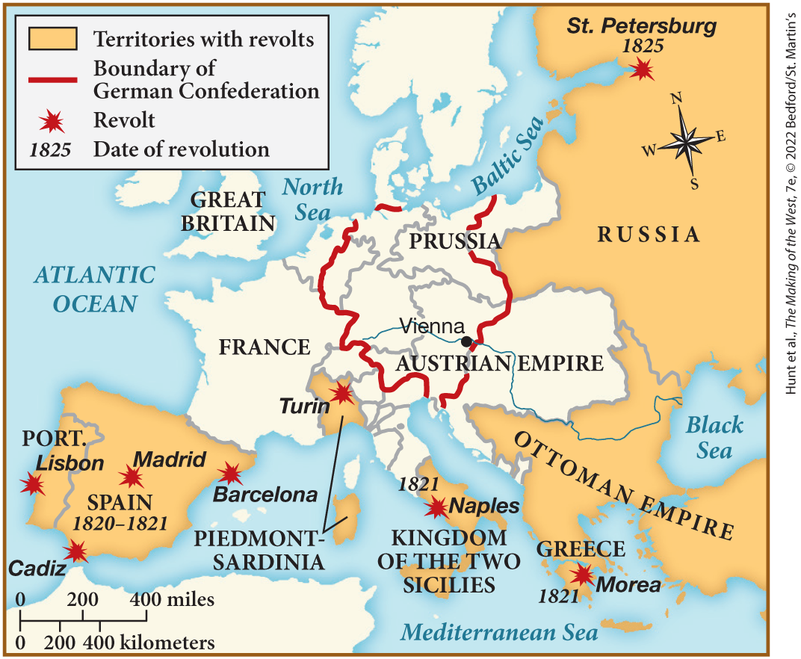
MAP 20.3 Revolutionary Movements of the 1820s

Slide 38
IV. Challenges to the Conservative Order (3 of 9)
B. Political Revolts in the 1820s (1 of 4)
  Constitutional governments did last after Napoleon’s fall
  Ferdinand VII restored the prerevolutionary nobility, church, and monarchy in Spain
  Members of the middle class and army officers adopt French ideas in secret societies
  Revolt by soldiers demanding restoration of the constitution was put down, Ferdinand’s absolute power restored
  Spanish revolt encouraged Italian rebellions, all squashed by Austria
  Great Britain opposed Austria, but the other powers supported them
Notes:
IV. Challenges to the Conservative Order (3 of 9)
B. Political Revolts in the 1820s (1 of 4)
Those who had hoped for constitutional government after Napoleon’s fall were disappointed.
In Spain, Ferdinand VII restored the prerevolutionary nobility, church, and monarchy, and established strict censorship.
Members of the middle class, disturbed by repressive policies, and army officers who had encountered and adopted French ideas joined secret societies.
A revolt by soldiers demanding that Ferdinand restore the constitution was put down by French troops, acting with the agreement of the other great powers, and Ferdinand’s absolute power was restored.
The Spanish revolt encouraged Italian rebellions in Naples, Piedmont, and Sardinia, all squashed by Austria in 1821.
Great Britain opposed Austria’s actions, but the other great powers supported them.

Slide 39
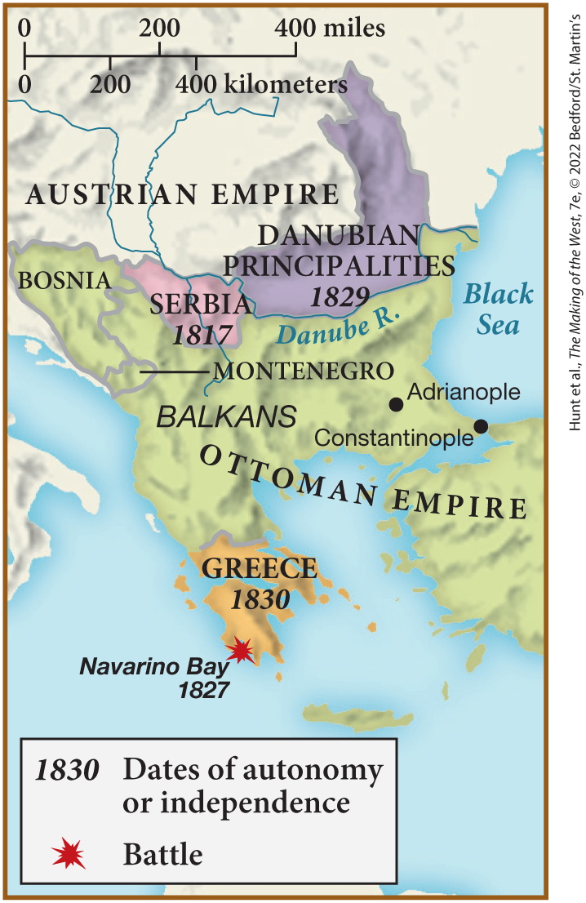
SPOT MAP 20.1 Nationalistic Movements in the Balkans, 1815–1830

Slide 40
IV. Challenges to the Conservative Order (4 of 9)
B. Political Revolts in the 1820s (2 of 4)
  Student groups advocate a racially pure German nationalism; Carlsbad Decrees suppress these groups
  A brief revolt erupts in Russia over Alexander I’s successor
  His brother Nicholas was to be crowned, but rebels preferred another brother, Constantine
  Soldiers loyal to Nicholas suppressed rebels in the Decembrist Revolt
  Nicholas I dedicated his reign to preventing any further calls for reform
  Serbia revolted and gained independence from the Turks
Notes:
IV. Challenges to the Conservative Order (4 of 9)
B. Political Revolts in the 1820s (2 of 4)
In the German Confederation, student groups advocated a racially pure German nationalism. The Carlsbad Decrees (1819) suppressed the groups.
In Russia, a brief revolt erupted in December 1825 over Alexander I’s successor.
His brother Nicholas was to be crowned, but a faction of rebel officers preferred another brother, Constantine, because he would favor reform and a constitution.
When the officers called for Constantine to take the throne, soldiers loyal to Nicholas suppressed them in the so-called Decembrist Revolt; the rebels became heroes to later generations.
Nicholas I (r. 1825–1855) dedicated his reign to preventing any further calls for reform.
Serbia revolted and gained independence from the Turks in 1817.

Slide 41
IV. Challenges to the Conservative Order (5 of 9)
B. Political Revolts in the 1820s (3 of 4)
  Prince Alexander Ypsilanti leads failed Greek revolt
  Second Greek revolt unleashed atrocities; public opinion supported the Greeks
  Coalition force destroys Turkish fleet at Navarino Bay; Russia declares war on Turkey
  Treaty of Adrianople gives Russia protectorate over the Danubian principalities in the Balkans
  Greece declared an independent kingdom
  Successful nationalist struggle was the first under conservative system
Notes:
IV. Challenges to the Conservative Order (5 of 9)
B. Political Revolts in the 1820s (3 of 4)
Prince Alexander Ypsilanti led a Greek revolt in 1820 but failed because he had not gained support from the great powers.
A second Greek revolt, led by peasants, unleashed atrocities in 1821 and 1822; public opinion in Europe supported the Greeks.
In 1827, a combined British, French, and Russian force destroyed the Turkish fleet at Navarino Bay; and in 1828, Russia declared war on Turkey and advanced close to Istanbul.
The 1829 Treaty of Adrianople gave Russia a protectorate over the Danubian principalities in the Balkans and provided for an international congress that included Great Britain, Russia, and France.
In 1830, Greece was declared an independent kingdom.
This successful nationalist struggle was the first breach in Metternich’s conservative system.

Slide 42
IV. Challenges to the Conservative Order (6 of 9)
B. Political Revolts in the 1820s (4 of 4)
  Revolt spreads across the Atlantic, colonists from Mexico to Argentina revolt
  Simón Bolívar leads revolts
  Independent republics formed in Latin America
  U.S. president James Monroe issues Monroe Doctrine, opposing European interference, Great Britain declares neutrality
Notes:
IV. Challenges to the Conservative Order (6 of 9)
B. Political Revolts in the 1820s (4 of 4)
Revolt spread across the Atlantic, when colonists from Mexico to Argentina took advantage of the upheaval in Spain and Portugal.
Leading these revolts was Simón Bolívar, the son of a slave owner, who had been educated in Europe on the works of Voltaire and Rousseau.
Independent republics were formed in Latin America between 1821 and 1823.
In 1823, U.S. president James Monroe issued the foreign policy statement, the Monroe Doctrine, in opposition to European interference in the Americas. However, the more important decision was that of Great Britain, the dominant naval power, which declared neutrality, in effect supporting the rebels.

Slide 43
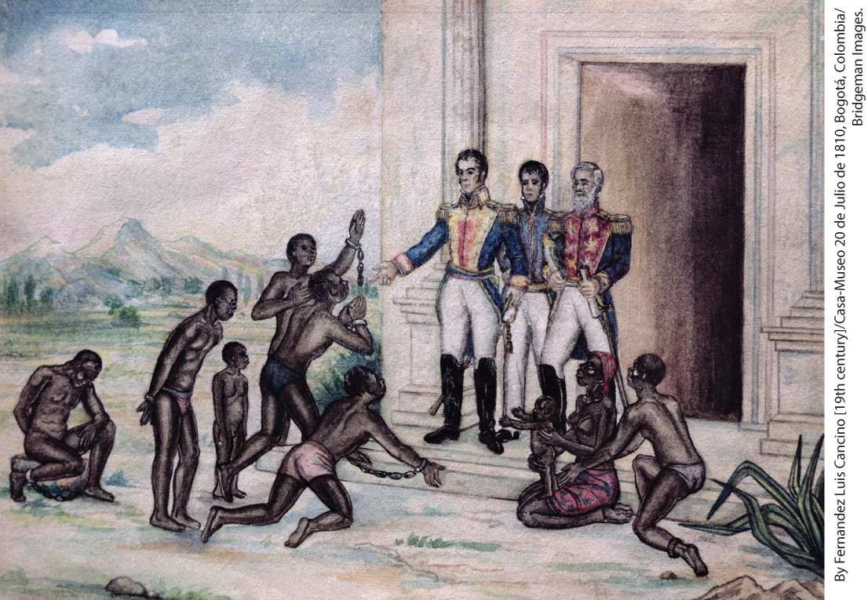
Simón Bolívar

Slide 44
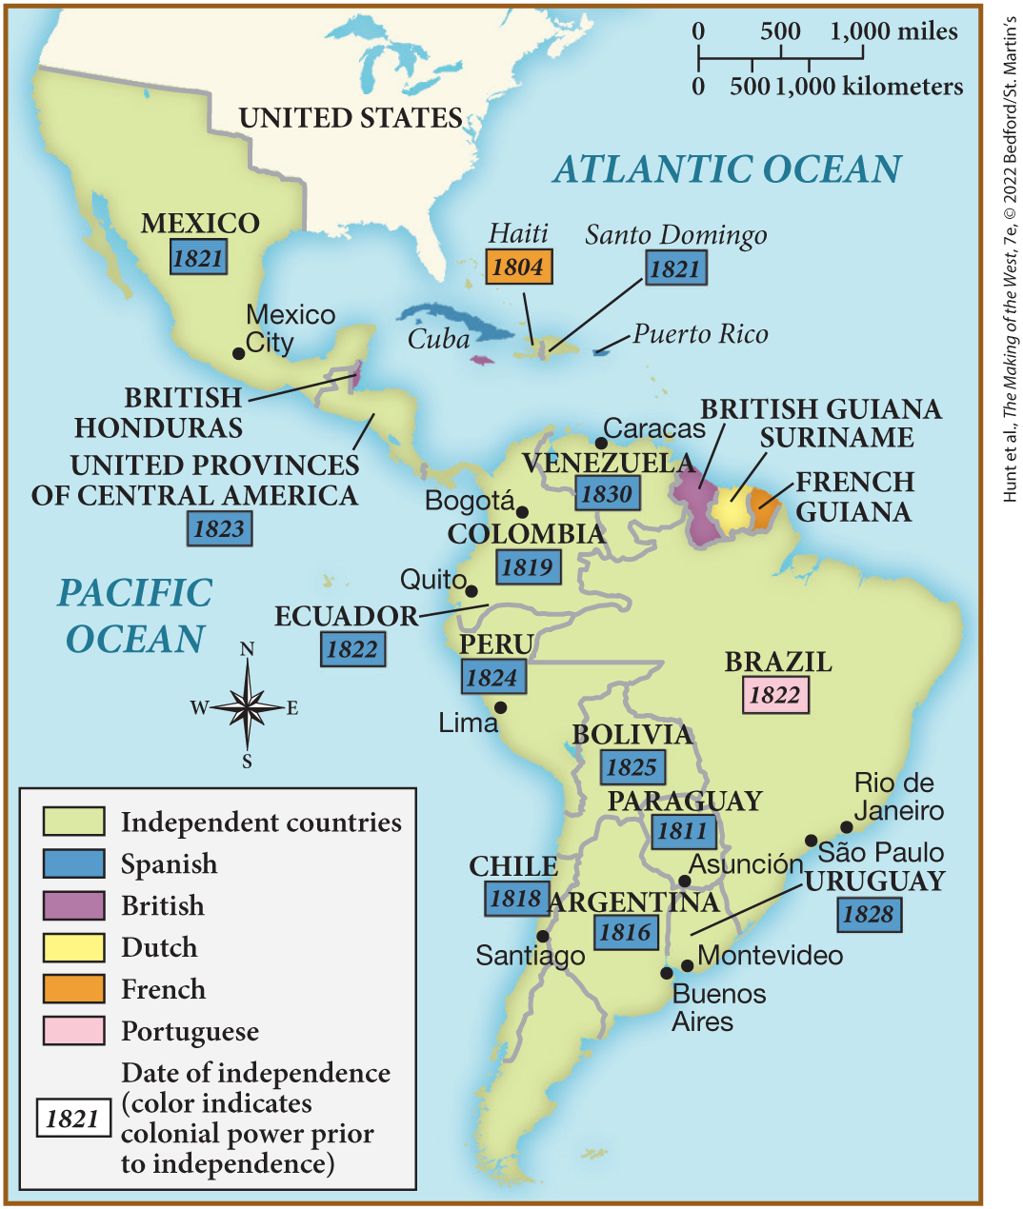
MAP 20.4 Latin American Independence, 1804–1830

Slide 45
IV. Challenges to the Conservative Order (7 of 9)
C. Revolution and Reform, 1830–1832 (1 of 3)
  New wave of revolts break out throughout Europe
  Charles X passes a Law of Indemnity in France
  Charles dissolves the legislature, removes voters from the rolls, and imposes censorship
  Revolution begins, group of moderate liberals ask Charles X’s cousin, Louis-Philippe, to take the throne
  Louis-Philippe extended suffrage, but only small minority could vote
  Indigent and working classes start failed rebellion
Notes:
IV. Challenges to the Conservative Order (7 of 9)
C. Revolution and Reform, 1830–1832 (1 of 3)
In 1830, a new wave of liberal and nationalist revolts broke out throughout the European continent.
In France, Charles X (r. 1824–1830) passed a Law of Indemnity, which compensated those nobles who had lost estates during the Revolution, and a Law of Sacrilege, which imposed the death penalty for offenses such as stealing religious objects from churches.
Charles also enraged liberals when he dissolved the legislature, removed many wealthy and powerful voters from the rolls, and imposed strict censorship.
A revolution began on July 26, 1830, and, after three days of street fighting and the flight of the king, a group of moderate liberals asked Charles X’s cousin, Louis-Philippe, to take the throne.
Although Louis-Philippe extended suffrage, only 170,000 out of a population of 30 million could vote.
Expressing their dissatisfaction, the indigent and working classes rebelled in Lyon in 1831, but the revolt was quickly put down.

Slide 46
IV. Challenges to the Conservative Order (8 of 9)
C. Revolution and Reform, 1830–1832 (2 of 3)
  Events in France inspire revolt in Belgium
  Belgium granted independence in exchange for neutrality
  Unsuccessful revolts in Austrian Empire’s Italian territories
  Poland rebels against Russia, Polish aristocrats form provisional government
  Rebels defeated by Russian forces
  Nicholas I abolishes Polish constitution, executes or banishes thousands
Notes:
IV. Challenges to the Conservative Order (8 of 9)
C. Revolution and Reform, 1830–1832 (2 of 3)
Events in France inspired a revolt in Belgium, which had been annexed to the Netherlands in 1815.
At a congress of the great powers, Belgium was granted its independence as a constitutional monarchy in exchange for neutrality in international affairs.
Revolts in the Austrian Empire’s Italian territories were also unsuccessful because of a lack of outside support.
In November 1830, Poland rebelled against Russia, and Polish aristocrats formed a provisional government.
Without support from the British or French, the rebels were defeated by Russian forces.
Nicholas I abolished the Polish constitution and ordered thousands of Poles executed or banished.

Slide 47
IV. Challenges to the Conservative Order (9 of 9)
C. Revolution and Reform, 1830–1832 (3 of 3)
  British government passes Six Acts, forbidding large political meetings and restricting press criticism
  Sir Robert Peel, secretary for home affairs, revises the criminal code, establishes municipal police force
  Laws prohibiting unions repealed, Catholics allowed to sit in Parliament
  Whigs in Parliament enact Reform Bill, extend voting rights
  Bill only granted the vote to one-fifth of British people
  The bill did set a precedent for widening suffrage without revolution
Notes:
IV. Challenges to the Conservative Order (9 of 9)
C. Revolution and Reform, 1830–1832 (3 of 3)
Reform of Parliament rather than revolution preoccupied the British. In August 1819, the government crushed a large demonstration in Manchester and passed the repressive Six Acts, which forbade large political meetings and restricted press criticism.
In the 1820s, Sir Robert Peel (1788–1850), the secretary for home affairs, revised the criminal code and established a municipal police force.
In 1824, laws prohibiting unions were repealed (but the restrictions placed on strikes remained), and in 1829, Catholics were allowed to sit in Parliament and hold most public offices.
In 1832, Whigs in Parliament enacted the Reform Bill to extend voting rights.
Mass demonstrations in favor of the bill had been held in many cities, but the bill granted the vote to only one-fifth of British voters, and still only male property owners could vote.
The bill, however, increased the number of voters by about 50 percent, granted representation to the new industrial centers in the north for the first time, and set a precedent for widening suffrage without revolution.

Slide 48
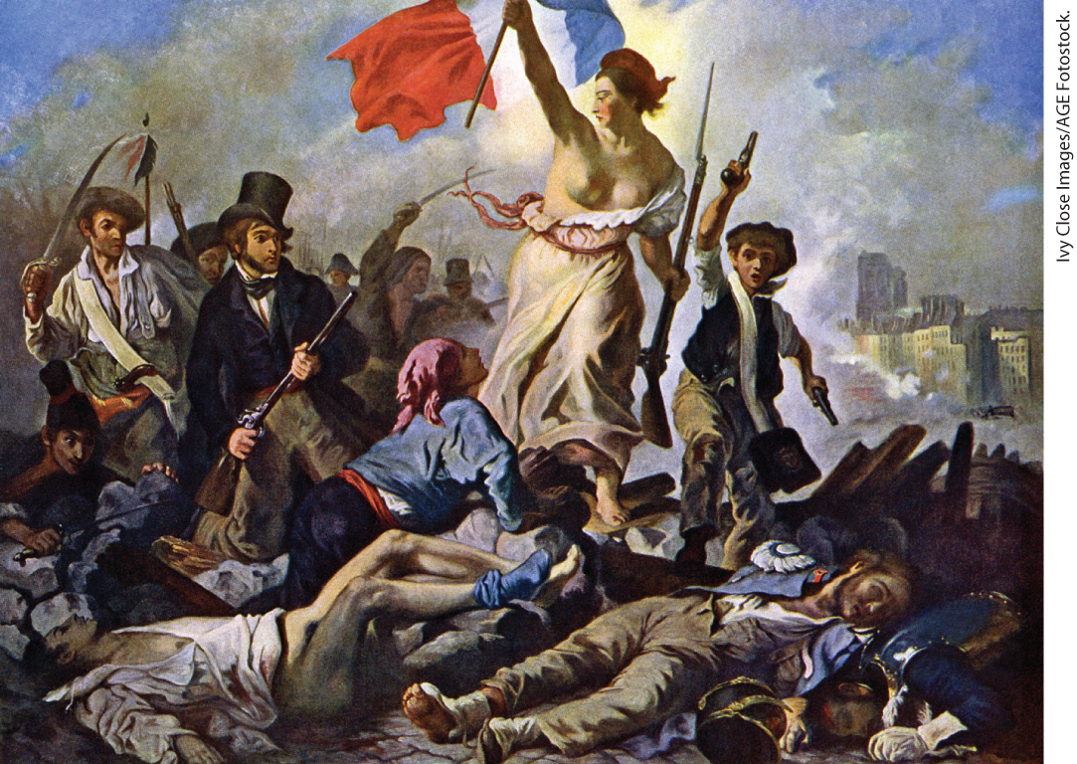
Eugène Delacroix, Liberty Leading the People (1830)

Slide 49
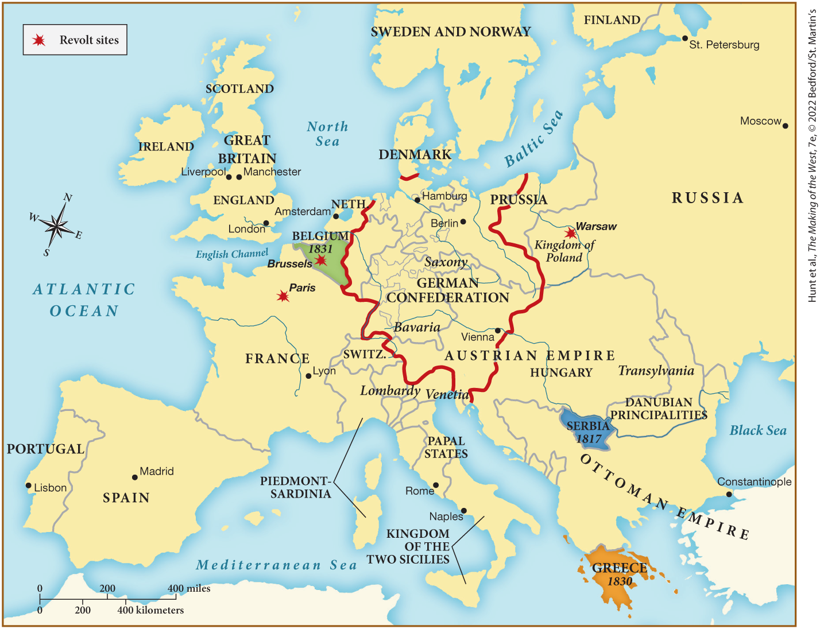
MAP 20.5 Mapping the West: Europe in 1830

