Slide 1
WESTERN CIVILIZATION: A Brief History
Tenth Edition
CHAPTER 26
The Futile Search for Stability: Europe between the Wars, 1919–1939
© 2020 Cengage. All rights reserved.

Slide 2
Chapter 26 Outline
26-1 An Uncertain Peace
26-2 The Democratic States
26-3 The Authoritarian and Totalitarian States
26-4 The Expansion of Mass Culture and Mass Leisure
26-5 Cultural and Intellectual Trends in the Interwar Wars

Slide 3
26-1 An Uncertain Peace (1 of 3)
Focus Question: What problems did European countries face immediately after World War I, and what impact did the Great Depression have on those problems?
The French policy of coercion, 1919–1924
  Tough policy toward Germany began with strict enforcement of Treaty of Versailles
  Reparations set at 132 billion marks ($33 billion) repayable in installments of 2.5 billion (gold) marks
  Germans failed to make second payment
    France sent troops to occupy Ruhr valley
  German mark became worthless

Slide 4
26-1 An Uncertain Peace (2 of 3)
The hopeful years, 1924–1929
  Dawes plan reduced reparations and stabilized Germany’s payments on basis of ability to pay
    Opened door to heavy U.S. investment and European prosperity
  Prosperity led to spirit of cooperation and Treaty of Locarno in 1925

Slide 5
26-1 An Uncertain Peace (3 of 3)
The Great Depression
  Downturn in European economies and U.S. stock market crash led to Great Depression
  American withdrawal of funds led to collapse of central European banks
  Unemployed and homeless filled streets of cities throughout industrialized countries
  Marxism gained renewed interest
    New movement of fascism was attractive

Slide 6
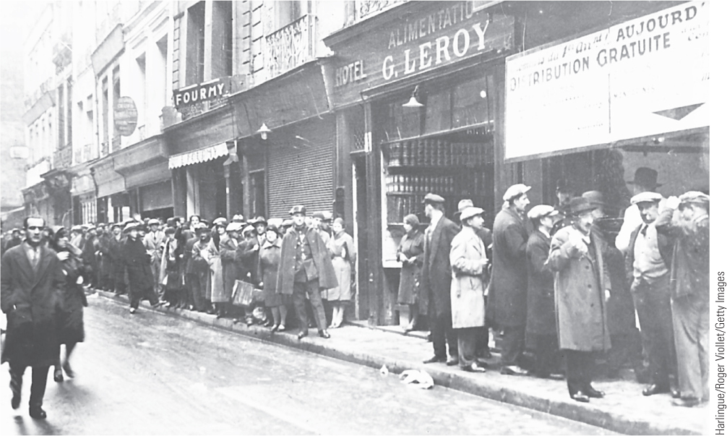
26.2 The Great Depression: Bread Lines in Paris. By 1931 France was experiencing lines of unemployed people at free-food centers.

Slide 7
26-2 The Democratic States (1 of 4)
Focus Questions: How did Great Britain, France, and the United States respond to the various crises, including the Great Depression, that they faced in the interwar years? How did World War I affect Europe’s colonies in Asia and Africa?
Great Britain
  Britain’s Labour Party failed to solve economic problems and fell from power
  National Government used traditional policies to bring Britain out of depression

Slide 8
26-2 The Democratic States (2 of 4)
France
  No French government seemed capable of solving financial problems
  Popular Front succeeded in reform but not in formulating a solution to the depression
United States
  After Germany, no Western nation was more affected than the U.S.
  Industrial production fell 50 percent; 15 million unemployed
  Franklin Delano Roosevelt’s New Deal provided social reform
    Only World War II would solve unemployment problem

Slide 9
26-2 The Democratic States (3 of 4)
European states and the world: the colonial empires
  Great Britain and France added to empires by dividing up many of Germany’s colonial possessions
  The Middle East
    Modernizing regimes emerged in Turkey and Iran
    Independent government established in Saudi Arabia and Iraq
    Mustafa Kemal modernized Turkey along Western lines

Slide 10
26-2 The Democratic States (4 of 4)
European states and the world: the colonial empires
  India
    Mahatma Gandhi’s nonviolent resistance movement and civil disobedience led to Britain granting India self-government
    Complete independence would not come until after World War II
  Africa
    Peace settlement after World War I was a disappointment to Africans
    Africans became more politically active; sought reform

Slide 11
26-3 The Authoritarian and Totalitarian States (1 of 9)
Focus Questions: Why did many European states experience a retreat from democracy in the interwar years? What are the characteristics of totalitarian states, and to what degree were these characteristics present in Fascist Italy, Nazi Germany, and Stalinist Russia?
The retreat from democracy: did Europe have totalitarian states?
  Many postwar societies were badly divided along class lines and by gender
    Great Depression deepened social conflict
    Postwar politics became more polarized
    Italy became a fascist state; Soviet Union moved toward repressive Communist state

Slide 12
26-3 The Authoritarian and Totalitarian States (2 of 9)
The retreat from democracy: did Europe have totalitarian states?
  Characteristics of a totalitarian state: expectation of the active loyalty and commitment of citizens and use of mass propaganda and communications to conquer hearts and minds
    Control of economic, political, social, intellectual, and cultural aspects by the state
    Led by a single leader and a single party
  Revisionist historians challenged the usefulness of the term because no state was successful in establishing total control of its society

Slide 13
26-3 The Authoritarian and Totalitarian States (3 of 9)
Fascist Italy
  Mussolini created Fascio di Combattimento in 1919
    In 1920 and 1921, squadristi formed and attacked Socialist offices
    By 1922, movement mushroomed as fear of Communism made Fascism attractive
    King Victor Emmanuel III capitulated and Mussolini became prime minister
  Mussolini and the Italian Fascist state
    Fascist dictatorship established by 1926
    Dichotomy between Fascist promises and practice
    Failure to establish degree of totalitarian control achieved in Germany and the Soviet Union

Slide 14
26-3 The Authoritarian and Totalitarian States (4 of 9)
Hitler and Nazi Germany
  Weimar Germany
    Established after World War I but attacked from left and right and faced serious economic difficulties even before Depression
    Political, economic, and social problems provided environment for Hitler and Nazis to seize power
  Rise of the Nazis
    Hitler’s control of the German Workers’ Party: developed into mass political movement with party militia
    Beer Hall Putsch of 1923 crushed and Hitler imprisoned; Hitler wrote Mein Kampf
    Extreme nationalism, anti-Semitism, and anti-communism linked to Social Darwinian theory and Lebensraum

Slide 15
26-3 The Authoritarian and Totalitarian States (5 of 9)
Hitler and Nazi Germany
  The Nazi seizure of power
    After prison, Hitler reorganized Nazi party regionally, and it spread across Germany, growing dramatically
    Hitler became chancellor in January 1933 and enacted “legal seizure” of power in March
    Nazi actions: enacted and enforced Gleichschaltung; purged civil service of Jews; established concentration camps for opponents
    Death of President Hindenburg in August left Hitler the sole ruler of Germany

Slide 16
26-3 The Authoritarian and Totalitarian States (6 of 9)
Hitler and Nazi Germany
  The Nazi state, 1933–1939
    Goal: development of “Aryan” racial state to dominate Europe
    Mass demonstrations and spectacles
    Control of economic sphere
    Schutzstaffel or SS created under direction of Heinrich Himmler
    Churches and school came under Nazi control
    “Nuremberg laws” in 1935; Kristallnacht in November 1938

Slide 17
26-3 The Authoritarian and Totalitarian States (7 of 9)
The Soviet Union
  Lenin’s policies
    The New Economic Plan (NEP): modified old capitalist system
    Formation of the USSR
  The struggle for power
    Lenin’s death in 1924 provoked struggle in Politburo
    Personal rivalry existed between Trotsky and Stalin
    Stalin gained control of Communist party; Trotsky expelled in 1927
    Stalin established dictatorship by 1929

Slide 18
26-3 The Authoritarian and Totalitarian States (8 of 9)
The Soviet Union
  The Stalin era, 1929–1939
    Stalin launched first five-year plan in 1928: goal to transform from agricultural country into industrial state overnight
    Social and political costs of industrialization were enormous
    Created collective farms: 26 million family farms reorganized into 250,000 collective units by 1934 and 10 million peasants died in 1932–1933
    Inculcation of values of duty, discipline, and hard work

Slide 19
26-3 The Authoritarian and Totalitarian States (9 of 9)
Authoritarian states
  Eastern Europe
    Little tradition of liberalism and parliamentary government, no middle-class, largely rural states enabled authoritarian control
  Franco’s Spain
    After winning Spanish Civil War, General Francisco Franco established dictatorship

Slide 20
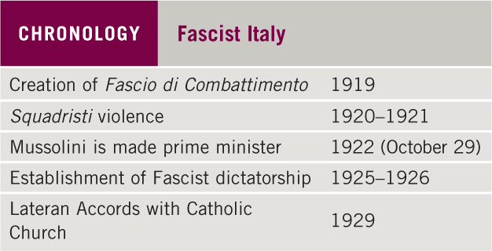
Chronology: Fascist Italy

Slide 21
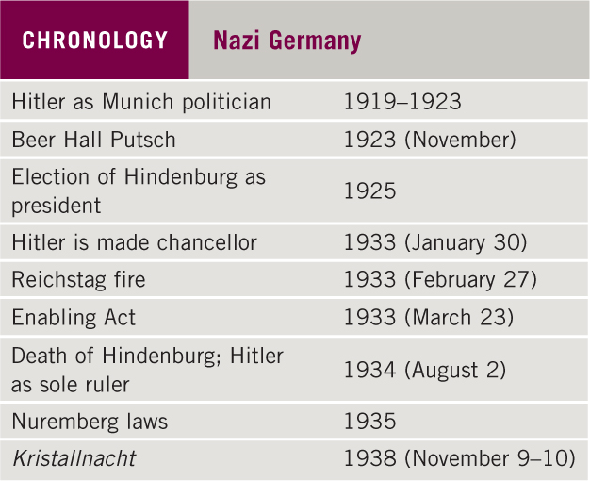
Chronology: Nazi Germany

Slide 22
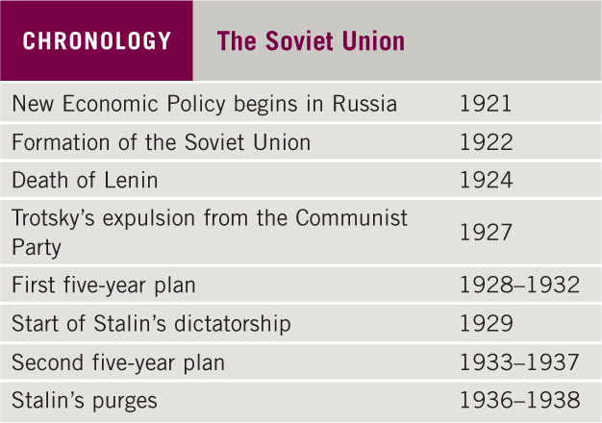
Chronology: The Soviet Union

Slide 23
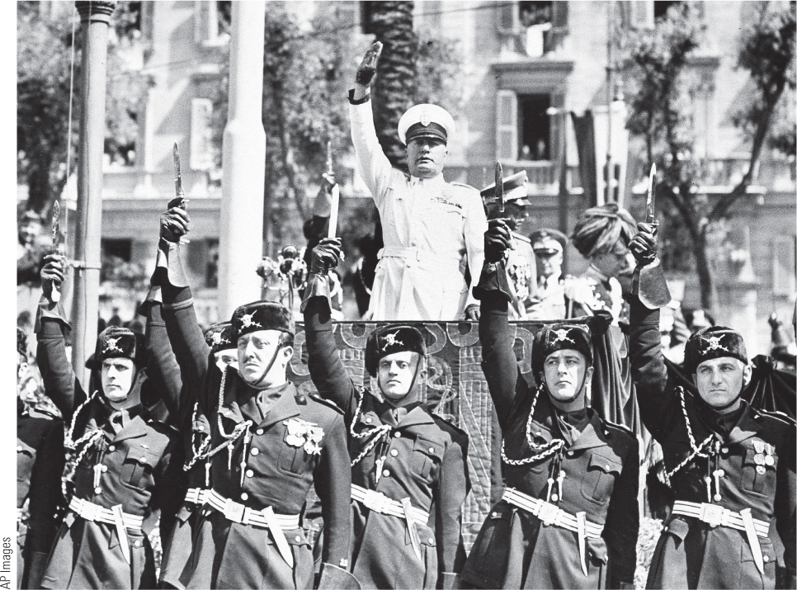
26.3 Mussolini, the Iron Duce. Mussolini styled himself as a strong leader who was always right and was often seen in military-style uniforms and military poses.

Slide 24
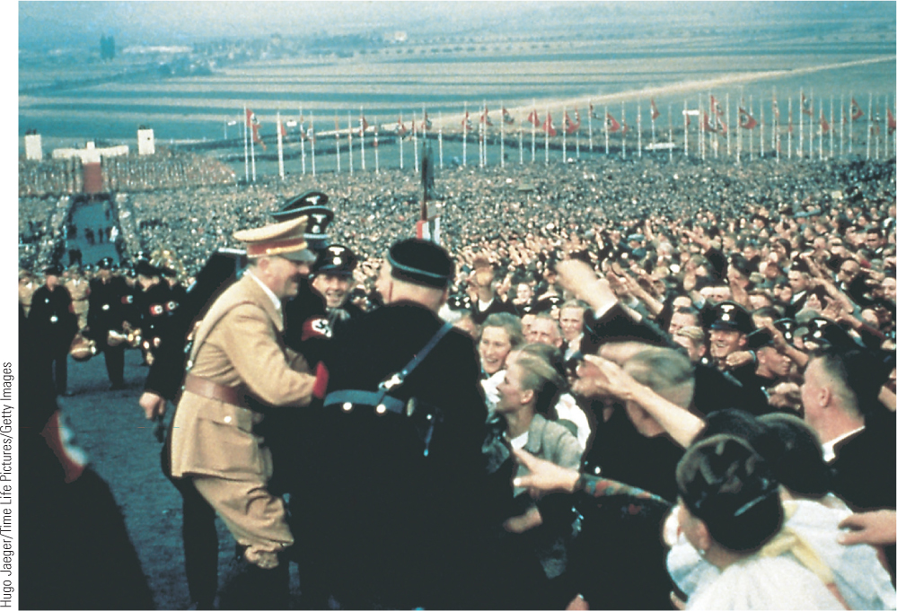
26.4 The Nazi Mass Spectacle. Hitler and the Nazis made clever use of mass spectacles to rally the German people behind the Nazi regime.

Slide 25
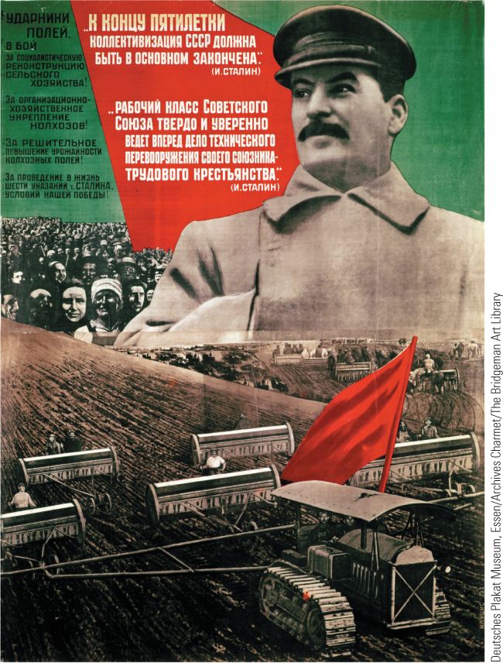
26.5 Stalin and the First Five-Year Plan. This poster, published in 1932 with a photograph of Stalin, celebrates the achievements of the first five-year plan.

Slide 26
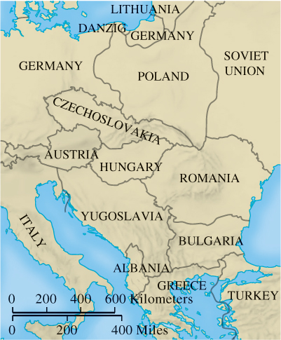
Map 26.1 Eastern Europe in the 1920s

Slide 27
26-4 The expansion of mass culture and mass leisure (1 of 2)
Focus Question: What new dimensions in mass culture and mass leisure emerged during the interwar years, and what role did these activities play in the totalitarian states?
The Roaring Twenties: an exuberant culture
Radio and movies
  Permanent radio broadcasting facilities constructed in United States, Europe, and Japan during 1921–1922 and mass production of radios began
  Full-length feature films made before World War I
  Radio and movies used as propaganda
    Joseph Goebbels; Triumph of the Will

Slide 28
26-4 The expansion of mass culture and mass leisure (2 of 2)
Mass leisure
  Professional sports
    1930: First World Cup
    The Berlin Olympics, 1936
  Travel opportunities
    1919: airmail began; passenger service followed
  Mass leisure controlled by fascist and Nazi regimes

Slide 29
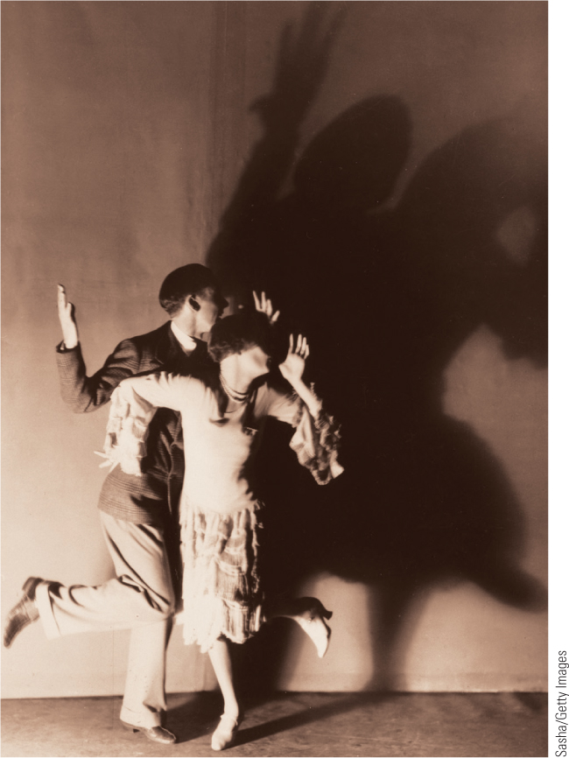
26.6 The Charleston. Dancing became the rage during the Roaring Twenties, and the Charleston was the most popular and enduring dance of the decade.

Slide 30
26-5 Cultural and Intellectual Trends in the Interwar Years (1 of 5)
Focus Question: What were the main cultural and intellectual trends in the interwar years?
The impact of World War I
  The acceptance of avant-garde culture
    The profound sense of despair and disillusionment
    Political and economic uncertainties paralleled by social insecurities

Slide 31
26-5 Cultural and Intellectual Trends in the Interwar Years (2 of 5)
Nightmares and new visions: art and music
  German Expressionists
    George Grosz and Otto Dix: graphic presentations of the effects of war
  Dadaism
    Attempted to enshrine purposelessness of life
  Surrealism
    Surrealism sought reality beyond material world through portrayal of fantasies
    The work of Salvador Dalí

Slide 32
26-5 Cultural and Intellectual Trends in the Interwar Years (3 of 5)
Nightmares and new visions: art and music
  Functionalism in architecture
    Architect Walter Gropius founded Bauhaus School of art, architecture, and design in 1919
  Art in Nazi Germany
    Hitler and Nazis rejected modern art as “degenerate” or “Jewish” art
    Art no longer expressed individual freedom but was a form of propaganda
  A new style in music
    Arnold Schönberg experimented with atonal music

Slide 33
26-5 Cultural and Intellectual Trends in the Interwar Years (4 of 5)
The search for the unconscious in literature
  “Stream of consciousness” technique
    James Joyce’s Ulysses
  Heinrich Hess reflected new psychology and Eastern religions
    Works Demian and Steppenwolf mirrored psychological confusion of modern existence
The unconscious in psychology
  Popularization of Freud after World War I led to misconceptions
  Carl Jung: believed Freud’s theory was too narrow
    Unconscious as twofold: “personal unconscious” and deeper “collective unconscious”
    Archetypes proved mind was only in part personal or individual

Slide 34
26-5 Cultural and Intellectual Trends in the Interwar Years (5 of 5)
The “Heroic Age of Physics”
  The undermining of the old scientific certainties of class physics
  German physicist Werner Heisenberg posited the uncertainty principle
    Shattered confidence in predictability
    Dared to propose that uncertainty was at the root of all physical laws; became new worldview

Slide 35
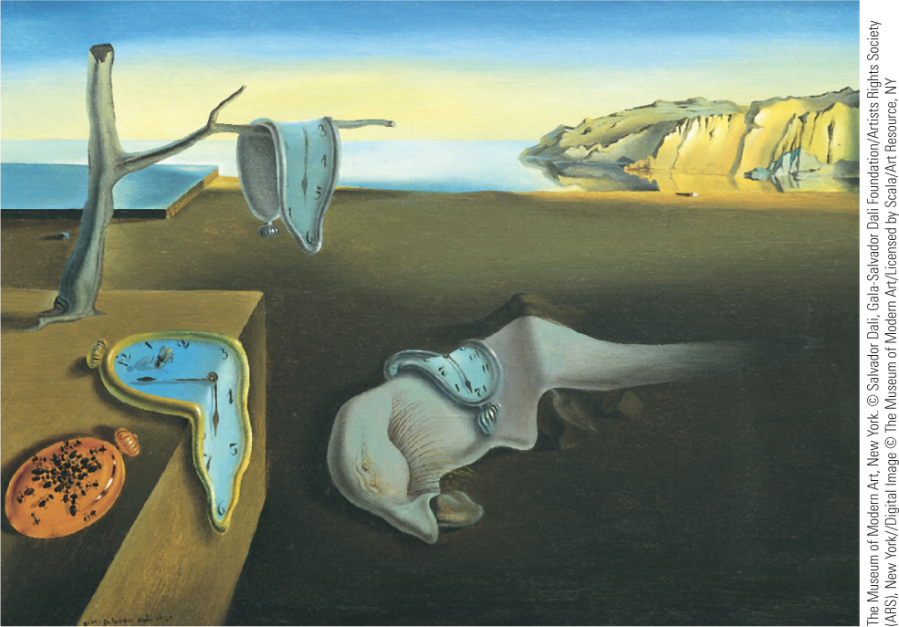
26.7 Salvador Dalí, The Persistence of Memory. Salvador Dalí sought to portray the world of dreams by painting recognizable objects in unrecognizable relationships.

Slide 36
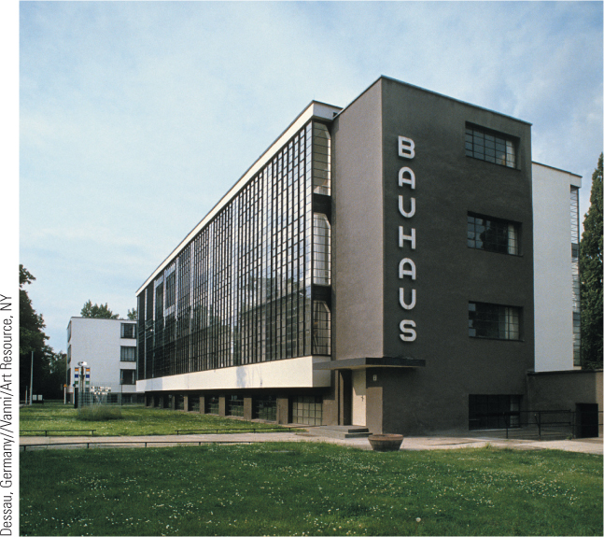
26.8 Walter Gropius, The Bauhaus. The straightforward use of steel, reinforced concrete, and rows of windows reflects the move to functionalism in modern architecture.

Slide 37
Chapter 26 Summary
The devastation wrought by World War I destroyed the liberal optimism of the pre-war era, but many in the 1920s still hoped that the progress of Western civilization could somehow be restored.
The democratic states—Great Britain, France, the Scandinavian countries, and the United States—spent much of the 1930s trying to recover from the Great Depression.
New authoritarian governments that required the active commitment and loyalty of their citizens came to power in Italy, Germany, and the Soviet Union.
For many people, despite the loss of personal freedom, mass movements offered some sense of security in a world that seemed fraught with uncertainty, an uncertainty that was also evident in popular culture, the arts, literature, and even physics.

Slide 38
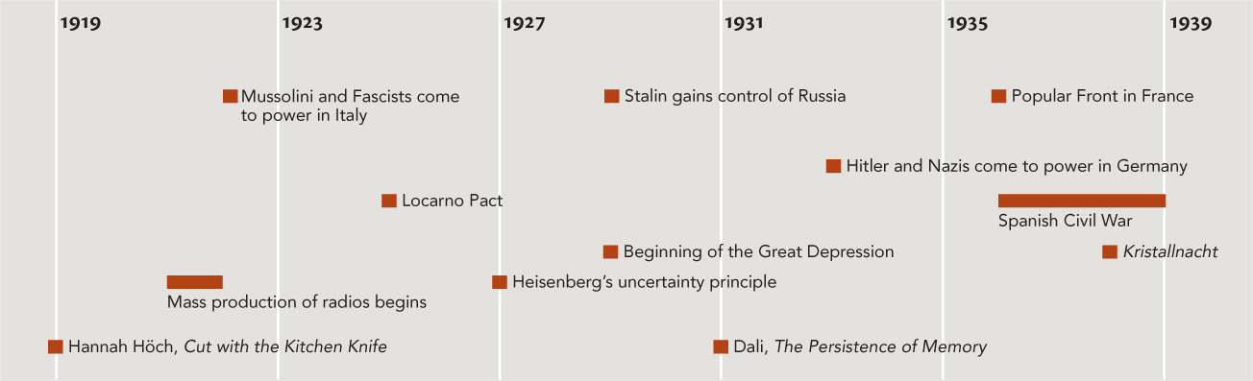
Chapter 26 Timeline

