Slide 1
WESTERN CIVILIZATION: A Brief History
Tenth Edition
CHAPTER 6
The Roman Empire
© 2020 Cengage. All rights reserved.

Slide 2
Chapter 6 Outline
6-1 The Age of Augustus (31 b.c.e.–14 c.e.)
6-2 The Early Empire (14–180)
6-3 Roman Culture and Society in the Early Empire
6-4 Transformation of the Roman World:
Crises in the Third Century
6-5 Transformation of the Roman World:
The Rise of Christianity

Slide 3
6-1 The Age of Augustus (31 b.c.e.–14 c.e.)
(1 of 2)
Focus Question: In his efforts to solve the problems Rome had faced during the late republic, what changes did Augustus make in Rome’s political, military, and social institutions?
Augustus princeps (“chief citizen”) and the senate: the theory and reality of power
The new order
  The military: the standing army and the establishment of the praetorian guard
Roman provinces and frontiers
  The principate, expansion, and provincial governors

Slide 4
6-1 The Age of Augustus (31 b.c.e.–14 c.e.)
(2 of 2)
Augustan society
  Three basic classes: senatorial, equestrian, and lower classes
  Initiation of social legislation to arrest the decline of Roman morals
Significance of the Augustan Age
  Created a new order while placating the old by restoring and maintaining traditional values

Slide 5
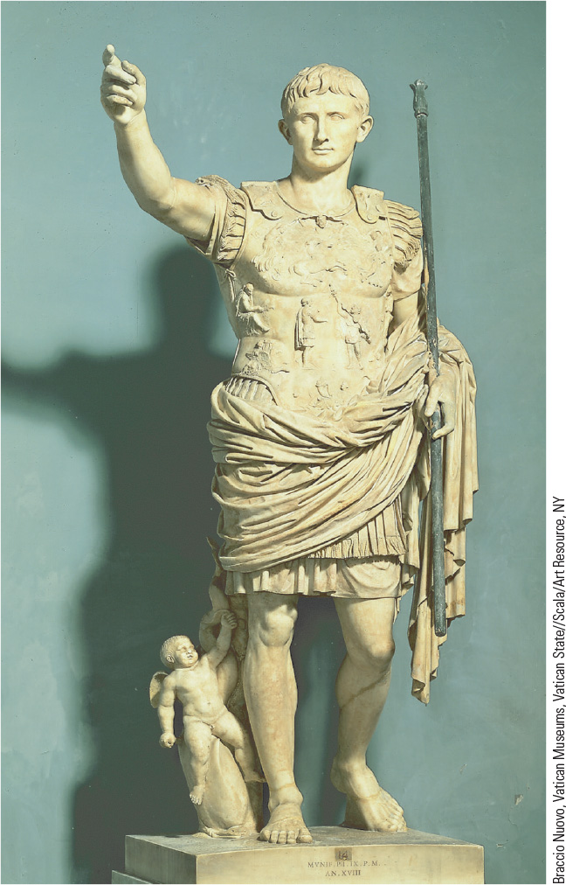
6.2 Augustus. The statue of Augustus was meant to be a propaganda piece depicting a youthful general addressing his troops.

Slide 6
6-2 The early empire (14–180) (1 of 3)
Focus Question: What were the chief features of the Roman Empire at its height during the second century?
The Julio-Claudians and Flavians
  Institution of imperial bureaucracy; acted as real rulers rather than first citizens
  Vespasian established himself as sole ruler after civil war in 69 and founded a new dynasty
The Five “Good Emperors” (96–180)
  Pax Romana and good emperors: Nerva, Trajan, Hadrian, Antonius Pius, and Marcus Aurelius
    Nearly a century of peace and prosperity but also inequality

Slide 7
6-2 The early empire (14–180) (2 of 3)
The Roman Empire at its height: frontiers and provinces
  What was Romanization?
    Debate: imposition or initiation by the conquered?
  Cities
    Important in the spread of Roman culture, law, and Latin language
  Roman law
    Established standards of justice applicable to all people, many of which are recognizable today

Slide 8
6-2 The early empire (14–180) (3 of 3)
Prosperity in the early empire
  Unprecedented levels of trade
    Long-distance trade beyond Roman frontiers including along the Silk Road
    Trade as a stimulus for manufacturing
  Agriculture as a continuing and underlying basis for prosperity
  The enormous gulf between rich and poor

Slide 9
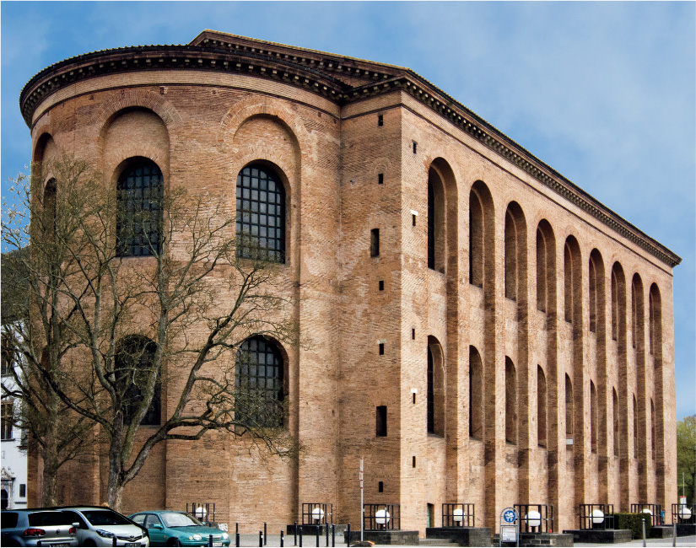
6.3 Rome in Germany. The Roman army helped bring Roman culture and institutions to the provinces, as shown by the Aula Palatina in Germany.

Slide 10
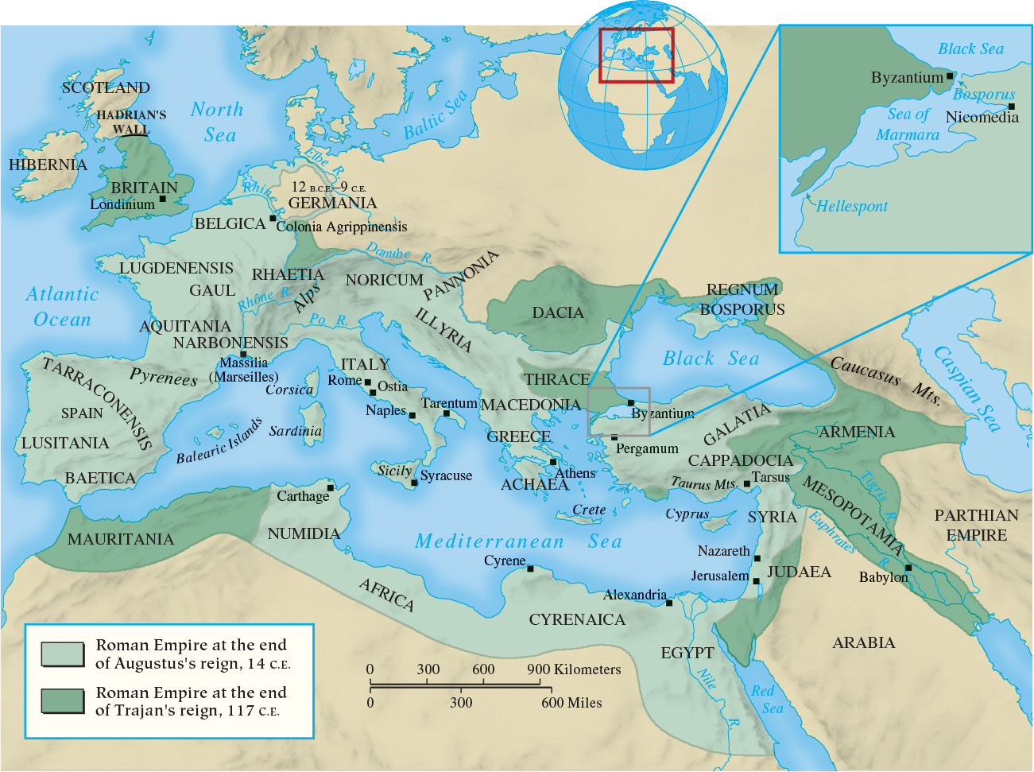
Map 6.1 Roman Empire from Augustus
Through Trajan (14–117)

Slide 11
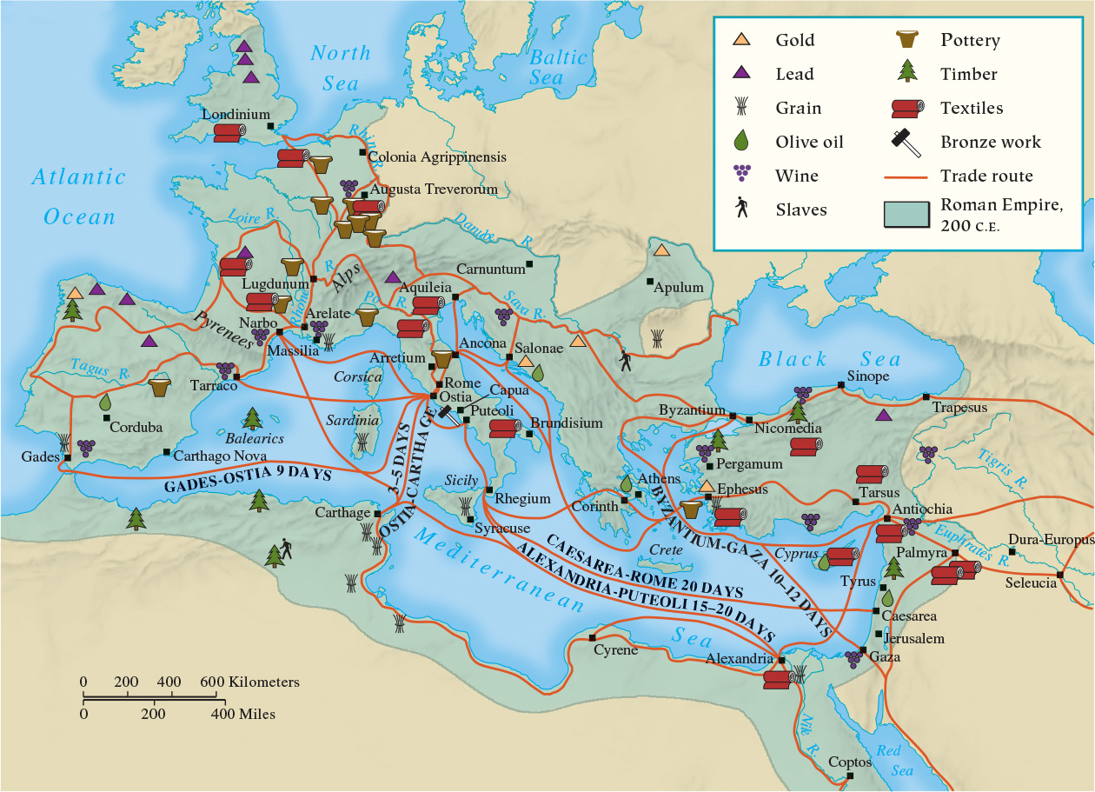
Map 6.2 Trade Routes and Products in the Roman Empire, ca. 200

Slide 12
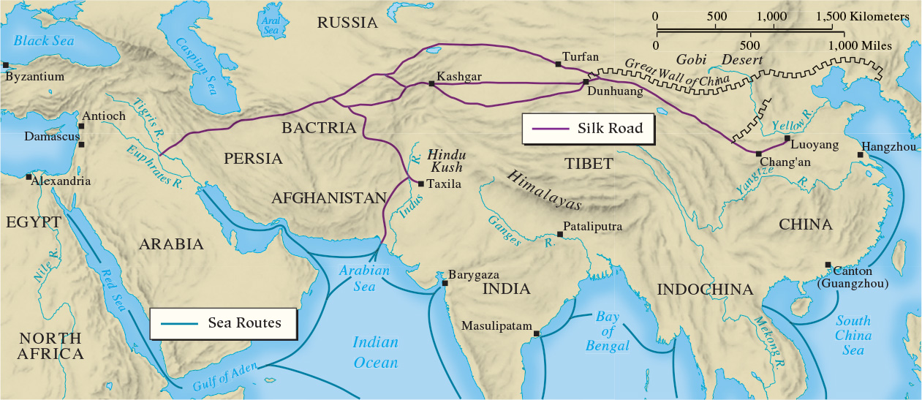
Map 6.3 The Silk Road

Slide 13
6-3 Roman culture and society in the early empire (1 of 2)
Focus Question: What were the chief intellectual, artistic, and social developments in the early empire? How did these differ from the intellectual, artistic, and social developments of the republic?
The golden age of Latin literature
  The poets Virgil, Horace, and Ovid; the historian Livy
The silver age of Latin literature
  The playwright Seneca; the historian Tacitus
The upper-class Roman family
  The undermining of male authority and the significant freedom and influence of women

Slide 14
6-3 Roman culture and society in the early empire (2 of 2)
Imperial Rome
  Capital city, largest population (ca. 1 million)
  Sophisticated but overcrowded and dangerous
  Rome as a parasite, devouring food and entertainments
The gladiatorial shows
  Bloodthirsty contests to the death between trained fighters and staged shows
  Wild popularity made them an integral part of Roman society

Slide 15
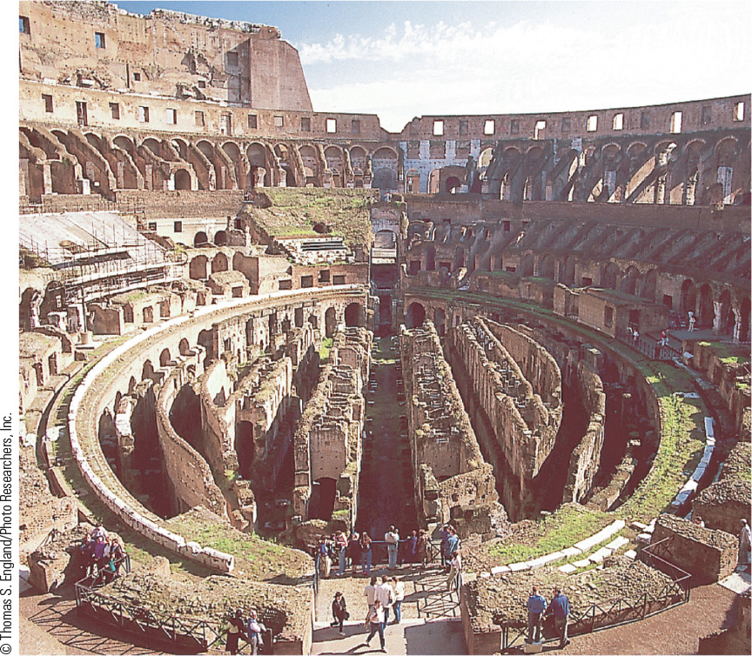
6.5 Interior of the Colosseum. Amphitheaters, in which gladiatorial contests were held, such as the Colosseum in Rome, were built throughout the empire.

Slide 16
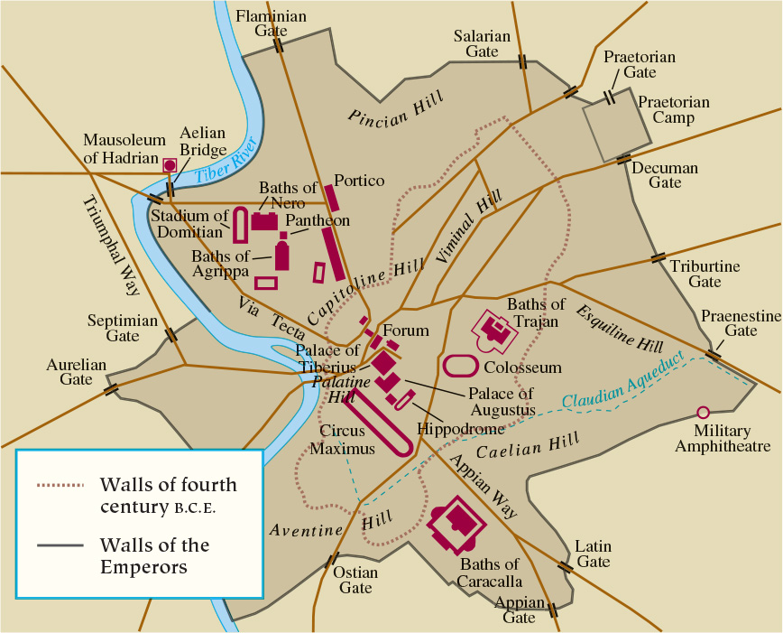
Map 6.4 Imperial Rome

Slide 17
6-4 transformation of the roman world: crises in the third century
Focus Question: What political, military, economic, and social problems did the Roman Empire face during the third century?
Political and military woes
  Septimus Severus seized power, creating a military monarchy
  Chaos of continual civil war (235–284)
    Provinces breaking away
Economic and social crises
  Invasions, civil wars, and plague nearly caused economic collapse

Slide 18
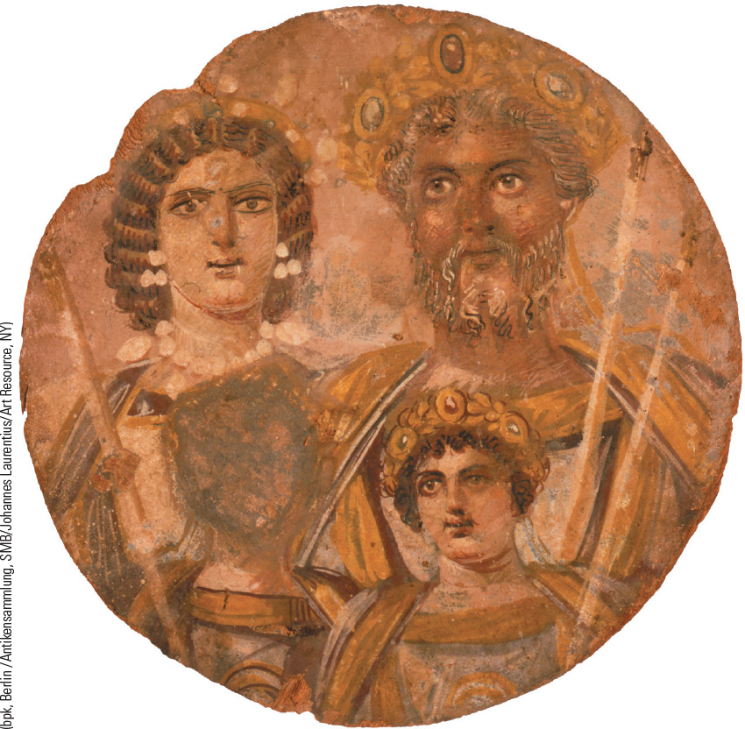
6.6 Septimius Severus and His Family. This portrait, which was painted on wood, is the only existing painted likeness of a Roman emperor, shown with gray hair and beard.

Slide 19
6-5 Transformation of the roman world: the rise of Christianity (1 of 3)
Focus Question: What characteristics of Christianity enabled it to grow and ultimately to succeed?
The religious world of the Roman Empire
  Official state religion focused on worship of pantheon of gods and goddesses
    Tolerant of other religions, including the mystery religions
    Desire for more emotional spiritual experiences
The Jewish background
  Sadducees, Pharisees, Essenes, and Zealots
  Jewish revolt in 66 c.e. crushed by Romans
    Temple in Jerusalem destroyed

Slide 20
6-5 Transformation of the roman world: the rise of Christianity (2 of 3)
The origins of Christianity
  Jesus of Nazareth’s message, denunciation, and crucifixion
    Resurrection, the Messiah (Christ, “anointed one”)
  The importance of Paul, the most important figure after Jesus in early Christianity
    Transformation from a Jewish sect into a broader religious movement
  The spread of Christianity
    Paul’s epistles and the Gospels of Matthew, Mark, Luke, and John
    Christianity values and growth in cities led to persecution

Slide 21
6-5 Transformation of the roman world: the rise of Christianity (3 of 3)
The growth of Christianity
  The appeal
    Promise of salvation
    New meaning to life
    Offered a personal relationship with God and a link to higher worlds
    Belonging
    Attractive to all classes
  Women and early Christianity
    Subject, but offered new roles and new companionship
  The failure of persecution

Slide 22
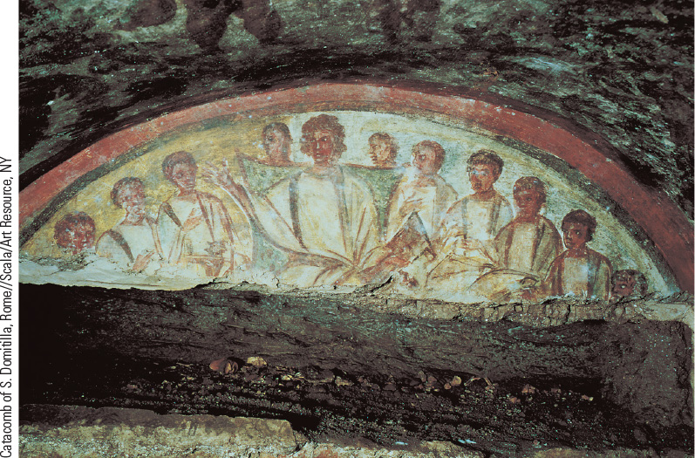
6.7 Jesus and His Apostles. This fourth-century fresco from a Roman catacomb depicts Jesus and his apostles.

Slide 23
Chapter 6 Summary
After a series of bloody civil wars, Augustus created a
new order and a dynasty that began the Roman Empire.
In the second century, five “good emperors” maintained a period of peace and prosperity when trade flourished and the provinces were governed efficiently.
Roman political and cultural ideals spread throughout its empire, although an era of decline set in by the third century.
At the same time, the new religion of Christianity was spreading throughout the empire.

Slide 24
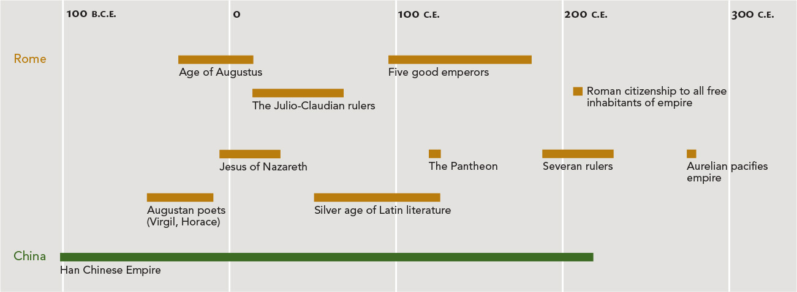
Chapter 6 Timeline

