Slide 1

A CULTURAL LANDSCAPE
Walking the LCC Campus
By Mylene Buck & Eve Hanson

Slide 2
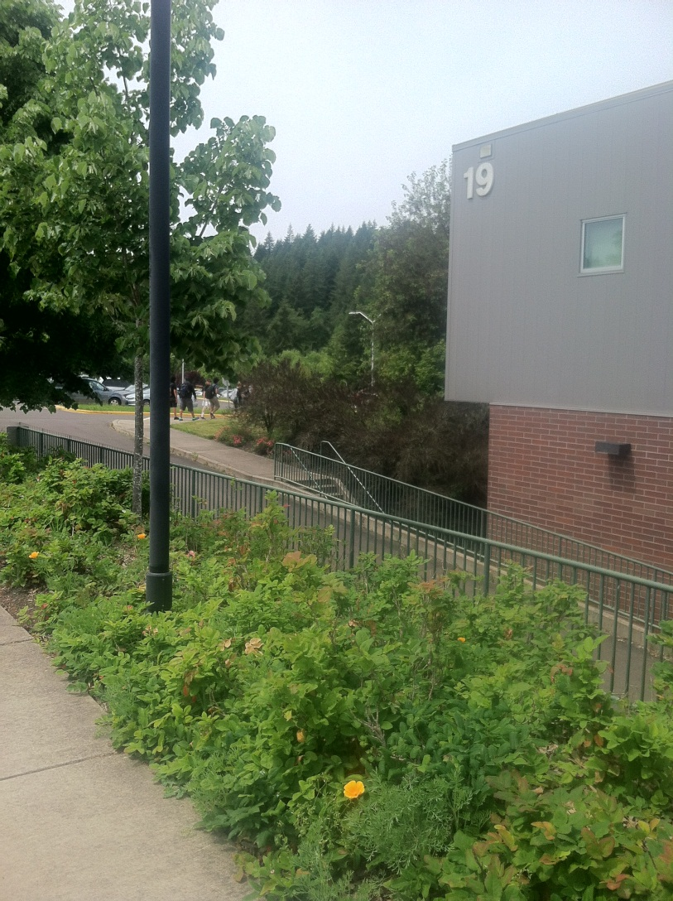
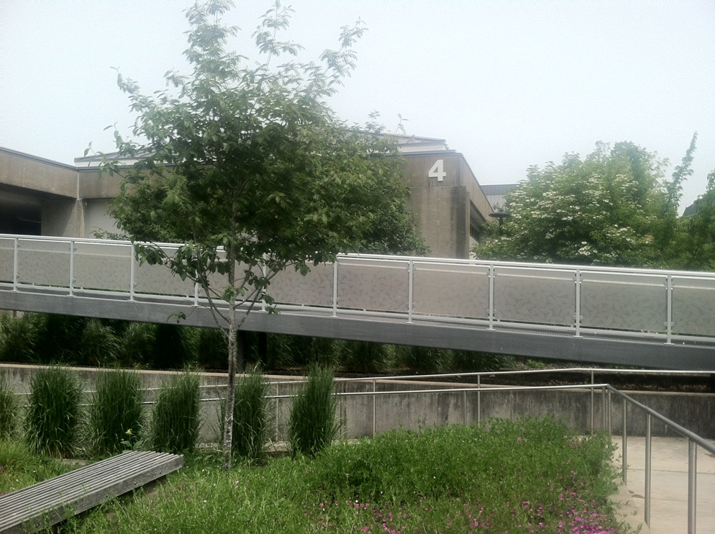
NUMBERED BUILDINGS
This diffusion corollary could be in imitation of government buildings or doctor’s offices, or be a reflection of other colleges’ format. Some colleges give each building a name instead of a number.

Slide 3
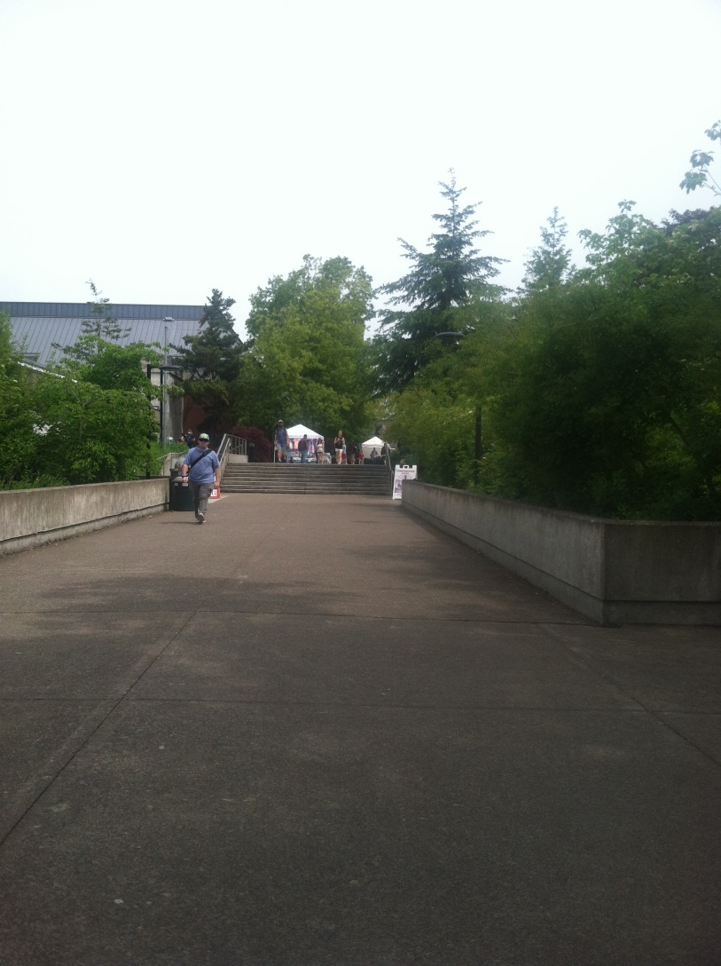
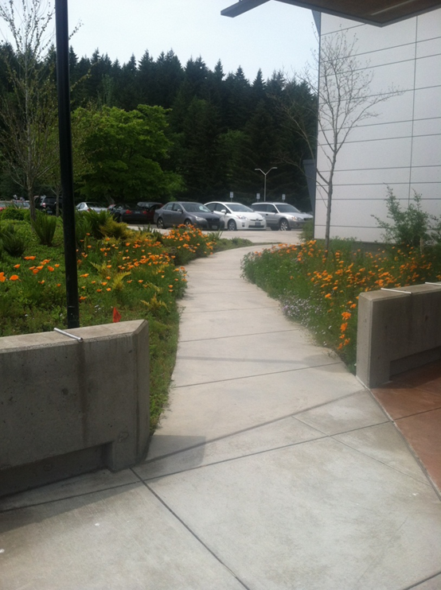
CONCRETE PATHS LINED WITH TREES
Concrete everywhere was the norm that LCC’s architects imitated when they first designed the campus⁽¹⁾. Incorporating many varieties and numbers of plants is a regional corollary that is found throughout Oregon.
(1) http://www.lanecc.edu/archives/parnell-years-2#campus

Slide 4

RAMPS FOR EASY ACCESS
Disability ramps are an example of cultural change due to our college’s increased awareness of the need to be culturally aware by making education accessible to everyone.

Slide 5
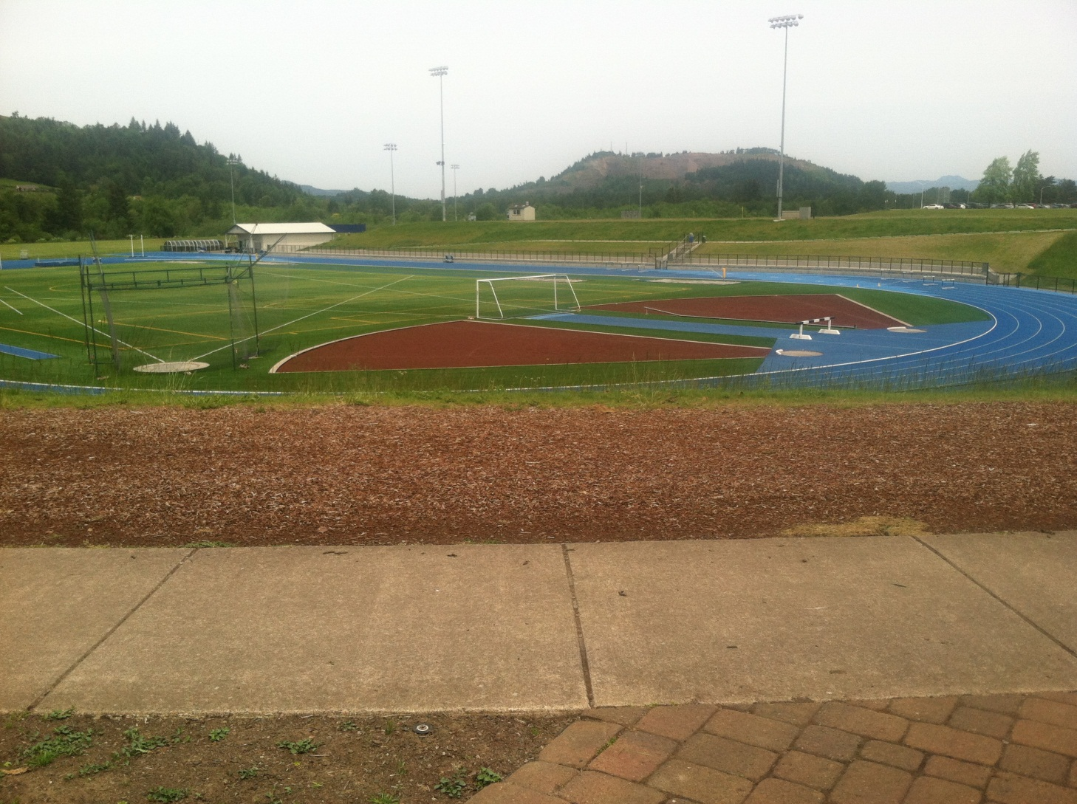
SPORTS & STADIUM
Diffusion from Ancient History Meets Modern Cultural Fad
LCC’s original building plans called for “locating sports facilities close to the campus entrance and parking” based on layouts of other college campuses in 1965. The colored track is an example of converging America’s fad of bright colors everywhere with the traditional athletics’ track layout.
(1) http://www.lanecc.edu/archives/parnell-years-2#campus

Slide 6
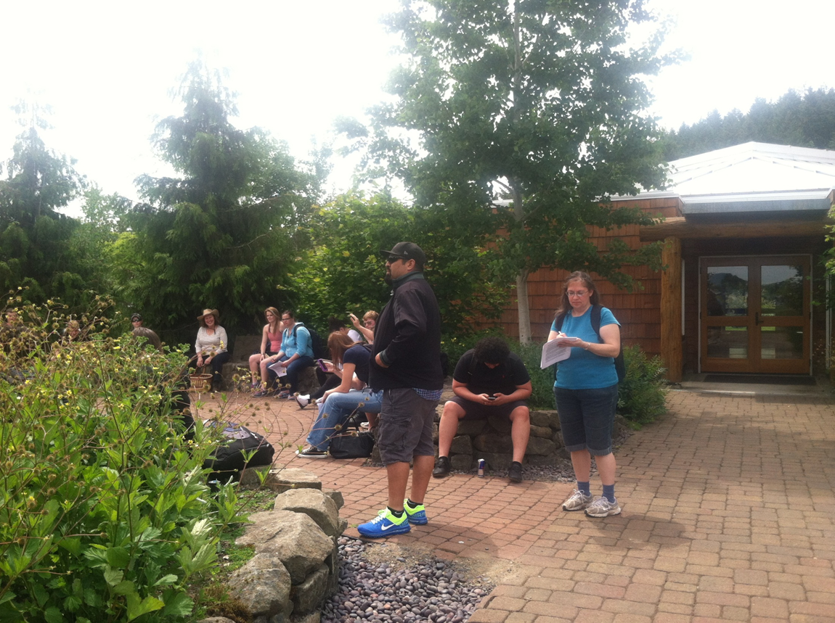
OUTDOOR STUDY AREAS: THE GATHERING PLACE OUTSIDE THE LONGHOUSE (PROVIDED BY THE NATIVE TRIBES OF OREGON)
Another example of cultural change is the promotion of Native American influences in the campus landscape. LCC is dotted with landscaped resting spots and study areas that reflect the regional and convergence corollaries.

Slide 7
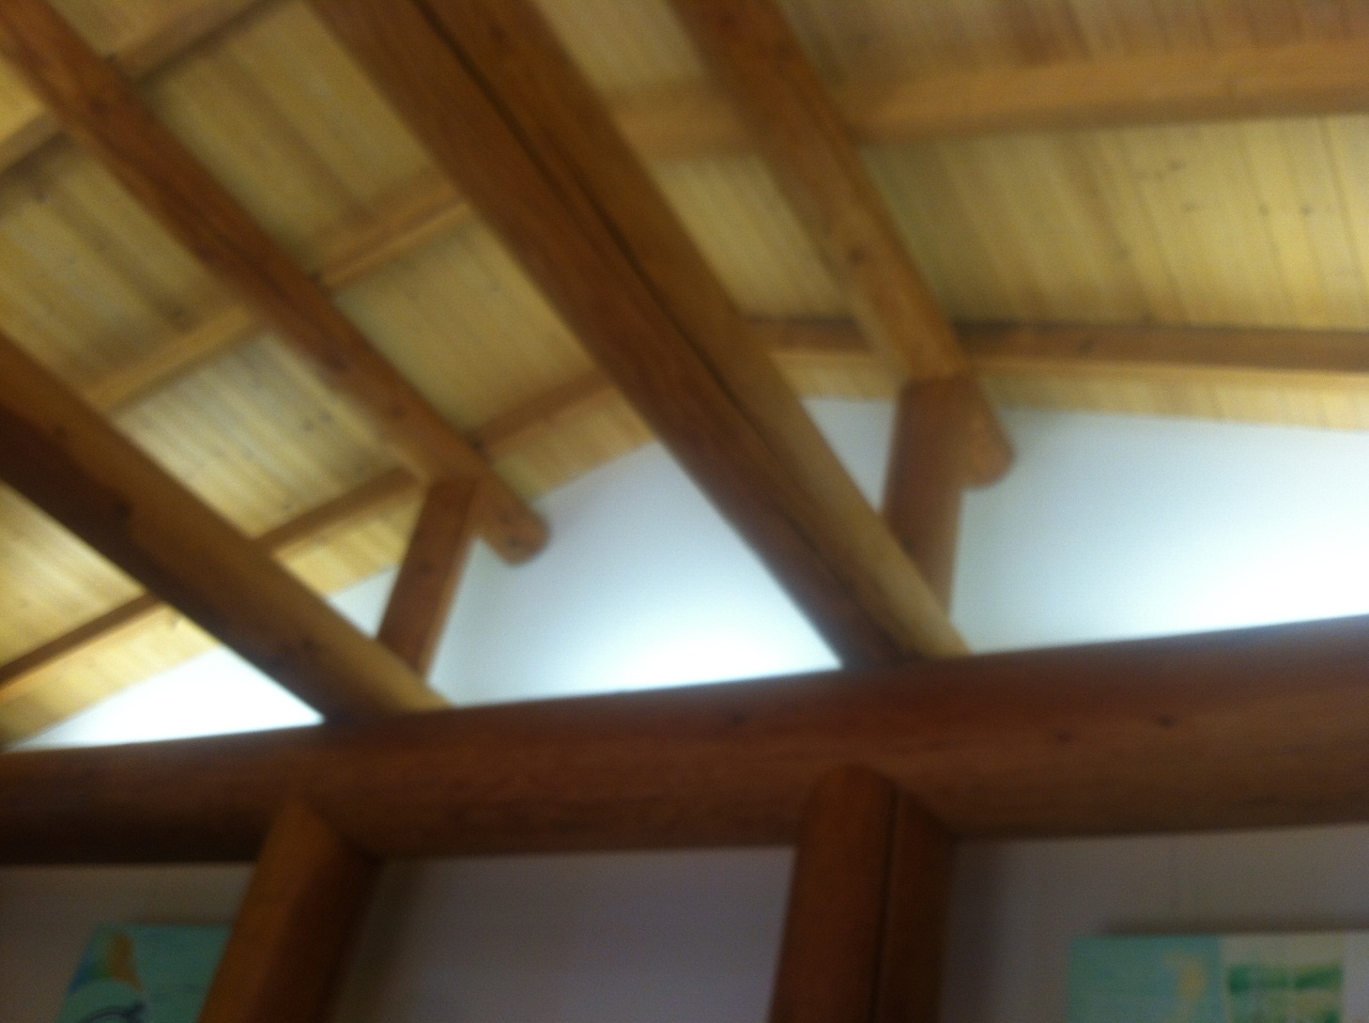
BEAMS & TRUSSES IN THE LONGHOUSE
The wood construction and environmentally friendly aspects of the Longhouse only make this gift all that more wonderful. It fits in perfectly with our Oregon regional culture even while it encourages LCC to converge with that culture by replacing concrete with natural mediums of construction and a more open design plan where and whenever possible. We see this with the current renovations of the Center building.

Slide 8
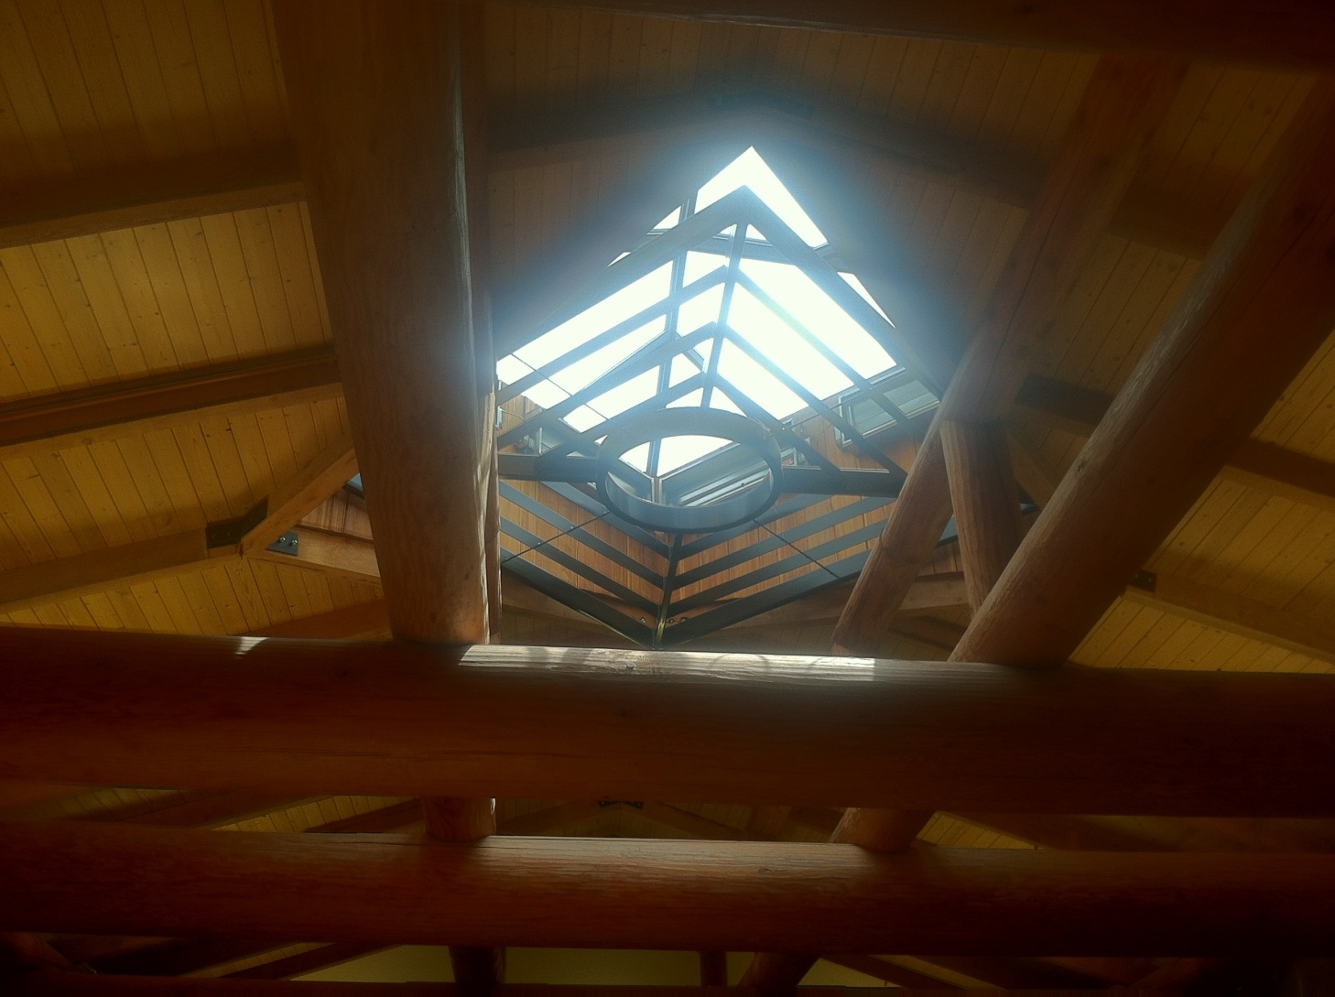
TRADITIONAL LOG HOUSE MEETS MODERN SKYLIGHT
This cultural change from the traditional roof reminds us that aspects of heritage, even while influencing modern life, can be influenced by modern innovations and technologies, especially when they are environmentally friendly, visually appealing, and useful.

Slide 9
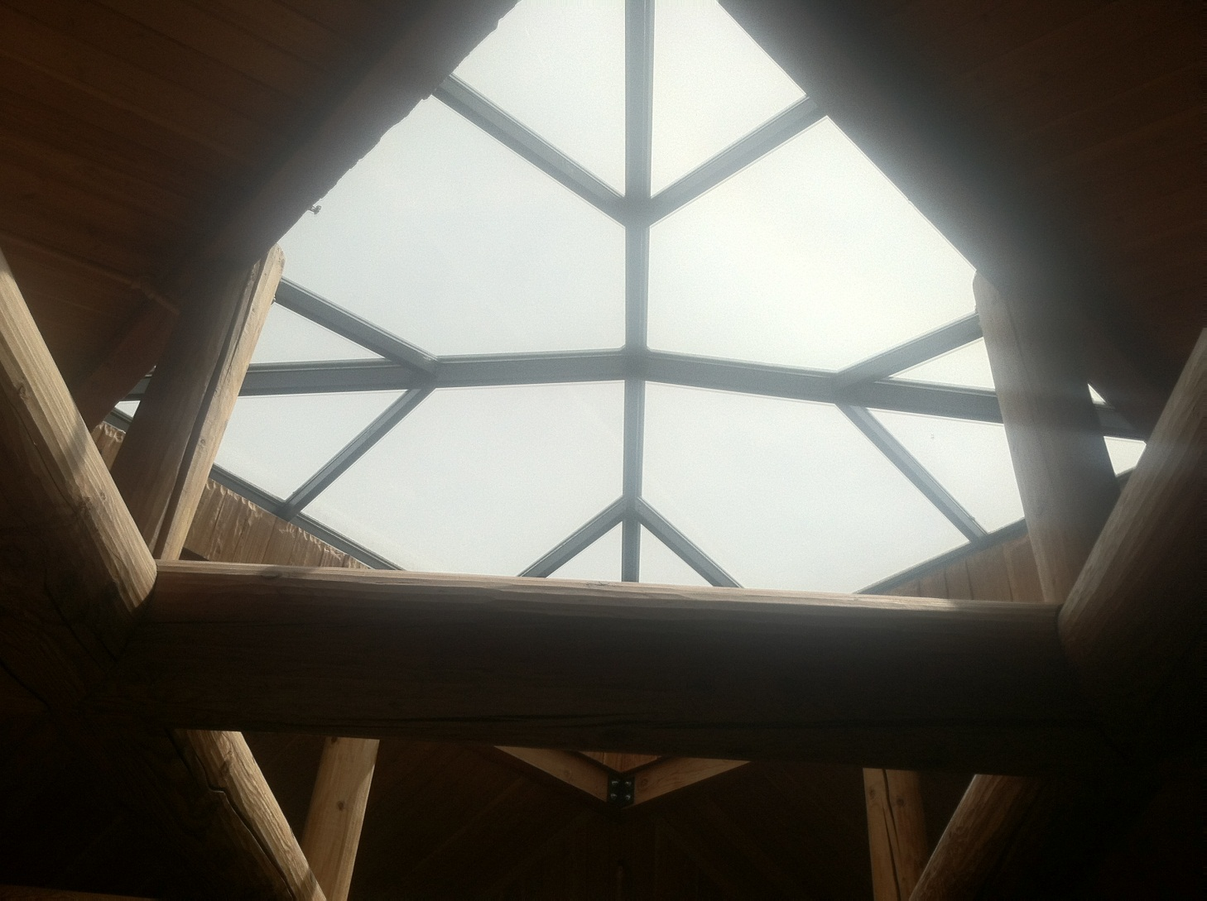
AESTHETICS + LIGHTING
All over campus we see examples like this of the combination of regional art and architecture . . .

Slide 10
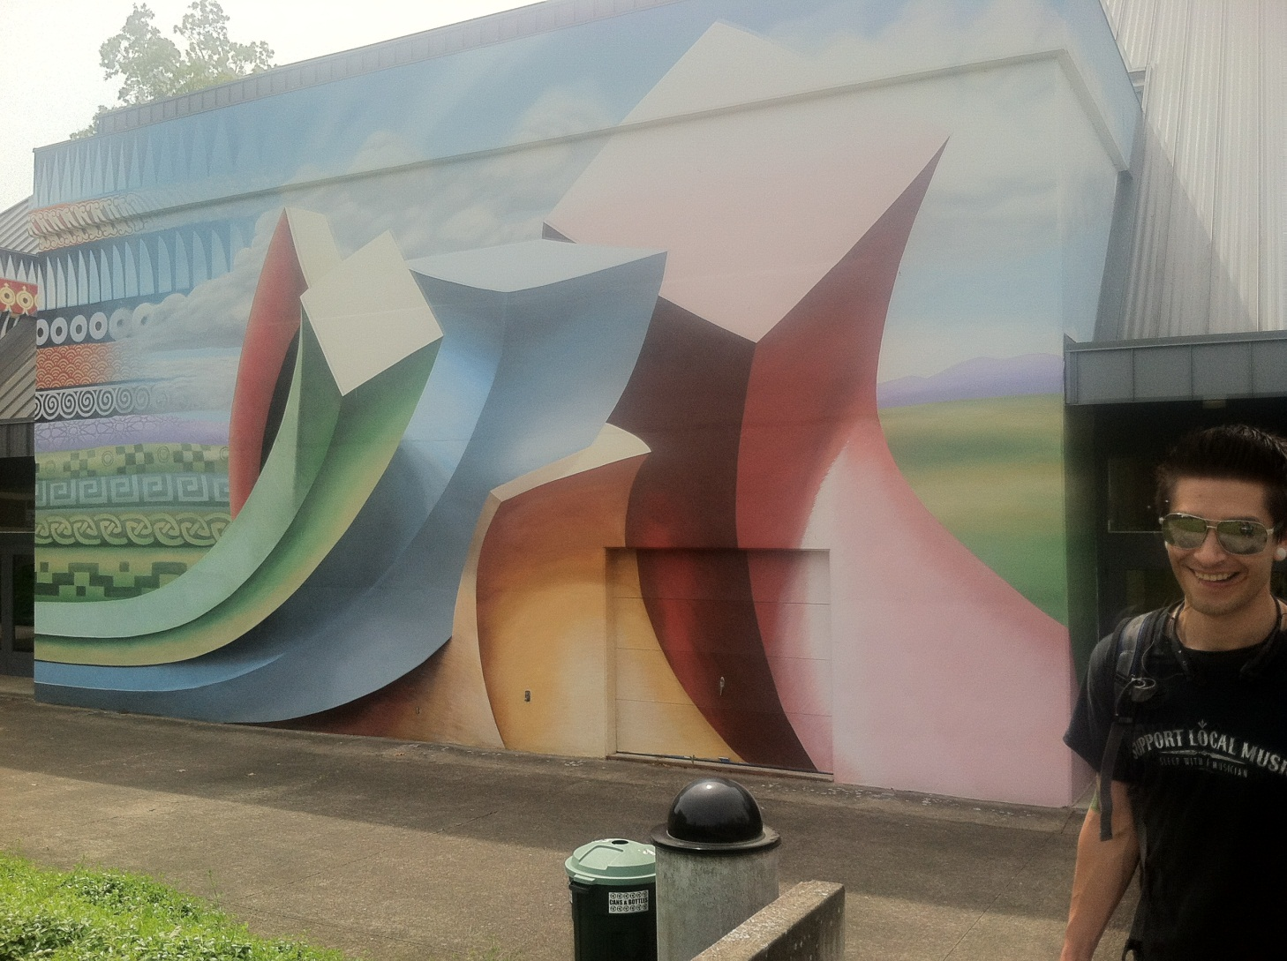
MODERN ART MURAL
. . , but here we see modern art combined with cultural heritage overlaid on modern, concrete architecture. This is an interesting example of not only the cultural change of awareness of how our past influences our present, but also how the need in modern society for a more aesthetically pleasing academic environment converges with utility or necessity.

Slide 11
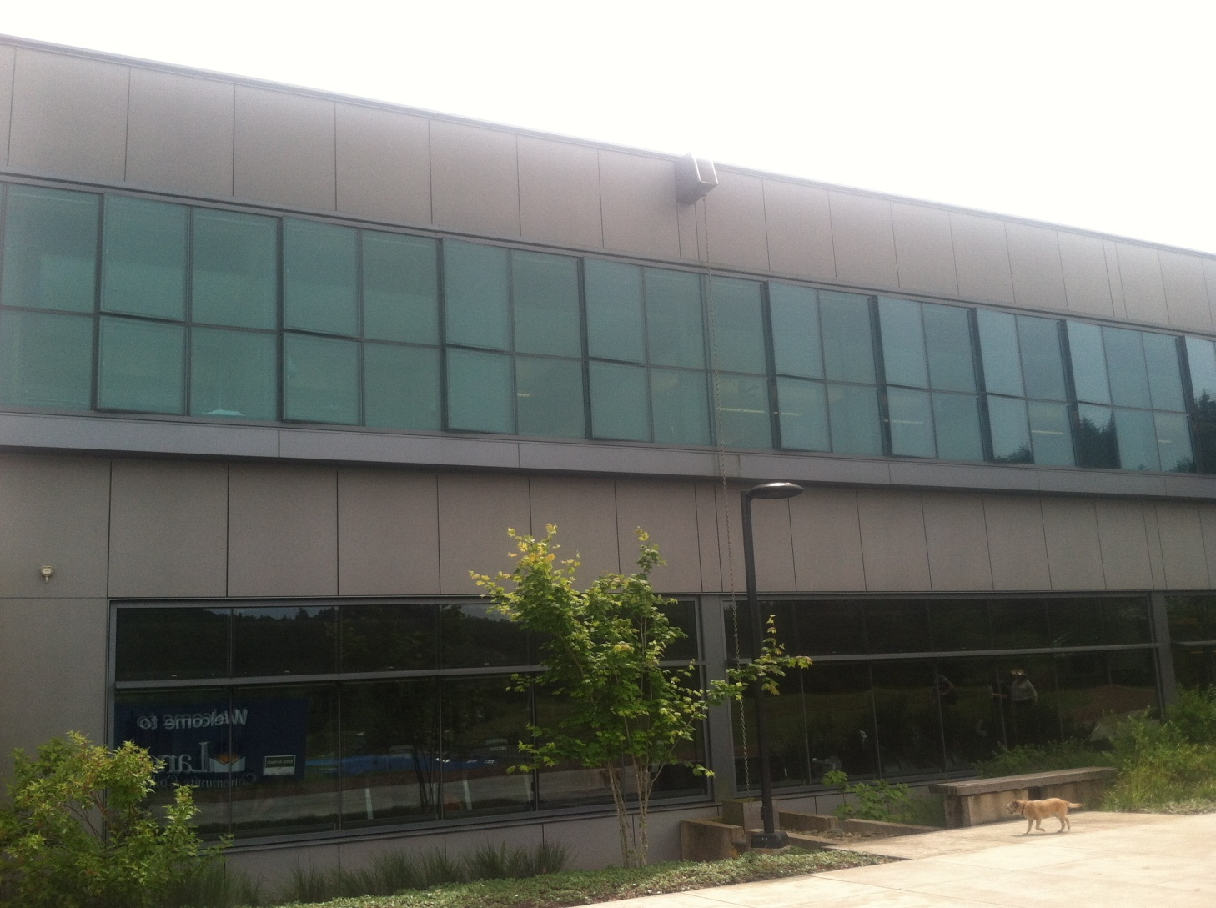
CONCRETE + GLASS =
MODERN ARCHITECTURE
Change doesn’t always happen quickly. Here is a blend of old-style (concrete) with new elements (lots of glass). Most modern buildings combine this amount of glass with mostly metal.

Slide 12
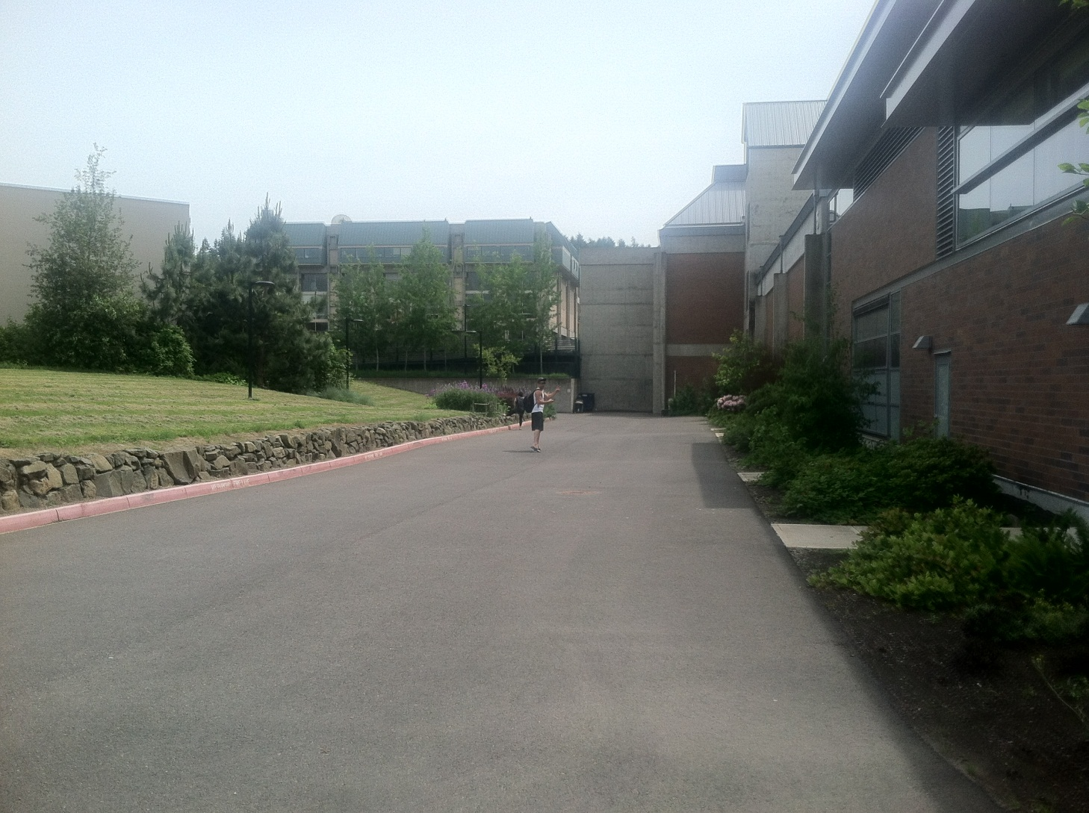
CHANGING THE CONCRETE CAMPUS
This scene shows the variety of corollaries that greet students each day. The renovation of the Center building is contrasted with the hodge-podge of modern glass and metal mixed with the traditional concrete buildings and pathways which are surrounded by native & imported vegetation.

Slide 13
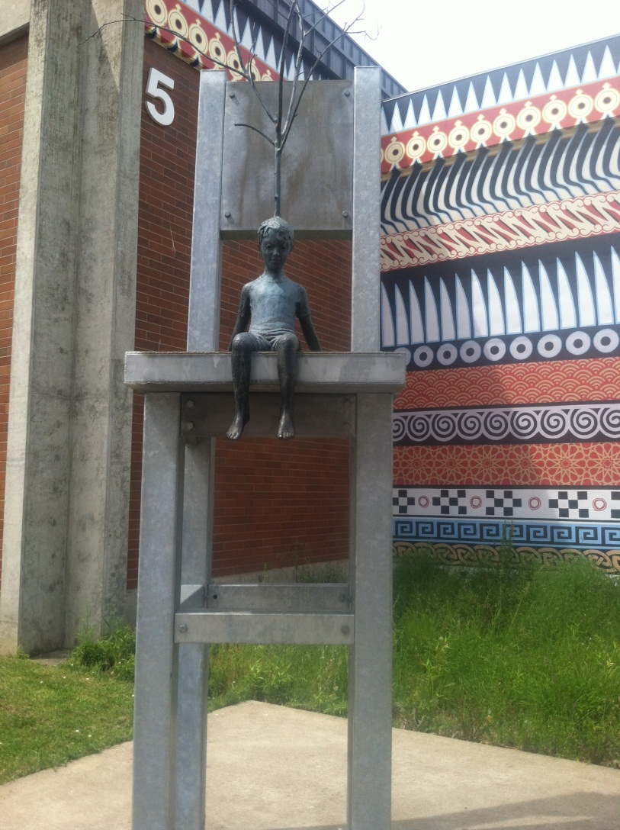
ART & ARCHITECTURE
Changes
by Eve Hanson
Upon a chair sits
a boy. Lofty thoughts
like unyielding steel
frozen under hard packed snow;
trapped by barren icy paths.
Thawing, his eyes see-
wondering, exploring like
birds, the spaciousness,
emerging garden pathways
flowing thru fields of knowledge.
His mind filled with awe,
delves, celebrating truth, life
--waves over hot rock,
freedom to climb sculpted paths
that lead to fruitful orchards.
Feeling connected;
settling, accepting of
briskly swirling days
enveloped in colored paths;
resting in hues of splendor.
Envoy
Such are the seasons
of life, of love, of learning.
We get stuck in us
until we blossom with change,
accept the lessons of life,
and use them to live.
This piece of modern college art is framed by the ancient designs of native culture. The art inspired poem is as evolving as the college landscape and reflects another aspect of the convergence of old-school academia with modern art.

Slide 14
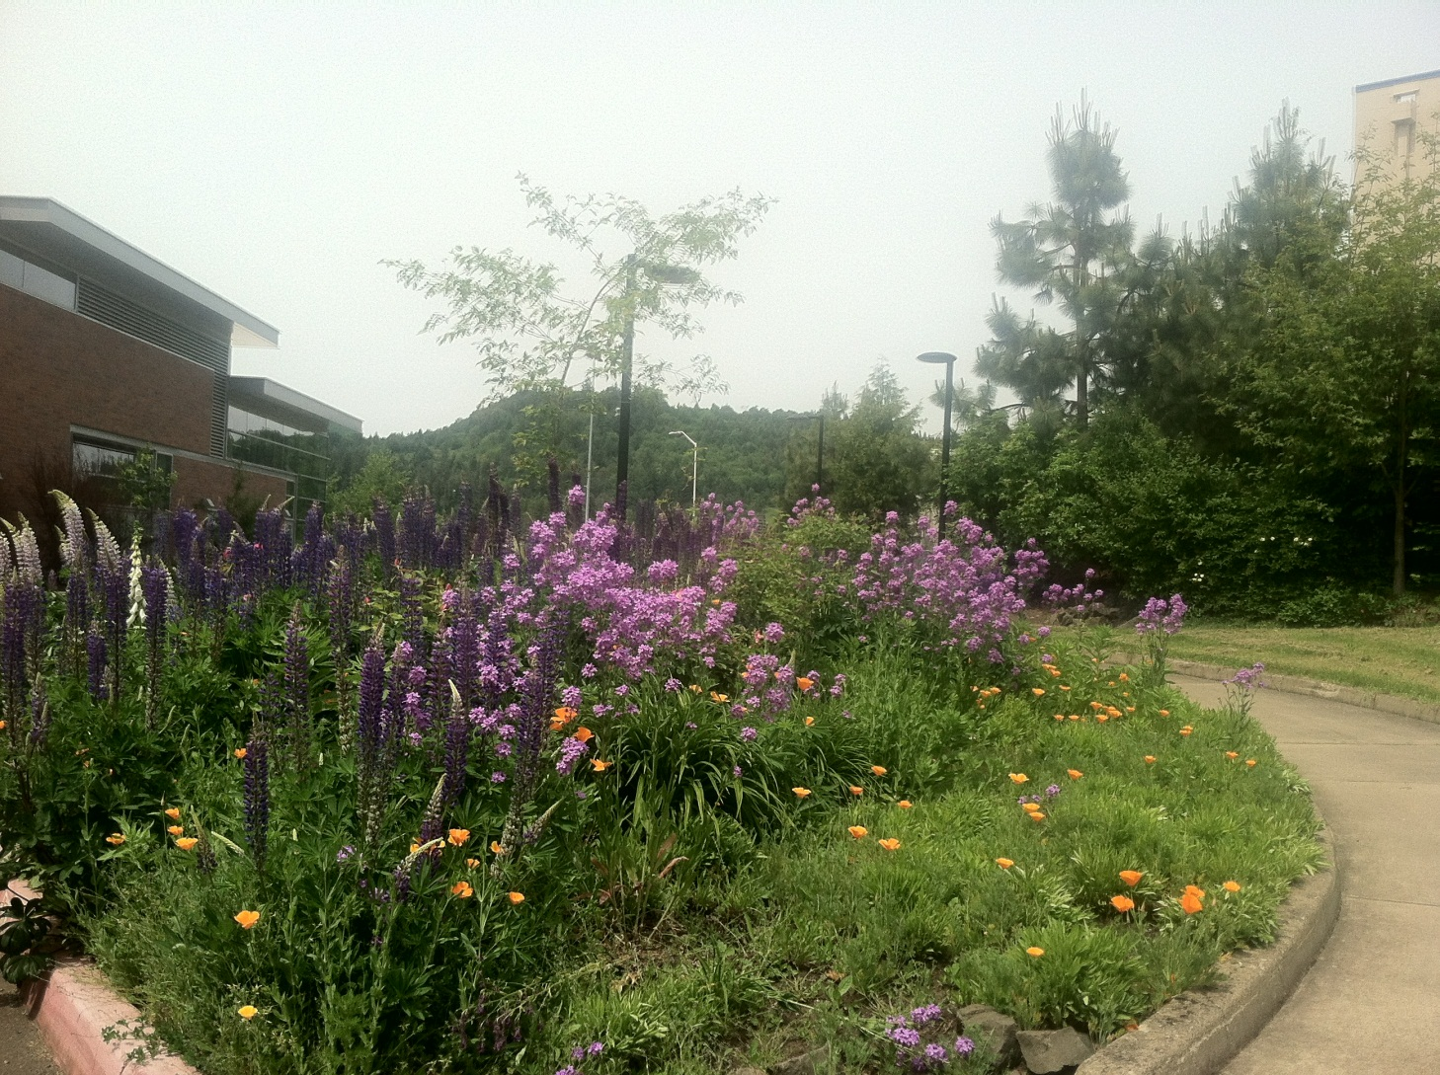
NATURE BREAKS THE CONCRETE LANDSCAPE . . .
just as beautifully as varieties of cultures converge at LCC to create a landscape of wondrous beauty mixed with similarities, such as backpacks, relaxed clothing styles, sports, love of all kinds of music, art & regional and ethnic foods, and of course, learning in multitudes of ways.

Slide 15
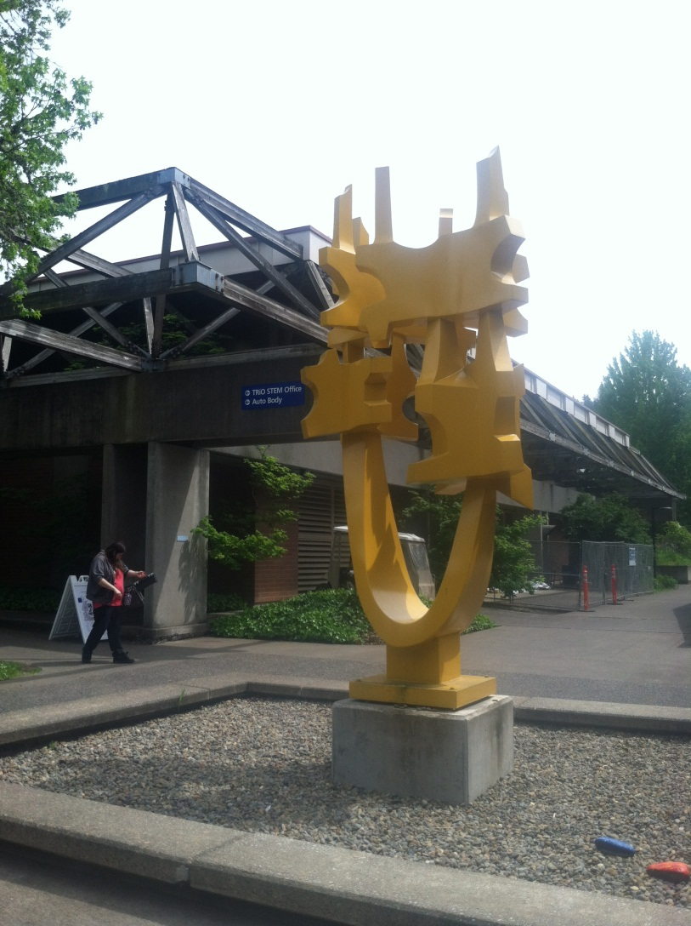
ART AS CULTURAL & GEOGRAPHIC LANDSCAPE
SCIENCE & TECHNOLOGY BUILDING
Even the modern aspects of college existence are constantly changing and evolving as seen by this fairly recent addition to the east courtyard by the cafeteria. But modern as it is, it complements the unusual architecture of these few buildings. Their differences make them stand out even as those same differences cement their connection to the rest of the college which is also constantly undergoing changes in taste.

Slide 16
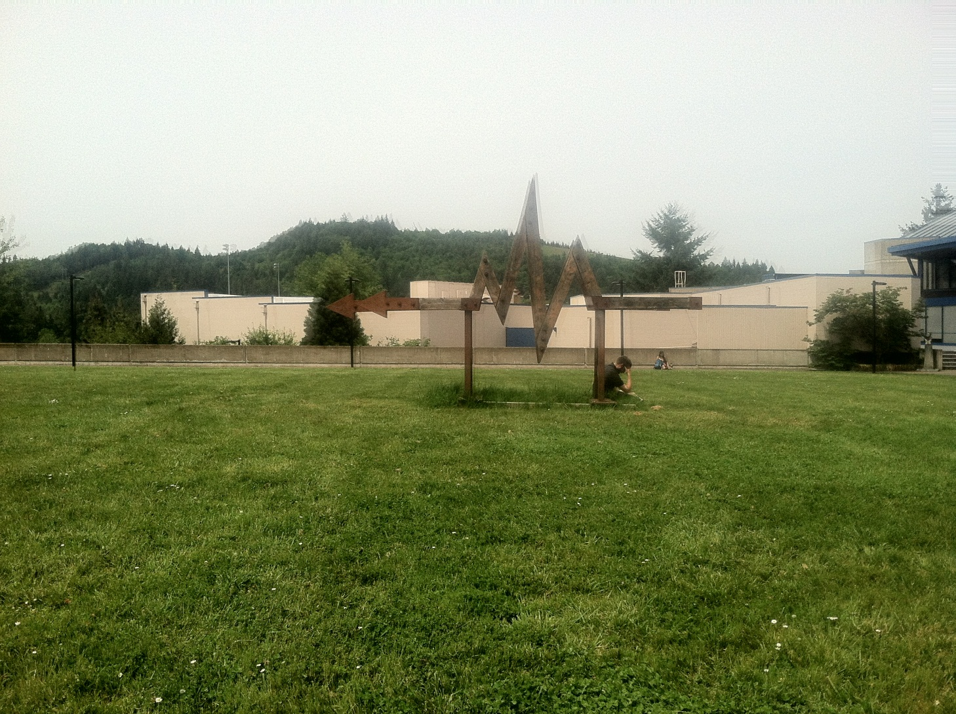
MORE ART AS CULTURAL & GEOGRAPHIC LANDSCAPE:
HEART BEAT ARROW POINTS TO HEALTH AND WELLNESS CENTER
These are definitely “signs” of the cultural changes in American society wherein modern art is used to reinforce our ever-growing awareness of our state of health, . . .

Slide 17
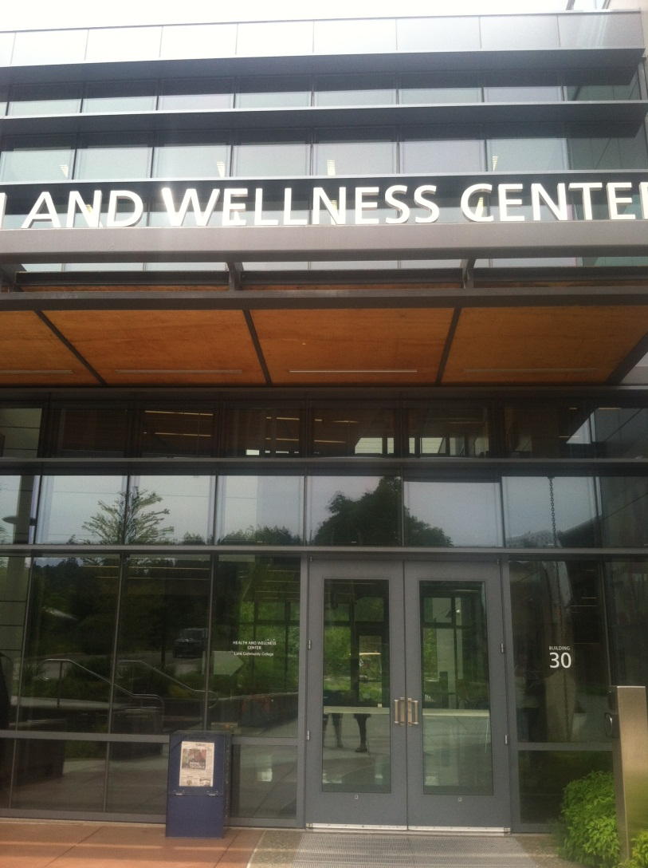
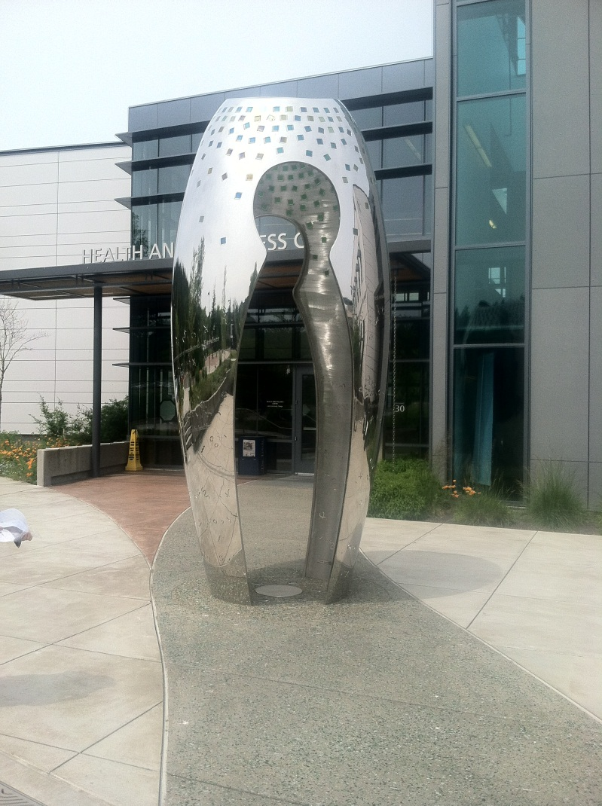
. . . the need to be proactive, and the need to beware of culturally ingrained habits and attitudes.
HEALTH & WELLNESS CENTER

Slide 18
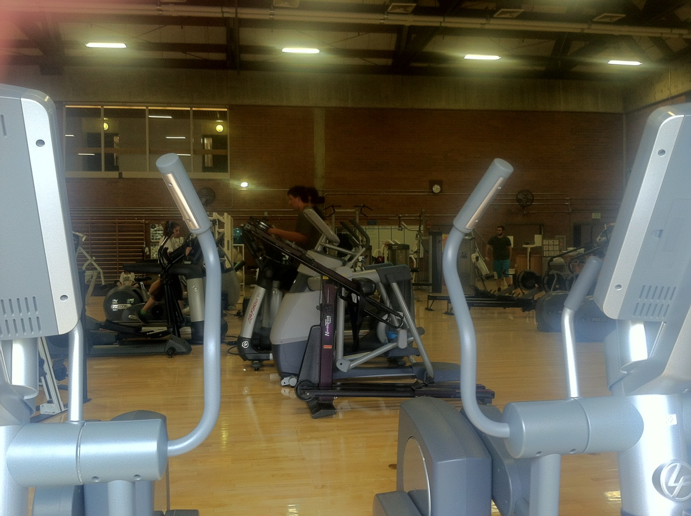
The gym combines natural wood with modern technology.
It keeps occupants cool through the use of roll-up glass windows that let in fresh air rather than relying on air conditioning.
Converging technology with regional culture
Diffusion of healthy living to the college scene.
LCC’s Gym

Slide 19
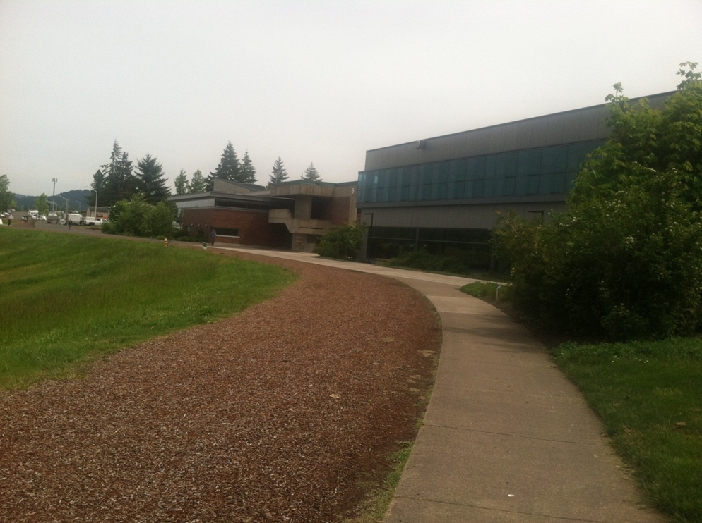
“LANDSCAPED”
CONCRETE + BARK + GRASS + TREES
The European tradition of landscaping adds to the combination of beauty and utility at LCC while bark and sloping, tiered grounds represent Northwest regional corollaries.

Slide 20
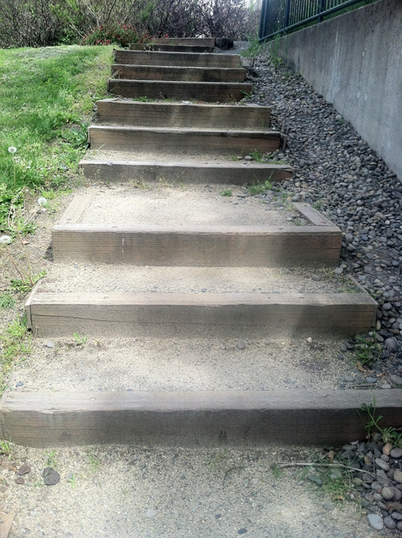
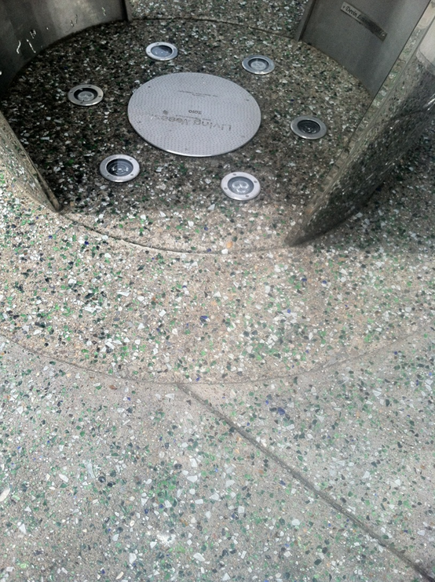
FOR AESTHETICS:
WOODEN “RAILROAD TIE” STEPS and
COLORED GLASS CONCRETE SIDEWALK
Our regional hiking trails are diffused in miniature at LCC in these wood & dirt steps. Offset by that is a modern taste for embedding glittering glass in concrete.
The best of many cultural elements are found here at LCC; the old, the new, the rustic, the contemporary, the native, regional, and international.

