Slide 1
WESTERN CIVILIZATION: A Brief History
Tenth Edition
CHAPTER 30
After the Fall: The Western World in a Global Age
(Since 1985)
© 2020 Cengage. All rights reserved.

Slide 2
Chapter 30 Outline
30-1 Toward a New Western Order
30-2 After the Cold War: New World Order or Age of Terrorism?
30-3 New Directions and New Problems in Western Society
30-4 Western Culture Today
30-5 Toward a Global Civilization

Slide 3
30-1 Toward a New Western Order (1 of 11)
Focus Questions: What reforms did Gorbachev institute in the Soviet Union, and what role did he play in its demise? What are the major political developments in eastern Europe, western Europe, and North America since 1985?
The revolutionary era in the Soviet Union
  The Gorbachev era
    The cornerstone of radical reform: perestroika or “restructuring,” with glasnost (openness) as instrument
    Political restructuring with Soviet parliament and political parties; Gorbachev became first Soviet president in 1990
    The troubles of a multiethnic country and nationalist movements

Slide 4
30-1 Toward a New Western Order (2 of 11)
The revolutionary era in the Soviet Union
  The end of the Soviet Union
    Gorbachev’s struggle to deal with problems unleased by reform
    Conservative leaders of traditional Soviet institutions arrested Gorbachev and attempted to seize power
    Coup disintegrated but Soviet republics moved for complete independence
    Gorbachev’s resignation, with responsibilities turned over to Boris Yeltsin, president of Russia

Slide 5
30-1 Toward a New Western Order (3 of 11)
The revolutionary era in the Soviet Union
  Why did the Soviet Union collapse?
    Factors: expense of the arms race, denial of massive inefficiencies, and the multiethnic character of the Soviet system
  The new Russia
    Yeltsin’s reforms and Russian fragility
    Nagging troubles with crime mobs and in Chechnya
  The Putin era
    Putin’s centralization of power, assertive role in international affairs, and silencing of critics
    Annexation of Crimea and accusations of interference in the U.S. presidential election of 2016

Slide 6
30-1 Toward a New Western Order (4 of 11)
Eastern Europe: the revolutions of 1989 and the collapse of the Communist order
  The fall
    A peaceful way to new political systems in Poland under Solidarity, in Hungary, and in Czechoslovakia
    Violence in Romania: execution of Ceauşescu
  After the fall
    Challenges: little experience with democratic systems, ethnic divisions, and painful economic shifts
    Membership in NATO and EU; impact of 2008 economic crises
The reunification of Germany
  Achieved in 1990

Slide 7
30-1 Toward a New Western Order (5 of 11)
The disintegration of Yugoslavia
  Slovenia, Croatia, Bosnia-Herzegovina, and Macedonia lobbied for new federal structure; rejected by Milosevic
  Slovenia and Croatia declared independence, 1991
    Assault on Croatia by increasingly Serbian Yugoslavian army, capturing one-third of Croatia
  The war in Bosnia
    Serbian assault and policy of “ethnic cleansing” of Bosnian Muslims; NATO involvement weakened Serb military positions and monitored new Serb republic and Muslim-Croat federation

Slide 8
30-1 Toward a New Western Order (6 of 11)
The disintegration of Yugoslavia
  The war in Kosovo
    Yugoslavia president Milošević stripped Kosovo of autonomous status, 1989
    Albanians founded Kosovo Liberation Army (KLA), 1993
    Bombing campaign by U.S. and NATO allies forced Yugoslavian government to comply
  The aftermath
    2000: Milošević ousted from power; died in 2006 during trial
    In Bosnia, only EU troops have kept violence from erupting
    In Kosovo, ongoing violence has hindered EU attempts to rebuild
    Independence for all six Yugoslavian republics and for Kosovo

Slide 9
30-1 Toward a New Western Order (7 of 11)
Western Europe and the search for unity
  Germany restored
    Reunification made Germany the leading power in Europe
    Revitalization of eastern Germany was costly; Kohl faced with need to raise taxes and struggle to build new Germany brought Gerhard Schröder to power
    Angela Merkel became first female chancellor, 2005; took leading role in affairs of the EU and reforms during 2008 economic crisis
  Post-Thatcher Britain
    Anti-tax riots led to Thatcher’s resignation
    Rise of the Labour Party, 1997–2010: Blair and Brown
    Cameron’s Conservatives after 2010: emphasis on austerity
    A new chapter: the Brexit vote in 2016; May in as prime minister

Slide 10
30-1 Toward a New Western Order (8 of 11)
Western Europe and the search for unity
  France: a move to the right
    High unemployment leads to conservative gains in the 1990s
    Growing resentment against foreign-born residents: tensions as a chronic source of unrest
    After 2008, unemployment near 22 percent for those under 25
    François Hollande became president, 2012: increased taxes on the wealthy; increased spending on renewable energy and education; terrorist attacks, 2015
    Emmanuel Macron’s centrist party and pro-European message

Slide 11
30-1 Toward a New Western Order (9 of 11)
The unification of Europe
  The European Union’s economic integration: the euro and the European Central Bank
  Goals
    Common agricultural policy, with subsidies
    Flexibility in travel with the end of national passports
    Less success in unified foreign policy goals
    Bureaucratic power: presidential post and Parliament
  Toward a united Europe
    Goal: integrating eastern and southeastern European states; expansion in 2004, 2007, and 2013

Slide 12
30-1 Toward a New Western Order (10 of 11)
The United States: move to center
  Clinton: seizing the center of the American political agenda, helped by lengthy economic revival
    Overshadowed by impeachment proceedings
  Controversies of the administration of George W. Bush
    The war on terrorism and the war on Iraq; tax cuts for the wealthy
  The Obama presidency: dealing with the recession; the passage of the Affordable Health Act; the fight for gun control; race tensions; climate change initiative
  The election of Donald Trump

Slide 13
30-1 Toward a New Western Order (11 of 11)
Contemporary Canada
  Conservatives overwhelmingly defeated by Liberals in 1993; policies led to budget surplus in late 1990s and Liberal victory in 1997
  Corruption charges led Stephen Harper and Conservative party to power in 2006
    Harper led Canada through 2008 economic crisis and stabilized economy by 2013
  The victory of Justin Trudeau in 2015
  Since late 1960s, the Parti Québécois has sought Quebec’s secession
    Quebec voters narrowly rejected a plan to negotiate Quebec’s independence in 1995

Slide 14
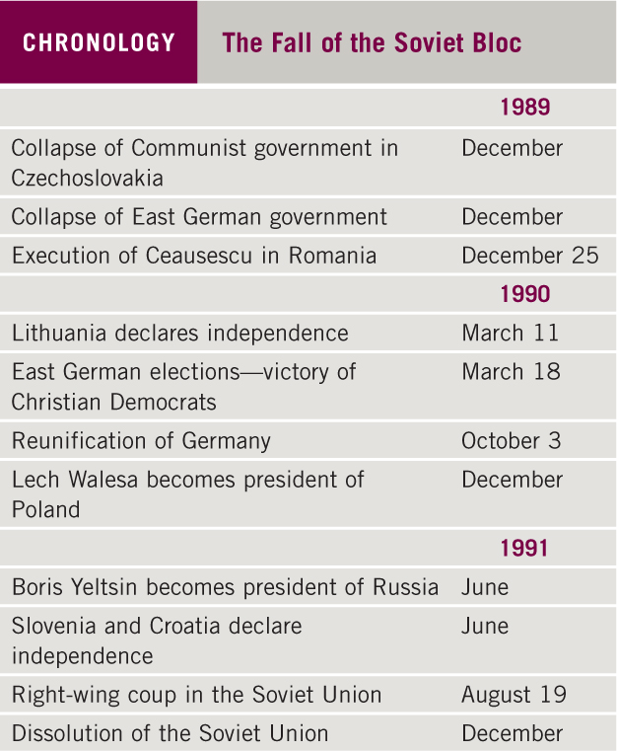
Chronology: The Fall of the Soviet Bloc

Slide 15
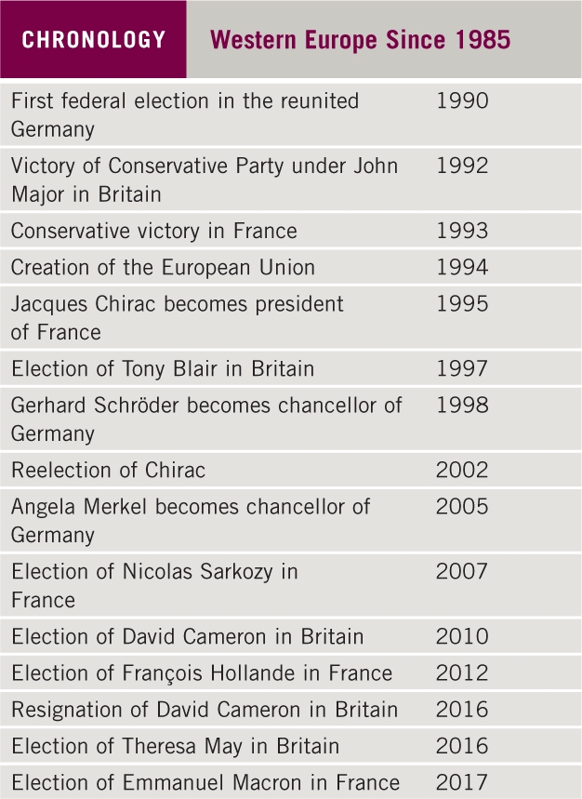
Chronology: Western Europe Since 1985

Slide 16
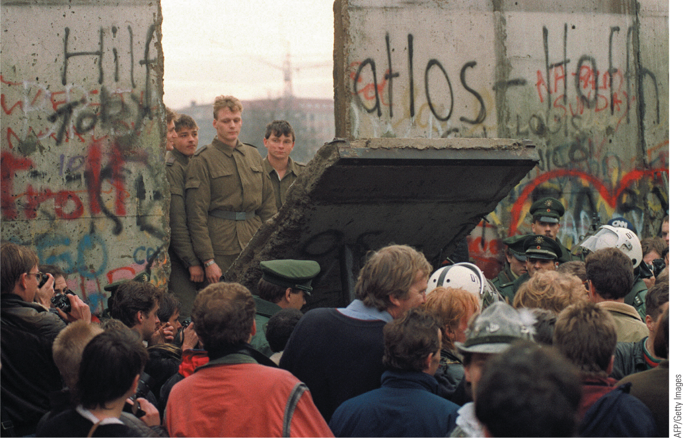
30.2 And the Wall Came Tumbling Down. The Berlin Wall became the site of massive celebrations after the East German government opened its border with the West.

Slide 17
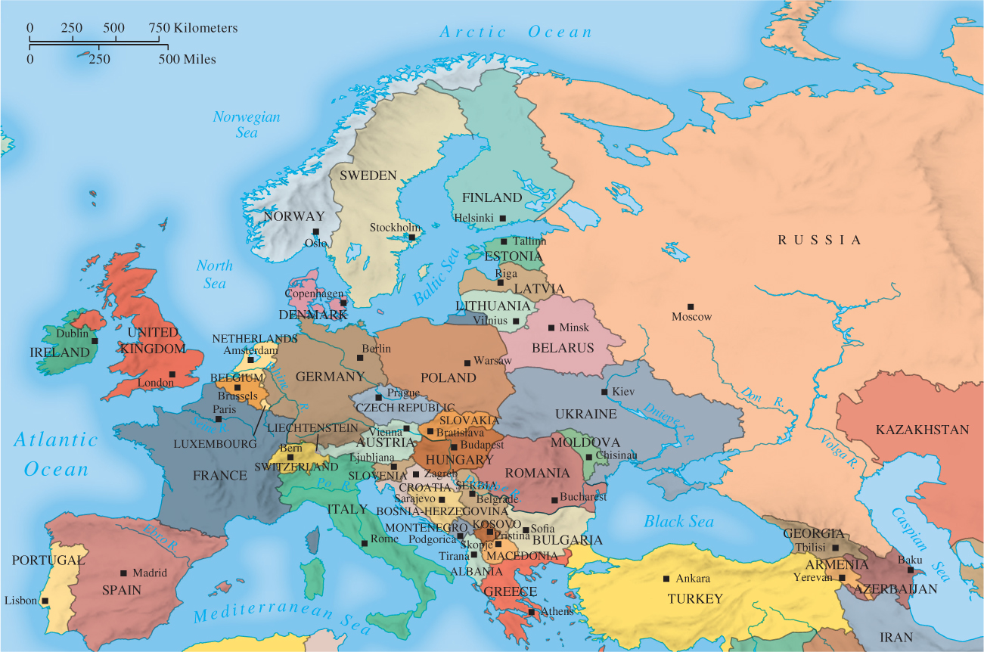
Map 30.1 The New Europe

Slide 18
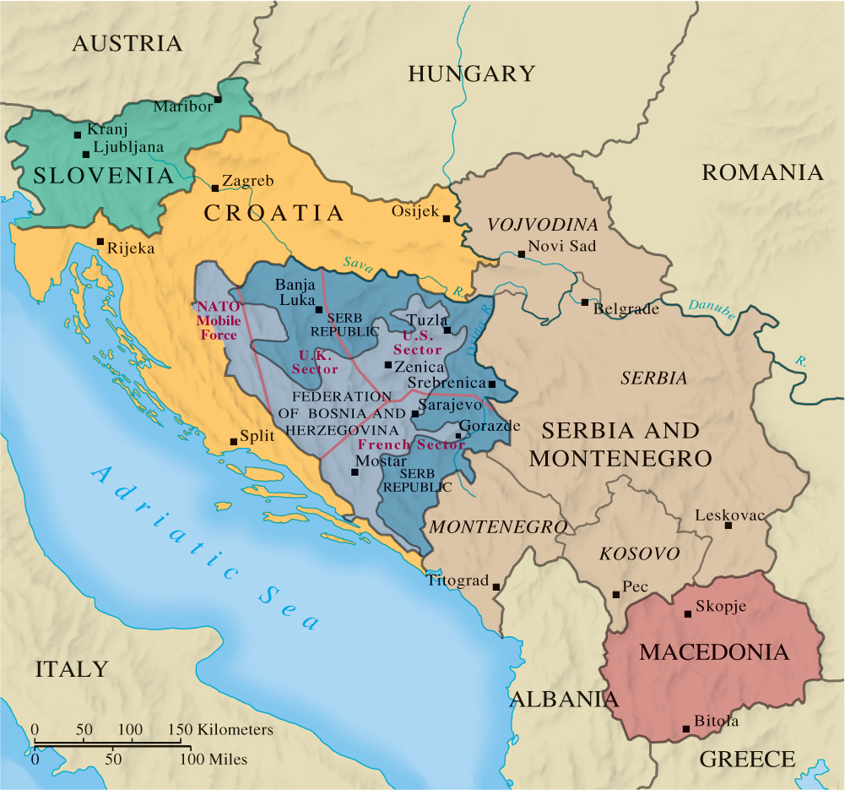
Map 30.2 The Lands of the Former Yugoslavia, 1995

Slide 19
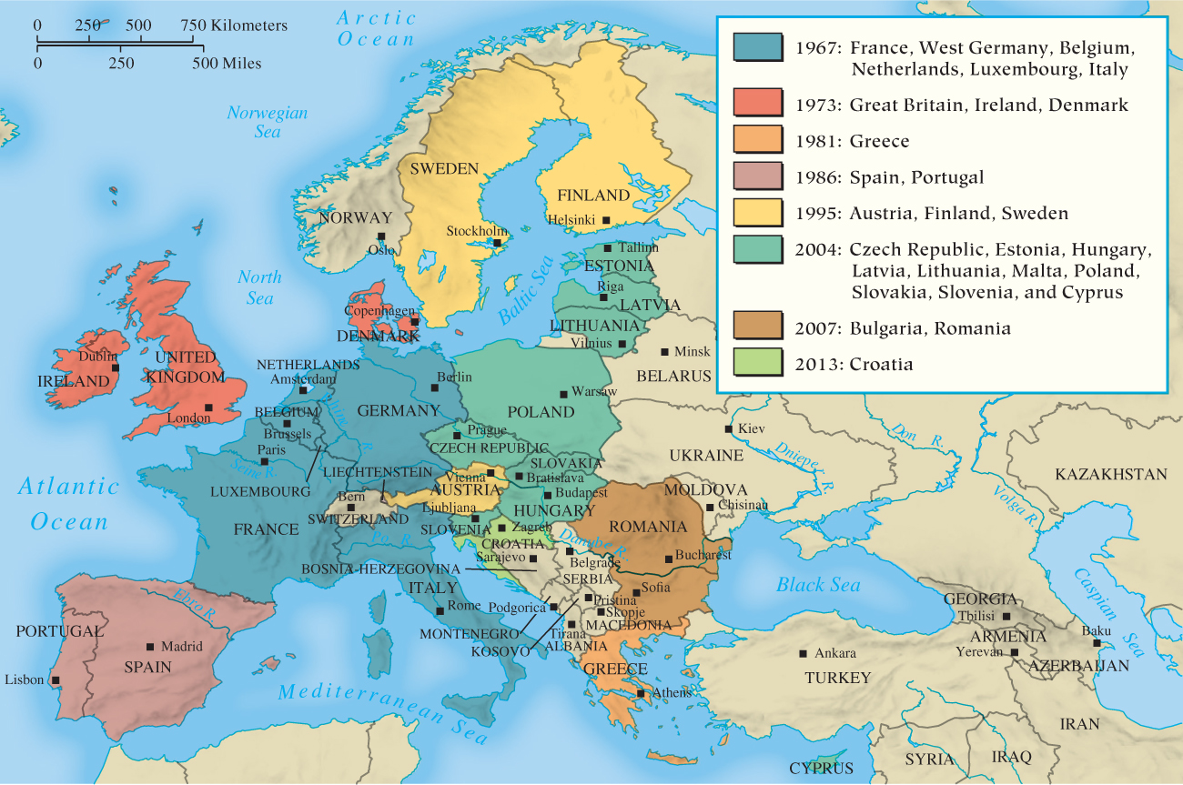
Map 30.3 European Union, 2013

Slide 20
30-2 After the cold war: New World Order or Age of Terrorism? (1 of 3)
Focus Questions: How and why did the Cold War end? What are the main issues in the struggle against terrorism?
The end of the Cold War
  Gorbachev’s arms limitation plan led to INF Treaty
  Postwar settlement unstuck in 1989 and 1990
    Persian Gulf War, 1990: first test of new relationship
  End of Soviet Union made superpower rivalry obsolete
An age of terrorism?
  Motivations for terrorist acts varied: left-wing groups, right-wing groups, militant nationalists

Slide 21
30-2 After the cold war: New World Order or Age of Terrorism? (2 of 3)
Terror attack on the United States
  Coordinated acts of terror in 2001 by al-Qaeda and Osama bin Laden (killed in 2011)
  War in Afghanistan
    Taliban-controlled centers targeted in 2001, multiethnic government installed; U.S. troops withdrew in 2014
  War in Iraq
    Iraqi leader Saddam Hussein charged with aiding bin Laden and developing “weapons of mass destruction”
    Invasion in 2003: Iraqis defeated
    Establishment of new government proved difficult: differences among major groups in Iraqi society—Shi’ite Muslims, Sunni Muslims, and ethnic Kurds

Slide 22
30-2 After the cold war: New World Order or Age of Terrorism? (3 of 3)
The West and Islam
  Anti-Western feeling inflamed by ongoing Israel-Palestinian conflict, U.S. liberation of Kuwait, and invasion of Iraq
  Terrorism as global war
    Al-Qaeda’s merger with other jihadist groups: formation of the Islamic State of Iraq and al-Sham or Syria (ISIS, or ISIL)
    ISIL’s responsibility for terrorist attacks in Paris and other cities

Slide 23
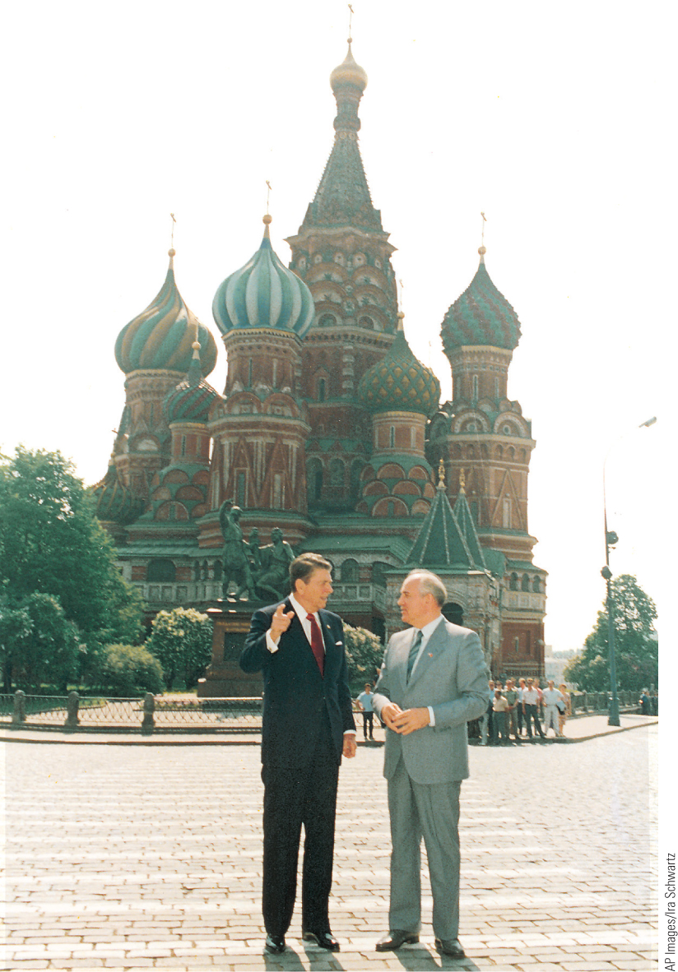
30.3 Reagan and Gorbachev. The willingness of the two leaders to slow the arms race helped end the Cold War confrontation between the U.S. and the Soviet Union. This picture was taken during Reagan’s visit to Moscow in 1988.

Slide 24
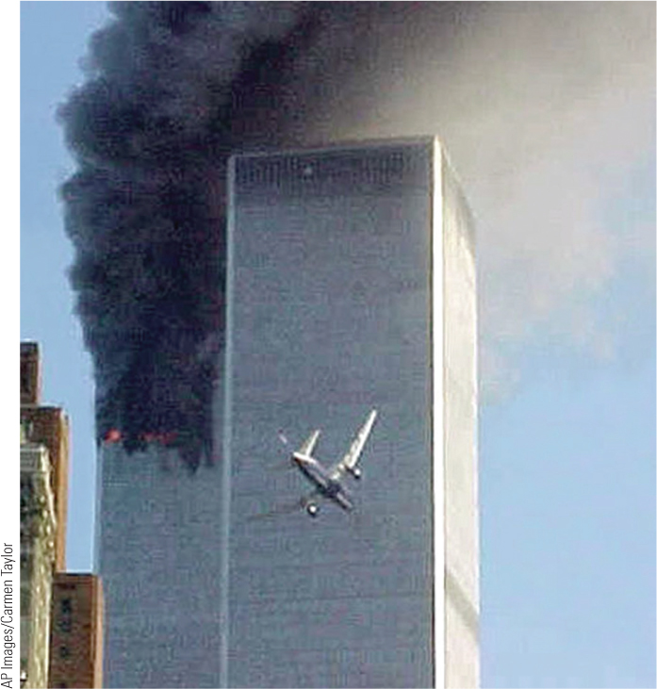
30.4 Terrorist Attack on the World Trade Center in New York City. On September 11, 2001, hijackers flew two commercial jetliners into the World Trade Center.

Slide 25
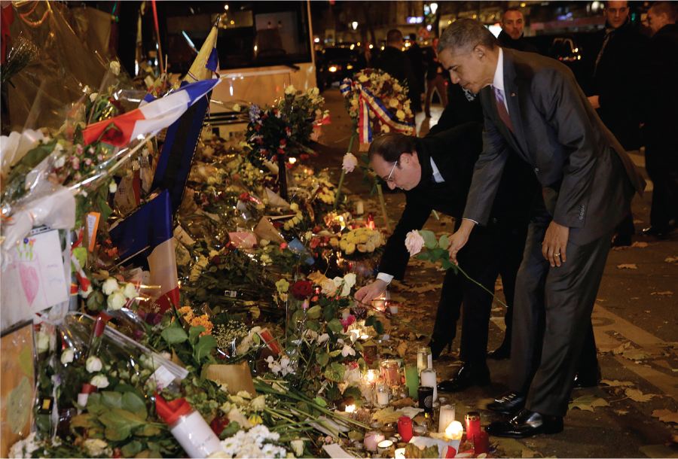
30.5 Paris Terrorist Attacks. U.S. President Barack Obama (on the right) pays tribute to the victims of the Paris attacks in November 2015 with French president François Hollande.

Slide 26
30-3 New Directions and New Problems in Western Society (1 of 2)
Focus Questions: What are the major developments in the women’s movement since 1985? What problems have immigrants created for European society?
Transformation in women’s lives
  Declining birthrates and increase of women in the workforce
    Economic inequality often prevailed
The Women’s Movement
  European women worked to repeal contraception and abortion laws in the 1960s and 1970s
  Women’s activities
    Protested nuclear missiles and joined the ecological movement
    UN women’s conferences to change conditions of women’s lives
    Women’s March in 2017 in Washington, D.C., and around the world

Slide 27
30-3 New Directions and New Problems in Western Society (2 of 2)
Guest workers and immigrants
  Massive influx of workers and refugees strained social services of European countries and stirred antiforeign sentiment
    Proposed EU quota system rejected
    Anti-immigrant parties reemerged at the fore of European politics following migration crises in 2015

Slide 28
30-4 Western Culture Today (1 of 3)
Focus Question: What major Western cultural trends have emerged since 1985?
Varieties of religious life
  The growth of Islam
    Fundamentalism in Islam referred to a return to traditional Islamic values in opposition to Western influence
    Islam has continued to grow in both Europe and U.S.
  Pope John Paul II and the Catholic Church
    Catholic Church dominated by Pope John Paul II in the 1980s and 1990s; reasserted traditional Catholic teaching
    March 13, 2013: Pope Francis elected; first non-European since eighth century and first Latin American

Slide 29
30-4 Western Culture Today (2 of 3)
The digital age
  The technological world
    The advent of electronic mail and the growth of the Internet
    Advances in communication: cellular phones, smartphones, GPS tracking, and social media
Art in the contemporary world
  Transformed by developments in technology and finance
  Impact of Postmodernism: Neo-Expressionism
    Exploration of multiculturalism
    Installation as the most “contemporary” form of art

Slide 30
30-4 Western Culture Today (3 of 3)
Music since 1985
  Digital technology sparked exploration with synthesizers and electronic instruments
  “Grunge” music in the 1990s reflected disenchantment
  Popularity of hip-hop and rap
  Computer technology (iTunes, Spotify) has made music more fragmented yet accessible

Slide 31
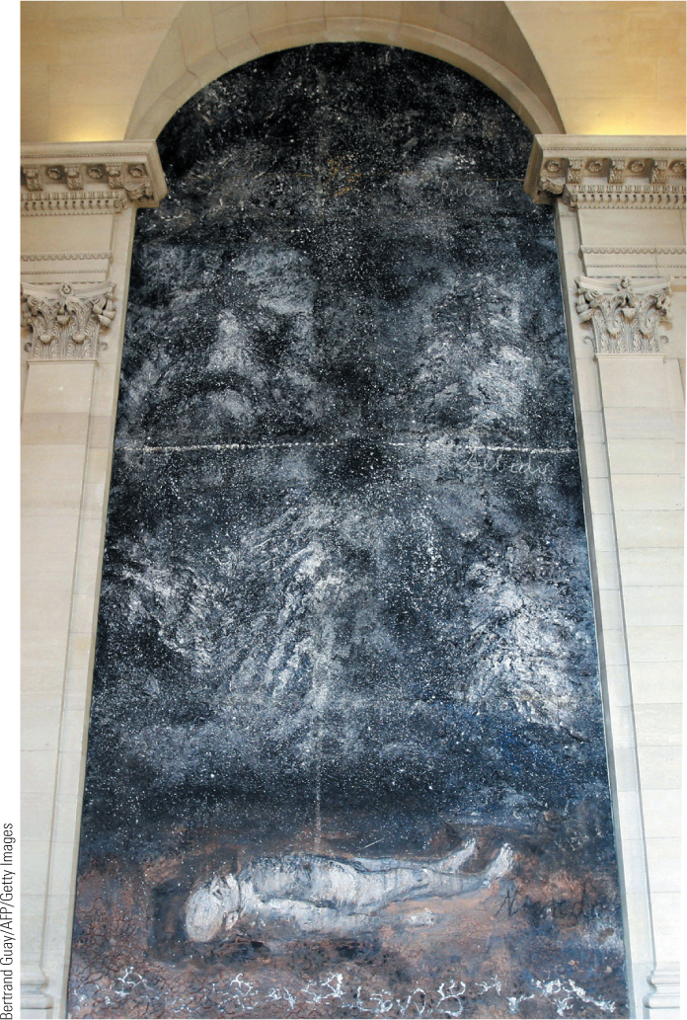
30.6 Anselm Kiefer, Athanor (2007). Kiefer painted this monumental work (30 feet by 15 feet) on the wall of a stairwell in the Louvre Museum in Paris.

Slide 32
30-5 Toward a Global Civilization (1 of 2)
Focus Question: What is globalization, and what are its main characteristics in the twenty-first century?
Globalization: process by which people and nations have become more interdependent
The global economy
  International institutions
    World Bank and the International Monetary Fund (IMF)
    The multinational corporation or transnational corporation
  The end of excess?
    Global crisis after 2007
    European Central Bank and IMF created European Financial Stability Facility to provide recapitalization; austerity measures

Slide 33
30-5 Toward a Global Civilization (2 of 2)
Globalization and the environmental crisis
  Problems of population growth
  Global warming: greenhouse effect
    The Paris Accord in 2015; pledges to cut greenhouse gas emissions; removal of U.S. in 2017
The social challenges of globalization
  Challenges of migration
  Gap between developed nations and developing nations
New global movements and new hopes
  Grassroots social movements and nongovernmental organizations
  Continued political, ethnic, and religious disputes

Slide 34
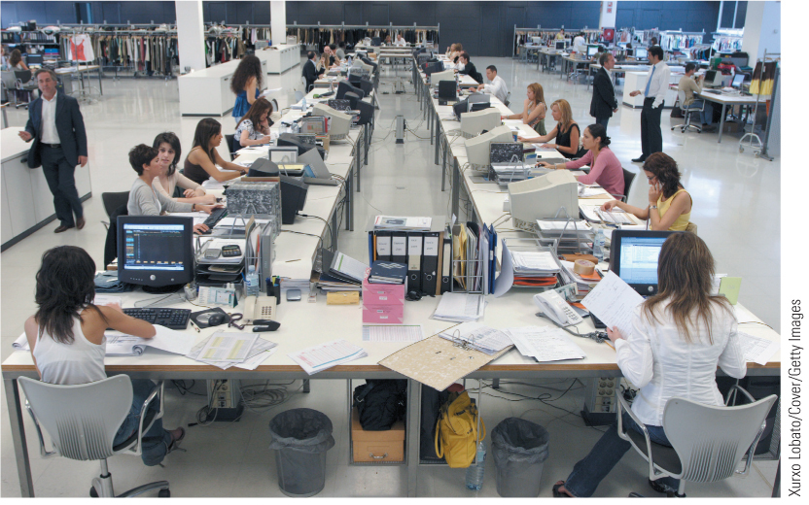
30.8a Zara Factory. Fashionable global clothing brand Zara makes 840 million garments a year and has around 5,900 stores in eighty-five countries.

Slide 35
Chapter 30 Summary
Following the reforms of Mikhail Gorbachev, a wave of revolution swept through eastern Europe as communist regimes were overthrown and a new, mostly democratic order emerged.
Although many people were optimistic about a new world order after the collapse of communism, uncertainties still prevailed, leading to violence and repression.
The arrival of many foreigners, especially in western Europe, not only strained the social services of European countries but also led to antiforeign sentiment and right-wing political parties.
Terrorism, especially that carried out by some parts of the Muslim world, emerged as a threat to many Western states.
Nations and peoples have become more interdependent, and many Westerners recognize that a global perspective must also now become a part of the Western tradition.

Slide 36
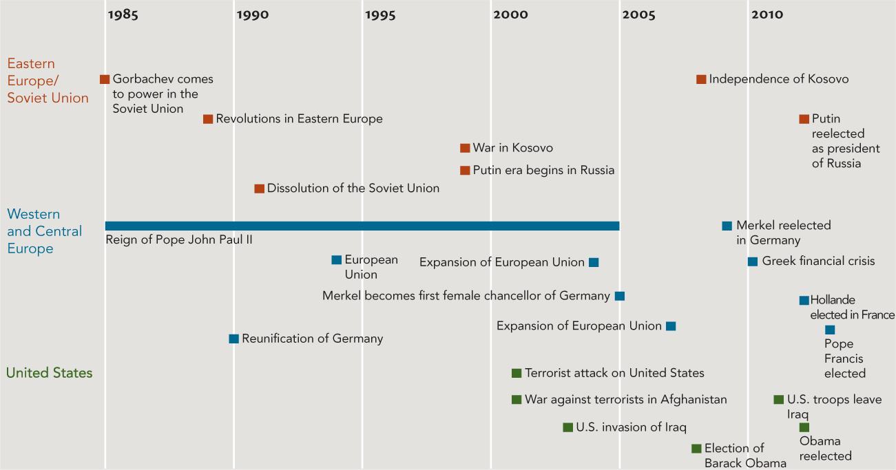
Chapter 30 Timeline

