Slide 1
WESTERN CIVILIZATION: A Brief History
Tenth Edition
CHAPTER 29
Protest and Stagnation: The Western World,
1965–1985
© 2020 Cengage. All rights reserved.

Slide 2
Chapter 29 Outline
29-1 A Culture of Protest
29-2 A Divided Western World
29-3 The Cold War: The Move to Détente
29-4 Society and Culture in the Western World

Slide 3
29-1 A Culture of Protest (1 of 3)
Focus Questions: What were the goals of the revolt in sexual mores, the youth protests and student revolts, the feminist movement, and the antiwar protests? To what extent were their goals achieved?
A revolt in sexual mores
  Society of postwar Europe dubbed permissive society
    Sweden led sexual revolution with sex education in schools and decriminalization of homosexuality
  Gay rights movement began in California and spread to France, Italy, and Britain
  New standards: birth control, increased divorce rates, and increased premarital and extramarital sexual experience

Slide 4
29-1 A Culture of Protest (2 of 3)
Youth protest and student revolt
  Drug culture emerged in 1960s
    Marijuana for recreational use; hallucinogenic experiences
  Youth rebellion was a full-fledged protest movement by second half of the 1960s
    Spurred on by opposition to Vietnam War and growing political consciousness
  Greater equality of opportunity in higher education, with dramatic growth in enrollments and tensions
    Student radicalism sparked by desire for reform, the Vietnam War, materialism, the impersonal modern world

Slide 5
29-1 A Culture of Protest (3 of 3)
The feminist movement
  Women began to assert rights during late 1960s as feminism, or the women’s liberation movement, took hold
  Betty Friedan was an important contributor
    Published The Feminine Mystique, 1963
    Founded National Organization for Women (NOW), 1966
Antiwar protests
  Protests broke out in 1968 against the Vietnam War in universities in Italy, France, and Britain
  Antiwar protests divided the American people as war dragged on
    Military draft ensued and protests escalated
    Four student protesters killed at Kent State University by Ohio National Guard in 1970

Slide 6
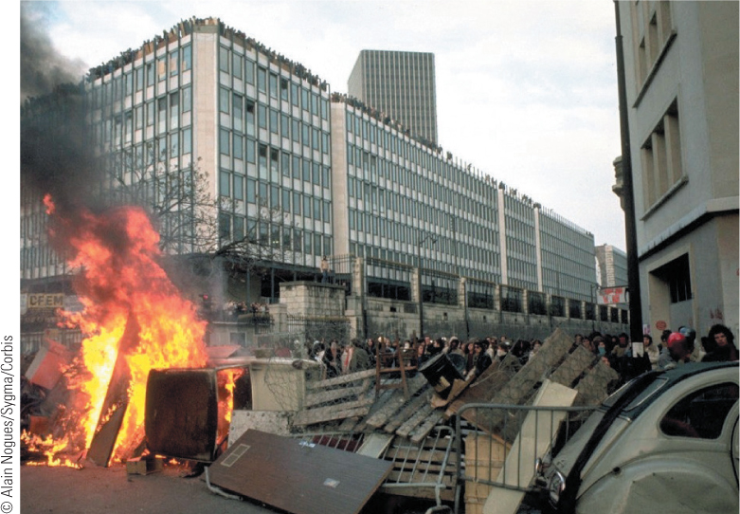
29.1 Barricades in Paris, 1968. In May 1968 student protests led to the building of barricades in the streets of Paris and violence.

Slide 7
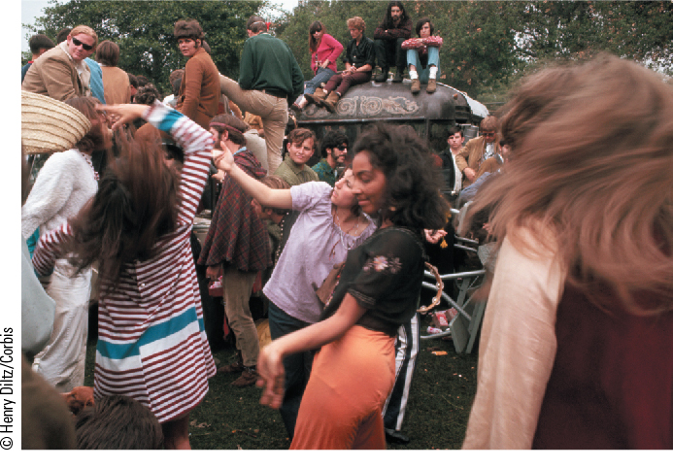
29.2b Youth Culture in the 1960s. Shown here are dozens of hippies dancing around a decorated bus at a “love-in” during the Summer of Love, 1967.

Slide 8
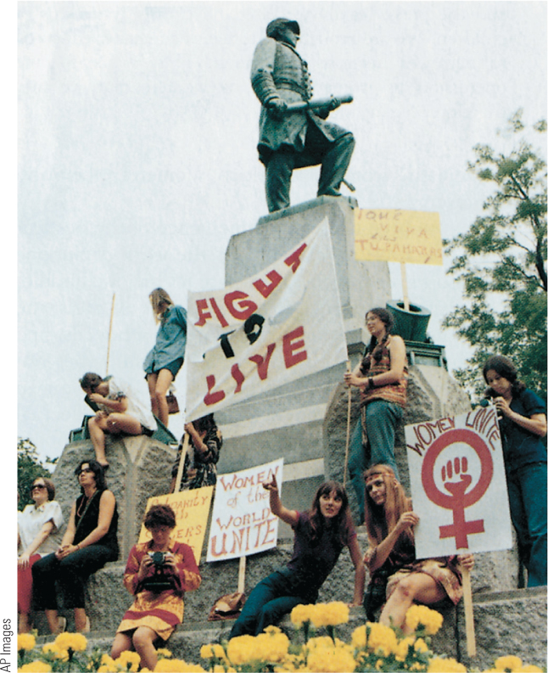
29.3 The Women’s Liberation Movement. In the late 1960s, as women began once again to assert their rights, a revived women’s liberation movement emerged.

Slide 9
29-2 A Divided Western World (1 of 7)
Focus Question: What were the major political developments in the Soviet Union, eastern Europe, western Europe, and the United States between 1965 and 1985?
Stagnation in the Soviet Union
  The Brezhnev Years
    The Brezhnev Doctrine: right of the Soviet Union to intervene if socialism threatened
    The benefits of détente
    Emphasis on heavy industry but problems of central planning and apathy
    Immense privileges of party and state leaders
    Emergence of reformers

Slide 10
29-2 A Divided Western World (2 of 7)
Conformity in Eastern Europe
  In Poland, Lech Walesa led independent labor movement called Solidarity
    Walesa and other leaders arrested in 1981; union outlawed; military rule imposed
  Hungary, under János Kádár, enacted far reaching reforms
  The Prague Spring
    After resignation of Antonín Novotný, reformer Alexander Dubček elected first secretary of Communist Party
    Red Army invaded to forestall “spring” fever and crushed reform

Slide 11
29-2 A Divided Western World (3 of 7)
Conformity in Eastern Europe
  Repression in East Germany and Romania
    Building of the Berlin Wall, 1961, and the strength of the East German economy
    The control of East Germany by party hardliner Erich Honecker
    By 1948, Communist People’s Democratic Front controlled Romania
    Nicolae Ceauşescu became Romania’s leader in 1965: ruled with iron grip and used secret police—the Securitate—as personal weapon against dissent

Slide 12
29-2 A Divided Western World (4 of 7)
Western Europe: the winds of change
  West Germany
    Social Democratic Chancellor Brandt: “opening toward the east”
    Schmidt: elimination of debt but collapse of coalition
  Great Britain: Thatcher and Thatcherism
    Troubles in Northern Ireland and economy difficulties plagued Conservatives and Labour
    Thatcher’s economic policies improved economy but at a price: high unemployment, poverty, and cutbacks in education
    Thatcher’s hardline approach to communism: military buildup and the conflict in the Falkland Islands

Slide 13
29-2 A Divided Western World (5 of 7)
Western Europe: the winds of change
  Uncertainties in France
    Mitterand: the failure of radical Socialist reform and privatization
The European Community
  Continued integration: the addition of new states to the European Community (EC) and the formation of a common front

Slide 14
29-2 A Divided Western World (6 of 7)
The United States: turmoil and tranquility
  The Nixon presidency: the end of U.S. involvement in Vietnam; Watergate and resignation
  Economic problems
    Stagflation stemming from OPEC oil embargo
    Iran hostage crisis and Carter’s defeat
  The Reagan Revolution
    Reversal of spending on social welfare and increased military buildup
    “Supply side” economics and tax cuts for the wealthy
    Government debt soared

Slide 15
29-2 A Divided Western World (7 of 7)
Canada
  Economic recession returned Liberals to power, 1963
  Pierre Trudeau came to power in 1968
    Passed Official Languages Act—both English and French allowed in federal civil service
  Economic recession and Trudeau’s unpopular use of federal governmental power brought Brian Mulroney and the Progressive Conservative Party to power in 1984

Slide 16
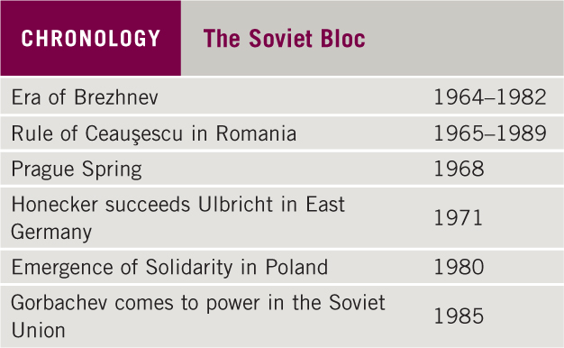
Chronology: The Soviet Bloc

Slide 17
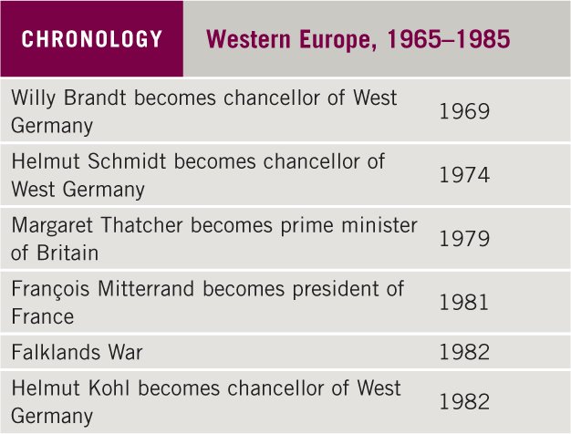
Chronology: Western Europe, 1965–1985

Slide 18
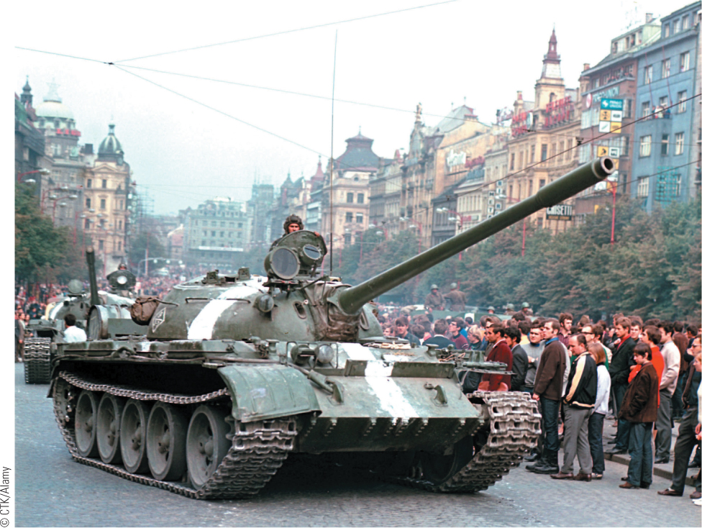
29.4 Soviet Invasion of Czechoslovakia, 1968. The attempt of Alexander Dubček to liberalize Communist rule failed when Soviet troops crushed the reform movement.

Slide 19
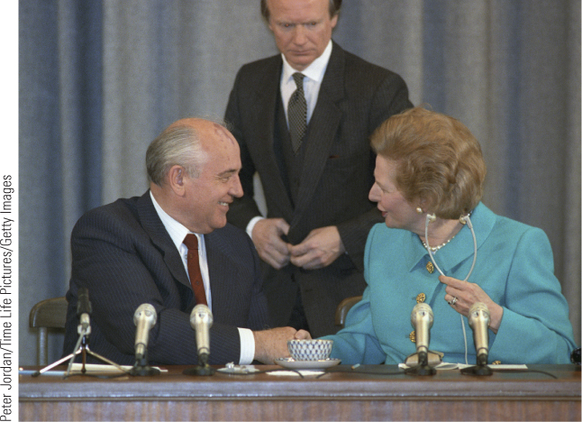
29.5 Margaret Thatcher. Great Britain’s first female prime minister, Margaret Thatcher was a strong leader who dominated British politics in the 1980s.

Slide 20
29-3 The Cold War: The Move to DÉTENTE (1 of 3)
Focus Question: What were the main events in the Cold War between 1965 and 1985, and how important was the role of détente in those events?
The Vietnam War
  Johnson increased American troops in Vietnam to avoid domino theory spread of communism
  U.S. troops, superior in equipment and firepower, failed to prevail against Vietcong guerrilla forces
  Nixon withdrew troops in 1973; Communists from North forcibly united Vietnam
  Domino theory proved unfounded; emergence of détente

Slide 21
29-3 The Cold War: The Move to DÉTENTE (2 of 3)
China and the Cold War
  The Great Proletarian Cultural Revolution
    1966–1976: Mao’s Red Guards set out to eliminate old ideas, old culture, old customs, and old habits; temples, books written by foreigners, and jazz records destroyed
    Practical-minded reformers seized power after Mao’s death
  U.S.-China relations
    Nixon’s visit, 1972, and establishment of diplomatic ties in 1979

Slide 22
29-3 The Cold War: The Move to DÉTENTE (3 of 3)
The practice of détente
  1972: Antiballistic Missile Treaty signed limiting systems for launching antiballistic missiles
  1975: Helsinki Accords: recognized all borders established in Europe since end of World War II and protected human rights of citizens
The limits of détente
  Soviet invasion of Afghanistan, 1979, hardened relations
  Carter cancelled U.S. participation in 1980 Olympic games in Moscow and placed embargo on shipments of U.S. grain to the Soviet Union
  Reagan stimulated a renewed arms race

Slide 23
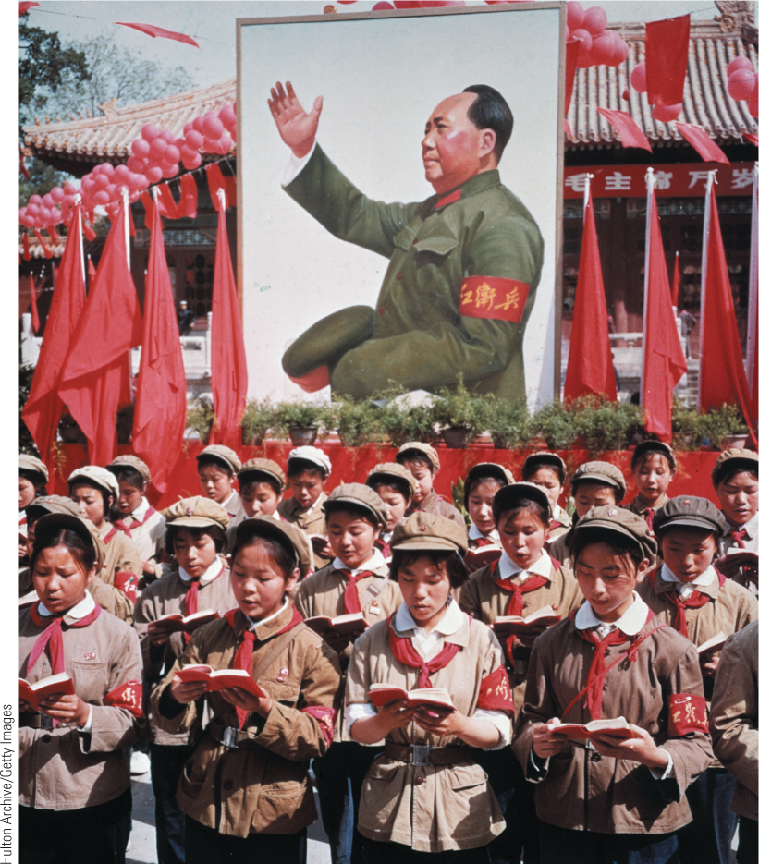
29.6 The Great Proletarian Revolution. Shown here is a group of Chinese children in uniform holding Mao’s Little Red Book during the Cultural Revolution in 1968.

Slide 24
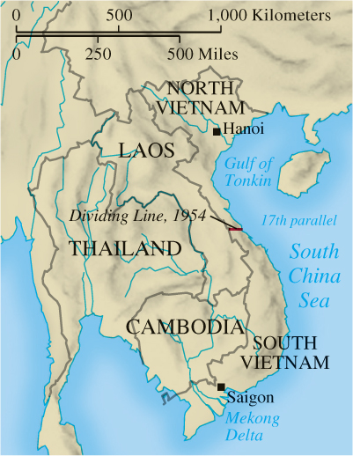
Map 29.1 Southeast Asia at the Time of the Vietnam War

Slide 25
29-4 Society and Culture in the Western World (1 of 5)
Focus Question: What were the major social and cultural developments in the Western world between 1965 and 1985?
The world of science and technology
  The computer: possibly most revolutionary technological invention of twentieth century
    Invention of the microprocessor
  Dangers of science and technology
    Chemical fertilizers wreaked havoc with ecological balance of streams, rivers, and woodlands

Slide 26
29-4 Society and Culture in the Western World (2 of 5)
The environment and the Green movements
  By 1970s, serious ecological problems became apparent
  Chernobyl nuclear disaster in 1986 and other Eastern European environmental destruction led to Green movement
    Increasing political success of Green movements and parties
    Increased government sponsorship of projects to safeguard the environment

Slide 27
29-4 Society and Culture in the Western World (3 of 5)
Postmodern thought
  Postmodernism: rejection of belief in objective truth
  Study of language and signs
    Derrida and poststructuralism, or deconstruction: culture as created and therefore able to be analyzed
    Foucault’s exploration of power as exercised rather than possessed

Slide 28
29-4 Society and Culture in the Western World (4 of 5)
Trends in art, literature, and music
  Art
    Rejection of object-based artwork and eclectic mix of past tradition and Modernist innovation
  Literature
    European Postmodernism is well represented by Czech writer Milan Kundera’s The Unbearable Lightness of Being: blending fantasy with realism
  Music
    Focus on variety and radical experimentation: serialism and minimalism

Slide 29
29-4 Society and Culture in the Western World (5 of 5)
Popular culture: image and globalization
  Golden age of rock music, 1967–1973
    Some focus on social issues
  MTV radically changed the music scene in the 1980s
  Development of rap and hip-hop
    Hip-hop encompassed breakdancing, graffiti art, and fashion
    Rap groups Public Enemy and Grandmaster Flash instilled social commentary into songs
  The growth of mass sports
    Sports became major product of both popular culture and leisure industry
    Satellite TV made sports a global phenomenon
    Olympics became funded primarily by television sponsors

Slide 30

29.7 Robert Smithson, Spiral Jetty. Earthworks like Spiral Jetty increased in number as concern for the welfare of the world’s ecosystems grew in the 1960s and 1970s.

Slide 31
Chapter 29 Summary
The late 1960s experienced a rash of protest movements, from the sexual revolution to the youth movement to the women’s movement.
In the 1970s, the Cold War took a new direction known as détente as the Soviet Union and the United States moved toward a lessening of tensions, although tensions were renewed in the 1980s.
Between 1965 and 1985, the Western world remained divided between a prosperous capitalistic and democratic West and a stagnant, politically repressed eastern Europe.
Dramatic social and cultural developments accompanied political and economic changes after 1965.

Slide 32
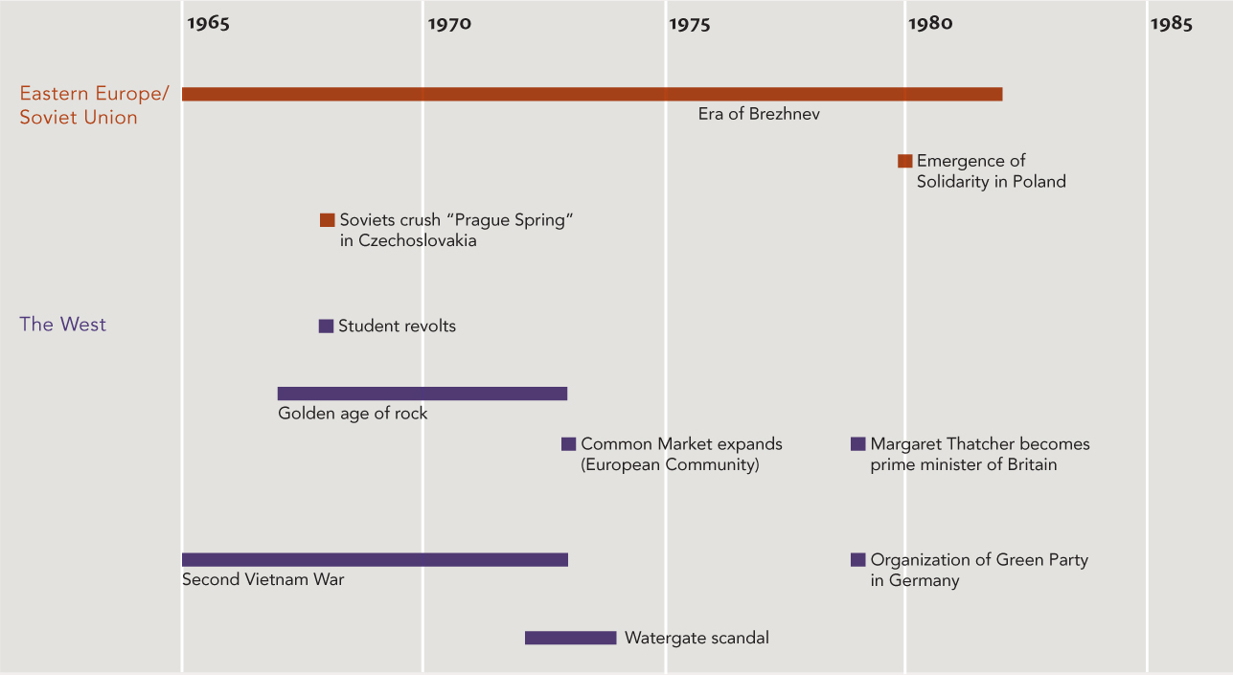
Chapter 29 Timeline

