Slide 1
WESTERN CIVILIZATION: A Brief History
Tenth Edition
CHAPTER 28
Cold War and a New Western World,
1945–1965
© 2020 Cengage. All rights reserved.

Slide 2
Chapter 28 Outline
28-1 Development of the Cold War
28-2 Europe and the World: Decolonization
28-3 Recovery and Renewal in Europe
28-4 The United States and Canada: A New Era
28-5 Postwar Society and Culture in the Western World

Slide 3
28-1 Development of the Cold War (1 of 6)
Focus Questions: Why were the United States and the Soviet Union suspicious of each other after World War II, and what events between 1945 and 1949 heightened the tensions between the two nations? How and why did the Cold War become a global affair after 1949?
Confrontation of the superpowers: who started the Cold War?
  Historians’ debate
    Scholars from the 1950s believed Stalin’s plans for eastern Europe justified Western fears
    Scholars from the 1960s argued Truman and his anti-communist advisors were to blame
    Recent scholars noted that both powers acted unwisely

Slide 4
28-1 Development of the Cold War (2 of 6)
Confrontation of the superpowers: who started the Cold War?
  The Truman Doctrine
    United States to provide money to countries threatened by communist expansion
    Marshall Plan to rebuild prosperity and stability in Europe
  Containment
    By 1948, containment of the Soviet Union had become formal American policy

Slide 5
28-1 Development of the Cold War (3 of 6)
Confrontation of the superpowers: who started the Cold War?
  Contention over Germany
    Ulbricht and German Communist Party reconstructed Soviet Zone
    Western Allies merged zones; planned to unify sections by February 1948
    Soviets responded with a blockade of West Berlin, countered by the Berlin Air Lift
    1949: creation of the Federal Republic of Germany and the German Democratic Republic

Slide 6
28-1 Development of the Cold War (4 of 6)
Confrontation of the superpowers: who started the Cold War?
  New military alliances
    Search for security took form of mutual deterrence
    North Atlantic Treaty Organization (NATO) formed in 1949
    Eastern Europe responded with Warsaw Pact

Slide 7
28-1 Development of the Cold War (5 of 6)
Globalization of the Cold War
  The Korean War
    Invasion by Soviet-supported North Korea of U.S.-supported South Korea led to UN intervention
    China’s entry into the conflict led to the retreat of U.S. and South Korean troops
    Uneasy truce reached in 1953 that left Korea divided
  Escalation of the Cold War
    By mid-1950s, U.S. allied militarily with forty-two states around the world
    Death of Stalin led to talk of rapprochement
    New tensions over Berlin; the building of the Berlin Wall

Slide 8
28-1 Development of the Cold War (6 of 6)
Globalization of the Cold War
  The Cuban Missile Crisis
    American supported attempt to overthrow Castro’s Soviet-supported totalitarian regime in 1961 failed
    Soviets decided to station nuclear missiles in Cuba; U.S. responded with a blockade of Cuba
    The delay allowed for a search for a peaceful resolution and a reduction of tensions

Slide 9
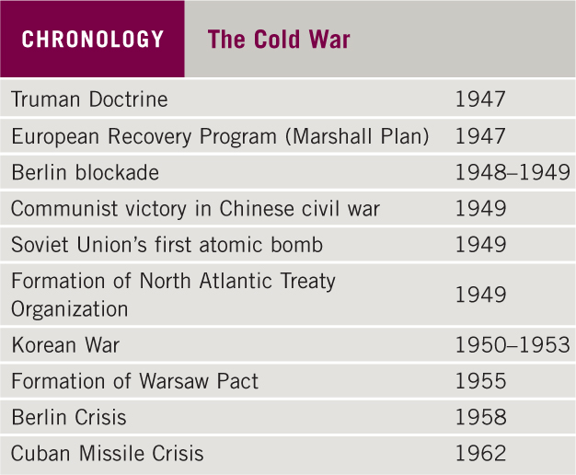
Chronology: The Cold War

Slide 10
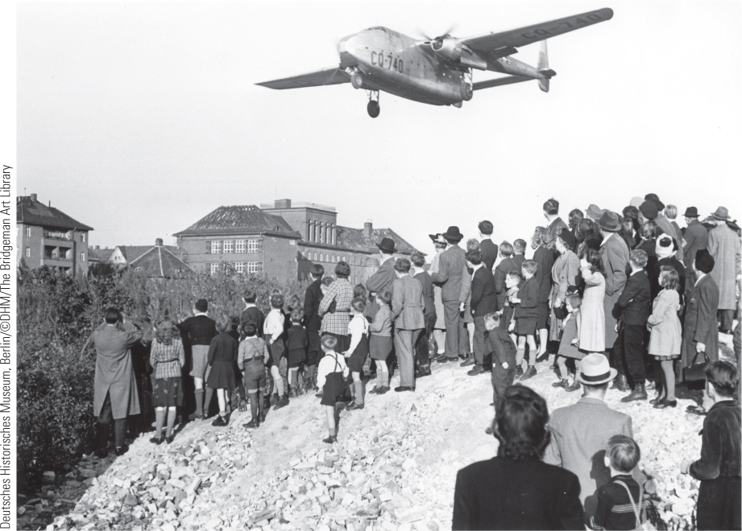
28.2 The Berlin Air Lift. During the Berlin Air Lift, the United States and its Western allies flew 13,000 tons of supplies daily to Berlin to break the Soviet blockade of the city.

Slide 11
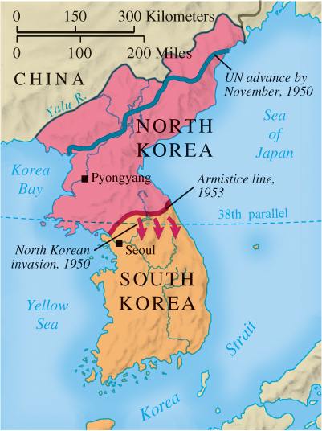
Map 28.1 The Korean War

Slide 12
28-2 Europe and the World: Decolonization
(1 of 3)
Focus Question: Why and how did the European colonies in Africa, the Middle East, and Asia gain independence between 1945 and 1965?
A rush of decolonization between 1947 and 1962
Africa: the struggle for independence
  Little done to prepare Africans for self-rule
  France granted Morocco and Tunisia full independence in 1956, but retained Algeria
    Conflict over Algeria, granted in independence in 1962
  Complicated transition in South Africa: apartheid
  Newly-independent nations faced severe challenges
    Religious and ethnic conflict

Slide 13
28-2 Europe and the World: Decolonization
(2 of 3)
Conflict in the Middle East
  Emergence of independent states after World War II
  Ideas of Arab unity led to the Arab League
  Tensions between Jews and Arabs
    Sympathy for a Jewish state in Palestine after the Holocaust
    U.S. support assisted the proclamation of Israel in 1948
    Growing Arab hostility and the threat to the security of Israel: formation of the Palestine Liberation Organization (PLO)
    Six-Day War in 1967 tripled the size of Israel but aroused even more hatred among the Arabs

Slide 14
28-2 Europe and the World: Decolonization
(3 of 3)
Asia: nationalism and Communism
  Britain’s creation of two states: India and Pakistan
  Independence for other areas
    French efforts in Indochina and turmoil in Vietnam
  China under Communism
    Nationalist and Communist governments failed to form a coalition, leading to full-scale war
    Communist victory and Nationalist flight to Taiwan
    Chairman Mao’s goal of building a socialist society: collectivization, nationalization, and the Great Leap Forward

Slide 15
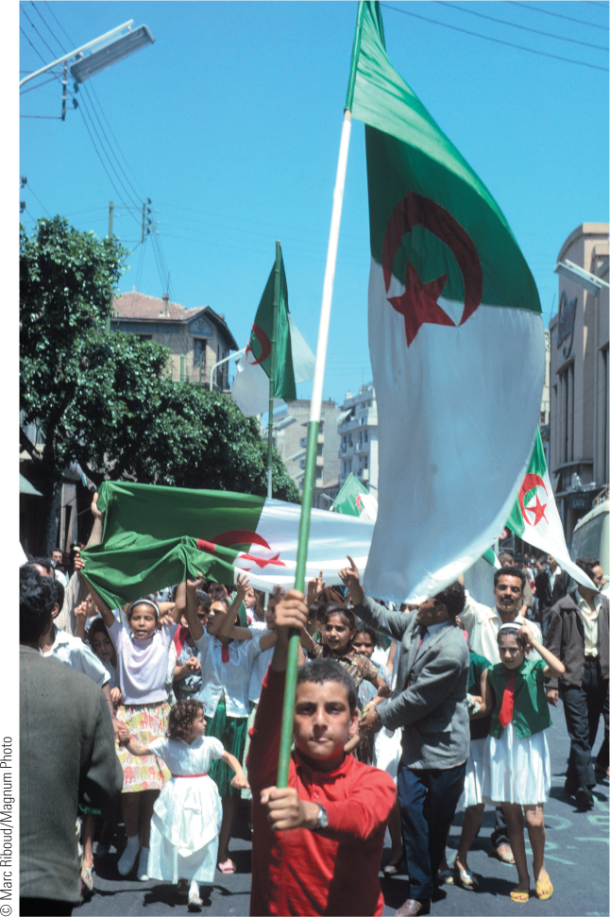
28.3 Algerian Independence. Although the French wanted to retain control of their Algerian colony, a bloody war of liberation finally led to Algeria’s freedom. This photograph shows a group of Algerians celebrating the announcement of independence on July 3, 1962.

Slide 16
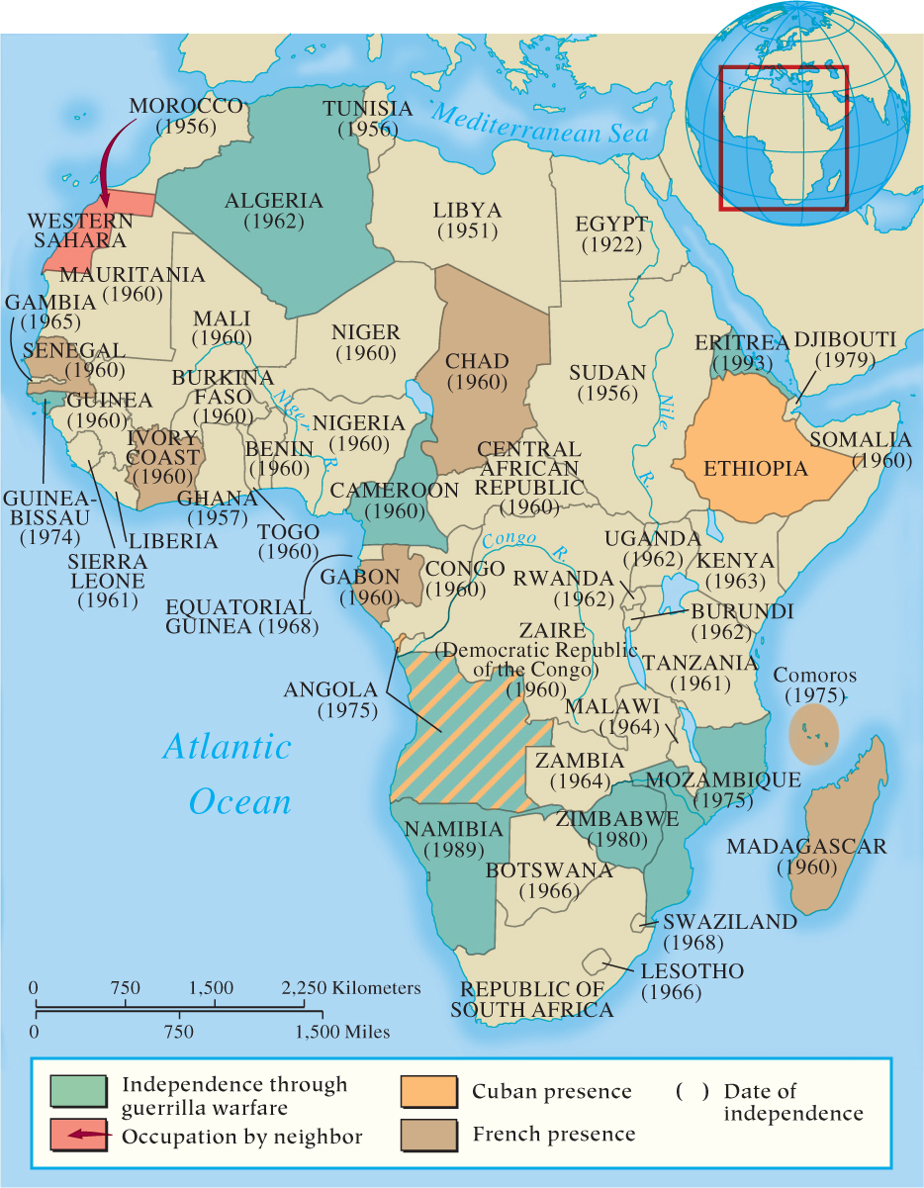
Map 28.2 Decolonization in Africa

Slide 17
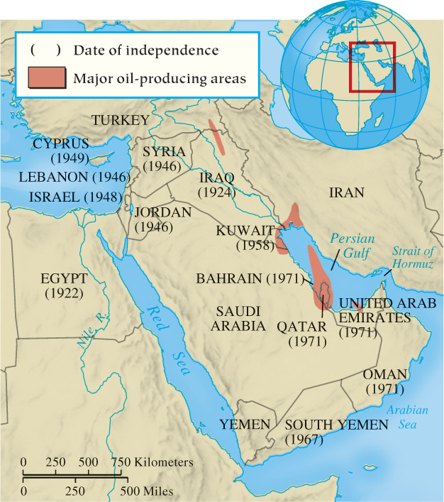
Map 28.3 Decolonization in the Middle East

Slide 18
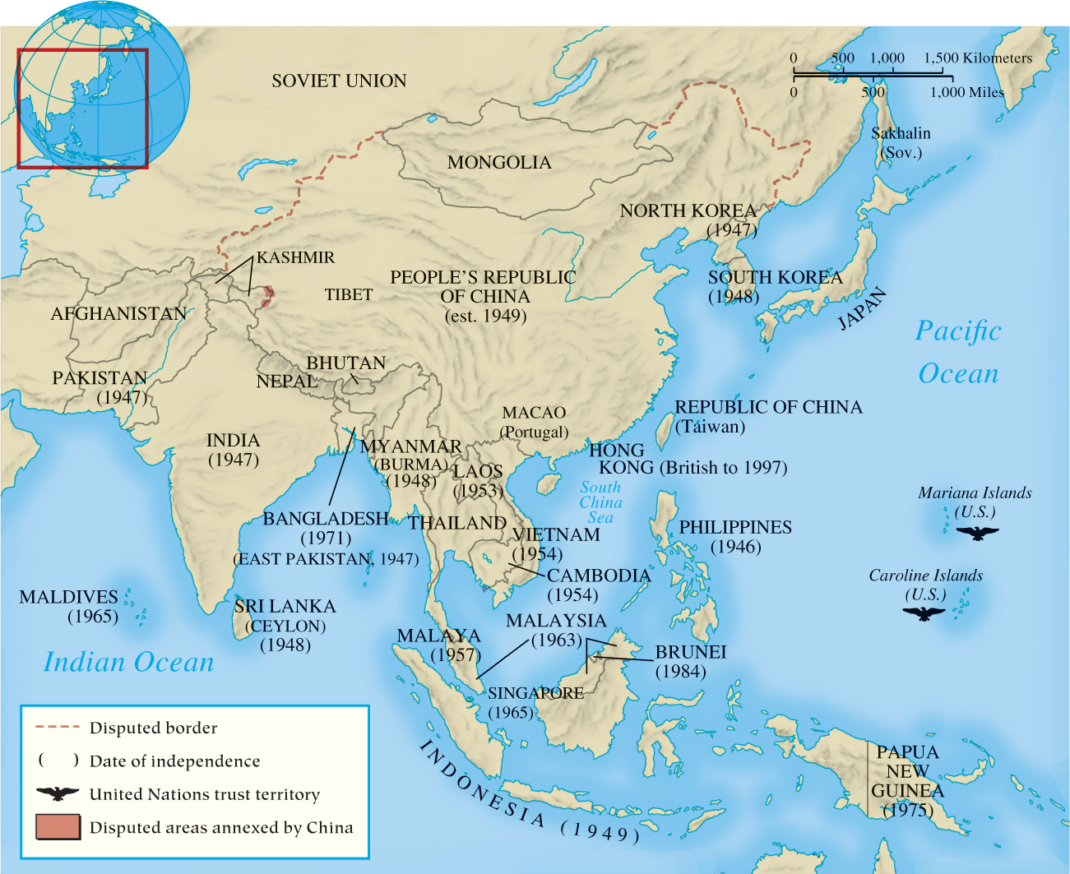
Map 28.4 Decolonization in Asia

Slide 19
28-3 Recovery and Renewal in Europe (1 of 6)
Focus Question: What were the main developments in the Soviet Union, eastern Europe, and western Europe between 1945 and 1965?
The Soviet Union Union: from Stalin to Khrushchev
  Stalin’s policies
    Industrial growth, removal of opposition, and prioritization of the military
  Khrushchev’s rule
    Condemnation of Stalin and de-Stalinization: reduction of powers of secret police and closing prison camps
    Attempt to emphasize light industry and consumer goods led to economic decline
    Foreign policy failures led to forced retirement

Slide 20
28-3 Recovery and Renewal in Europe (2 of 6)
Eastern Europe: behind the Iron Curtain
  One-party Communist governments entrenched in East Germany, Bulgaria, Romania, Poland, and Hungary by 1947; Czechoslovakia by 1948
    Albania and Yugoslavia were exceptions
  Stalinization in satellite states
  1956: Upheaval in Eastern Europe
    Worker protests in Poland; compromise with the Soviets
    Attempts to reform Hungary under Imre Nagy led to attack on Budapest and re-establishment of Soviet control, although many economic reforms saved

Slide 21
28-3 Recovery and Renewal in Europe (3 of 6)
Western Europe: the revival of democracy and the economy
  Impact of the Marshall Plan on dramatic economy recovery
  France: the domination of de Gaulle
    Troubles of the Fourth Republic, established postwar
    Charles De Gaulle’s increased control after the Algerian crisis and French defeat in Indochina; formation of the Fifth Republic, with increased presidential power
    Emphasis on centralizing the economy helped make France a major industrial producer but prompted unrest
    Increased dissatisfaction with de Gaulle’s policies led to protest in 1968 and resignation in 1969

Slide 22
28-3 Recovery and Renewal in Europe (4 of 6)
Western Europe: the revival of democracy and the economy
  West Germany: a nation reborn
    Leadership of Konrad Adenauer: rearmament, membership in NATO, and the resurrection of the Western German economy, assisted by guest workers
    Denazification of West Germany and war crimes trials
    Economic downturn of the mid-1960s opened the door to the rise of the Social Democrats

Slide 23
28-3 Recovery and Renewal in Europe (5 of 6)
Western Europe: the revival of democracy and the economy
  Great Britain: the welfare state
    Labour, under Clement Atlee, promised far-reaching reforms that created a welfare state
    Nationalization of Bank of England, coal and steel industries, public transportation, and public utilities
    National Insurance Act
    National Health Service Act: the creation of socialized medicine
    Dismantling the British Empire and reduction of Britain’s ability to play the role of a world power

Slide 24
28-3 Recovery and Renewal in Europe (6 of 6)
Western Europe: the move toward unity
  Formation of the European Coal and Steel Community (ECSC), 1951
    Created common market for coal and steel by eliminating tariffs and other trade barriers
  Treaty of Rome created the European Economic Community (EEC), 1957
    Eliminated customs barriers and provided large free-trade area

Slide 25
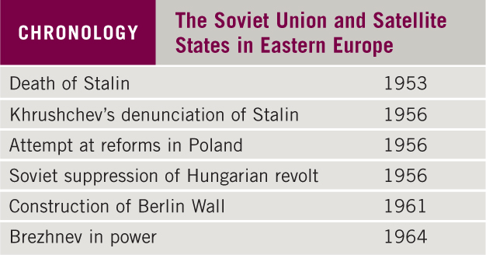
Chronology: The Soviet Union and Satellite States in Eastern Europe

Slide 26
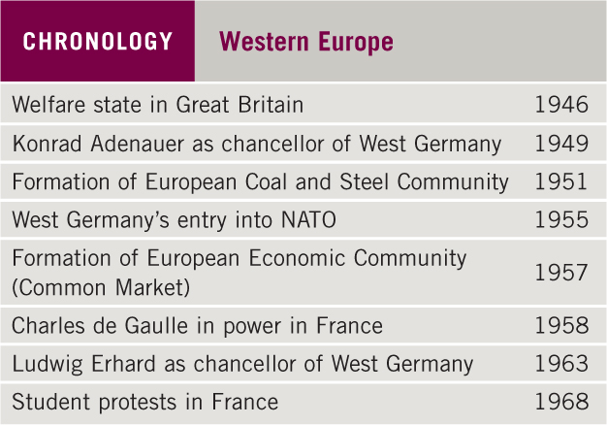
Chronology: Western Europe

Slide 27
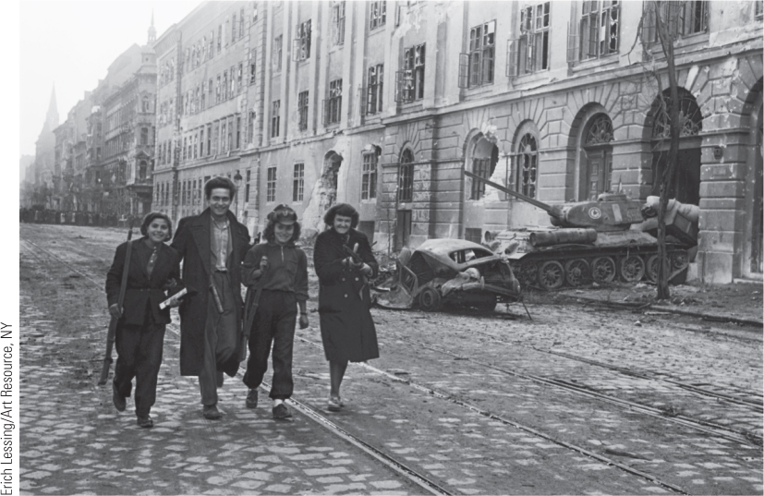
28.4 Hungarian Revolt. This image shows young fighters walking with their weapons away from the Kilian barracks in the background during the Hungarian Revolution.

Slide 28
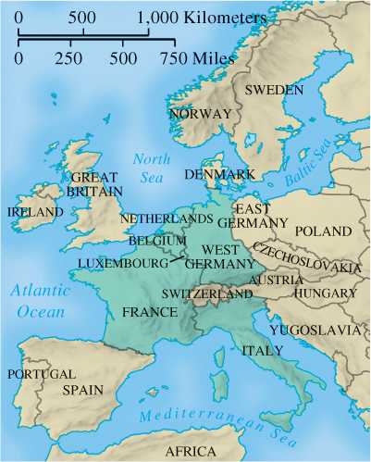
Map 28.5 European Economic Community, 1957

Slide 29
28-4 The United States and Canada: a new Era
(1 of 3)
Focus Question: What were the main political developments in North America between 1945 and 1965?
American politics and society in the 1950s
  New Deal largely determined patterns of domestic politics
  Economic boom after World War II fueled confidence in American way of life
  Cold War repercussions: censure by Congress ended McCarthy’s “Red Scare” in 1954
An age of upheaval: America in the 1960s
  The civil rights movement

Slide 30
28-4 The United States and Canada: a new Era
(2 of 3)
An age of upheaval: America in the 1960s
  The Kennedy presidency: focus on foreign affairs
  Johnson’s Great Society: health care for elderly, “war on poverty,” Department of Housing and Urban Development, and federal assistance for education
  The civil rights movement
    Striking down racial segregation in public schools, 1954
    The leadership of Martin Luther King, Jr.: march on Washington for Jobs and Freedom, 1963
    Civil Rights Act passed in 1964; voting rights act in 1965
    Calls to action: race riots in Watts (Los Angeles), Cleveland, San Francisco, Chicago, Newark, and Detroit, 1965–1967; led to “white backlash” and severe division

Slide 31
28-4 The United States and Canada: a new Era
(3 of 3)
The development of Canada
  In post war years, Canada experienced many of same developments as occurred in United States
  Canada Joined NATO in 1949
    Sent forces to Korean War
  North American Air Defense Command (NORAD) formed, 1957
  Liberals under Pearson created Canada’s welfare state

Slide 32
28-5 Postwar Society and culture in the western world (1 of 4)
Focus Question: What major changes occurred in Western society and culture between 1945 and 1965?
The structure of European society
  Most noticeable changes in middle-class
    Traditional middle-class joined by managers and technicians
  Changes in lower-class
    Dramatic shift from rural to urban as agricultural jobs declined
  Progression to consumer society
    Rising incomes along with shorter workweek increased mass leisure, including tourism

Slide 33
28-5 Postwar Society and culture in the western world (2 of 4)
Women in the postwar Western world
  Postwar “baby boom” followed by decrease in family size
  Women in the workforce
    More married women in the workplace: 62 percent of female workforce by 1970
    Lower salaries of working-class women
    Double burden of earning income and raising family
  Suffrage and the search for liberation
    After World War II, suffrage in France and Italy; European women fell back into traditional roles
    Women’s liberation movement emerged in late 1960s from earlier work of Simone de Beauvoir (The Second Sex)

Slide 34
28-5 Postwar Society and culture in the western world (3 of 4)
Postwar art
  New style Abstract Expressionism: Jackson Pollock best known practitioner
  Pop art emerged in the 1960s with Andy Warhol most famous Pop artist
Postwar literature
  Theater of the Absurd
    Samuel Beckett’s Waiting for Godot (1952)
    Underscored philosophy of existentialism of Albert Camus and Jean Paul Sartre

Slide 35
28-5 Postwar Society and culture in the western world (4 of 4)
The attempt to revive religion
  Protestant theologian Karl Barth infused Christian teaching with new life while Pope John XXIII sparked revival of Catholicism
  Churches saw upswing in 1940s and 1950s
    By late 1950s and 1960s attendance declined
The explosion of popular culture
  Popular culture and the Americanization of the world
    U.S. as the most influential force in shaping popular culture in West: motion pictures and television
    U.S. domination of popular music: jazz, blues, rhythm and blues, and rock-and-roll

Slide 36
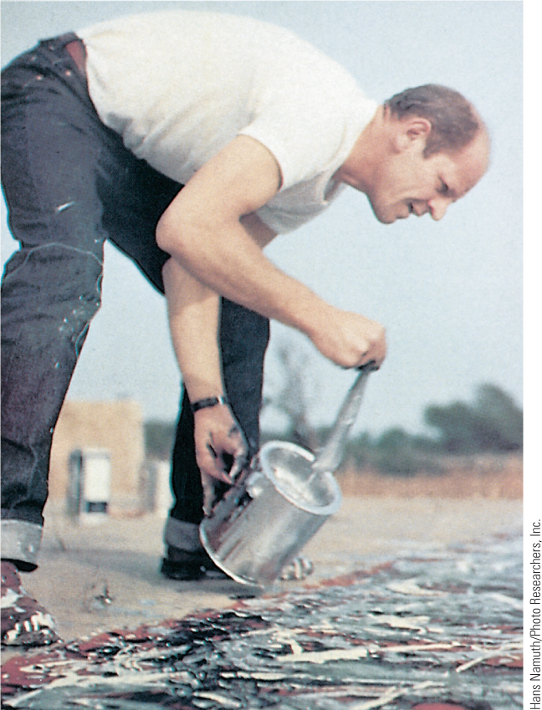
28.6 Jackson Pollock Painting. Abstract Expressionism moved into the artistic mainstream, and American Jackson Pollock was one of its best-known practitioners.

Slide 37
Chapter 28 Summary
A new kind of conflict erupted in the Western world as two of the victors, the United States and the Soviet Union, emerged as superpowers and began to argue over the political organization of a liberated Europe.
The Western world was soon divided between supporters of an increasingly-unified capitalistic West and adherents of a communist East.
While the western European economy boomed during the 1950s and 1960s, eastern Europe seemed to stagnate under the control of the Soviet Union.
A new European society emerged after World War II featuring a consumer society, mass leisure activities, the welfare state, and changing family dynamics.
The European colonial empires were largely dissolved, and the liberated territories of Africa, Asia, and the Middle East emerged as sovereign states, often subject to Cold War rivalries.

Slide 38
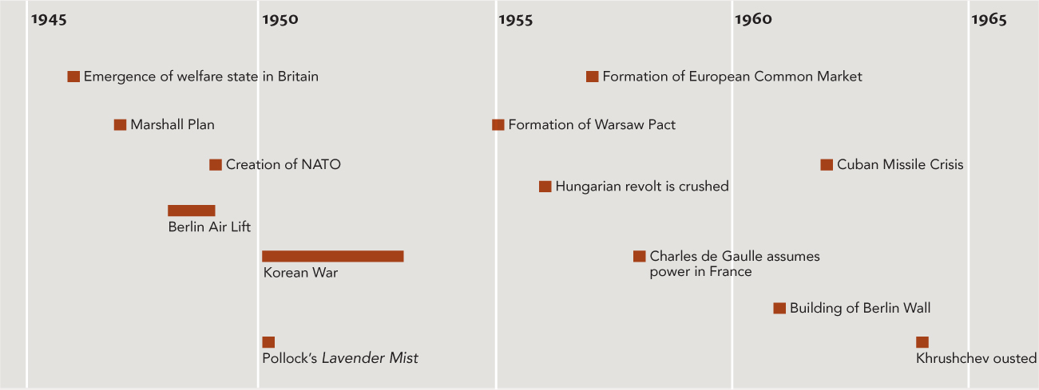
Chapter 28 Timeline

