Slide 1
WESTERN CIVILIZATION: A Brief History
Tenth Edition
CHAPTER 27
The Deepening of the European Crisis:
World War II
© 2020 Cengage. All rights reserved.

Slide 2
Chapter 27 Outline
27-1 Prelude to War
27-2 The Course of World War II
27-3 The New Order
27-4 The Home Front
27-5 Aftermath of the War

Slide 3
27-1 Prelude to War (1 of 3)
Focus Questions: What were Hitler’s foreign policy goals, and what steps did he take to achieve them between 1933 and 1939? How did Japan’s policies lead to war in Asia?
The coming of total war
  Collective security of 1920s proved meaningless in light of growth of Nazi Germany
The “Diplomatic Revolution,” 1933–1937
  Hitler: desire to revise the Treaty of Versailles and rearm
    Warning from France, Great Britain, and Italy
    March 1936: German troops sent into Rhineland; Britain and France divided on response
    October 1936: Mussolini and Hitler became allies in Rome-Berlin Axis; Japan and Germany concluded Anti-Comintern Pact

Slide 4
27-1 Prelude to War (2 of 3)
The path to war in Europe, 1938-1939
  Austria
    March 1938: Hitler’s annexation of Austria, acknowledged by Great Britain
  Czechoslovakia
    September 1938: Hitler demanded Sudetenland
    Munich Conference essentially met all of Hitler’s demands; high point of Western appeasement of Hitler
  Poland
    August 1939: Hitler and Stalin announce treaty
    German invasion of Poland followed by declarations of war against Germany by Britain and France; USSR invades eastern Poland

Slide 5
27-1 Prelude to War (3 of 3)
The path to war in Asia
  Japan swiftly rose to world power
    September 1931: Japan seized Manchuria; expanded control into north China
    July 1937: Japanese and Chinese forces clashed near Marco Polo Bridge; Japan seizure of Nanjing
  German-Russian nonaggression pact caused Japan to shift focus southward
  Japan occupation of Indochina
    America responded with sanctions
    Japan attacked American naval fleet in Pacific

Slide 6
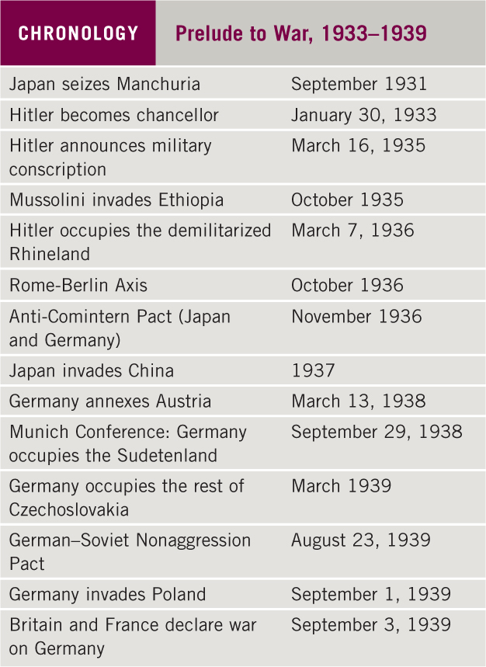
Chronology: Prelude to War, 1933–1939

Slide 7
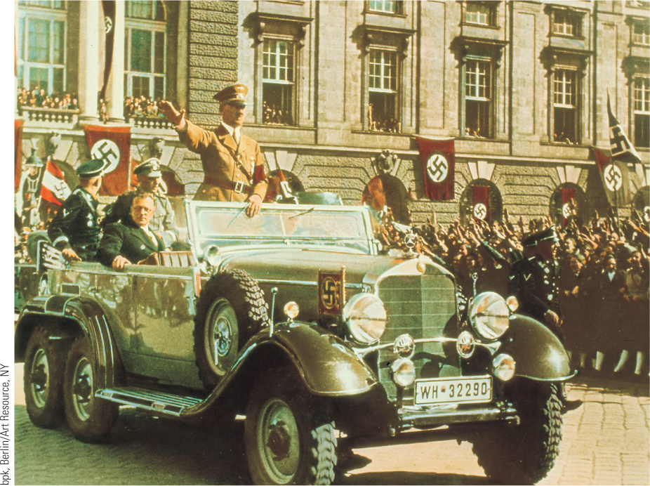
27.2 Hitler Arrives in Vienna. By threatening to invade Austria, Hitler forced the Austrian government to capitulate to his wishes.

Slide 8
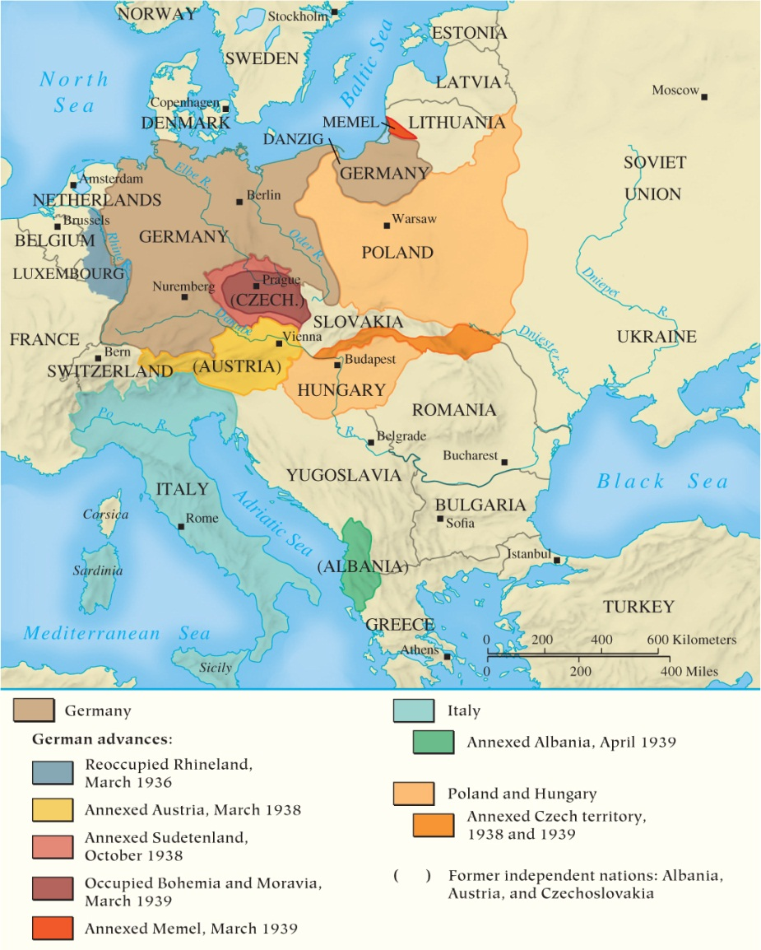
Map 27.1 Changes in Central Europe, 1936–1939

Slide 9
27-2 The Course of World War II (1 of 4)
Focus Question: What were the major events of World War II in Europe and in Asia, and why were the Allies ultimately victorious?
Lightning war: Blitzkrieg
  Hitler stunned Europe with the attack on Poland: panzer division and 1.5 million troops engage on two front
Victory and stalemate
  German Blitzkrieg against Norway and Denmark; attacks against Netherlands, Belgium, and France
    The evacuation of Dunkirk and surrender of France

Slide 10
27-2 The Course of World War II (2 of 4)
Victory and stalemate
  The problem Britain
    The Battle of Britain: German Luftwaffe launched a major offensive against Britain, with massive bombings of cities
    Rebuilt British air force inflicted losses on the Luftwaffe, leading to the postponement of invasion
  Invasion of the Soviet Union
    June 1941: Hitler invaded the Soviet Union to acquire living space in the east
    Early successes were followed by reverses and Soviet counterattack

Slide 11
27-2 The Course of World War II (3 of 4)
The war in Asia
  Japanese aggression: attack on U.S. at Pearl Harbor, the Philippines, Dutch East Indies, occupied Pacific islands, and advanced toward British colony Malaysia
The turning point of the war, 1942–1943
  Entry of U.S. created the Grand Alliance, cemented by principle of unconditional surrender
  War turned against the Germans
    British halted Rommel in Africa; German troops surrendered in Stalingrad
  Reverses for Japan at the Battles of Coral Sea and Midway
    Allied forces moved to the offensive

Slide 12
27-2 The Course of World War II (4 of 4)
The last years of the war
  Allied advances in the west
    The defeat of Italy in 1943–1944
    The Allies’ assault on Normandy and the breach of the German lines
  Soviet offensive in the east
    Hitler’s offensive failed, and the Soviets advanced into the Baltic States and into Poland and Germany
    Hitler committed suicide on April 30, 1945
  Defeat of Japan
    Unconditional surrender following the dropping of the atomic bomb on Hiroshima and Nagasaki

Slide 13
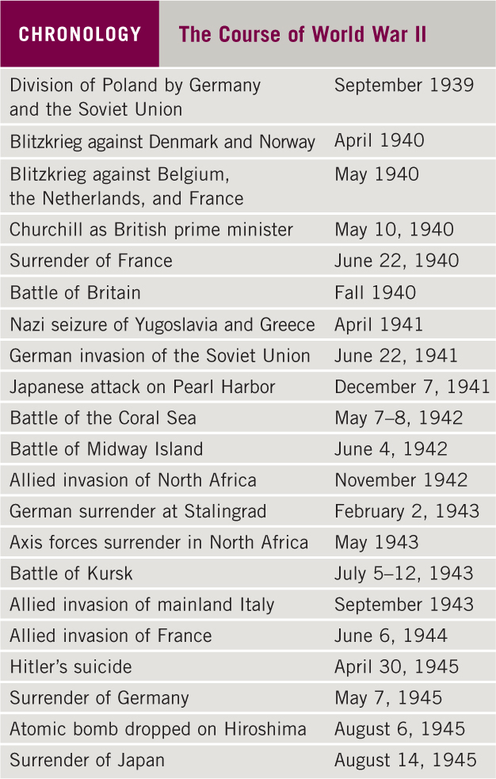
Chronology: The Course of World War II

Slide 14
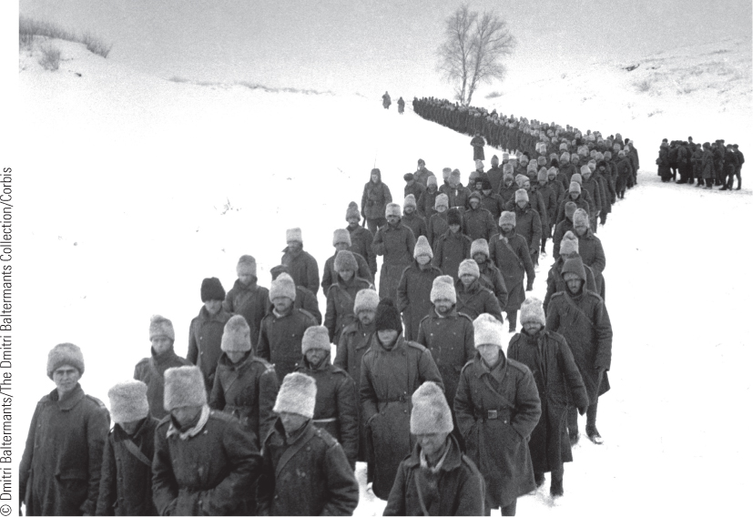
27.4b The Battle of Stalingrad. This illustration shows thousands of captured soldiers being marched across frozen Soviet soil to prison camps.

Slide 15
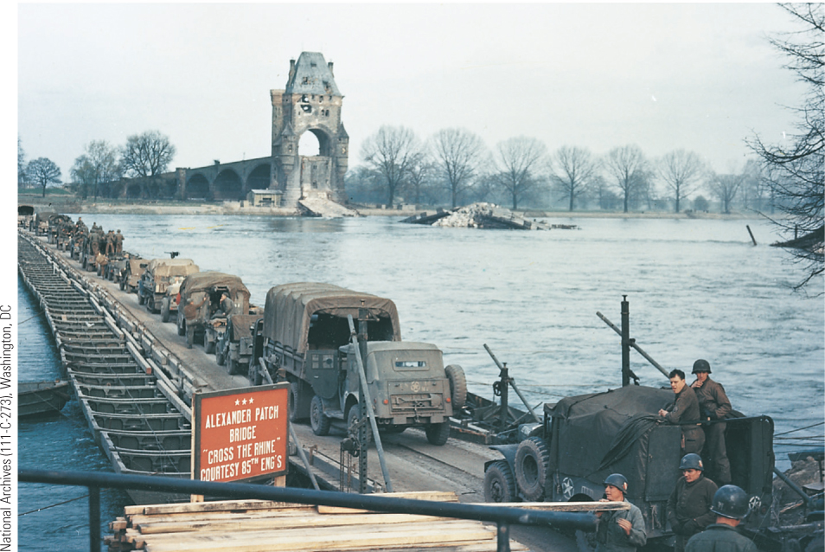
27.5 Crossing the Rhine. Following the liberation of France, makeshift bridges enabled the Allies to cross the Rhine in some areas and advance deeper into Germany.

Slide 16
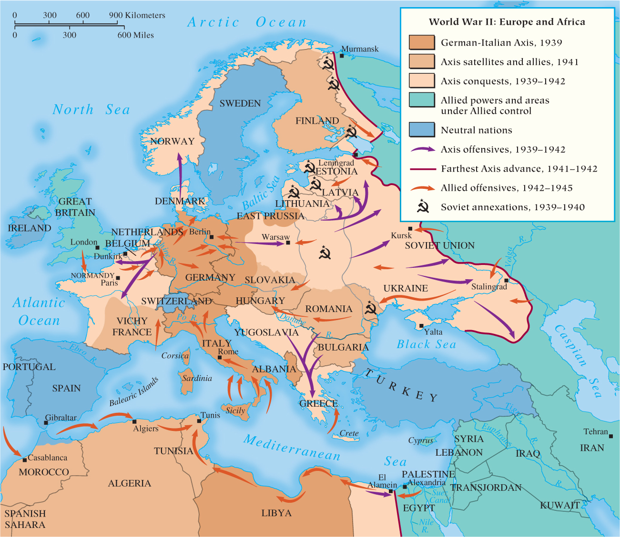
Map 27.2 World War II in Europe and North Africa

Slide 17
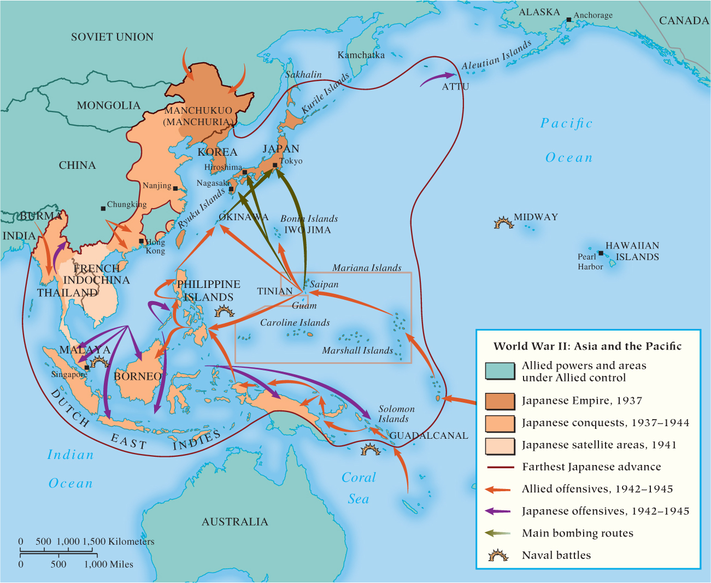
Map 27.3 World War II in Asia and the Pacific

Slide 18
27-3 The New Order (1 of 4)
Focus Questions: How was the Nazi empire organized? What was the Holocaust, and what was the relationship between Hitler’s worldview, his foreign policy, and the Holocaust?
The Nazi empire
  Nazi New Order
    Civil administrations in Aryan nations: Norway, Denmark, Netherlands
    Military administrations in “inferior” Latin nations: France
    By 1943, all occupied territories ruthlessly exploited

Slide 19
27-3 The New Order (2 of 4)
The Nazi empire
  Plans for an Aryan racial empire
    Himmler in charge of evacuating Slavic peoples and replacing them with Germans
    Hitler’s plans for social engineering after the war, with Poles, Ukrainians, and Russians as slave labor while German peasant settled abandoned lands
  Use of foreign workers
    Labor shortages in Germany led to ruthless mobilization of foreign labor

Slide 20
27-3 The New Order (3 of 4)
The Holocaust
  Hitler’s ideology of opposites: Aryans against Jews
  The SS and the Einsatzgruppen
    The Final Solution of annihilation of the Jews: ghettos and Einsatzgruppen’s mobile killing units
  The death camps
    The systematic annihilation of the European Jewish population
    Extermination centers: death of between 5 and 6 million Jews
  The other Holocaust
    Nazis responsible for death of another 9 to 10 million
    Targeted Gypsies, Slavic peoples, and homosexuals; others died in forced labor; Soviet prisoners killed in captivity

Slide 21
27-3 The New Order (4 of 4)
The New Order in Asia
  “Asia for the Asians” promised independent governments under Japanese tutelage
    Real power rested with Japanese military authorities in each territory
  Economic resources of colonies were exploited for war machine
    Little respect for lives of their subject people

Slide 22
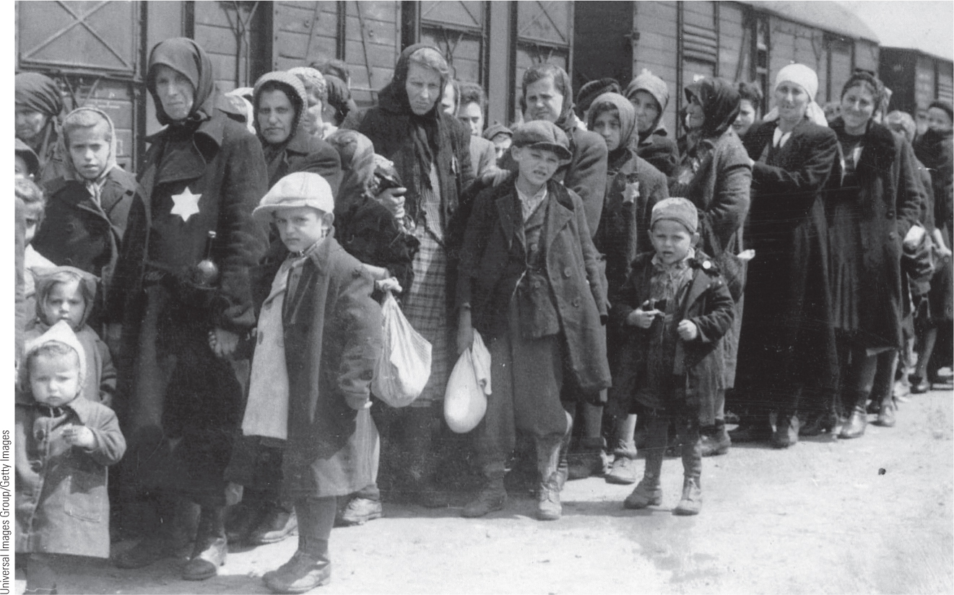
27.6 The Holocaust: The Extermination Camp at Auschwitz. It is estimated that 1.1 million people (90 percent of them Jews) were killed at Auschwitz.

Slide 23
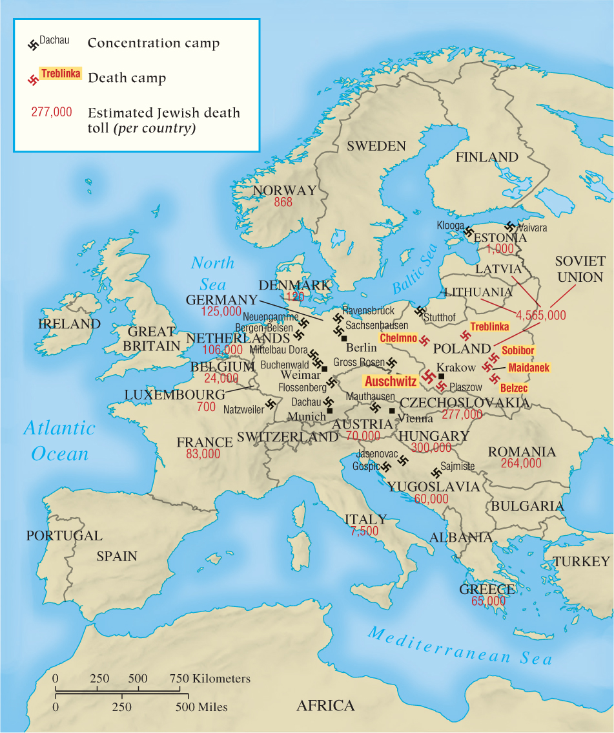
Map 27.4 The Holocaust

Slide 24
27-4 The Home Front (1 of 3)
Focus Question: What were conditions like on the home front for the Soviet Union, the United States, Germany, and Japan in World War II?
The mobilization of peoples
  The Soviet Union
    Two of every five killed in war were Soviets
    Women and girls worked in industries, mines, and railroads; women were also combatants
  The United States
    Faced no threat of war on homeland
    Massive mobilization caused social problems: housing shortages in boomtowns; broken social mores; racial tensions and riots; encamped Japanese Americans

Slide 25
27-4 The Home Front (2 of 3)
The mobilization of peoples
  Germany
    Early victories avoided diverting resources away from civilian economy but reverses led to total mobilization of economy
  Japan
    Society was highly mobilized: with controlled prices, wages, utilization of labor, and allocation of resources
    Warrior code of bushido culminated in final years of war with kamikaze
    Female rights were sacrificed; women worked in traditional areas of motherhood, textiles, and farming
    Labor shortages met by Korean and Chinese workers

Slide 26
27-4 The Home Front (3 of 3)
Front-line civilians: the bombing of cities
  Luftwaffe attacks
    Nightly raids on London and attack on Coventry
  The bombing of Germany
    British nighttime bombing of larger cities; U.S. daytime missions aimed at precision bombing of transportation facilities and wartime industries
    Germans suffered, but wartime production dropped only 7 percent
  The bombing of Japan: the atomic bomb
    Fears of Japanese fanaticism led to the dropping of the atomic bomb on Hiroshima and Nagasaki

Slide 27
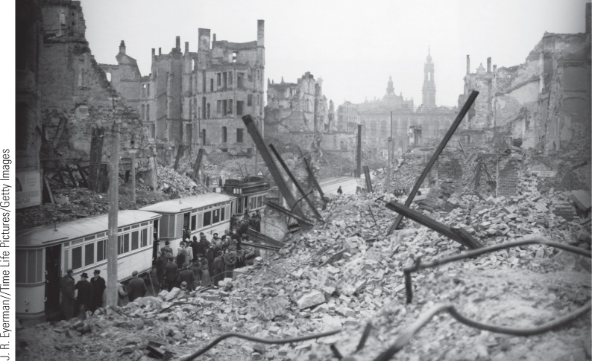
27.7b Dresden. In Dresden, Germany, as a result of British and American bombing raids in 1945, 2.5 square miles in the city was destroyed, and as many as 35,000 people died.

Slide 28
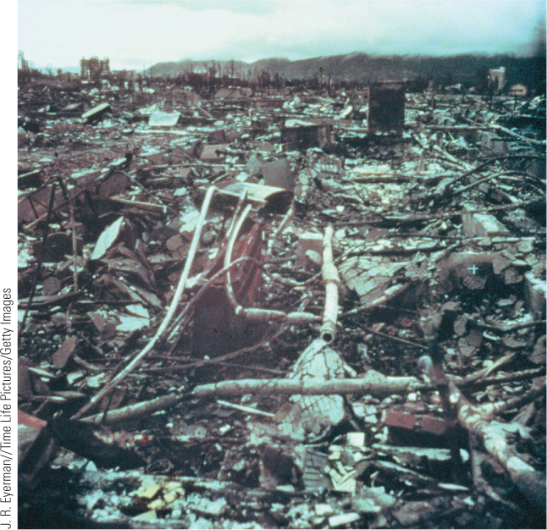
27.7c Hiroshima. This panoramic view of Hiroshima shows the incredible devastation produced by the atomic bomb.

Slide 29
27-5 Aftermath of the War (1 of 4)
Focus Questions: What were the costs of World War II? How did the Allies’ visions of postwar Europe differ, and how did these differences contribute to the emergence of the Cold War?
The costs of World War II
  At least 21 million soldiers died
  Civilian deaths estimated at 40 million
  In 1945, millions faced starvation and 30 million displaced in Europe
  Total monetary cost estimated at $4 trillion

Slide 30
27-5 Aftermath of the War (2 of 4)
The impact of technology
  The development of new weapons and practical instruments of war
    Turing’s primitive computer for breaking German code
    Later adaptation of technology to peacetime uses
Allied war conferences
  The looming Cold War
  The Tehran Conference
    Stalin, Roosevelt, and Churchill met to decide future course of war and agreed to partition postwar Germany

Slide 31
27-5 Aftermath of the War (3 of 4)
Allied war conferences
  The Yalta Conference
    Met in February 1945 when Germany’s defeat was a foregone conclusion
    Notion of spheres of influence and self-determination but disagreement over elections in eastern Europe
    Creation of United Nations major American concern
    Big Three reaffirmed unconditional German surrender and created occupation zones
    Soviets and Americans committed acts viewed as unbecoming of allies: U.S. termination of Lend-Lease aid and Soviet failure to fulfill Yalta agreement

Slide 32
27-5 Aftermath of the War (4 of 4)
Allied war conferences
  The Potsdam Conference
    July 1945: conference began under cloud of mistrust
    Roosevelt died in April; succeeded by Truman
    Truman demanded free elections in eastern Europe; Stalin disagreed
    West saw Soviet policy as part of a Communist conspiracy; Soviets saw U.S. as economic imperialists

Slide 33
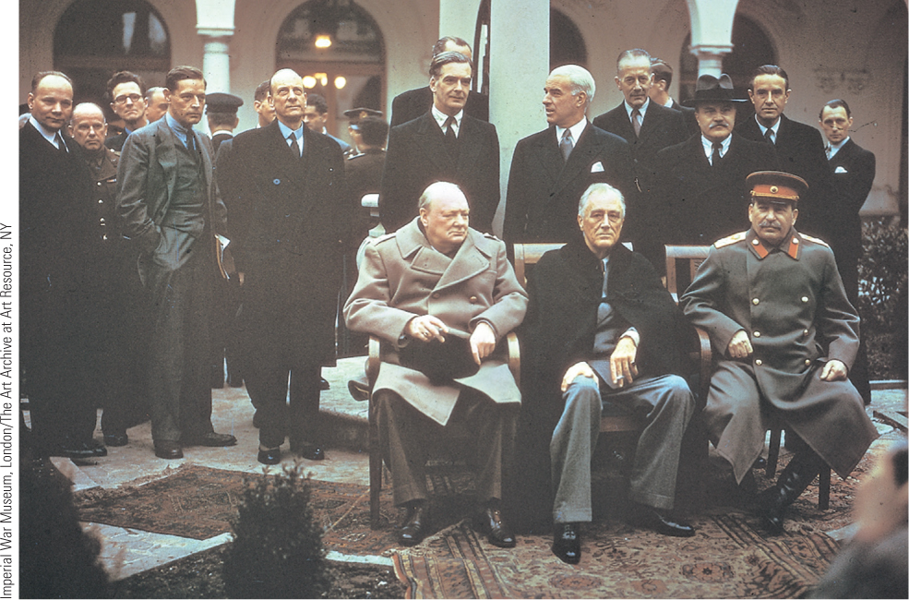
27.8 The Victorious Allied Leaders at Yalta. Churchill, Roosevelt, and Stalin met in wartime conferences to negotiate the outlines of the postwar settlement.

Slide 34
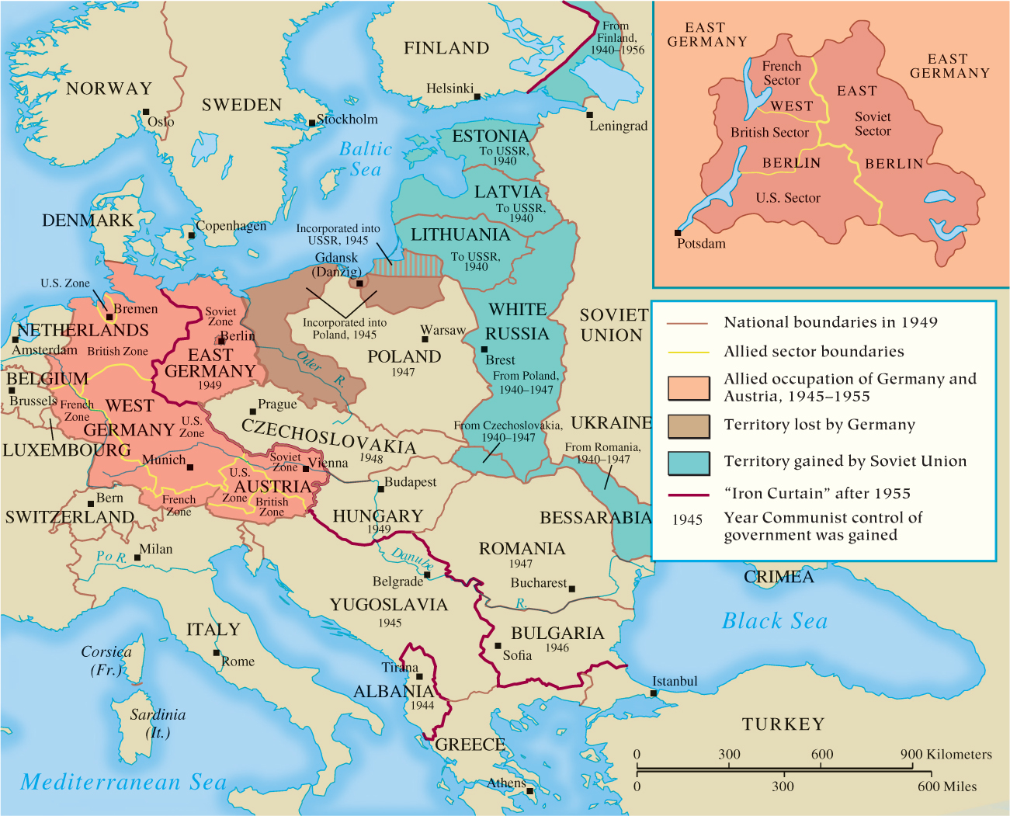
Map 27.5 Territorial Changes after World War II

Slide 35
Chapter 27 Summary
Between 1933 and 1939, Hitler rebuilt Germany into a great military power to create a German racial empire, and Japan fell under the influence of military leaders and right-wing forces who pushed a program of expansion.
While the aggressive Axis nations were victorious in the opening stages of the global conflict that became the most devastating war in human history, after 1942, World War II had turned in favor of the Allies, leading to the defeat of the Axis powers in 1945.
The Nazi empire brought death and destruction to those the Nazis considered racially inferior peoples, and the Japanese New Order also brought economic exploitation, hardships, and death for subject peoples.
Europeans, who had been accustomed to dominating the world at the beginning of the twentieth century, watched helplessly at midcentury as the two new superpowers created by the two world wars took control of their destinies.

Slide 36
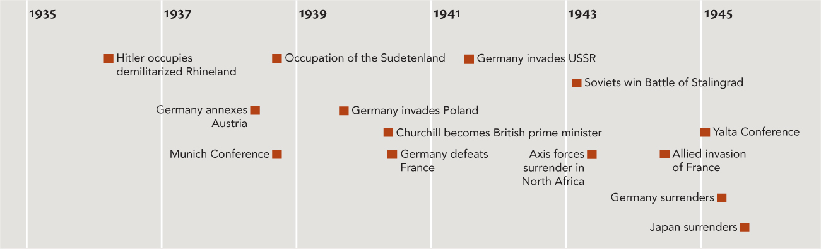
Chapter 27 Timeline

