Slide 1
WESTERN CIVILIZATION: A Brief History
Tenth Edition
CHAPTER 25
The Beginning of the Twentieth-Century Crisis: War and Revolution
© 2020 Cengage. All rights reserved.

Slide 2
Chapter 25 Outline
25-1 The Road to World War I
25-2 The Great War
25-3 War and Revolution
25-4 The Peace Settlement

Slide 3
25-1 The Road to World War I (1 of 2)
Focus Question: What were the long-range and immediate causes of World War I?
Nationalism and internal dissent
  System of nation-states led to competition
    By 1914, two alliances—Triple Alliance and Triple Entente—dominated Europe
  Nationalist aspirations of minorities and socialist labor movement caused internal strife
Militarism
  Conscription well established in Europe before 1914
    United States and Britain were exception
  Militarism involved large armies and inflexible, influential military leaders

Slide 4
25-1 The Road to World War I (2 of 2)
The outbreak of war: the summer of 1914
  Another crisis in the Balkans
    Austria-Hungary and Russian rivalry
    Russian-supported Serbia sought an independent Slavic state and opposed by Austria
  The assassination of Francis Ferdinand: a “blank check”?
  Declarations of war
    July 28 and 29: mobilization of Russian army against Austria and Germany
    August 1: Germans declared war on Russia
    Schlieffen Plan called for declaration of war against France
    August 4: Great Britain declared war against Germany

Slide 5
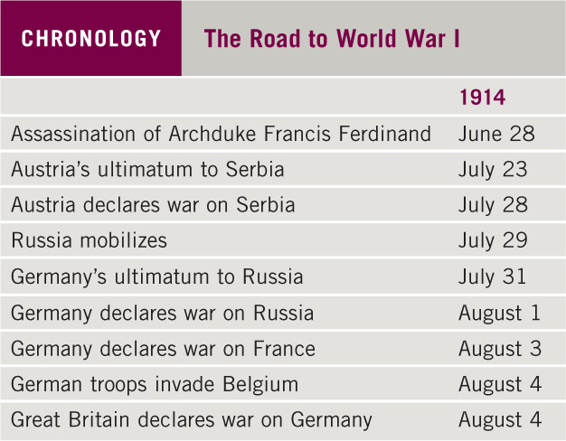
Chronology: The Road to World War I

Slide 6
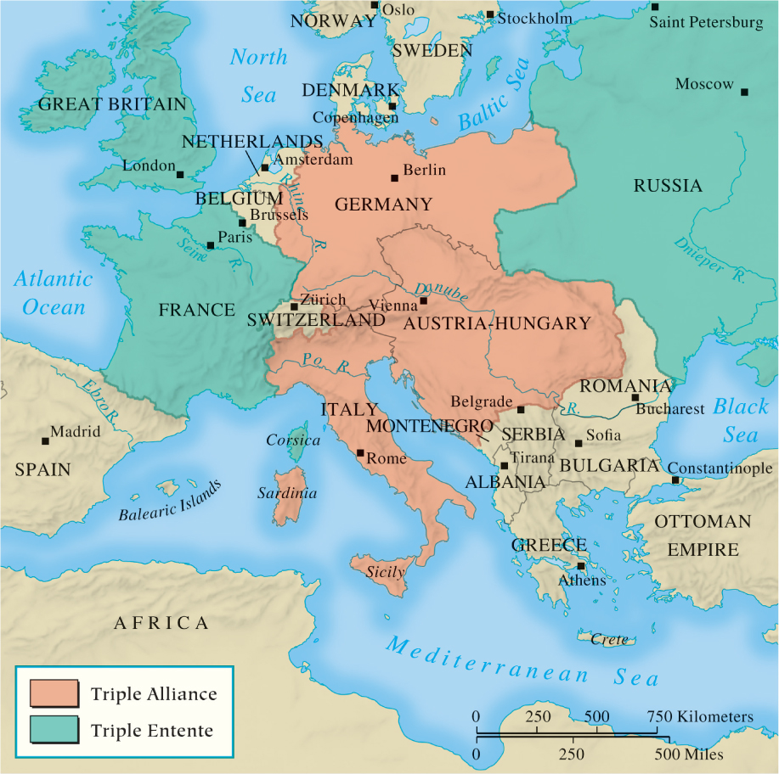
Map 25.1 Europe in 1914

Slide 7
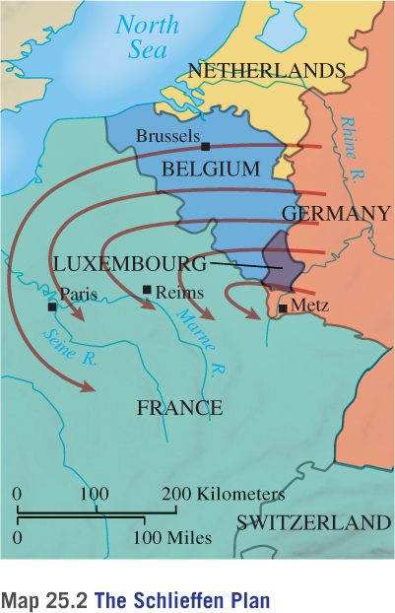
Map 25.2 The Schlieffen Plan

Slide 8
25-2 The Great War (1 of 7)
Focus Questions: What did the belligerents expect at the beginning of World War I, and why did the course of the war turn out to be so different from their expectations? How did World War I affect the belligerents’ governmental and political institutions, economic affairs, and social life?
1914–1915: illusions and stalemate
  Government propaganda led to enthusiasm and nationalism
    Many believed war would end in matter of weeks
  Schlieffen Plan called for German troops to invade France through Belgium
  First Battle of Marne led to trench warfare and stalemate for four years on western front

Slide 9
25-2 The Great War (2 of 7)
1914–1915: illusions and stalemate
  Eastern front marked by mobility
    Germans defeated Russians at the Battles of Tannenburg and the Masurian Lakes
    Austrians defeated by Russians in Galicia and thrown out of Serbia
  Italians broke alliance and entered war against Germany and Austria
  German-Austrian army routed Russians

Slide 10
25-2 The Great War (3 of 7)
1916–1917: the great slaughter
  Renewed German offensive in the west
  Trench warfare baffled military leaders
    Elaborate trenches separated from the enemy by “no man’s land”
    Millions of young men killed in search for breakthrough
    Trench warfare and machine guns produced unimaginable horrors

Slide 11
25-2 The Great War (4 of 7)
The widening of the war
  A global conflict
    Stalemate on western front led to search for new allies
    Allies declared war on Ottoman Empire to open a Balkan front
    Bulgaria entered war on Central Powers’ side: caused Allied withdrawal at Gallipoli
    British officer T. E. Lawrence, or Lawrence of Arabia, incited Arab princes to revolt against Ottoman overlords in 1917
    Allies attempted to seize German colonies in Africa
    African soldiers sought political and social equality
    Japan joined allies to seize German territories

Slide 12
25-2 The Great War (5 of 7)
The widening of the war
  Entry of the United States
    German sinking of British passenger ship Lusitania in May 1915 led to strong American protest
    Renewed German unrestricted submarine warfare brought U.S. fully into war in April 1917
    The psychological boost to the Allied Powers

Slide 13
25-2 The Great War (6 of 7)
The home front: the impact of total war
  Political and economic repercussions
    Prolonged war led to unforeseen economic problems
    Great Britain forced to resort to conscription
    Wartime governments expanded powers over economy, including nationalization of transportation and industry
  Public order and public opinion
    Germany, Russia, and Austria-Hungary relied on force to subdue population
    At outset of war, British Parliament passed the Defence of the Realm Act (DORA): later expanded to include censorship
    In France, Georges Clemenceau suppressed civil liberties in 1917 for duration of war

Slide 14
25-2 The Great War (7 of 7)
The social impact of total war
  Total war ended unemployment
    Many new jobs created for women
  French government established minimum wage for women home-workers in textiles in 1915
  French decreed equal rates for piece-work in 1917
  Women given right to vote in Germany and Austria; United States followed (1920)

Slide 15
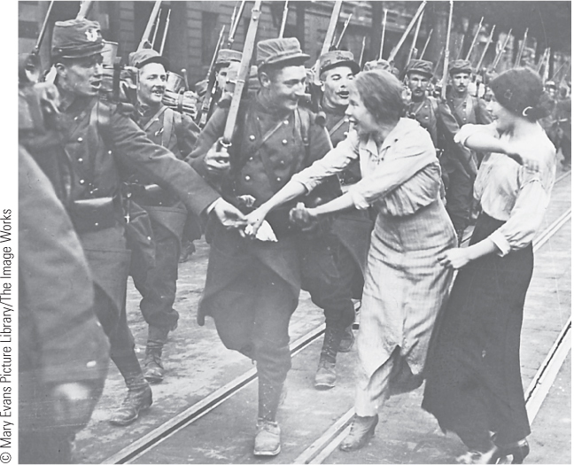
25.2a The Excitement of War. The outbreak of World War I was greeted with incredible enthusiasm, as indicated in this image showing French troops marching off to war.

Slide 16
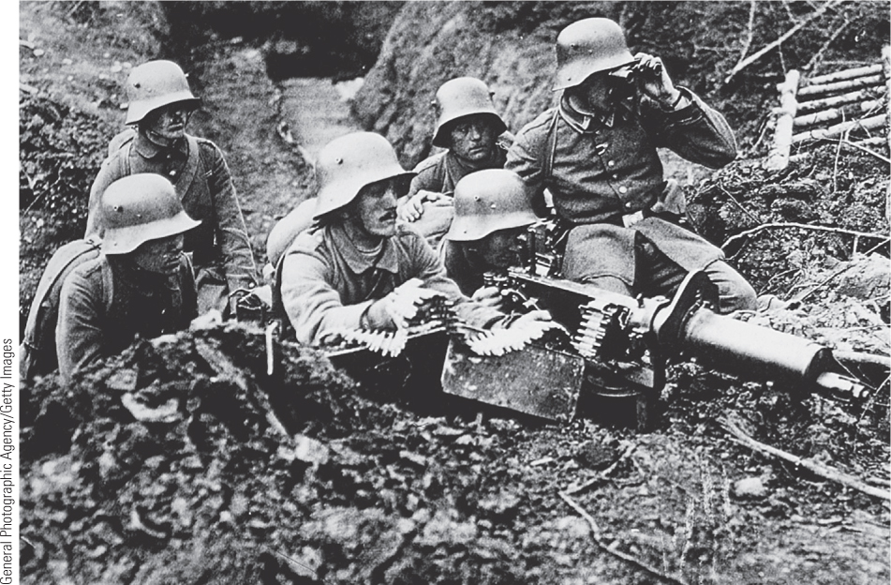
25.3 Impact of the Machine Gun. Efforts to effect a breakthrough on the western front were cut down by the brutal efficiency of the machine gun.

Slide 17
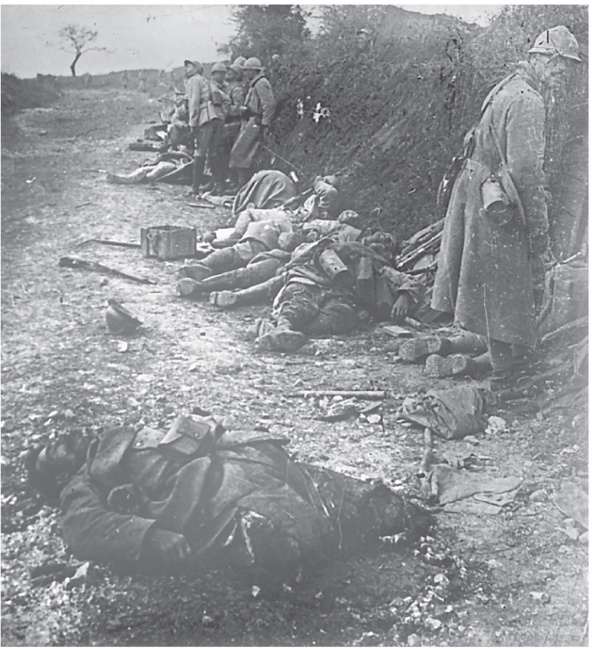
25.4a Life in the Trenches. Soldiers learned to harden themselves against the stench of decomposing bodies and the sight of bodies dismembered by artillery barrages.

Slide 18
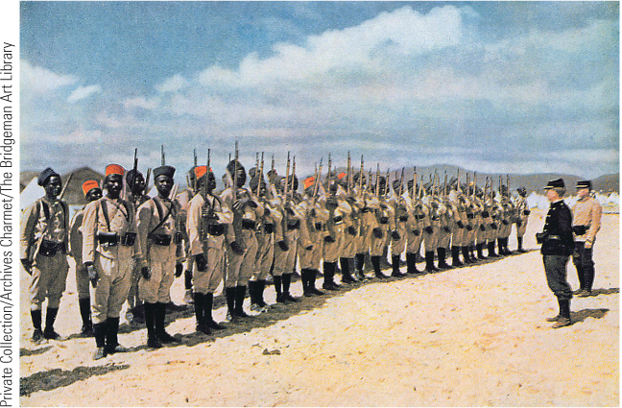
25.6a A Global Conflict. World War I began in Europe but soon became a global conflict, as demonstrated by this image of French Senegalese troops arriving in France in 1915.

Slide 19
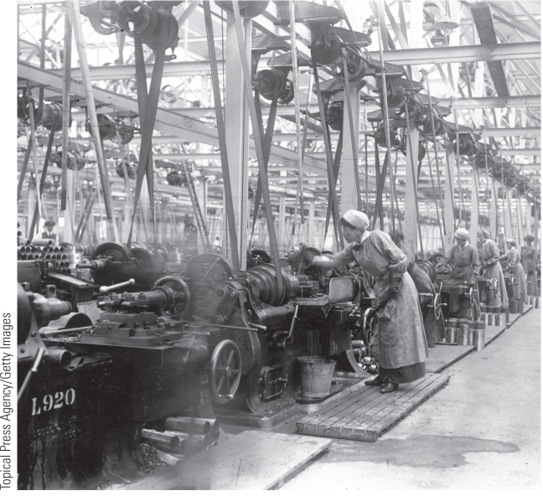
25.7a Women Munition Workers in a British Factory. World War I created new opportunities for women, including these women making munitions in an armaments factory.

Slide 20
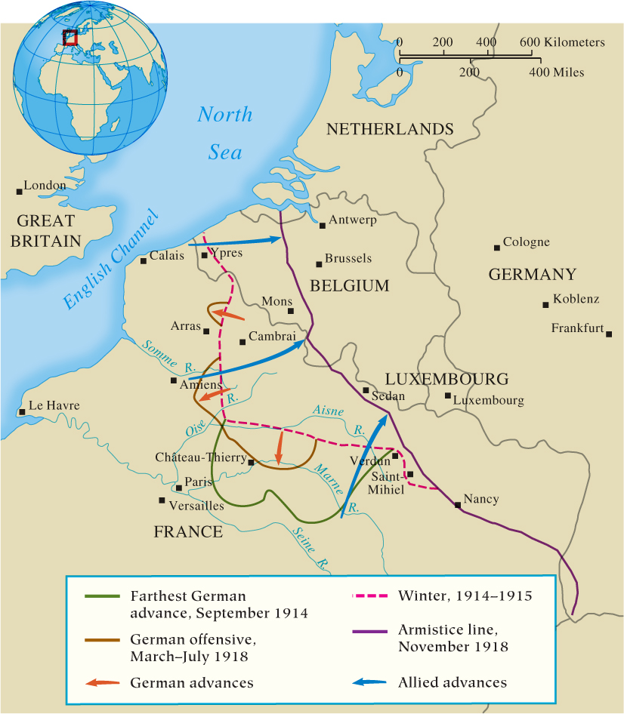
Map 25.3 The Western Front, 1914–1918

Slide 21
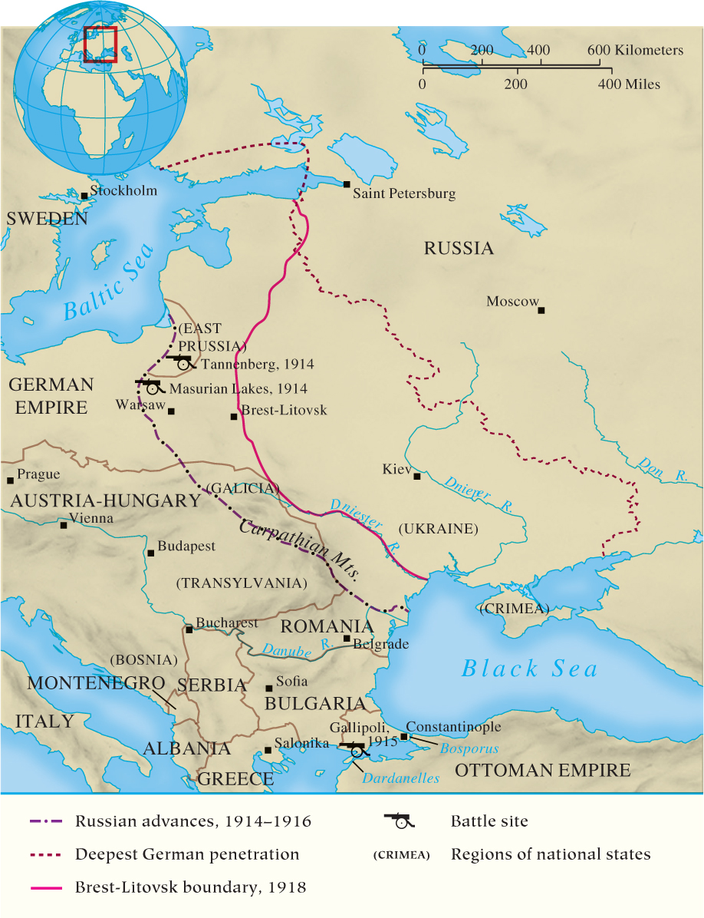
Map 25.4 The Eastern Front, 1914–1918

Slide 22
25-3 War and Revolution (1 of 4)
Focus Question: What were the causes of the Russian Revolution of 1917, and why did the Bolsheviks prevail in the civil war and gain control of Russia?
The Russian Revolution
  Precondition: Russia’s lack of preparation for total war
  The March Revolution
    Strikes broke out in capital city of Petrograd shutting down all factories; soldiers joined demonstrators
    Duma assumed control of government
    Provisional government formed and the abdication of the tsar
    Soviets opposed new provisional government
  The Bolshevik Revolution
    Bolsheviks: small faction of the Marxist Social Democrats under the leadership of Lenin

Slide 23
25-3 War and Revolution (2 of 4)
The Russian Revolution
  The Bolshevik Revolution
    Bolsheviks: small faction of the Marxist Social Democrats under the leadership of Lenin dedicated to violent revolution
    Slogans summed up Bolshevik program: “Peace, land, bread”; “Worker control of production”; “All power to the soviets”
    Bolsheviks and soviets seized power in November

Slide 24
25-3 War and Revolution (3 of 4)
The Russian Revolution
  Civil war
    Between 1918 and 1921, Bolshevik (Red) Army forced to fight on many fronts
    Red army defeated White army by 1920 and reclaimed the Ukraine
    Royal family murdered in July 1918
    Leon Trotsky’s organizational genius, war communism, and Red terror were key to success

Slide 25
25-3 War and Revolution (4 of 4)
The last year of the war
  Germany’s last gamble failed with defeat at the Second Battle of the Marne
    Civilians and military forced William II to abdicate
    Armistice agreed to by new German government in November 1918
  The casualties of the war
    Between 8 and 9 million soldiers died on battlefield, with 22 million wounded
    “Lost generation” of war veterans who would support Hitler and Mussolini
    One million Armenians victims of genocide

Slide 26
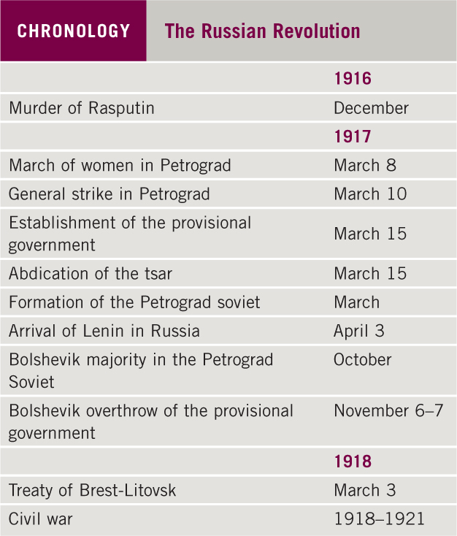
Chronology: The Russian Revolution

Slide 27
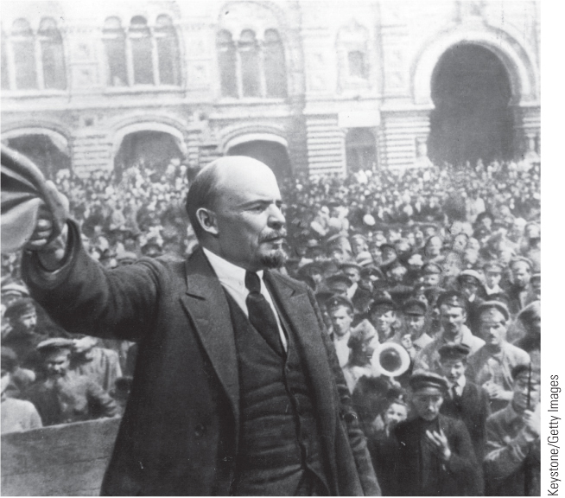
25.8a Lenin. V. I. Lenin, leader of the Bolsheviks, is seen here addressing a rally in Moscow in 1917.

Slide 28
25-4 The Peace settlement (1 of 2)
Focus Question: What were the objectives of the chief participants at the Paris Peace Conference of 1919, and how closely did the final settlement reflect these objectives?
Paris Peace Conference in 1919 guided by principle of self-determination
  The League of Nations
  Approaches to national security and divisions among the Big Three—Britain, France, and the United States
The Treaty of Versailles
  One of five treaties, punishing Germany with the War Guilt Clause, reparations payments, and loss of territories

Slide 29
25-4 The Peace settlement (2 of 2)
The other peace treaties
  Extensively redrew map of eastern Europe
    Ottoman Empire dismembered
    France took control of Lebanon and Syria
    Britain received Iraq and Palestine—acquisitions called mandates
  U.S. Senate failed to ratify treaty
    United States never joined League of Nations
    Senate rejected Wilson’s defensive alliance with Great Britain and France

Slide 30
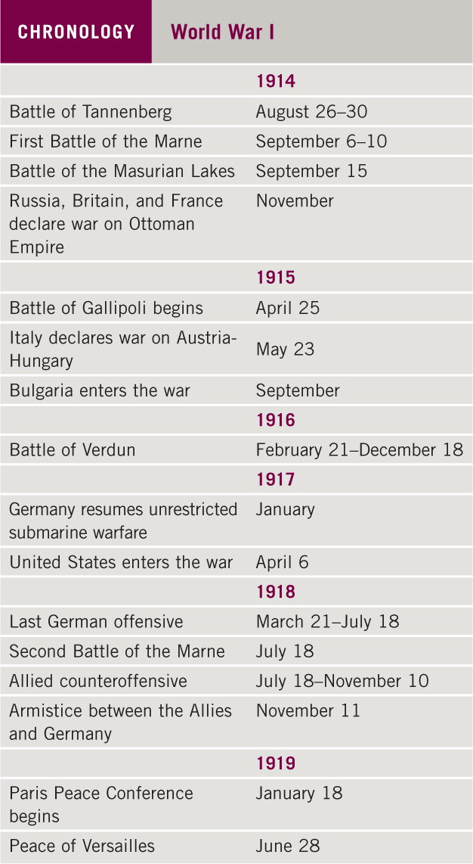
Chronology: World War I

Slide 31
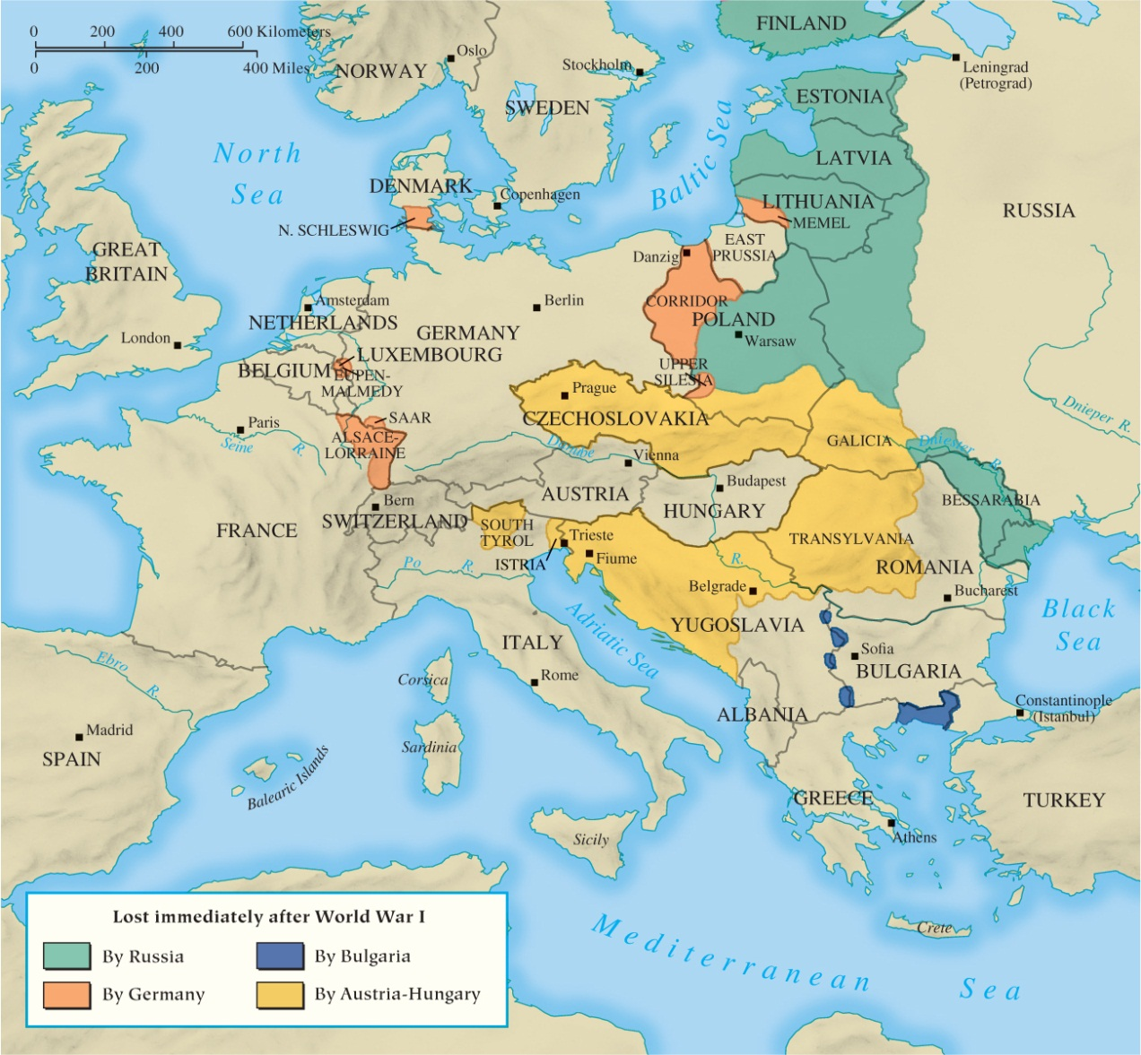
Map 25.5 Europe in 1919

Slide 32
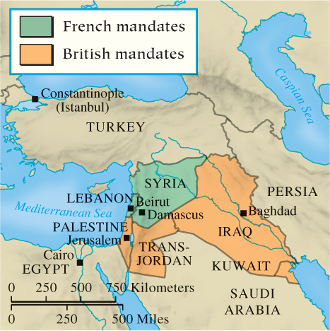
Map 25.6 The Middle East in 1919

Slide 33
Chapter 25 Summary
Crisis in the Balkans in 1914 sparked a global conflict that led to trench warfare and stalemate in the west, while Russia’s lack of preparation sparked revolution in the east.
World War I, the defining event of the twentieth century, shattered the liberal and rational assumptions of late-nineteenth and early-twentieth-century European society and caused incredible destruction and meaningless slaughter.
World War I was a total war that required extensive mobilization of resources and populations and increased the power of the state over the lives of its citizens.
World War I ended the age of European hegemony over world affairs and represented the waning of the European age.

Slide 34
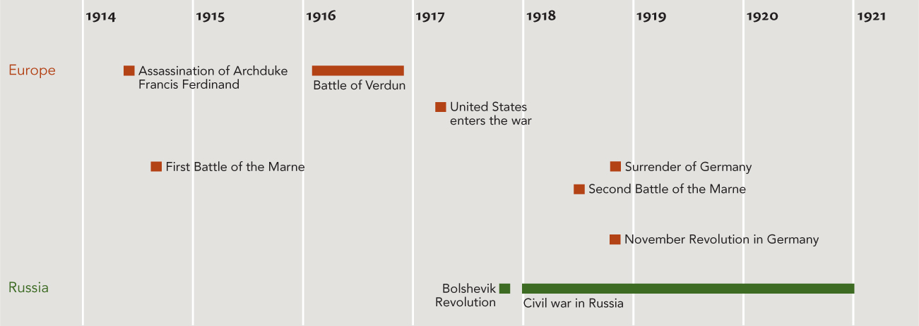
Chapter 25 Timeline

