Slide 1
WESTERN CIVILIZATION: A Brief History
Tenth Edition
CHAPTER 24
An Age of Modernity, Anxiety, and Imperialism, 1894–1914
© 2020 Cengage. All rights reserved.

Slide 2
Chapter 24 Outline
24-1 Toward the Modern Consciousness: Intellectual and Cultural Developments
24-2 Politics: New Directions and New Uncertainties
24-3 The New Imperialism
24-4 International Rivalry and the Coming of War

Slide 3
24-1 Toward the Modern Consciousness: Intellectual and Cultural Developments (1 of 5)
Focus Question: What developments in science, intellectual affairs, and the arts in the late nineteenth and early twentieth centuries “opened the way to a modern consciousness,” and how did this consciousness differ from earlier worldviews?
Developments in the sciences: the emergence of a new physics
  Marie and Pierre Curie discovered radium
  Max Planck formulated quantum theory
  The work of Einstein
    Relatively theory explained vast energies contained within the atom and led to the atomic age

Slide 4
24-1 Toward the Modern Consciousness: Intellectual and Cultural Developments (2 of 5)
Toward a new understanding of the irrational: Nietzsche
  Claimed that humans were at mercy of irrational life forces
  Rejected and condemned political democracy, social reform, and universal suffrage
Sigmund Freud and psychoanalysis
  Human behavior strongly determined by the unconscious
    Psychoanalysis was accomplished through dialogue: therapist probed deeply into memory to retrace chain of repression back to childhood origins
    Inner life was a battleground of contending forces—id, ego, and superego

Slide 5
24-1 Toward the Modern Consciousness: Intellectual and Cultural Developments (3 of 5)
The impact of Darwin: Social Darwinism and racism
  Social Darwinism: societies are organisms that evolve through time from a struggle with their environment
  Rabid nationalists and racists applied Darwin’s ideas to human society
    Houston Stewart Chamberlain: chief propagandist of German racism

Slide 6
24-1 Toward the Modern Consciousness: Intellectual and Cultural Developments (4 of 5)
The culture of modernity
  Change produced by writers and artists called Modernism
  Naturalism and Symbolism in literature
    Naturalists including French author Émile Zola emphasized realism in literature
    Symbolists reacted against Realism: poets William Butler Yeats and Rainer Maria Rilke

Slide 7
24-1 Toward the Modern Consciousness: Intellectual and Cultural Developments (5 of 5)
The culture of modernity
  Modernism in the arts
    Impressionism: utilized bright colors, dynamic brushstrokes, and a smaller, more private scale than predecessors
    Impressionist Berthe Morisot broke with the practice of women as amateur artists; became a professional painter
    Post-Impressionism: Vincent van Gogh viewed art as a spiritual experience
    The impact of photography
    Pablo Picasso developed Cubism
    Wassily Kandinsky: abstract painting
    Expressionism in music: composer Igor Stravinsky and The Rite of Spring

Slide 8
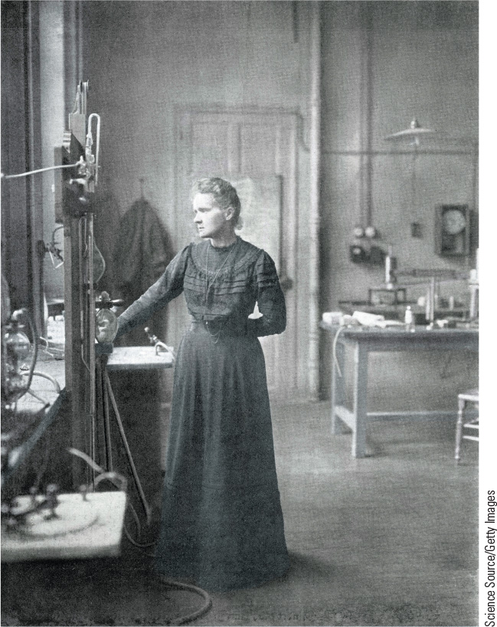
24.2 Marie Curie. Marie Curie was the first person and only woman to win two Noble Prizes, one in 1903 in physics and another in 1911 in chemistry.

Slide 9
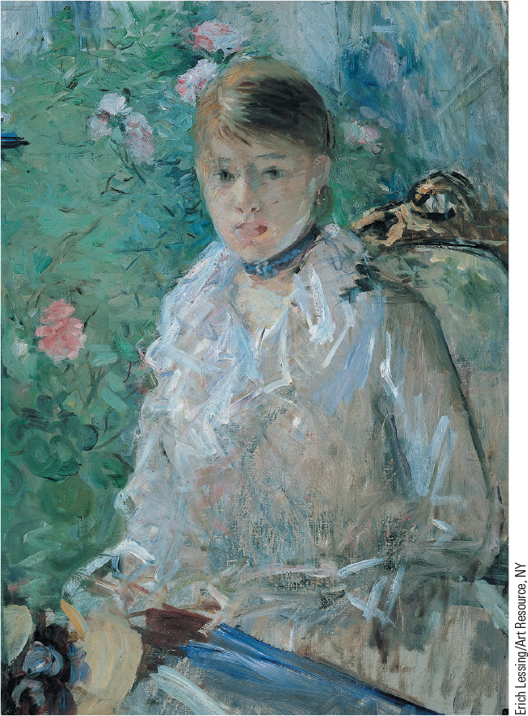
24.3a Young Girl by the Window. Berthe Morisot, the first female painter to join the Impressionists, focused on women and domestic scenes in her work.

Slide 10
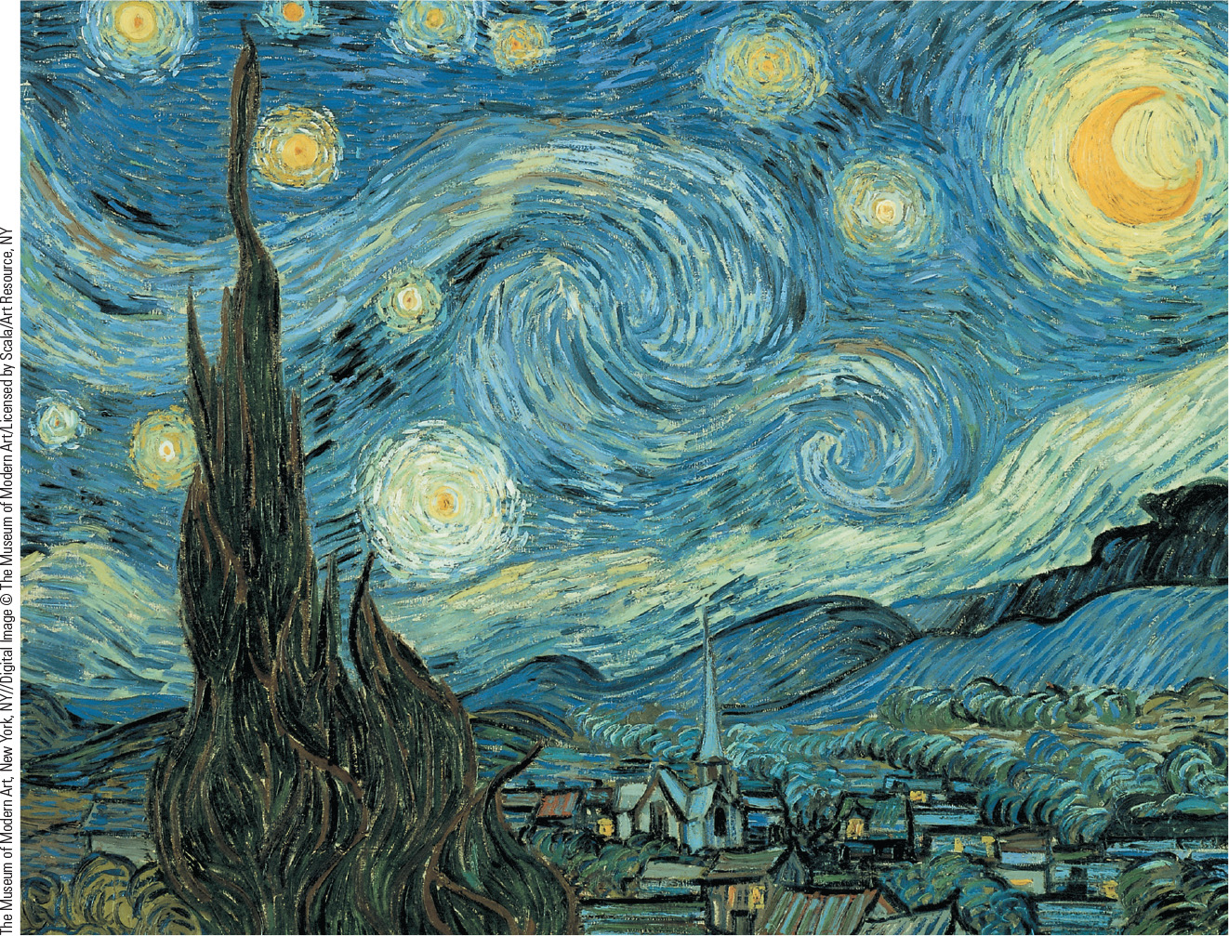
24.4 Vincent Van Gogh, The Starry Night. Dutch painter Vincent van Gogh’s originality and power of expression made a strong impact on his artistic successors.

Slide 11
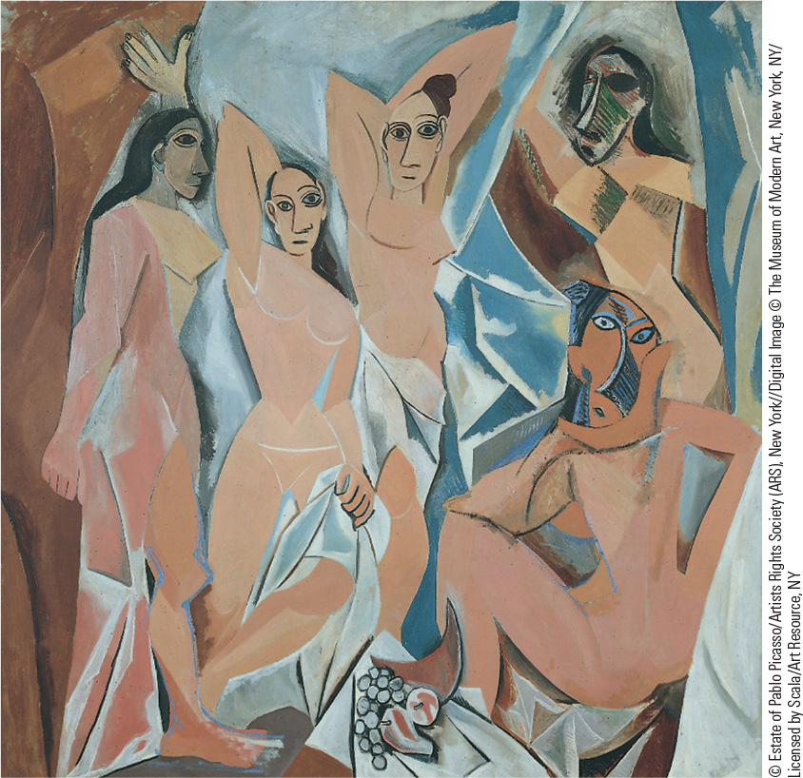
24.5 Pablo Picasso, Les Demoiselles d’Avignon. In this first great example of Cubism, geometric shapes replace traditional forms, forcing the viewer to re-create reality.

Slide 12
24-2 Politics: New Directions and New Uncertainties (1 of 6)
Focus Questions: What gains did women make in their movement for women’s rights? How did a new right-wing politics affect the Jews in different parts of Europe? What political problems did Great Britain, France, Austria-Hungary, Germany, and Russia face between 1894 and 1914, and how did they solve those problems?
Growing anxieties
  Liberal principles and political democracy: shift from growth to stagnation after 1894

Slide 13
24-2 Politics: New Directions and New Uncertainties (2 of 6)
The movement for women’s rights
  New professions
    Teaching and nursing professions
  The right to vote
    The aim of suffragists was women’s full citizenship: the Pankhursts in Britain
    Women and peace movements: Bertha von Suttner
  The new woman
    Rejection of traditional feminine roles
    Maria Montessori: following a rational, scientific perspective and establishing a new system of childhood education

Slide 14
24-2 Politics: New Directions and New Uncertainties (3 of 6)
Jews in the European nation-state
  Jews granted legal equality in many European countries
    Assimilated into cultures around them
  Anti-Semitic parties formed in Germany and Austria in the 1880s and 1890s
  Eastern Europe, home to 72 percent of the world’s Jewish population, displayed worst treatment of Jews
  Palestine and Zionism: Jewish nationalist movement
    Leader Theodor Herzl

Slide 15
24-2 Politics: New Directions and New Uncertainties (4 of 6)
The transformation of liberalism: Great Britain
  Trade unions and the Labour Party forced social reforms
    Advocated radical change in economic system
  Fabian Socialists formed Labour Party and elected twenty-nine members to House of Commons in 1906
  Liberals and social reforms: first steps toward the welfare state; reducing the power of the House of Lords
France: travails of the Third Republic
  The growth of anti-Semitism and the Dreyfus Affair
  Radical republicans gained control of government; the power of the army and Catholic church broken

Slide 16
24-2 Politics: New Directions and New Uncertainties (5 of 6)
Growing tensions in Germany
  Expansion of industry and cities led to demand for political participation and reform
  Conflict between modernization and traditionalism
    Pan-German League stressed nationalism, imperialism, and anti-Semitism
Austria-Hungary: the problem of the nationalists
  Divisions in parliament; prime ministers ruled by decree
  Nationalist working-class parties created
Industrialization and revolution in imperial Russia
  Industrialization after 1890, the development of socialist parties, and revolution in 1905
    The short-lived constitutional monarchy of Nicholas II

Slide 17
24-2 Politics: New Directions and New Uncertainties (6 of 6)
The rise of the United States
  By 1900, United States was the richest nation and greatest industrial power
    Labor unrest over working conditions, strict work discipline, and devastating unemployment
    American Federation of Labor emerged as labor’s dominant voice
  Progressive era reforms
The growth of Canada
  By 1871, Canada stretched from the Atlantic to the Pacific
  Distrust between English speaking majority and French Canadians in Quebec
  Wilfred Laurier became first French Canadian prime minister
    Reconciled the English speaking majority and French Canadians

Slide 18
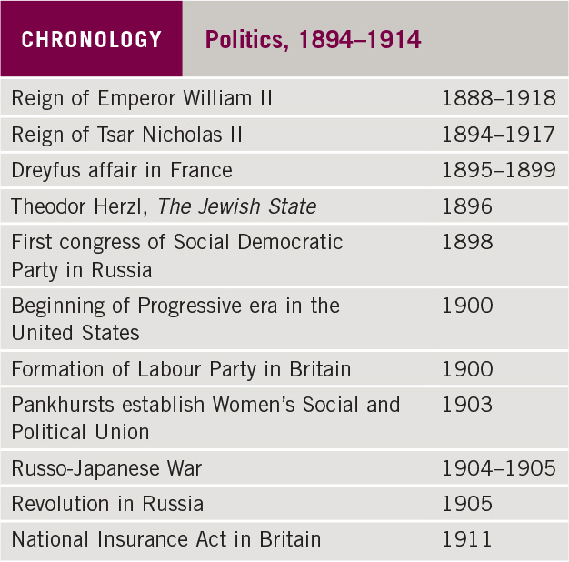
Chronology: Politics, 1894–1914

Slide 19
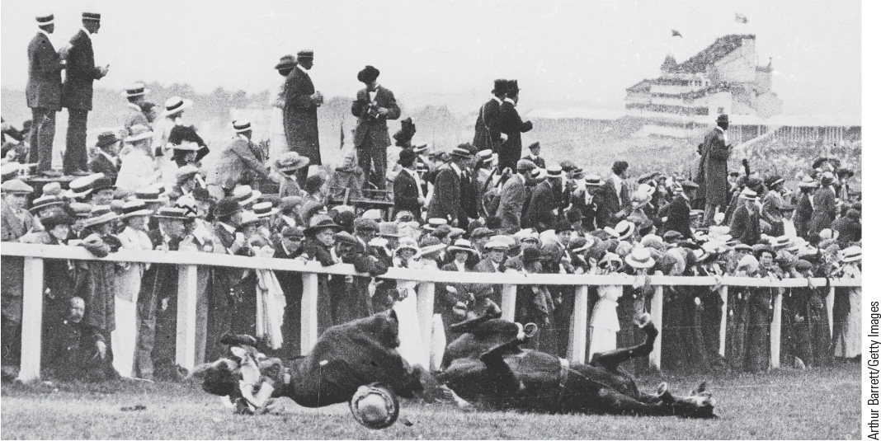
24.6c Suffragist Protests. Among the most dramatic of suffragist protest acts was Emily Davison throwing herself under the king’s horse at the Epsom Derby horse race.

Slide 20
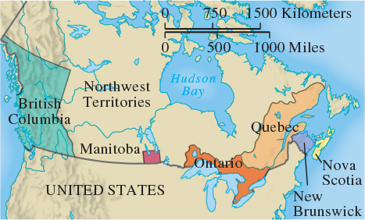
Map 24.2 Canada, 1871

Slide 21
24-3 The new imperialism (1 of 6)
Focus Question: What were the causes of the new imperialism that took place after 1880, and what effects did the European quest for colonies have on Africa and Asia?
Impetus for the new imperialism
  Great Britain expanded into new regions to keep the French, Germans, and Russians from setting up bases that could harm British interests
  Colonies were source of international prestige
  Social Darwinism and racism factors: superior races dominated inferior races
  Economic imperialism provided direct control of natural resources and products

Slide 22
24-3 The new imperialism (2 of 6)
The creation of empires
  The scramble for Africa
    Cecil Rhodes determined British policy driving Boers or Afrikaners north on the Great Trek
    Union of South Africa became self-governing dominion
    By 1900, French added huge area of French West Africa and Tunisia and in 1912, established a protectorate over Morocco
    British established protectorate over Egypt; seized Sudan
    Italy defeated by Ethiopia; seized Tripoli and renamed it Libya
    European colonies in Central Africa
    Germany established colonies in South West Africa, Cameroons, Togoland, and East Africa
    By 1914, only Liberia and Ethiopia remained free states

Slide 23
24-3 The new imperialism (3 of 6)
The creation of empires
  Imperialism in Asia
    Australian self-government: Commonwealth of Australia
    British East India Company crushed in 1858
    1876: Queen Victoria proclaimed empress of India
    Russia expanded into Siberia and south to Ottoman Empire
    Russo-Japanese War in 1905: Japanese protectorate in Korea
    Russians and British agreed to make Afghanistan buffer state

Slide 24
24-3 The new imperialism (4 of 6)
The creation of empires
  Imperialism in Asia
    Britain obtained Hong Kong and rights to trade in a number of Chinese cities
    Other Western nations rushed to gain similar privileges
    Commodore Matthew Perry forced Japan to grant United States trading and diplomatic privileges
    In Southeast Asia Britain controlled Burma and the Malay states and France subjugated Indochina
    United States on the imperialist stage: Hawaii, Cuba, Puerto Rico, Guam, and Philippine Islands

Slide 25
24-3 The new imperialism (5 of 6)
Responses to imperialism
  Africa
    Educated native peoples organized political parties and movements seeking end of foreign rule
  China
    The Boxer Rebellion in 1900–1901 and Western response
    Manchu dynasty overthrown; Republic of China created
  Japan
    Samurai revolt restored emperor, 1867; the Meiji: adopted Western methods
  India
    Britain brought order, efficient government, and technology
    Poor conditions and British racial attitudes led to Indian nationalist movement
    By 1919, Indians demanded independence

Slide 26
24-3 The new imperialism (6 of 6)
Results of the New Imperialism
  By 1900, societies of Africa and Asia were either under full colonial rule or at a point of collapse
    Thailand, Ethiopia, and Afghanistan maintained autonomy
  Japan avoided common fate through concerted strategy of political and economic reform
  Competition for lands abroad exacerbated rivalry among European states

Slide 27
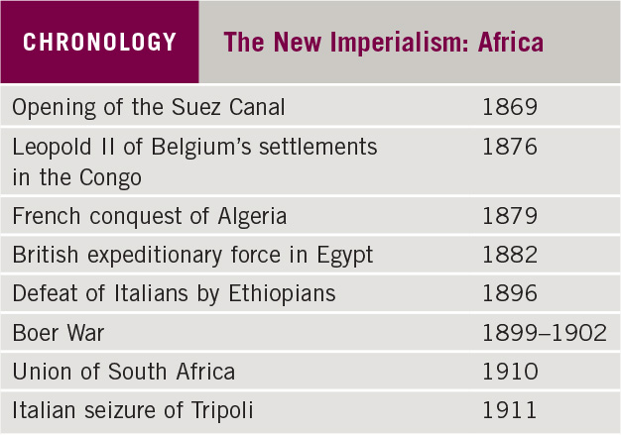
Chronology: The New Imperialism: Africa

Slide 28
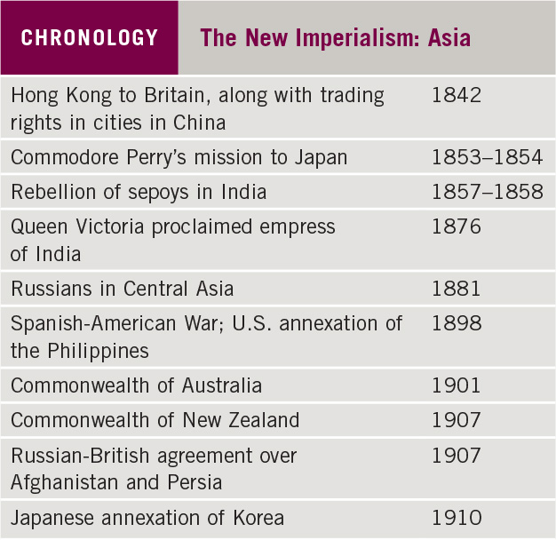
Chronology: The New Imperialism: Asia

Slide 29
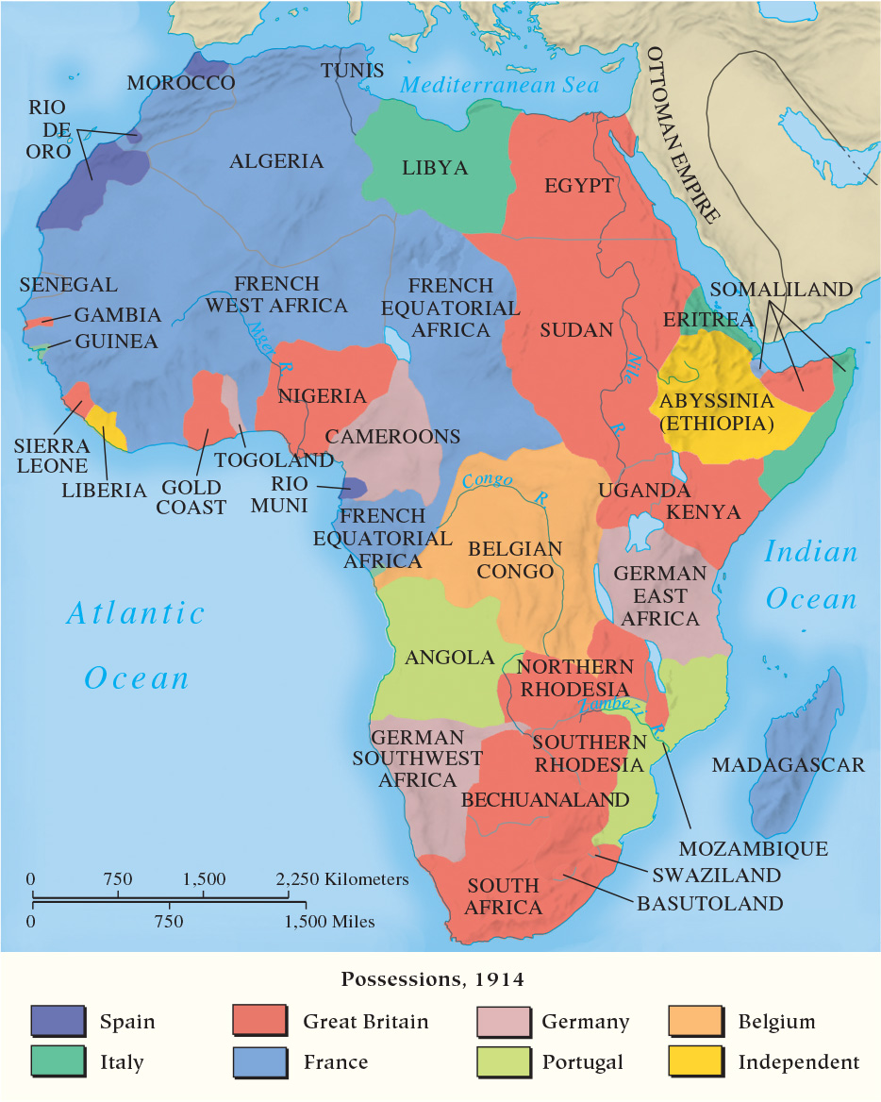
Map 24.3 Africa in 1914

Slide 30
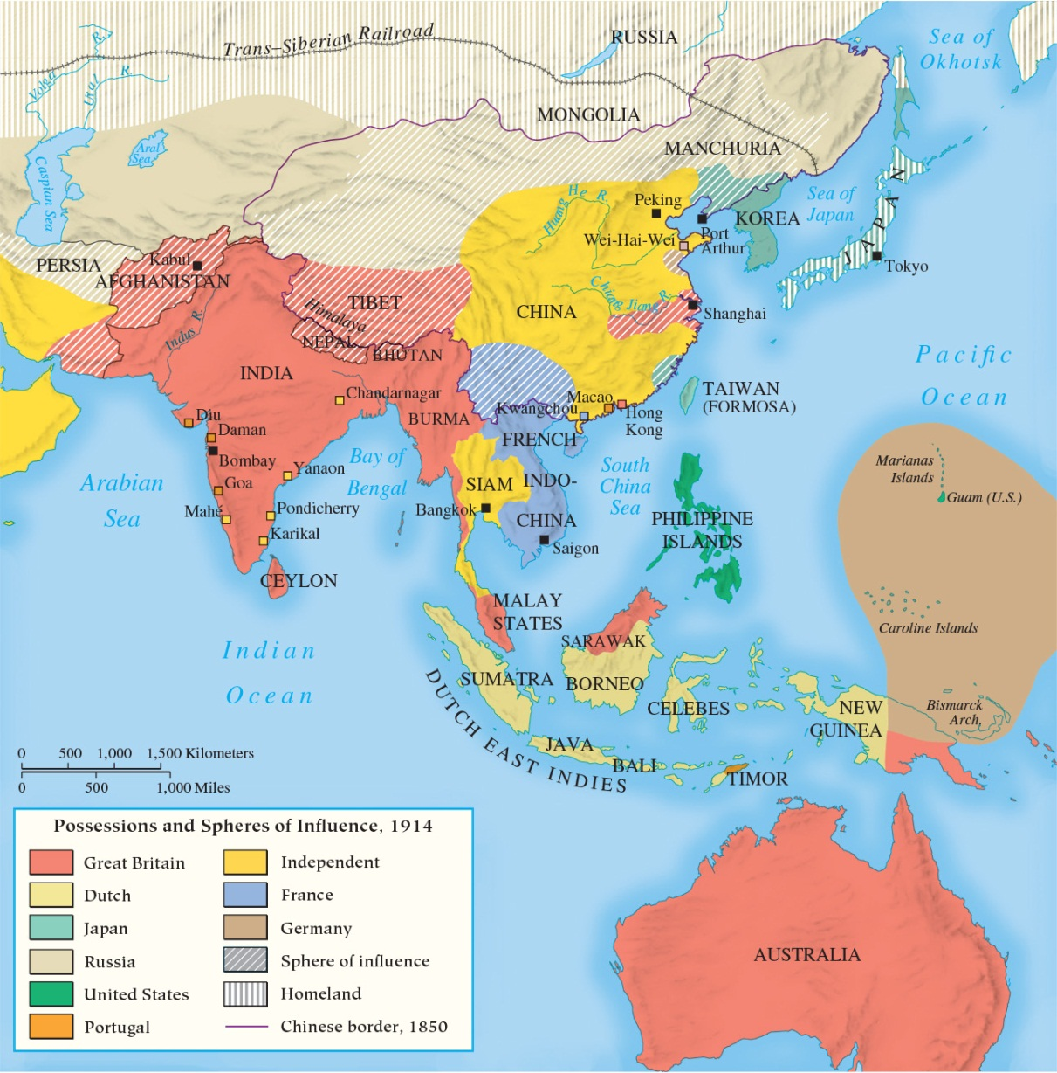
Map 24.4 Asia in 1914

Slide 31
24-4 International Rivalry and the Coming of War (1 of 2)
Focus Questions: What was the Bismarckian system of alliances, and how successful was it at keeping the peace? What issues lay behind the international crises that Europe faced in the late nineteenth and early twentieth centuries?
The Bismarckian system of alliances
  The Triple Alliance: Germany, Austria-Hungary, and Italy
New directions and new crises
  Britain, France and Russia formed loose confederation: the Triple Entente
    Divided Europe into two opposing camps

Slide 32
24-4 International Rivalry and the Coming of War (2 of 2)
Crises in the Balkans, 1908–1913
  Austrian annexation of Serbia and Herzegovina led to Serbian outrage and Russian military assistance
  William II demanded Russian acceptance of annexation
  Balkan League defeated Ottomans in First Balkan War, 1912
  Second Balkan War erupted in 1913 when Balkan League unable to divide territories
  Serbian ambition to acquire Albanian territory led to Austrian and German help in creating independent Albania
  Austrian conviction that Serbia should be crushed renewed Russian-French alliance and closer ties between France and Britain

Slide 33
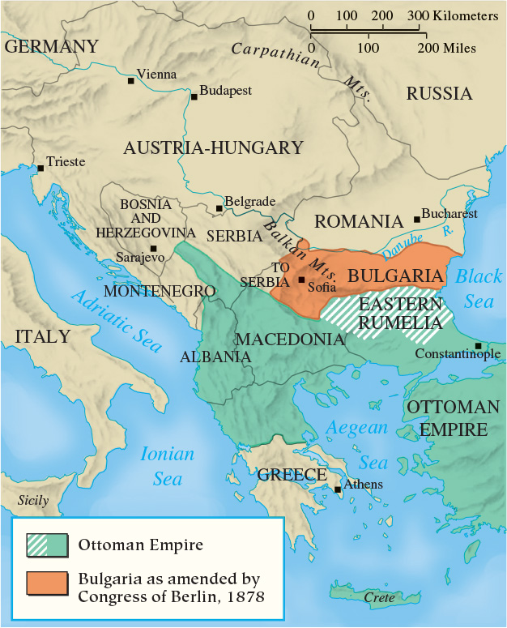
Map 24.5 The Balkans in 1913

Slide 34
Chapter 24 Summary
Driven by national rivalry, Social Darwinism, religious and humanitarian concerns, and economic demands for raw materials and overseas investment, Western nations at the end of the nineteenth century began a renewed frenzy of imperialist expansion around the world.
At the same time, Western treatment of non-Western peoples as racial inferiors caused educated, non-Western elites in the colonies to initiate movements for national independence.
In competing with and fearing each other, the European nations formed defensive alliances that helped maintain a balance of power but also led to the creation of large armies, enormous military establishments, and immense arsenals.
Cultural revolutions in art and science before 1914 also produced anxiety and a crisis of confidence in European
civilization.

Slide 35
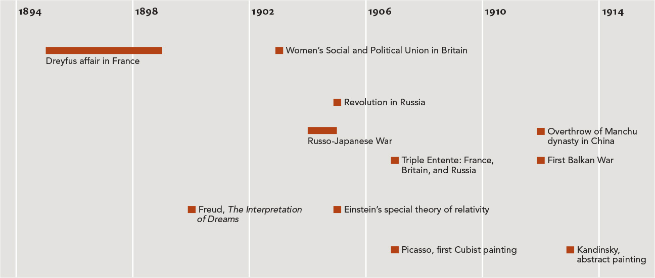
Chapter 24 Timeline

