Slide 1
WESTERN CIVILIZATION: A Brief History
Tenth Edition
CHAPTER 23
Mass Society in an “Age of Progress,” 1871-1894
© 2020 Cengage. All rights reserved.

Slide 2
Chapter 23 Outline
23-1 The Growth of Industrial Prosperity
23-2 The Emergence of a Mass Society
23-3 The National State

Slide 3
23-1 The Growth of Industrial Prosperity
(1 of 4)
Focus Questions: What was the Second Industrial Revolution, and what effects did it have on European economic and social life? What roles did socialist parties and trade unions play in improving conditions for the working classes?
New products
  Steel, substitution for iron
  Electricity
    The lightbulb, the telephone, and electric streetcars and subways
    The transformation of the factory
  The internal combustion engine

Slide 4
23-1 The Growth of Industrial Prosperity
(2 of 4)
New markets
  Renewed focus on the domestic market
    Ability of Europeans to spend more on consumer products
  Evolution of mass marketing and department stores
  Return of protective tariffs
  Cartels formed to decrease competition

Slide 5
23-1 The Growth of Industrial Prosperity
(3 of 4)
New patterns in an industrial economy
  The Second Industrial Revolution and modern economic life
    Germany as the new industrial leader
    The division of Europe into two economic zones
  The spread of industrialization
    Developments in Japan and Russia
  A world economy
Women and work: new job opportunities
  Low-paying service and white-collar jobs after 1870
    Routine work with little hope of advancement

Slide 6
23-1 The Growth of Industrial Prosperity
(4 of 4)
Organizing the working classes
  Socialist parties
    Germany’s Social Democratic Party (SPD) sought to improve the condition of the work class
    Socialist parties in other European states
    Agitation of international organization
  Evolutionary socialism
    Revisionism caused division of Marxists; arguments for gradualist approach
  Trade unions
    Strikes to achieve workers’ goals

Slide 7
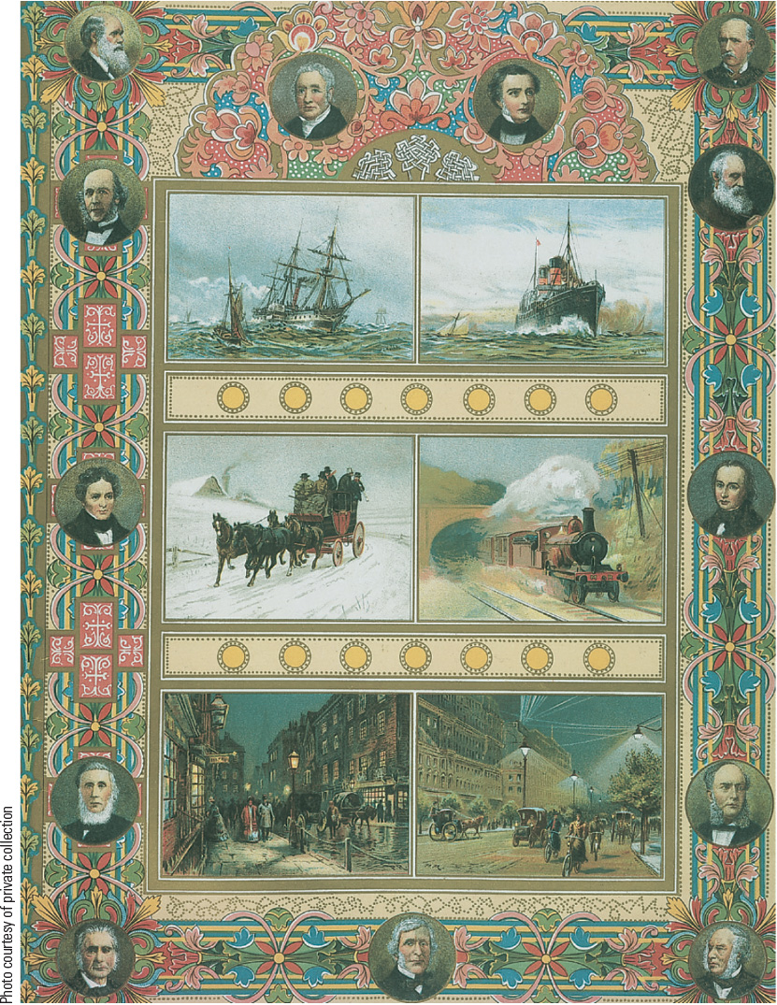
23.2 An Age of Progress. This illustration is taken from a special issue of the Illustrated London News celebrating the Diamond Jubilee of Queen Victoria in 1897. On the left are scenes from 1837, when Queen Victoria came to the British throne, and on the right are scenes from 1897, showing rapid progress.

Slide 8
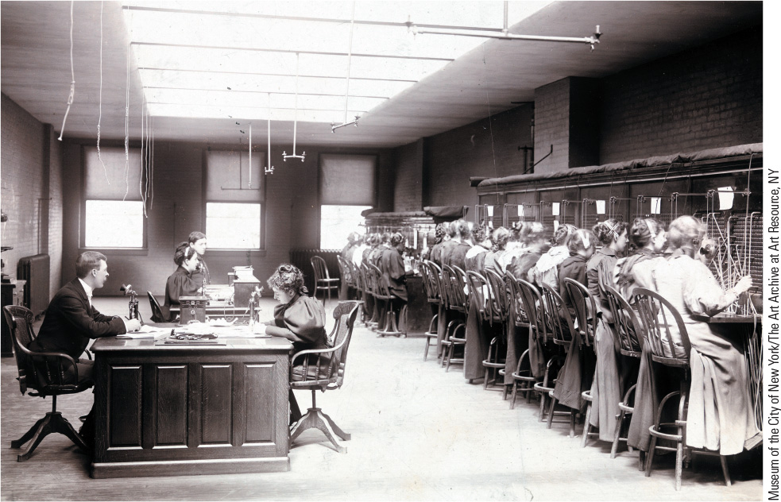
23.4 New Jobs for Women: The Telephone Exchange. The widespread use of the telephone created one of a number of new jobs for women.

Slide 9
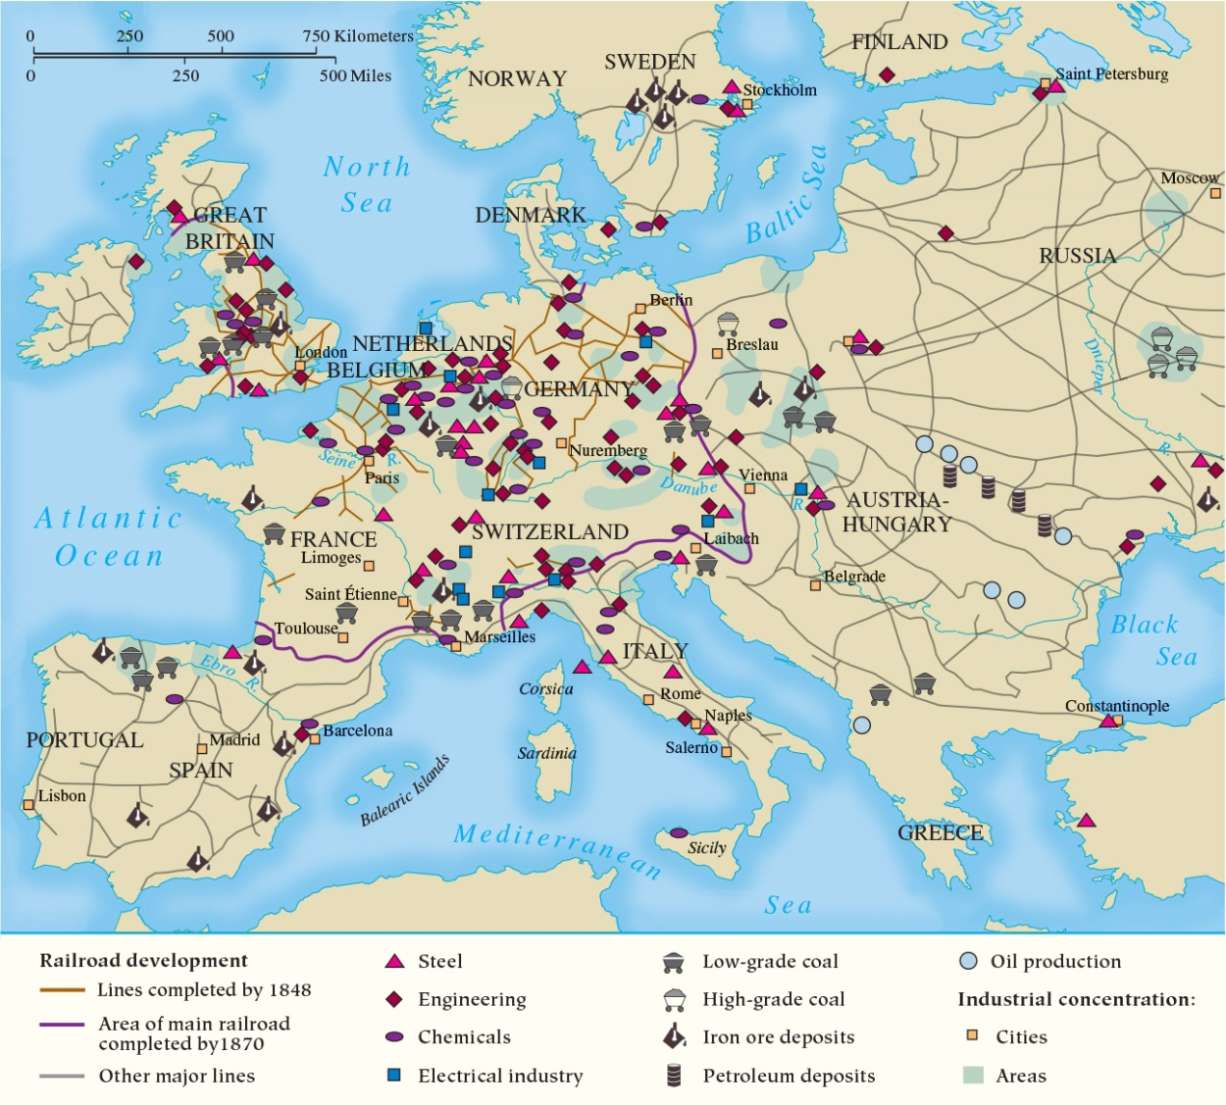
Map 23.1 The Industrial Regions of Europe at the end of the Nineteenth Century

Slide 10
23-2 The Emergence of a Mass Society (1 of 7)
Focus Questions: What is a mass society, and what were its main characteristics? What role were women expected to play in society and family life in the latter part of the nineteenth century, and how closely did patterns of family life correspond to this ideal?
Mass society emerged in Europe after 1870
Population growth
  270 million to more than 460 million from 1870 to 1910
  Rising birthrate from 1850 to 1880
  After 1880, decline in death rate due to medical discoveries and environmental improvements

Slide 11
23-2 The Emergence of a Mass Society (2 of 7)
Emigration
  Excess labor from underdeveloped areas migrated to industrial regions of Europe and America
Transformation of the urban environment
  Improving living conditions
    Britain’s Public Health Act of 1875: running water and drainage
    Fresh water from system of dams and reservoirs
  Housing needs
    Reformers believed in construction of model dwellings rented at reasonable price
    Weak governmental attempts in Britain and Germany
    Reconstruction of Paris as model

Slide 12
23-2 The Emergence of a Mass Society (3 of 7)
Social structure of the mass society
  Wide disparities in wealth
  The upper classes
    Fusion of aristocrats and plutocrats
  The middle classes
    Variety: from traditional professionals to business managers, small shopkeepers, and white-collar workers
    Common lifestyles and values
  The lower classes
    80 percent of the population: landholding peasants, artisans, and urban laborers
    Betterment of conditions for urban workers

Slide 13
23-2 The Emergence of a Mass Society (4 of 7)
The “woman question”: the role of women
  Women remained legally inferior, economically dependent, and largely defined by family and household roles
  Significant drop in birthrates
    New technology and change in attitudes
  The middle-class family
    Family was central institution of middle-class life
    Domestic servants used in many homes
    Middle-class females educated in domestic crafts, singing, and piano playing

Slide 14
23-2 The Emergence of a Mass Society (5 of 7)
The “woman question”: the role of women
  The working-class family
    Women more accustomed to hard work
    End of childhood by the age of nine or ten
    High-paying jobs in heavy industry and improvements in standard of living led to change in working-class family
    More women able to stay at home
    Children seen as dependents, so limited family size

Slide 15
23-2 The Emergence of a Mass Society (6 of 7)
Education in the mass society
  Universal elementary education
    Mass education: a product of mass society
    Primary education offered by government to children between six and twelve
    Reasoning behind mass education: more skilled laborers, an educated electorate, indoctrination in national values
  Female teachers
    In the United States, women constituted two-thirds of all teachers by the 1880s
    Teaching was extension of women’s “natural role”
  Literacy and the mass newspaper
    Dramatic increase in literacy led to mass newspapers, specialty magazines, and pulp fiction

Slide 16
23-2 The Emergence of a Mass Society (7 of 7)
Mass leisure
  The role of technology
  First market for tourism
  Team sports become more organized
    Football and rugby in Britain; baseball in United States
Mass consumption
  Consumption fueled by improvements in standard of living, factory system, population growth, expanded transportation systems, and urbanization
  Modernization of retailing through standardization
  Advertisements

Slide 17
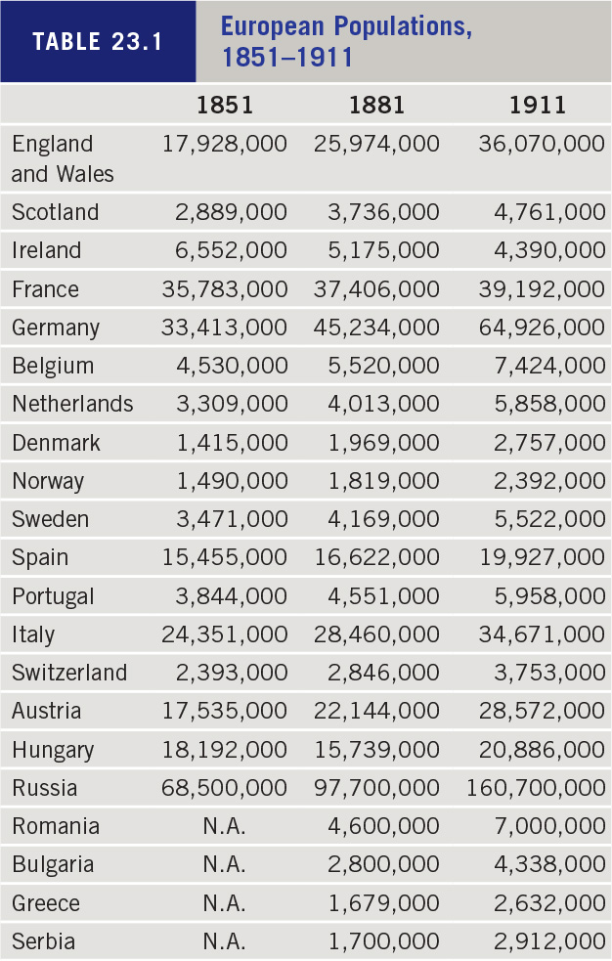
Table 23.1: European Populations, 1851–1911

Slide 18
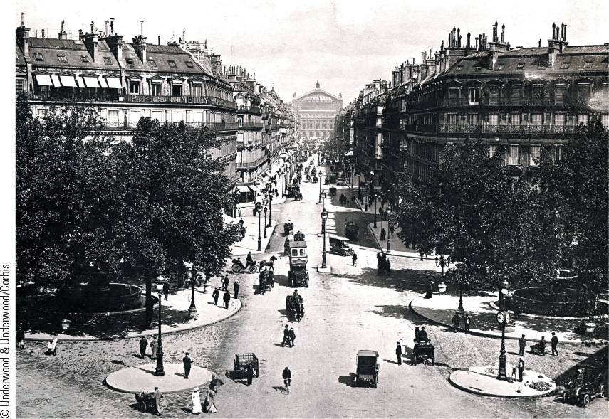
23.5b Paris Transformed. This image of Paris from the 1880s shows new uniform buildings, gas street lamps, and broad boulevards that linked the city’s great cultural sites.

Slide 19
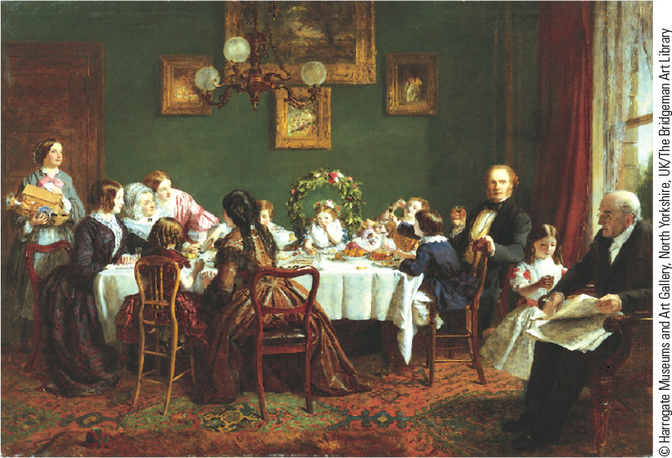
23.6a The Middle-Class Family. This image of middle-class domesticity shows grandparents, parents, and children taking part in a family birthday celebration for a little girl.

Slide 20
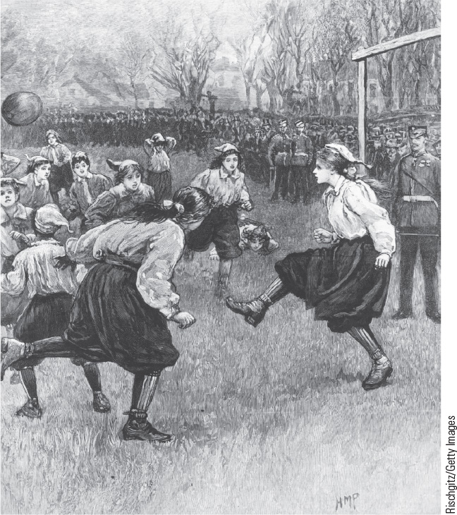
23.7 Soccer Moments. In this sketch from The Graphic, two players are depicted with the rose of England on their jerseys playing in an international soccer match in 1872.

Slide 21
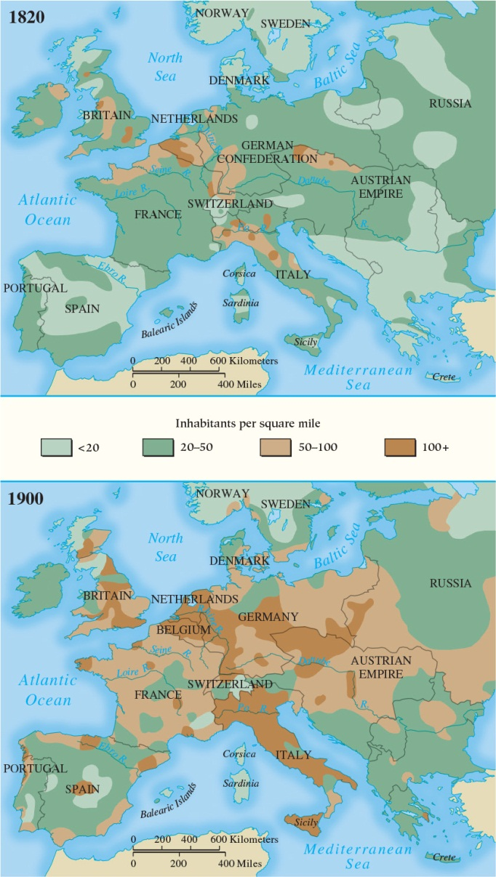
Map 23.2 Population Growth in Europe, 1820–1900

Slide 22
23-3 The National State (1 of 4)
Focus Question: What general political trends were evident in the nations of western Europe in the last decades of the nineteenth century, and how did these trends differ from the policies pursued in Germany, Austria-Hungary, and Russia?
The new reality of mass politics

Slide 23
23-3 The National State (2 of 4)
Western Europe: the growth of political democracy
  Reform in Britain
    Reform Acts of 1867 and 1884 expanded suffrage
    Redistribution Act of 1885 established constituencies with approximately equal populations
  The Third Republic in France
    Monarchists won election after fall of Second Empire
    Paris Commune, 1871: government massacred thousands of republican Commune defenders
    Bicameral legislature established, 1875
  Italy
    North/South differences hindered unity
    Extensive corruption existed in government

Slide 24
23-3 The National State (3 of 4)
Central and Eastern Europe: persistence of the old order
  Germany
    Constitution provided for a federal system, but the emperor, Bismarck, and the army maintained extensive power
    Bismarck: attacks on Kulturkampf and socialists and concessions with social security
  Austria-Hungary
    Emperor Francis Joseph ignored ministerial responsibility; ruled by decree
    Ethnic Germans governed, but threatened by Czechs, Poles, and other Slavic groups
    Unifying factors included the emperor, Catholic Church, and large imperial bureaucracy

Slide 25
23-3 The National State (4 of 4)
Central and Eastern Europe: persistence of the old order
  Russia
    Alexander III instituted “exceptional measures”
    Secret police expanded
    Radical Russification program pursued
    Nicholas II adopted Alexander III convictions

Slide 26
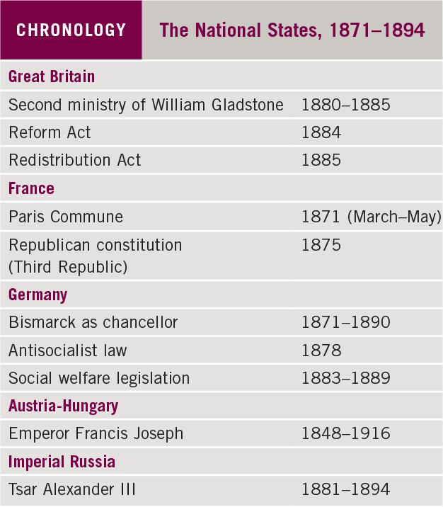
Chronology: The National States, 1871–1894

Slide 27
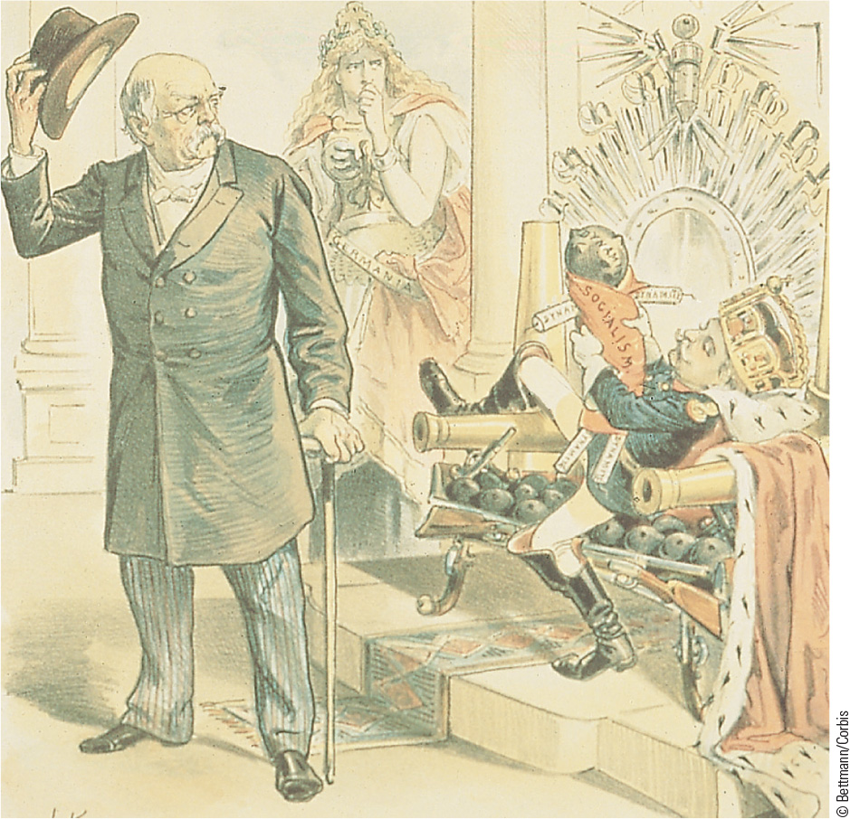
23.8 Bismarck and William II. This political cartoon shows William II reclining on a throne holding a doll labeled “socialism” while Bismarck bids farewell.

Slide 28
Chapter 23 Summary
The Second Industrial Revolution helped create a new material prosperity that led Europeans to believe they had ushered in a new age of progress.
Major features of the new age included the emergence of a mass society, dramatic population increases, emigration, class divisions, and mass consumption.
New forms of mass transportation, combined with new work patterns, enabled large numbers of people to participate in mass leisure activities, including weekend excursions to amusement parks and sea-side resorts, dance halls, and sporting events.
The extension of state functions and greater participation took place in an atmosphere of growing national loyalty.

Slide 29
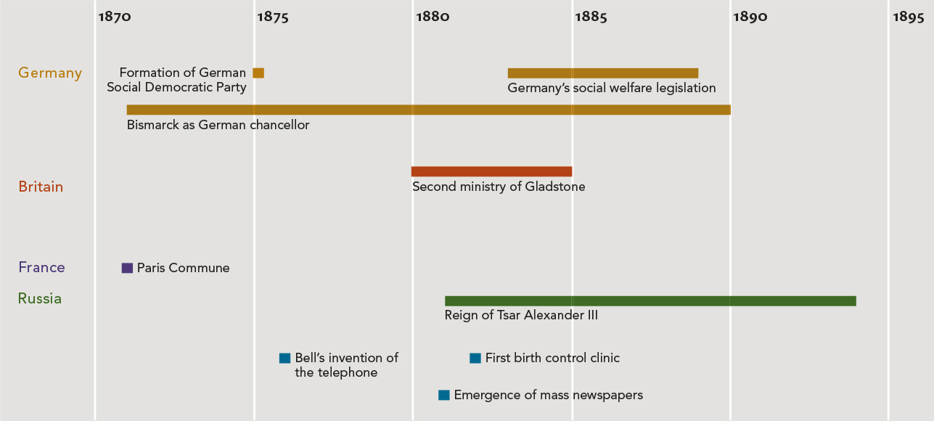
Chapter 23 Timeline

