Slide 1
WESTERN CIVILIZATION: A Brief History
Tenth Edition
CHAPTER 22
An Age of Nationalism and Realism, 1850–1871
© 2020 Cengage. All rights reserved.

Slide 2
Chapter 22 Outline
22-1 The France of Napoleon III
22-2 National Unification: Italy and Germany
22-3 Nation Building and Reform: The National State in Midcentury
22-4 Industrialization and the Marxist Response
22-5 Science and Culture in an Age of Realism

Slide 3
22-1 The France of Napoleon III (1 of 2)
Focus Question: What were the characteristics of Napoleon III’s government, and how did his foreign policy contribute to the unification of Italy and Germany?
Louis Napoleon: toward the Second Empire
  From president to emperor as Napoleon III
The second Napoleonic Empire
  Napoleon III controlled armed forces, police, civil service, and the ability to introduce legislation and declare war
  Policies: stimulate economy and expand industrial growth; fund infrastructure and the reconstruction of Paris
  Opposition and failures led to end of regime

Slide 4
22-1 The France of Napoleon III (2 of 2)
Foreign policy: The Mexican adventure
  Troops to Mexico in 1861
  Napoleon installed Maximillian as emperor of Mexico; surrendered to Mexican forces in 1867 and executed
Foreign policy: the Crimean War
  The Ottoman Empire
    Decline led to European and Russian expansion
  War in the Crimea
    Poorly planned and poorly fought; costly to both sides
    Innovations: telegraph and Florence Nightingale
    Treaty of Paris, signed in 1856: Concert of Europe destroyed

Slide 5
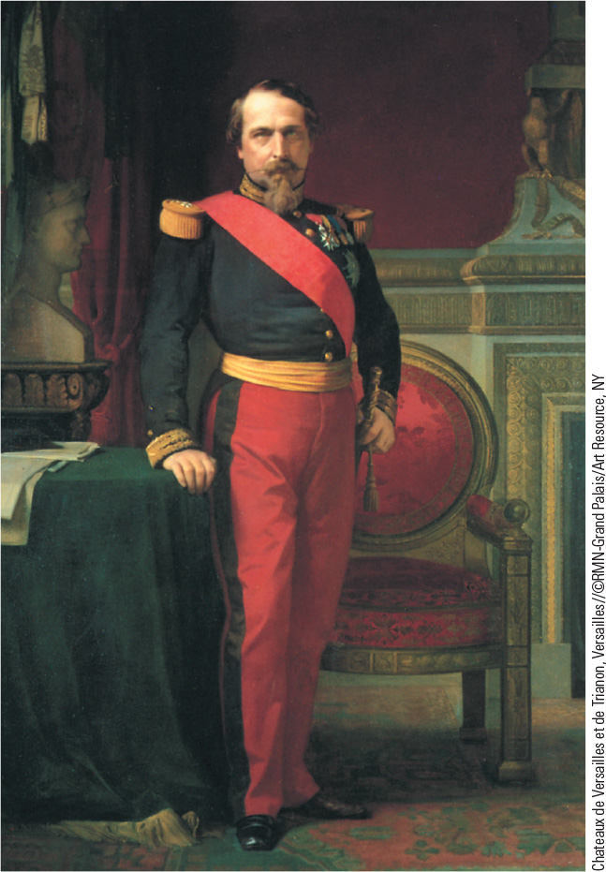
22.2 Emperor Napoleon III. Louis Napoleon of France took the title of Napoleon III in 1852 and created an authoritarian monarchy until opposition forced him to liberalize.

Slide 6
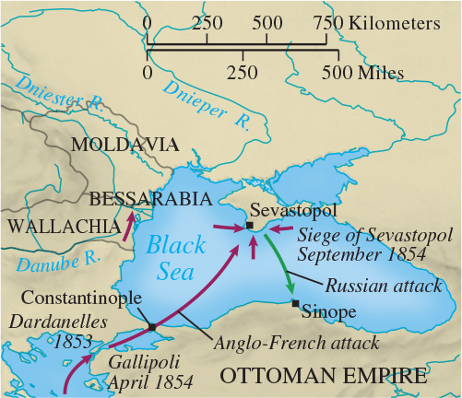
Map 22.1 The Crimean War

Slide 7
22-2 National Unification: Italy and Germany
(1 of 3)
Focus Question: What actions did Cavour and Bismarck take to bring about unification in Italy and Germany, respectively, and what role did war play in their efforts?
The unification of Italy
  The leadership of Cavour
    Policy of economic expansion to increase revenue and equip an army to challenge Austria, with help from France
    Parma, Modena, and Tuscany joined Piedmont
  The efforts of Garibaldi
    The unification of the south under the Red Shirts
    The new Italian state and the completion of unification

Slide 8
22-2 National Unification: Italy and Germany
(2 of 3)
The unification of Germany
  Bismarck
    Strengthening the army and ignoring parliament: “iron and blood”
    Realpolitk
  The Danish War (1864)
    Bismarck persuaded Austrians to join defeat of Danes
    Prussia gained land and exploited tensions with Austria

Slide 9
22-2 National Unification: Italy and German
(3 of 3)
The unification of Germany
  The Austro-Prussian War (1866)
    Superior railroads and artillery enabled Prussian victory
    Creation of the North German Confederation
  The Franco-Prussian War (1870–1871)
    France goaded into declaring war in July 1870
    At Sedan, an entire French army and Napoleon III captured
    Paris capitulated on January 28, 1871
    Before war ended, William I was proclaimed kaiser of Second German Empire on January 18, 1871

Slide 10
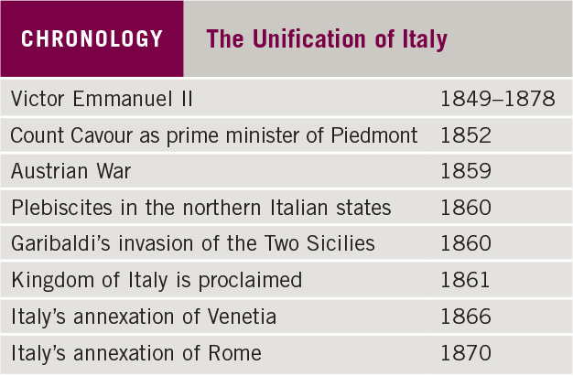
Chronology: The Unification of Italy

Slide 11
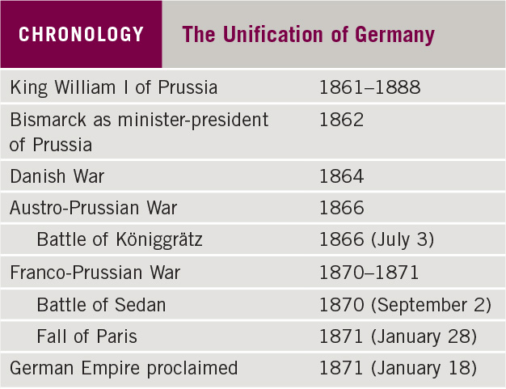
Chronology: The Unification of Germany

Slide 12
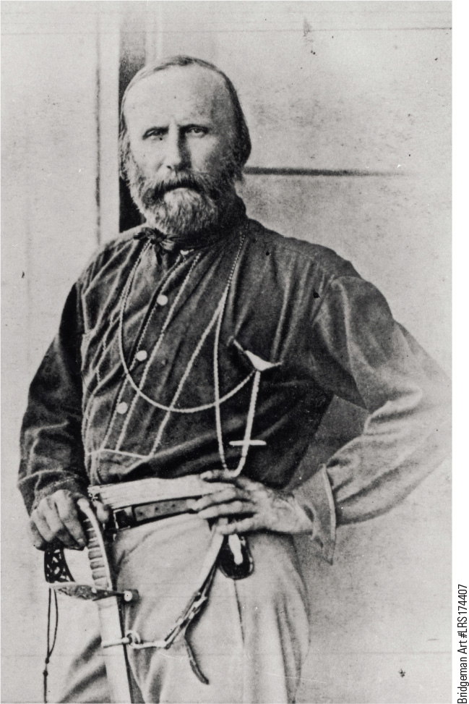
22.4 Garibaldi. An important figure in the cause of Italian unification was Giuseppe Garibaldi, a determined patriot. He is shown here in an 1860 photograph by French photographer Gustave Le Gray.

Slide 13
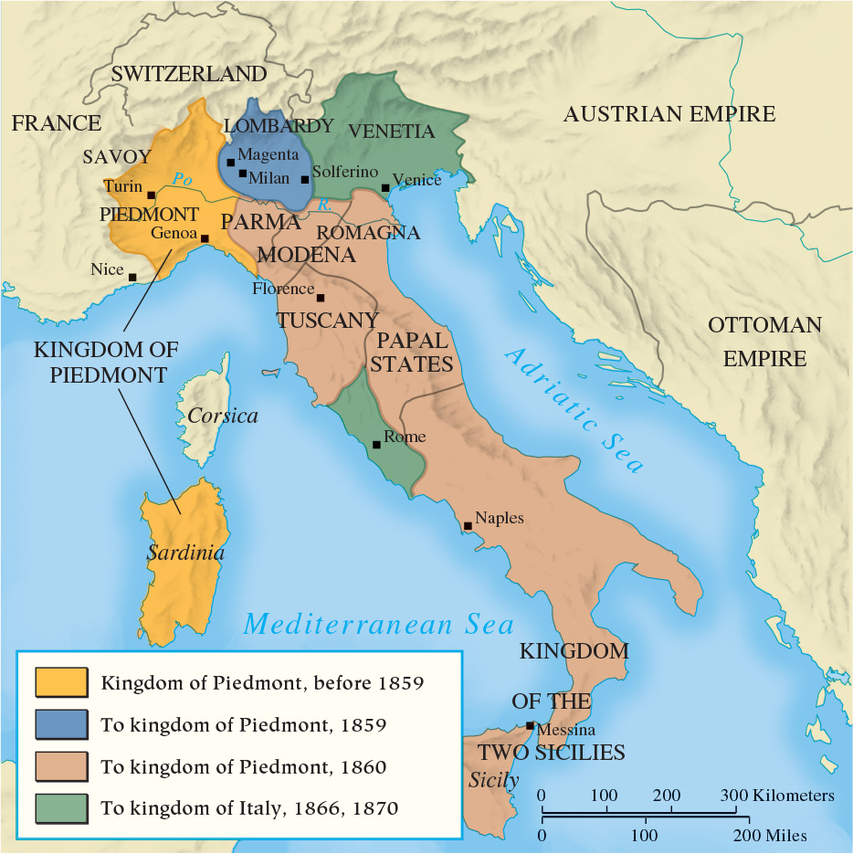
Map 22.2 The Unification of Italy

Slide 14
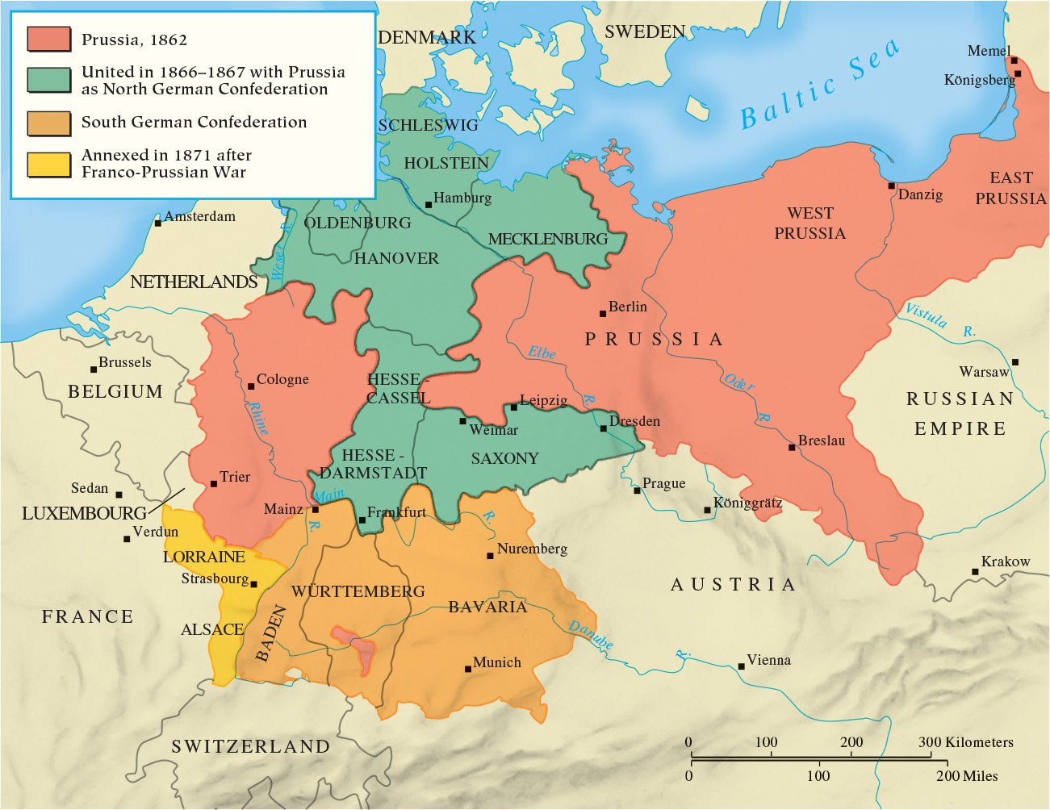
Map 22.3 The Unification of Germany

Slide 15
22-3 Nation Building and Reform: The National State in Midcentury (1 of 5)
Focus Question: What efforts for reform occurred in the Austrian Empire, Russia, and Great Britain between 1850 and 1870, and how successful were they in alleviating each nation’s problems?
The Austrian Empire: toward a dual monarchy
  Defeated by Prussians, Austria forced to deal with nationalistic Hungary
  Ausgleich of 1867 created the Dual Monarchy of Austria-Hungary
    Each state had own constitution, legislature, and governmental machinery for domestic affairs, and capital
    Single monarch held two states together

Slide 16
22-3 Nation Building and Reform: The National State in Midcentury (2 of 5)
Imperial Russia
  March 3, 1861: Alexander issues emancipation edict
    Peasants can own property, marry freely, and bring suits to law court; expected to repay state in long-term installments to mir (village commune)
  Zemstvos (assemblies) provided moderate degree of self-government
  Alexander II assassinated in 1881
    Alexander III returned to repressive methods

Slide 17
22-3 Nation Building and Reform: The National State in Midcentury (3 of 5)
Great Britain: the Victorian Age
  Continuing economic growth created British stability
    From 1850–1870, real wages increased 25 percent
  National pride reflected in Queen Victoria
  Extension of voting rights
    Reform Act of 1867 nearly doubled the number of voters by enfranchising many male urban workers

Slide 18
22-3 Nation Building and Reform: The National State in Midcentury (4 of 5)
The United States: slavery and war
  Polarization between North and South over the issue of slavery
  The Civil War (1865–1865)
    More than 600,000 dead
    Began as a war to save Union, became war against slavery
    January 1,1863: Lincoln’s Emancipation Proclamation
    April 9, 1865: General Ulysses S. Grant forced General Robert E. Lee’s Confederate army to surrender

Slide 19
22-3 Nation Building and Reform: The National State in Midcentury (5 of 5)
The emergence of a Canadian nation
  By 1800, most Canadians favored more independence
  After 1815, increased immigration fueled desire for self-government
  In 1837, Canadian groups rebelled against Britain
  In 1867, Parliament established Canadian nation, the Dominion of Canada

Slide 20
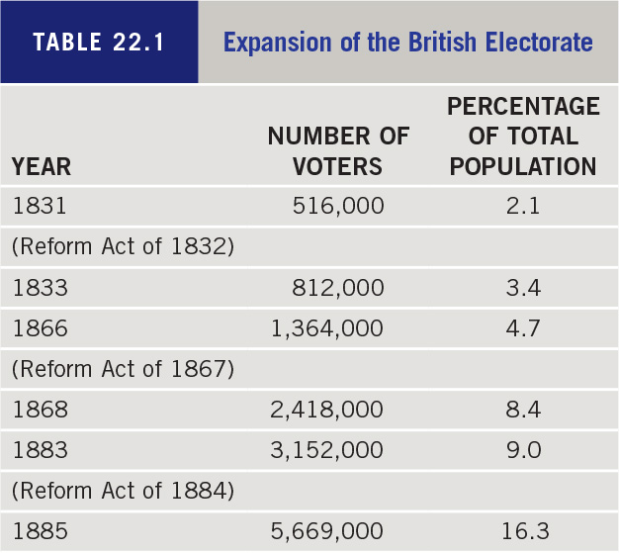
Table 22.1: Expansion of the British Electorate

Slide 21
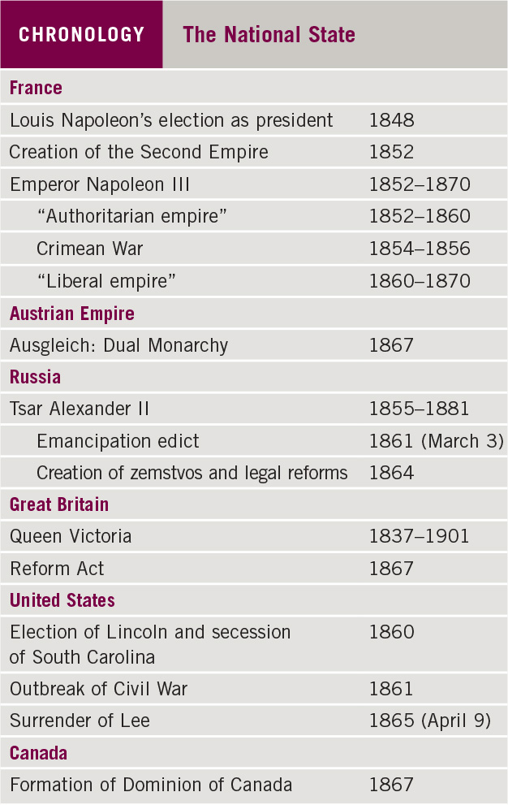
Chronology: The National State

Slide 22
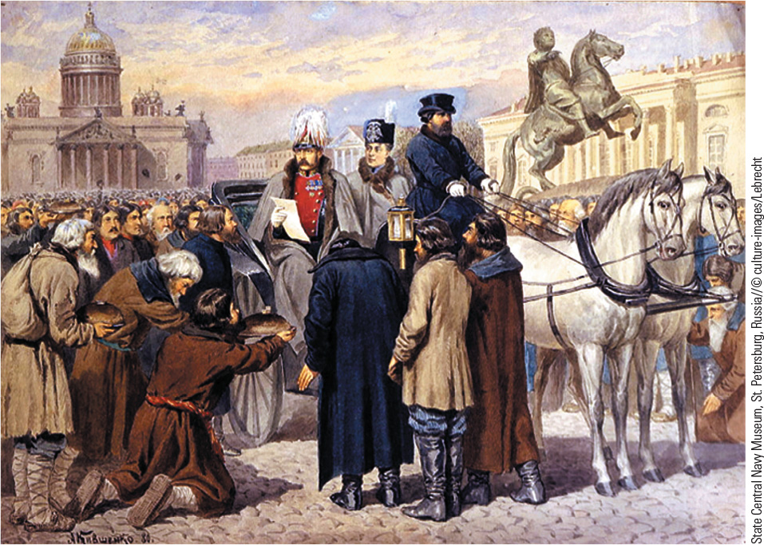
22.5 Emancipation of the Serfs. On March 3, 1861, Tsar Alexander II, shown here, issued an edict emancipating the Russian serfs.

Slide 23
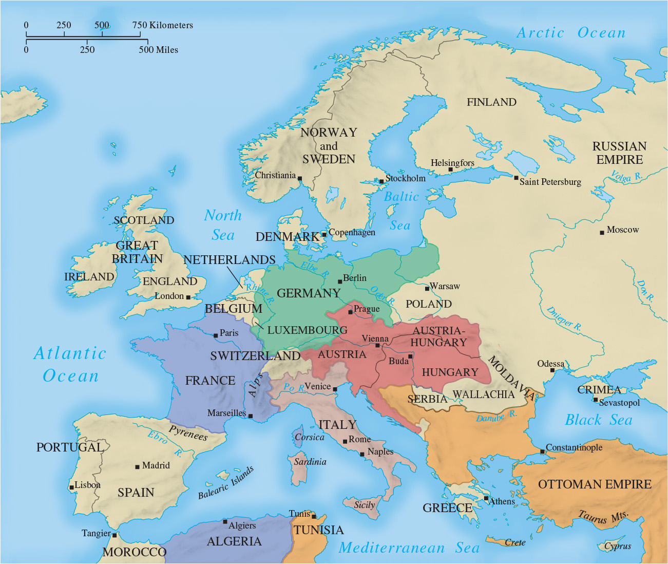
Map 22.4 Europe in 1871

Slide 24
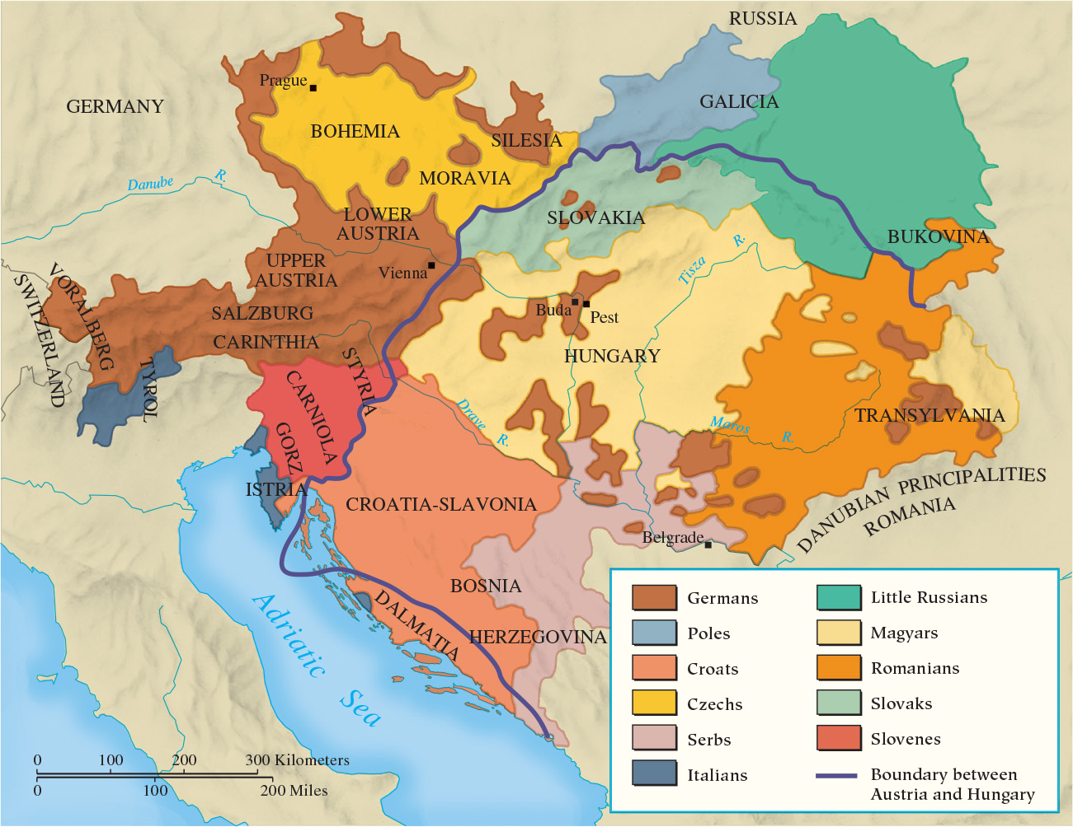
Map 22.5 Ethnic Groups in the Dual Monarchy, 1867

Slide 25
22-4 Industrialization and the Marxist Response
Focus Question: What were the main ideas of Karl Marx?
Marx and Marxism
  1848: The Communist Manifesto of Karl Marx and Friedrich Engels marked the beginning of Marxism
    Focus on the emerging class struggle between proletariat and bourgeoisie that will lead to a classless society
  Flight to Britain
    Continued writing on political economy; active in the International Working Men’s Association

Slide 26
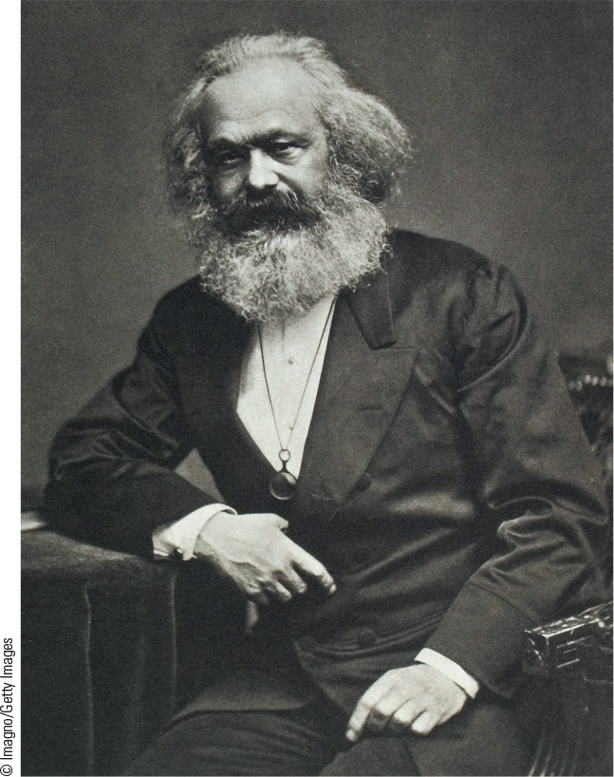
22.6 Karl Marx.
Karl Marx was a radical journalist who, with Friedrich Engels, wrote The Communist Manifesto, which proclaimed the ideas of a revolutionary socialism.

Slide 27
22-5 Science and Culture in an Age of Realism
(1 of 3)
Focus Question: How did the belief that the world should be viewed realistically manifest itself in science, literature, and art in the second half of the nineteenth century?
A new age of science
  Louis Pasteur devised germ theory of disease
  Robert Koch furthered study of bacteriology with work on bacteria and tuberculosis
  Dmitri Mendeleyev created first periodic table of elements
  Michael Faraday laid groundwork for use of electricity
  Materialism increased

Slide 28
22-5 Science and Culture in an Age of Realism
(2 of 3)
Charles Darwin and the theory of organic evolution
  1859: On the Origin of Species by Means of Natural Selection published
    Presented principle of organic evolution and process of natural selection
  1871: The Descent of Man published
    Argued for animal origins of human beings
  From controversy to acceptance
    Attempts to apply Darwin’s ideas to society

Slide 29
22-5 Science and Culture in an Age of Realism
(3 of 3)
Realism in literature
  Deliberate rejection of Romanticism
    Gustave Flaubert perfected Realist novel in Madame Bovary
    William Thackeray, Vanity Fair: A Novel without a Hero
    Charles Dickens’ realistic novels focused on lower and middle classes
Realism in Art
  Gustave Courbet, the most famous artist of the Realist school
    No subject was too ordinary, too harsh, or too ugly to be of interest
  Jean-François Millet preoccupied with scenes from rural life

Slide 30
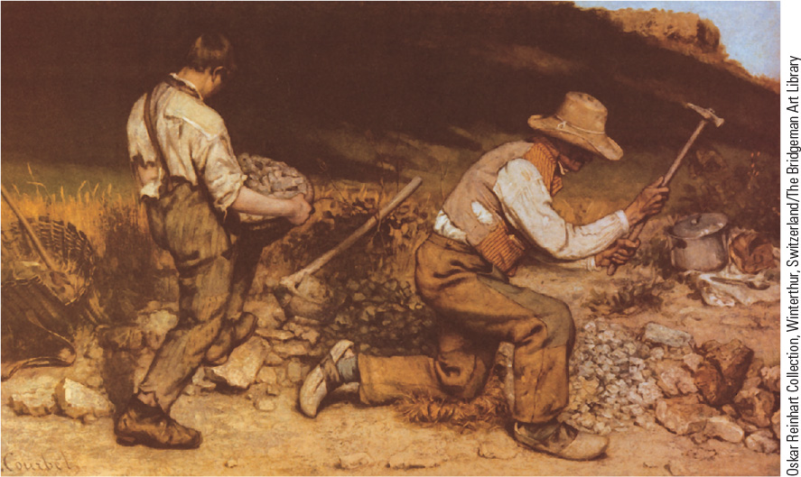
22.7 Gustave Courbet, The Stonebreakers. Gustave Courbet, the most famous of the Realist artists, shows road builders in tattered clothing engrossed in their dreary work.

Slide 31
Chapter 22 Summary
The national state became the focus of people’s loyalty between 1850 and 1871, and the nations of Europe spent their energies in achieving unification or reform.
Unification to achieve a national state preoccupied leaders in Italy and Germany, with national unity achieved in 1870 and 1871, respectively.
Reform characterized developments in other Western states, which had to contend with political nationalism.
The emergence of Marxian socialism and new advances in science, including the laws of thermodynamics and Darwin’s theory of evolution, also characterized the period between 1850 and 1871.

Slide 32
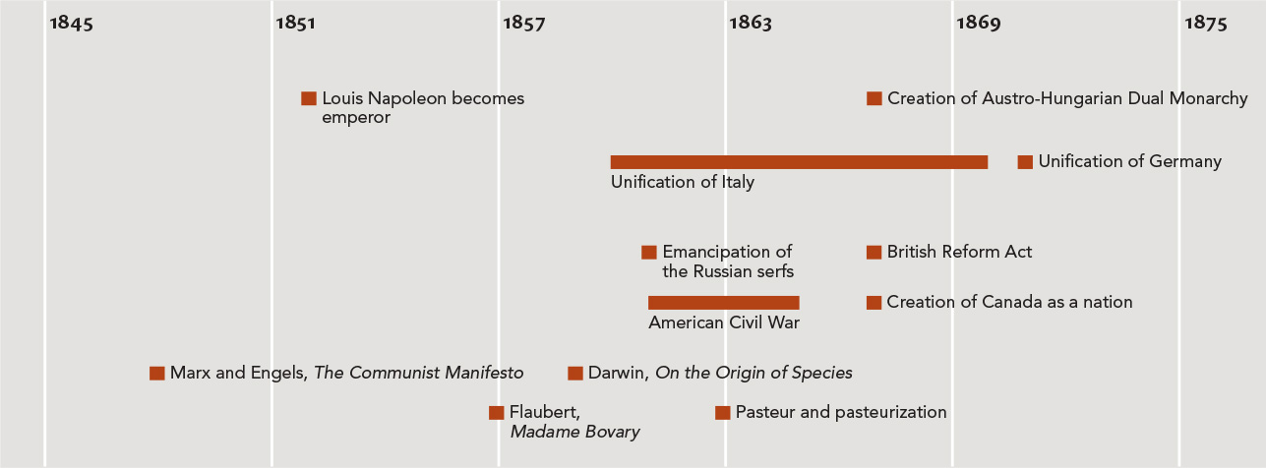
Chapter 22 Timeline

