Slide 1
WESTERN CIVILIZATION: A Brief History
Tenth Edition
CHAPTER 21
Reaction, Revolution, and Romanticism, 1815–1850
© 2020 Cengage. All rights reserved.

Slide 2
Chapter 21 Outline
21-1 The Conservative Order, 1815–1850
21-2 The Ideologies of Change
21-3 Revolution and Reform, 1830–1850
21-4 Culture in an Age of Reaction and Revolution: The Mood of Romanticism

Slide 3
21-1 The Conservative Order, 1815–1830
(1 of 4)
Focus Question: What were the goals of the Congress of Vienna and the Concert of Europe, and how successful were they in achieving those goals?
The Congress of Vienna
  Leadership: Klemens von Metternich
    Principle of legitimacy – legitimate monarchs to preserve traditional institutions
  Balance of power – no single country able to dominate Europe

Slide 4
21-1 The Conservative Order, 1815–1830
(2 of 4)
Conservative domination
  Ideology known as conservatism
    Origins in 1790 with Edmund Burke’s Reflections on the Revolution in France
  The Concert of Europe
    Formation of the Quintuple Alliance and adoption of the principle of intervention
  The revolt of Latin America
    Simón Bolívar liberated Colombia and Venezuela
    José de San Martín liberated Argentina, Chile, and Peru
  The Greek revolt
    The only successful revolution in Europe

Slide 5
21-1 The Conservative Order, 1815–1830
(3 of 4)
Conservatives in the European states
  Great Britain
    Tory domination of government until 1830
    Corn Law of 1815 imposed high tariffs
    Mass protests in 1819 led to restrictions
  Restoration in France
    Bourbon family restored to throne in 1814
    Louis XVIII accepted Napoleon’s Civil Code
    Public outrage at Charles X’s attempt to restore the old regime

Slide 6
21-1 The Conservative Order, 1815–1830
(4 of 4)
Conservatives in the European states
  The Italian states
    Nine kingdoms largely under Austria’s thumb
    Reactionary governments eager to smother any liberal or nationalist sentiment
  Repression in Central Europe
    Metternich managed to repress nationalist forces and hold empire together
  Russia: autocracy of the tsars
    Alexander I, initially willing to make reforms, became reactionary after Napoleon’s defeat
    Nicholas I, known as the Policeman of Europe

Slide 7
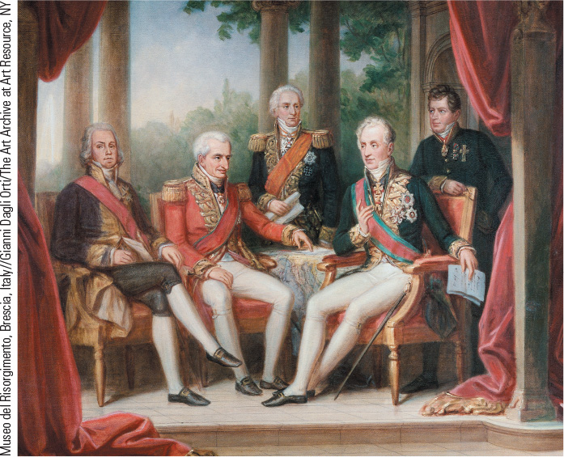
21.1 A Gathering of Statesmen at the Congress of Vienna. In 1814 statesmen gathered at Vienna to arrange a final peace settlement after almost a decade of war.

Slide 8
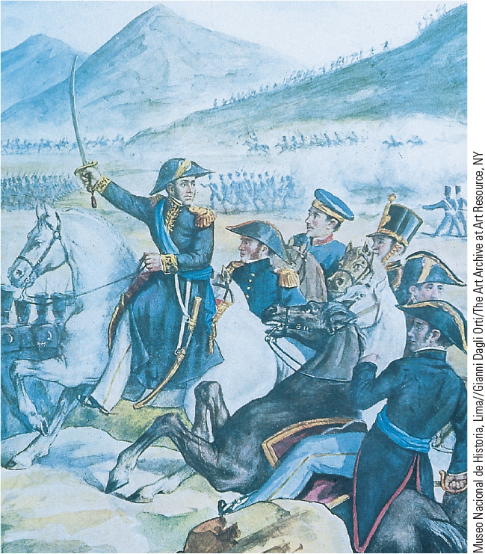
21.2 A Liberator of South America. José de San Martín of Argentina was hailed as one of the leaders of the Latin American independence movement.

Slide 9
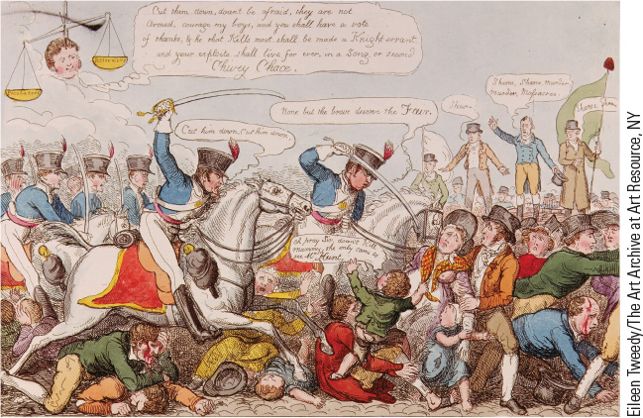
21.3 Peterloo Massacre. This colored etching depicts the massacre in 1819 in St. Peter’s Field in Manchester when protesters gathered to call for parliamentary reforms.

Slide 10
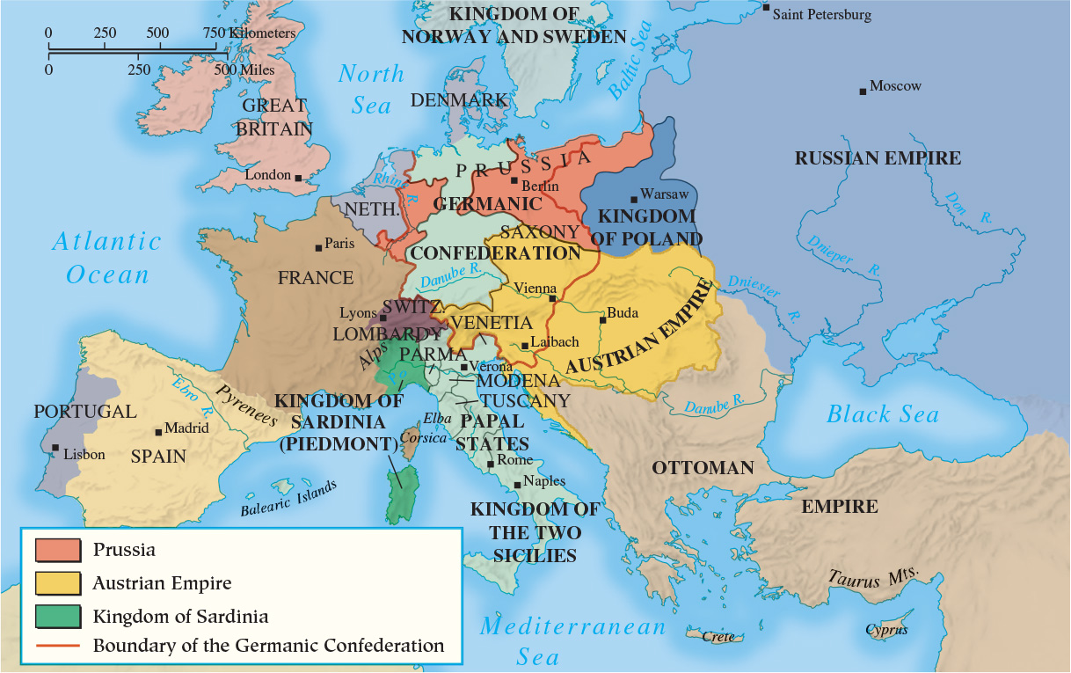
Map 21.1 Europe After the Congress of Vienna, 1815

Slide 11
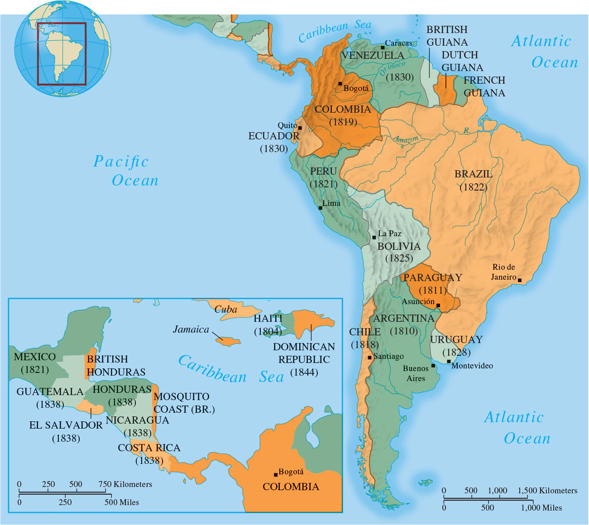
Map 21.2 Latin America in the First Half of the
Nineteenth Century

Slide 12
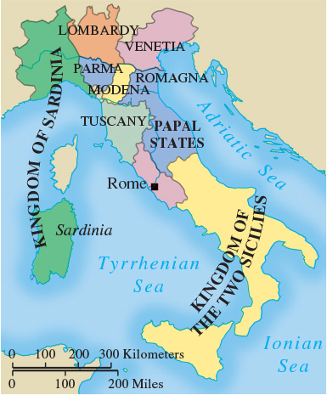
Map 21.4 Italy, 1815

Slide 13
21-2 The Ideologies of change (1 of 2)
Focus Question: What were the main tenets of conservatism, liberalism, nationalism, and utopian socialism, and what role did each ideology play in Europe in the first half of the nineteenth century?
Liberalism
  Economic liberalism
    Laissez faire: state should not interrupt natural economic forces
    Primary functions of government: defense of country, protection of individual, and maintenance of public works
  Political liberalism
    Civil liberties: basic rights of all people
    Ministerial responsibility to legislature, not king
    John Stuart Mill: On Liberty; women’s rights

Slide 14
21-2 The Ideologies of change (2 of 2)
Nationalism
  Awareness of being part of community with common institutions, historical traditions, language, and customs
    Became a force for change during French Revolution
  Threatened to upset the existing political order
  Nationalism and liberalism became strong allies
Early socialism
  Largely a product of political theorists or utopian socialists who believed human cooperation was superior to competition
    Robert Owen’s New Lanark and New Harmony

Slide 15
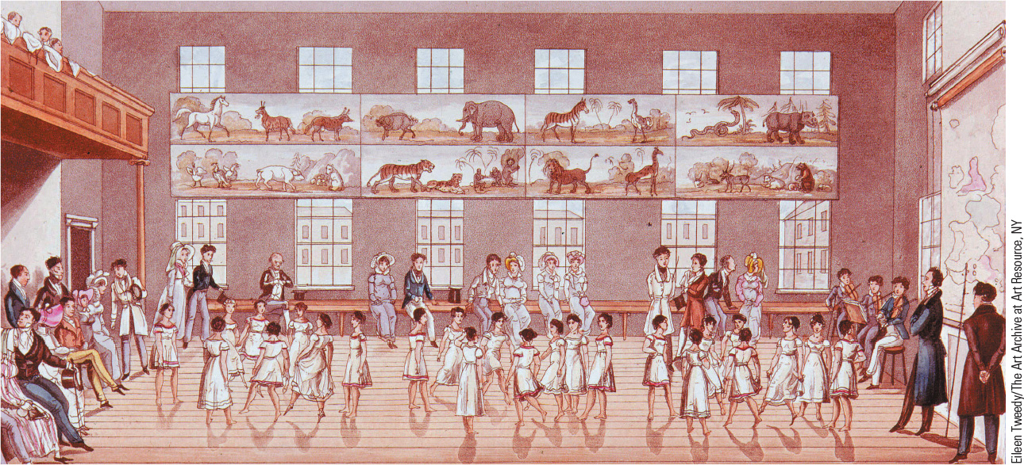
21.4 Children at New Lanark. In this illustration, children of factory workers at Robert Owen’s model industrial community in Scotland are shown dancing the quadrille.

Slide 16
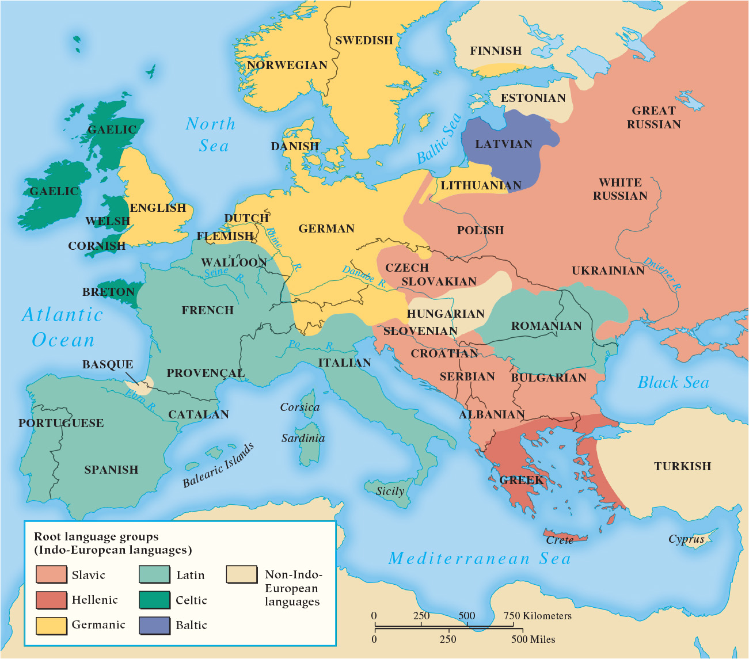
Map 21.5 The Distribution of Languages in Nineteenth-Century Europe

Slide 17
21-3 Revolution and Reform, 1830–1850
(1 of 4)
Focus Questions: What forces for change were present in France and Great Britain between 1830 and 1848, and how did each nation respond? What were the causes of the revolutions of 1848, and why did the revolutions fail?
The Revolutions of 1830
  July Revolution in France and Louis-Philippe’s bourgois monarchy
  Belgian independence from the Dutch
  Unsuccessful uprisings in Poland and Italy
  The coming to power of the Whigs
    British Reform Act of 1832: concessions avoided revolution

Slide 18
21-3 Revolution and Reform, 1830–1850
(2 of 4)
The Revolutions of 1848
  Another French Revolution
    Industrial and agricultural depression led to hardship and unemployment
    Monarchy overthrown on February 24, 1848
    Provisional government called for a new constitution and established national workshops
    Failure of working class revolt
    Second Republic established in November 1848
  Revolution in the Germanic states
    Prussia’s Frederick William IV made liberal reforms
    Frankfurt Assembly failed to achieve united Germany

Slide 19
21-3 Revolution and Reform, 1830–1850
(3 of 4)
The Revolutions of 1848
  Upheaval in the Austrian empire
    Hungarian liberals agitated for commonwealth status
    Emperor Ferdinand I made concessions but moved to reestablish firm control
    Francis Joseph I crushed Hungarian revolution with aid of Nicholas I
  Revolts in the Italian states
    Sicily, Lombardy, Venetia, and Piedmont all revolt
    Only Piedmont kept its liberal constitution
The failures of 1848
  Failure of revolutionaries to remain united led to reestablishment of old regimes

Slide 20
21-3 Revolution and Reform, 1830–1850
(4 of 4)
The maturing of the United States
  Bitter conflict erupted between the Federalists and the Republicans
  John Marshall and the Supreme Court
    Asserted right to overrule an act of Congress if found to be in violation of Constitution
  Election of Andrew Jackson in 1828 opened new era in American politics
    Suffrage for all adult white males by end of presidency

Slide 21
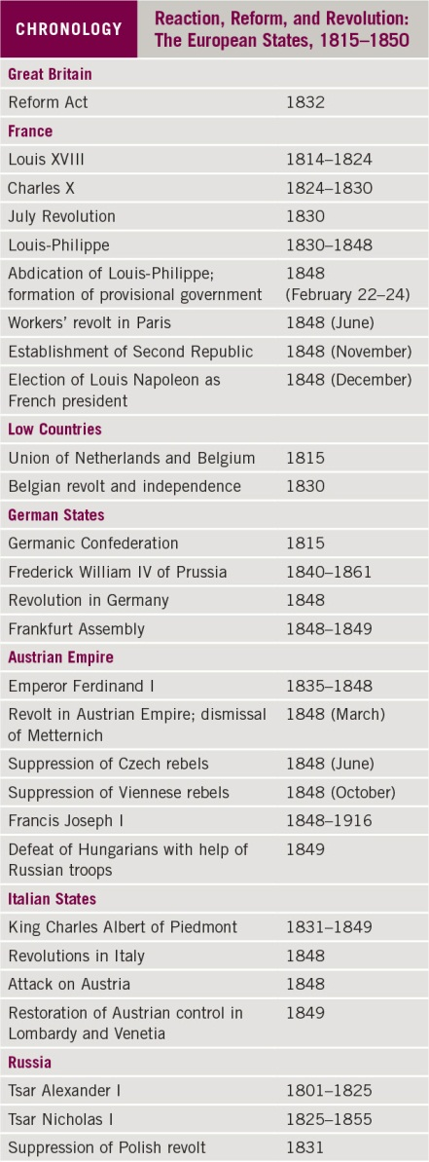
Chronology: Reaction, Reform, and Revolution: The European States, 1815–1850

Slide 22
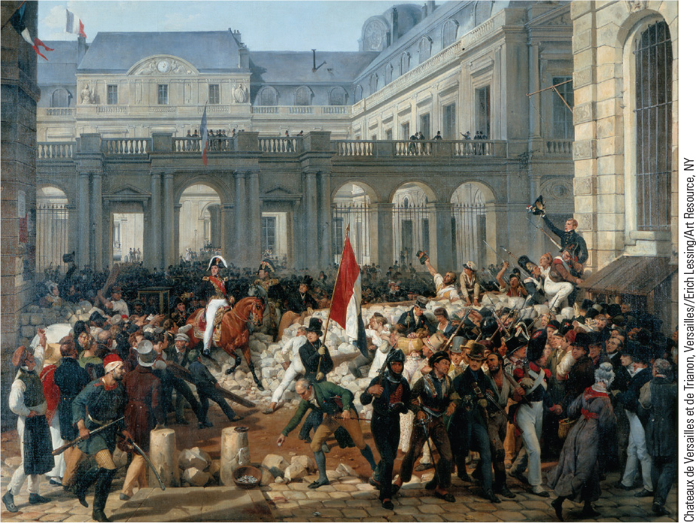
21.5 The Revolution of 1830. In this painting Louis-Philippe is seen riding to city hall, preceded by a man holding the French revolutionary tricolor flag.

Slide 23
21-4 Culture in an age of reaction and revolution: the mood of romanticism (1 of 2)
Focus Question: What were the characteristics of Romanticism, and how were they reflected in literature, art, and music?
The characteristics of Romanticism
  Individualism and sentiment: Goethe
  Passionate interest in past
    Grimm brothers, Anderson, Scott
  An attraction in the bizarre and unusual: Gothic literature
    Poe and Shelley

Slide 24
21-4 Culture in an age of reaction and revolution: the mood of romanticism (2 of 2)
Romantic poets and the love of nature
  Poetry as direct expression of one’s soul
  Shelley’s Prometheus Unbound
  Byron’s Childe Harold’s Pilgrimage
  Wordsworth’s view of nature as alive and sacred led to pantheism
Romanticism in art
  Romantics abandoned classical restraint for warmth, emotion, and movement
  Friedrich and Delacroix
Romanticism in music
  Beethoven bridged gap between Classical and Romantic periods of music

Slide 25
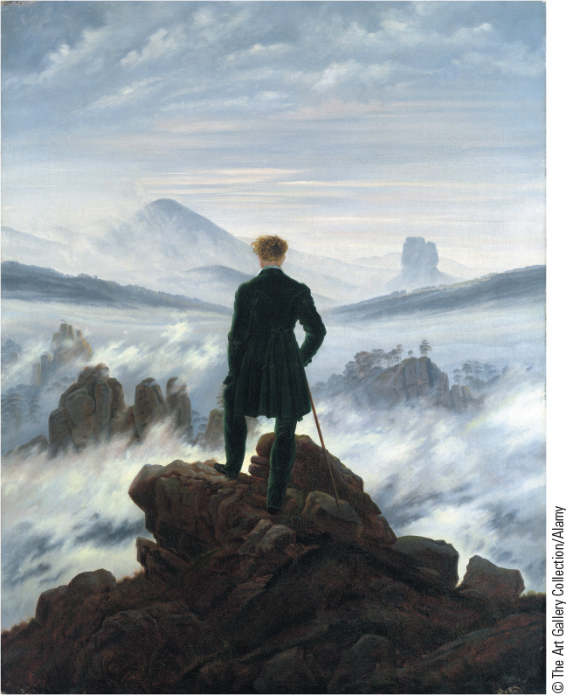
21.6 Caspar David Friedrich, The Wanderer Above the Sea of Fog. Overwhelmed by the all-pervasive presence of nature, the figure expresses the human longing for infinity.

Slide 26
Chapter 21 Summary
After the Congress of Vienna, the great powers attempted to ensure the durability of the new conservative order by intervening to uphold conservative governments.
The status quo was threatened in the 1820s and 1830s by liberalism and nationalism.
The continuing force of revolution led to upheavals in 1848, but they failed to bring radical change.
Efforts at reform had a cultural side as well in the movement of Romanticism, which served as a reaction against the Enlightenment’s emphasis on reason and focused instead of nature and emotion.

Slide 27
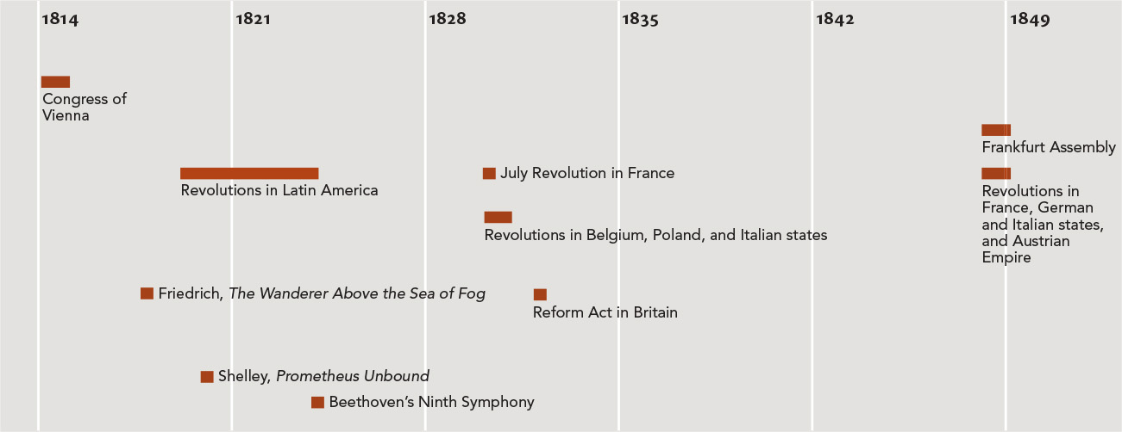
Chapter 21 Timeline

