Slide 1
WESTERN CIVILIZATION: A Brief History
Tenth Edition
CHAPTER 20
The Industrial Revolution and Its Impact on European Society
© 2020 Cengage. All rights reserved.

Slide 2
Chapter 20 Outline
20-1 The Industrial Revolution in Great Britain
20-2 The Spread of Industrialization
20-3 The Social Impact of the Industrial Revolution

Slide 3
20-1 The Industrial Revolution in Great Britain (1 of 4)
Focus Questions: Why did the Industrial Revolution occur first in Great Britain, and why did it happen when it did? What were the basic features of the new industrial system created by the Industrial Revolution?
Origins of the Industrial Revolution
  Advantageous conditions in Britain
    The agricultural revolution and increased food production
    Substantial labor pool
    Ready supply of capital for investment in new industrial machines
    Ample mineral resources
    Ability to export goods

Slide 4
20-1 The Industrial Revolution in Great Britain (2 of 4)
Technological changes and new forms of industrial organization
  The cotton industry
    Flying shuttle, spinning jenny, and power loom transform cotton industry
  The steam engine
    Invented in the 1760s by James Watt and later improved by rotary engine
    Boosted productivity exponentially
    Led to expansion of coal industry

Slide 5
20-1 The Industrial Revolution in Great Britain (3 of 4)
Technological changes and new forms of industrial organization
  The iron industry
    Puddling removed impurities from pig iron producing wrought iron
    Exponential increase of iron production
  A revolution in transportation
    Richard Trevithick pioneered the steam locomotive, 1804
    George Stephenson’s Rocket appeared on first public railway line
    Railroads created new jobs and engineering innovations
    The impact on industry: creating a fundamental break with the traditional European economy

Slide 6
20-1 The Industrial Revolution in Great Britain (4 of 4)
Technological changes and new forms of industrial organization
  The industrial factory
    Organized labor for the new machines
    Factory owners forced to create time-work discipline with regular, unvarying hours and regulations
    Fines and dismissal for adult workers; punishment, including beatings, for children
The Great Exhibition: Britain in 1851
  First world industrial fair at the Crystal Palace
    Palace made entirely of glass and iron covering 19 acres
    Six million visitors in six months
    Great Britain: the world’s first and richest industrial nation

Slide 7
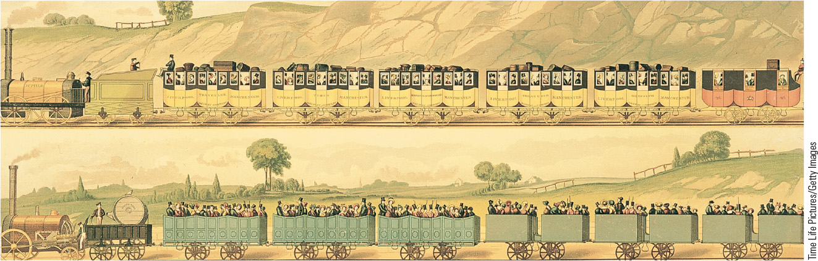
20.2 Railroad Line from Liverpool to Manchester. The railroad line from Liverpool to Manchester, which opened in 1830, relied on steam locomotives.

Slide 8
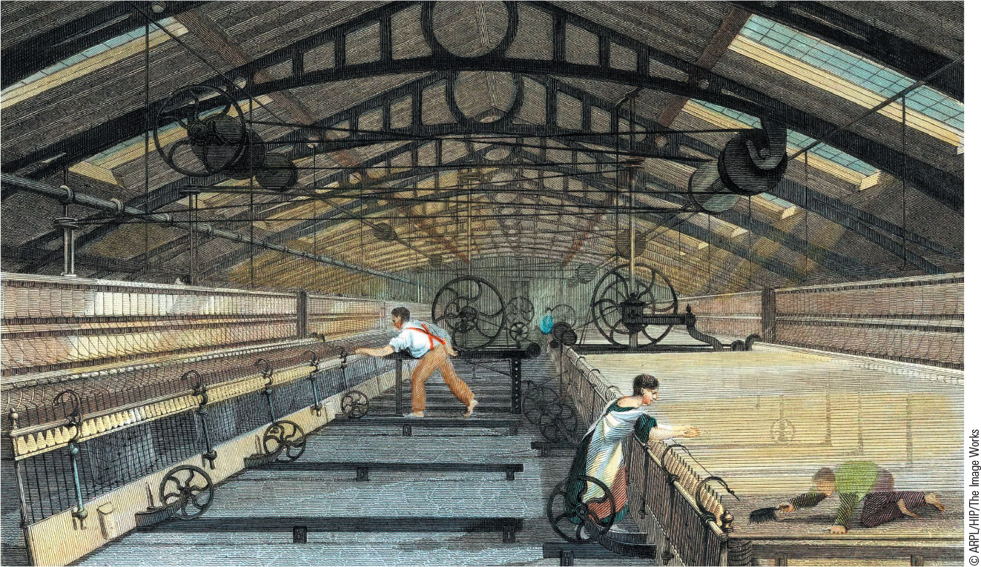
20.3 A British Textile Factory. The factory changed the relationship between workers and employers, with workers coerced into putting in a standard workday.

Slide 9
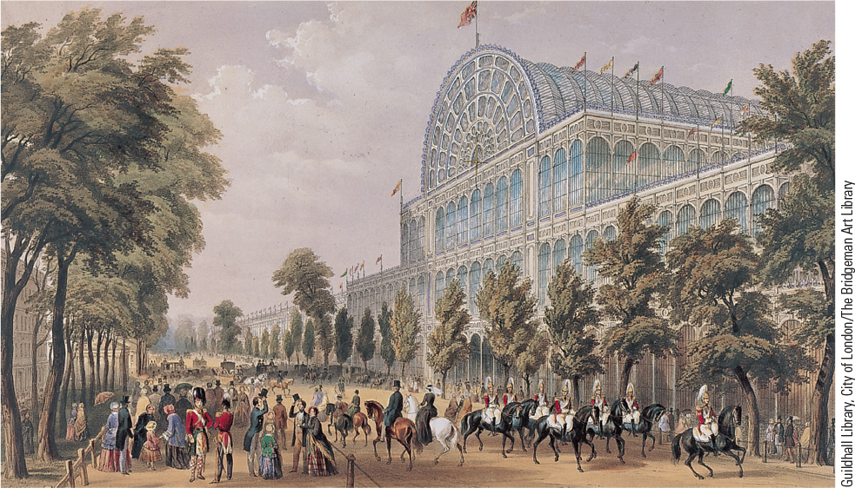
20.4a The Great Exhibition of 1851. More than 100,000 exhibits were housed in the Crystal Palace, a giant structure of cast iron and glass, shown here.

Slide 10
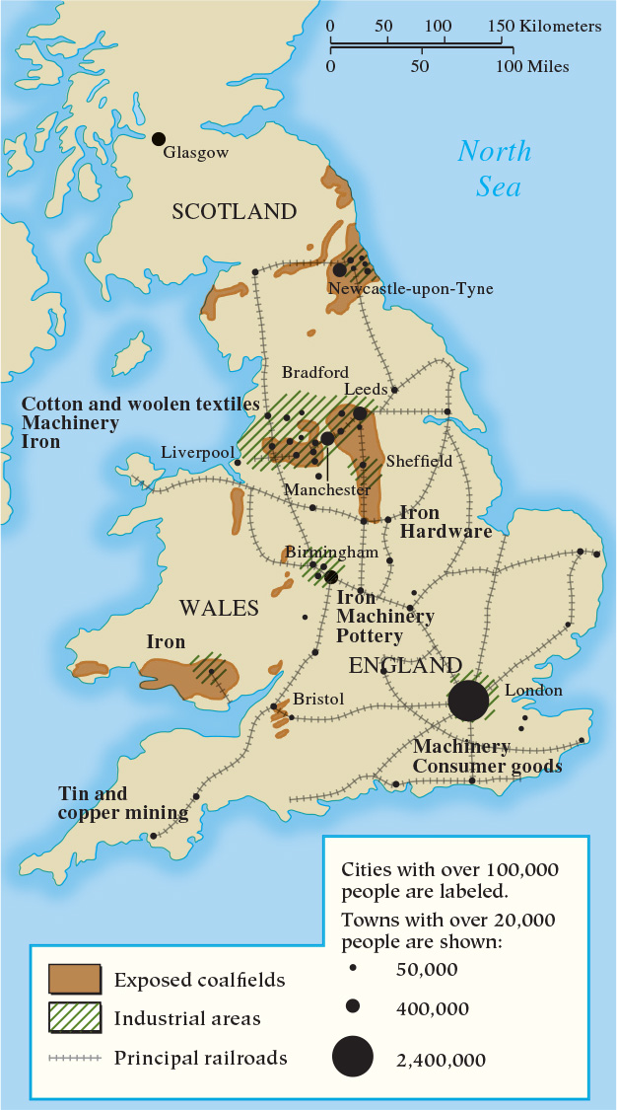
Map 20.1 The Industrial Revolution in Britain by 1850

Slide 11
20-2 The Spread of Industrialization
(1 of 3)
Focus Question: How did the Industrial Revolution spread from Great Britain to the European continent and the United States, and how did industrialization in those areas differ from industrialization in Britain?
Industrialization on the continent
  Proceeded after 1815, with borrowing of British techniques and practices
    British prohibitions against movement of experts and exports of machines were ineffective
    Wide range of technical schools established
  Government support of industrialization
    Bore costs of building roads, canals, and iron rails

Slide 12
20-2 The Spread of Industrialization
(2 of 3)
Centers of continental industrialization
  Belgium, France, and the German States
    Cotton dispersed through many regions
    Heavy industry before 1850 was a mix of old and new
The Industrial Revolution in the United States
  1800–1860: United States population grows from 5 million to 60 million
  Steamboats and railroad turned the United States into a single massive market
  European immigration began
    Immigrants replaced women and children in the workplace

Slide 13
20-2 The Spread of Industrialization
(3 of 3)
Limiting the spread of industrialization
  The example of India
    Eighteenth century: largest exporter of handmade cotton cloth
    Nineteenth century: control by British East India Company saw import of factory-made British textiles and out-of-work artisans in India

Slide 14
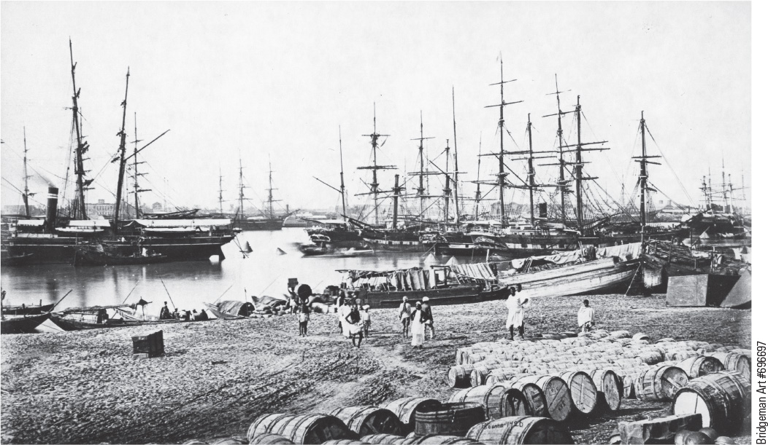
20.5 British Ships in Calcutta. The British increased their trade and development in eighteenth-century India but thwarted the spread of the Industrial Revolution there.

Slide 15
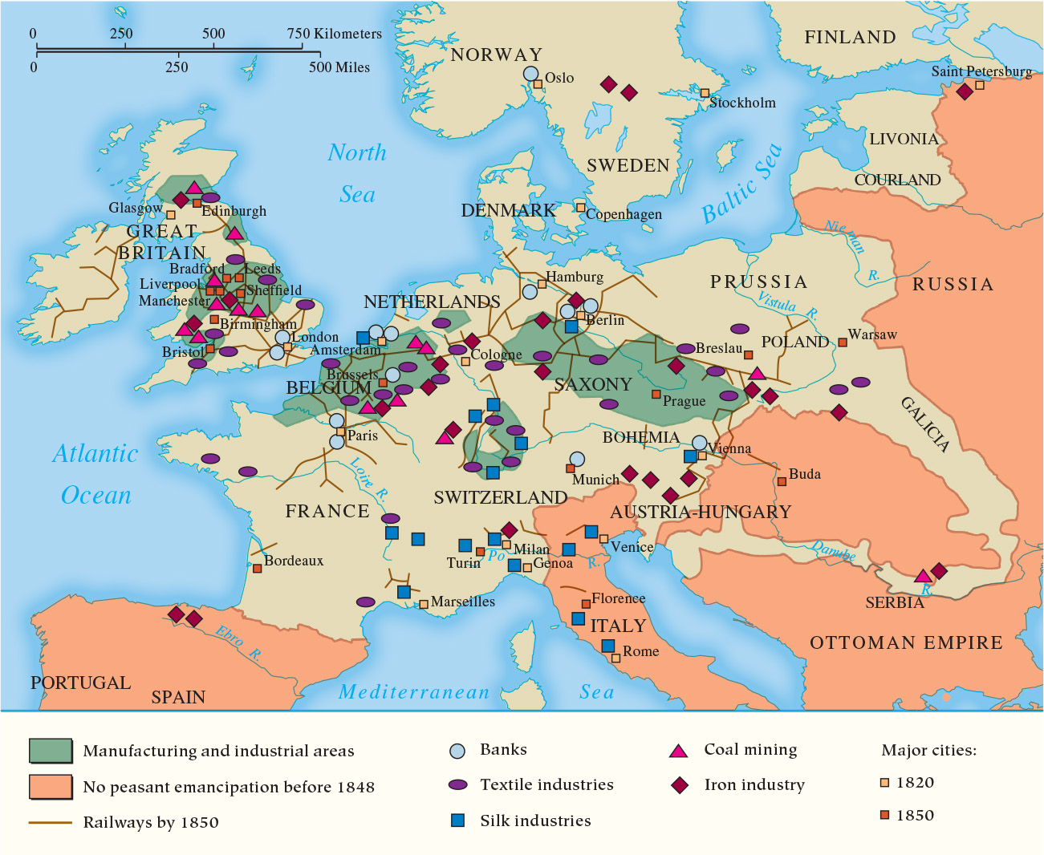
Map 20.2 The Industrialization of Europe by 1850

Slide 16
20-3 The Social Impact of the Industrial Revolution (1 of 4)
Focus Questions: What effects did the Industrial Revolution have on urban life, social classes, family life, and standards of living? What were working conditions like in the early decades of the Industrial Revolution, and what efforts were made to improve them?
Population growth
  European population nearly doubled between 1750 and 1850
    Better nutrition and fewer premature deaths
  The Great Hunger
    Fungus blighted potato crop in Ireland in 1845 causing famine
    More than one million Irish died from starvation and disease

Slide 17
20-3 The Social Impact of the Industrial Revolution (2 of 4)
The growth of cities
  Urban living conditions in the early industrial era
    Rapid urbanization intensified problems
    Wealthy lived in suburbs or outer ring of the cities; inner ring had row houses for artisans and lower middle class; center had row houses for industrial workers
    Overcrowding and sanitation issues
  Urban reformers
    Edwin Chadwick advocated for a system of modern sanitary reforms consisting of efficient sewers and piped water supply
    Public Health Act creates National Board of Health

Slide 18
20-3 The Social Impact of the Industrial Revolution (3 of 4)
New social classes: the industrial middle class
  Constructed factories, purchased machines, and figured out where markets were
    Traditional entrepreneurs replaced by new business aristocracy
    Resourceful, resolute, visionary, ambitious, and often greedy
New social classes: workers in the industrial age
  Working conditions for the industrial working class
    12- to 16-hour days, six days a week, without employment security or minimum wage
    Cotton mills and coal mines: worst conditions, with women and children exploited
  Did industrialization bring an improved standard of living?
    Widened gap between rich and poor

Slide 19
20-3 The Social Impact of the Industrial Revolution (4 of 4)
Efforts at change: the workers
  Trade unions formed by cotton spinners, ironworkers, coal miners, and shipwrights
  Luddites
    Skilled craftsmen in the Midlands and northern England who in 1812 physically attacked machines
  Chartism
    People’s Charter aimed to achieve political democracy
    National petitions rejected by Parliament but organized millions
Efforts at change: reformers and government
  Success during the reform-minded 1830s and 1840s
    The Factory Act, the Coal Mines Act, and the Ten Hours Act

Slide 20
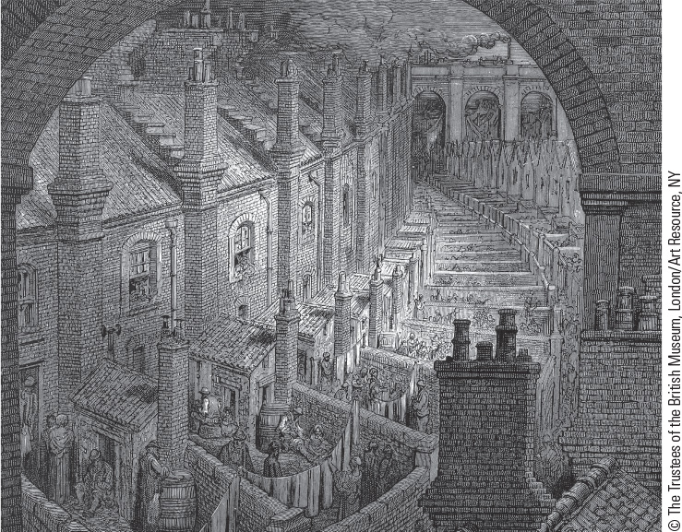
20.6a Living Conditions of London’s Poor. This image from 1872 by French illustrator Gustave Doré shows a London slum district overshadowed by rail viaducts.

Slide 21
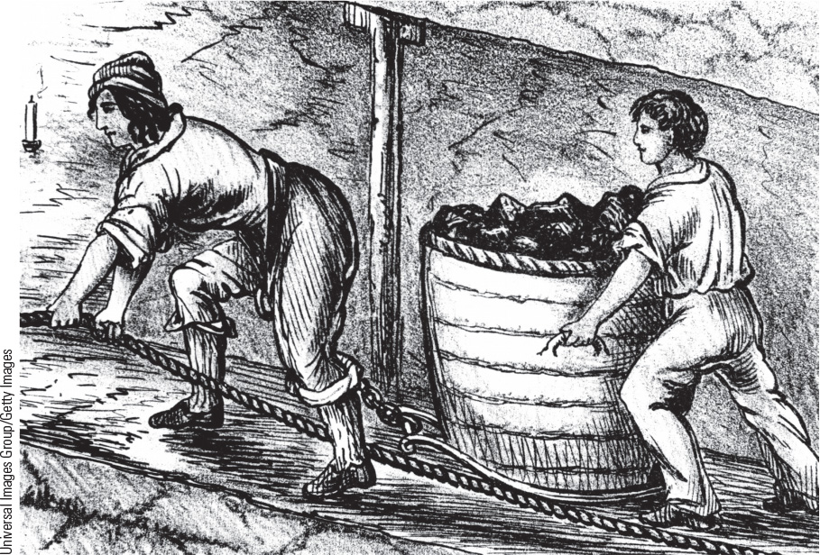
20.7 Women and Children in the Mines. Women and children were often employed in the factories and mines of the early nineteenth century.

Slide 22
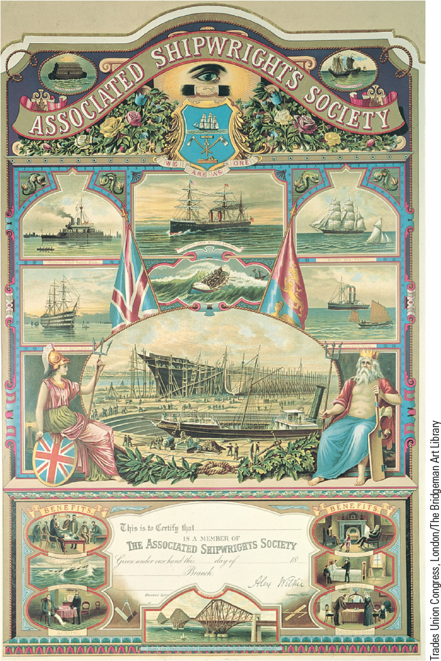
20.8 A Trade Union Membership Card. Skilled workers formed trade unions in an attempt to gain higher wages, better working conditions, and special benefits.

Slide 23
Chapter 20 Summary
The Industrial Revolution, one of the major forces of change in the nineteenth century, began in Britain, which possessed domestic advantages and access to overseas markets.
The Great Exhibition of 1851 in London showed the world the achievements of Britain’s Industrial Revolution.
By 1860, industrialization had spread to the continent and the United States, while in the non-Western world, industrial development was much slower.
The Industrial Revolution also transformed the social world of Europe, and the creation of an industrial proletariat produced a whole new force for change.

Slide 24
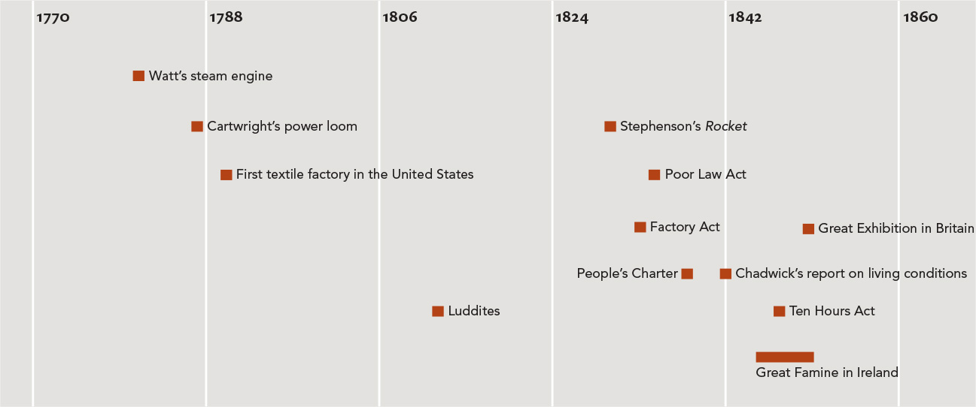
Chapter 20 Timeline

