Slide 1
WESTERN CIVILIZATION: A Brief History
Tenth Edition
CHAPTER 19
A Revolution in Politics: The Era of the French Revolution and Napoleon
© 2020 Cengage. All rights reserved.

Slide 2
Chapter 19 Outline
19-1 The Beginning of the Revolutionary Era: The American Revolution
19-2 Background to the French Revolution
19-3 The French Revolution
19-4 The Age of Napoleon

Slide 3
19-1 The Beginning of the Revolutionary era: The American Revolution (1 of 2)
Focus Question: What were the causes and results of the American Revolution, and what impact did it have on Europe?
Different conceptions of empire spark tensions
  Crises during the 1770s
The war for independence
  Civil war, Patriots, and Loyalists
  The Second Continental Congress and the Continental Army under Washington
  Aid to the colonists from foreign countries

Slide 4
19-1 The Beginning of the Revolutionary era: The American Revolution (2 of 2)
Forming a new nation
  Motivations: fear of concentrated power and concern for own interests
  A new model for government
    Articles of Confederation, ratified 1781
    Constitution, approved 1788: executive, legislative, and judicial branches
    Bill of Rights, ratified 1789: ten amendments, many based on natural rights philosophy of the eighteenth-century philosophes

Slide 5
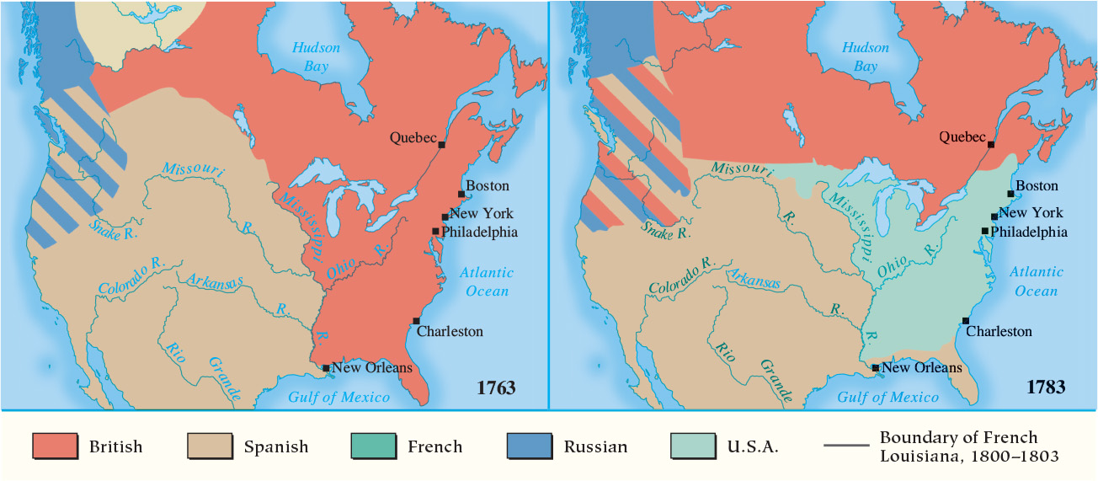
Map 19.1 North America, 1763 and 1783

Slide 6
19-2 Background to the French Revolution
(1 of 2)
Focus Question: What were the long-range and immediate causes of the French Revolution?
Social structure of the old regime
  The First Estate
    130,000 clergy owned 10 percent of land
  The Second Estate
    No more than 350,000; owned 30 percent of land
    Held leading positions and sought to expand privileges
  The Third Estate
    Peasants: 75–80 percent of population; owned 35–40 percent of land
    Bourgeoisie 8 percent of population; owned 20–25 percent of land
    New nobles, opposed the old order

Slide 7
19-2 Background to the French Revolution
(2 of 2)
Other problems facing the French monarchy
  Inability to deal with new social realities
  Food shortages, rising prices, and unemployment in cities
  Number of poor approached one-third of population
  Debt of nearly four billion livres (about $40 billion)
    Required the summoning of the Estates-General

Slide 8
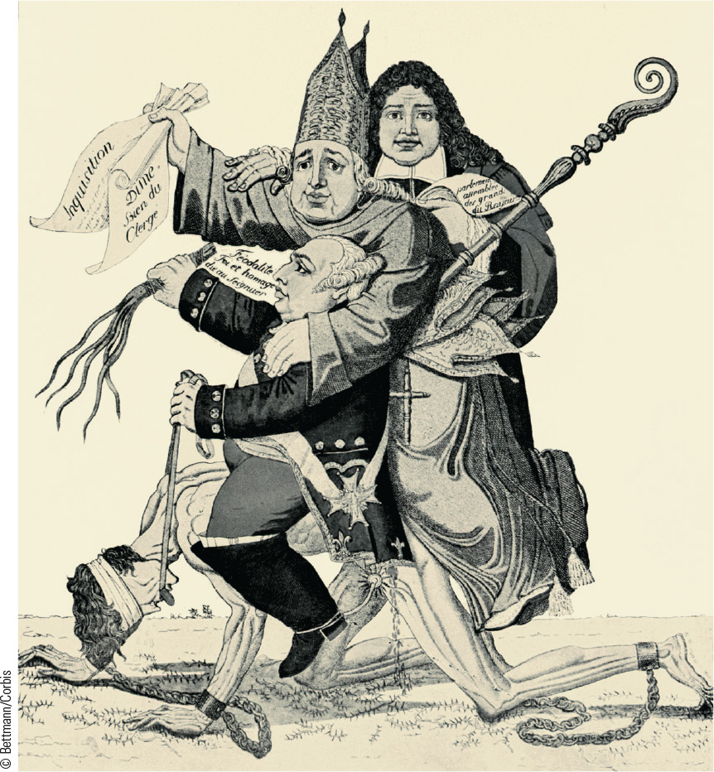
19.2 The Three Estates. This political cartoon reveals a critical view of France’s privileged orders, with a naked common man held in chains and ridden by elites.

Slide 9
19-3 The French Revolution (1 of 8)
Focus Questions: What were the main events of the French Revolution between 1789 and 1799? What role did each of the following play in the French Revolution: lawyers, peasants, women, the clergy, the Jacobins, the sans-culottes, the French revolutionary army, and the Committee of Public Safety?
Calling the Estates-General
  Monarchy needed a solution to financial crisis
    No desire for major reform

Slide 10
19-3 The French Revolution (2 of 8)
From Estates-General to National Assembly
  Opened on May 5, 1789, at Versailles
    Divided over voting by order or by head
  Third Estate voted to constitute as National Assembly
    Tennis Court Oath produced French constitution
    Response: king and First Estate threatened to dissolve Estates-General
    Parisians attacked the Bastille on July 14
  Popular revolts in the countryside
    The Great Fear

Slide 11
19-3 The French Revolution (3 of 8)
Destruction of the Old Regime
  National Assembly abolishes seigneurial rights and fiscal privileges of nobles, clergy, towns, and provinces (August 4)
  Adoption of the Declaration of the Rights of Man and the Citizen
    The question of women: Declaration of the Rights of Woman and the Female Citizen, Olympe de Gouges
  The women’s march to Versailles and the king’s return to Paris, October
  July 1790: Civil Constitution of the Clergy put into effect

Slide 12
19-3 The French Revolution (4 of 8)
Destruction of the Old Regime
  A new constitution
    Completed by 1791: established limited constitutional monarchy
    Legislative Assembly: 745 members chosen by indirect system of election
  Opposition from within
    Clergy angered by Civil Constitution of the Clergy
    Discontent: lower classes hurt by rise in cost of living and peasants angry that dues not abandoned
    Jacobins and other political clubs offered radical solutions
  Opposition from abroad
    Defeat against Austria, scapegoats, and the sans-coulottes

Slide 13
19-3 The French Revolution (5 of 8)
The Radical Revolution
  The National Convention
    Monarchy abolished (September 1792)
    King Louis XVI found guilty of treason (executed: January 21, 1793)
  Domestic turmoil and foreign crisis
    Most of Europe poised to invade France
    Convention gave broad power to Robespierre and the Committee of Public Safety
  A nation in arms
    Mass mobilization and the creation of modern nationalism

Slide 14
19-3 The French Revolution (6 of 8)
The Radical Revolution
  The Committee of Public Safety and the Reign of Terror
    16,000 killed by guillotine in nine months
    Total numbers killed closer to 50,000
    No class prejudice—noble, clergy, middle class, and peasant opposition all put to death
    The example of Lyons
  The “republic of virtue”
    Attempts at control: the Law of the General Maximum and the policy of de-Christianization

Slide 15
19-3 The French Revolution (7 of 8)
The Radical Revolution
  Equality and slavery
    Debate of abolition of slavery
    Rebellion in Saint-Domingue: seizure of control Hispaniola by Toussaint L’Ouverture and the eventual freedom for Haiti
  The decline of the Committee of Public Safety
    French victories reduced the justification of the Terror
    The fall of Robespierre
    Accomplished creation of a nation in arms and defense against counter-revolutionary forces through bloodshed

Slide 16
19-3 The French Revolution (8 of 8)
Reaction and the Directory
  Thermidorean Reaction and the abating of the Terror
    August 1795: new constitution that reflected conservative republicanism
  Assembly with two houses, Council of 500 and Council of Elders
    Responsible for election of the Directory, the executive
  The Directory: era of materialistic reaction to Reign of Terror and Republic of Virtue
    Contending with political enemies
    Coup d’état put Napoleon Bonaparte in power in 1799

Slide 17
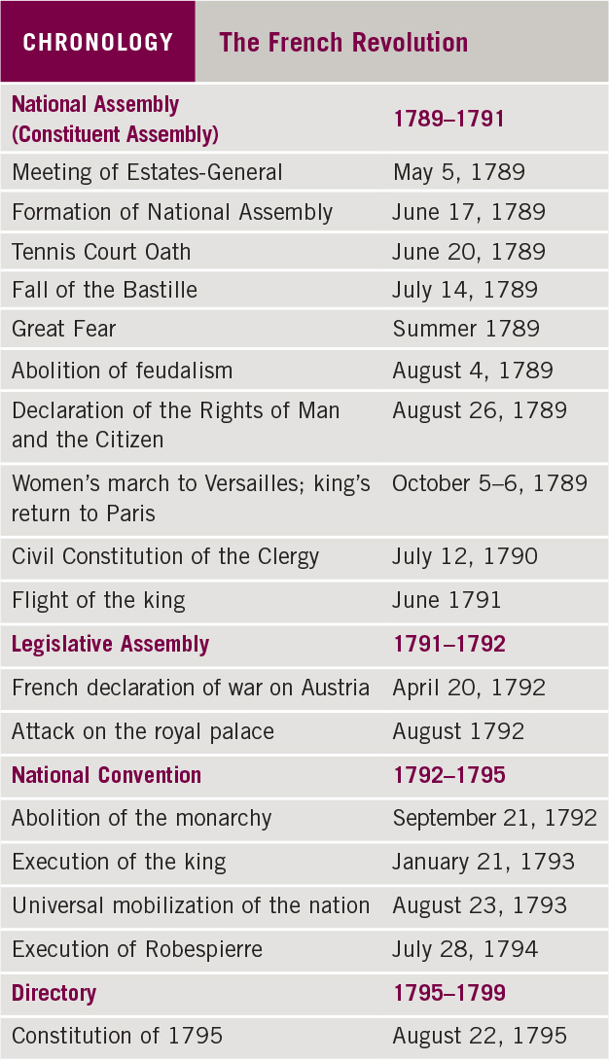
Chronology: The French Revolution

Slide 18
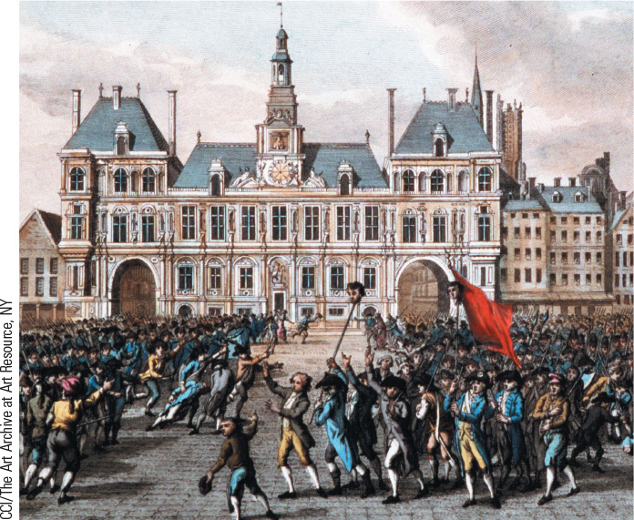
19.1 The Storming of the Bastille. Parisian crowds captured the royal armory at the Bastille on July 14, 1789, and its fall marked the triumph of “liberty” over despotism.

Slide 19
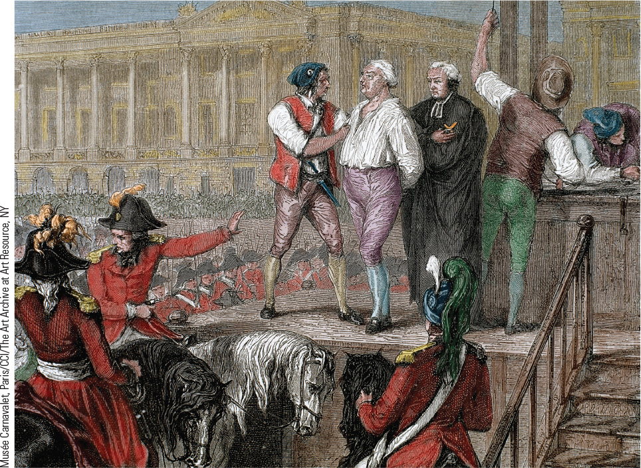
19.3 Execution of the King. The National Convention sentenced the king to death, and Louis XVI was duly executed on January 21, 1793.

Slide 20
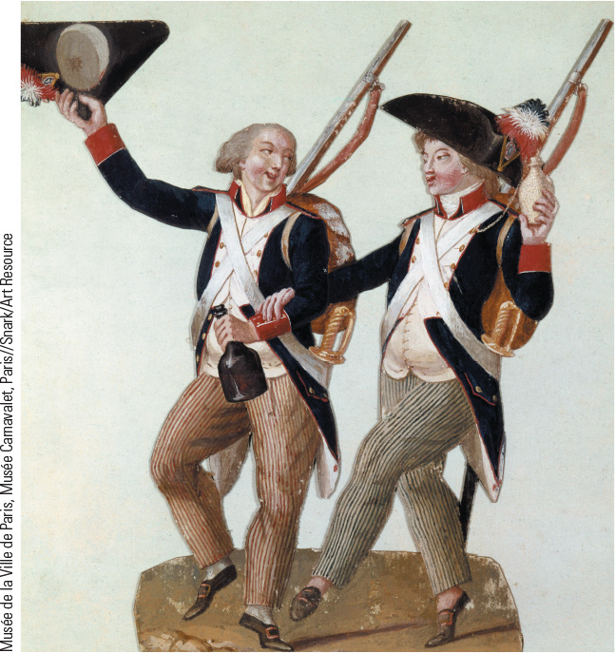
19.4b Citizens in the New French Army. The National Convention created an army of unprecedented size; this image shows two volunteers joyfully going off to fight.

Slide 21
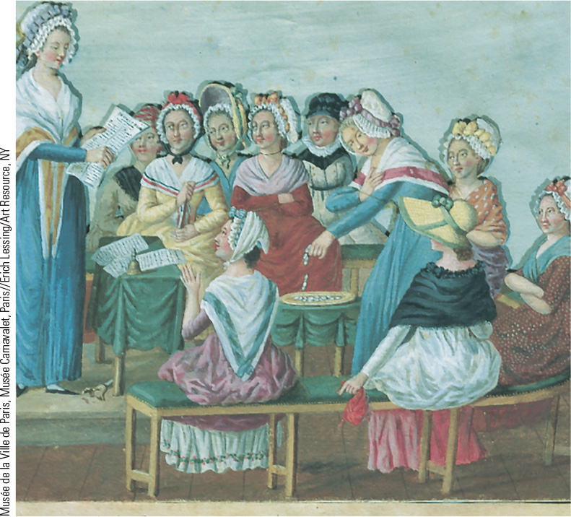
19.5 Women Patriots. This picture shows a middle-class women’s patriotic club discussing the decrees of the National Convention.

Slide 22
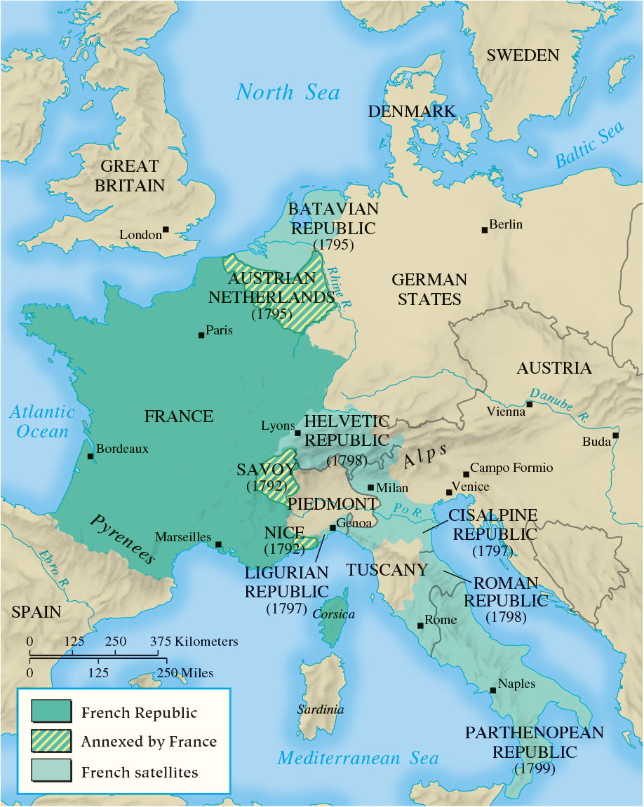
Map 19.2 French Expansion During the Revolutionary Wars, 1792–1799

Slide 23
19-4 The Age of Napoleon (1 of 4)
Focus Question: Which aspects of the French Revolution did Napoleon preserve, and which did he destroy?
The rise of Napoleon
  1789: lieutenant in the army
  1794: promoted to major general
  1796: made commander in Italy
  1799: coup d’état at age 30 gave him executive authority of government
  1802: made consul for life
  1804: self-crowned Emperor Napoleon I

Slide 24
19-4 The Age of Napoleon (2 of 4)
The domestic policies of Emperor Napoleon
  Napoleon and the Catholic Church
    Established peace with Catholic Church in 1801
    Reassured possession of Church property gained during the Revolution
  A new code of laws
    Civil Code codified French law and preserved most revolutionary gains
    Code strictly curtailed rights of women
  The French bureaucracy
    Powerful centralized administrative machine
    New aristocracy based on merit in the state service
  Napoleon’s growing despotism

Slide 25
19-4 The Age of Napoleon (3 of 4)
Napoleon’s empire and the European response
  War against rival Britain,
    Joined with Austria and Russia in the Third Coalition
    Prussia joined Third Coalition and defeated in 1806; Russia defeated, 1807; end of fighting: Treaties of Tilsit
  Napoleon’s Grand Empire
    The French Empire, dependent states, and allied states
    Sought acceptance of revolutionary principles and destruction of the old order
  The problem of Great Britain
    The failure of the Continental System

Slide 26
19-4 The Age of Napoleon (4 of 4)
Napoleon’s empire and the European response
  Nationalism
    Nationalist movements in the German states, Spain, and Prussia arose from spread of French nationalism
  The fall of Napoleon
    Failed invasion of Russia in 1812 led to war of liberation across Europe
    Defeated and exiled to Elba in 1814
    Suffered bloody defeat at Waterloo and exiled to Saint Helena, 1815
    Napoleon died, 1821

Slide 27
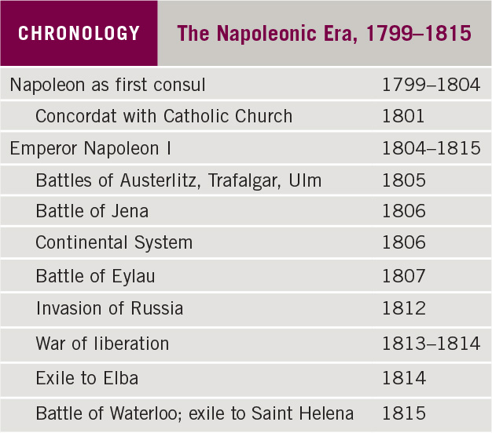
Chronology: The Napoleonic Era, 1799–1815

Slide 28
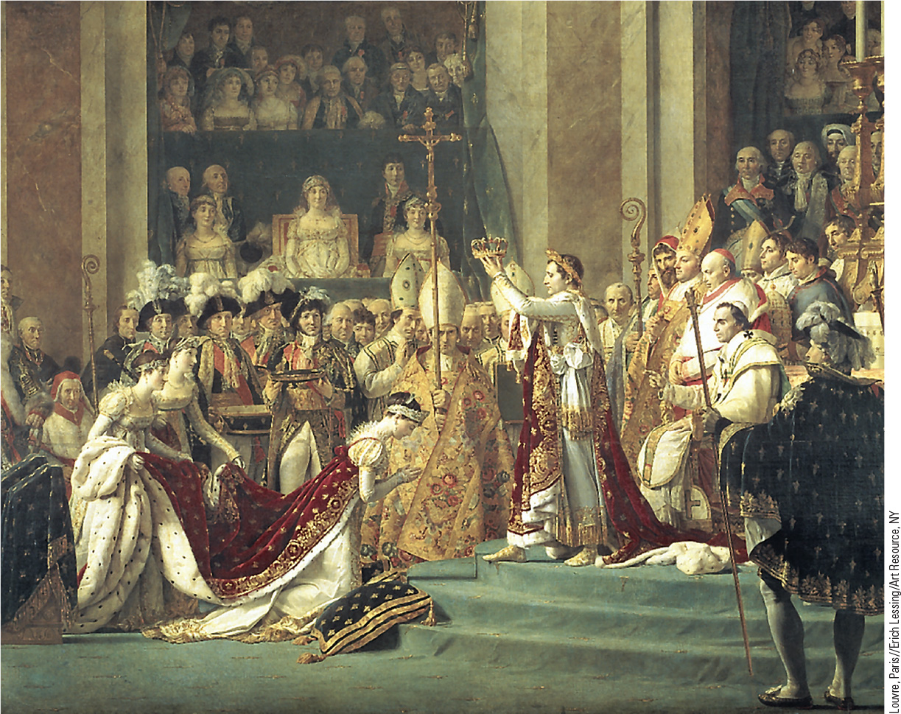
19.6 The Coronation of Napoleon. In 1804, Napoleon restored monarchy to France when he crowned himself emperor, as shown in this painting by Jacques-Louis David.

Slide 29
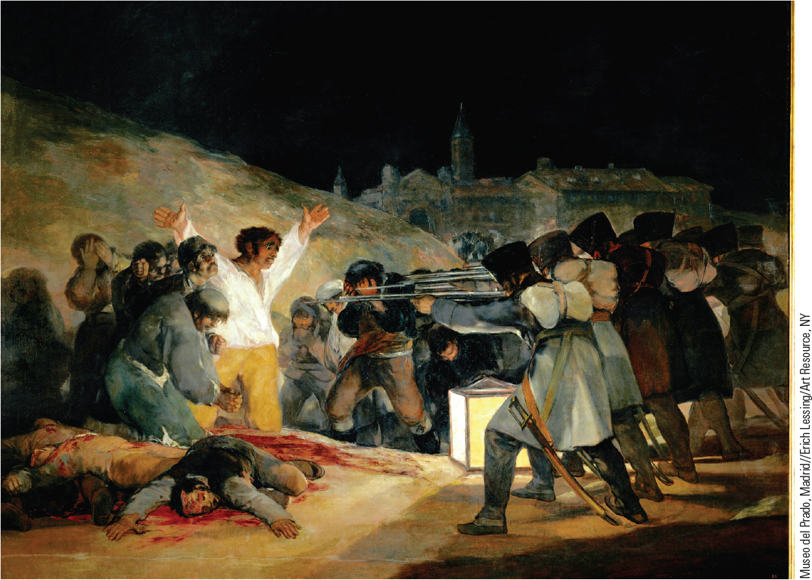
19.7 Francisco Goya, The Third of May 1808. Goya’s painting shows the horrors of war in Napoleonic Spain—the deliberate execution of Spanish citizens by French soldiers.

Slide 30
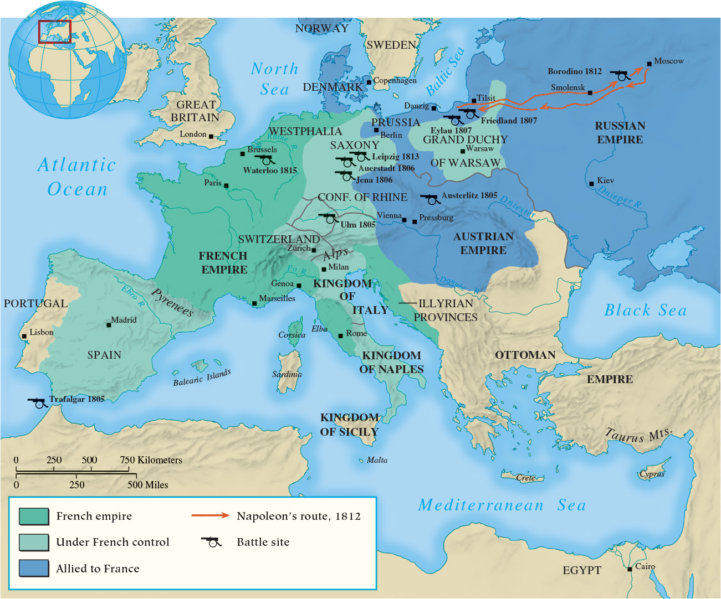
Map 19.4 Napoleon’s Grand Empire in 1810

Slide 31
Chapter 19 Summary
Revolutionary upheavals, beginning in North America and continuing in France, produced movements for political liberty and equality that embodied the fundamental ideas of the Enlightenment, including the principles of liberty and equality.
In the first, liberal phase of the French Revolution, the old order was demolished as a new constitution established a limited constitutional monarchy.
The decision to go to war with European monarchs ushered in a more radical, democratic, and violent stage, led by the Committee of Public Safety and the Terror.
The government of Napoleon Bonaparte diminished freedom by establishing order and centralizing the government, but it also preserved some key revolutionary ideals.

Slide 32
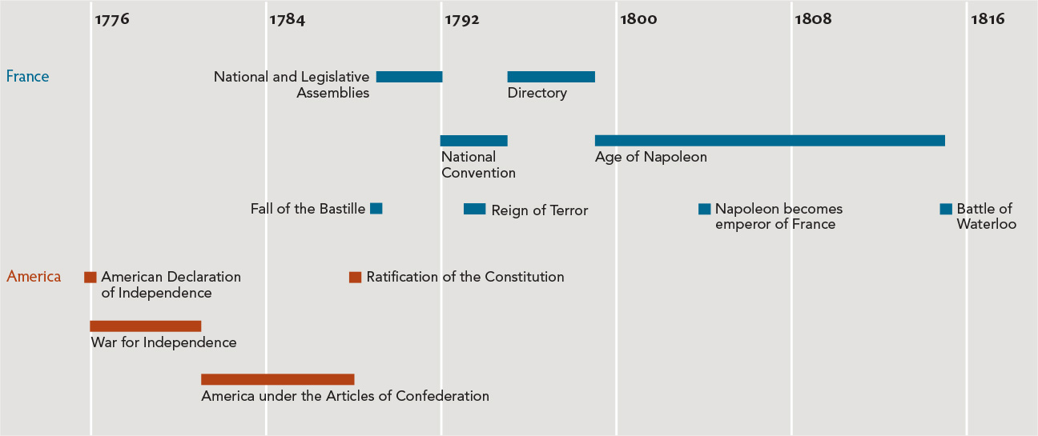
Chapter 19 Timeline

