Slide 1
WESTERN CIVILIZATION: A Brief History
Tenth Edition
CHAPTER 18
The Eighteenth Century: European States, International Wars, and Social Change
© 2020 Cengage. All rights reserved.

Slide 2
Chapter 18 Outline
18-1 The European States
18-2 Wars and Diplomacy
18-3 Economic Expansion and Social Change
18-4 The Social Order of the Eighteenth Century

Slide 3
18-1 The European States (1 of 5)
Focus Questions: What were the main developments in France and Great Britain in the eighteenth century? What do historians mean by the term enlightened absolutism, and to what degree did eighteenth-century Prussia, Austria, and Russia exhibit its characteristics?
Enlightened absolutism?
  Influence of Enlightenment ideas of natural laws and natural rights
  Making rulers enlightened: religious toleration; freedom of speech and the press; the right to hold property; support for the arts, sciences, and education; obedience of the law
    The debate over enlightened absolutism in practice

Slide 4
18-1 The European States (2 of 5)
The Atlantic seaboard states
  France: the problems of the French monarchy
    Louis XIV left enlarged territories but enormous debt and an unhappy populace
    The reign of Louis XV saw tax increases, more public debt, and more hungry people
    Louis XVI: worsening financial debt
  Great Britain: king and Parliament
    Parliament dominated by a landed aristocracy and patronage
    George I: chief ministers allowed to run Parliament
    George II: appointment of William Pitt the Younger as prime minister

Slide 5
18-1 The European States (3 of 5)
Absolutism in central and eastern Europe
  Prussia: army and bureaucracy
    Frederick William I established the General Directory
    Frederick William II established single code of law granting limited freedom of speech, complete religious toleration, and the elimination of torture
    Growth of the army: from 45,000 to 200,000
  The Austrian Empire of the Habsburgs
    Empress Maria Theresa made administrative reforms and modernized the army
    Joseph II’s far-reaching reforms proved overwhelming

Slide 6
18-1 The European States (4 of 5)
Russia under Catherine the Great
  Familiar with the works of the philosophes and claimed desire for reform
    Questioned institution of serfdom, torture, and capital punishment
    Policies strengthened landholding class at expense of all others
  Pugachev’s Rebellion as a response to worsening conditions for the peasantry
    Crushed insurrection and halted rural reform
  Russian expansion
    Partitions of Poland

Slide 7
18-1 The European States (5 of 5)
Enlightened absolutism revisited
  Joseph II, Frederick II, and Catherine the Great: guided primarily by concern for power and well-being of their states
    Military, political, and social realities limited ability of enlightened rulers to make reforms
    Pursued such enlightened ideas as legal reform, religious toleration, and the extension of education to strengthen their states

Slide 8
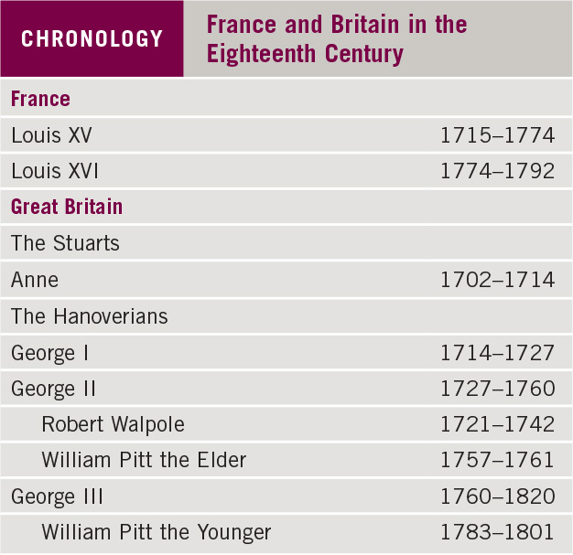
Chronology: France and Britain in the Eighteenth Century

Slide 9
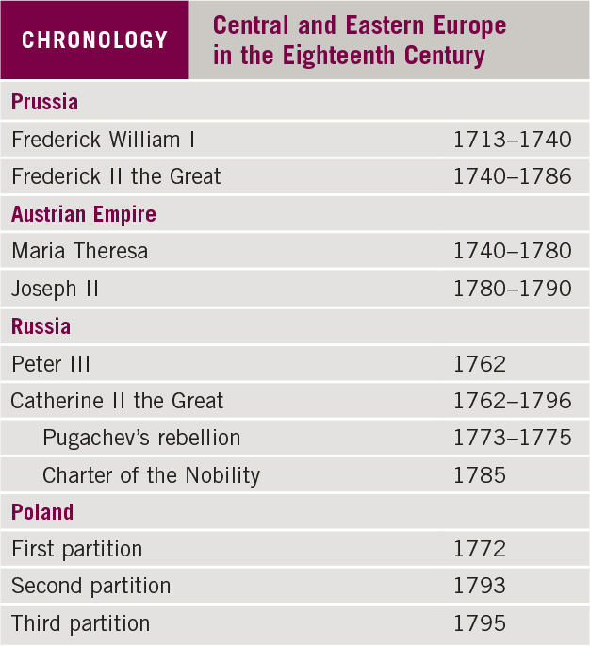
Chronology: Central and Eastern Europe in the
Eighteenth Century

Slide 10
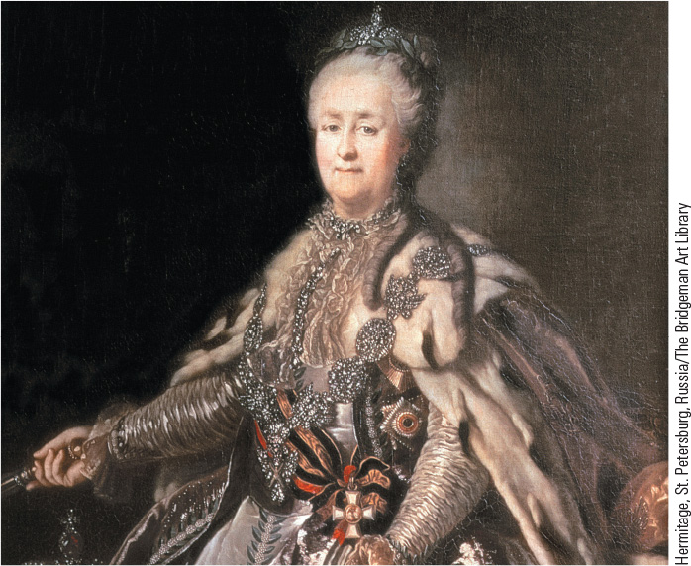
18.1 Catherine the Great. This painting by Johann Lampi from 1793 shows Russian monarch Catherine II, known as Catherine the Great.

Slide 11
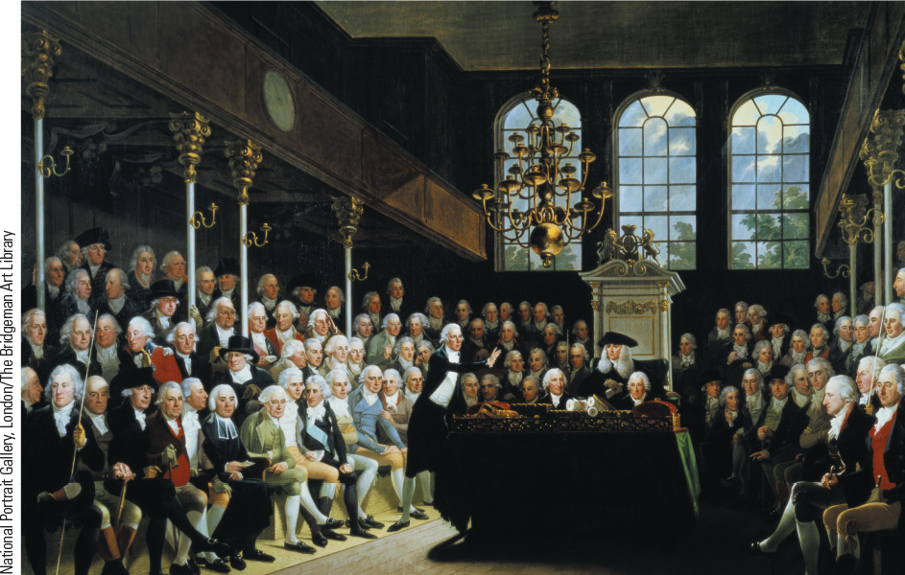
18.3 The British House of Commons. This painting shows the House of Commons in session in 1793 during a debate over the possibility of war with France.

Slide 12
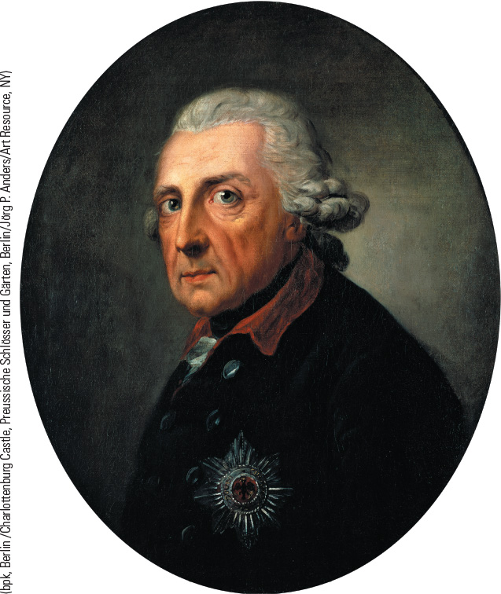
18.4 Frederick II. Prussian king Frederick II was one of the most cultured and best-educated European monarchs.

Slide 13
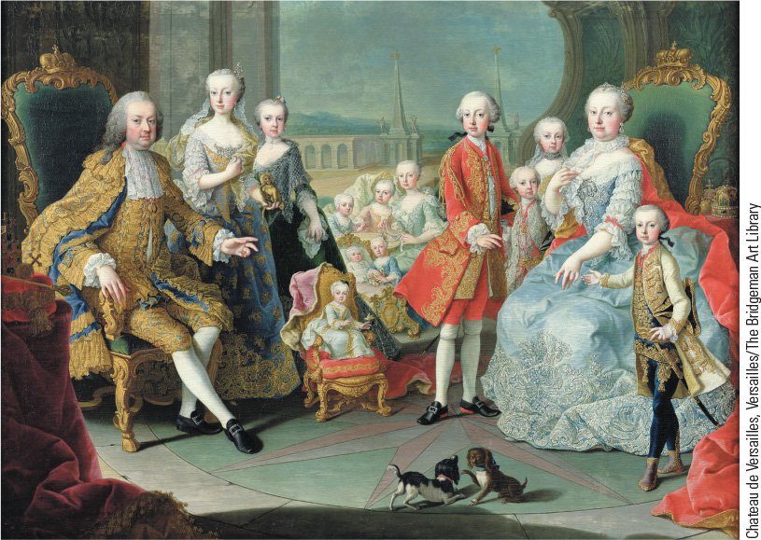
18.5 Maria Theresa and Her Family. This painting shows Maria Theresa, who ruled the Austrian Empire from 1740 to 1780, with her children, including successor Joseph II.

Slide 14
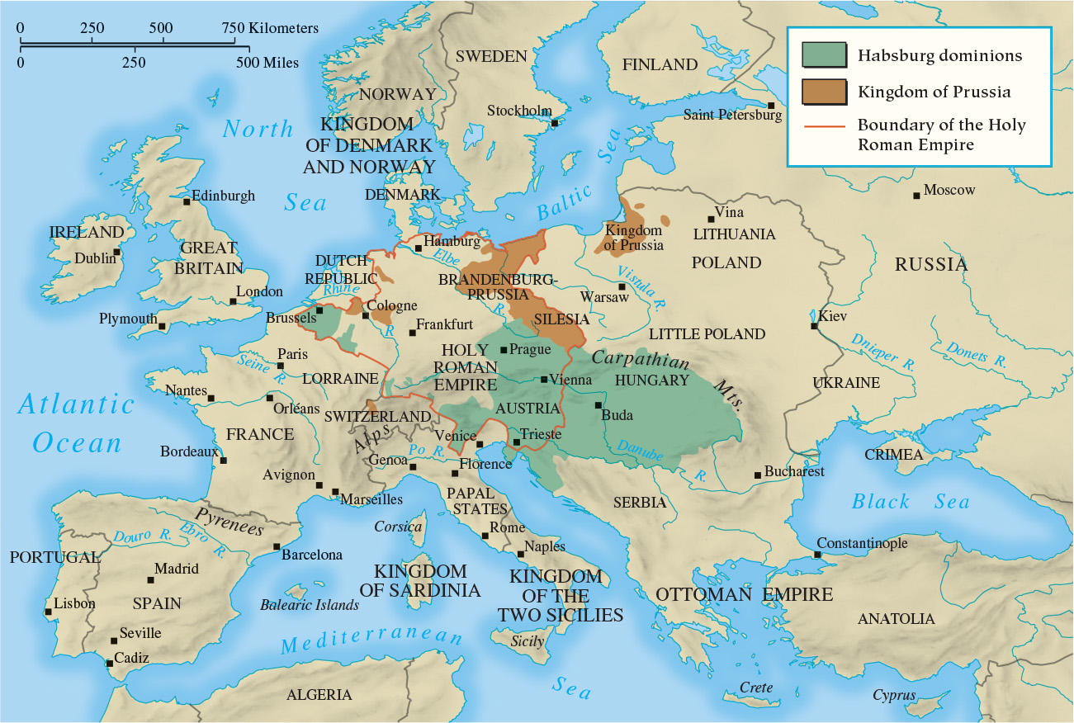
Map 18.1 Europe in 1763

Slide 15
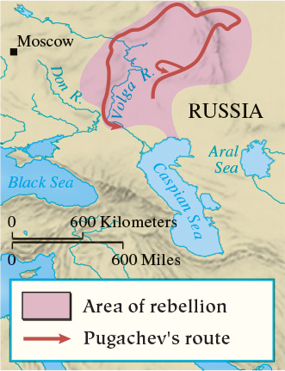
Map 18.2 Pugachev’s Rebellion

Slide 16
18-2 Wars and Diplomacy
Focus Question: What were the causes and results of the Seven Years’ War?
Linking international rivalry and state centralization
The Seven Years’ War (1756–1763)
  The diplomatic revolution of 1756
  Conflict in Europe
    Peace of Hubertusburg: permanent Prussian control of Silesia
  Conflict in India
    Treaty of Paris: British control of India
  Conflict in North America: the French and Indian War
    Treaty of Paris: French ceded Canada and lands east of Mississippi to British

Slide 17
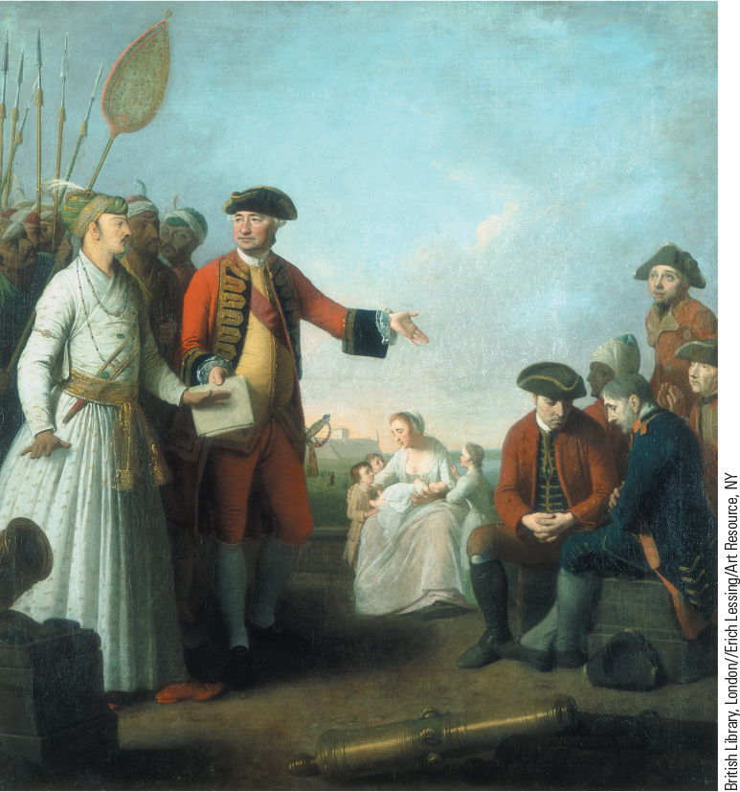
18.6 Robert Clive in India. In this painting by Edward Penny, Robert Clive is shown receiving a grant of money for his injured soldiers from the local nabob of Bengal.

Slide 18
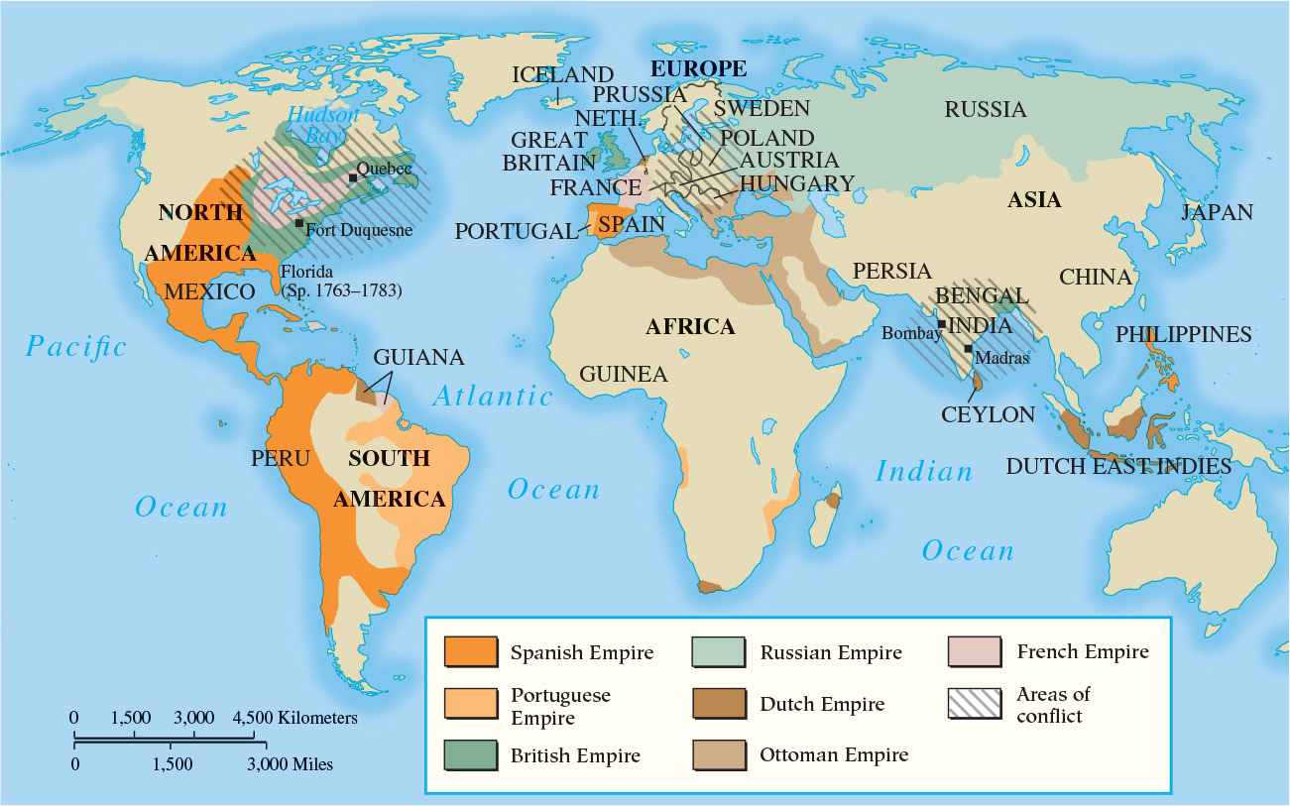
Map 18.3 Battlefields of the Seven Years’ War

Slide 19
18-3 Economic Expansion and Social Change
(1 of 2)
Focus Question: What changes occurred in agriculture, finance, industry, and trade during the eighteenth century?
Population and food
  Agricultural revolution leads to plentiful food and population growth
Family, marriage, and birthrate patterns
  Nuclear family became the common pattern
  Late marriages and birth control began to limit number of children per family

Slide 20
18-3 Economic Expansion and Social Change
(2 of 2)
New methods of finance
  New public and private banks
  Acceptance of paper notes and expansion of credit
    The Bank of England and a “national debt”
European industry
  Cottage industry and textiles
Mercantile empires and worldwide trade
  Emergence of truly global economy with trading posts in America, Asia, and Africa
  Impact: growth of European towns and cities
The new consumers

Slide 21
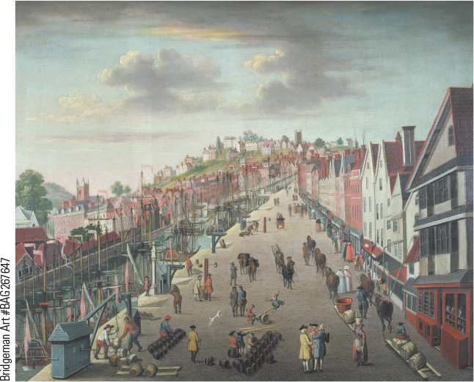
18.7 Bristol. By the seventeenth century Bristol was the second-largest shipping port in Britain.

Slide 22
18-4 The Social Order of the Eighteenth Century
Focus Question: Who were the main groups making up the European social order in the eighteenth century, and how did the conditions in which they lived differ both between groups and between different parts of Europe?
The peasants
  Largest social group (85 percent): free peasants and serfs
    Obligations and compulsory service: tithes
The nobility
  Dominant role in society (2 to 3 percent of population)
The inhabitants of towns and cities
  Patricians, middle class, including rentiers, and petty bourgeoisie
  Urban working and living conditions

Slide 23
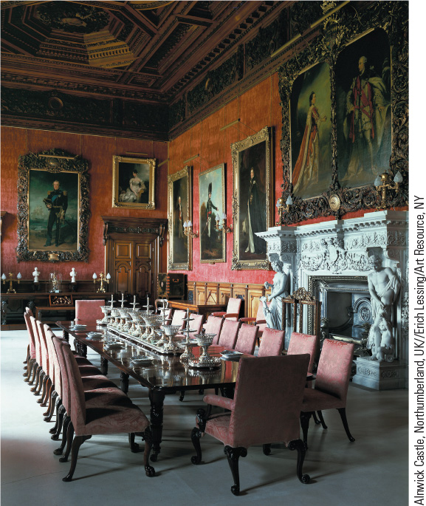
18.8c British Dining Room.
The eighteenth-century country house in Britain fulfilled the desire of aristocrats for both elegance, as shown in this image, and greater privacy.

Slide 24
Chapter 18 Summary
Everywhere in the eighteenth century, monarchs sought to enlarge their bureaucracies to raise taxes to support the new large standing armies that had originated in the seventeenth century.
Although associated with the concept of “enlightened absolutism,” monarchs Frederick the Great, Catherine the Great, and Joseph II were all guided by a policy of using state power to amass armies and wage wars to gain more power.
The emergence of five great powers, two of them (France and Britain) in conflict in the East and North America, initiated a new scale of military confrontation.
The growth in population in the eighteenth century, combined with dramatic changes in finance, trade, and industry and an increase in poverty, created tensions that undermined the traditional foundations of European society.

Slide 25
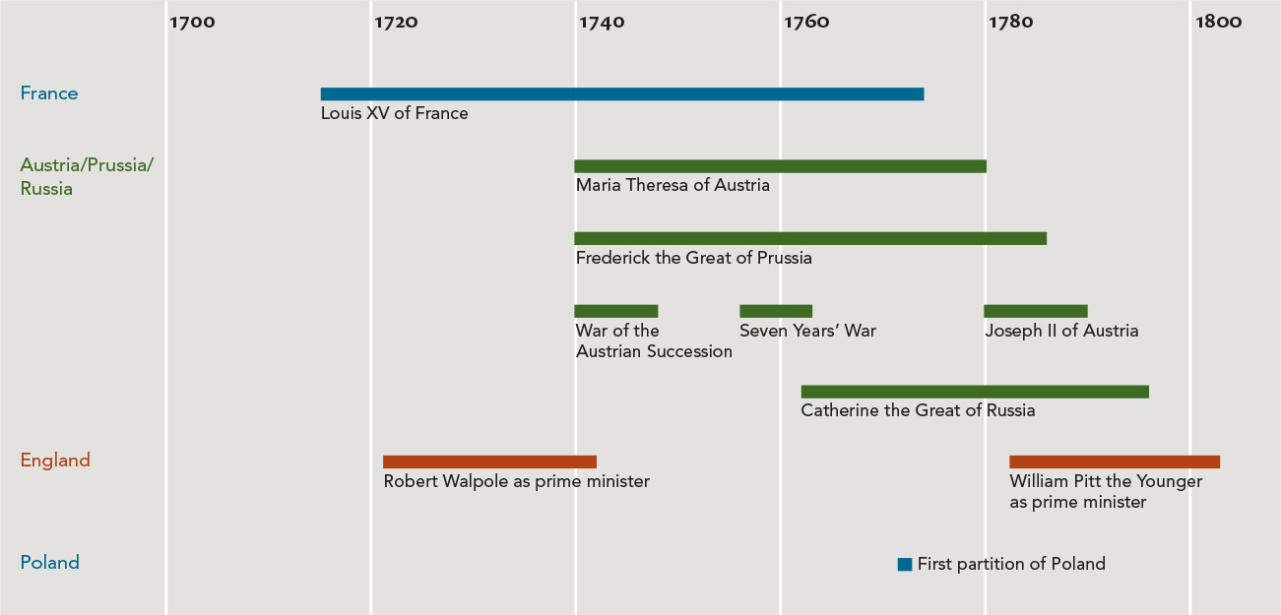
Chapter 18 Timeline

