Slide 1
WESTERN CIVILIZATION: A Brief History
Tenth Edition
CHAPTER 17
The Eighteenth Century: An Age of Enlightenment
© 2020 Cengage. All rights reserved.

Slide 2
Chapter 17 Outline
17-1 The Enlightenment
17-2 Culture and Society in the Enlightenment
17-3 Religion and the Churches

Slide 3
17-1 The Enlightenment (1 of 5)
Focus Questions: What intellectual developments led to the emergence of the Enlightenment? Who were the leading figures of the Enlightenment, and what were their main contributions? In what type of social environment did the philosophes thrive, and what role did women play in that environment?
Immanuel Kant
  Defined Enlightenment as “man’s leaving his self-caused immaturity”
  Proclaimed the motto of Enlightenment: “Dare to know! Have the courage to use your own intelligence!”
Eighteenth-century buzzwords
  Reason, natural law, hope, and progress

Slide 4
17-1 The Enlightenment (2 of 5)
The Paths to Enlightenment
  The spread of scientific ideas by popularizers
  A new skepticism
    Skepticism toward religion and growing secularization of thought
  The impact of travel literature
    Certainties about European practices gave way to cultural relativism
  The legacy of Locke and Newton
    Newton demonstrated how reason enabled enlightened people to discover the natural laws to which all institutions should conform
    Locke’s philosophy implied that people were molded by their environment and experiences

Slide 5
17-1 The Enlightenment (3 of 5)
The philosophes and their ideas
  Philosophes: social reformers from all walks of educated life in an international and cosmopolitan movement
  Montesquieu and political thought
    Importance of checks and balances achieved through separation of powers
  Voltaire and the Enlightenment
    Championed both religious tolerance and deism
  Diderot and the Encyclopedia
    Twenty-eight-volume Encyclopedia expressed philosophes’ concerns
  Toward a New “Science of Man”
    Physiocrats and Adam Smith founded modern economics: doctrine of laissez-faire and economic liberalism

Slide 6
17-1 The Enlightenment (4 of 5)
The later Enlightenment
  Baron Paul d’Holbach preached a doctrine of strict atheism and materialism
  Jean-Jacques Rousseau sought to harmonize individual liberty with governmental authority
    The social contract and the general will
    Émile and emotion: a precursor to Romanticism
The “woman’s question” in the Enlightenment
  Mary Astell believed that women needed to be better educated
  Mary Wollstonecraft viewed by many as the founder of modern European feminism
    Vindication of the Rights of Woman
    Argued that women should have equal rights with men in education and in economic and political life

Slide 7
17-1 The Enlightenment (5 of 5)
The social environment of the philosophes
  Philosophes’ social backgrounds varied considerably
    Greatest appeal to the aristocrats and upper middle classes in cities
  Salons and the spread of Enlightenment ideas
    Brought together writers and artists with aristocrats, government officials, and wealthy members of the bourgeoisie
    Women as hostesses
    Promoted conversation and sociability between upper-class men and women
  Other gathering places: coffeehouses, cafés, reading clubs, lending libraries, and secret societies

Slide 8
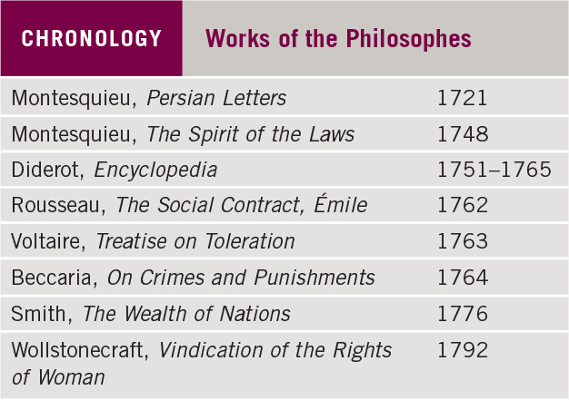
Chronology: Works of the Philosophes

Slide 9
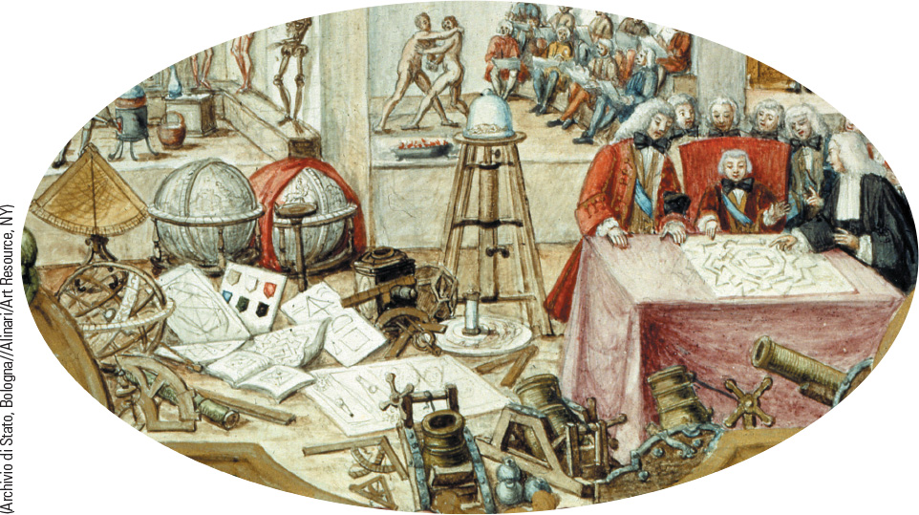
17.2 The Popularization of Science in the Enlightenment. The German Academy of Sciences and other societies were especially valuable in the spreading of new scientific ideas.

Slide 10
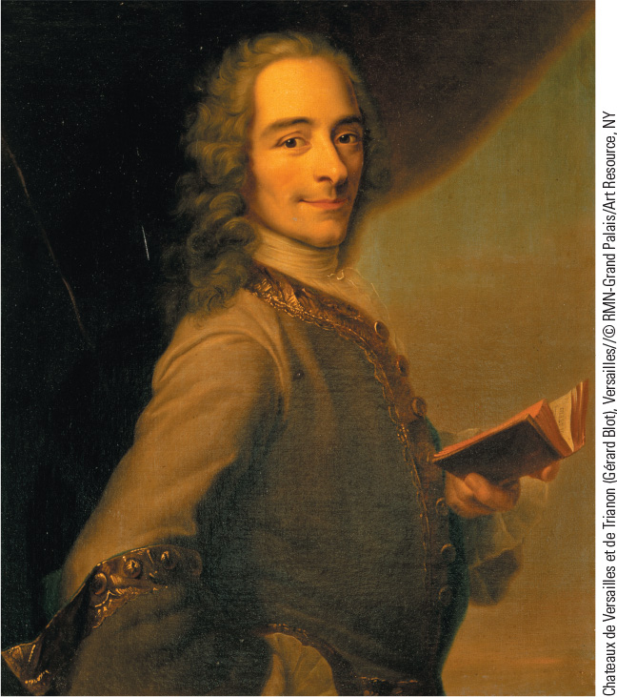
17.3 Voltaire. A philosophe and the greatest figure of the Enlightenment, Voltaire was known for his criticism of traditional religion and his support of religious toleration.

Slide 11
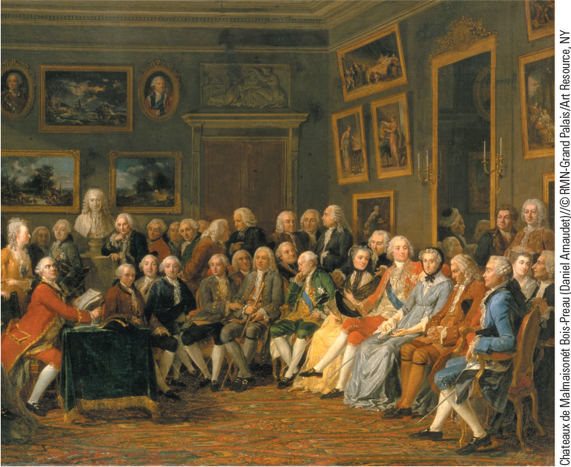
17.4 Madame Geoffrin. Shown here is Madame Geoffrin, the prominent salon hostess, surrounded by various philosophes in her home on the rue Saint-Honoré.

Slide 12
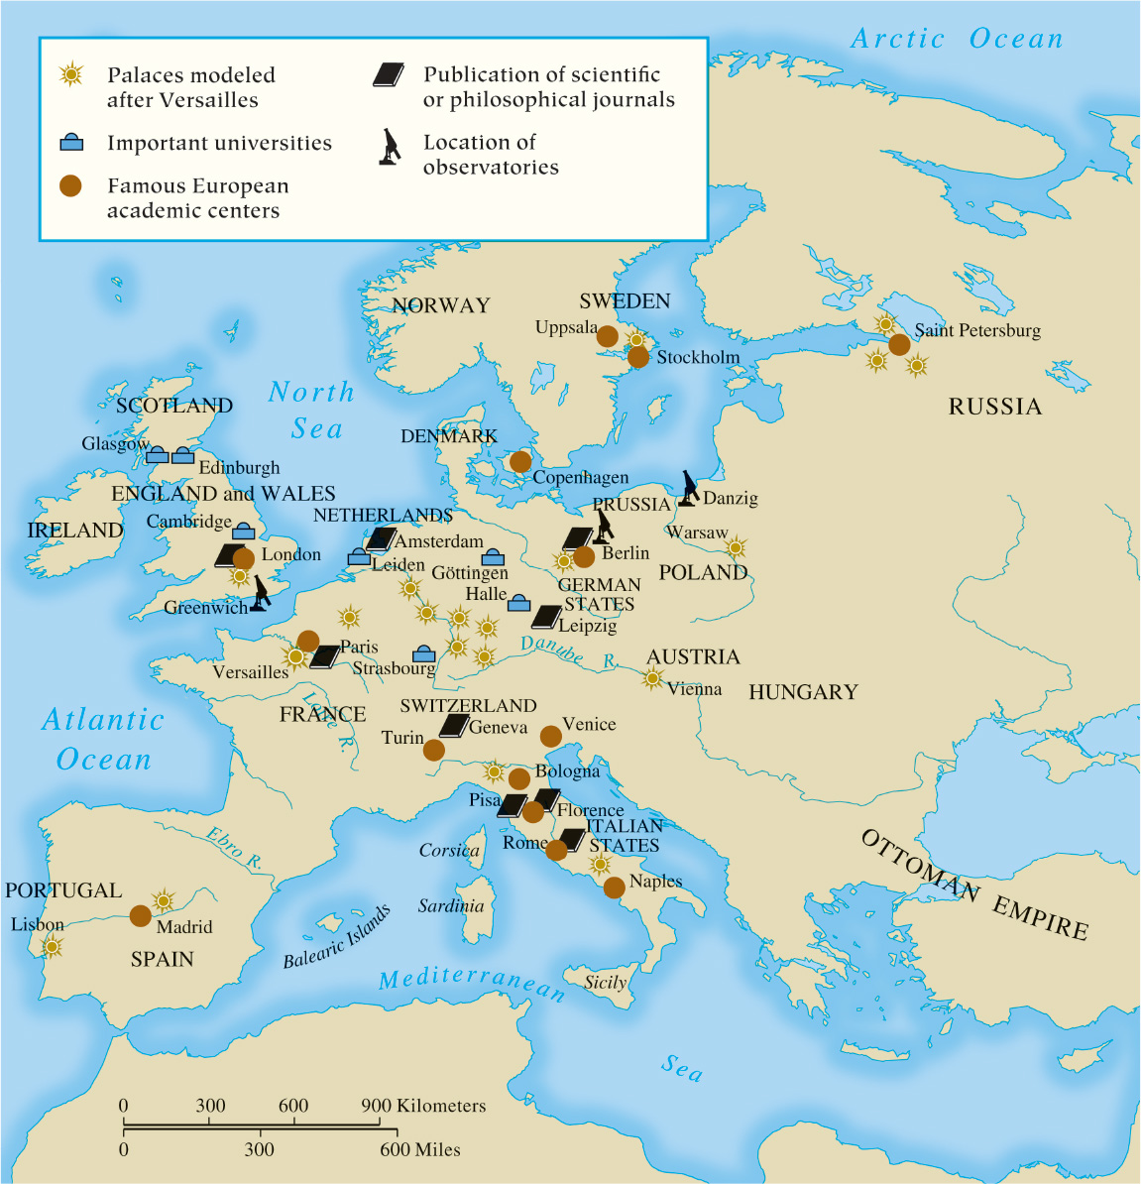
Map 17.1 The Enlightenment in Europe

Slide 13
17-2 Culture and Society in the Enlightenment (1 of 3)
Focus Questions: What innovations in art, music, and literature occurred in the eighteenth century? How did popular culture differ from high culture in the eighteenth century?
Innovations in art, music, and literature
  Rococo emphasized grace and gentle action
    Antoine Watteau’s lyrical views of aristocratic life
    Baroque-Rococo architecture: the works of Balthasar Neumann
  The development of music
    Bach and Handel perfected Baroque musical style
    Hayden and Mozart shifted Europe’s musical center to the Austrian Empire
  Development of the novel

Slide 14
17-2 Culture and Society in the Enlightenment (2 of 3)
The high culture of the eighteenth century
  Learned world of theologians, scientists, philosophers, intellectuals, poets, and dramatists
  Expansion of the reading public and publishing
    The development of magazines
Popular culture
  Characterized by its collective and public nature
    Festival: relaxation and enjoyment
    Carnival as a time of indulgence
    Taverns and cabarets
  Gulf between elite and poor widened

Slide 15
17-2 Culture and Society in the Enlightenment (3 of 3)
Crime and punishment
  Judicial torture and public executions
  A new approach to justice: Cesare Beccaria, On Crimes and Punishments
    Argued that punishments should serve only as deterrents
  Decline of corporal and capital punishment

Slide 16
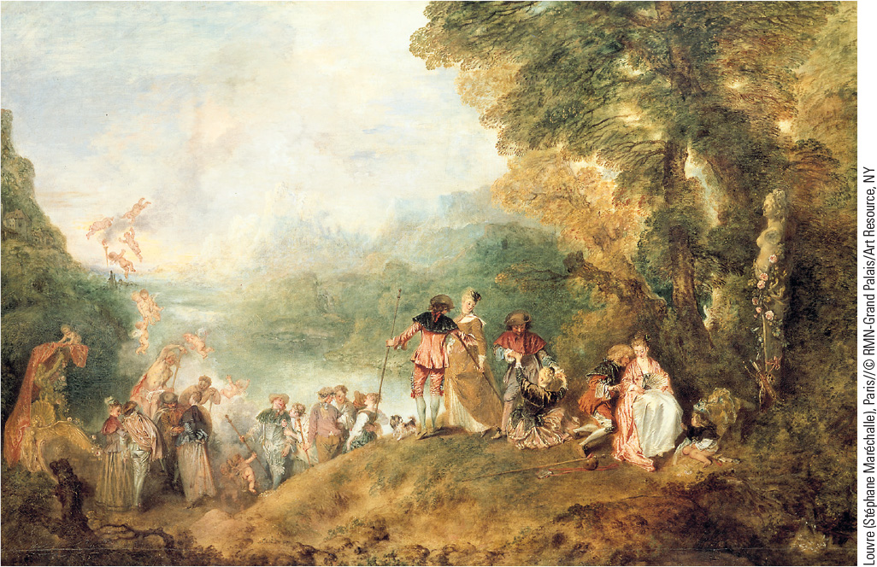
17.5 Antoine Watteau, Return from Cythera. Watteau’s portrayal of aristocratic life reveals a world of elegance, wealth, and pleasure.

Slide 17
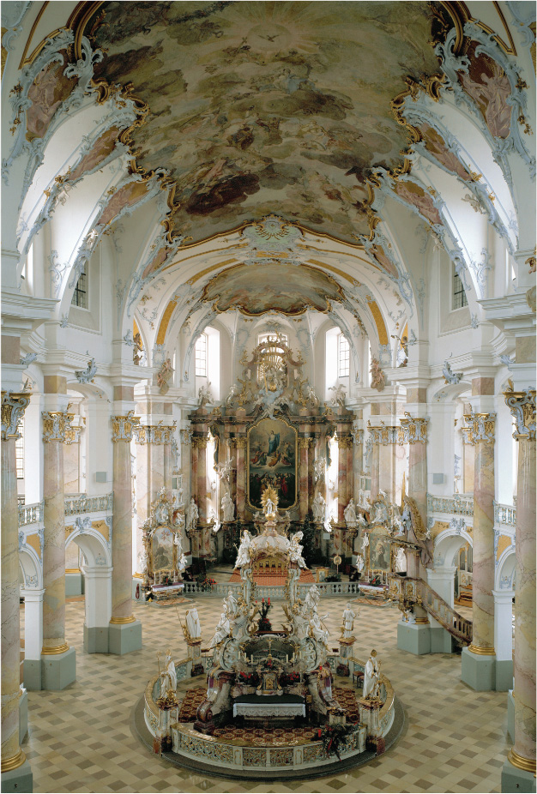
17.6 Vierzehnheiligen, Interior View. Balthasar Neumann produced Baroque-Rococo buildings in which secular and spiritual elements became interchangeable.

Slide 18
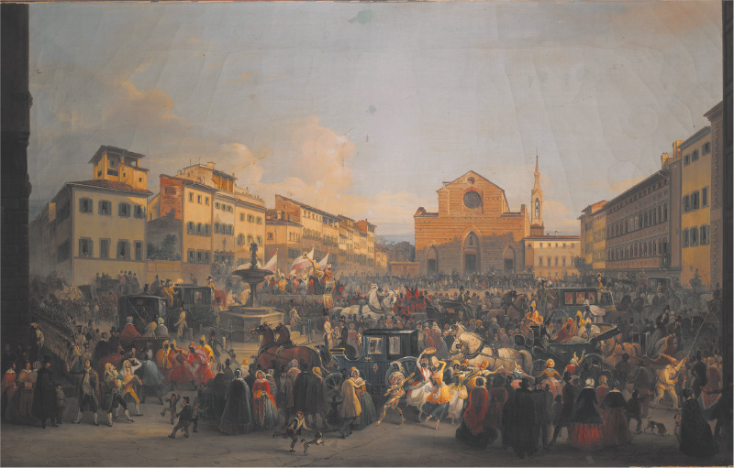
17.7a Popular Culture. This image shows a scene from the celebration of Carnival on the Piazza Santa Croce in Florence, Italy.

Slide 19
17-3 Religion and the Churches (1 of 2)
Focus Question: How did popular religion differ from institutional religion in the eighteenth century?
The institutional church
  Conservative institutions that upheld society’s hierarchical structure, privileged classes, and traditions
    Priest or pastor remained center of religious practice
    Parishes provided charity and education
Toleration and religious minorities
  Jews restricted in eastern Europe and subject to pogroms
  Some Enlightenment thinkers favored a new acceptance of religious minorities
    New policies of Austrian emperor Joseph II
    Toleration of various religious orders in the Dutch Republic

Slide 20
17-3 Religion and the Churches (2 of 2)
Popular religion in the eighteenth century
  Catholic parish church remained important center of life for entire community
  Protestant churches settled down into established patterns controlled by state authorities
    Desire for greater depths of religious experience
    John Wesley led the Methodist movement

Slide 21
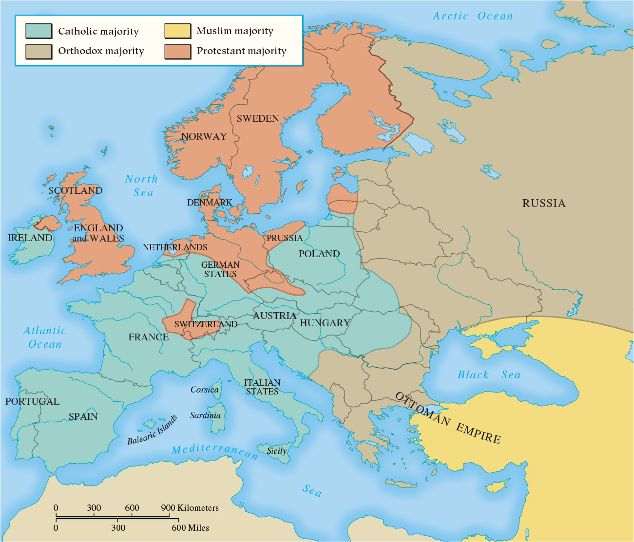
Map 17.2 Religious Populations of Eighteenth-Century Europe

Slide 22
Chapter 17 Summary
The popularization of the ideas of the Scientific Revolution, the impact of travel literature, a new skepticism, and the ideas of Locke and Newton led to what historians call the Age of Enlightenment.
Philosophes believed that education could create better human beings and a better human society.
Female intellectuals began to argue for the equality of the sexes and the right of women to be educated.
The cultural fertility of the age is evident in Rococo painting and architecture; the achievements of Bach, Handel, Haydn, and Mozart in music; and the birth of the novel in literature.
Most people in eighteenth-century Europe still lived by seemingly eternal verities and practices—God, religious worship, and farming.

Slide 23
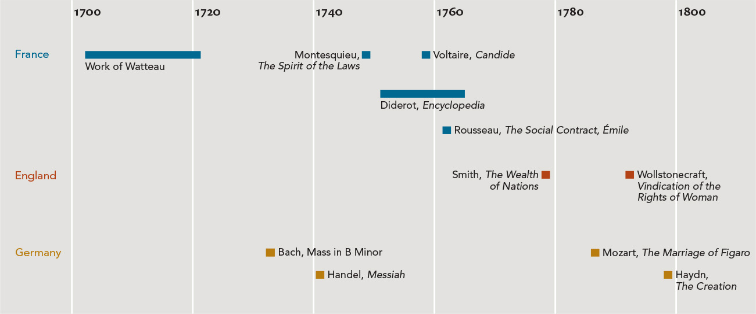
Chapter 17 Timeline

