Slide 1
WESTERN CIVILIZATION: A Brief History
Tenth Edition
CHAPTER 16
Toward a New Heaven and a New Earth:
The Scientific Revolution and the Emergence of Modern Science
© 2020 Cengage. All rights reserved.

Slide 2
Chapter 16 Outline
16-1 Background to the Scientific Revolution
16-2 Toward a New Heaven: A Revolution in Astronomy
16-3 Advances in Medicine and Chemistry
16-4 Women in the Origins of Modern Science
16-5 Toward a New Earth: Descartes, Rationalism, and a New
View of Humankind
16-6 The Spread of Scientific Knowledge

Slide 3
16-1 Background to the Scientific Revolution
(1 of 2)
Focus Question: What developments during the Middle Ages and the Renaissance contributed to the Scientific Revolution of the seventeenth century?
Before the Scientific Revolution
  Medieval philosophers and ideas
  Fifteenth- and sixteenth-century developments
Ancient authors and Renaissance artists
  New scientific work stimulated by the desire to discover which school of thought was correct
  Artists and the imitation of nature
    Increased reliance on close observation of nature

Slide 4
16-1 Background to the Scientific Revolution
(2 of 2)
Technological innovations and mathematics
  Impact of the discovery of the New World and increased trade
    Academic study supported by states, outside the universities
    New instruments and machines: telescope, microscope, and the printing press
  The rediscovery of works by ancient mathematicians
Renaissance magic
  The fusion of Hermetic magic and alchemical thought
    Engagement with experimentation

Slide 5
16-2 Toward a New Heaven: A Revolution in Astronomy (1 of 3)
Focus Question: What did Copernicus, Kepler, Galileo, and Newton contribute to a new vision of the universe, and how did it differ from the Ptolemaic conception of the universe?
Cosmological views of the later Middle Ages
  Ptolemaic or geocentric conception
    Motionless earth at center of a universe of concentric spheres
    A Christianized finite universe

Slide 6
16-2 Toward a New Heaven: A Revolution in Astronomy (2 of 3)
Copernicus
  Copernican heliocentric (sun-centered) conception
    On the Revolutions of the Heavenly Spheres: planets revolved around the sun and earth rotated daily on its axis
Kepler
  Discovering the “music of the spheres”: laws of planetary motion based on detailed astronomical data
    Elimination of the idea of uniform circular motion and crystalline spheres revolving in circular orbits

Slide 7
16-2 Toward a New Heaven: A Revolution in Astronomy (3 of 3)
Galileo
  First to make observations of heavens using a telescope
    Published The Starry Messenger in 1610
  Ordered by the Holy Office to reject Copernican thesis
    Condemnation of Galileo by the Inquisition: undermining scientific work in Italy
Newton
  Mathematical Principles of Natural Philosophy
    Proofs of universal law of gravitation
    Culmination of theories of Copernicus, Kepler, and Galileo
  A new cosmology: the world-machine
    Conceived as operating absolutely in space, time, and motion

Slide 8
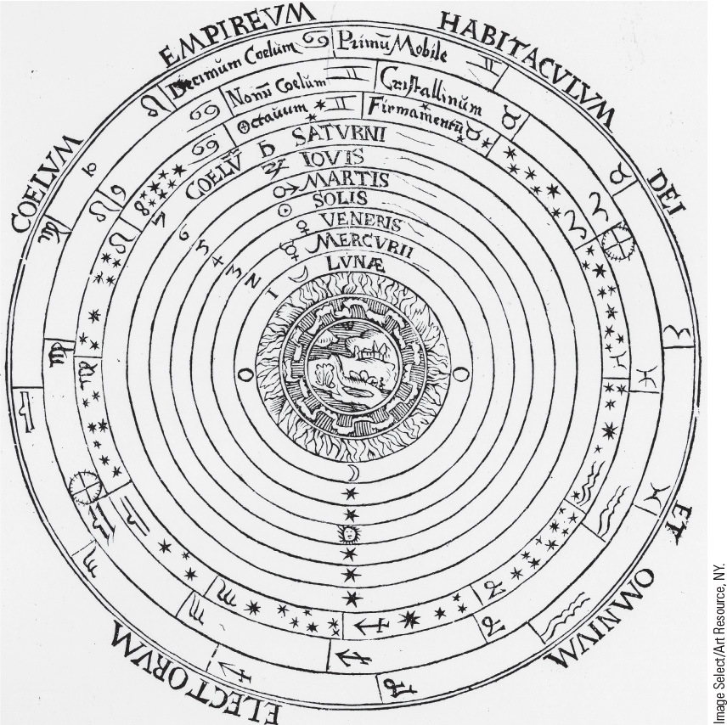
16.2 Medieval Conception of the Universe. This sixteenth-century illustration shows the earth at the center of the universe, surrounded by a series of concentric spheres.

Slide 9
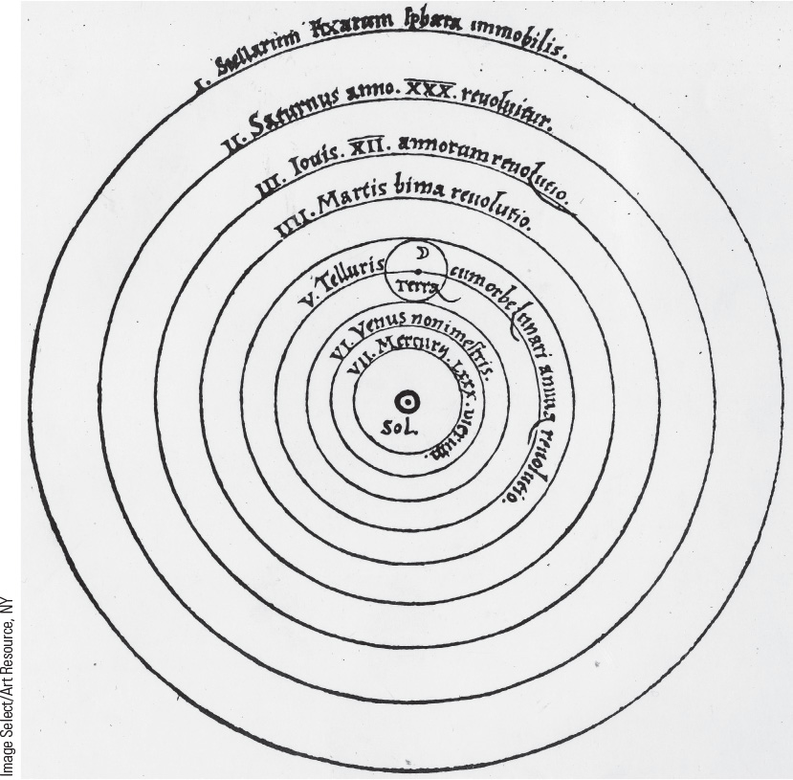
16.3 The Copernican System. Copernicus maintained that the sun was at the center of the universe and that the planets, including the earth, revolved around it.

Slide 10
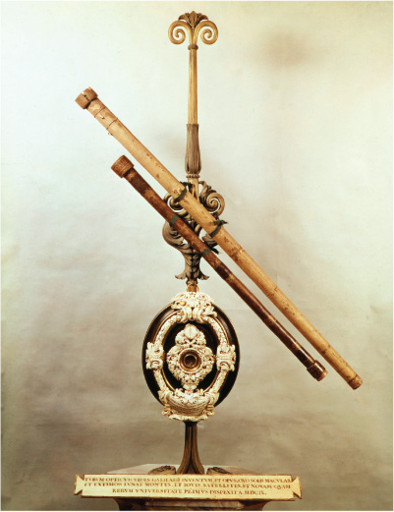
16.4b The Telescope. This is a photograph of Galileo’s original telescope, built in 1609.

Slide 11
16-3 Advances in Medicine and Chemistry
(1 of 2)
Focus Question: What did Vesalius, Harvey, Boyle, and Lavoisier contribute to a scientific view of medicine and chemistry?
The influence of Galen on the medieval medical world
  Galenic anatomy and physiology
Vesalius
  On the Fabric of the Human Body
    Rectifying some of Galen’s errors
Harvey
  On the Motion of the Heart and Blood
    A new theory of circulation

Slide 12
16-3 Advances in Medicine and Chemistry
(2 of 2)
Chemistry
  Properties of gas: Boyle’s law
  Boyle’s view of matter as composed of atoms
  Antoine and Marie-Anne Lavoisier
    Naming the chemical elements

Slide 13
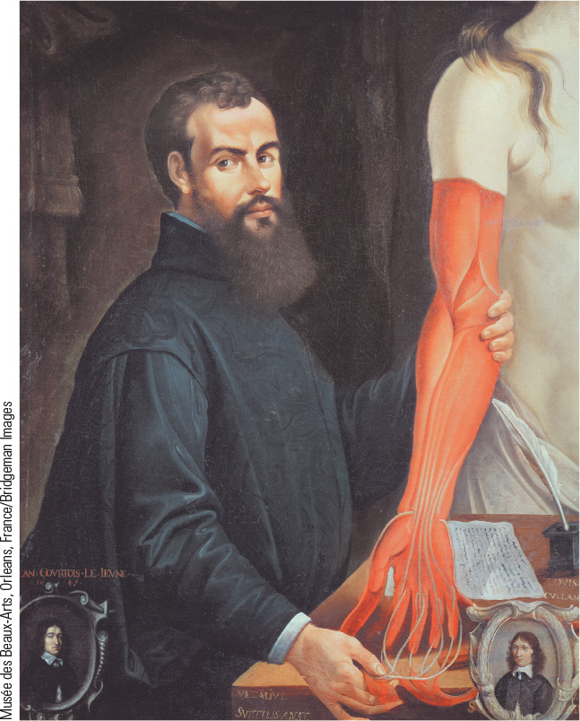
16.5 Andreas Vesalius. The work of Vesalius established new understanding of the human body, and new artistic developments gave accurate representations of his findings.

Slide 14
16-4 Women in the Origins of Modern Science
Focus Question: What role did women play in the Scientific Revolution?
Margaret Cavendish
  Able, as an aristocrat, to participate in crucial scientific debates
Maria Winkelmann
  Most famous of female astronomers in Germany but faced difficulties with being accepted
Debates on the nature of women
  Science used to find support for stereotypical views about a woman’s “true place” in the scheme of things
    Women argued against male images of women
    Reaffirmation of traditional ideas about women

Slide 15
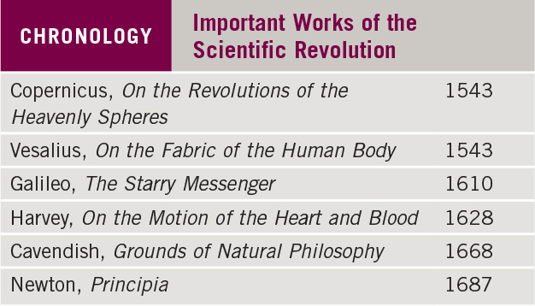
Chronology: Important Works of the Scientific Revolution

Slide 16
16-5 Toward a New Earth: Descartes, Rationalism, and a New View of Humankind
Focus Question: Why is Descartes considered the “founder of modern rationalism”?
Cartesian dualism and rationalism
  Split between mind and body led Westerners to equate identity with mind and reason rather than with the whole organism
  Devastating implications not only for traditional religious views of the universe, but also for how Westerners viewed themselves

Slide 17
16-6 The Spread of Scientific Knowledge (1 of 2)
Focus Question: How were the ideas of the Scientific Revolution spread, and what impact did they have on society and religion?
The Scientific Method
  Newton synthesized Bacon’s empiricism with Descartes’s rationalism
The scientific societies
  Emphasized the practical value of scientific research
    English Royal Society
    French Royal Academy of Sciences

Slide 18
16-6 The Spread of Scientific Knowledge (2 of 2)
Science and society
  Science became a part of high culture
  Rulers provided patronage for prestige and practicality
Science and religion
  Dichotomy existed between scientific investigations and religious beliefs
  Pascal sought to keep science and religion united
    The Pensées

Slide 19
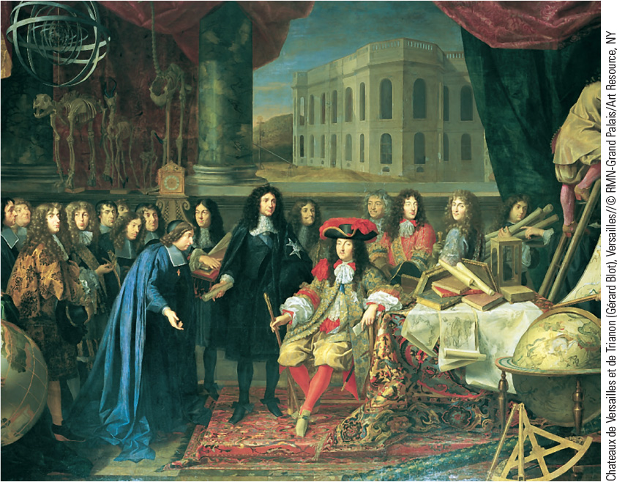
16.6 Louis XIV and Colbert Visit the Academy of Sciences. Urged on by his minister Colbert, Louis XIV of France, shown here, gave formal recognition to the French Academy in 1666.

Slide 20
Chapter 16 Summary
In the Scientific Revolution, the Western world overthrew the medieval, Ptolemaic-Aristotelian worldview and geocentric universe and arrived at a new conception of the universe: the sun at the center, the planets as material bodies revolving around the sun in elliptical orbits, and an infinite rather than finite world.
The contributions of each key individual built on the contributions of others, thus establishing one of the basic principles of the new science—cooperation in the pursuit of new knowledge.
The development of a scientific methodology furthered the work of the scientists, and the creation of scientific societies and learned journals spread its results.
New ways of thinking created a more fundamental break with the past and forced Europeans to change their conception of themselves.

Slide 21
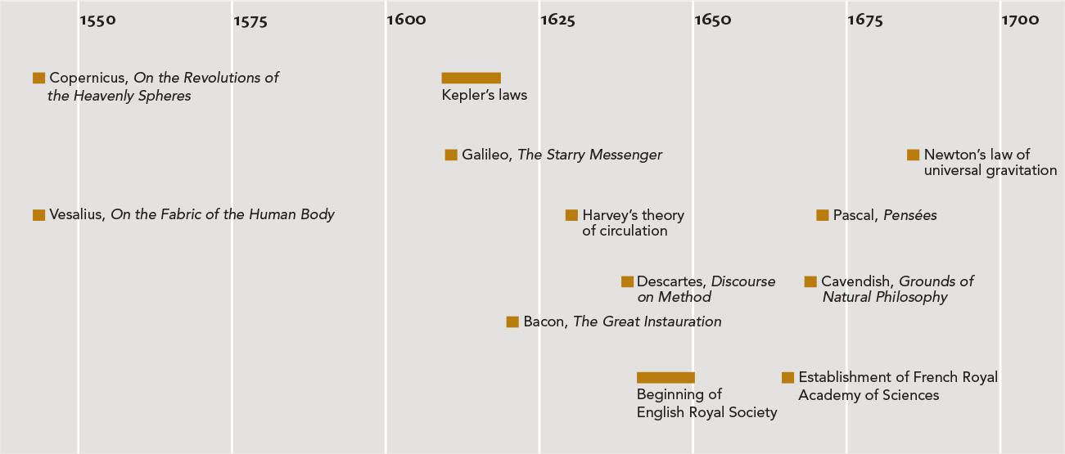
Chapter 16 Timeline

