Slide 1
WESTERN CIVILIZATION: A Brief History
Tenth Edition
CHAPTER 15
State Building and the Search for Order in the Seventeenth Century
© 2020 Cengage. All rights reserved.

Slide 2
Chapter 15 Outline
15-1 Social Crises, War, and Rebellions
15-2 The Practice of Absolutism: Western Europe
15-3 Absolutism in Central and Eastern Europe
15-4 Limited Monarchy: The Dutch Republic and England
15-5 The Flourishing of European Culture

Slide 3
15-1 Social Crises, War, and Rebellions (1 of 2)
Focus Question: What economic, social, and political crises did Europe experience in the first half of the seventeenth century?
Worsening economic conditions and population challenges
The witchcraft craze
  The spread of witchcraft
    Increased trials and executions
    Religious tensions and uncertainties
    Social conditions and the susceptibility of women to accusations
  Decline

Slide 4
15-1 Social Crises, War, and Rebellions (2 of 2)
The Thirty Years’ War
  Outbreak: militant Catholicism versus militant Calvinism
  Wider conflict determined by political motivations
    Struggle for European leadership
  The Peace of Westphalia
Rebellions
  Causes: discontent of nobles and commoners
    1590–1640: revolts in central and southern France, Austria, Hungary, Portugal, and Catalonia
    1641, 1645, and 1648: urban uprisings in Russia
    More disturbances in Scandinavia, the United Provinces, and England

Slide 5
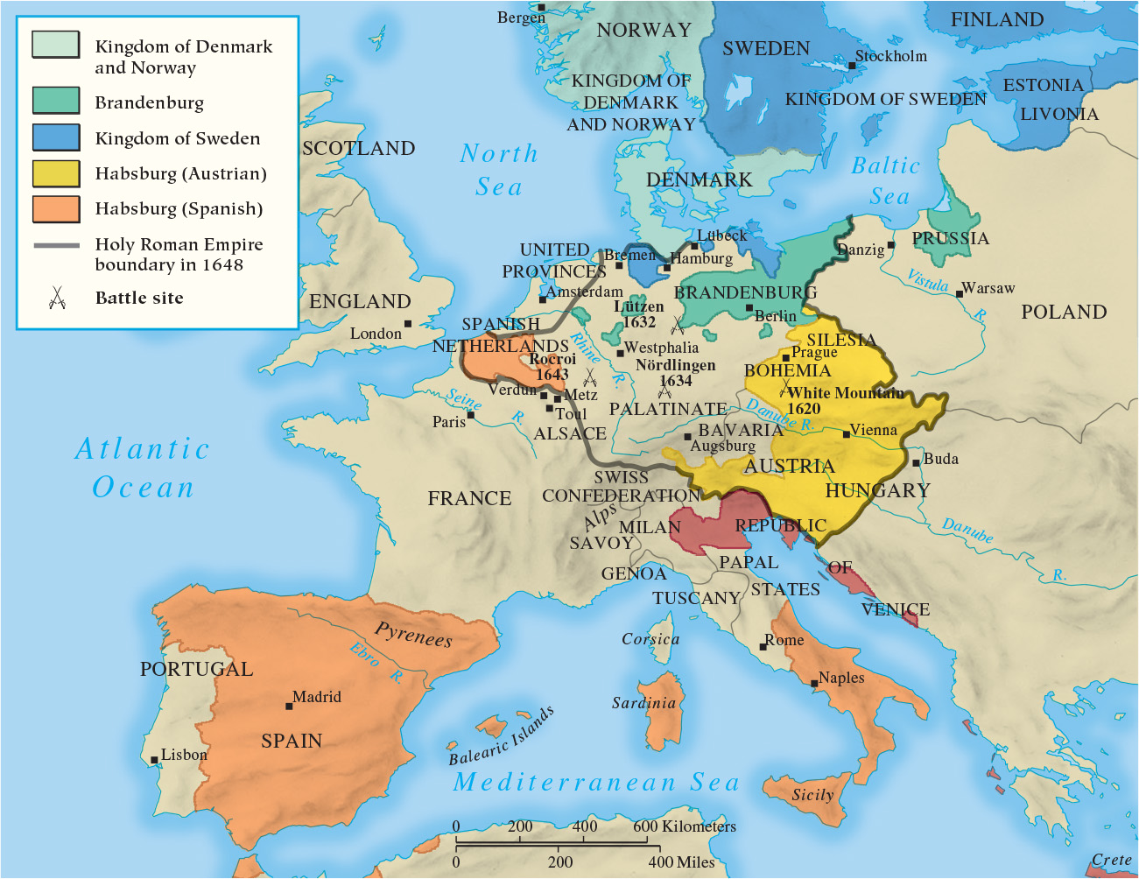
Map 15.1 The Thirty Years’ War

Slide 6
15-2 The Practice of Absolutism: Western Europe (1 of 3)
Focus Question: What was absolutism in theory, and how did its actual practice in France reflect or differ from the theory?
France: Foundations of Absolutism
  Cardinal Richelieu’s policies
    Strengthening the power of monarchy during the reign of Louis XIII
  Cardinal Mazarin
    The Fronde: revolt to curb centralized administrative power

Slide 7
15-2 The Practice of Absolutism: Western Europe (2 of 3)
The Reign of Louis XIV (1643–1715)
  The myth and reality of the Sun King
    Grandeur at Versailles, challenges of authority
  Administration of the government
    High nobles removed from royal council
  Religious policy
    Edict of Fontainebleau: revocation of Nantes
  Financial issues
    Jean-Baptiste Colbert and mercantilism
  The Wars of Louis XIV
    Four wars waged between 1667 and 1713 to increase power and military glory

Slide 8
15-2 The Practice of Absolutism: Western Europe (3 of 3)
The decline of Spain
  Signs of weakness
    Empty treasury
    Out-of-date military
    Inefficient government
    Suppressed peasantry
    Weak commercial class
    Luxury-loving nobles
    Oversupply of priests and monks
  Unsuccessful attempts at reform, led by the count of Olivares
    Defeats in Europe and internal revolts

Slide 9
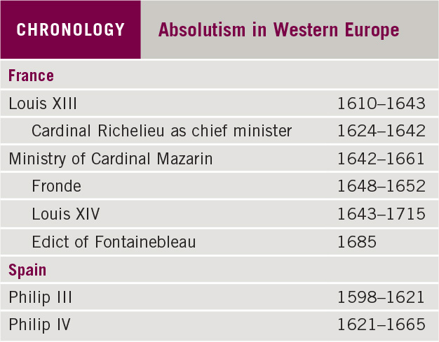
Chronology: Absolutism in Western Europe

Slide 10
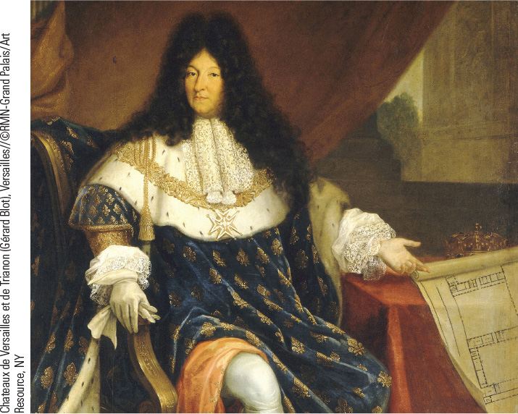
15.1 Portrait of Louis XIV. Nicolas-René Joallain the Elder’s Portrait of Louis XIV Captures the King’s Sense of Royal Grandeur.

Slide 11
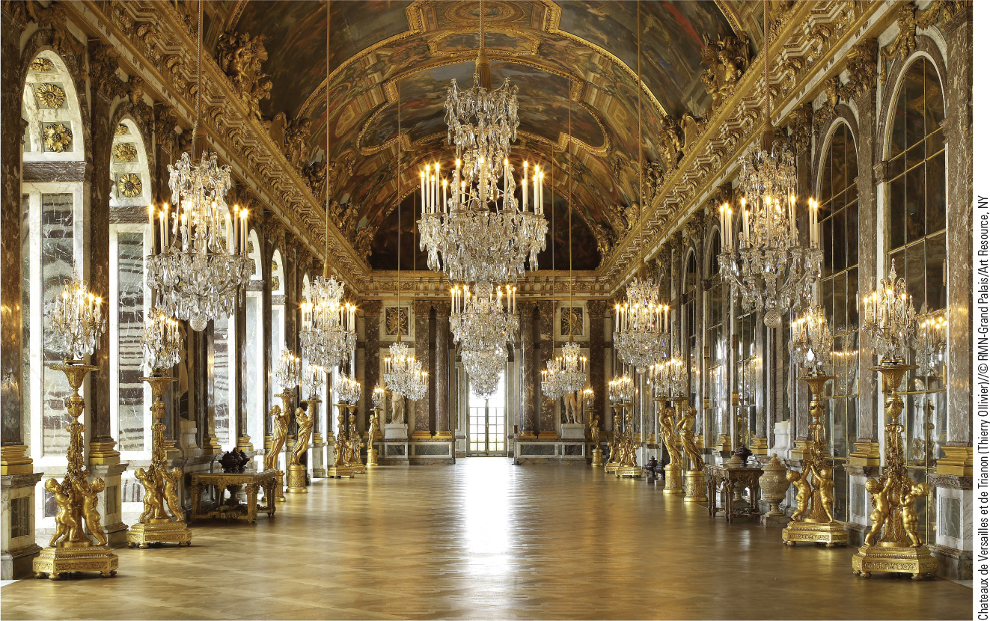
15.3 Interior of Versailles: The Hall of Mirrors. The exquisite Hall of Mirrors overlooks the park below and represents the grandeur of Versailles.

Slide 12
15-3 Absolutism in Central and Eastern Europe (1 of 3)
Focus Question: What developments enabled Brandenburg-Prussia, Austria, and Russia to emerge as major powers in the seventeenth century?
The German states
  The rise of Brandenburg-Prussia
    The power of the Hohenzollern dynasty: from Frederick William the Great Elector to Frederick III (King Frederick I)
The emergence of Austria
  Eventual defeat of the Ottomans expands empire
  The challenge of national groups to centralization

Slide 13
15-3 Absolutism in Central and Eastern Europe (2 of 3)
Russia: From fledgling principality to major power
  Ivan IV the Terrible (1533–1584) and the boyars
  The reign of Peter the Great (1689–1725)
    Acceleration of Westernization
    Reorganized army and created navy
    Divided Russia into eight provinces
    Created Holy Synod with a procurator
    Domestic reforms and benefits to women
    Fought in Great Northern War (1701–1721)

Slide 14
15-3 Absolutism in Central and Eastern Europe (3 of 3)
The Ottoman Empire
  From “sleeping giant” to a renewed offensive during the seventeenth century
    Repulsed by a mixed army, Ottomans retained the core empire but were never again a threat
The limits of absolutism
  The continued importance of local institutions, urban and provincial privileges, and exemptions

Slide 15
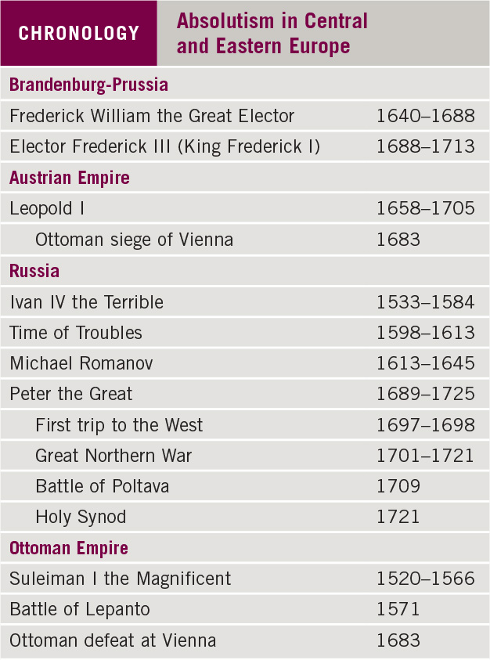
Chronology: Absolutism in Central and Eastern Europe

Slide 16
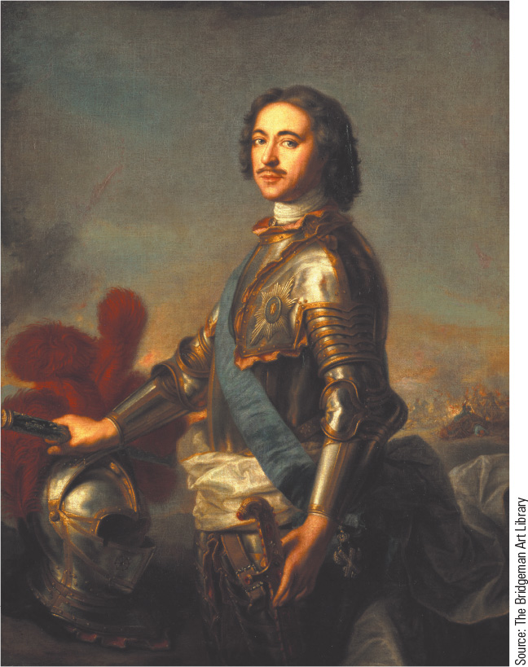
15.4 Peter the Great.
Peter the Great wished to westernize Russia and make it a great power through the creation of a strong army and navy and the acquisition of new territory.

Slide 17
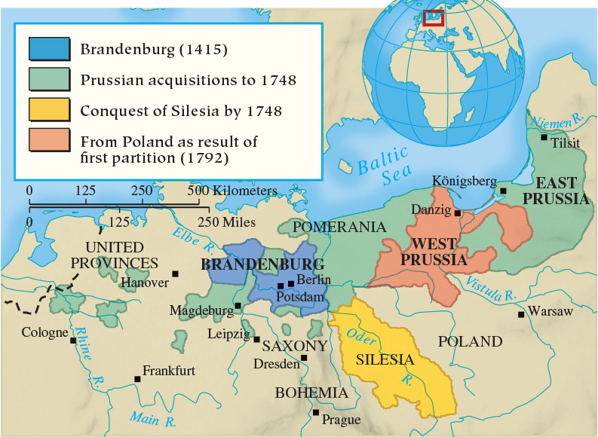
Map 15.2 The Growth of Brandenburg-Prussia

Slide 18
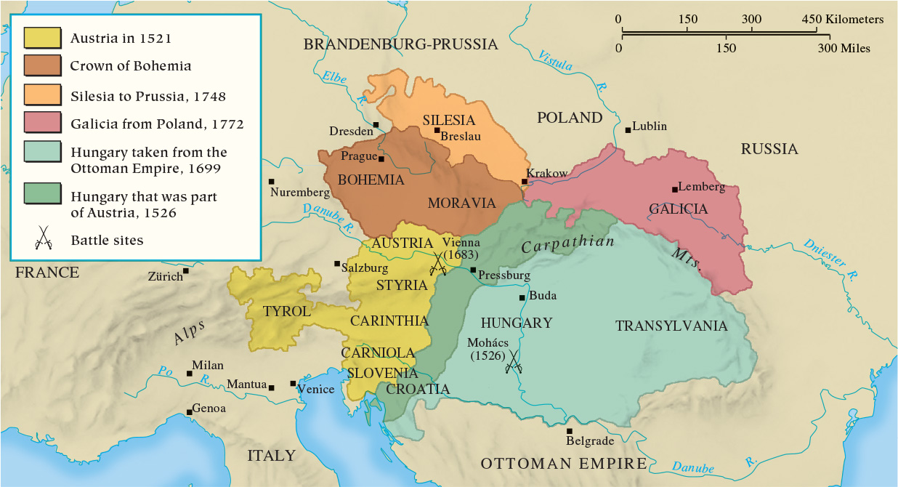
Map 15.3 The Growth of the Austrian Empire

Slide 19
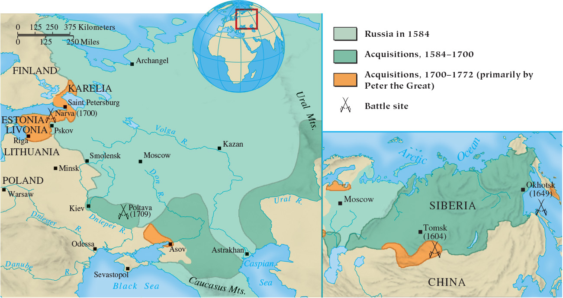
Map 15.4 Russia: From Principality to Nation-State

Slide 20
15-4 Limited Monarchy: The Dutch Republic and England (1 of 3)
Focus Question: What were the main issues in the struggle between king and Parliament in seventeenth-century England, and how were they resolved?
The golden age of the Dutch Republic
  Independence: tensions between republicanism and monarchy
  Economic prosperity fueled by trade
England and the emergence of constitutional monarchy
  King James I and Parliament
    James’s claim of the divine right of kings alienated Parliament
    The gentry and religious divisions
  Charles I and the move toward revolution

Slide 21
15-4 Limited Monarchy: The Dutch Republic and England (2 of 3)
Civil war and a new government
  New Model Army and Oliver Cromwell (1599–1658)
    January 30, 1649: Charles I executed
    Parliament proclaimed England a republic or commonwealth
    Cromwell dissolved Parliament and divided the country into eleven regions
  Monarchy reestablished after Cromwell’s death

Slide 22
15-4 Limited Monarchy: The Dutch Republic and England (3 of 3)
Restoration and a Glorious Revolution
  Charles II’s sympathy for Catholicism
    Declaration of Indulgences
    Test Act of 1673
  James II’s new Declaration of Indulgences
  The Glorious Revolution
    January 1689: William and Mary offered throne
    Bill of Rights
Responses to revolution
  The political thought of Thomas Hobbes and John Locke

Slide 23
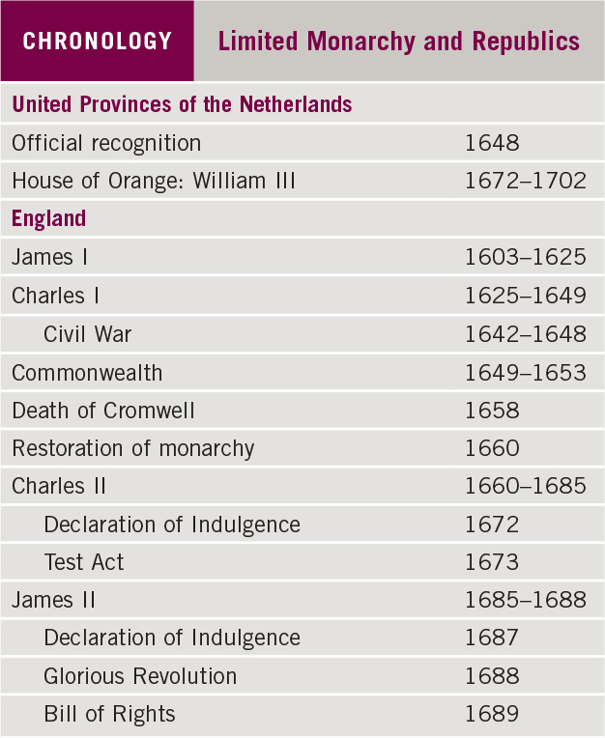
Chronology: Limited Monarchy and Republics

Slide 24
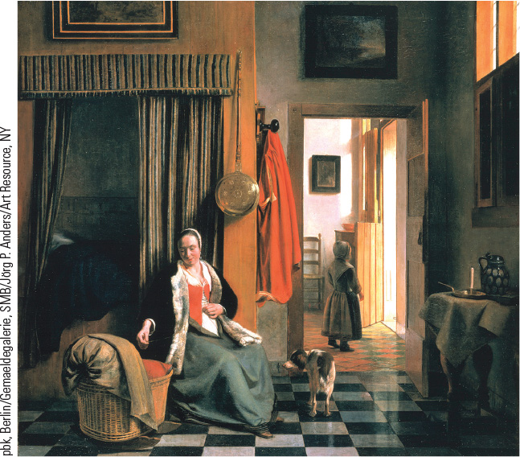
15.5a The Mother. This painting by Dutch Golden Age master Pieter de Hooch portrays a tranquil domestic scene of a mother with her children.

Slide 25
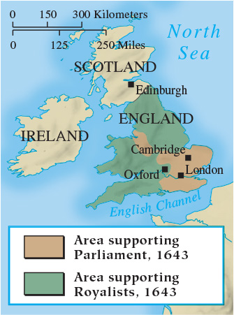
Map 15.5 Civil War in England

Slide 26
15-5 The Flourishing of European Culture
(1 of 2)
Focus Question: How did the artistic and literary achievements of this era reflect the political and economic developments of the period?
The changing faces of art
  Mannerism
    Breaking down the High Renaissance principles of balance, harmony, and moderation
  The Baroque
    Artists sought merge classical ideals of Renaissance art and spiritual feelings of sixteenth-century religious revival
  French Classicism and Dutch Realism
    French emphasis on clarity, simplicity, balance, and harmony
    Dutch interest in realistic portrayal of secular everyday life

Slide 27
15-5 The Flourishing of European Culture
(2 of 2)
Focus Question: How did the artistic and literary achievements of this era reflect the political and economic developments of the period?
The changing faces of art
  Mannerism
    Breaking down the High Renaissance principles of balance, harmony, and moderation
  The Baroque
    Artists sought merge classical ideals of Renaissance art and spiritual feelings of sixteenth-century religious revival
  French Classicism and Dutch Realism
    French emphasis on clarity, simplicity, balance, and harmony
    Dutch interest in realistic portrayal of secular everyday life

Slide 28
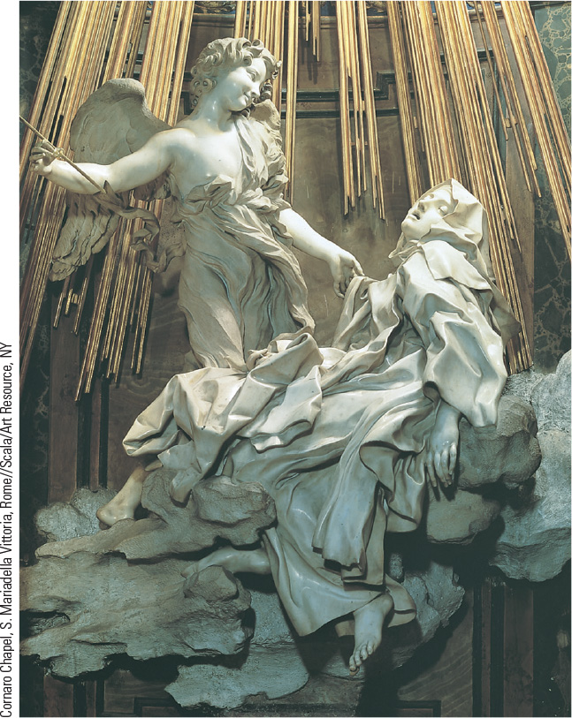
15.6 Gian Lorenzo Bernini, Ecstasy of Saint Theresa. Bernini sought to convey visually Theresa’s mystical experience in this famous Baroque sculpture in Rome.

Slide 29
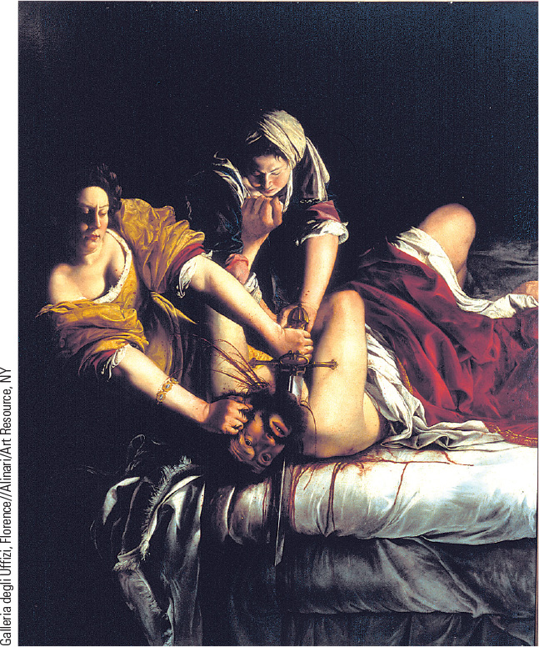
15.7 Artemisia Gentileschi,
Judith Beheading Holofernes. Gentileschi realistically and dramatically shows the gruesome nature of Judith’s act.

Slide 30
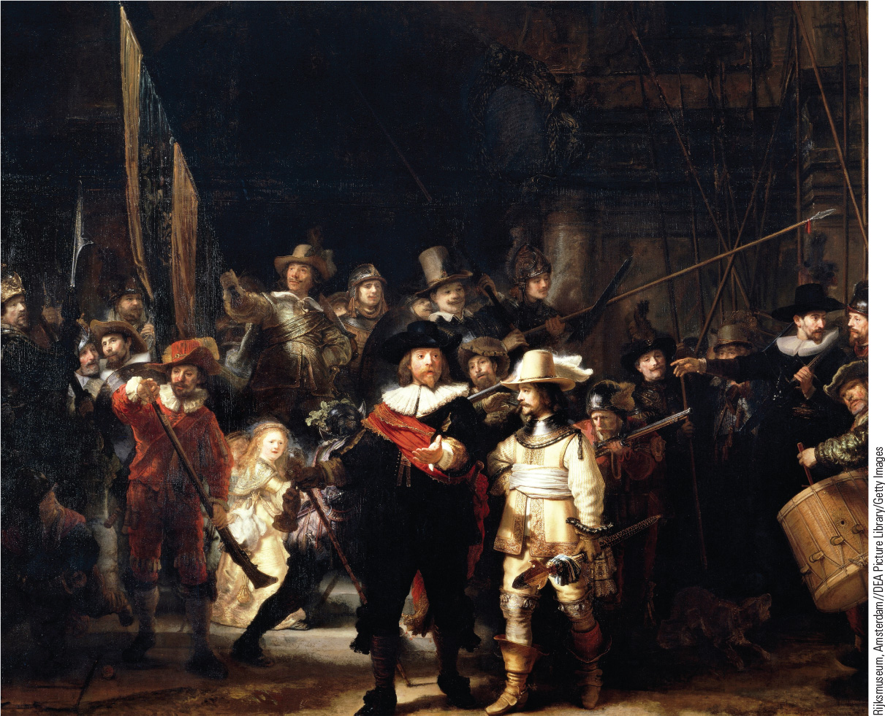
15.8 Rembrandt van Rijin, The Night Watch. This painting shows the two leaders and sixteen members of a civic militia preparing for a parade in the city of Amsterdam.

Slide 31
Chapter 15 Summary
In the seventeenth-century states called absolutist, strong monarchs with the assistance of their aristocracies took the lead in providing the leadership for greater centralization.
While Louis XIV served as the model of absolutism in the west, strong monarchies were also a feature in central and eastern Europe, with the new powers of Prussia, Austria, and Russia.
The Dutch Republic established limited monarchy, and England’s seventeenth century produced a constitutional monarchy and new ideas about the relationship between leaders and governed.
In literature and art, religion lost ground to secular subjects and concerns.

Slide 32
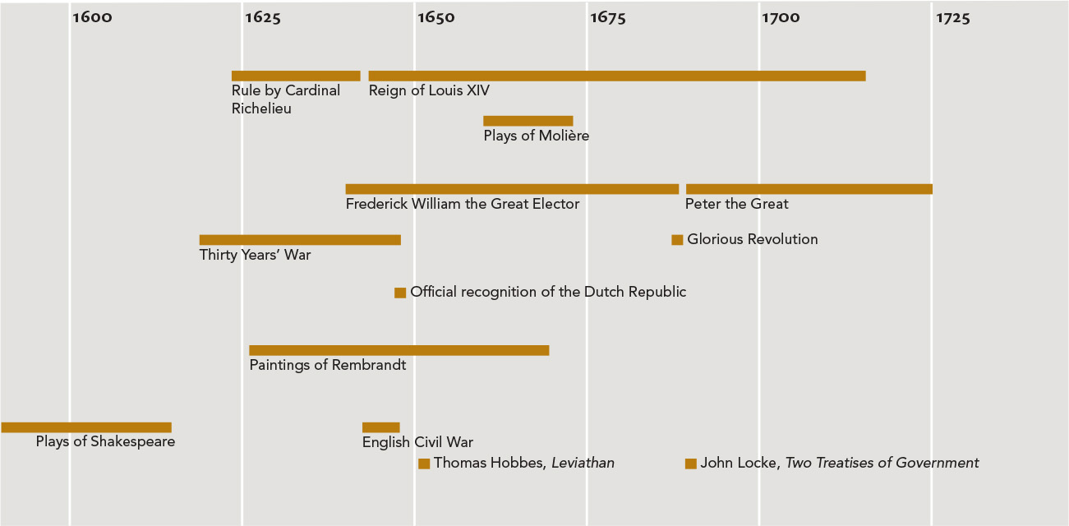
Chapter 15 Timeline

