Slide 1
WESTERN CIVILIZATION: A Brief History
Tenth Edition
CHAPTER 14
Europe and the World:
New Encounters, 1500–1800
© 2020 Cengage. All rights reserved.

Slide 2
Chapter 14 Outline
14-1 On the Brink of a New World
14-2 New Horizons: The Portuguese and Spanish Empires
14-3 New Rivals on the World Stage
14-4 The Impact of European Expansion
14-5 Toward a World Economy

Slide 3
14-1 On the Brink of a New World
Focus Question: Why did Europeans begin to embark on voyages of discovery and expansion at the end of the fifteenth century?
The motives for expansion
  Intrigue: fantasy literature about “other worlds”
  Economics and the drive for trade
  Religious zeal
The means for expansion
  Increased authority and resources of European monarchies
  Wealth and technologies of European states
  The impact of Ptolemy’s world map

Slide 4
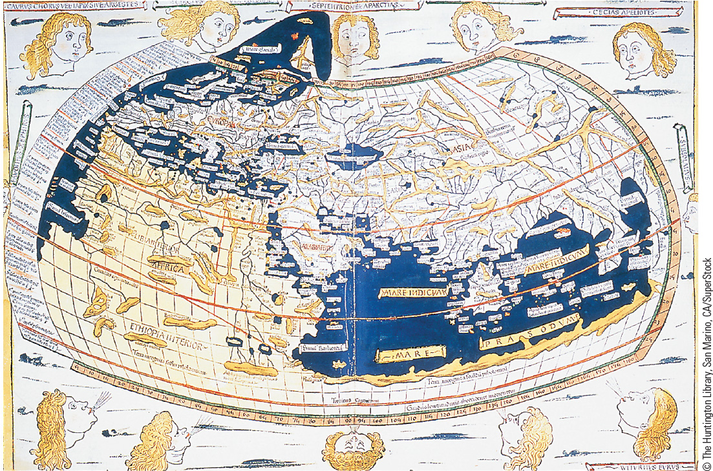
14.2 Ptolemy’s World Map. This world map, not available to Europeans until the fifteenth century, was considered the most accurate map of its time, despite the errors it contains.

Slide 5
14-2 New Horizons: The Portuguese and Spanish Empires (1 of 3)
Focus Question: How did Portugal and Spain acquire their overseas empires, and how did their empires differ?
The development of a Portuguese maritime empire
  The voyages of Bartholomeu Dias and Vasco da Gama
  The Portuguese ring of commercial-military bases
    Developing the spice trade
  Keys to success: guns and seamanship
Voyages to the New World
  Spanish patronage: Christopher Columbus’s discovery of the Caribbean
  State-sponsored explorers: the race to the New World

Slide 6
14-2 New Horizons: The Portuguese and Spanish Empires (2 of 3)
The Spanish Empire in the New World
  Conquistadors: motivated by a blend of glory, greed, and religious zeal
  Early civilizations in Mesoamerica
    The Maya
    Aztecs: consolidated rule over much of modern Mexico
  Spanish conquest of the Aztec Empire
    Hernán Cortés and his allies destroy the Aztecs
  The Inca and the Spanish
    Francisco Pizarro’s superior weaponry and internal turmoil led to conquest

Slide 7
14-2 New Horizons: The Portuguese and Spanish Empires (3 of 3)
Disease in the New World
  Indians of America had no immunity to smallpox, measles, influenza, pneumonic plague, typhus, yellow fever, and cholera
    High mortality rates led to a shorter of workers and the African slave trade
Administration of the Spanish Empire
  Misguided paternalism combined with exploitation
    Encomienda: a system of tribute and labor
    Administration based on viceroys
    Spanish control of the church in the New World

Slide 8
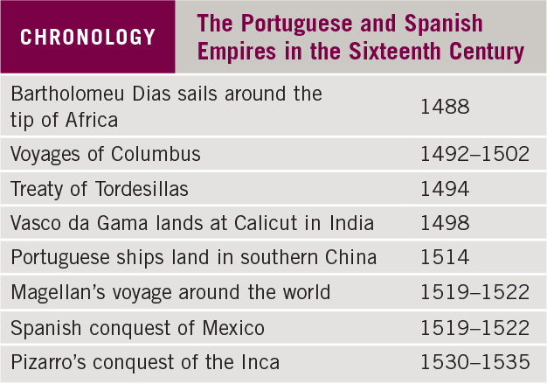
Chronology: The Portuguese and Spanish Empires in the
Sixteenth Century

Slide 9
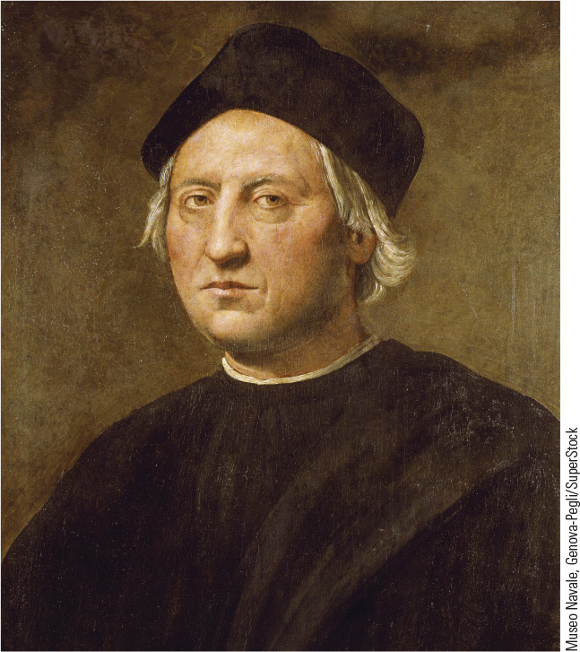
14.4 Christopher Columbus. Columbus, an Italian explorer who worked for the queen of Spain, is an heroic explorer to some and a destructive force to others.

Slide 10
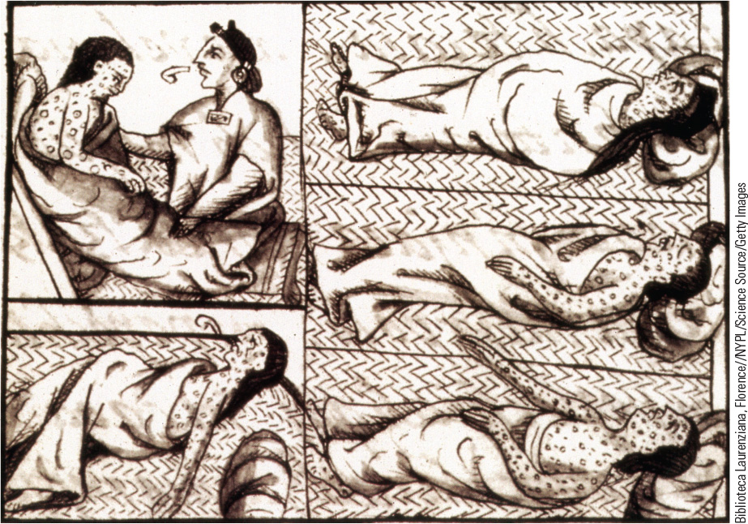
14.5 Aztec Victims of Smallpox. This sixteenth-century drawing by a Franciscan friar portrays Native Americans afflicted with smallpox.

Slide 11
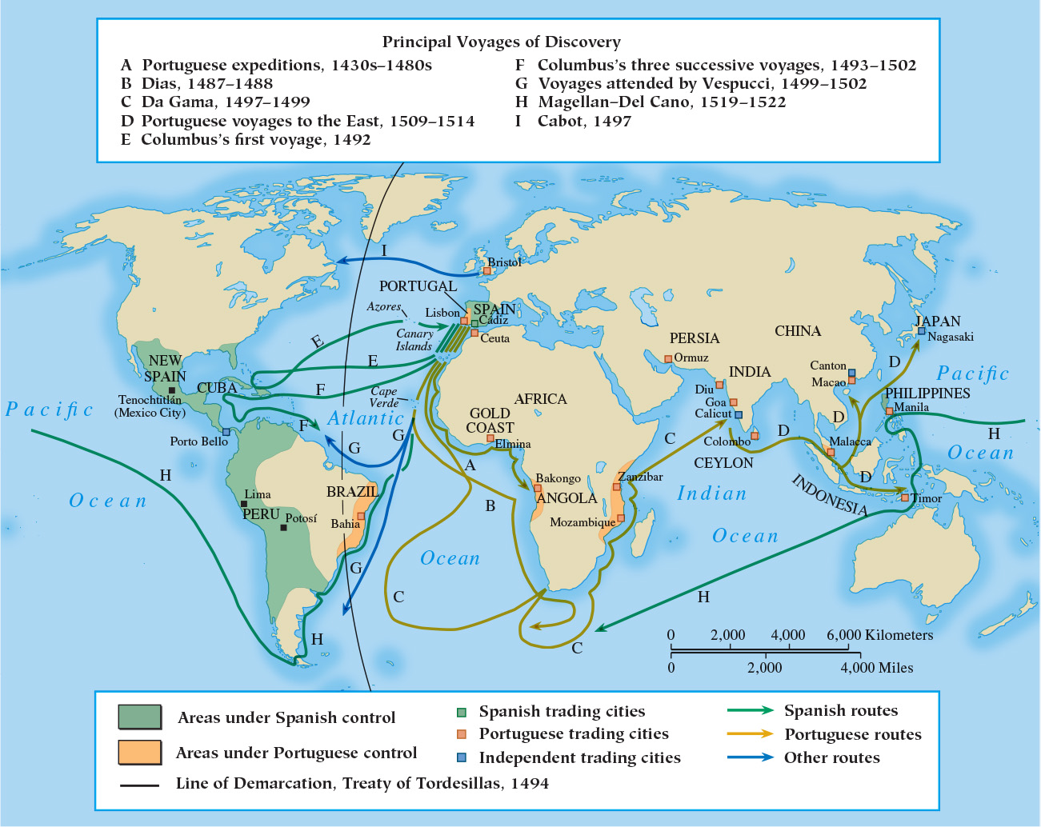
Map 14.1 European Discoveries and Possessions in the Fifteenth and Sixteenth Centuries

Slide 12
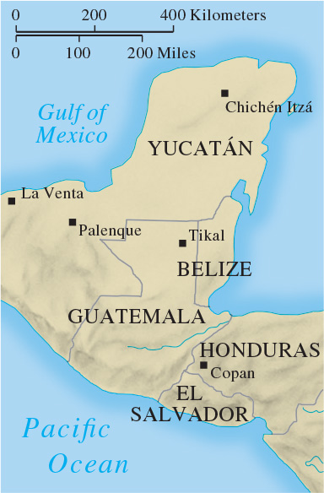
Map 14.2 Lands of the Maya

Slide 13
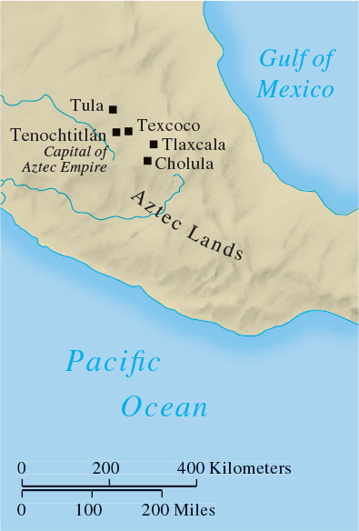
Map 14.3 The Aztec Empire

Slide 14
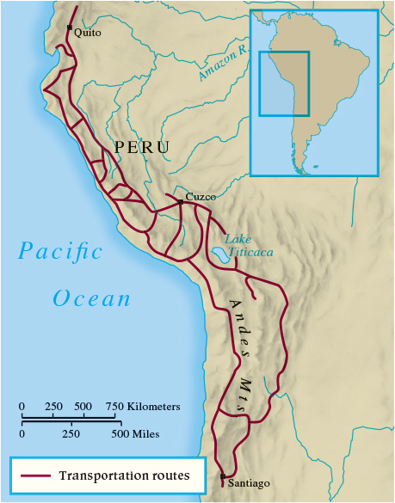
Map 14.4 Lands of the Inca

Slide 15
14-3 New Rivals on the World Stage (1 of 5)
Focus Questions: How did the arrival of the Dutch, British, and French on the world scene in the seventeenth and eighteenth centuries affect Africa, India, Southeast Asia, China, and Japan? What were the main features of the African slave trade, and what effects did it have on Africa?
New rivals
  Seventeenth-century competition in Africa, Asia, and the Americas

Slide 16
14-3 New Rivals on the World Stage (2 of 5)
Africa: the slave trade
  Traffic in slaves to work on sugarcane plantations
  Growth in the slave trade
    Triangular trade
    The Middle Passage
  Effects of the slave trade
    Economic and political repercussions
The West in Southeast Asia
  From Portuguese to Dutch dominance
    The Dutch East India Company

Slide 17
14-3 New Rivals on the World Stage (3 of 5)
The French and British in India
  The Mughal Empire
    Akbar brought Mughal rule to most of India
    Eighteenth-century decline and power vacuum
  The impact of the Western powers
    Portuguese, British, Dutch, and French all competed for trading privileges
    The British East India Company’s successes

Slide 18
14-3 New Rivals on the World Stage (4 of 5)
China
  Portuguese arrived in 1514, at height of Ming dynasty
  Western inroads
    Weakening Qing dynasty coincides with Western arrival
Japan
  Opening to the West
    Portuguese arrived in 1543
    Jesuits and Francis Xavier arrived in 1549
    Reactions against Westerners

Slide 19
14-3 New Rivals on the World Stage (5 of 5)
The Americas
  The West Indies
    African slaves produced tobacco, cotton, coffee, and sugar, all products in demand in Europe
  British North America
    Jamestown settled in 1607
    Thirteen colonies on the eastern seaboard
  French North America
    1663: Canada became part of French crown
    Autocratic government of a vast trading area

Slide 20
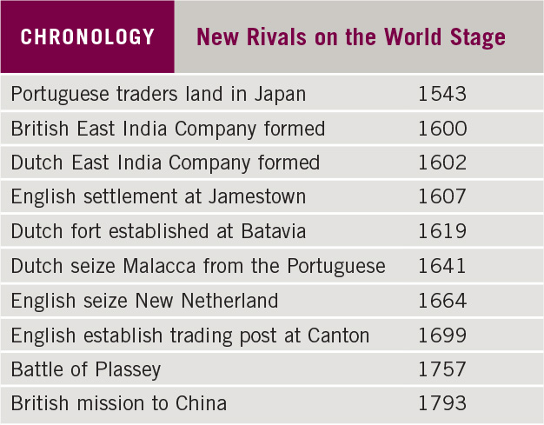
Chronology: New Rivals on the World Stage

Slide 21
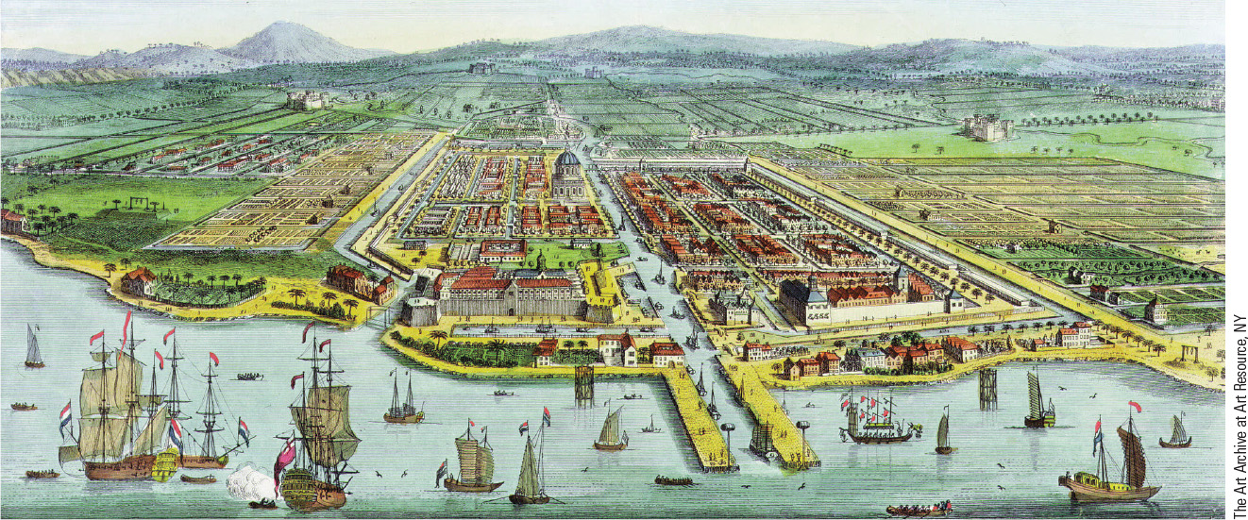
14.6b Europe in Asia. This scene shows a seventeenth-century view of Batavia, which the Dutch built as their headquarters on the northern coast of Java in 1619.

Slide 22
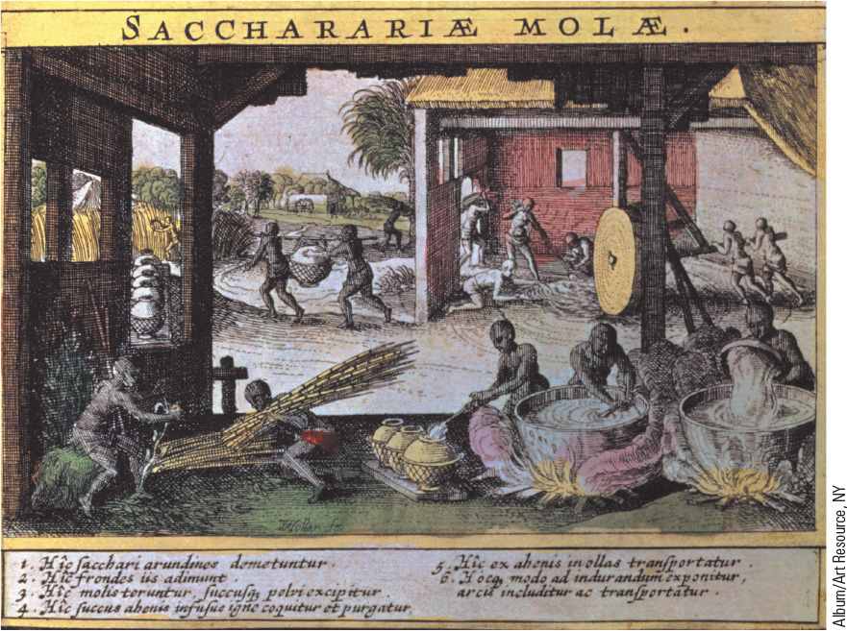
14.7 A Sugar Mill in the West Indies. This seventeenth-century French illustration shows the operation of a sugar mill in the French West Indies.

Slide 23
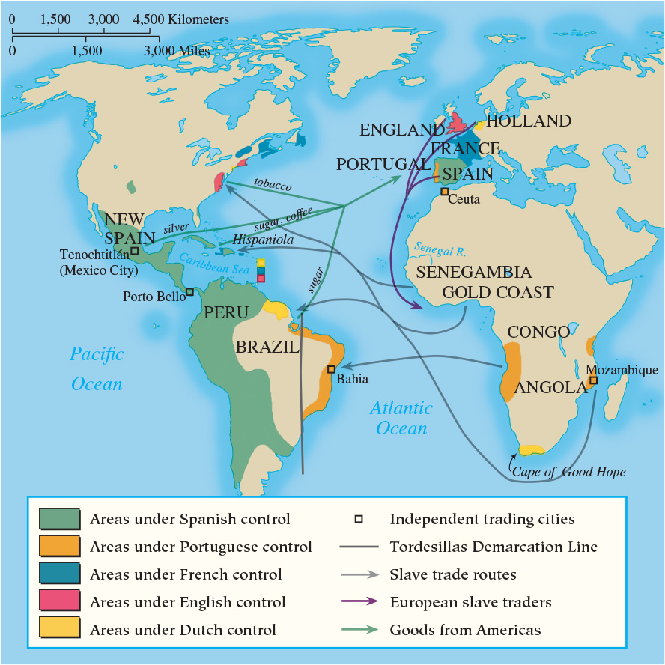
Map 14.5 Triangular Trade in the Atlantic Economy

Slide 24
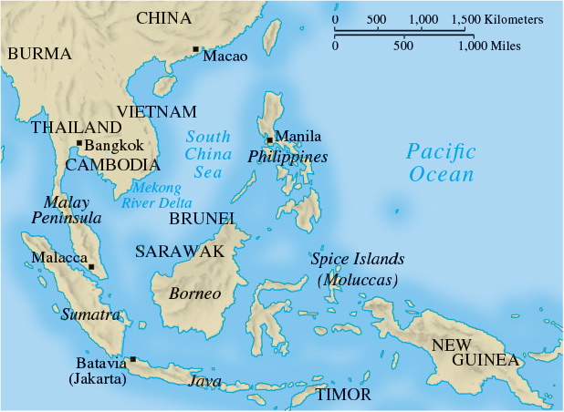
Map 14.6 Southeast Asia, ca. 1700

Slide 25
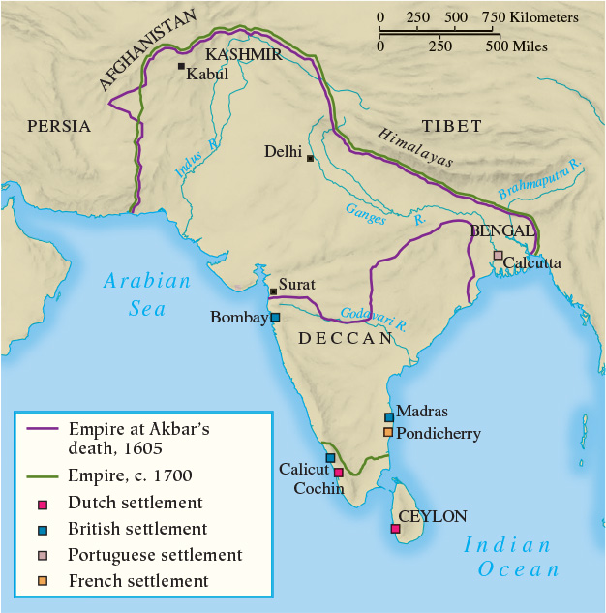
Map 14.7 The Mughal Empire

Slide 26
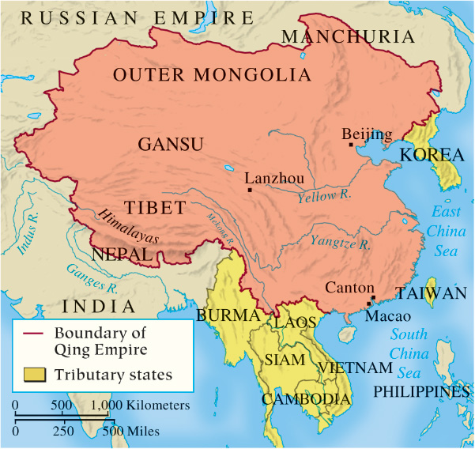
Map 14.8 The Qing Empire

Slide 27
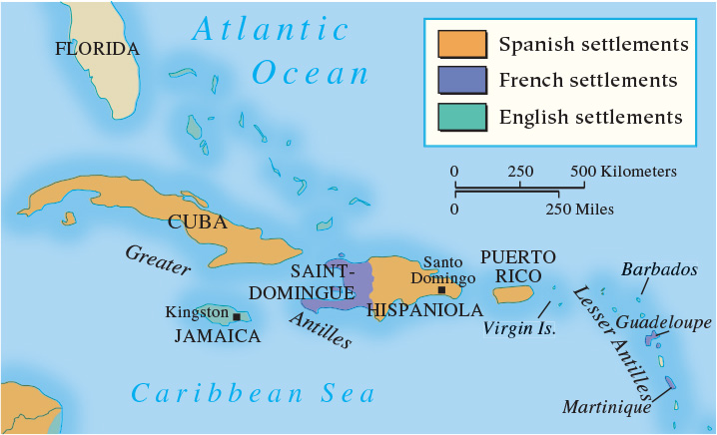
Map 14.9 The West Indies

Slide 28
14-4 The Impact of European Expansion
(1 of 2)
Focus Question: How did European expansion affect both the conquered and the conquerors?
The conquered
  Native American civilization virtually destroyed
  Africa and the slave trade
  Little impact in China and Japan
  India subject to growing British encroachment
  New Latin American civilization in Central and South America
  Catholic missionaries
    Dominicans, Franciscans, and Jesuits

Slide 29
14-4 The Impact of European Expansion
(2 of 2)
The conquerors
  The search for riches and social advancement
    The importation of precious metals
  Columbian Exchange
    Reciprocal importation and exportation of plants and animals between Europe and the Americas
  Lifestyle changes in Europe caused by new products
  European expansion deepened rivalries and prompted a new view of the world
  Psychological impact of colonization

Slide 30
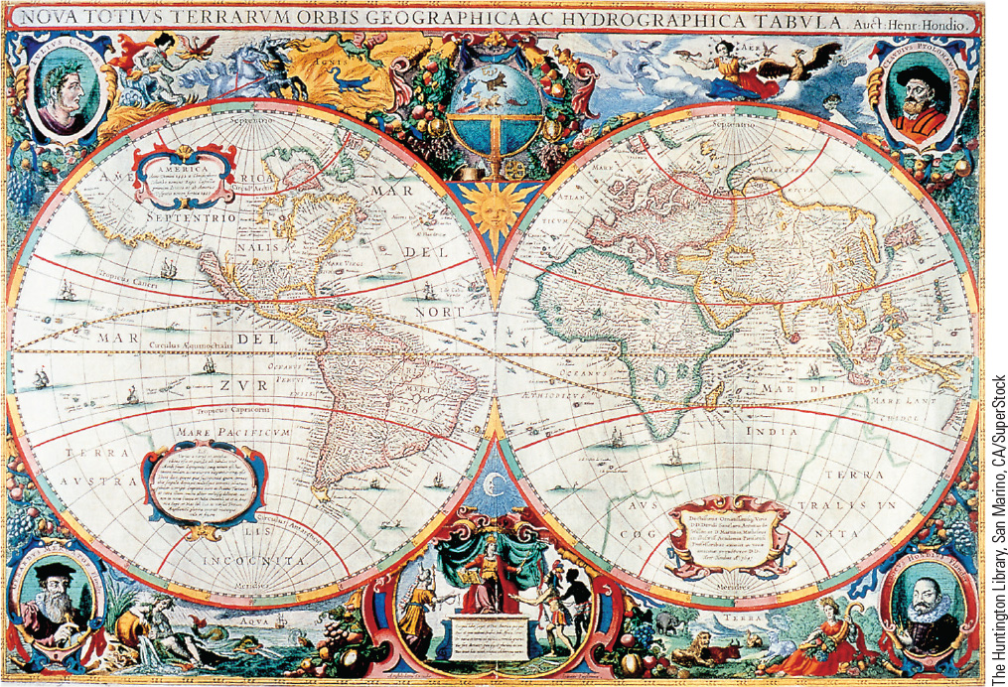
14.8 A Seventeenth-Century World Map. This map shows how much Europeans had learned about the shape of the world by the seventeenth century.

Slide 31
14-5 Toward a World Economy
Focus Question: What was mercantilism, and what was its relationship to colonial empires?
Economic conditions in the sixteenth century
  The price revolution: inflation
The growth of commercial capitalism
  Joint stock company: raising large amounts of capital
  New banking institutions
Mercantilism
  Total volume of trade unchangeable, so states protected their economies
    National prosperity depended on bullion supply
Overseas trade and the movement toward globalization

Slide 32
Chapter 14 Summary
Europeans sailed out into the world in all directions in at the end of the fifteenth century, with Portugal creating an empire based on trade and Spain creating a colonial empire.
By the end of the eighteenth century, European rivals had created a global trade network dominated by Western ships and Western power.
The insatiable need for labor drove the African slave trade that devastated Africa, but European expansion dramatically affected areas across the globe.
Europeans increasingly saw their culture, with its religion, languages, and technology, as a coherent force to be exported to all corners of the world.

Slide 33
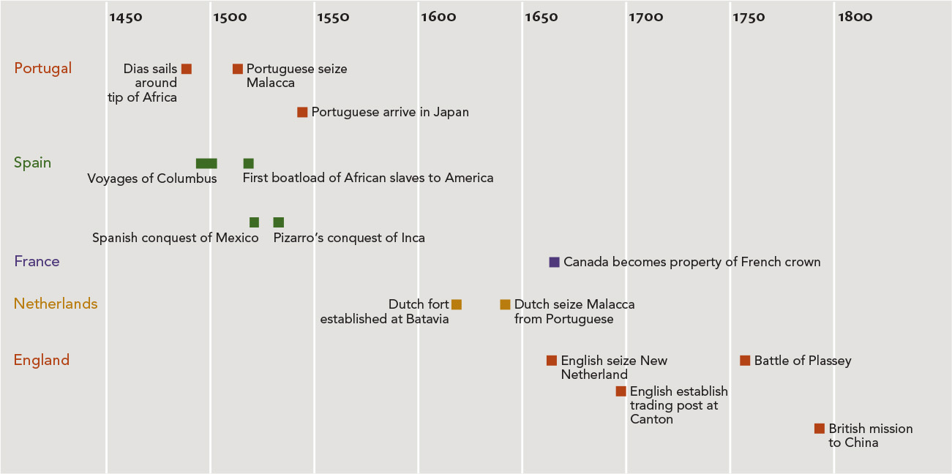
Chapter 14 Timeline

