Slide 1
WESTERN CIVILIZATION: A Brief History
Tenth Edition
CHAPTER 13
Reformation and Religious Warfare in the Sixteenth Century
© 2020 Cengage. All rights reserved.

Slide 2
Chapter 13 Outline
13-1 Prelude to Reformation
13-2 Martin Luther and the Reformation in Germany
13-3 The Spread of the Protestant Reformation
13-4 The Social Impact of the Protestant Reformation
13-5 The Catholic Reformation
13-6 Politics and the Wars of Religion in the Sixteenth Century

Slide 3
13-1 Prelude to Reformation
Focus Question: What were the chief ideas of the Christian humanists, and how did they differ from the ideas of the Protestant reformers?
The reform of Christendom before the Reformation
Christian or Northern Renaissance Humanism
  Idea that education could instill inner piety and lead to a reform of the church and society
  Erasmus
    Spreading “the philosophy of Christ”
    Criticisms of the clergy and papacy
Church and religion on the eve of the Reformation
  Corruption and abuse: pluralism and indulgences

Slide 4
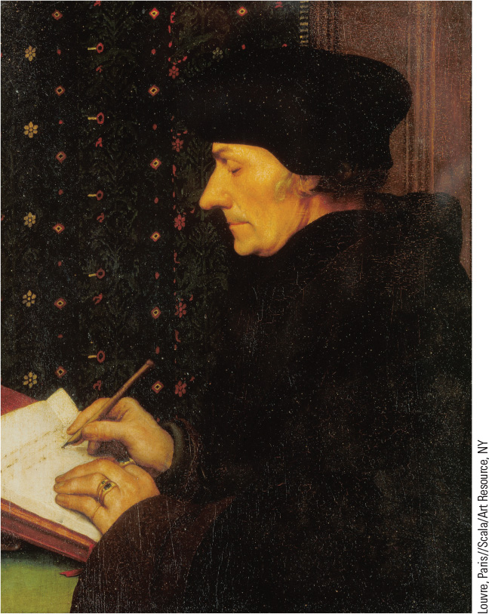
13.2 Erasmus. Desiderius Erasmus, the most influential northern Renaissance humanist, sought to restore Christianity to the simplicity found in the teachings of Jesus.

Slide 5
13-2 Martin Luther and the Reformation in Germany (1 of 3)
Focus Question: What were Martin Luther’s main disagreements with the Roman Catholic Church, and what political, economic, and social conditions help explain why the movement he began spread so quickly across Europe?
The early Luther
  Concerns about salvation: study and a solution
    Justification by grace and the Bible as sole authority
  The Indulgence Controversy
    The Ninety-Five Theses’ objections to indulgences
  The quickening rebellion
    Luther’s dissent and excommunication

Slide 6
13-2 Martin Luther and the Reformation in Germany (2 of 3)
The rise of Lutheranism
  The organization of a reformed church
    German translation of the Bible
    Dissemination of ideas: sermons and pamphlets
    Support of the elector of Saxony and other German rulers
    Dissent and rebellion: the Peasants’ War
  Organizing the Church
    Redefining the sacraments: baptism and the Eucharist
    Denial of transubstantiation
    Replacement of Mass with German liturgy

Slide 7
13-2 Martin Luther and the Reformation in Germany (3 of 3)
Germany and the Reformation: religion and politics
  The fate of Luther’s movement was closely tied to political affairs and rulers
    Charles V’s goals of dynastic control and the unity of the Catholic faith
    Rivalry with the Valois king of France, Francis I
    Opposition from Pope Clement VII
    The advance of the Ottoman Turks
    Internal politics of the Holy Roman Empire

Slide 8
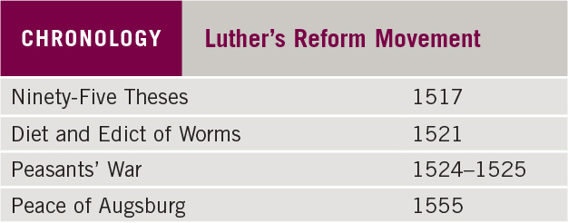
Chronology: Luther’s Reform Movement

Slide 9
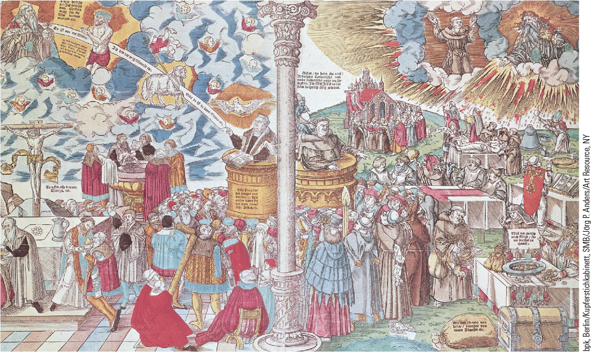
13.3 Woodcut: Luther Versus the Pope. Pamphlets containing picturesque woodcuts were important in the spread of Luther’s ideas.

Slide 10
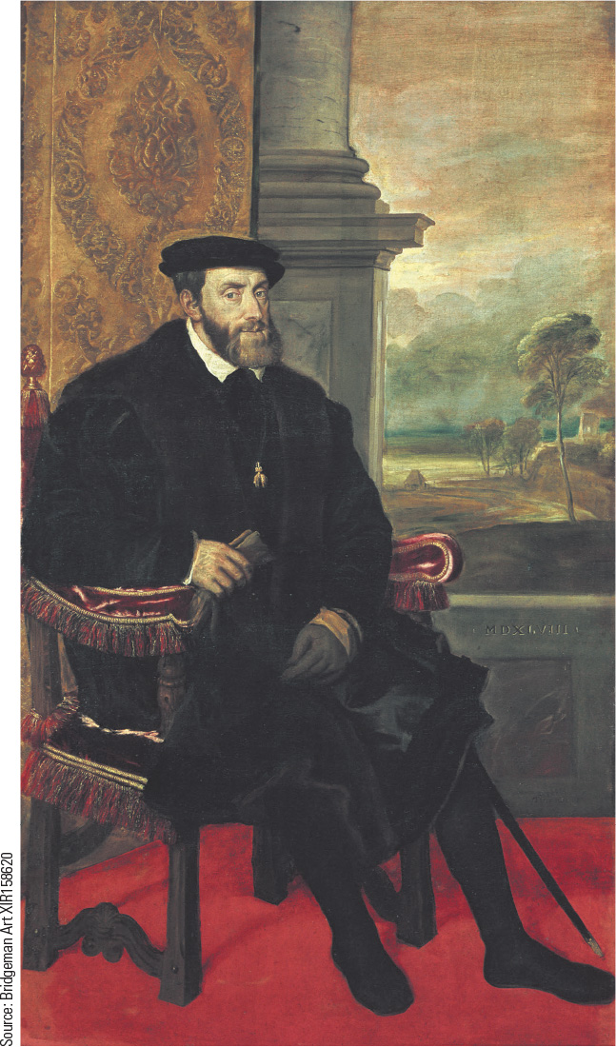
13.4 Charles V. Charles V sought to maintain religious unity throughout his vast empire by keeping all his subjects within the bounds of the Catholic Church.

Slide 11
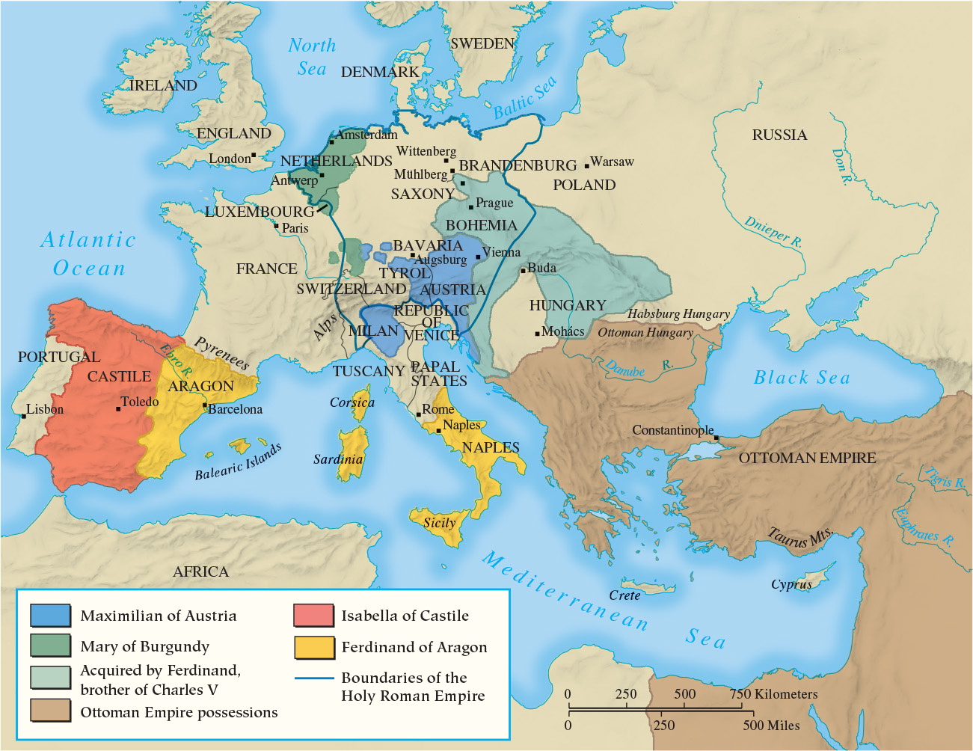
Map 13.1 The Empire of Charles V

Slide 12
13-3 The Spread of the Protestant Reformation (1 of 2)
Focus Questions: What were the main tenets of Lutheranism, Zwinglianism, Anabaptism, and Calvinism, and how did they differ from each other and from Catholicism? What impact did political, economic, and social conditions have on the development of these four reform movements?
The Zwinglian Reformation
  Zwingli’s evangelical reforms and the Marburg Colloquy
  War between the Swiss Protestant and Catholic cantons
The radical reformation: the Anabaptists
  Common characteristics: voluntary association of believers, return to early Christian practices, separation of church and state
    Anabaptist persecution
    Rejuvenation under Menno Simmons

Slide 13
13-3 The Spread of the Protestant Reformation (2 of 2)
The Reformation in England
  King Henry VIII and the need for an heir
    The Act of Supremacy (1534): Parliament finalized the break with Rome
  The move in a more Protestant direction under Edward VI
  Mary’s restoration of Catholicism
John Calvin and the development of Calvinism
  Calvin’s ideas
    The sovereignty of God: predestination
  Calvin’s Geneva
    Consistory as church government
    Missionaries

Slide 14
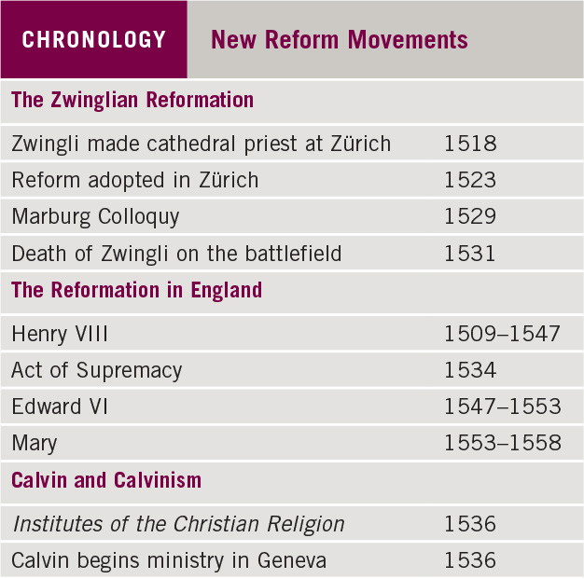
Chronology: New Reform Movements

Slide 15
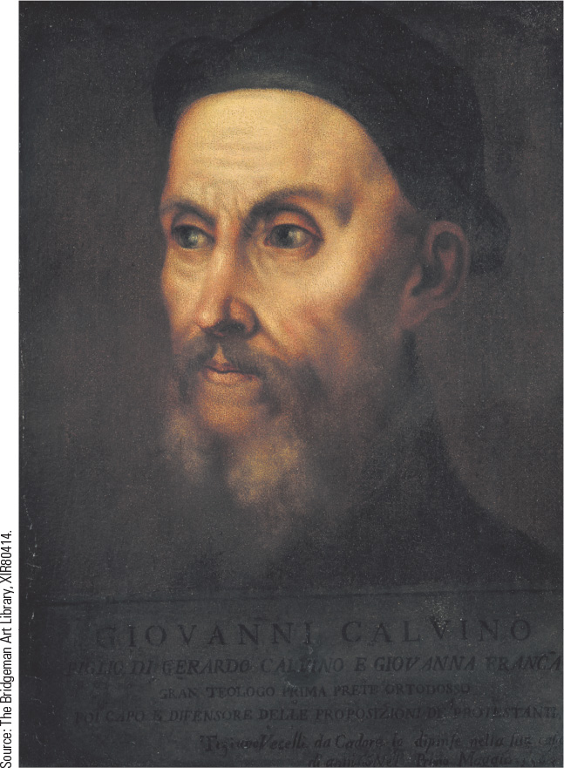
13.5 John Calvin. After a conversion experience, John Calvin abandoned his life as a humanist and became a reformer.

Slide 16
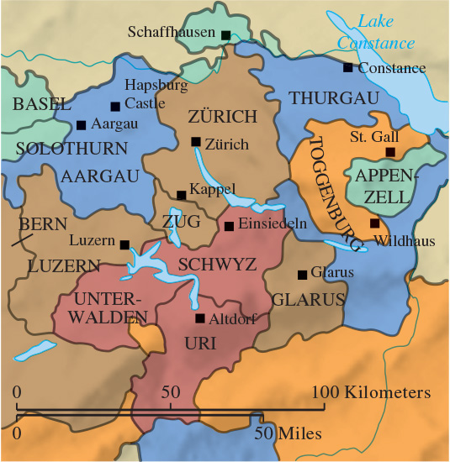
Map 13.2 The Swiss Cantons

Slide 17
13-4 The Social Impact of the Protestant Reformation
Focus Question: What impact did the Protestant Reformation have on society in the sixteenth century?
The family
  Family placed at center of human life
  No noticeable transformation of women’s subordinate place in society
Religious practices and popular culture
  Religious ceremonies and imagery replaced with individual private prayer, family worship, and collective prayer and worship

Slide 18
13-5 The Catholic Reformation (1 of 2)
Focus Question: What measures did the Roman Catholic Church take to reform itself and to combat Protestantism in the sixteenth century?
Catholic Reformation or Counter-Reformation?
  Debate: internal reform or reaction against Protestantism
    Revived best features of medieval Catholicism
    Emergence of a new mysticism
    Regeneration of religious orders
The Society of Jesus
  Ignatius of Loyola, founder of the Jesuits
    The Spiritual Exercises, an order of discipline and obedience, and missionary activity

Slide 19
13-5 The Catholic Reformation (2 of 2)
A revived papacy
  A turning point: the pontificate of Pope Paul III
    The colloquy at Regensburg
    The Roman Inquisition or Holy Office and the Index of Forbidden Books
The Council of Trent
  Three sessions between 1545 and 1563
    Reaffirmation traditional Catholic teachings
    Created a clear body of doctrine and a unified church

Slide 20
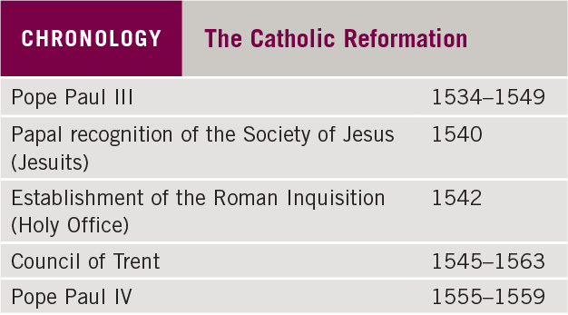
Chronology: The Catholic Reformation

Slide 21
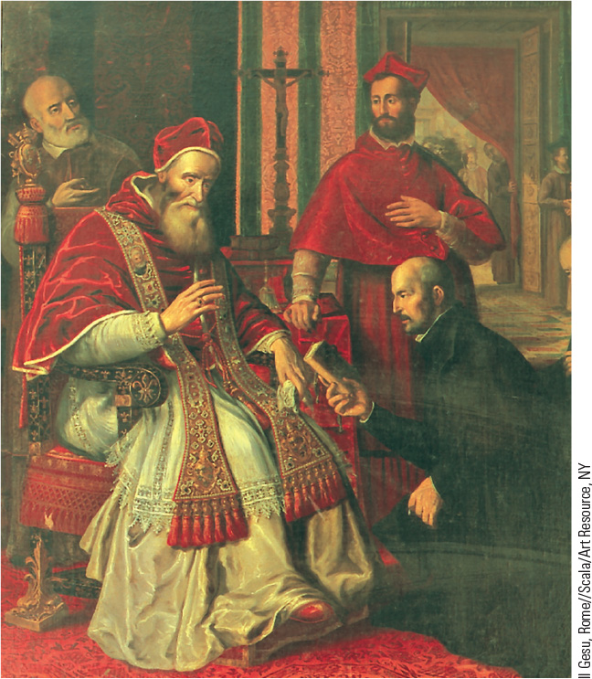
13.6 Ignatius of Loyola. Ignatius of Loyola, shown here, founded the Society of Jesus, which became the most important new order of the Catholic Reformation.

Slide 22
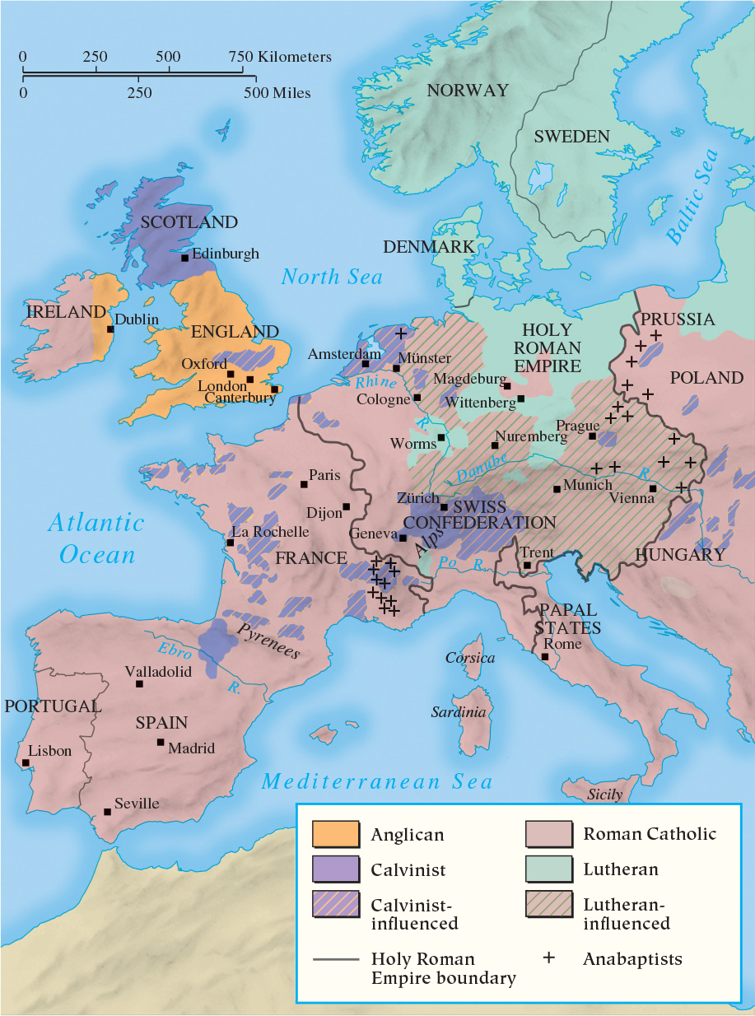
Map 13.3 Catholics and Protestants in Europe by 1560

Slide 23
13-6 Politics and the Wars of Religion in the Sixteenth Century (1 of 2)
Focus Question: What role did politics, economic and social conditions, and religion play in the European wars of the sixteenth century?
The French wars of religion (1562–1598)
  Huguenots: French Calvinists
    From all layers of society, including the nobility
    Opposition to the Catholic majority, monarchy, and the Ultra-Catholic party
    Other contributing factors
  Politiques
    Placed politics before religion and prevailed
    The Edict of Nantes

Slide 24
13-6 Politics and the Wars of Religion in the Sixteenth Century (2 of 2)
Philip II and militant Catholicism
  Goal: consolidate and secure the lands he inherited through strict conformity to Catholicism
Revolt of the Netherlands
  Resentment against Spanish control and religion
    Violence between 1566 and 1609
    The formation of the Dutch Republic
The England of Elizabeth
  Religious policy based on moderation and compromise
  Adept in foreign policy and religious affairs
    Defeat of the Spanish armada

Slide 25
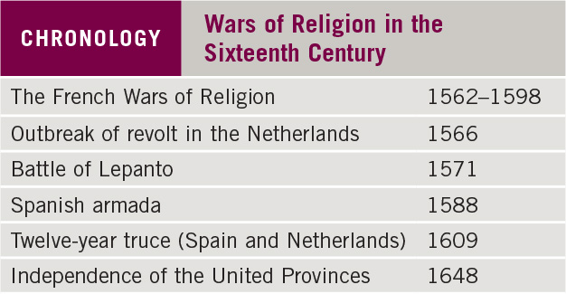
Chronology: Wars of Religion in the Sixteenth Century

Slide 26
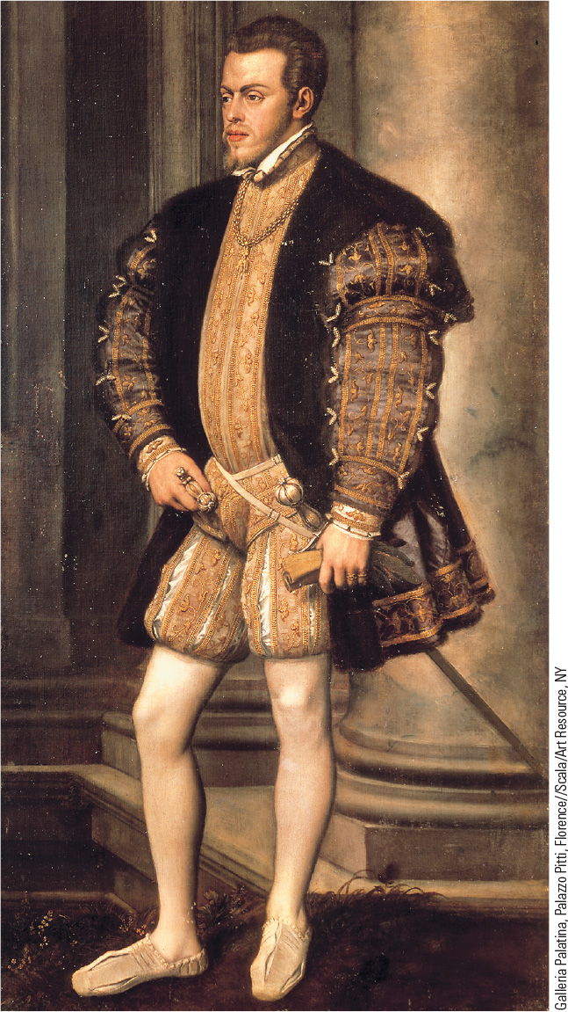
13.7 Philip of Spain. Philip II’s attempts to make Spain a great power led to large debts, crushing taxes, and military failures.

Slide 27
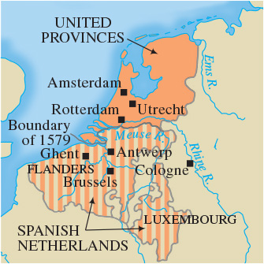
Map 13.4 The Netherlands

Slide 28
Chapter 13 Summary
Martin Luther established the twin pillars of the Protestant Reformation: the doctrine of justification by faith alone and the Bible as the sole authority in religious affairs.
Protestantism fragmented into different sects—Zwinglianism, Calvinism, Anglicanism, Anabaptism—which, though united in their dislike of Catholicism, were themselves divided over the interpretation of the sacraments and religious practices.
New religious orders based on reform, a revived and reformed papacy, and the Council of Trent, which reaffirmed traditional Catholic doctrine, gave the Catholic Church a renewed vitality.
The religious division (Catholic versus Protestant) was instrumental in beginning a series of religious wars that were also complicated by economic, social, and political forces.

Slide 29
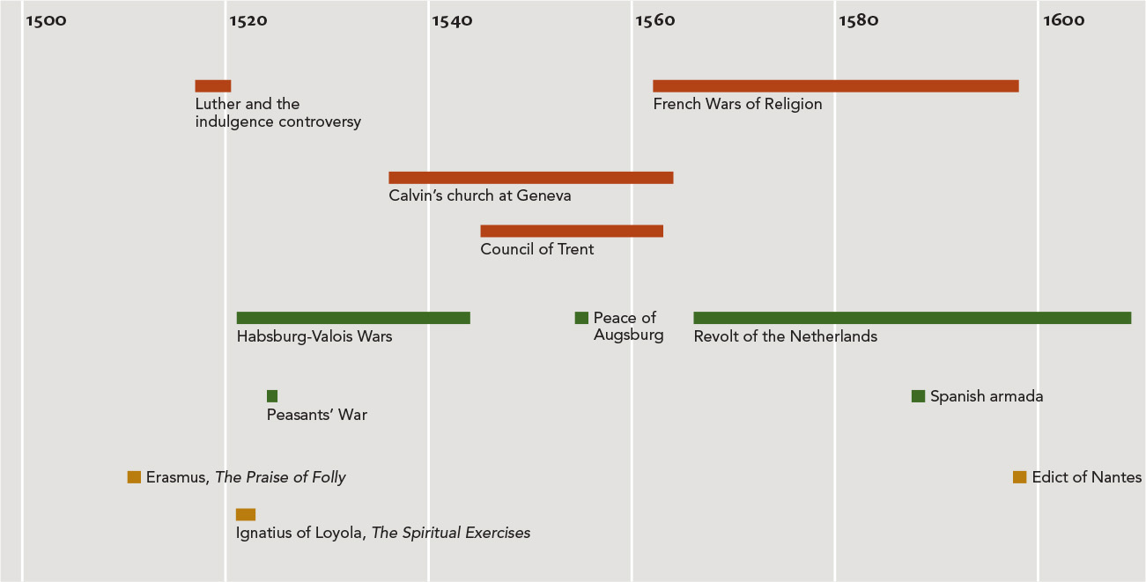
Chapter 13 Timeline

