Slide 1
WESTERN CIVILIZATION: A Brief History
Tenth Edition
CHAPTER 12
Recovery and Rebirth: The Age of the Renaissance
© 2020 Cengage. All rights reserved.

Slide 2
Chapter 12 Outline
12-1 Meaning and Characteristics of the Italian Renaissance
12-2 The Making of Renaissance Society
12-3 The Italian States in the Renaissance
12-4 The Intellectual Renaissance in Italy
12-5 The Artistic Renaissance
12-6 The European State in the Renaissance
12-7 The Church in the Renaissance

Slide 3
12-1 Meaning and Characteristics of the Italian Renaissance
Focus Question: What characteristics distinguish the Renaissance from the Middle Ages?
The Middle Ages and the Renaissance: continuity and change
  The Renaissance of Jacob Burckhardt
    Civilization of the Renaissance in Italy (1860): revival of antiquity, “perfecting of the individual,” and secularism
  Characteristics of the Renaissance
    Age of recovery
    Urban and more secular society
    Revived emphasis on individual ability

Slide 4
12-2 The Making of Renaissance Society (1 of 3)
Focus Question: What major social changes occurred during the Renaissance?
Economy recovery
  Expansion of trade
    The Hanseatic League in the north and the Italian commercial empires of the Mediterranean
  Industries old and new
    The recovery of the woolen industry (old), and luxury industries, printing, mining, and metallurgy (new)
  Banking and the Medici
    The preeminence of Florence under Medici control

Slide 5
12-2 The Making of Renaissance Society (2 of 3)
Social changes in the Renaissance
  Social divisions: three estates
    First Estate (clergy); Second Estate (nobles); Third Estate (peasants, inhabitants of town and cities)
  The nobility
    Reconstruction of the aristocracy by 1500: domination of society as military officers and advisors to the king
    Aristocratic ideals and courtly standards: The Book of the Courtier (1528), Baldassare Castiglione
  Peasants and townspeople
    Acceleration of the decline of serfdom
    Types of townspeople: patricians, burghers, workers, slaves

Slide 6
12-2 The Making of Renaissance Society (3 of 3)
The family in Renaissance Italy
  The security of the family bond
  Arranged marriages
    Dowry
  Father-husband as center of the family
    Authority in legal and financial matters and over children
  Wife as manager of the household
    Ten percent of mothers died in childbirth
    High mortality rates for children

Slide 7
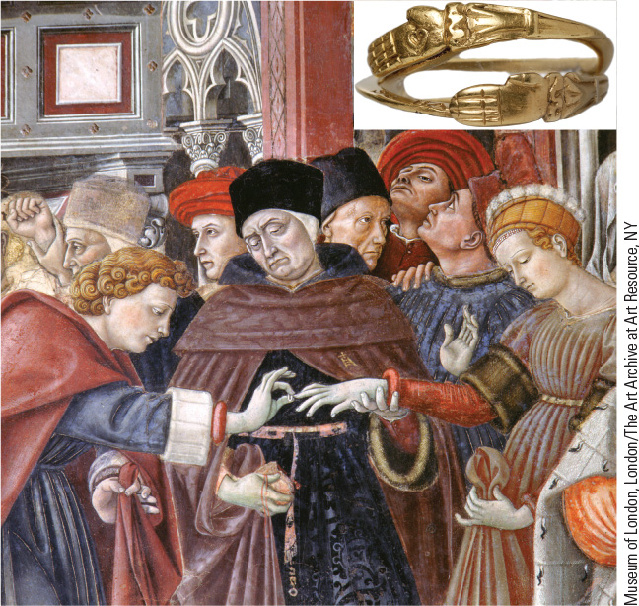
12.2 A Renaissance Wedding Ceremony. In the upper classes, parents arranged marriages to reinforce business or family connections.

Slide 8
12-3 The Italian States in the Renaissance
Focus Question: How did Machiavelli’s works reflect the political realities of Renaissance Italy?
The five rival states: Milan, Florence, Venice, the Papal States, and the kingdom of Naples
The smaller independent city-states
French and Spanish competition to dominate Italy
The birth of modern diplomacy
  Resident diplomatic agents or ambassadors as servants of the state
Machiavelli and the new statecraft
  The Prince: the abandonment of morality as the basis for the analysis of political activity

Slide 9
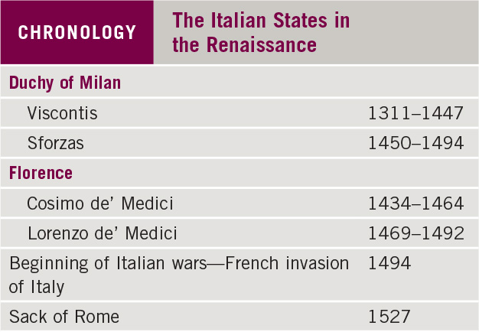
Chronology: The Italian States in the Renaissance

Slide 10
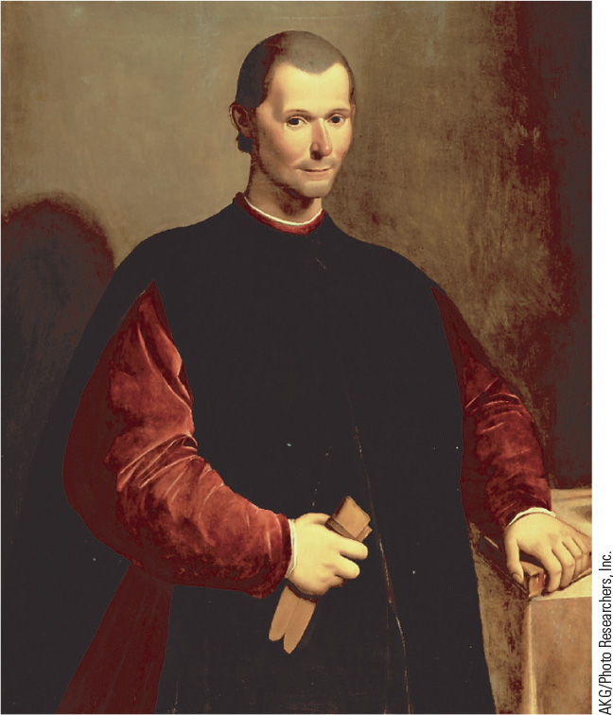
12.3 Niccolò Machiavelli. In The Prince, Machiavelli gave concrete expression to the Renaissance preoccupation with political power.

Slide 11
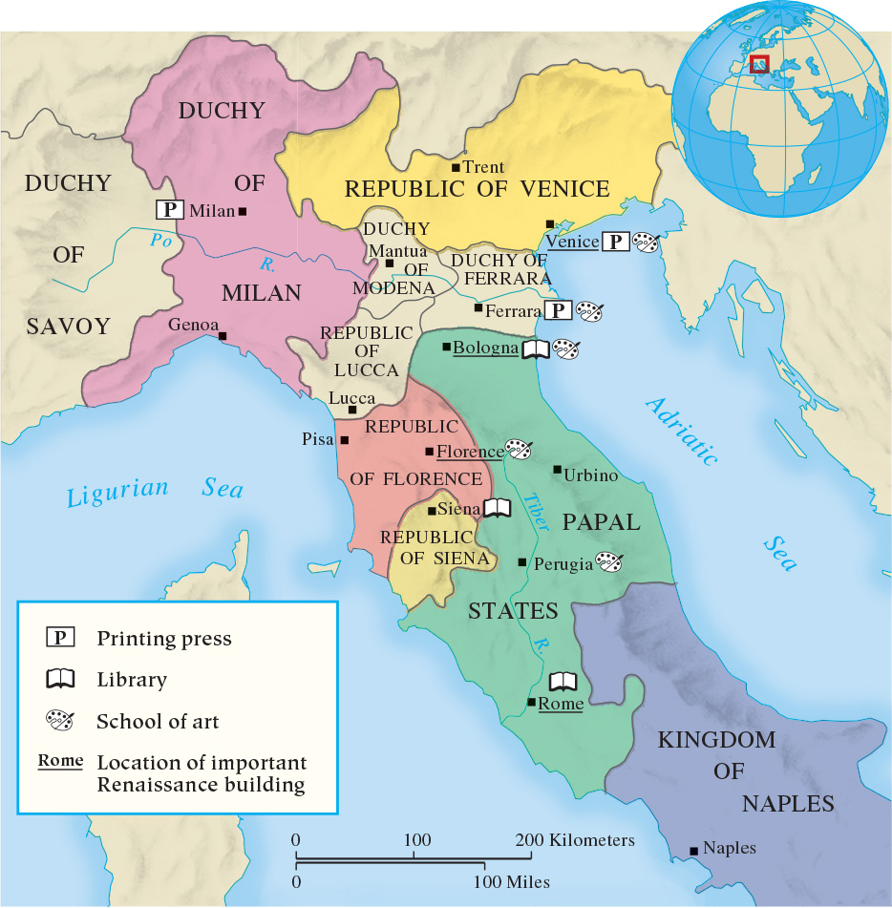
Map 12.1 Renaissance Italy

Slide 12
12-4 The Intellectual Renaissance in Italy
(1 of 2)
Focus Question: What was humanism, and what effect did it have on philosophy, education, and attitudes toward politics?
New culture and characteristics
  Individualism and secularism in intellectual and artistic realms; humanism in literature
Italian Renaissance humanism
  Petrarch (father of Renaissance humanism): Latin learning
  Civic humanism (Florence) and interest in Greek learning
  Humanism and philosophy
    Neoplatonism (Ficino)
  Renaissance Hermeticism
    Human struggle to regain divinity

Slide 13
12-4 The Intellectual Renaissance in Italy
(2 of 2)
Education in the Renaissance
  Humanists believed that human beings could be dramatically changed by education
    “Liberal studies” as the key to true freedom
    Education as practical preparation for life for elite
  Was there a Renaissance for women?
    Debate: greater freedom or continued bleak conditions?
    Some women may have had more opportunities
The impact of printing
  Johannes Gutenberg and new printing capability
  Stimulation of research, standardization, and literacy

Slide 14
12-5 The Artistic Renaissance (1 of 2)
Focus Question: What were the chief characteristics of Renaissance art, and how did they differ in Italy and northern Europe?
Primary goal: imitation of nature
Art in the early Renaissance
  Mathematical side of painting emphasized
  Investigation of movement and anatomical structure
  Revolutionary achievement in painting, sculpture, and architecture
The artistic High Renaissance
  Dominated by Leonardo da Vinci, Raphael, and Michelangelo

Slide 15
12-5 The Artistic Renaissance (2 of 2)
The artist and social status
  No longer regarded as artisans but as artistic geniuses
    Creative energies akin to the divine
  Artists of the High Renaissance were first to embody the modern concept of the artist
The Northern Renaissance
  Emphases: illuminated manuscripts and altarpieces
  Jan van Eyck
    Oil painting – varied range of colors and fine details
  Albrecht Dürer
    Studied with and was influenced by Italian artists

Slide 16
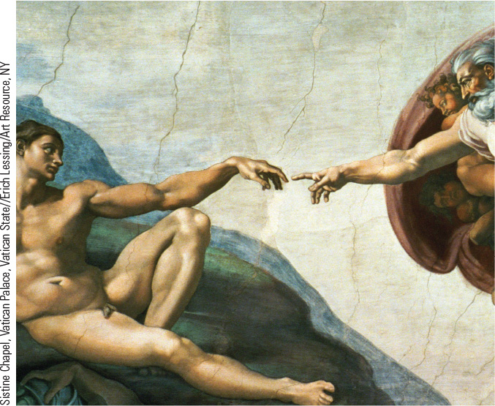
12.1 Michelangelo’s Creation of Adam on the Sistine Chapel Ceiling. The artist’s image of creation is one of the most famous images of the Italian Renaissance.

Slide 17
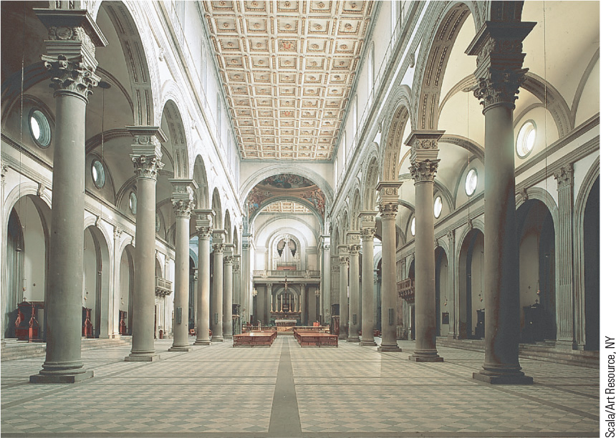
12.6 Brunelleschi, Interior of San Lorenzo. Brunelleschi’s architectural designs were based on the basilica plan borrowed by early Christians from pagan Rome.

Slide 18
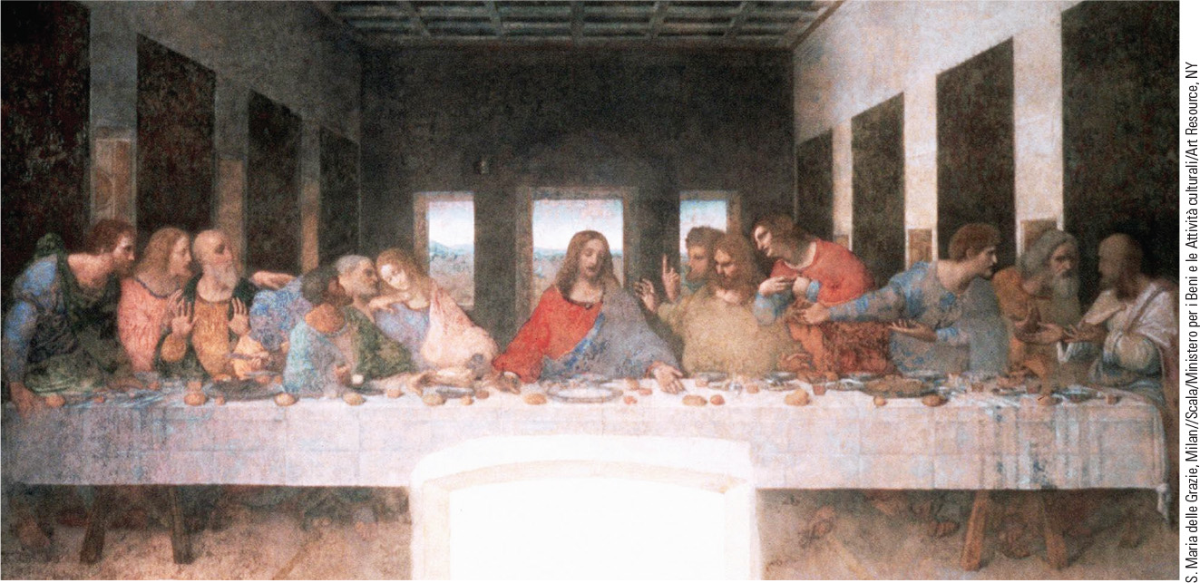
12.7 Leonardo da Vinci, The Last Supper. Leonardo’s Last Supper demonstrates an effort to depict a person’s character and inner nature by the use of gesture and movement.

Slide 19
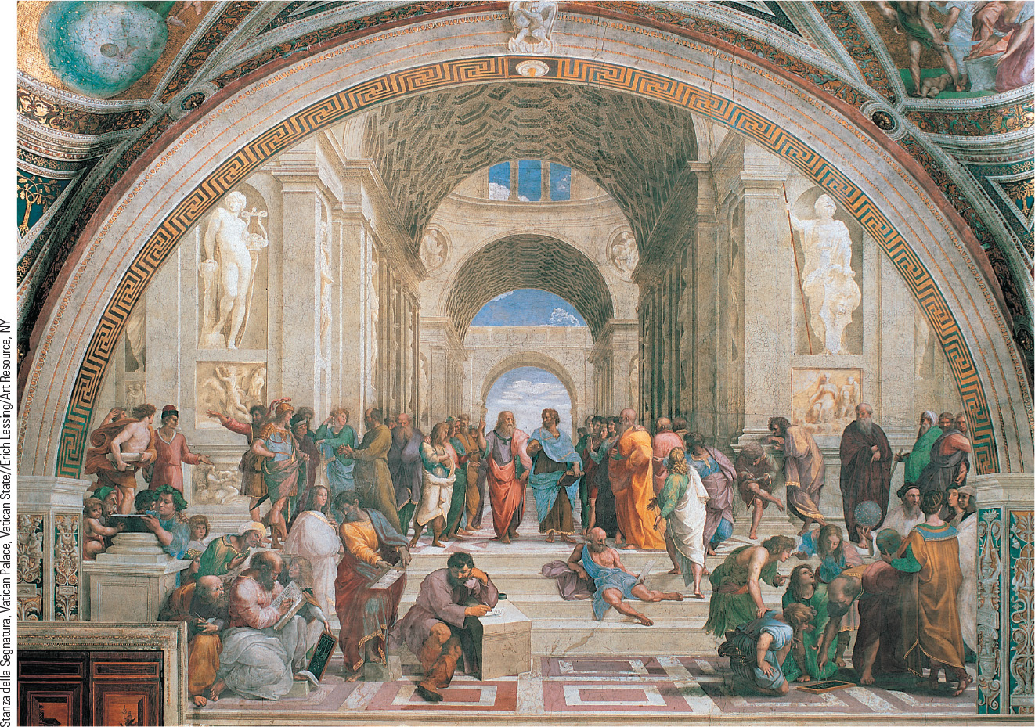
12.8 Raphael, School of Athens. Located in the papal apartments at the Vatican, this painting imagines a gathering of classical philosophers, including Plato and Aristotle.

Slide 20
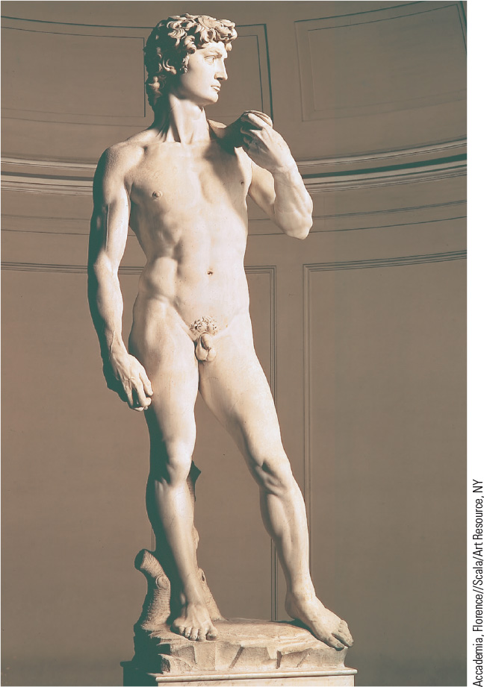
12.9 Michelangelo, David. Cut from an eighteen-foot-high piece of marble, David is a fitting symbol of the Italian Renaissance’s affirmation of human beauty and power.

Slide 21
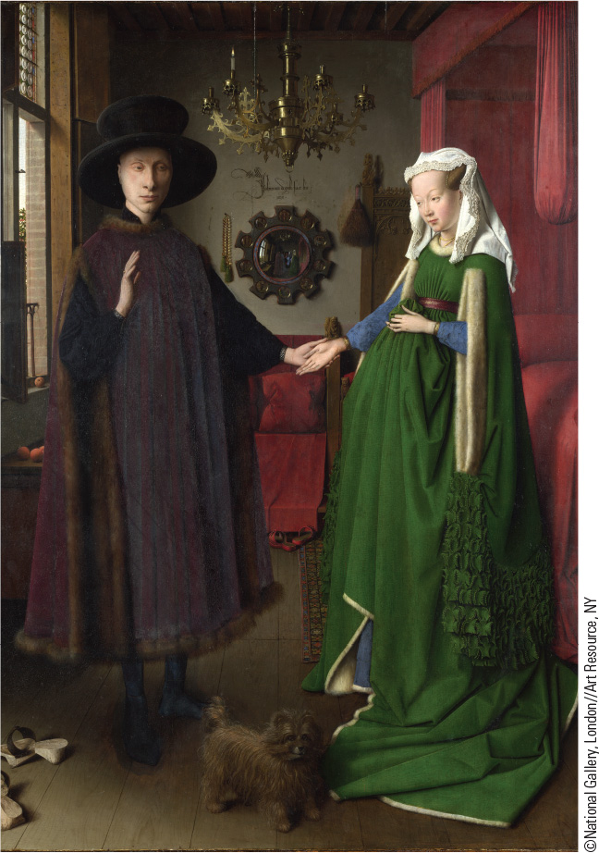
12.10 Van Eyck, Giovanni Arnolfini and His Bride. This oil painting of an Italian merchant and his wife shows the emphasis of northern painters on a realistic portrayal.

Slide 22
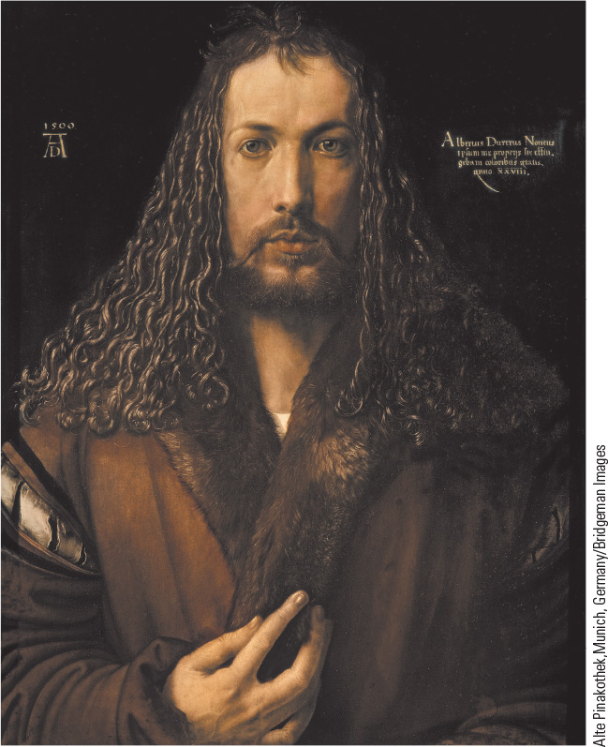
12.11 Dürer, Self-Portrait. This oil painting of an Italian merchant and his wife shows the emphasis of northern painters on a realistic portrayal.

Slide 23
12-6 The European State in the Renaissance
(1 of 2)
Focus Question: Why do historians sometimes refer to the monarchies of the late fifteenth century as “new monarchies” or “Renaissance states”?
“New monarchies”
  The attempt to reestablish authority
The Renaissance State in Western Europe
  England
    Civil wars in the 1450s
    First Tudor king, Henry VII
  Spain
    Marriage of Isabella of Castile and Ferdinand of Aragon
    Foundation of a Spanish Catholic Church

Slide 24
12-6 The European State in the Renaissance
(2 of 2)
Central Europe: The Holy Roman Empire
  Habsburg policy: dynastic marriages
  Maximilian I’s attempts to centralize administration
The struggle for strong monarchy in Eastern Europe
  Conflict between Roman Catholics, Greek Orthodox Christians, and pagans
The Ottoman Turks and the end of the Byzantine Empire
  Ottoman Turks seize lands from the Seljuk Turks and the Byzantine Empire and move into the Balkans
  Sultan Mehmet II completed the demise of the Byzantine Empire in 1453

Slide 25
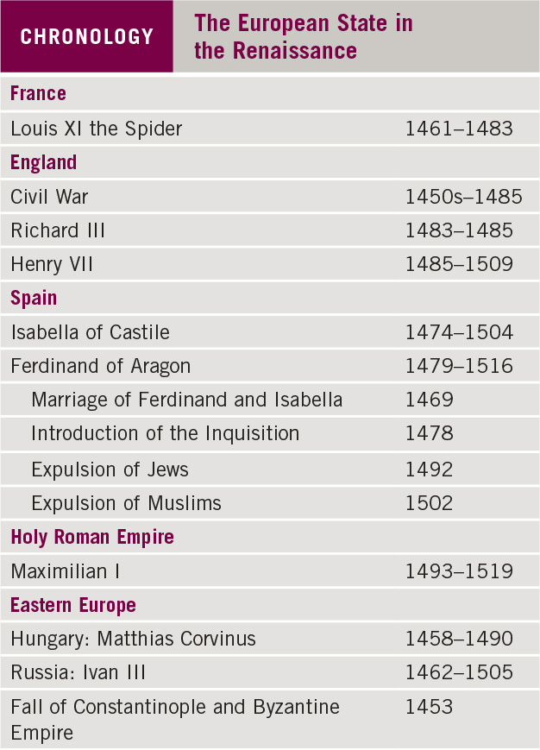
Chronology: The European State in the Renaissance

Slide 26
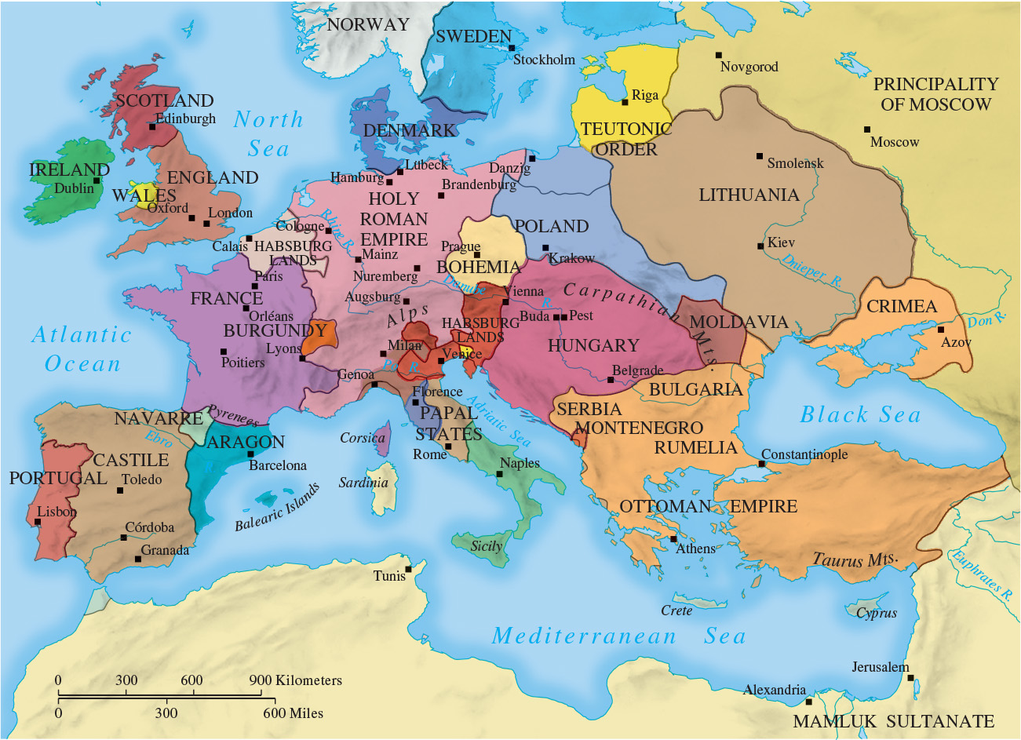
Map 12.2 Europe in the Second Half of the Fifteenth Century

Slide 27
12-7 The Church in the Renaissance (1 of 2)
Focus Question: What were the policies of the Renaissance popes, and what impact did those policies have on the Roman Catholic Church?
Dealing with heresy and reform
  Wyclif and Lollardy
    Bible as sole authority and available in the vernacular
  Hus and the Hussites
    Urged elimination of corruption of clergy and attacked excessive power of the papacy
  The reform of the church
    Council of Constance and demise of conciliar movement

Slide 28
12-7 The Church in the Renaissance (2 of 2)
The Renaissance Papacy
  The exercise of power
    Used intrigue and even bloodshed
    Nepotism
  Great patrons of the arts
    St. Peter’s Basilica

Slide 29
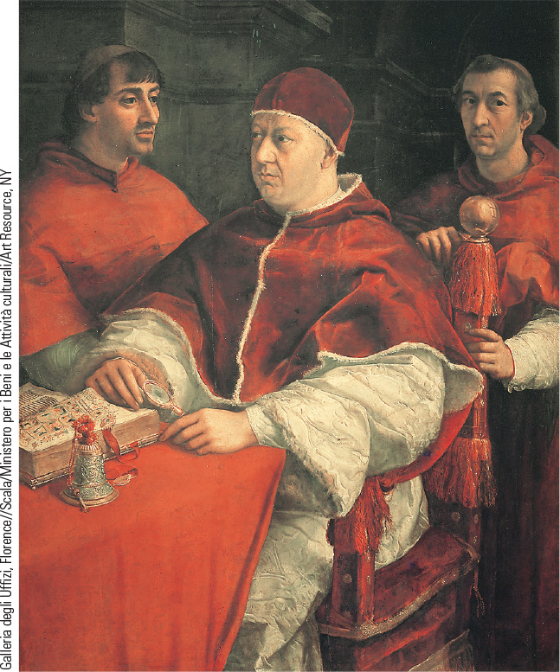
12.12 A Renaissance Pope: Leo X. The Renaissance popes allowed secular concerns to overshadow their spiritual duties.

Slide 30
Chapter 12 Summary
The Renaissance was an era that rediscovered and was influenced by the culture of ancient Greece and Rome.
Intellectuals and artists proclaimed a new vision of humankind and raised fundamental questions about the value and importance of the individual.
The Renaissance in Europe was also an era of “new monarchies,” best seen in England, France, and Spain.
Popes became increasingly mired in political and temporal concerns that overshadowed their spiritual responsibilities.

Slide 31
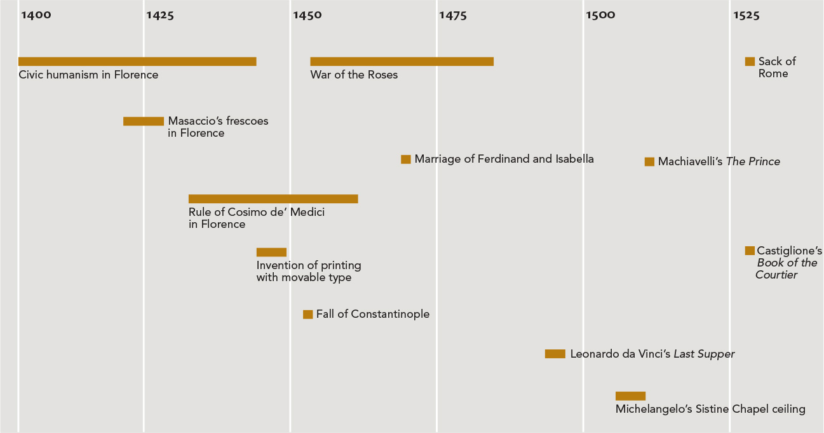
Chapter 12 Timeline

