Slide 1
WESTERN CIVILIZATION: A Brief History
Tenth Edition
CHAPTER 11
The Later Middle Ages: Crisis and Disintegration in the Fourteenth Century
© 2020 Cengage. All rights reserved.

Slide 2
Chapter 11 Outline
11-1 A Time of Troubles: Black Death and Social Crisis
11-2 War and Political Instability
11-3 The Decline of the Church
11-4 Culture and Society in an Age of Adversity

Slide 3
11-1 A Time of Troubles: Black Death and Social Crisis (1 of 4)
Focus Question: What impact did the Black Death have on the society and economy of Europe?
Thirteenth-century changes and contexts
  A “little ice age” shortened growing seasons and produced poor weather conditions
    Results: widespread famine and hunger, including the great famine of 1315–1317
    Malnutrition contributed to increased infant mortality, lower birthrates, and higher susceptibility to disease

Slide 4
11-1 A Time of Troubles: Black Death and Social Crisis (2 of 4)
The Black Death: From Asia to Europe
  Role of the Mongols
    Rats infested with fleas carrying the bacterium Yersinia pestis accompanied Mongol troops and spread plague into China
    Movement of people and goods throughout the Eurasian landmass controlled by the Mongols facilitated the spread of the plague
    From Central Asia, the disease was carried westward to Caffa, on the Black Sea (1346), Constantinople (1347), and Egypt and the Middle East (1348)

Slide 5
11-1 A Time of Troubles: Black Death and Social Crisis (3 of 4)
The Black Death in Europe
  Plague reached Sicily in October 1347 and spread along commercial trade routes throughout Europe
  High mortality rates, with losses between 25 and 50 percent of the population between 1347 and 1351
Life and death: reactions to the plague
  The search for causation and cures led to extremism
    Flagellants, anti-Semitism, and pogroms
    The cheapness of life and a morbid preoccupation with death
Art and the Black Death
  Pessimistic subjects: ars moriendi, the art of dying

Slide 6
11-1 A Time of Troubles: Black Death and Social Crisis (4 of 4)
Economic dislocation and social upheaval
  Demographic crisis led to a shortage of labor and falling prices
    Lower standards of living for landowning elites and attempts to lower the wage rate
    Improving conditions for peasants, including the weakening of manorialism
  Peasant revolts
    1358: Jacquerie in France
    1381: English Peasants’ Revolt
  Revolts in the Cities
    1378: revolt of the ciompi in Florence

Slide 7
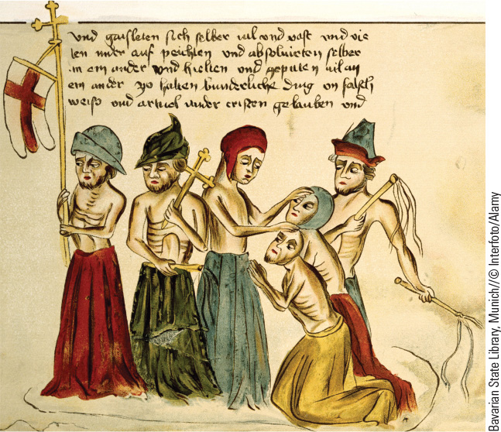
11.2 The Flagellants. Believing that asceticism could atone for humanity’s sins and win God’s forgiveness, flagellants flogged themselves and each other with whips.

Slide 8
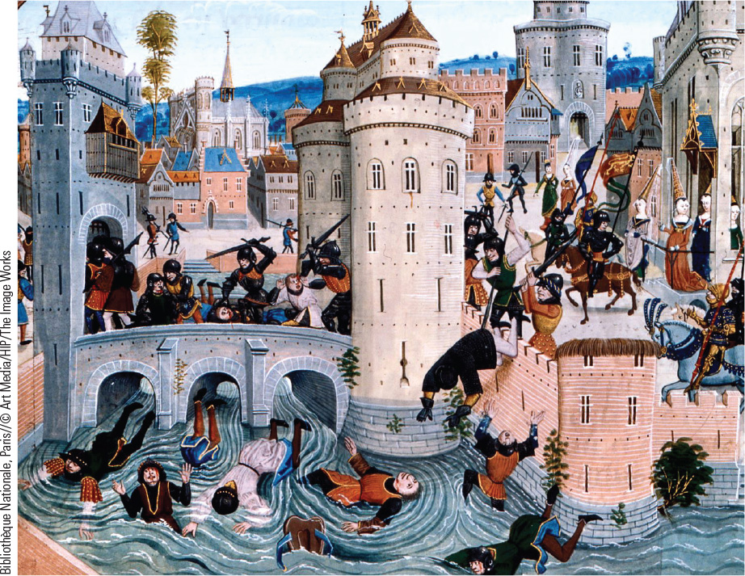
11.3 Peasant Rebellion. The fourteenth century witnessed a number of failed revolts of the peasantry against noble landowners.

Slide 9
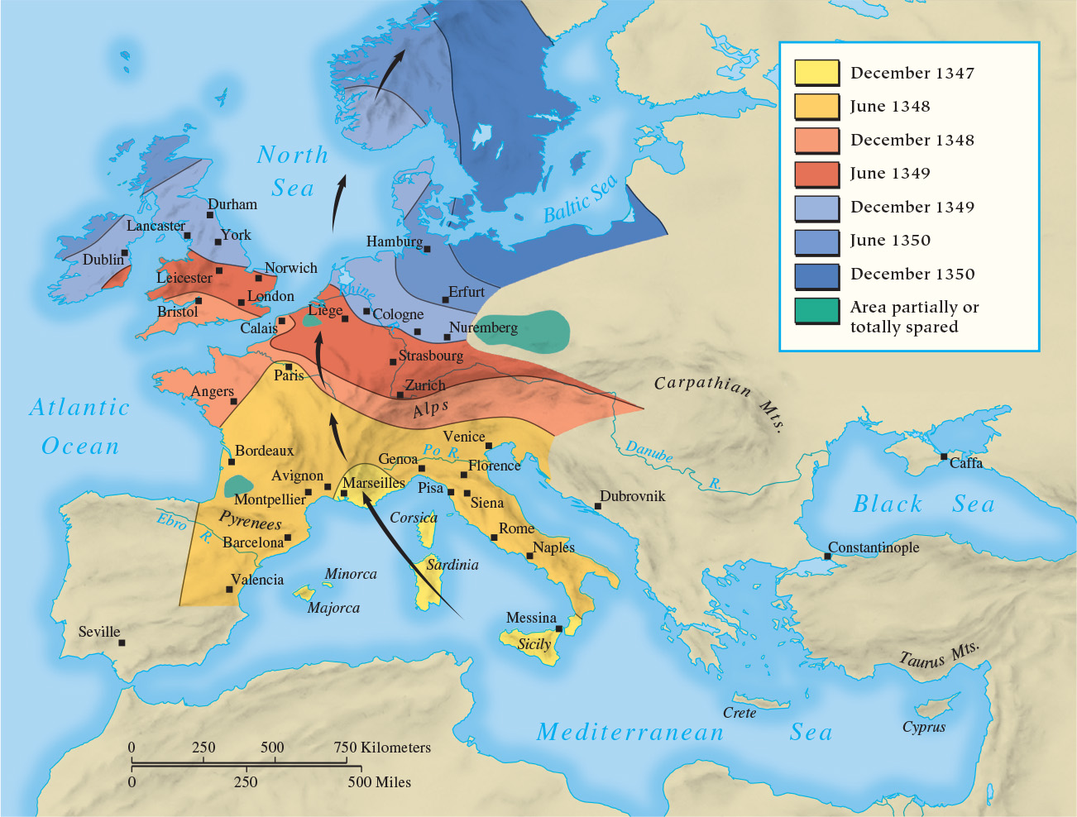
Map 11.1 Spread of the Black Death

Slide 10
11-2 War and Political Instability (1 of 5)
Focus Question: What major problems did European states face in the fourteenth century?
The Hundred Years’ War
  Initiation of conflict: Edward III (1327–1377) of England’s claim of the French throne
    Combatants and the changing nature of war: knights, foot soldiers, pikes, and longbows
  Course of the war
    England: from victories at Crécy and Agincourt to troubles
  Joan of Arc
    Visions, leadership, condemnation, and sainthood
  The end of the war

Slide 11
11-2 War and Political Instability (2 of 5)
Political instability
  Governments and questions of control
    Changing lord–vassal relationship, replacing old requirements for military service with monetary payments (scutage)
    Monarchs and the hiring of professional soldiers
    New avenues of political advantage and service
  New dynasties and challenge of noble factions
  The problem of revenues: taxes and parliaments

Slide 12
11-2 War and Political Instability (3 of 5)
Western Europe: England and France
  Parliament in England increased in prominence
    Parliament levied new taxes in return for royal concessions
    Development of organizational structure: chief bishops and abbots with aristocratic peers formed the House of Lords while representatives of shires and boroughs formed the House of Commons
    Aristocratic factionalism led to deposition, baronial revolt, and civil war
  State of chaos in France
    Competition of powerful dukes to control the monarchy led to civil war

Slide 13
11-2 War and Political Instability (4 of 5)
The German Monarchy
  The disintegration of the Holy Roman Empire into hundreds of states of varying size and power
    Princely states
    Free imperial city-states
    Ecclesiastical states
  The principle of election led to weak kings and the verge of anarchy

Slide 14
11-2 War and Political Instability (5 of 5)
The states of Italy
  Lack of centralized monarchy and the replacement of republican governments by tyrants
  Expansion of larger city-states at the expense of the less powerful
    Condottieri (mercenary soldiers) sold services to highest bidder
    Domination of three major states in the north: Milan, Florence, and Venice

Slide 15
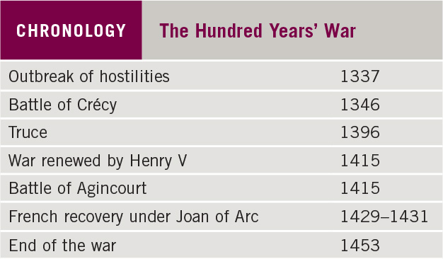
Chronology: The Hundred Years’ War

Slide 16
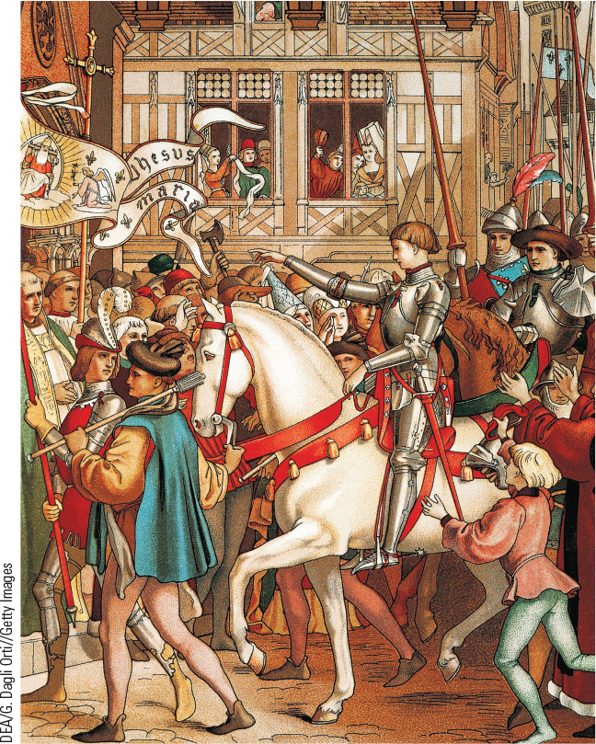
11.4 Joan of Arc. Pictured here in a fifteenth-century design for a window for the cathedral of Orléans, Joan of Arc is seen in a suit of armor entering the city.

Slide 17
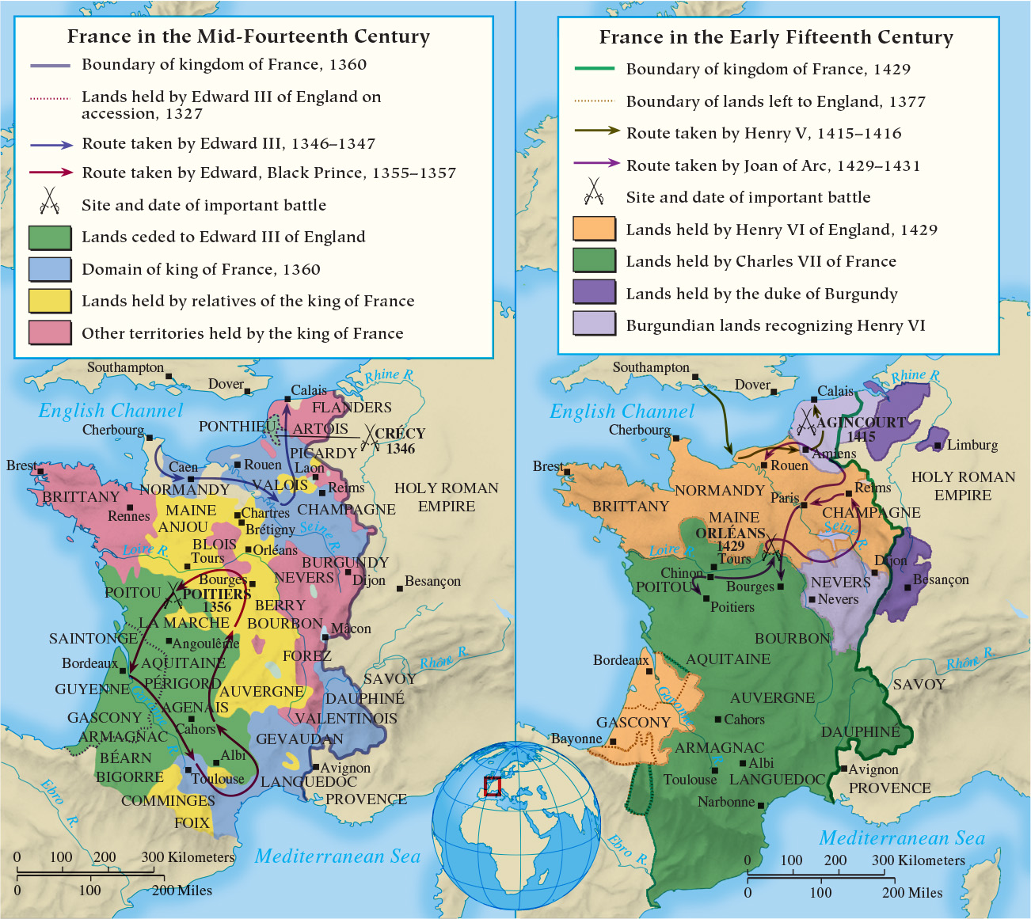
Map 11.2 The Hundred Years’ War

Slide 18
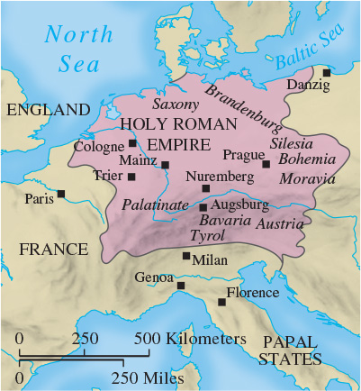
Map 11.3 The Holy Roman Empire in the Fourteenth Century

Slide 19
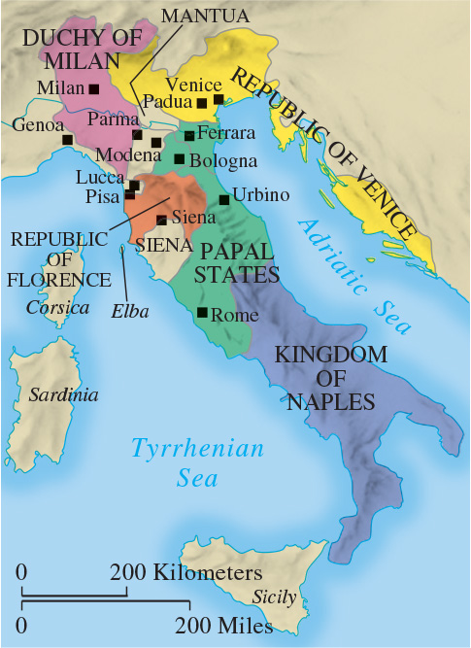
Map 11.4 The States of Italy in the Fourteenth Century

Slide 20
11-3 The Decline of the church (1 of 2)
Focus Question: How and why did the authority and prestige of the papacy decline in the fourteenth century?
Boniface VIII and the conflict with the state
  Taxation of the clergy led to conflict with Philip IV of France
    Unam Sanctam (1302)
    Victory of monarchy over the papacy
The Papacy at Avignon (1305–1378)
  Avignon as a powerful symbol of abuses within the church
  Calls for the pope’s return to Rome

Slide 21
11-3 The Decline of the church (2 of 2)
The Great Schism
  Disagreement over Urban VI’s plan to reform the papal curia led to divided loyalties
    Results: damage to the faith of believers
The Conciliar Movement
  Conciliarism: the belief only a general council of the church could end the schism
    Council of Pisa failed; resulted in more division
    Council of Constance (1414–1418) and its tasks: end the schism, eradicate heresy, and reform the church in “head and members”

Slide 22
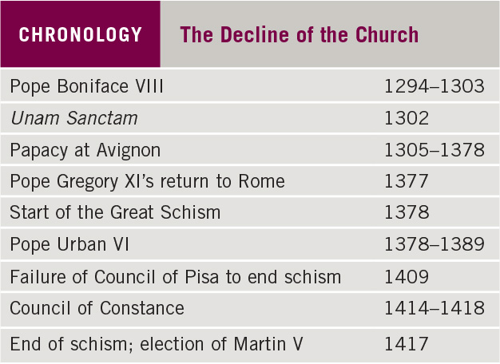
Chronology: The Decline of the Church

Slide 23
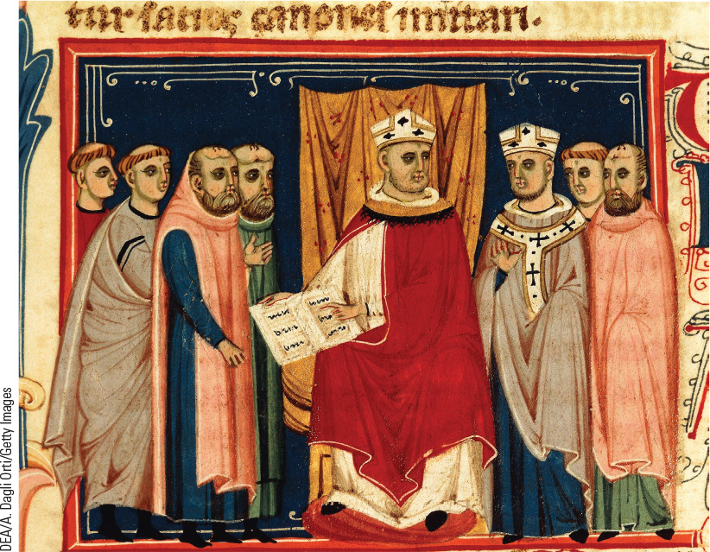
11.5 Pope Boniface VIII. The conflict between church and state in the Middle Ages reached its height in the struggle between Pope Boniface VIII and Philip IV of France.

Slide 24
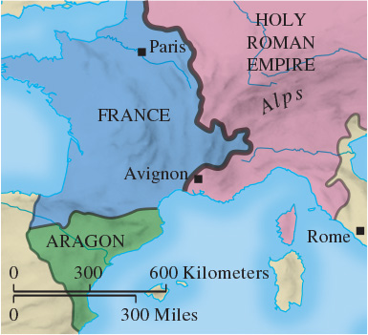
Map 11.5 Avignon

Slide 25
11-4 Culture and Society in an Age of Adversity (1 of 2)
Focus Questions: What were the major developments in art and literature in the fourteenth century? How did the adversities of the fourteenth century affect urban life?
The development of vernacular literature
  Dante Alighieri’s Divine Comedy and Petrarch’s poetry
  Geoffrey Chaucer’s The Canterbury Tales
  Christine de Pizan’s The Book of the City of Ladies
A new art: Giotto
  Considered a forerunner of Italian Renaissance painting
  A new kind of realism with three-dimensional depth, expressive faces, and physically realistic bodies

Slide 26
11-4 Culture and Society in an Age of Adversity (2 of 2)
Changes in urban life
  Greater regulation of urban activities
  Development of gender roles and new limits on employment opportunities for women
  Loss of so many male workers in cities opened up new jobs for women
    Positions as metalworkers and stevedores
Inventions and new patterns
  The mechanical clock
    Revolutionized how people thought about and used time
  Gunpowder
    Made castles, city walls, and armored knights obsolete

Slide 27
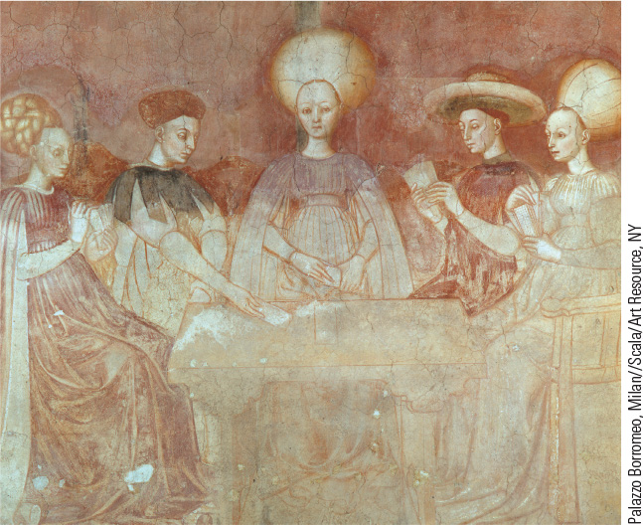
11.7a Medieval Entertainment. This image from a fifteenth-century fresco shows a group of ladies and gentlemen playing cards.

Slide 28
Chapter 11 Summary
Fourteenth-century European society was challenged by an overwhelming number of crises, including the devastating Black Death, that led to the disintegration of medieval civilization.
Economic crises and social upheavals, including a decline in trade and industry, bank failures, and peasant revolts, followed in the wake of the Black Death.
Political stability declined as the result of war, internal factionalism, and financial burdens.
The Catholic Church unsuccessfully confronted royal power and faced crisis during the Avignon Exile and the Great Schism.

Slide 29
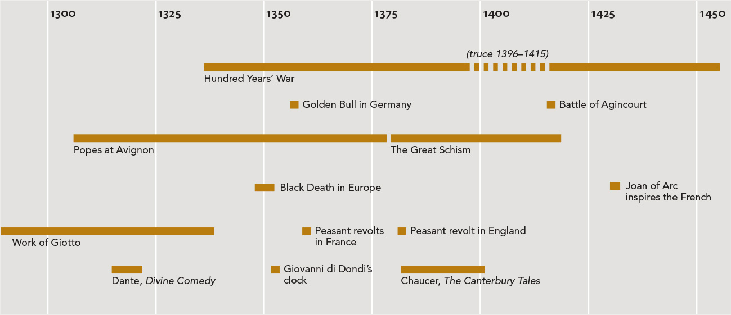
Chapter 11 Timeline

