Slide 1
WESTERN CIVILIZATION: A Brief History
Tenth Edition
CHAPTER 10
The Rise of Kingdoms and the Growth of Church Power
© 2020 Cengage. All rights reserved.

Slide 2
Chapter 10 Outline
10-1 The Emergence and Growth of European Kingdoms,
1000–1300
10-2 The Recovery and Reform of the Catholic Church
10-3 Christianity and Medieval Civilization
10-4 The Crusades

Slide 3
10-1 THE EMERGENCE AND GROWTH OF EUROPEAN KINGDOMS, 1000–1300 (1 of 5)
Focus Questions: What steps did the rulers of England and France take during the High Middle Ages to reverse the decentralizing tendencies of fief-holding? What were the major political and religious developments in Spain, the Holy Roman Empire, and northern and eastern Europe during the High Middle Ages?
The extension of royal authority
  Sources of royal power
    The growth of cities and revival of commerce
    The emergence of a money economy
    The ability to hire soldiers and officials and to rely less on vassals

Slide 4
10-1 THE EMERGENCE AND GROWTH OF EUROPEAN KINGDOMS, 1000–1300 (2 of 5)
England in the High Middle Ages
  William of Normandy’s conquest, 1066
    Fusion of victorious Normans and Anglo-Saxon ways and institutions
    The connection of England and France
  Henry II
    Strengthening the royal courts; common law
    Troubles with Becket and the church
  King John and Magna Carta
    Royal authority causes resentment among the barons, resulting in the “great charter” of feudal liberties
  Edward I and the emergence of parliament
    Barons, church lords, knights, and burgesses

Slide 5
10-1 THE EMERGENCE AND GROWTH OF EUROPEAN KINGDOMS, 1000–1300 (3 of 5)
The growth of the French kingdom
  The Capetian kings’ quest for centralized monarchy
  Philip II Augustus
    War with the Plantagenet rulers of England
    Successful in gaining control of most of Normandy, Maine, Anjou, and Aquitaine
  Philip IV and the Estates-General
    The creation of an effective royal bureaucracy
    The Estates-General: representative from the clergy (First Estate), nobles (Second Estate), and townspeople (Third Estate)

Slide 6
10-1 THE EMERGENCE AND GROWTH OF EUROPEAN KINGDOMS, 1000–1300 (4 of 5)
Christian reconquest: the Spanish kingdoms
  The reconquista
    Northern half of Spain consolidated in Christian kingdoms by the end of twelfth century; southern half controlled by Muslims
    Successful offensives expanded Christian territories: by mid-thirteenth century, the Moors held only Grenada
The lands of the Holy Roman Empire: Germany and Italy
  Frederick I
    The challenge of controlling northern Italy
  Frederick II
    Unsuccessfully sought a strong centralized state in Italy

Slide 7
10-1 THE EMERGENCE AND GROWTH OF EUROPEAN KINGDOMS, 1000–1300 (5 of 5)
New Kingdoms in Northern and Eastern Europe
  The three Christian Scandinavian kingdoms
  Stability in Hungary, turbulence for Poland and Russia
Impact of the Mongols
  Expansion under the successors of Chinggis Khan into China, Korea, the Islamic empire, and Europe
    Little lasting impact in Europe
The development of Russia
  Domination by the boyars
  Eastern Orthodox Church as a civilizing and unifying force
  Mongol conquest and Alexander Nevsky’s cooperation

Slide 8
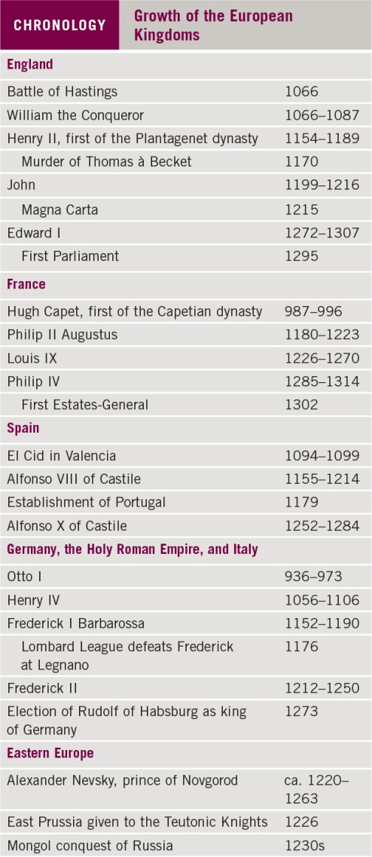
Chronology: Growth of the European Kingdoms

Slide 9
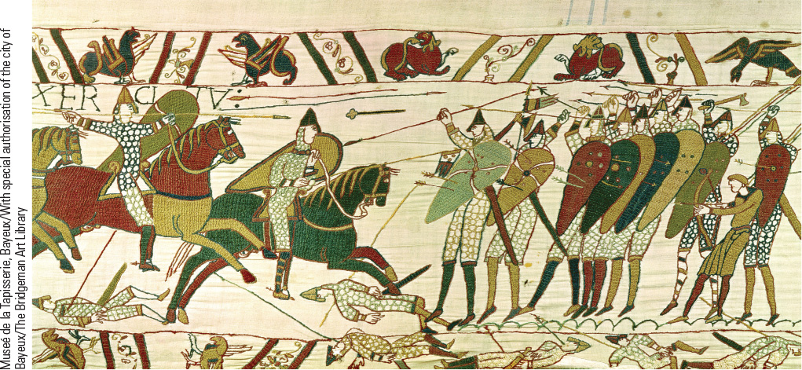
10.2b Norman Conquest of England. This segment of the Bayeux Tapestry shows the Norman cavalry charging the Saxon infantry during the Battle of Hastings.

Slide 10
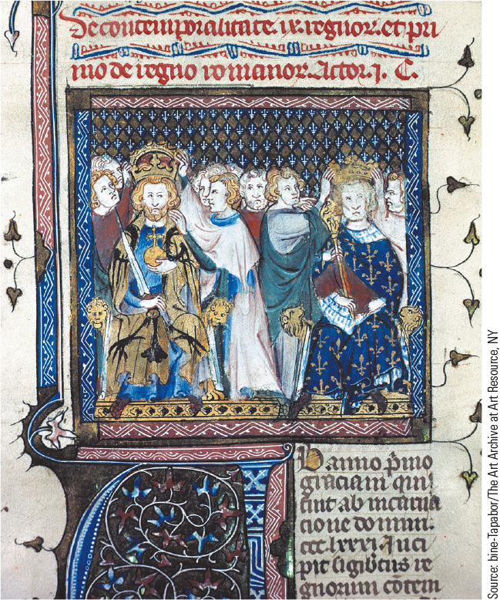
10.3 The Coronation of Frederick II. Pope Honorius II agreed to Frederick’s coronation after he promised to lead a Crusade to the Holy Land.

Slide 11
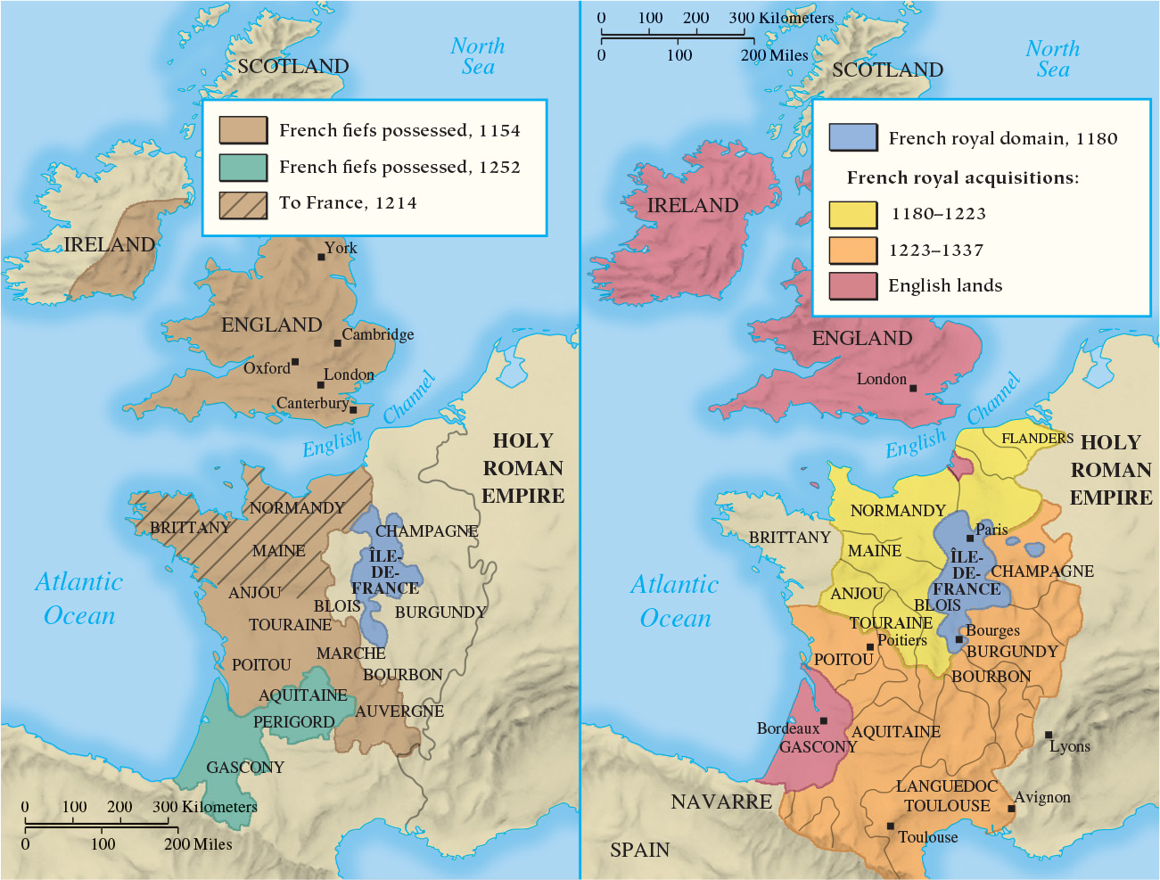
Map 10.1 England and France (1154–1337)

Slide 12
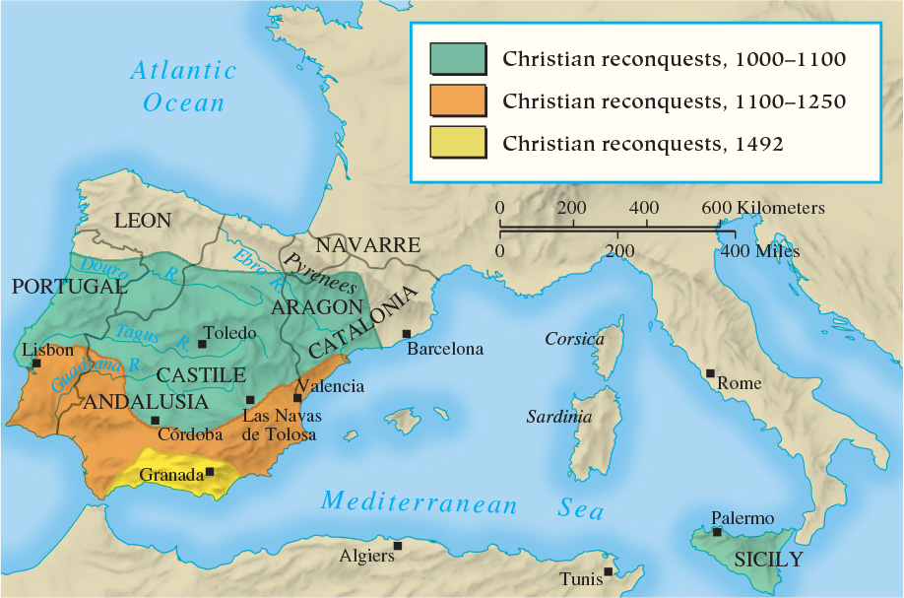
Map 10.2 Christian Reconquests in the Western Mediterranean

Slide 13
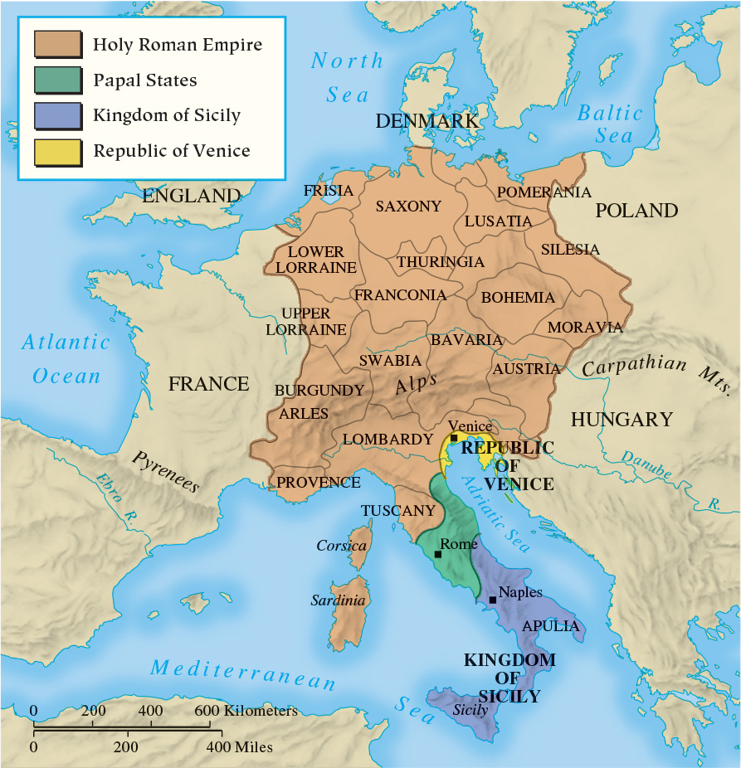
Map 10.3 The Lands of the Holy Roman Empire in the Twelfth Century

Slide 14
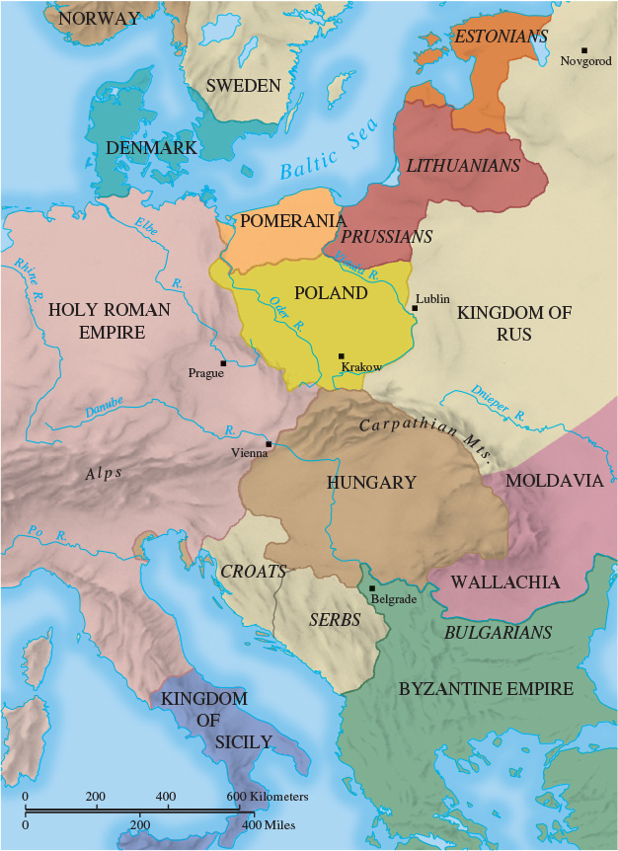
Map 10.4 Northern and Eastern Europe, ca. 1150

Slide 15
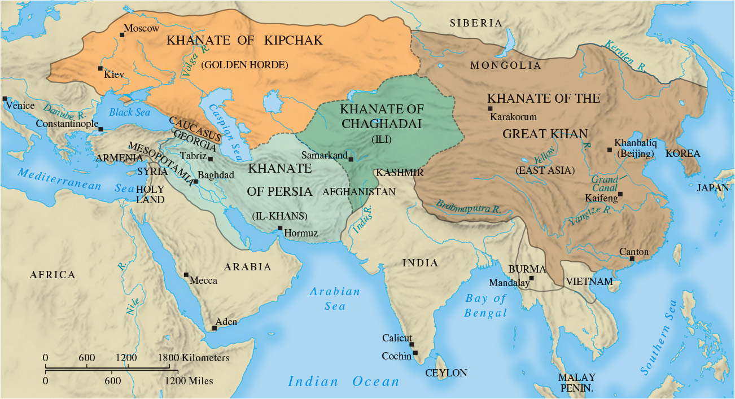
Map 10.5 The Mongol Empire in the Thirteenth Century

Slide 16
10-2 The Recovery AND Reform of the
Catholic Church
Focus Questions: What were the characteristics of the papal monarchy and the new religious orders of the High Middle Ages, and what role did women play in the religious life of the period? What was the church’s attitude toward heretics and Jews during the High Middle Ages?
Growth of the papal monarchy
  The pope and papal curia (staffed by cardinals): center of a hierarchical administrative structure
  Innocent III, zenith of papal monarchy
    Papal weapons: interdict (forbade the sacraments)

Slide 17
10-3 Christianity and Medieval Civilization
(1 of 3)
Focus Question: What was at issue in the Investiture Controversy, and what effect did the controversy have on the church and on Germany?
The problems of decline
  Political involvement, entanglements in lord-vassal relationships, monastic discipline declined
The Cluniac reform movement
  Renewed dedication to spiritual ideals of monasticism
Reform of the papacy
  Lay investiture and the Investiture Controversy

Slide 18
10-3 Christianity and Medieval Civilization
(2 of 3)
New religious orders and spiritual ideals
  The expansion of the Cistercian order, with strict discipline and an activist spiritual model
  Women in religious orders
    Convents and connections with the aristocracy
    Abbess Hildegard of Bingen
  Living the gospel life
    The friars: Franciscans and Dominicans
  Monasticism and social services
    Fed and clothed the poor, cared for the sick

Slide 19
10-3 Christianity and Medieval Civilization
(3 of 3)
Popular religion in the High Middle Ages
  The importance of the sacraments, especially the Eucharist
  The protection of the saints
    The prominence of the Virgin Mary
    The use of relics and miracles
  Voices of protest and intolerance
    The spread of heresy: the danger of Catharism and the crusade to halt it
    Persecution of the Jews: isolation and expulsion
    Intolerance and homosexuality

Slide 20
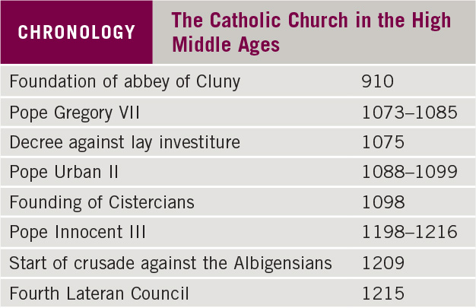
Chronology: The Catholic Church in the High Middle Ages

Slide 21
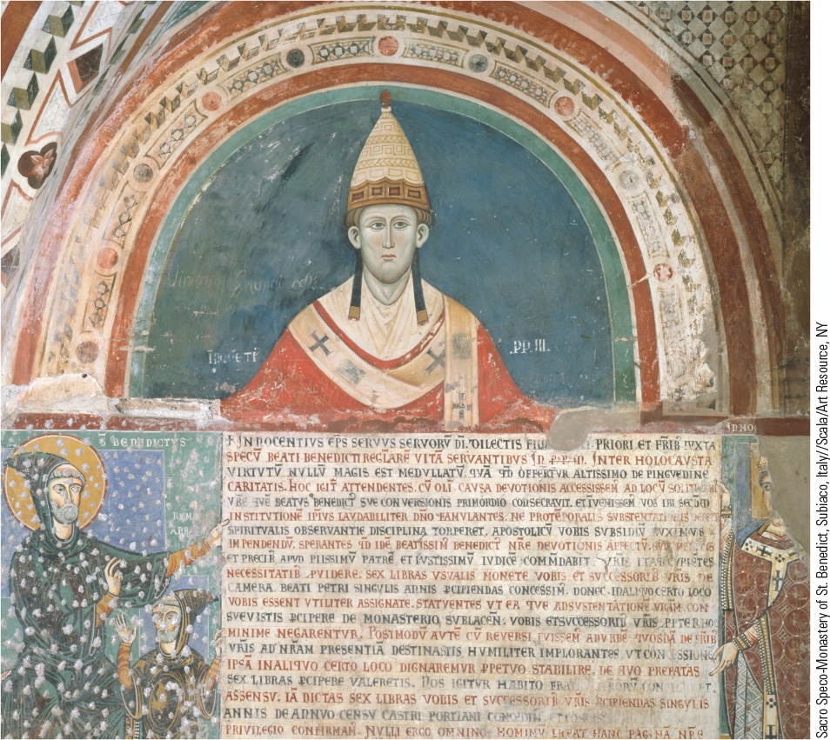
10.4 Pope Innocent III. Innocent III was arguably the most active and powerful pope during the Middle Ages.

Slide 22
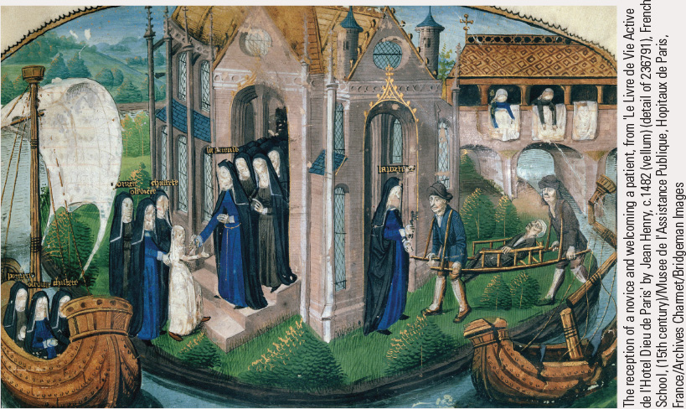
10.5a Medieval Nuns. Left, a group of nuns welcoming a novice (dressed in white) to their order; right, a nun receives a sick person on a stretcher for the order’s hospital care.

Slide 23
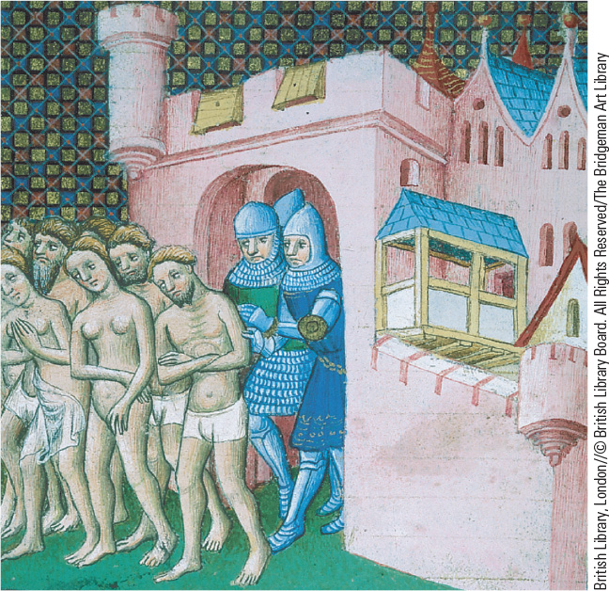
10.6 Expulsion of Albigensian Heretics. In this medieval illustration, French knights are shown expelling Albigensian heretics from the town of Carcassonne near Albi.

Slide 24
10-4 The Crusades (1 of 3)
Focus Question: What were the reasons for the Crusades, and who or what benefited the most from the experience of the Crusades?
Background to the Crusades
  Islam and the Seljuk Turks
    Command of the Abbasid Empire with the title of sultan
  The Byzantine Empire
    Internal struggles for power and the division with the West led to weakness
    External threats to security

Slide 25
10-4 The Crusades (2 of 3)
The early Crusades
  Urban II: the call and its appeal
  What motivated the Crusades
    Debate: religious fervor and salvation, fighting, territory, riches, status
  The First Crusade
    The conquest of Jerusalem and the establishment of the crusader states
  The Second Crusade
  The Third Crusade
    The fall of Jerusalem
    Saladin and the kings of Europe

Slide 26
10-4 The Crusades (3 of 3)
The Crusades of the thirteenth century
  Fourth Crusade
    Result: the Latin empire of Constantinople
  Children’s Crusade
  Four more crusades of adult warriors failed over the next half century
What were the effects of the Crusades?
  Debate: little long-term impact in Asia Minor and the Middle East; may have enhanced the revival of trade in the West but did not cause it
  The massacre of Jews: a regular feature of medieval European life

Slide 27
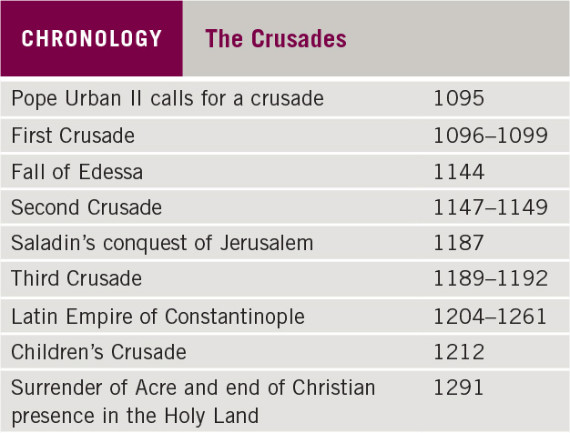
Chronology: The Crusades

Slide 28
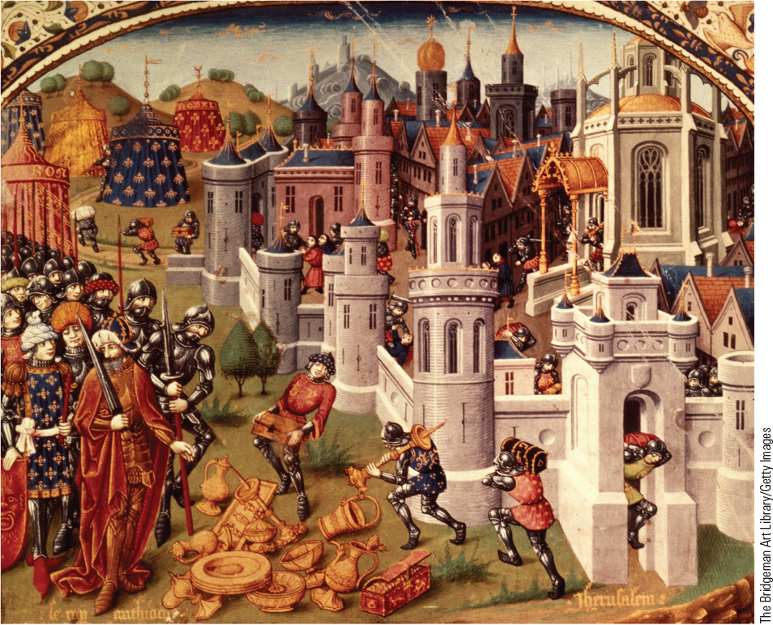
10.7 The First Crusade: The Capture of Jerusalem. This manuscript illustration is a fanciful recreation of the looting of Jerusalem after its capture by the Christian Crusaders.

Slide 29
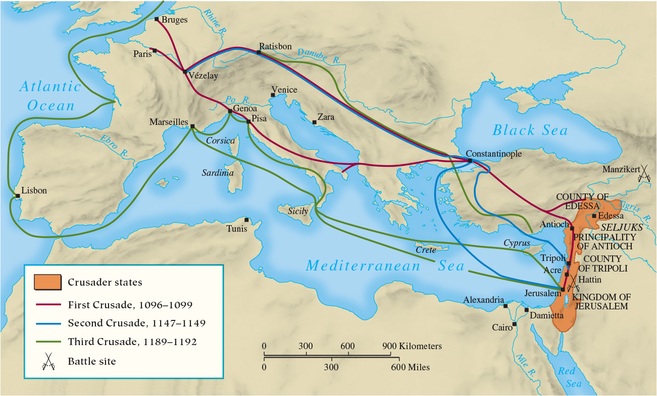
Map 10.6 The Early Crusades

Slide 30
Chapter 10 Summary
Medieval kings began to exert a centralizing authority and began developing new kinds of monarchical states.
The Catholic Church, perhaps the dominant institution of the Middle Ages, shared in the challenge of new growth by reforming itself and striking out on a path toward greater papal power.
The High Middle Ages also witnessed a spiritual renewal that led to numerous and even divergent paths, leading to intolerance.
The spiritual renewal of the High Middle Ages gave rise
to the crusading “holy warrior” who killed for God and gave the papacy increased authority, although not ultimate Christian victory in the Holy Land.

Slide 31
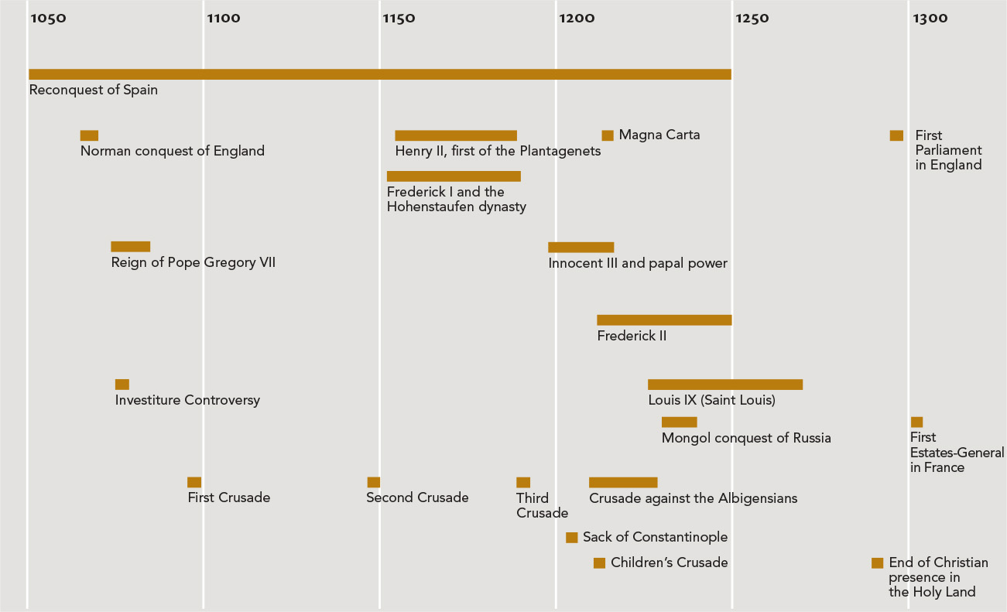
Chapter 10 Timeline

