Slide 1
WESTERN CIVILIZATION: A Brief History
Tenth Edition
CHAPTER 9
The Recovery and Growth of European Society in the High Middle Ages
© 2020 Cengage. All rights reserved.

Slide 2
Chapter 9 Outline
9-1 Land and People in the High Middle Ages
9-2 The New World of Trade and Cities
9-3 The Intellectual and Artistic World of the High Middle Ages

Slide 3
9-1 Land and People in the High Middle Ages
(1 of 3)
Focus Questions: What new agricultural practices arose in the High Middle Ages? What roles did peasants and aristocrats play in the civilization of the High Middle Ages?
The High Middle Ages (1000–1300): overview
  Period of recovery and growth for Western civilization
    Improvement in climate
    Fewer invasions
    Dramatic rise in population

Slide 4
9-1 Land and People in the High Middle Ages
(2 of 3)
The new agriculture
  Additional acreage brought under cultivation
  Technological changes
    Carruca (heavy, wheeled plow), watermills, dams, and windmills
    Cooperative agricultural villages
  The three-field system
    One field for winter grains
    One field for spring grains and vegetables
    One field allowed to lie fallow
    Fields rotated

Slide 5
9-1 Land and People in the High Middle Ages
(3 of 3)
The life of the peasantry
  Work determined by season
  Religious feast days and other holy days
  The duties of peasant women
The aristocracy and the High Middle Ages
  The way of the warrior
    Chivalry: a code of ethics for knights
  Aristocratic women
    Could legally hold property, but remained under the control of men
    Powerful queens

Slide 6
Table 9.1: Population Estimates (in millions), 1000 and 1340
AREA | 1000 | 1340
Mediterranean
Greece and Balkans | 5 | 6
Italy | 5 | 10
Iberia | 7 | 9
Total | 17 | 25
Western and Central Europe
France and Low Countries | 6 | 19
British Isles | 2 | 5
Germany and Scandinavia | 4 | 11.5
Total | 12 | 35.5
Eastern Europe
Russia | 6 | 8
Poland | 2 | 3
Hungary | 1.5 | 2
Total | 9.5 | 13
Grand Total | 38.5 | 73.5

Slide 7
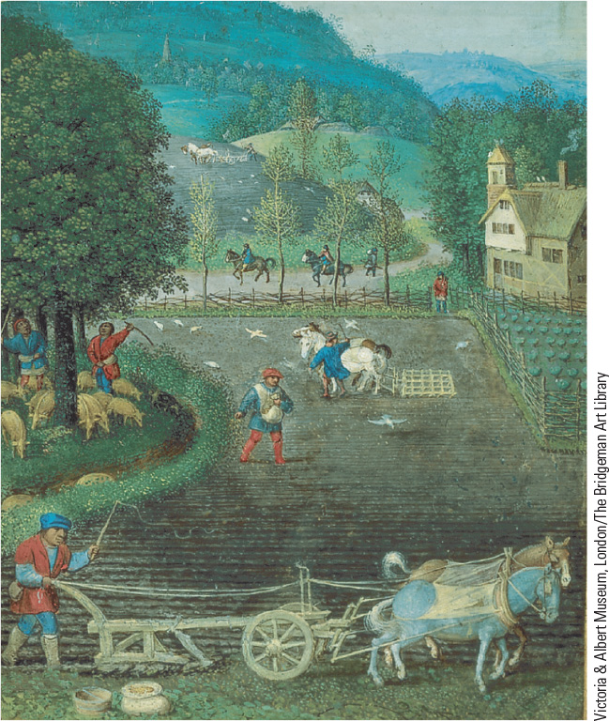
9.2 The Heavy, Wheeled Plow.
The heavy, wheeled plow was an important invention that enabled peasants to turn over the heavy clay soils of northern Europe.

Slide 8
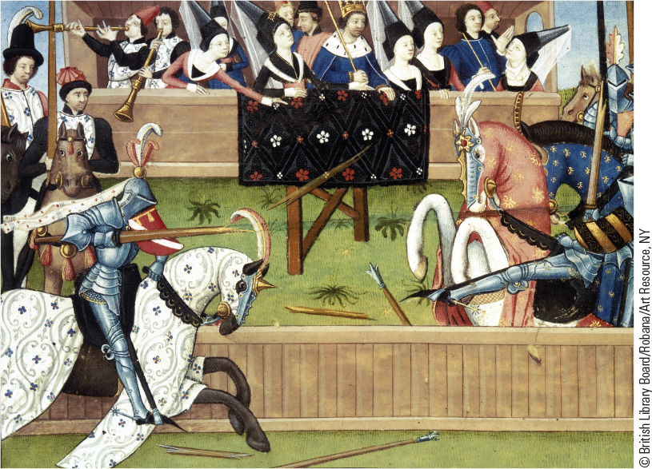
9.3a The Tournament and the Joust. The joust became the main event of the tournament, a socially acceptable alternative to the private warfare of the Middle Ages.

Slide 9
9-2 The New World of Trade and Cities (1 of 3)
Focus Questions: What developments contributed to the revival of trade during the High Middle Ages, and what areas were the primary beneficiaries of the revival? What were the major features of medieval cities?
The revival of trade
  Italian cities led the way in southern Europe, Flanders led the way in the north
    The emergence of a money economy
    The new practices of commercial capitalism

Slide 10
9-2 The New World of Trade and Cities (2 of 3)
The growth of cities
  Revival of old Roman cities
  Founding of new cities and towns
    Merchant settlements near fortress or walled enclosure, with ties to surrounding territories
    The needs of the burghers or bourgeoisie: charters of liberties
  City governments
    Citizens elected members of a governing council
    Authority and regulation

Slide 11
9-2 The New World of Trade and Cities (3 of 3)
Life in a medieval city
  Conditions: narrow, dirty, winding streets; water and air pollution
  More men than women
    Challenges for single women
Industry in medieval cities
  Guilds: organizations of artisans that directed all parts of the production process
    Master craftsmen, journeymen, and apprentices

Slide 12
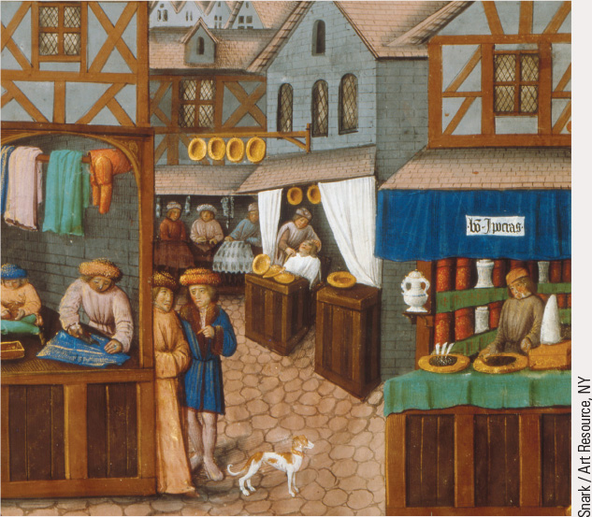
9.4a Shops in a European Medieval Town. Master craftsmen who worked in urban settings had their workshops in the ground-level rooms of their homes.

Slide 13
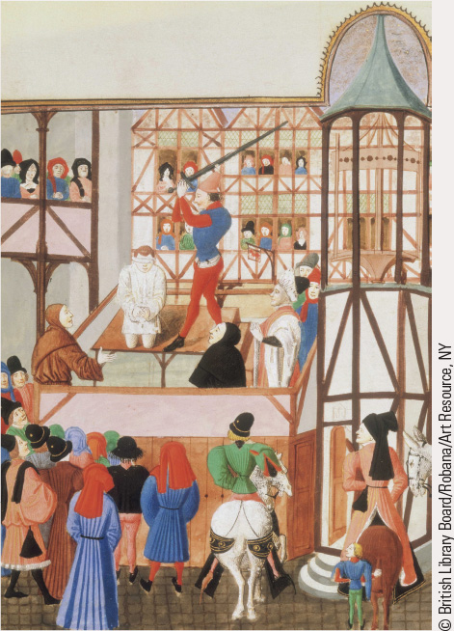
9.5b Life in a Medieval Town. Executions conducted in the public square were considered a deterrent to crime in the Middle Ages.

Slide 14
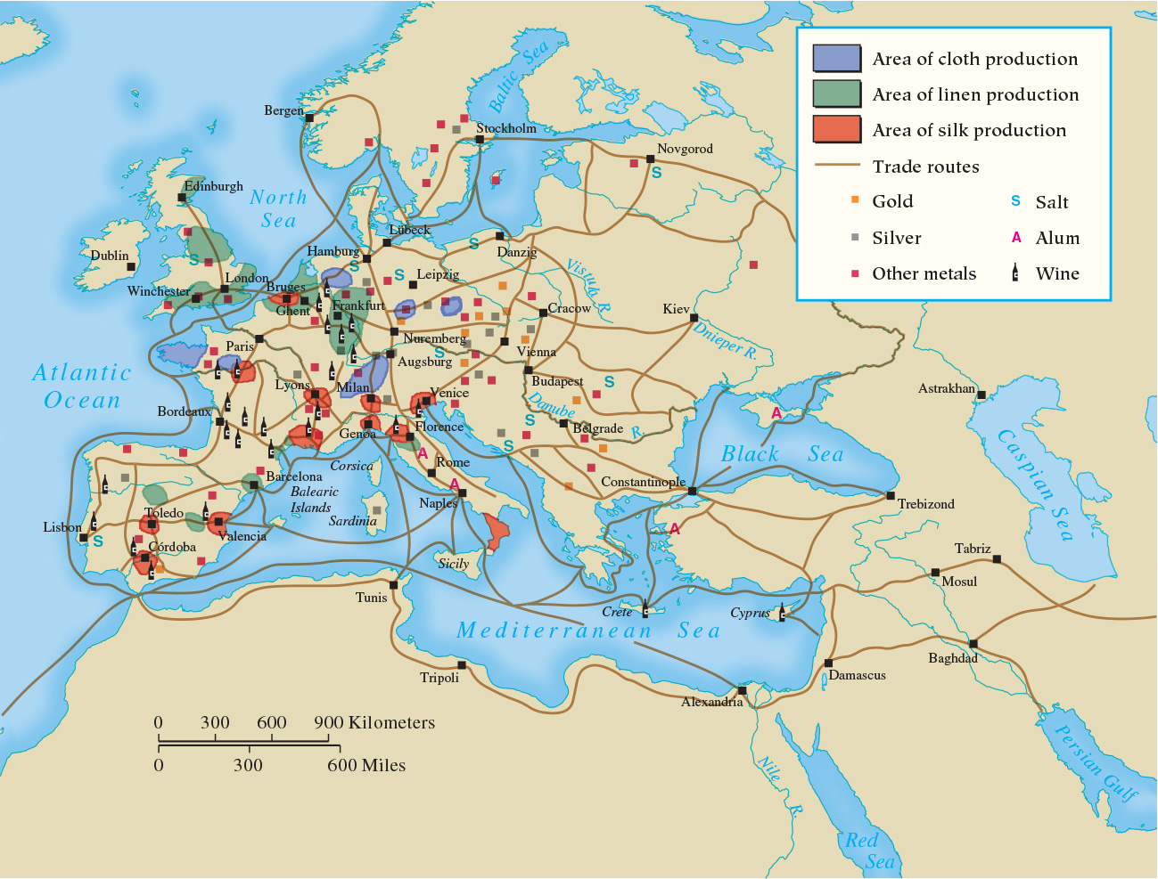
Map 9.1 Medieval Trade Routes

Slide 15
9-3 The Intellectual and Artistic World of the High Middle Ages (1 of 4)
Focus Question: What were the major intellectual and cultural achievements of European civilization in the High Middle Ages?
The rise of the universities
  The origins of universities
    First in Bologna, Italy, and coincided with revival of interest in Roman law; others followed, founded by kings and popes
  Teacher and students in the medieval university
    Liberal arts curriculum
    Classes conducted in Latin
    Male only
    Evaluation: comprehensive oral exam after four to six years of study

Slide 16
9-3 The Intellectual and Artistic World of the High Middle Ages (2 of 4)
A revival of classical antiquity
  Recovery of the works of Aristotle and other Greeks in the West through the Muslim world, especially Spain
    Influence of Arabic philosophers
  The revival of Roman law
    Rediscovery of Justinian’s Body of Civil Law
    Commentaries on Roman law
    Application of law: rational decision-making process based on the systematic collection and analysis of evidence replaced ordeal

Slide 17
9-3 The Intellectual and Artistic World of the High Middle Ages (3 of 4)
The development of scholasticism
  The attempt to reconcile faith and reason
    Harmonization of faith with Aristotle
    Thomas Aquinas, Summa Theologica
  Literature in the High Middle Ages
    Latin literature and verse
    Vernacular literature including troubadour poetry and chanson de geste

Slide 18
9-3 The Intellectual and Artistic World of the High Middle Ages (4 of 4)
Romanesque architecture: “a white mantle of churches”
  Normally built in the basilica shape used in the late Roman Empire; international unity of basic features
  Massive walls and pillars gave them a sense of solidity
The Gothic cathedral
  Two fundamental architectural innovations
    Ribbed vaults and pointed arches replaced the barrel vault
    Flying buttresses allowed for thinner walls and stained glass windows
  Represented the work of an entire community

Slide 19
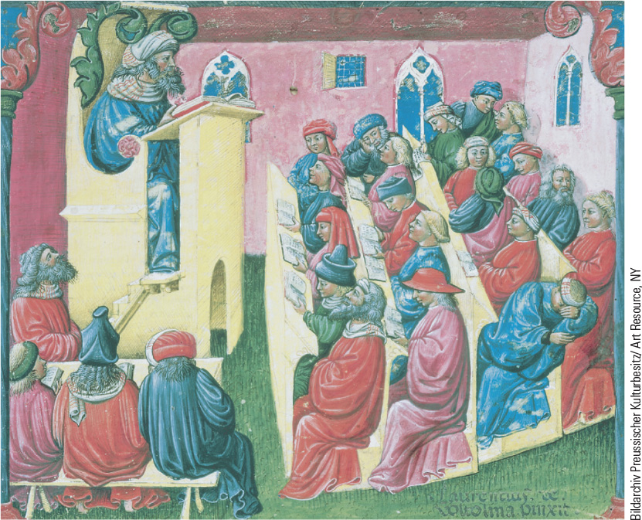
9.6 University Classroom. In this illustration a master teacher reads from a text for students for various ages.

Slide 20
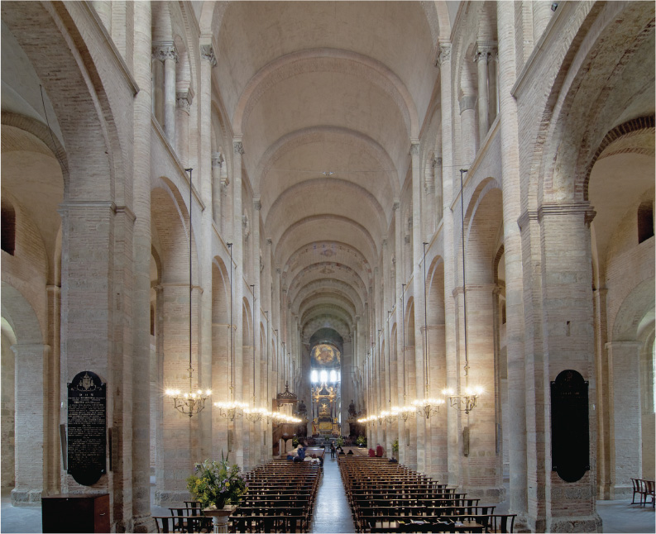
9.7 Barrel Vaulting. Utilizing the basilica shape, master builders replaced flat wooden roofs with long, round stone vaults known as barrel vaults.

Slide 21
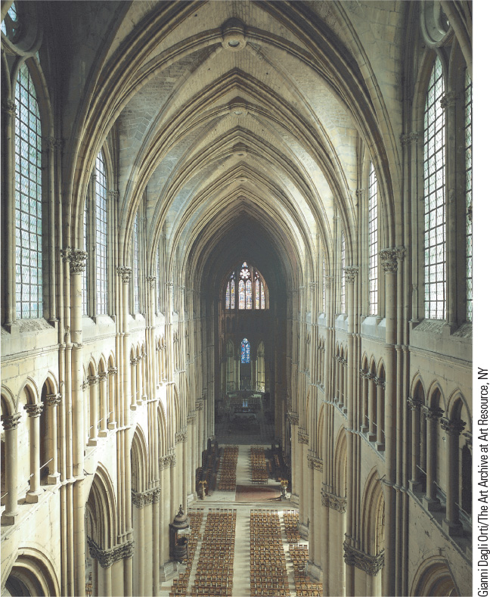
9.9 Interior of a Gothic Cathedral. The use of ribbed vaults and pointed arches gave the Gothic cathedral a feeling of upward movement.

Slide 22
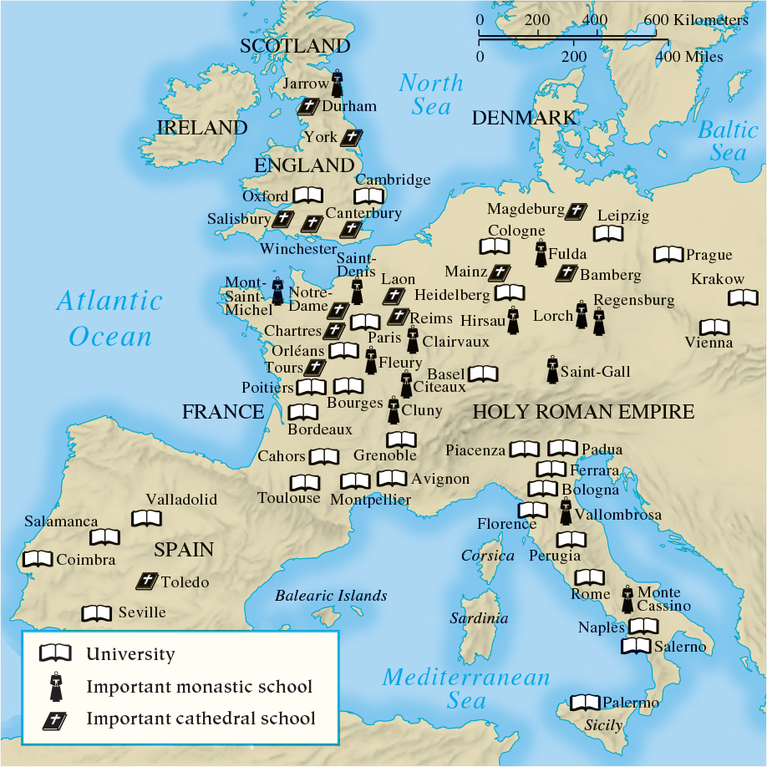
Map 9.3 Main Intellectual Centers of Medieval Europe

Slide 23
Chapter 9 Summary
The High Middle Ages (1000–1300) was characterized by a greater sense of security and a burst of energy and enthusiasm.
The development of trade, first in Italy and Flanders and then elsewhere, and the rise of cities opened the door to new ways to make a living and new opportunities for people to expand and enrich their lives.
An intellectual revival led to a rediscovery of important aspects of the classical heritage, the development of universities, and the emergence of literary trends in Latin and the vernacular.
The artistic revival of the High Middle Ages was
especially evident in architecture, with Romanesque and Gothic cathedrals.

Slide 24
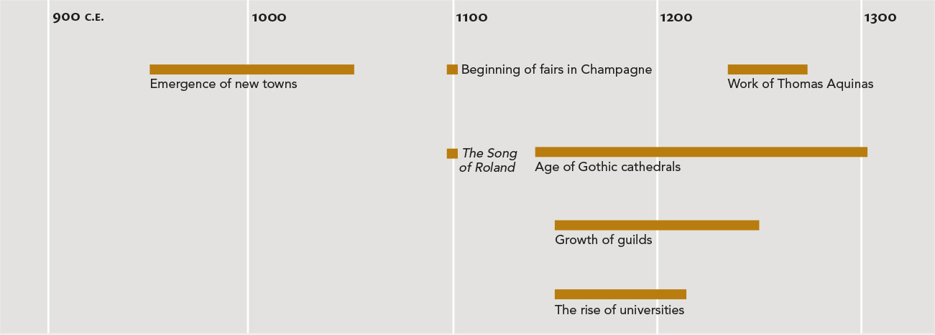
Chapter 9 Timeline

