Slide 1
WESTERN CIVILIZATION: A Brief History
Tenth Edition
CHAPTER 8
European Civilization in the Early Middle Ages, 750–1000
© 2020 Cengage. All rights reserved.

Slide 2
Chapter 8 Outline
8-1 The World of the Carolingians
8-2 Disintegration of the Carolingian Empire
8-3 The Emerging World of Lords and Vassals
8-4 The Zenith of Byzantine Civilization
8-5 The Slavic Peoples of Central and Eastern Europe
8-6 The World of Islam

Slide 3
8-1 The World of the Carolingians (1 of 3)
Focus Questions: What was the significance of Charlemagne’s coronation as emperor? In what ways did the political, intellectual, and daily life in the Carolingian Empire represent a fusion of Gallo-Roman, Germanic, and Christian practices?
The decline of the Merovingian dynasty
  Coronation of Pepin as king of the Franks
Charlemagne and the Carolingian Empire (768–814)
  Expansion of the Carolingian Empire
    Campaigns to the south, west, and east result in gains
  Governing the empire
    System based on loyalty (e.g., missi dominici), aided by church reform

Slide 4
8-1 The World of the Carolingians (2 of 3)
Charlemagne as emperor
  An ever-closer relationship with the papacy results in the acquisition of title of emperor of the Romans in 800
What is the significance of Charlemagne?
  Fusion of Roman, Christian, and Germanic elements
    Debate: Charlemagne as the “father of Europe”
    May have led to the foundation of European civilization
The Carolingian intellectual renewal
  Revival of classical studies through the scriptoria in monasteries
    Charlemagne’s promotion of learning

Slide 5
8-1 The World of the Carolingians (3 of 3)
Life in the Carolingian world
  Family
    Monogamy and the nuclear family
  Christianity and sexuality
    Celibacy and sex for procreation
    Homosexuality condemned
  Diet
    Bread as a staple, supplemented by pork, cheese, eggs, and vegetables
  Health
    Medicinal herbs and bleeding

Slide 6
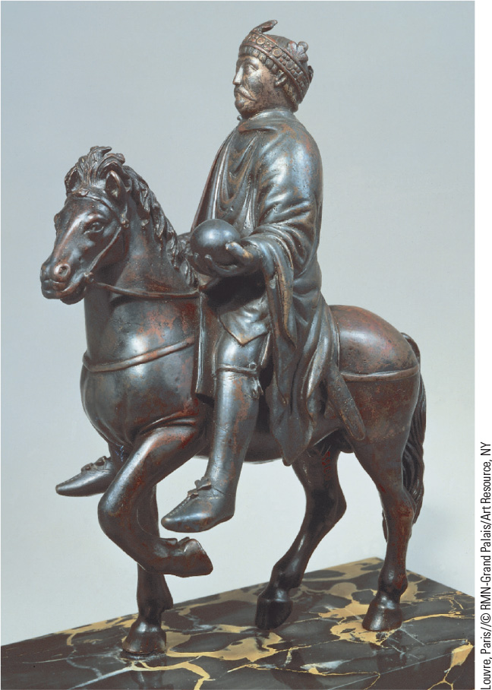
8.2 Bronze Equestrian Statue of Charlemagne. Wearing the imperial crown and grasping a globe, Charlemagne here symbolizes the renewal of the power of the Roman Empire.

Slide 7
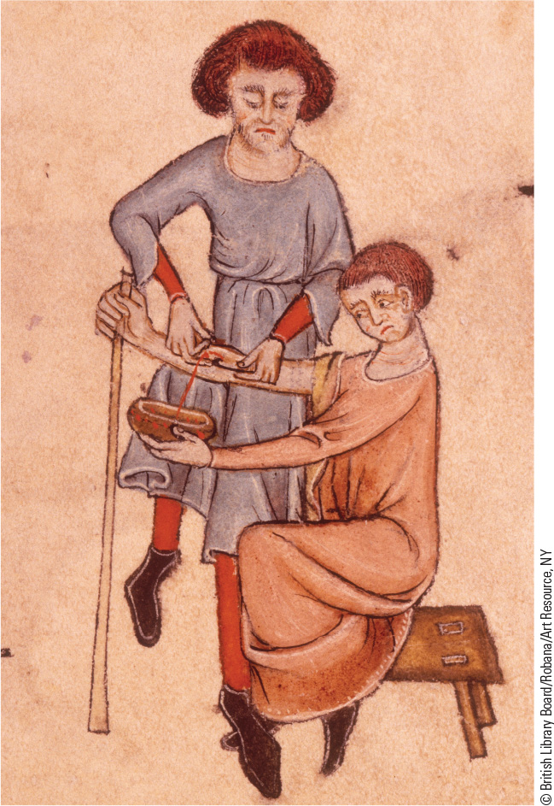
8.3 Bloodletting in Early Medieval Medicine. Medieval medicine involved the withdrawing of blood from a person to bring balance to the body and heal a diseased condition.

Slide 8
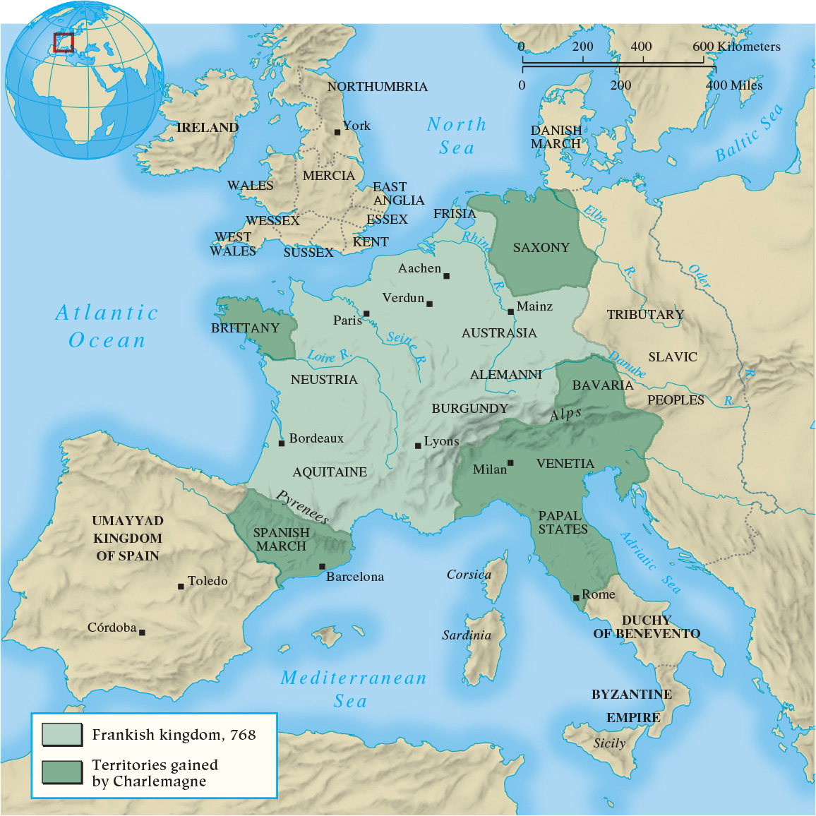
Map 8.1 The Carolingian Empire

Slide 9
8-2 Disintegration of the Carolingian Empire
Focus Question: What impact did the Vikings have on the history and culture of medieval Europe?
The division of Charlemagne’s empire by heirs
  The emergence of a two distinct cultures, east and west
  Aristocratic power and royal squabbling
Invasions of the ninth and tenth centuries
  Old enemies and new: Muslims and Magyars
  The Vikings
    Superb shipbuilding sailors, warriors, and explorers
    Political repercussions: Viking raids strengthened local aristocrats and local government at expense of the kings

Slide 10
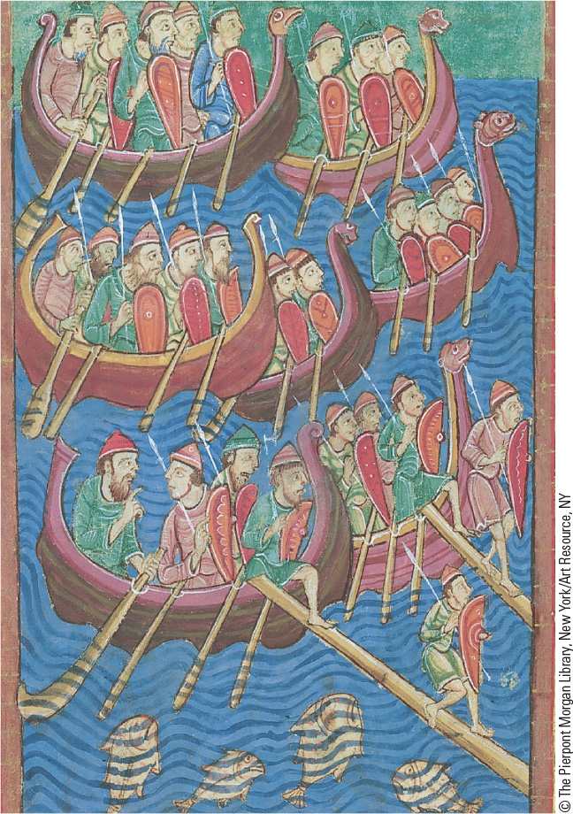
8.4 Vikings Attacking England. An illustration from an eleventh-century English manuscript depicts a group of armed Vikings invading England.

Slide 11
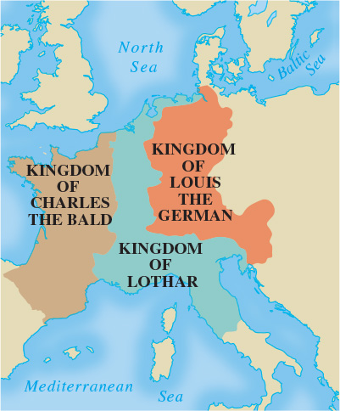
Map 8.2 Division of the Carolingian Empire by the Treaty of Verdun, 843

Slide 12
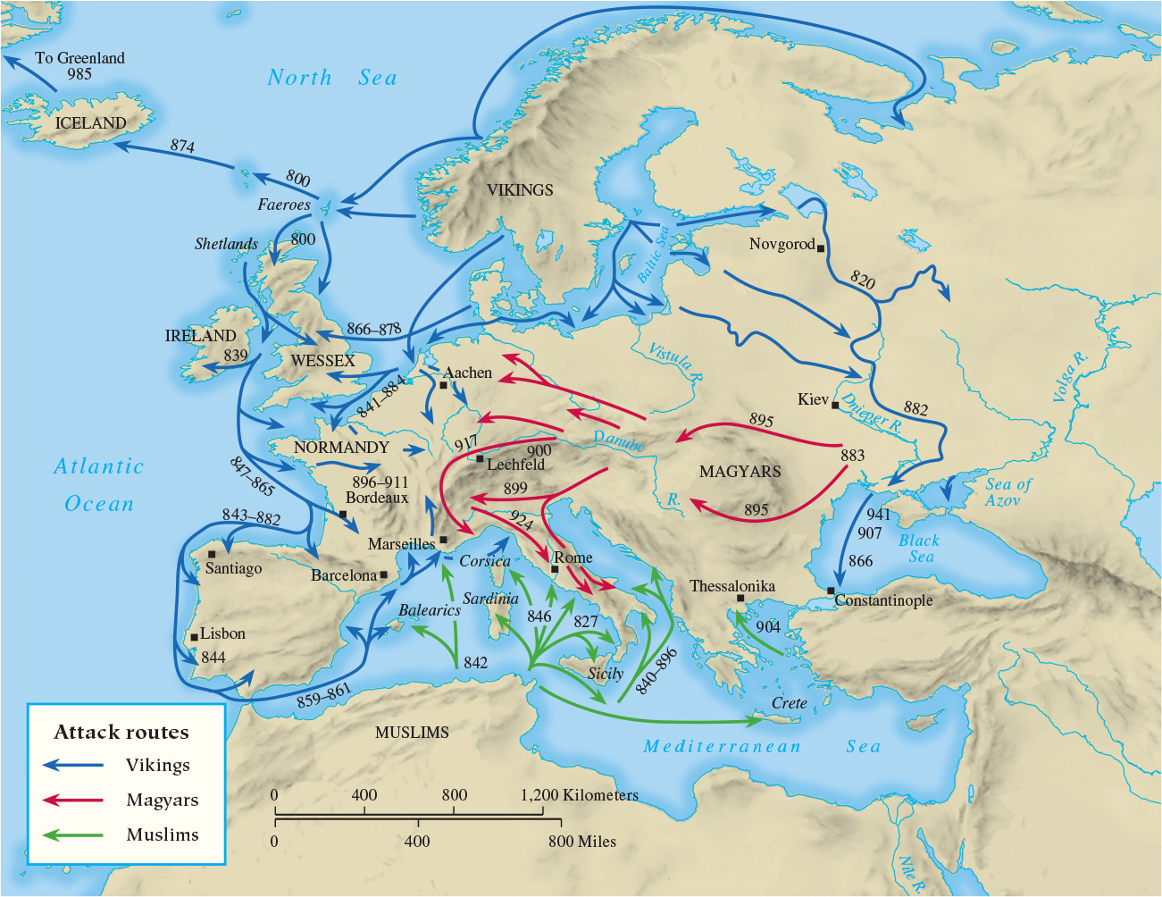
Map 8.3 Invasions of the Ninth and Tenth Centuries

Slide 13
8-3 The Emerging World of Lords and Vassals
(1 of 2)
Focus Question: What was fief-holding, and how was it related to manorialism?
Renewed invasion and Carolingian decline led to exchange of protection for service
Vassalage
  Warriors who swore oath of loyalty to their leader (lord)
  Military transformation: expenses of knights
Fief-holding
  Fief, land or other income granted to vassal in return for military service
  Complicated by subinfeudation and mutual obligation
  Spread beyond Carolingian lands

Slide 14
8-3 The Emerging World of Lords and Vassals
(2 of 2)
The manorial system
  Manor: an agricultural estate operated by a lord and worked by peasants
  Serfs: peasants bound to the land and required to pay labor services
    60 percent of the European population by ninth century
    Demesne, the land retained by the lord, worked by peasants as part of service requirement
    Rents and legal rights

Slide 15
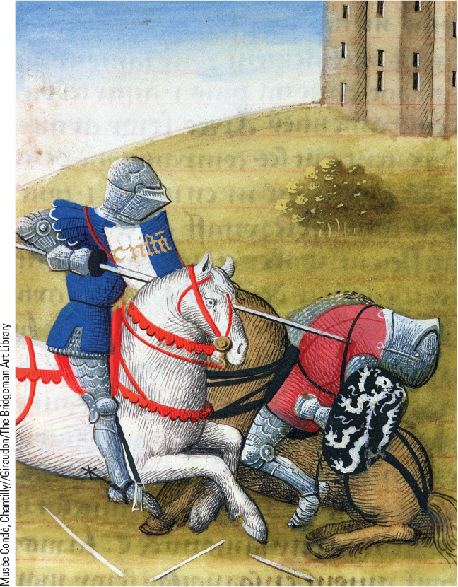
8.5 A Knight’s Equipment Showing Saddles and Stirrups. The introduction of the high saddle, stirrups, and larger horses vastly improved the fighting ability of the cavalry.

Slide 16
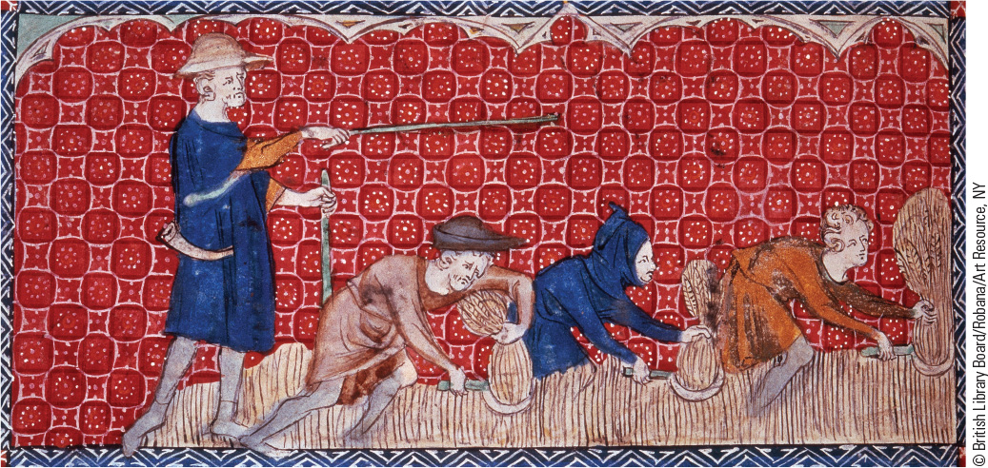
8.6 Peasants in the Manorial System. In the manorial system, peasants were required to provide labor services for their lord, like these English peasants harvesting grain.

Slide 17
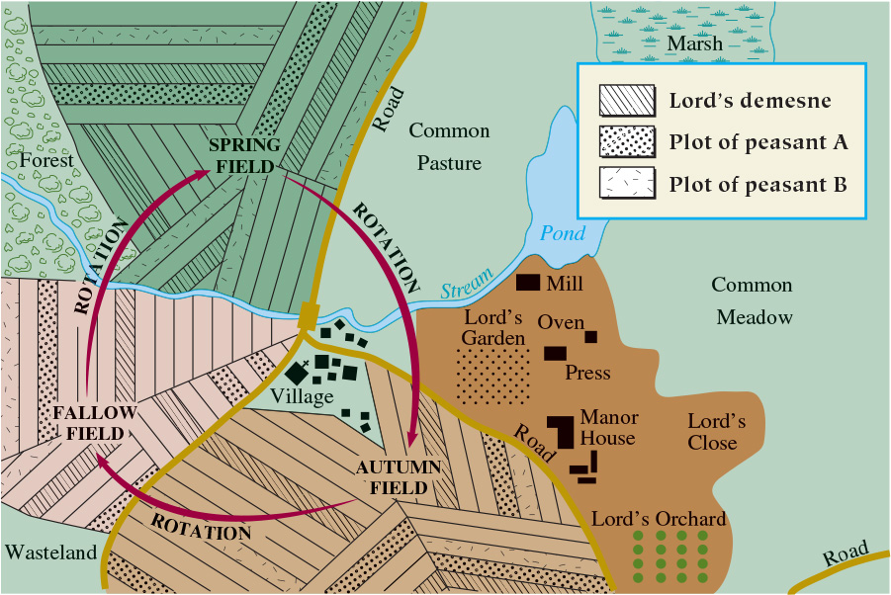
Map 8.4 A Typical Manor

Slide 18
8-4 The Zenith of Byzantine Civilization
Focus Question: What were the chief developments in the Byzantine Empire between 750 and 1000?
A “golden age”
  After territorial losses, renewed expansion
  The rift between the Eastern and Western churches
The Macedonian dynasty
  Strengthened position of free farmers, fostered economic prosperity, missionary efforts, strong civil service, and successful military campaigns
Women in Byzantium
  Duties: marry and bear children, maintain household, weave cloth
  Opportunities of upper-class women

Slide 19
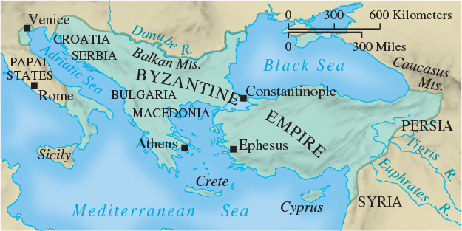
Map 8.5 The Byzantine Empire in 1025

Slide 20
8-5 The Slavic Peoples of Central and Eastern Europe (1 of 2)
Focus Question: What patterns of development occurred in central and eastern Europe as a result of the Slavic peoples?
Slavs in late antiquity
  Indo-European origins
  From a single people to division
Western Slavs
  Accepted Catholic (Western) Christianity and became closely tied to the Roman Catholic Church
Southern Slavs
  Converted by Byzantine missionaries to Eastern Orthodox Christianity and linked to Byzantine state

Slide 21
8-5 The Slavic Peoples of Central and Eastern Europe (2 of 2)
Eastern Slavs
  Contended with Viking invaders
    Viking rulers assimilated into the Slavic population
  Accepted Byzantine Christianity
Women in the Slavic world
  Subordinated to men
  Expected to focus their lives on their families

Slide 22
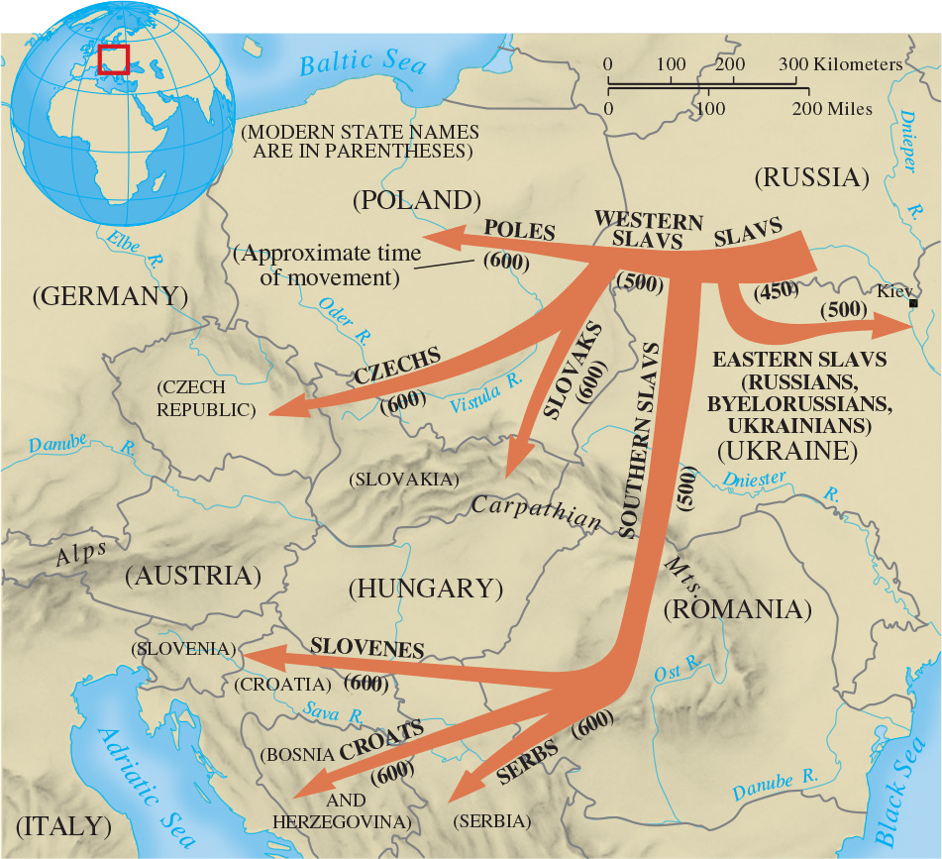
Map 8.6 The Migrations of the Slavs

Slide 23
8-6 The World of Islam
Focus Question: What were the chief developments in the Islamic world between 750 and 1000?
The Abbasid dynasty
  Prosperity, corruption, and fragmentation
Islamic civilization
  Willingness to absorb culture of conquered territories; heirs to the remaining Greco-Roman culture
  Women in the Islamic world
  The culture of Islam
    Made considerable advancement in mathematics and natural sciences

Slide 24
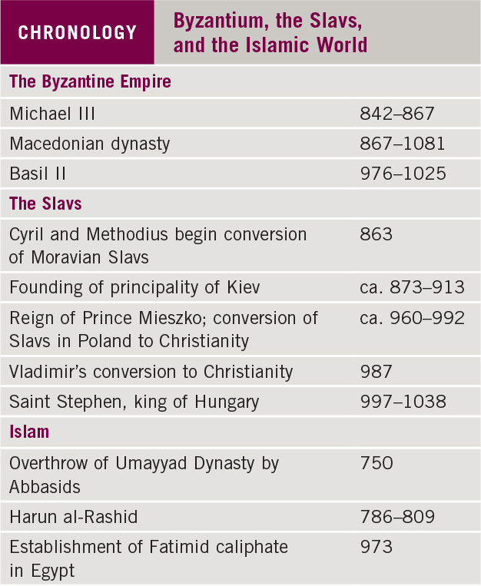
Chronology: Byzantium, the Slavs, and the Islamic World

Slide 25
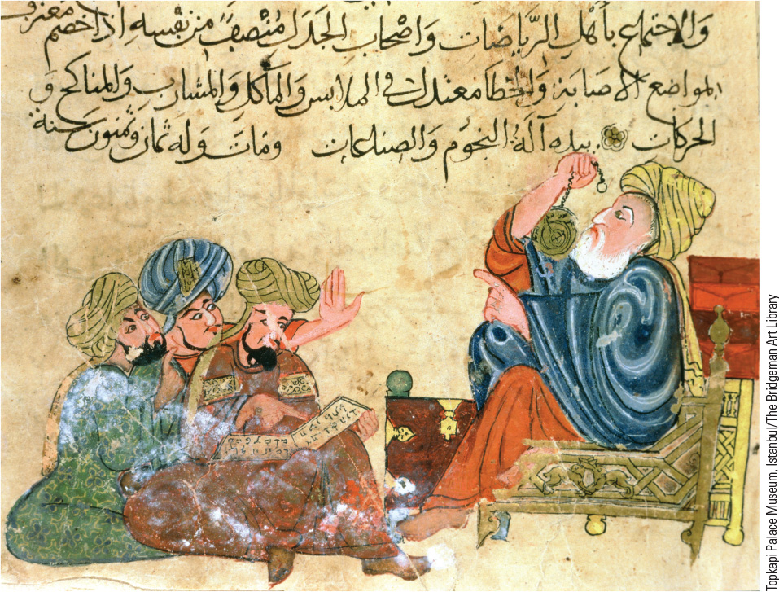
8.7 Preserving Greek Literature. Muslim scholars stored copies and translations of classical Greek writing in libraries in the Arab world and ensured their survival.

Slide 26
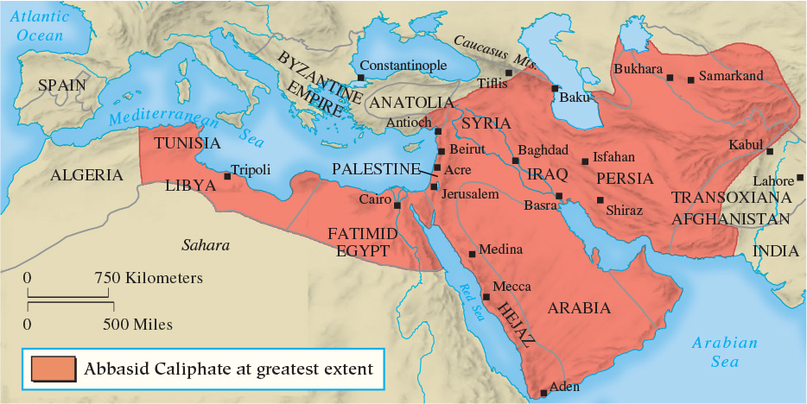
Map 8.7 The Abbasid Caliphate at the Height of Its Power

Slide 27
Chapter 8 Summary
The coronation of Charlemagne as emperor of the Romans in 800 symbolized the fusion of the three chief components of a new European civilization: the German tribes, the classical tradition, and Christianity.
A new political and military order, known as fief-holding, evolved to become an integral part of the political world of the Middle Ages after the decline of the Carolingian empire.
Invasions by Muslims, Magyars, and Vikings and the migrations of the Slavs transformed Europe.
The brilliance of the urban cultures of both the Byzantine Empire and the Islamic world stood in marked contrast to the underdeveloped rural world of Europe.

Slide 28
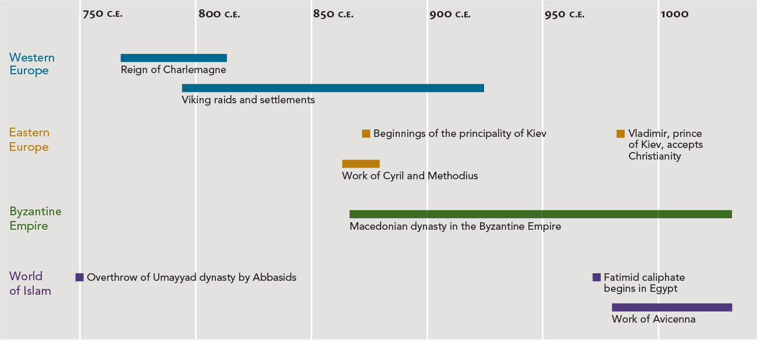
Chapter 8 Timeline

