Slide 1
WESTERN CIVILIZATION: A Brief History
Tenth Edition
CHAPTER 7
Late Antiquity and the Emergence of the Medieval World
© 2020 Cengage. All rights reserved.

Slide 2
Chapter 7 Outline
7-1 The Late Roman Empire
7-2 The Germanic Kingdoms
7-3 Development of the Christian Church
7-4 The Byzantine Empire
7-5 The Rise of Islam

Slide 3
7-1 The Late Roman Empire (1 of 3)
Focus Question: What reforms did Diocletian and Constantine institute, and to what extent were the reforms successful?
The reforms of Diocletian and Constantine
  Political reforms
    Division into four units and reunification; growth of autocratic power
  Military reforms
    Increased size and flexibility to face threats
  Economic and social trends
    Inflation, taxes, and coercion
  Constantine’s building program

Slide 4
7-1 The Late Roman Empire (2 of 3)
The Empire’s new religion
  The conversion of Constantine
    Milvian Bridge, Constantine’s vision, and Edict of Milan
  Organization and religious disputes
    The church’s system of government: archbishops and bishops
    The problem of heresy, including Arianism
    The Council of Nicaea

Slide 5
7-1 The Late Roman Empire (3 of 3)
The end of the Western empire
  Increasing contact between the Germans and Romans
    After the fourth century, Rome was no longer able to absorb these people without harm to its own political structure
    The threat of the Huns and the Visigoths
  The collapse of Western Roman imperial authority, replaced by a series of Germanic kingdoms
  Eastern empire remained intact under an emperor in Constantinople

Slide 6
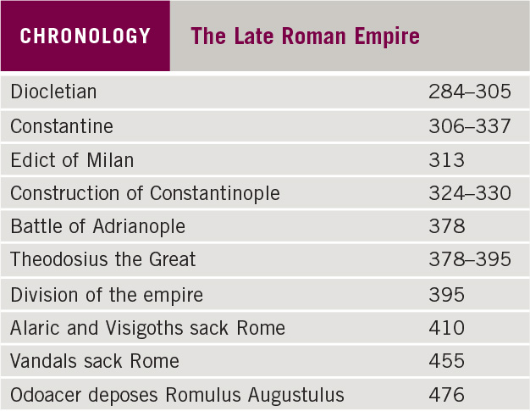
Chronology: The Late Roman Empire

Slide 7
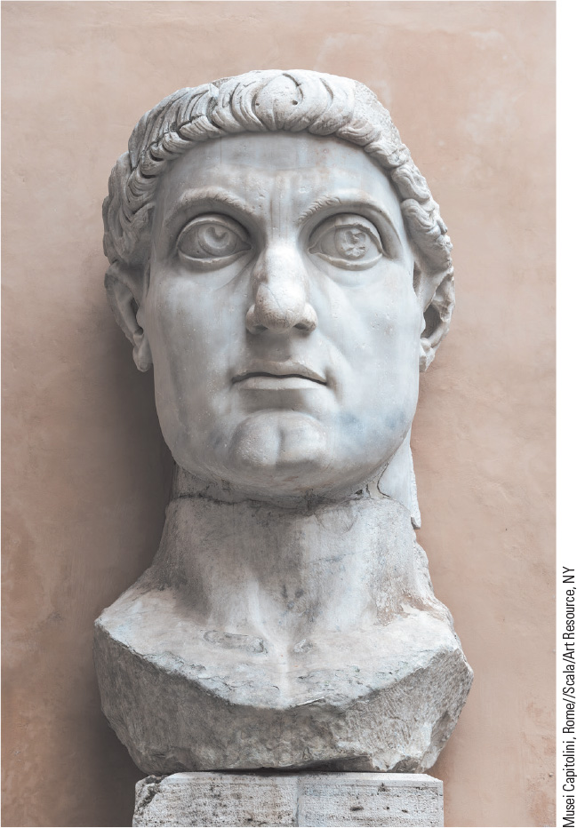
7.2 The Emperor Constantine. Constantine played an important role in restoring order and stability to the Roman Empire at the beginning of the fourth century.

Slide 8
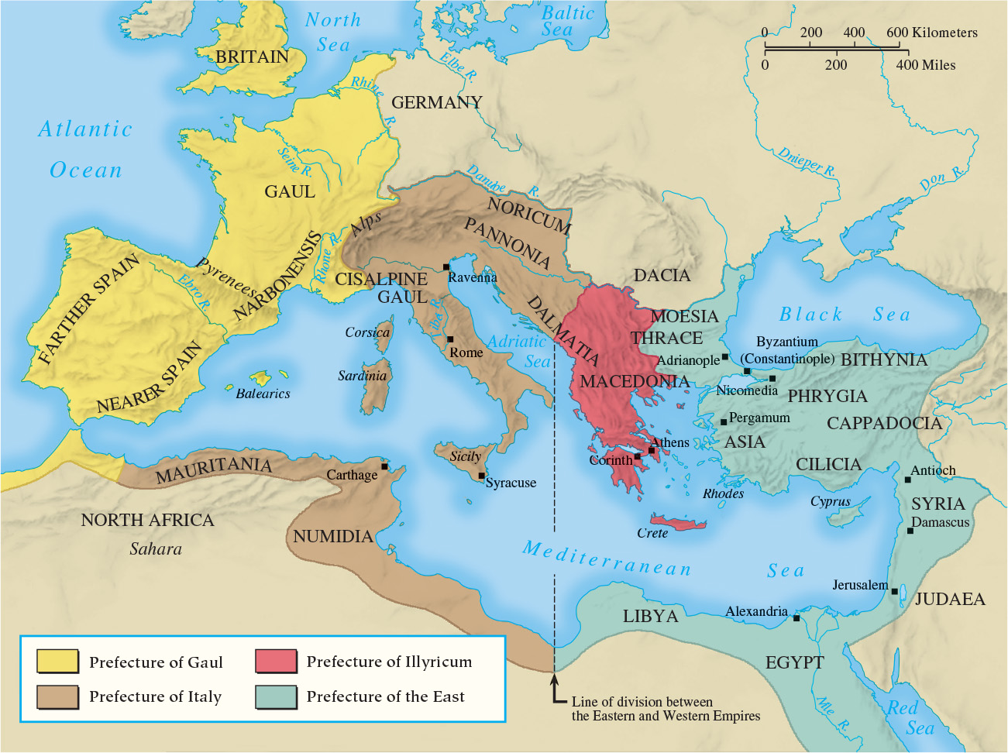
Map 7.1 Divisions of the Late Roman Empire, ca. 300

Slide 9
7-2 The Germanic Kingdoms (1 of 3)
Focus Questions: What changes did the Germanic peoples make to the political, economic, and social conditions of the Western Roman Empire? What were the main features of Germanic law and society, and how did they differ from those of the Romans?
The Ostrogothic kingdom of Italy
  Stability through Theodoric’s maintenance of Roman tradition of government
  Byzantine reconquest of Italy followed by Lombard control
The Visigothic kingdom of Spain
  Coexistence of Roman and German populations, warrior caste, and Roman governmental structure

Slide 10
7-2 The Germanic Kingdoms (2 of 3)
The Frankish kingdom
  Clovis and the establishment of the Merovingian dynasty
    Christian conversion, 500
  The only German state to prove long-lasting
    Fusion between Gallo-Roman and Frankish cultures and peoples
Anglo-Saxon England

Slide 11
7-2 The Germanic Kingdoms (3 of 3)
The society of Germanic kingdoms
  Extended family at the center of social organization, provided protection
  Personal nature of German law
    Feuds and wergeld: fine paid by wrongdoer to family of injured or killed person
    The procedures of compurgation and ordeal
Frankish family and marriage
  Male authority and arranged marriages
    Adulterous wives severely punished
    Divorce was relatively simple

Slide 12
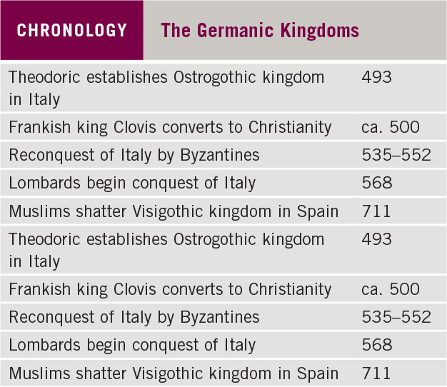
Chronology: The Germanic Kingdoms

Slide 13
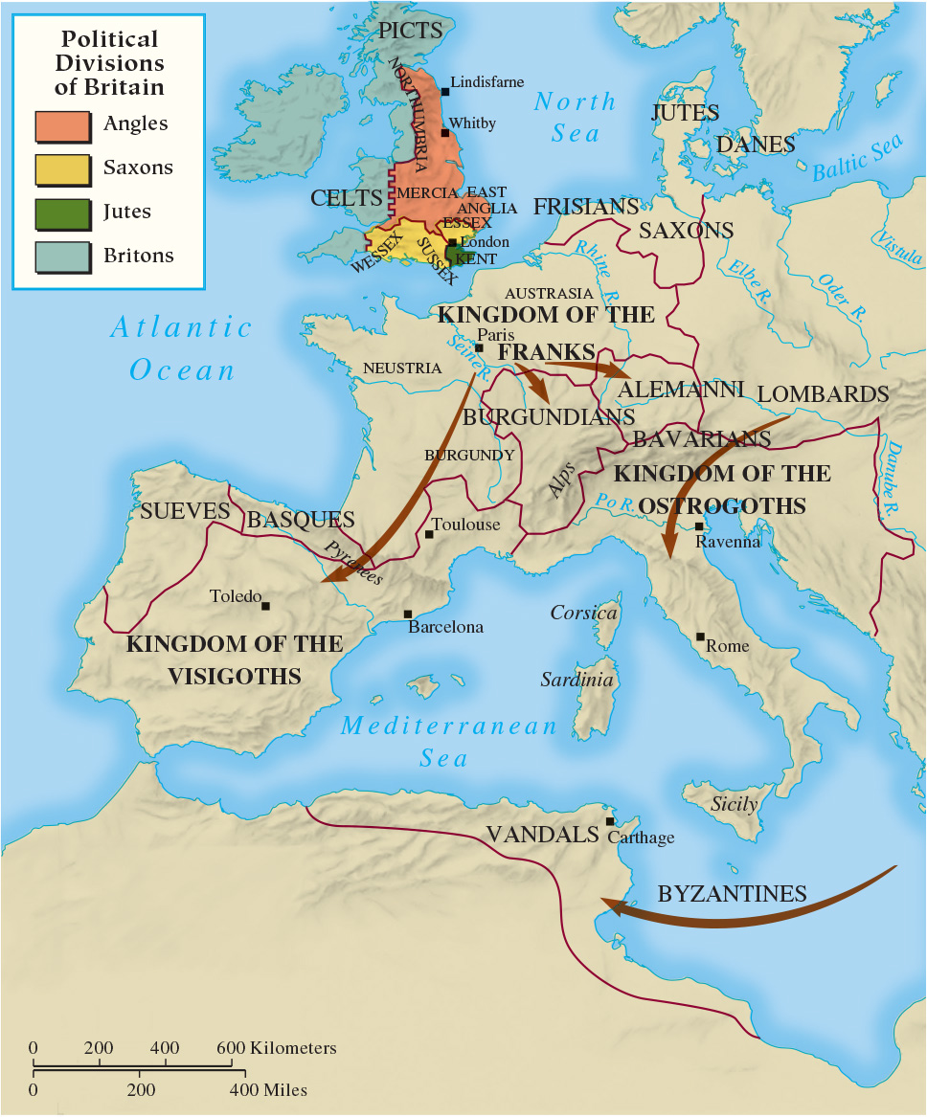
Map 7.2 The Germanic Kingdoms of the Old Western Empire

Slide 14
7-3 Development of the Christian Church
(1 of 4)
Focus Questions: How and why did the organization of the Christian church and its relations with the state change during the fourth and fifth centuries? What were the chief characteristics of Benedictine monasticism, and what role did monks play in both the conversion of Europe to Christianity and the intellectual life of the Germanic kingdoms?
The power of the pope
  The emergence of the bishop of Rome as the leader of the western Christian church
    Gregory I’s establishment of papal temporal power

Slide 15
7-3 Development of the Christian Church
(2 of 4)
The monks and their missions
  Benedictine monasticism
    St. Benedict of Nursia established fundamental form of monastic life in western Christian church
  Monks, abbots, nuns, and monasticism
  Monks as missionaries
    Irish monasticism: asceticism and exile into missionary activity
    Gregory’s efforts to convert England
    English monks’ efforts on the continent

Slide 16
7-3 Development of the Christian Church
(3 of 4)
The monks and their missions
  Women and monasticism
    Women played an important role in conversion of Germanic kingdoms
    Abbess: female leader of a monastery, often members of royal houses
  The path of celibacy
    Refusal to have sex was victory over desires of the flesh and an avenue to holiness
  The growing wealth of monasteries
    Gifts of land from elites helped make monasteries instruments of political power

Slide 17
7-3 Development of the Christian Church
(4 of 4)
Christianity and intellectual life
  The work of Augustine
    Example of Christian use of pagan culture
    The City of God
  Jerome and the Bible
    Master of Latin prose who translated the Bible into the standard edition in use in the Middle Ages
  Cassiodorus
    Creator of a compendium of the literature of both Christian and pagan antiquity
    Secular knowledge placed into the seven liberal arts: the trivium and quadrivium

Slide 18
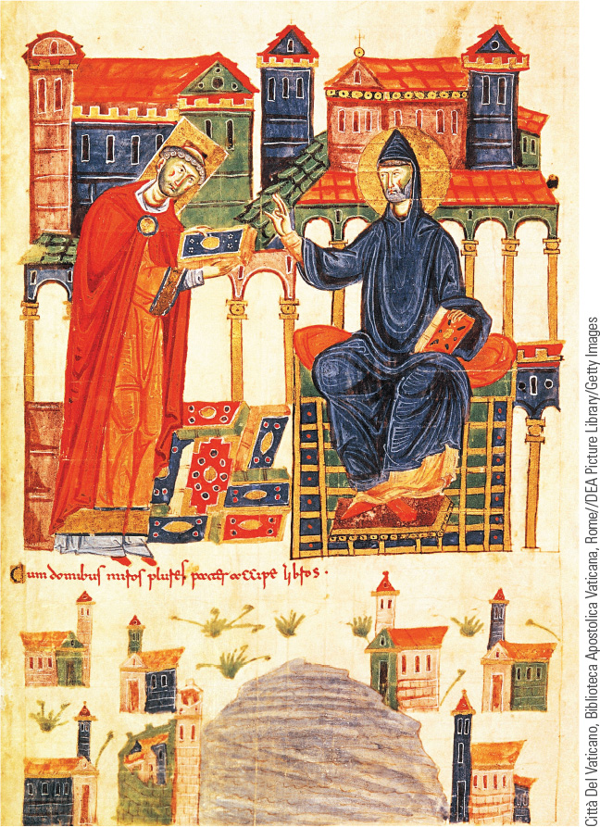
7.3 Saint Benedict. Benedict was the author of a set of rules that was instrumental in the development of monastic groups in the Catholic Church.

Slide 19
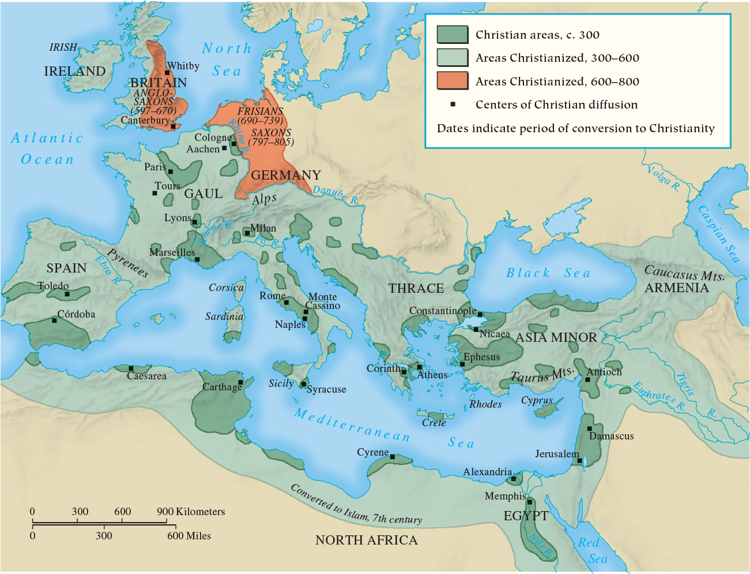
Map 7.3 The Spread of Christianity

Slide 20
7-4 The Byzantine empire (1 of 2)
Focus Question: How did the Byzantine Empire that had emerged by the eighth century differ from the empire of Justinian and from the Germanic kingdoms in the West?
The reign of Justinian
  Goal of reestablishing the empire in the entire Mediterranean, with mixed results
    Contributions in the codification of Roman law
  Life in Constantinople: trade and the emperor’s building program
    Europe’s greatest commercial center until the twelfth century
    Justinian’s addition of new buildings, including the Hagia Sophia

Slide 21
7-4 The Byzantine empire (2 of 2)
From Eastern Roman Empire to Byzantine Empire
  After Justinian: empty treasury and renewed threats
    The challenge of Islam and the Bulgars led to loss of lands
  Result: the Byzantine Empire, both a Greek and a Christian state, with an emperor chosen by God
    Emperors spent much energy on war
    Byzantium served as a buffer state, protecting the West

Slide 22
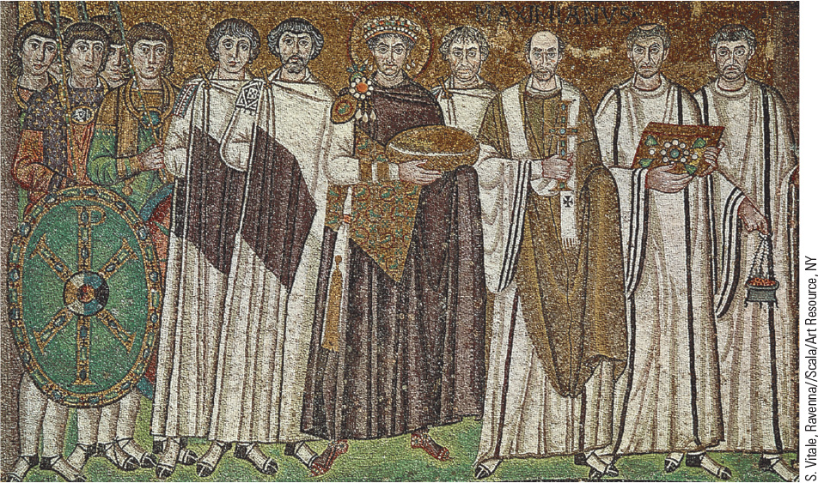
7.5 The Emperor Justinian and His Court. This mosaic shows the emperor as both head of state and head of the church.

Slide 23
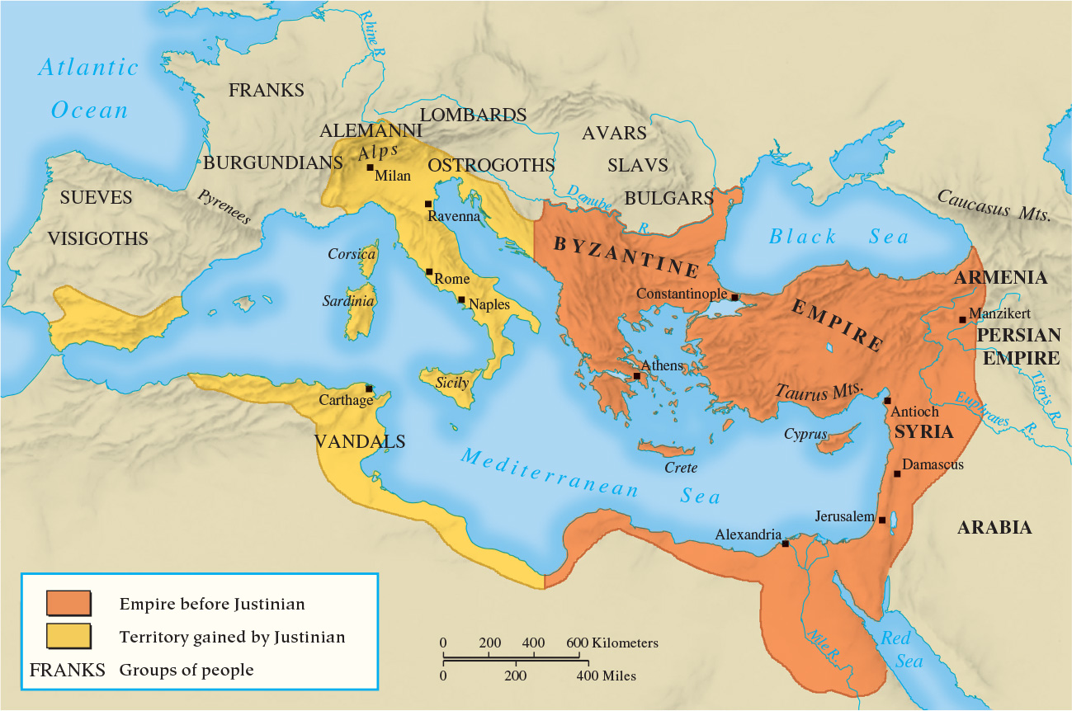
Map 7.4 The Eastern Roman Empire in the Time of Justinian

Slide 24
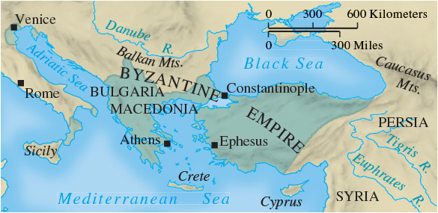
Map 7.5 The Byzantine Empire, ca. 750

Slide 25
7-5 The Rise of Islam (1 of 2)
Focus Question: What was the basic message of Islam, and why was it able to expand so successfully?
The Arabian setting
Muhammad
  Revelations and the Qur’an
  Prophet who became a political and religious leader
The teachings of Islam
  Five Pillars of Islam: belief in Allah and Muhammad as his Prophet; prayer five times a day, public prayer on Friday at midday; fast during Ramadan; hajj to Mecca; and alms to the poor

Slide 26
7-5 The Rise of Islam (2 of 2)
The spread of Islam
  Caliphs and jihad
  Success against the Persian and Byzantine Empires
  Internal dissent: the assassination of Ali
    The Umayyad dynasty
    The Shi’ites
  Faith swept across North Africa and into Europe

Slide 27
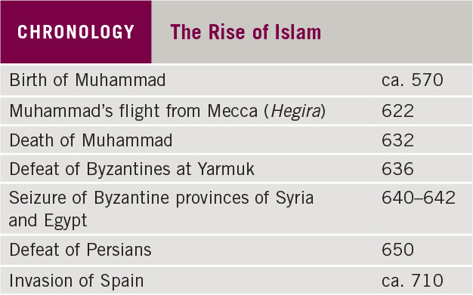
Chronology: The Rise of Islam

Slide 28
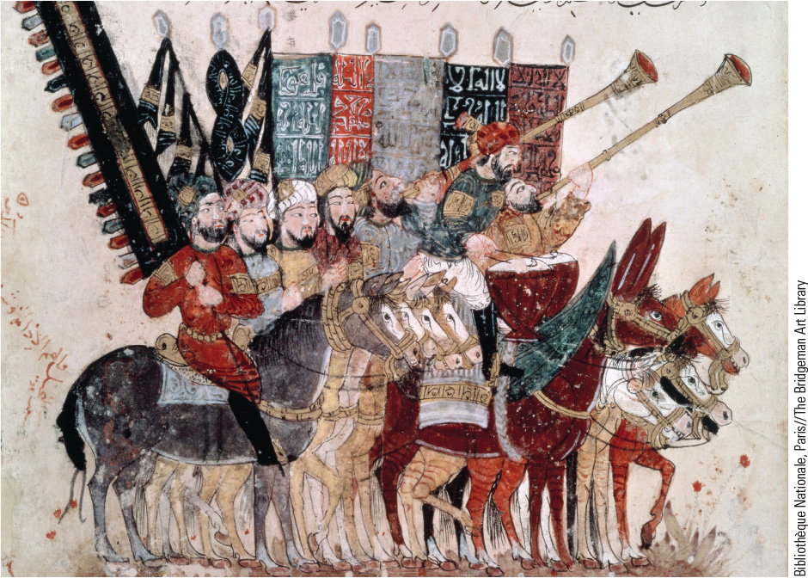
7.7 Muslims Celebrate the End of Ramadan. This Persian miniature depicts Muslims on horseback celebrating the end of the holy month of Islam.

Slide 29
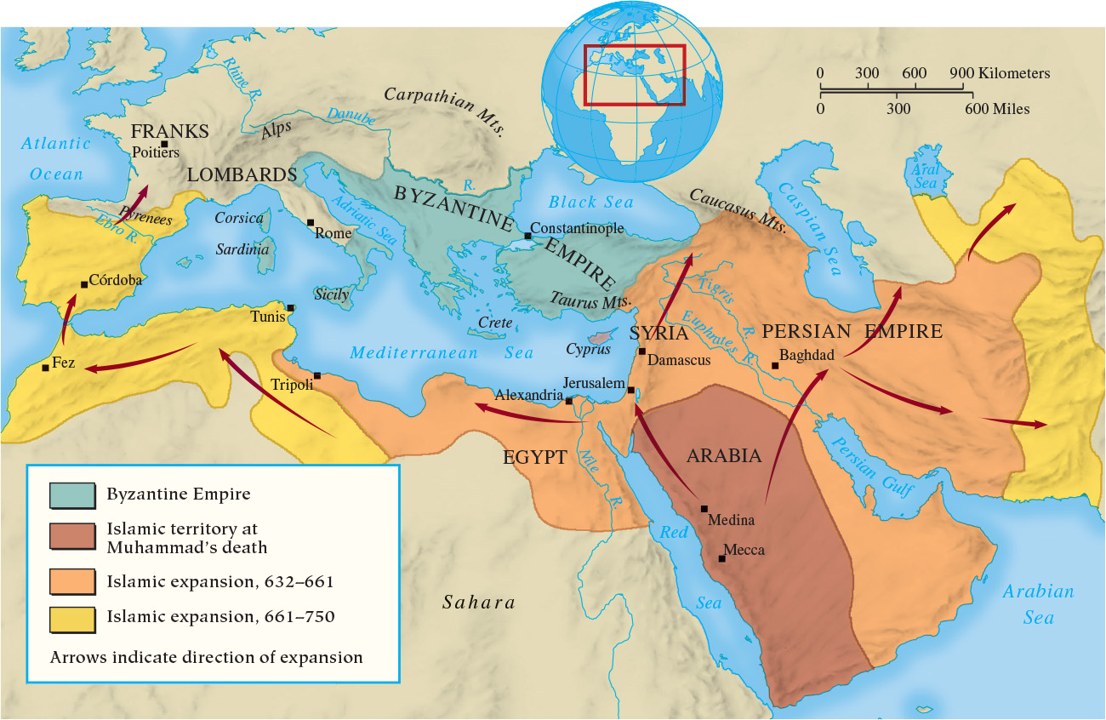
Map 7.6 The Expansion of Islam

Slide 30
Chapter 7 Summary
During late antiquity, the Roman world of the Mediterranean was gradually transformed, and Western part of the empire came under control of Germanic leaders.
The Germanic kingdoms fused Roman and Germanic elements to create a new society.
The Christian church played a crucial role in the development of a new civilization, with an effective organizational and intellectual structure.
The rise of the Byzantine Empire and of Islam transformed the East.

Slide 31
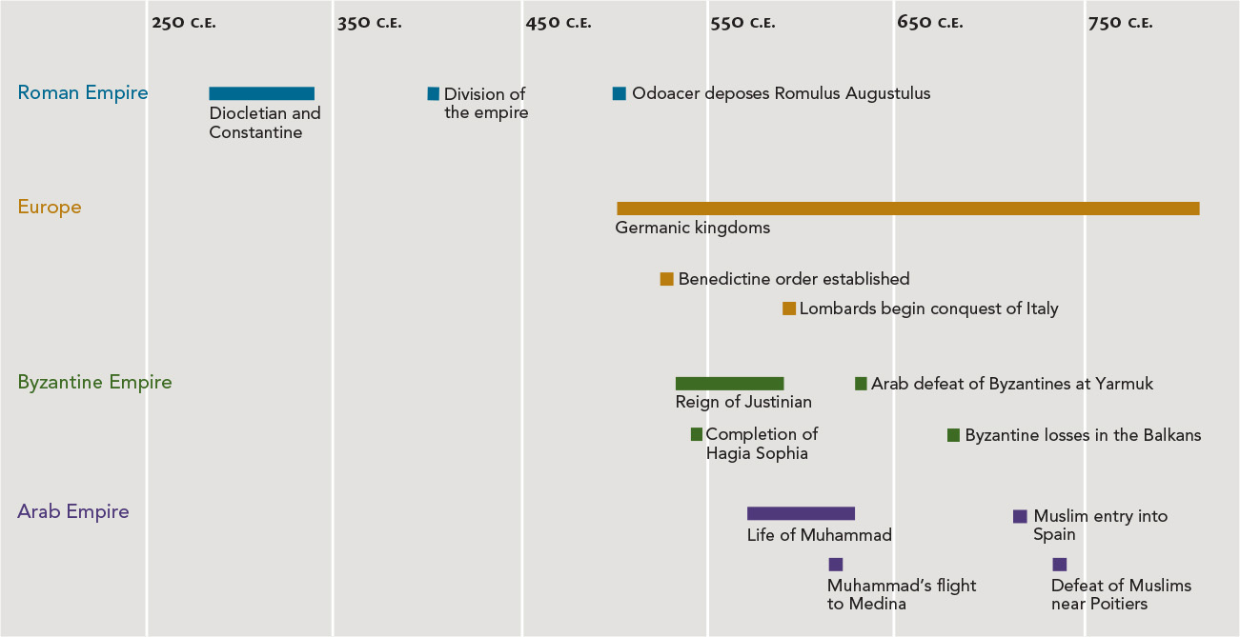
Chapter 7 Timeline

