Slide 1
WESTERN CIVILIZATION: A Brief History
Tenth Edition
CHAPTER 5
The Roman Republic
© 2020 Cengage. All rights reserved.

Slide 2
Chapter 5 Outline
5-1 The Emergence of Rome
5-2 The Roman Republic (ca. 509–264 b.c.e.)
5-3 The Roman Conquest of the Mediterranean
(264–133 b.c.e.)
5-4 Society and Culture in the Roman World
5-5 The Decline and Fall of the Roman Republic (133–31 b.c.e.)

Slide 3
5-1 The Emergence of Rome
Focus Question: What impact did geography have on the history of Rome, and what influence did the Greeks and Etruscans have on early Roman history?
Roman geography
  Peninsula with large fertile plains for farming
  Rome: defensible and inland, but with access to sea
The Greeks in Italy
  Early colonization and Greek influence
Who were the Etruscans?
  Debate: uncertain origins
Early Rome
  Rome was the Etruscans’ most enduring product

Slide 4
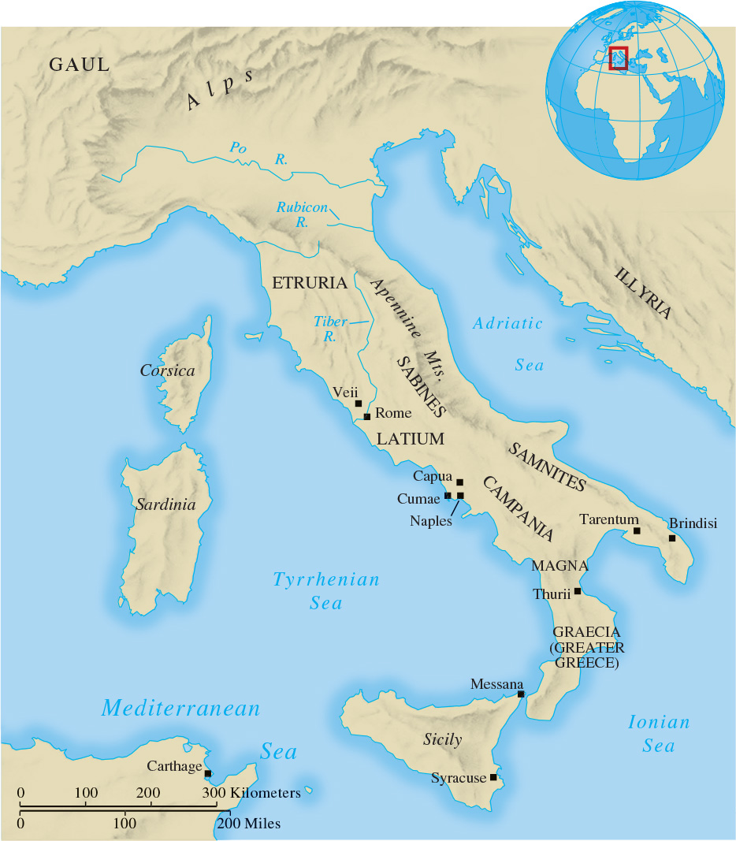
Map 5.1 Ancient Italy

Slide 5
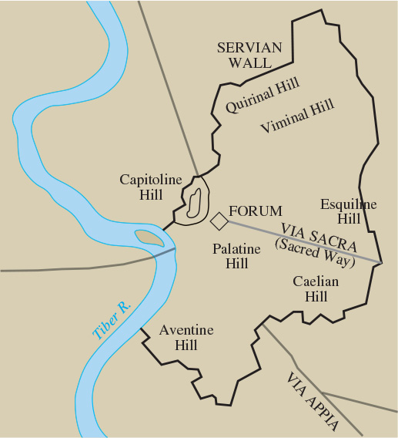
Map 5.2 The City of Rome

Slide 6
5-2 The Roman Republic (ca. 509–264 b.c.e.)
(1 of 2)
Focus Question: What were the major political institutions of the Roman republic, and what policies and institutions help explain the Romans’ success in conquering Italy?
The Roman state
  Political institutions and officials
    Consuls and praetors, chief executive officers, with imperium
    Administrative officials: quaestors and aediles
    Roman senate: council of elders
    Centuriate assembly, the army functioning in its political role

Slide 7
5-2 The Roman Republic (ca. 509–264 b.c.e.)
(2 of 2)
The struggle of the orders: social divisions within the Roman Republic
  Patricians (aristocratic governing class) and plebeians, who struggled for political and social equality
    Plebeian gains: tribunes of the plebs and council of the plebs: plebiscita
    The compromises did not result in democracy
The Roman conquest of Italy
  By 338 b.c.e., Rome had crushed the Latin states
  By 264 b.c.e., Rome controlled all but the extreme north
    The establishment of the Roman Confederation

Slide 8
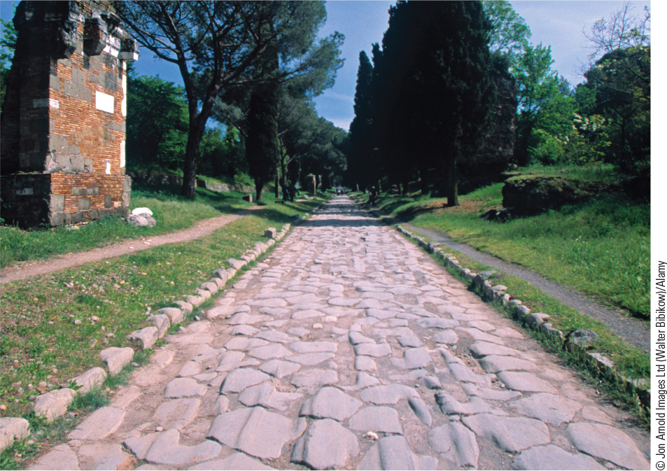
5.3 Roman Roads in Italy. By building roads the Romans created an impressive military and communications network that enabled them to rule effectively and efficiently.

Slide 9
5-3 The Roman Conquest of the Mediterranean (264–133 b.c.e.) (1 of 2)
Focus Question: How did Rome achieve its empire from 264 to 133 b.c.e., and what is meant by the phrase Roman imperialism?
The struggle with Carthage
  Hannibal and the Second Punic War
    Rome’s victory made it the dominant power in the western Mediterranean
  The destruction of Carthage

Slide 10
5-3 The Roman Conquest of the Mediterranean (264–133 b.c.e.) (2 of 2)
The eastern Mediterranean
  Macedonian and Seleucid support of the Greeks led to conflict with Rome
The nature of Roman imperialism
  Expansion in response to perceived threats
  Success brought growing arrogance and brutality
Evolution of the Roman army
  A citizen army led by magistrates

Slide 11
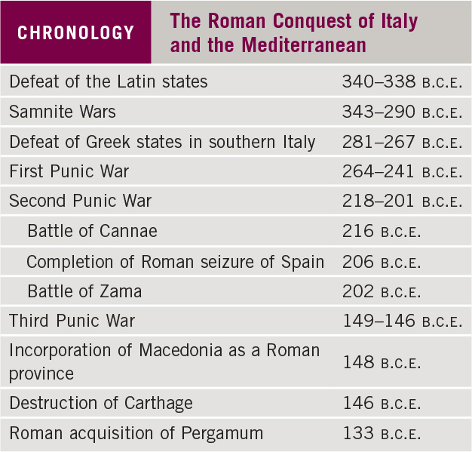
Chronology: The Roman Conquest of Italy and the Mediterranean

Slide 12
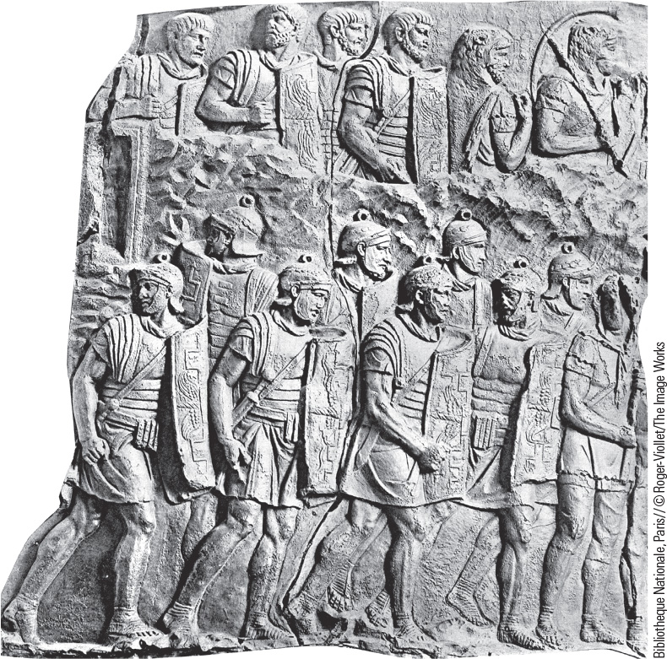
5.4b Roman Legionaries. Roman legionaries, famed for their courage and tenacity, made possible Roman domination of the Mediterranean Sea.

Slide 13
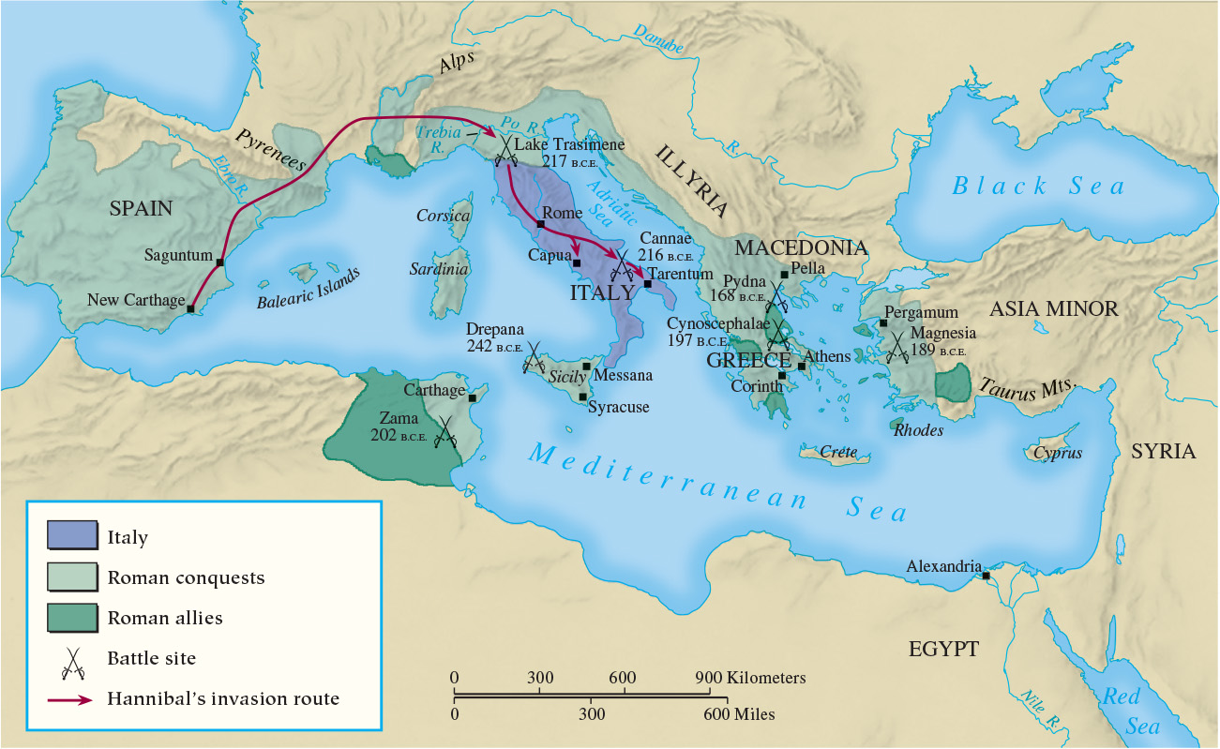
Map 5.4 Roman Conquests in the Mediterranean,
264–133 B.C.E.

Slide 14
5-4 society and culture in the roman world
(1 of 3)
Focus Question: How did the acquisition of an empire affect Roman social and economic institutions, values and attitudes, and art and literature?
The importance of Greek models
Roman religion
  Pantheon of gods and goddesses: Greco-Roman
  Performance of ritual crucial to establishing a right relationship with the gods
    The responsibilities of the paterfamilias
  Importance of religious festivals

Slide 15
5-4 society and culture in the roman world
(2 of 3)
The growth of slavery
  Roman conquests and foreign slaves
  Reliance on slave labor
    Latifundia and farm labor
    Treatment and slave revolts
The Roman family
  The male head of the family ruled virtually a small state
  The place of women in the Roman family
The evolution of Roman law
  Civil law derived from the Twelve Tables, corrected and added to by the praetors

Slide 16
5-4 society and culture in the roman world
(3 of 3)
The development of literature
  Strongly influenced by Greek styles
  New poetry and Roman prose
Roman art
  Dependent on Greeks for inspiration
  Roman excellence in architecture
Values and attitudes
  Conservative values
  Shift away from collective well-being to individualism

Slide 17
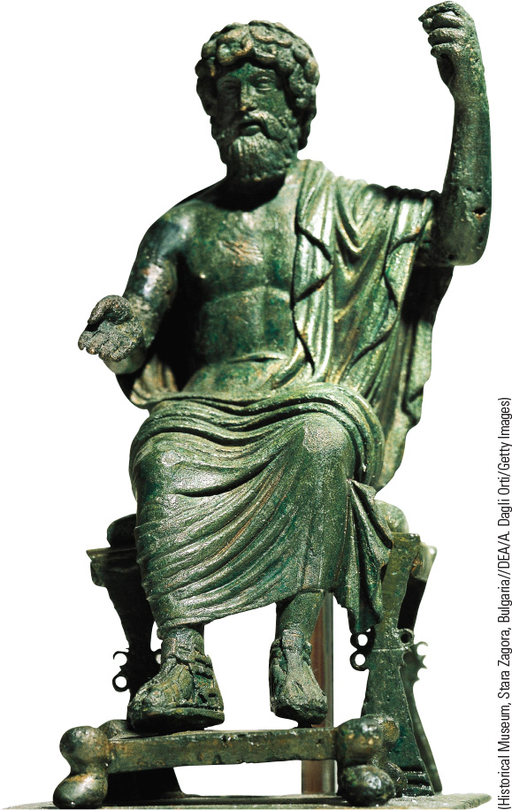
5.5 Roman Religion.
Statues of Jupiter, such as this one from the second century C.E., were found in major Roman temples.

Slide 18
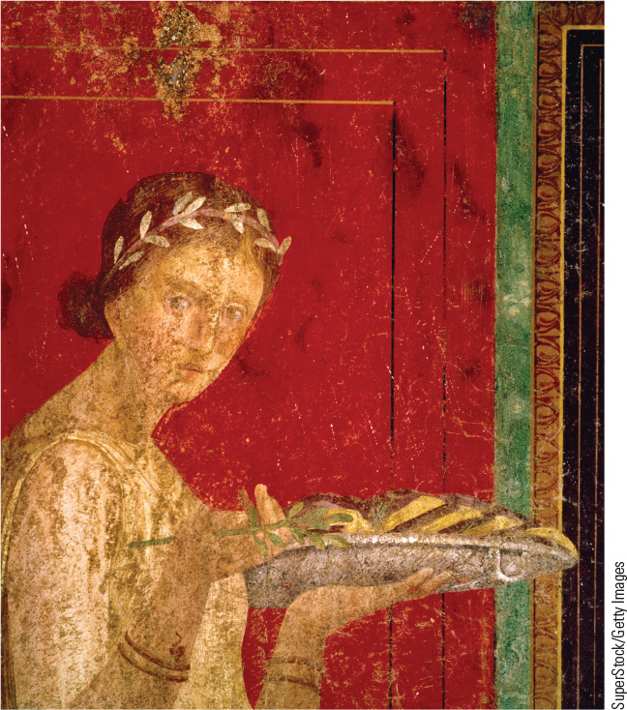
5.6 A Roman Woman. Roman women, especially those of the upper class, had comparatively more freedom than women in classical Athens.

Slide 19
5-5 The Decline and Fall of the Roman Republic (133–31 b.c.e.) (1 of 2)
Focus Question: What were the main problems Rome faced during the last century of the republic, and how were they ultimately resolved?
Background: social, economic, and political problems
  Magistracies and senate controlled by the nobiles
  Optimates versus populares
  The position of the small farmers
  Capitalistic agriculture and its consequences
The reforms of Tiberius and Gaius Gracchus
  The attempts to distribute land to small farmers
  The appeal to the equestrian order

Slide 20
5-5 The Decline and Fall of the Roman Republic (133–31 b.c.e.) (2 of 2)
A new role for the Roman army: Marius and Sulla
  Military setbacks and the admittance of volunteers
  Use of army by generals to seize power
The death of the republic
  Jostling for power and civil war
  Crassus, Pompey, and Julius Caesar: the First Triumvirate
  The dictatorship and assassination of Caesar, 44 b.c.e.
  The struggle between Octavian and Antony
    Octavian’s victory at Actium, 31 b.c.e.

Slide 21
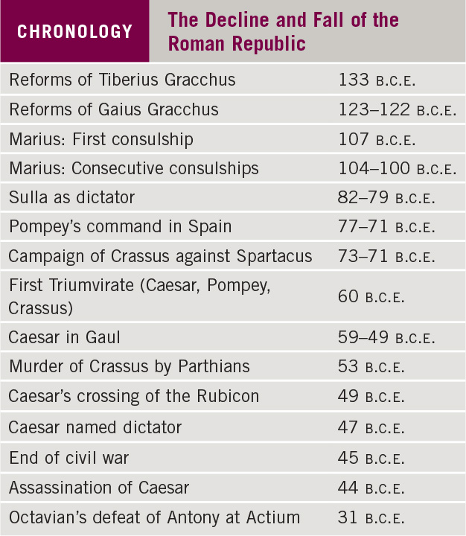
Chronology: The Decline and Fall of the Roman Republic

Slide 22
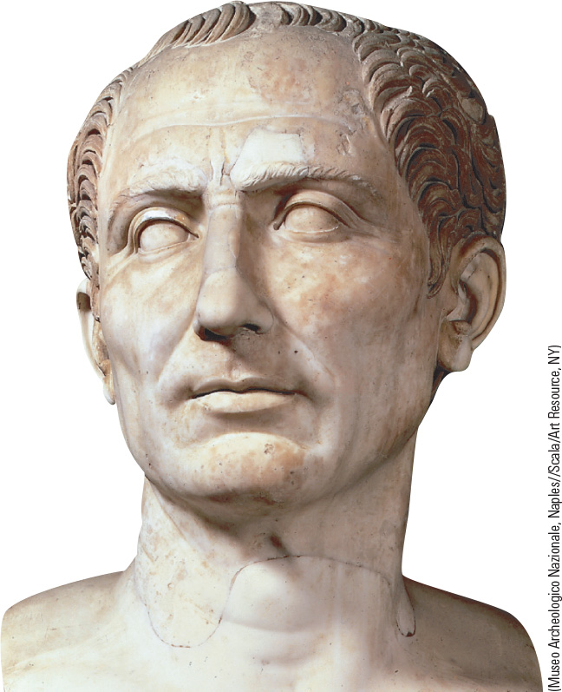
5.7 Caesar. Julius Caesar became dictator for life, but he was assassinated by members of the senate.

Slide 23
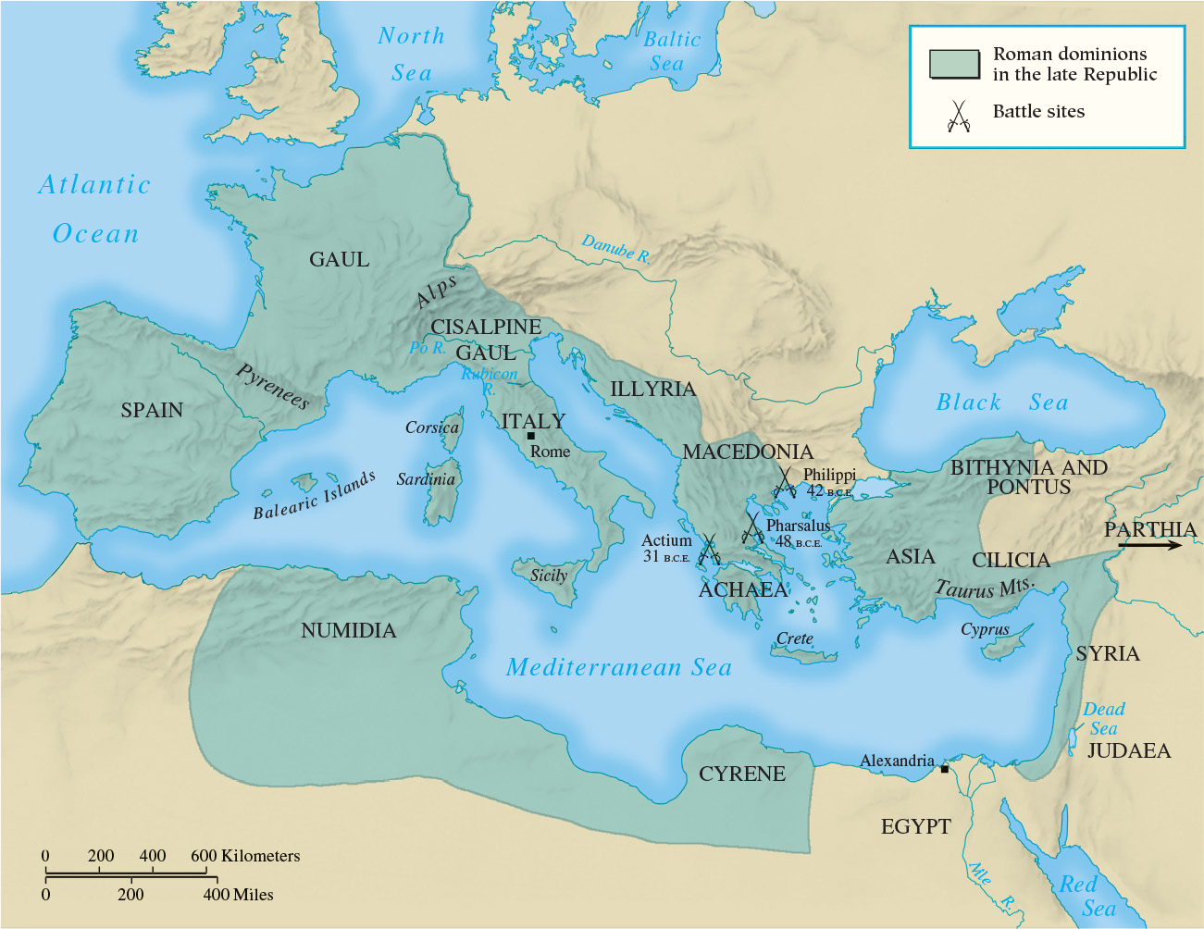
Map 5.5 Roman Dominions in the Late Republic, 31 B.C.E.

Slide 24
Chapter 5 Summary
After a period of domination by the Etruscans, Rome expanded and united almost all of Italy under its control between 509 and 264 b.c.e.
Rome developed the political institutions of a republic ruled by an aristocratic oligarchy and defeated leading rival Carthage and its allies.
Roman culture largely followed Greek models.
After 133 b.c.e., Rome’s republican institutions proved inadequate for the task of ruling an empire, and political competition and violence increased, leading to the decline of the republic.

Slide 25
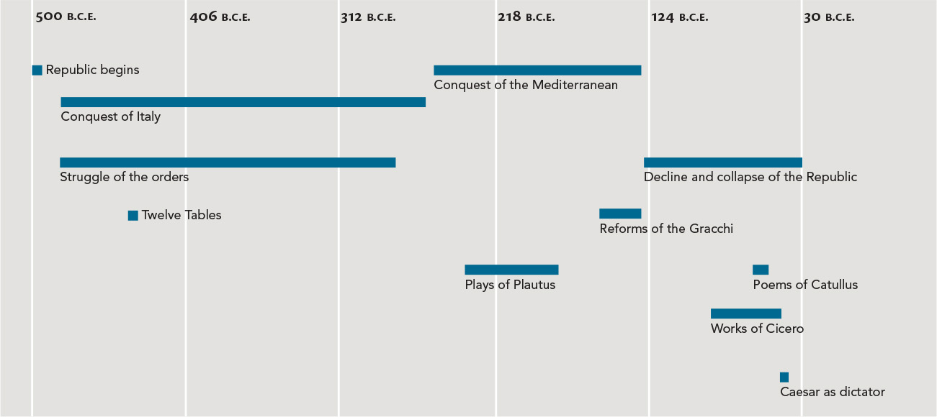
Chapter 5 Timeline

