Slide 1
WESTERN CIVILIZATION: A Brief History
Tenth Edition
CHAPTER 4
The Hellenistic World
© 2020 Cengage. All rights reserved.

Slide 2
Chapter 4 Outline
4-1 Macedonia and the Conquests of Alexander
4-2 The World of the Hellenistic Kingdoms
4-3 Culture in the Hellenistic World
4-4 Religion in the Hellenistic World

Slide 3
4-1 Macedonia and the conquests of alexander (1 of 2)
Focus Question: How was Alexander able to amass his empire, and what might his rule have been like if he had lived longer?
Macedonia became the chief power in the Greek world by King Philip II’s reign (359–336 b.c.e.)
  Philip’s military reforms and their consequences
    New phalanx with light swords and smaller shields
    Infantrymen with longer spears
    Led to a strengthened bond between army and leaders
Philip and the conquest of Greece
  The end of the independent polis, 338 b.c.e.

Slide 4
4-1 Macedonia and the conquests of alexander (2 of 2)
Alexander the Great
  Ascended to the throne after Philip’s assassination at age 20 but well prepared
The conquests of Alexander
  The defeat of the Persian Empire
  The extensive conquests: from Asia Minor, Syria, Palestine, and Egypt to northwestern India
The legacy: was Alexander Great?
  The character of the king
  Debate: military brilliance and promotion of Greek culture vs. ruthless, selfish autocratic aspirations

Slide 5
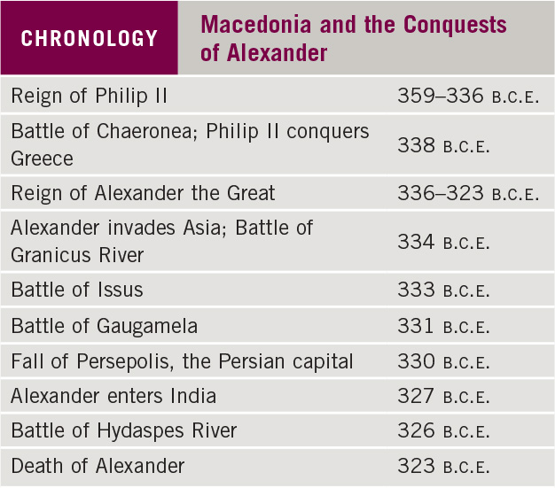
Chronology: Macedonia and the Conquests of Alexander

Slide 6
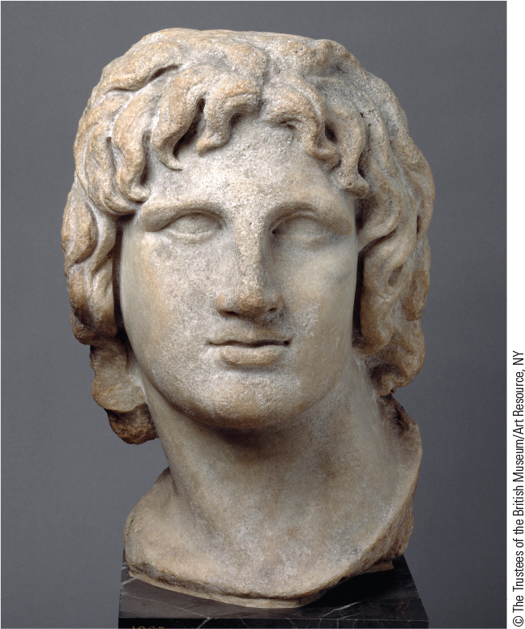
4.2 Alexander the Great. This portrait of Alexander, dated second or first century B.C.E., shows a youthful and even godlike appearance.

Slide 7
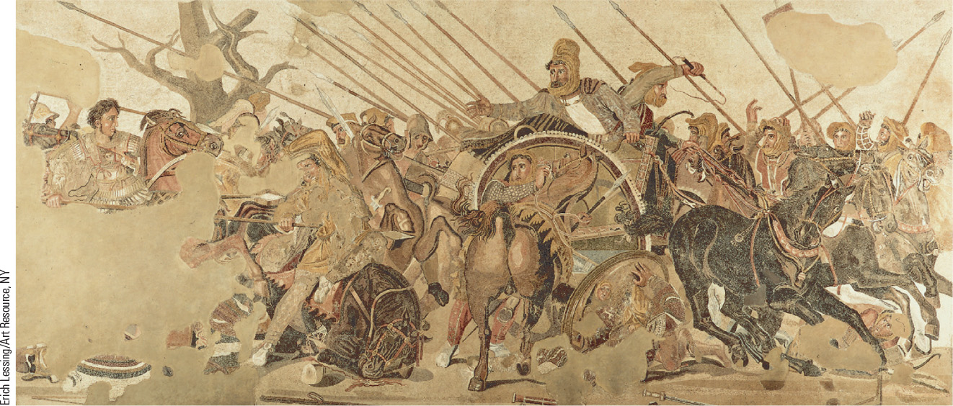
4.3 Alexander and Darius at the Battle of Issus. This mosaic depicts Alexander’s battle with the Persian king.

Slide 8
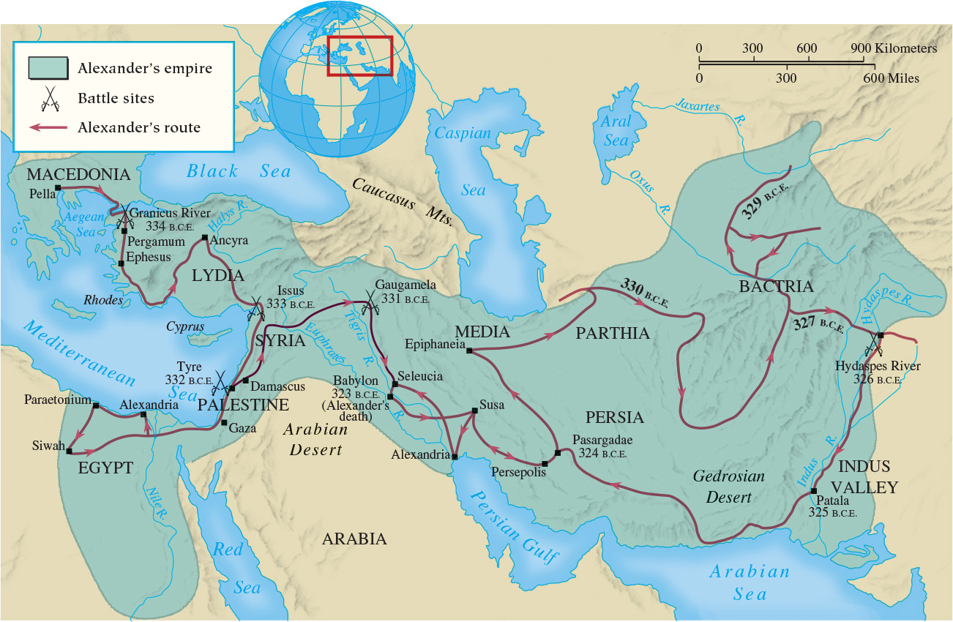
Map 4.1 The Conquests of Alexander the Great

Slide 9
4-2 The world of the Hellenistic kingdoms
(1 of 3)
Focus Questions: What were the main features of the political and military organization of the Hellenistic kingdoms, and how did the new political systems differ from those of the Greek city-states? What were the main social developments in the Hellenistic world?
Hellenistic monarchies that blended the achievements of the Eastern world with the cultural outlook and attitudes
of the Greeks
  Antigonid dynasty of Macendonia
  Ptolemaic dynasty of Egypt
  Pergamene dynasty of Asia Minor
  Seleucid dynasty of Syria

Slide 10
4-2 The world of the Hellenistic kingdoms
(2 of 3)
The threat from the Celts
  Sack of Rome, 390 b.c.e.
  Attacks on Macedonia and Greece, early third century b.c.e.
  Attack on Asia Minor; defeated in 230 b.c.e.
Political and military institutions
  Tensions between Macedonia and Greek practices
    Monarchy, while retaining democratic government in cities
  Phalanx and cavalry continue with addition of war elephants

Slide 11
4-2 The world of the Hellenistic kingdoms
(3 of 3)
Hellenistic cities
  Urban centers with primarily Greek culture and political institutions
Economic trends in the Hellenistic world
  Continued agrarian patterns with expanded commerce
New opportunities for women
  Upper-class women enjoyed some opportunities
    Management of slaves and property, the ability to make loans
    Education in literature, arts, music, and athletics
    The roles of monarchs’ wives

Slide 12
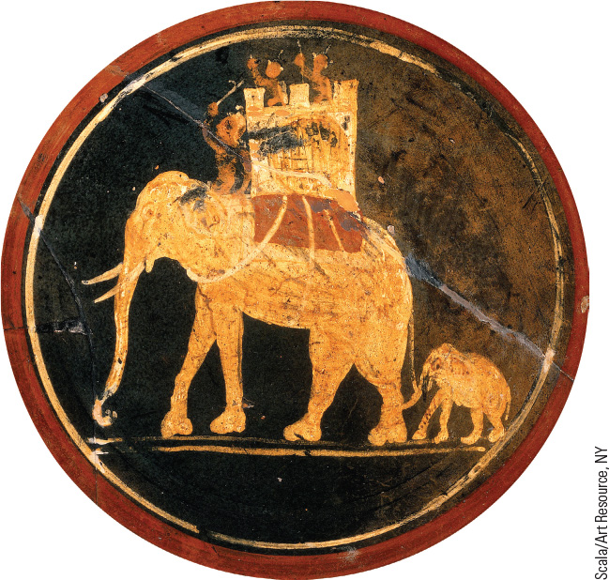
4.4 Greek War Elephants. Some of the armies in the Hellenistic world made use of elephants obtained from North Africa and India.

Slide 13
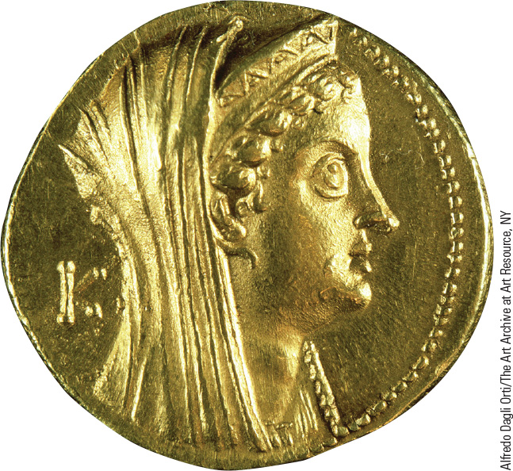
4.5 Queen Arsinoë II. Hellenistic queen Arsinoë II, sister and wife of King Ptolemy II, played an active role in Egyptian political affairs.

Slide 14
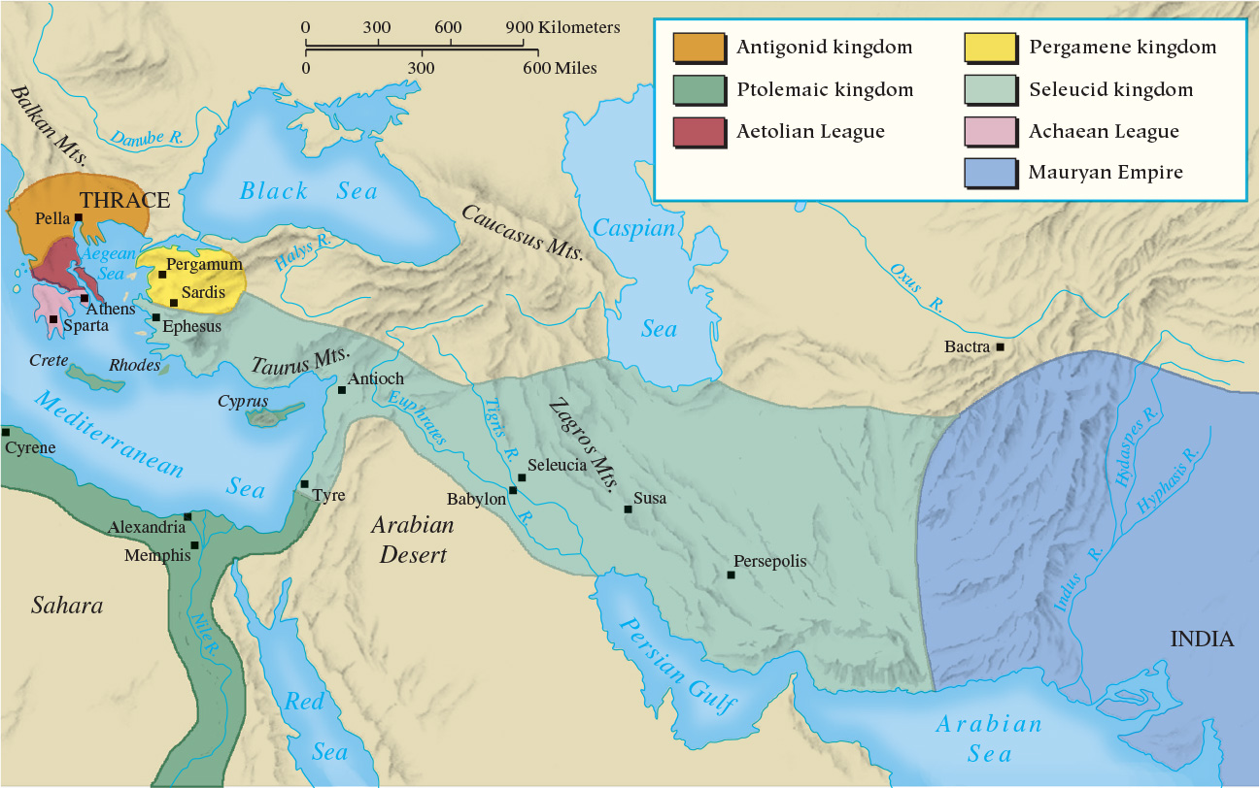
Map 4.2 The Hellenistic Kingdoms

Slide 15
4-3 Culture in the Hellenistic World
(1 of 2)
Focus Question: What achievements in literature, art, science, and philosophy occurred during the Hellenistic period?
New directions in literature
  Monarchs subsidized writers
  An outpouring of historical and biographical literature
Hellenistic art
  Shift from idealism of fifth-century classicism to more emotional and realistic art

Slide 16
4-3 Culture in the Hellenistic World
(2 of 2)
A golden age of science
  Conscious separation of science and philosophy
  Astronomy: heliocentric view
  Geometry: Euclid’s Elements and the work of Archimedes
Philosophy: new schools of thought
  Epicureanism: happiness and the pursuit of pleasure
  Stoicism: happiness and virtue
  The appeal of Epicureanism and Stoicism

Slide 17
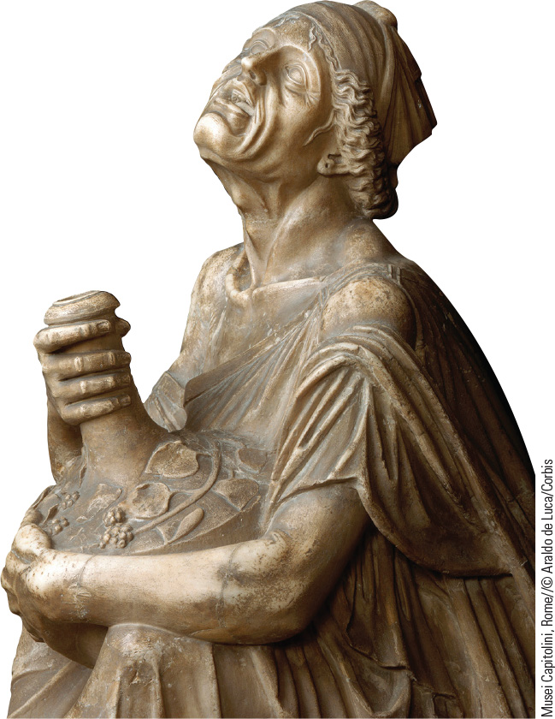
4.6 Drunken Old Woman. This statue of a drunken old woman demonstrates the trend away from depicting ideal beauty in art toward greater realism.

Slide 18
4-4 Religion in the Hellenistic world
Focus Question: Which religions were prominent during the Hellenistic period, and what does their popularity suggest about Hellenistic society?
Mystery religions
  Decline in the traditional Greek Olympian religion
  The path to salvation
  Receptivity to numerous religions of the eastern world
Jews in the Hellenistic world
  Syncretism
  Maintenance of own laws and judicial system

Slide 19
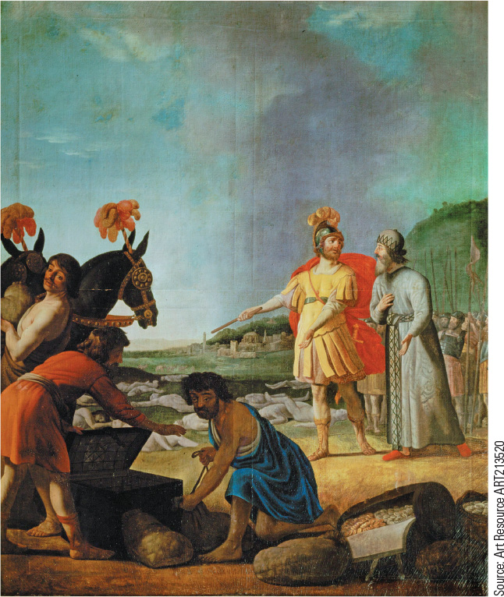
4.8 The Victory of Judas Maccabeus. In this painting by seventeenth- century Dutch artist Gerrit van Honthorst, Judas (in yellow) is seen after his victory over Nicator, but in seventeenth-century garb.

Slide 20
Chapter 4 Summary
Under King Philip II, the Macedonians undertook military reforms, defeated a Greek allied army in 338 b.c.e., and then consolidated their control over the Greek peninsula.
Alexander’s conquests created a massive empire, but he died before he could consolidate its administration.
After Alexander’s death the emergence of the Hellenistic kingdoms helped spread Greek culture, particularly in flourishing cities.
The Hellenistic world saw new cultural achievements in art, science, and philosophy as well as new religions.

Slide 21
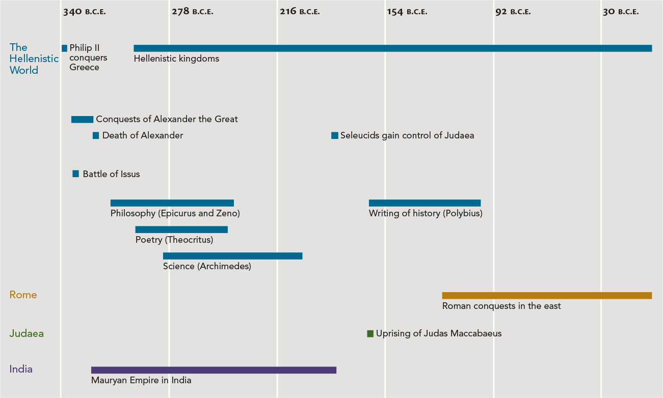
Chapter 4 Timeline

