Slide 1
WESTERN CIVILIZATION: A Brief History
Tenth Edition
CHAPTER 3
The Civilization of the Greeks
© 2020 Cengage. All rights reserved.

Slide 2
Chapter 3 Outline
3-1 Early Greece
3-2 The Greeks in a “Dark Age” (ca. 1100–ca. 750 b.c.e.)
3-3 The World of the Greek City-States (ca. 750–ca. 500 b.c.e.)
3-4 The High Point of Greek Civilization: Classical Greece
3-5 The Culture and Society of Classical Greece

Slide 3
3-1 Early Greece (1 of 2)
Focus Question: How did the geography of Greece affect Greek history?
The geography of Greece
  Mountainous terrain: separated independent Greek communities from one another
  Long seacoast: enabled contact with outside world and the later establishment of colonies
Minoan Crete
  A Bronze Age civilization that used metals in making weapons
  Established by 2800 b.c.e.
  Not Greek in language or religion

Slide 4
3-1 Early Greece (2 of 2)
The First Greek State: Mycenae
  Flourished between 1600 and 1100 b.c.e.
  Characterized by warriors who prided themselves on heroic deeds in battle
  The most famous of their supposed military adventures: the battle with Troy, recorded in the epic poetry of Homer
  Invaded from the north by Greek-speaking people; destroyed around 1190 b.c.e.

Slide 5
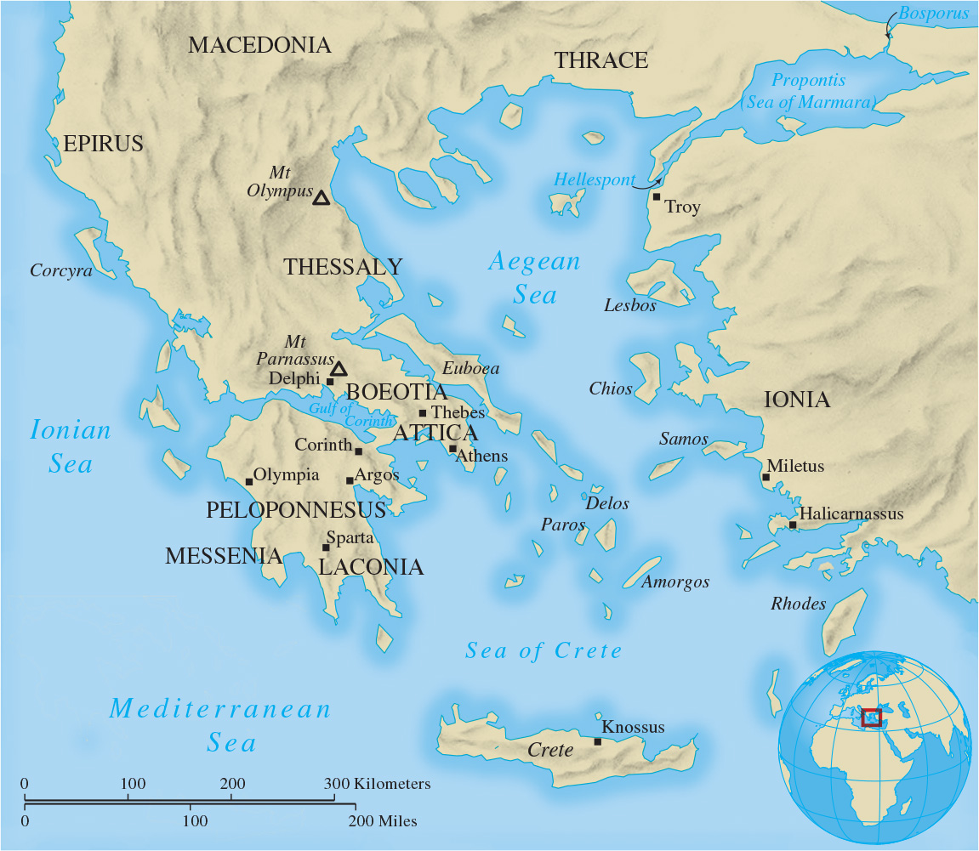
Map 3.1 Ancient Greece (ca. 750–338 B.C.E.)

Slide 6
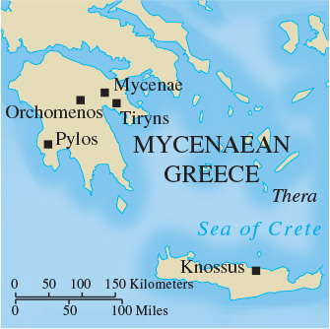
Map 3.2 Minoan Crete and Mycenaean Greece

Slide 7
3-2 The Greeks in a “Dark Age” (ca. 1100–ca.750 b.c.e.) (1 of 2)
Focus Question: Who was Homer, and why was his work used as the basis for Greek education?
The “Dark Age”: population and food production declined; transition from the Bronze Age to the Iron Age
Homer and Homeric Greece
  Illiad
    The tale of the Greek hero Achilles during the Trojan War and how the “wrath of Achilles” led to disaster
  Odyssey
    Epic journey of a Greek hero Odysseus, whose heroism is tested until he prevails by cunning and patience

Slide 8
3-2 The Greeks in a “Dark Age” (ca. 1100–ca.750 b.c.e.) (2 of 2)
Homer’s enduring importance
  The Iliad and the Odyssey were regarded as authentic history and created an idealized past
  Used as standard texts for the education of generations of Greek males’ striving for excellence, called arete
  In the Homeric world, aristocratic women were expected to pursue excellence

Slide 9
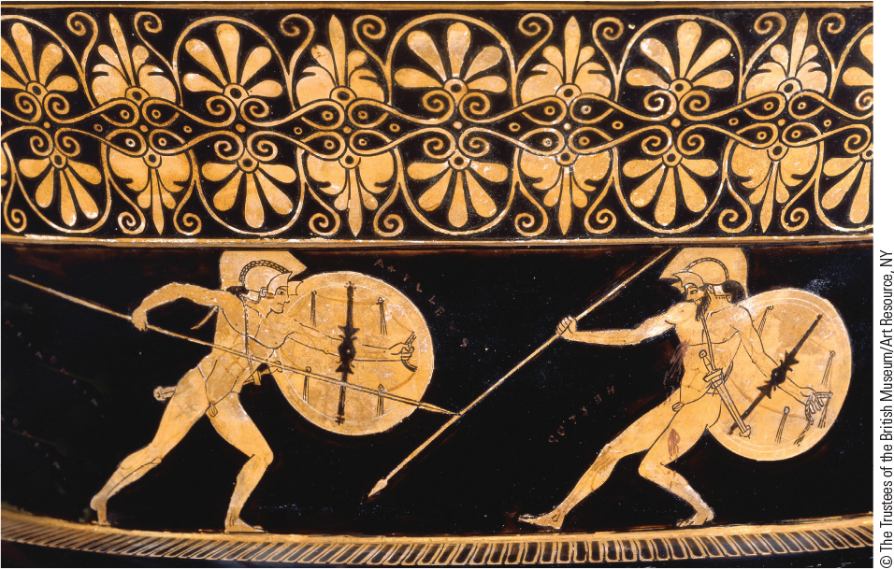
3.2 The Slaying of Hector. This vase depicts the final battle between Greek hero Achilles and Trojan hero Hector.

Slide 10
3-3 The world of the Greek city-states (ca. 750–ca. 500 b.c.e.) (1 of 4)
Focus Question: What were the chief features of the polis, or city-state, and how did the major city-states of Athens and Sparta differ?
The polis
  The central institution in Greek life by the eighth century b.c.e.
  The acropolis: the central point where the citizens of the polis could assemble for political, social, and religious activities
A new military system: the Greek way of war
  Hoplites: heavily armed infantrymen
  Phalanx: rectangular fighting formation
  The connections to the rise of democracy in Greece

Slide 11
3-3 The world of the Greek city-states (ca. 750–ca. 500 b.c.e.) (2 of 4)
Greek expansion and the growth of trade
  The founding of new Greek settlements, 750–550 b.c.e.
  Colonization led to the spread of Greek culture throughout the Mediterranean basin and to increased trade and industry
Tyranny in the Greek polis
  Tyrants: power by coup d’état
  Oligarchies: domination by aristocratic elites

Slide 12
3-3 The world of the Greek city-states (ca. 750–ca. 500 b.c.e.) (3 of 4)
Sparta
  Conquest of neighbors: perioikoi and helots
  The New Sparta
    The transformation to a military state, sixth century b.c.e., and the Lycurgan Reforms
    The Spartan state: led by two kings and five elected ephors, who oversaw education of youth and the conduct of all citizens
    Domination of the Peloponnesian League

Slide 13
3-3 The world of the Greek city-states (ca. 750–ca. 500 b.c.e.) (4 of 4)
Athens
  The reforms of Solon
    Canceled current land debts and outlawed new laws; freed people who had fallen into slavery for debt
  The reforms of Cleisthenes
    The demes as the unit of political life
Greek culture in the Archaic Age
    The revitalization of cultural life in art

Slide 14
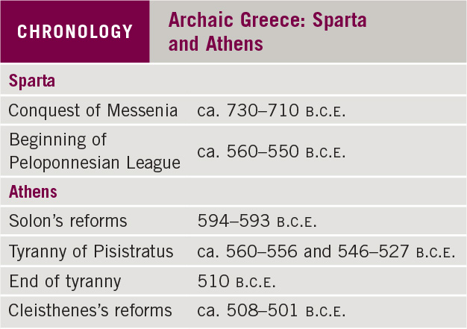
Chronology: Archaic Greece: Sparta and Athens

Slide 15
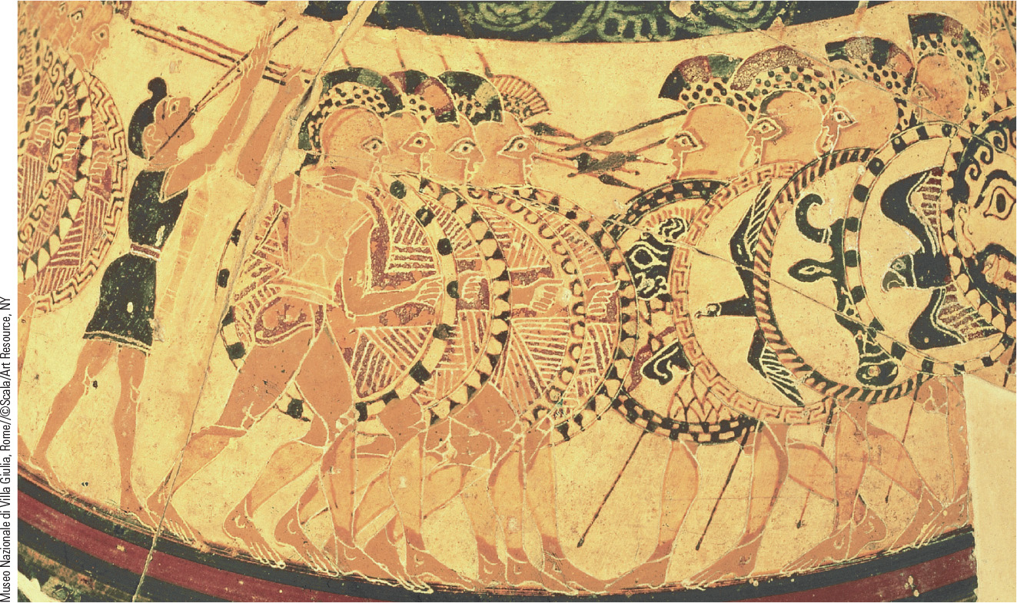
3.3 The Hoplite Forces. This vase shows opposing hoplite forces fighting in tight formation.

Slide 16
3-4 The high point of Greek civilization: classical Greece (1 of 2)
Focus Questions: What did the Greeks mean by democracy, and in what ways was the Athenian political system a democracy? What effect did the two great conflicts of the fifth century b.c.e.—the Persian wars and the Peloponnesian War—have on Greek civilization?
The Challenge of Persia
  Tensions in Asia Minor: the Ionian Greek cities
  The attack of Darius on mainland Greece, 490 b.c.e.
  The invasion of Greece by Xerxes
    Leonides and Themoplyae

Slide 17
3-4 The high point of Greek civilization: classical Greece (2 of 2)
The growth of an Athenian empire in the Age of Pericles
  The growth of democracy: the assembly, the scrutiny of officials, equal rights for citizens
  Athenian domination of the Delian League
The Great Peloponnesian War
  Sparta and its supporters against the Athenian empire
    Athenian surrender, 404 b.c.e.
The decline of the Greek states (404–338 b.c.e.)
  The consequences of weakness and new alliances

Slide 18
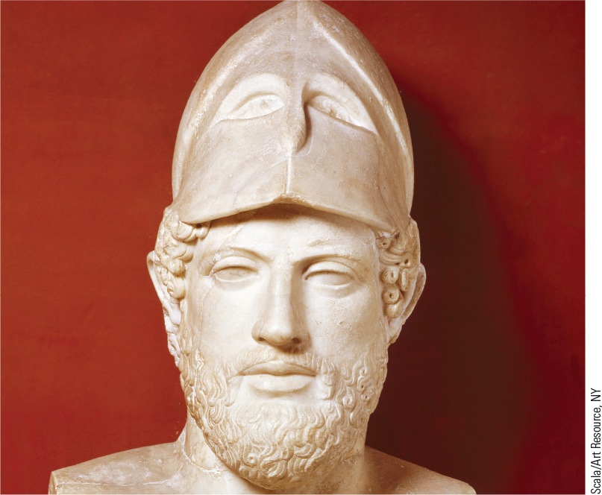
3.1 A Bust of Pericles. Pericles led Athens to new achievements in democracy and empire.

Slide 19
3-5 The Culture and society of classical Greece (1 of 3)
Focus Questions: Upon what ideals was classical Greek art based, and how were these ideals expressed? What questions did the Greek philosophers pose, and what answers did they suggest?
The writing of history
  History, an analysis of past events, as a Greek creation
    The Persian Wars by Herodotus regarded as the first history of Western civilization
    Thucydides: unconcerned with divine forces as causes
Greek drama
  Intended to educate and entertain citizens and supported by the state
  Tragic and comic playwrights and their themes

Slide 20
3-5 The Culture and society of classical Greece (2 of 3)
The arts: the classical ideal
  The influence of the Greek standard: the expression of eternally true ideals
  The precision of architecture and sculpture
Greek love of wisdom—philosophy
  Sophists and rhetoric (persuasive speaking)
  Socrates and the Socratic method
  Plato and ideals: The Republic as the ideal state
  Aristotle: analyzing and classifying

Slide 21
3-5 The Culture and society of classical Greece (3 of 3)
Greek religion
  Intricately connected to all aspects of life
  The social and practical functions of religion
Life in classical Athens
  Economy and lifestyle
    Largely agricultural but highly diversified
    Simple homes and diets
  Family and relationships
    The duty of the family: the production of new citizens
    The function of the Athenian wife

Slide 22
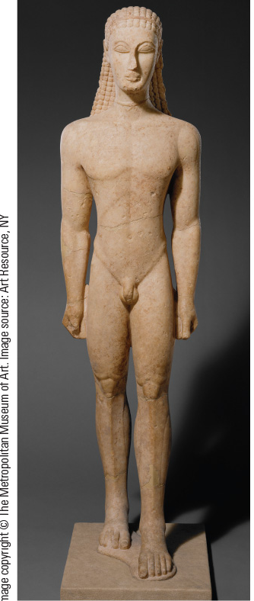
3.4a The Influence of the East on the Greeks. Shown is a statue of a young male nude around 600 B.C.E., making it an early example of Greek kouros sculpture.

Slide 23
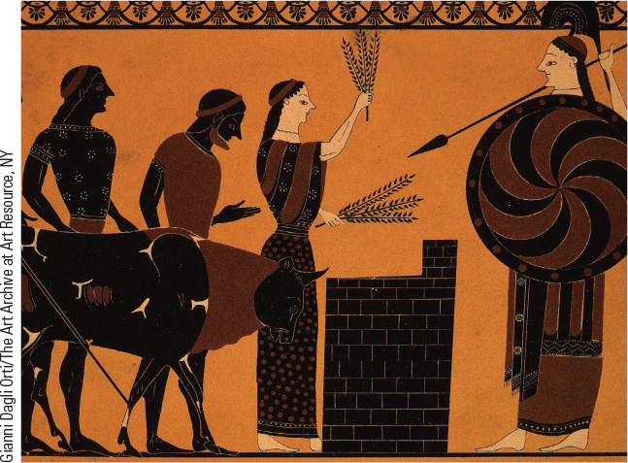
3.8 Athenian Women in Religious Rituals. This illustration indicates that women as priestesses played an important role in public religion.

Slide 24
Chapter 3 Summary
Early Greece was shaped by its geography and by Minoan and Mycenaean civilization.
During the “Dark Age” Homeric ideals influenced the transition of Greek society.
Sparta and Athens represented different types of city-states, emphasizing service to the polis through military and political activity.
The success of Athenian empire in classical Greece led to conflict with Sparta in the Peloponnesian War, which weakened the Greek states.
Many of the ideals of classical Greek culture and society significantly served as the fountainhead of Western civilization.

Slide 25
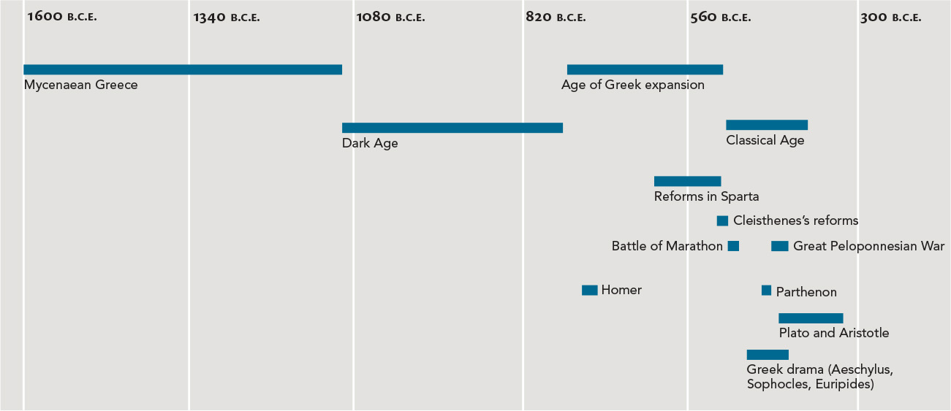
Chapter 3 Timeline

