Slide 1
WESTERN CIVILIZATION: A Brief History
Tenth Edition
CHAPTER 2
The Ancient Near East: Peoples and Empires
© 2020 Cengage. All rights reserved.

Slide 2
Chapter 2 Outline
2-1 On the Fringes of Civilization
2-2 The Hebrews: “The Children of Israel”
2-3 The Assyrian Empire
2-4 The Persian Empire

Slide 3
2-1 On the fringes of civilization (1 of 2)
Focus Question: What is the significance of the Indo-European-speaking peoples?
Significant developments took place on the fringes of Mesopotamia and Egypt
  Late Neolithic Europe, 3200–1500 b.c.e.
    Domesticated animals, farming, and megalithic structures
  The impact of the Indo-Europeans
    Language from a single parent tongue: Greek, Latin, Persian, Sanskrit, Germanic
    The migrations of the Indo-Europeans into Europe, India, and western Asia

Slide 4
2-1 On the fringes of civilization (2 of 2)
The Hittite Empire
  The Hittite migration into Asia Minor and Anatolia
  Suppiluliumas (ca. 1370–1330 b.c.e.) and the establishment of Hittite control from Turkey to Syria
  The first Indo-Europeans to use iron
  Assimilation of other cultures and the transmitting of Mesopotamian culture
  Internal troubles with succession and the attacks of the Sea Peoples led to decline after 1200 b.c.e.

Slide 5
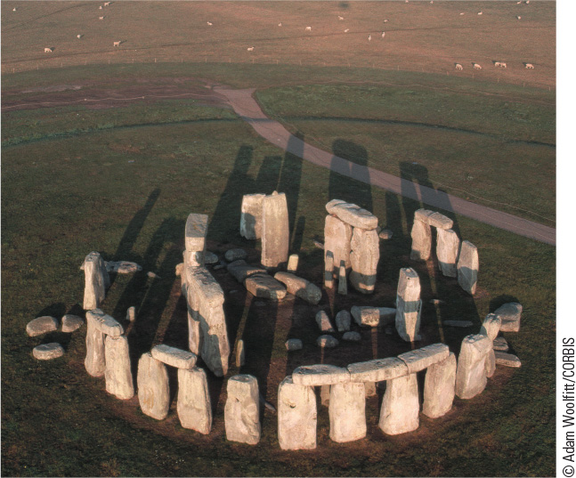
2.2 Stonehenge. This structure in England is the most famous of the megaliths built in northwestern Europe during the Bronze Age.

Slide 6
2-2 The Hebrews: “The Children of Israel”
(1 of 3)
Focus Question: To what extent did the Israelites establish a united state, and what became of it? In what ways was the Jewish faith unique in the ancient Near East, and how did it evolve over time? Who were the neighbors of the Israelites, and what was their significance?
Semitic-speaking people
  Early history and traditions recorded in the Hebrew Bible
    From Abraham to bondage and the Exodus to Canaan
    Scholarly debates over biblical accounts
Israelites emerged as a distinct group of people, possibly organized in tribes or a league of tribes between 1200 and 1000 b.c.e.

Slide 7
2-2 The Hebrews: “The Children of Israel”
(2 of 3)
Was there a United Kingdom of Israel?
  Saul (ca. 1020–1000 b.c.e.) and the Philistines
  Reunification under David (ca. 1000–970 b.c.e.)
  Solomon (ca. 970–930 b.c.e.): strengthening royal power
The kingdoms of Israel (ten northern tribes) and Judah (two southern tribes)
The spiritual dimension: monotheism
  “I Am the Lord Your God”
  “You Only Have I Chosen”: the covenant and the law
  The prophets and rabbis: spiritual leaders emerge in times of crisis

Slide 8
2-2 The Hebrews: “The Children of Israel”
(3 of 3)
The neighbors of the Israelites
  The Philistines
  The Phoenicians
    Cities and trade: purple dye and the cedars of Lebanon
    Navigation and colonies: from the Atlantic and west Africa throughout the Mediterranean
    The development and influence of the Phoenician alphabet, first to the Greeks and then to the Romans

Slide 9
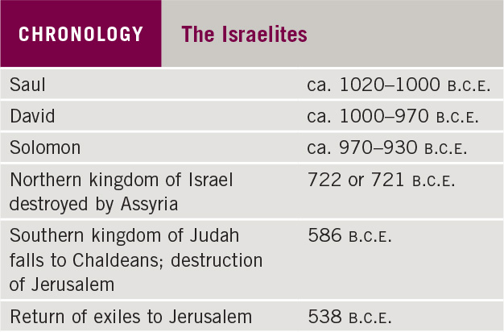
Chronology: The Israelites

Slide 10
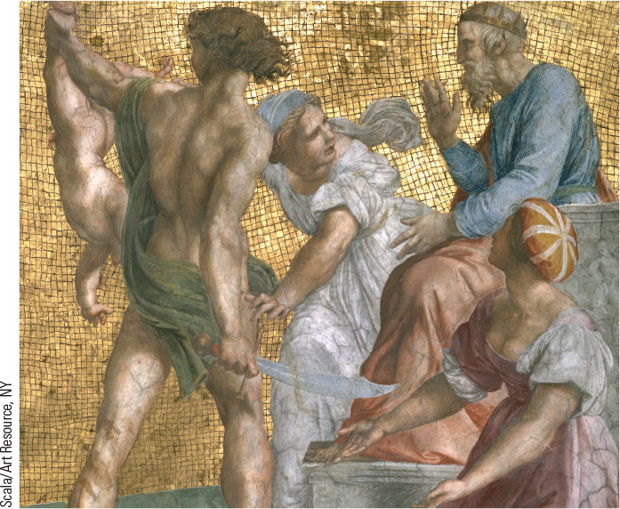
2.1 The Judgment of Solomon as painted by Raphael in the Sixteenth Century. This Renaissance image depicts the famed skill of the Israelite king as a judge.

Slide 11
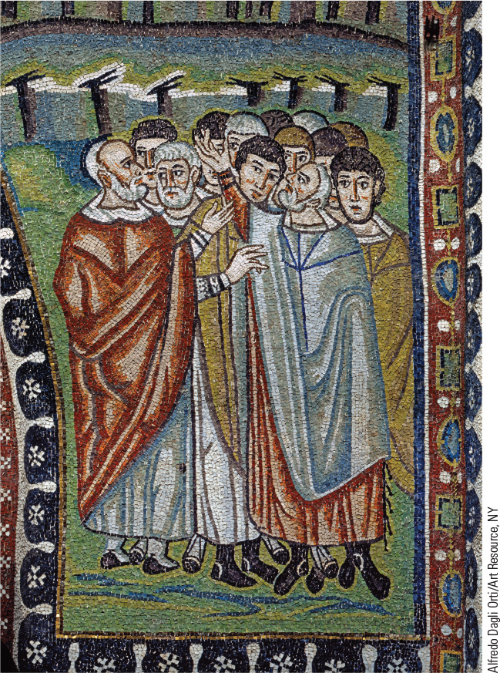
2.4 Moses and the Ten Commandments. This detail from a sixth-century mosaic shows Moses and the Ten Commandments, which created a standard for ethical behavior.

Slide 12
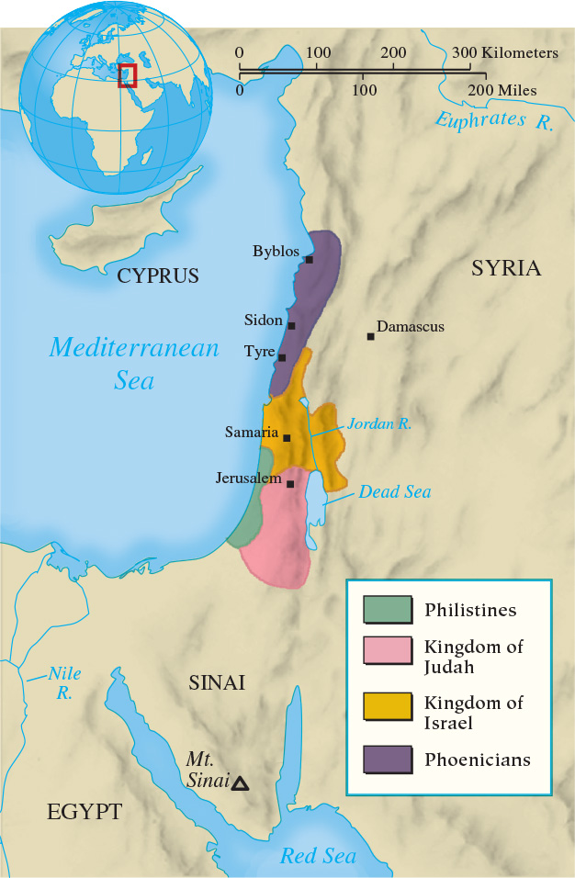
Map 2.1 The Israelites and their Neighbors in the First Millennium B.C.E.

Slide 13
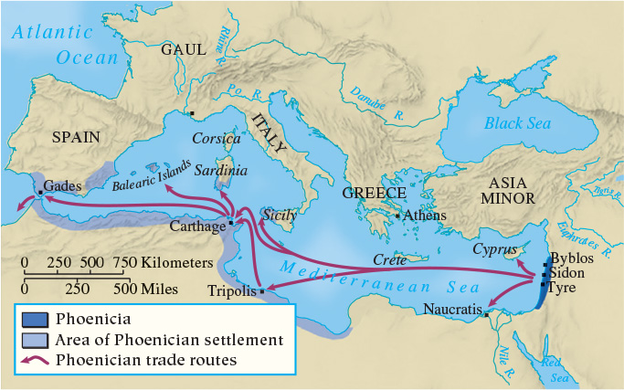
Map 2.2 Phoenician Colonies, Trade Routes, ca. 800 B.C.E.

Slide 14
2-3 The Assyrian Empire (1 of 2)
Focus Question: What methods and institutions did the Assyrians use to amass and maintain their empire?
Organization of the empire
  Kings and local officials
The Assyrian military machine
  Reasons for domination
    Large, disciplined, and well-organized forces
    Advantage through iron weapons and advanced tactics
    Creation of a climate of terror

Slide 15
2-3 The Assyrian Empire (2 of 2)
Assyrian Society
  Deportation of prisoners created a polyglot society
  The cohesive force of religion: “the land of Ashur”
  Hierarchical and patriarchal organization
  Economy based on agriculture and trade
Assyrian Culture
  Assimilation of Mesopotamian culture
    Ashurbanipal and the Library at Ninevah
    Art: relief sculptures in royal palaces

Slide 16
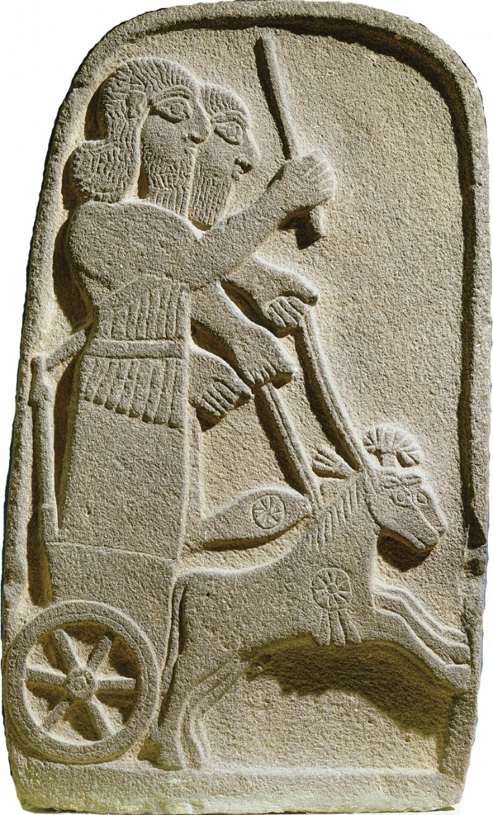
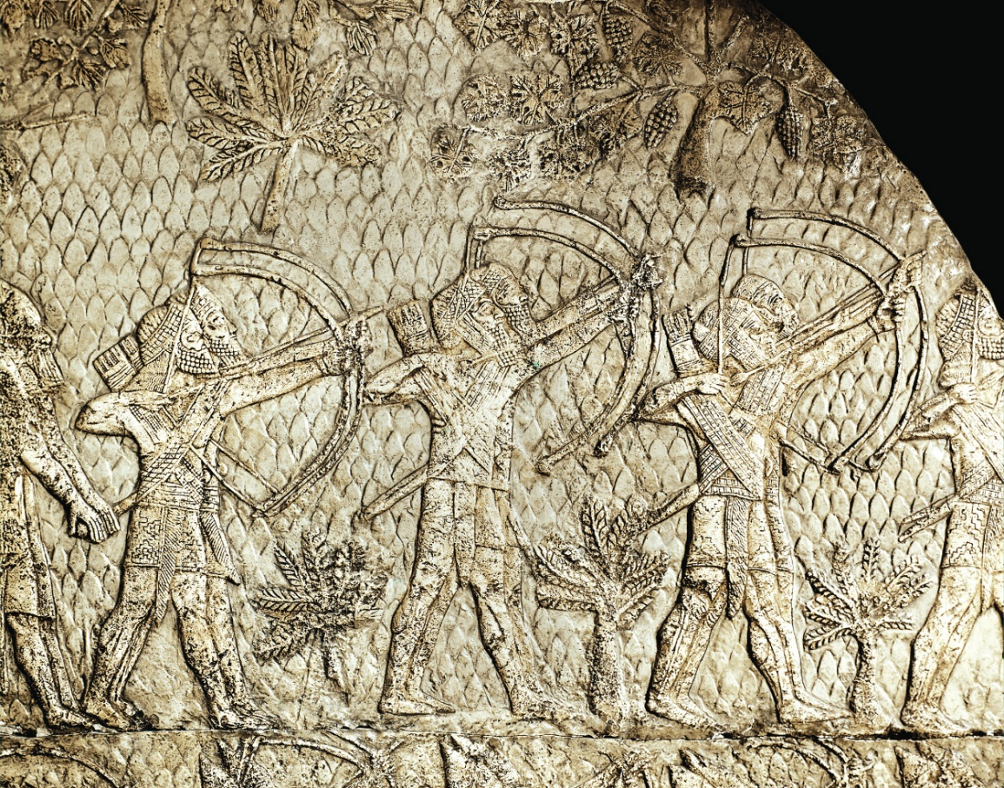
2.5a, 2.5b Assyrian Warriors. These images show Assyrian archers at work during a siege and Assyrian warriors on a chariot.

Slide 17
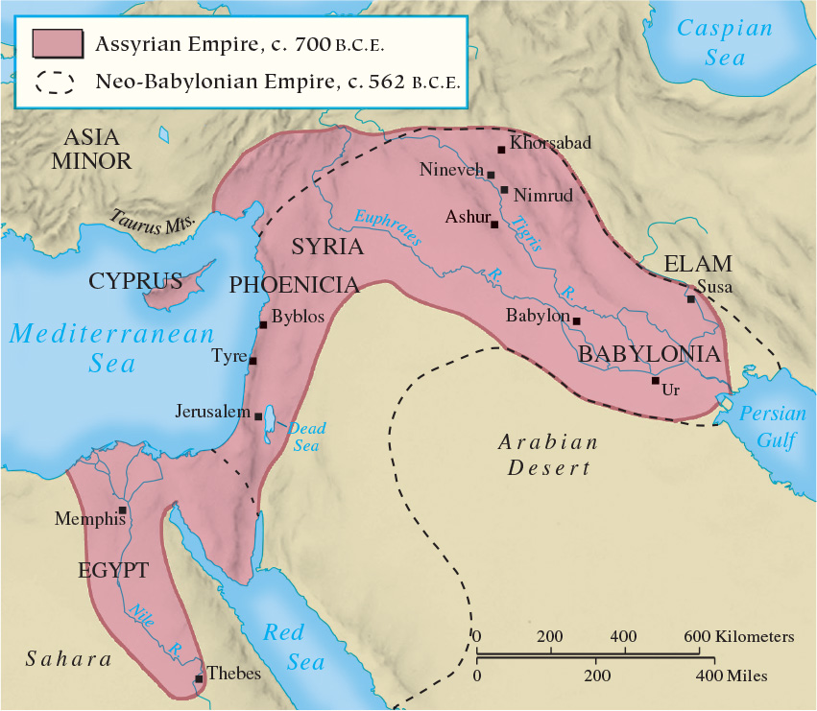
Map 2.3 The Assyrian and Neo-Babylonian Empires

Slide 18
2-4 The Persian Empire (1 of 2)
Focus Question: What methods and institutions did the Persians use to amass and maintain their empire, and how did these methods and institutions differ from those of the Assyrians?
Neo-Babylonian Empire
  Nebuchadnezzar II (605–562 b.c.e.) and Babylon
  Fell to the Persians in 539 B.C.
The origins of the Persians and the Medes
Cyrus the Great (559–530 b.c.e.)
  Media: the first satrapy, or province
  Expanding the empire: Lydia, Greece, western India
  Wisdom and compassion in governing

Slide 19
2-4 The Persian Empire (2 of 2)
Expanding and governing the empire
  “Protector of the kingdom:” satrap
  The system of communication: The Royal Road
The Great King: Darius (521–486 b.c.e.)
  Ruled the largest empire in the world to that point
  Source of all justice
  Palace builder
Imperial decline: weakened by hoarding of wealth/taxation
Persian religion: Zoroastrianism
  Struggle between good and evil; last judgment

Slide 20
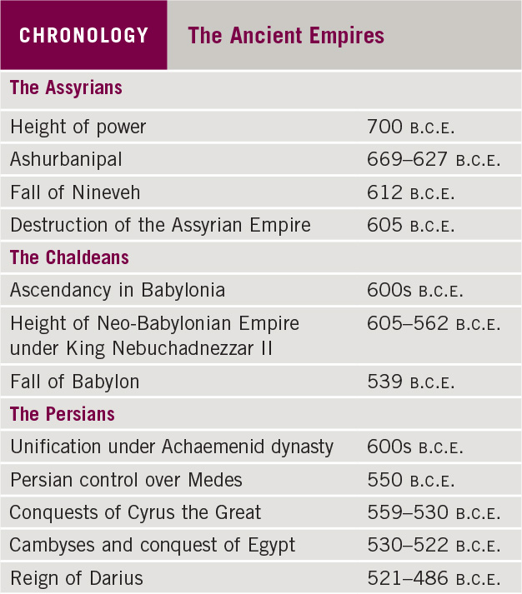
Chronology: The Ancient Empires

Slide 21
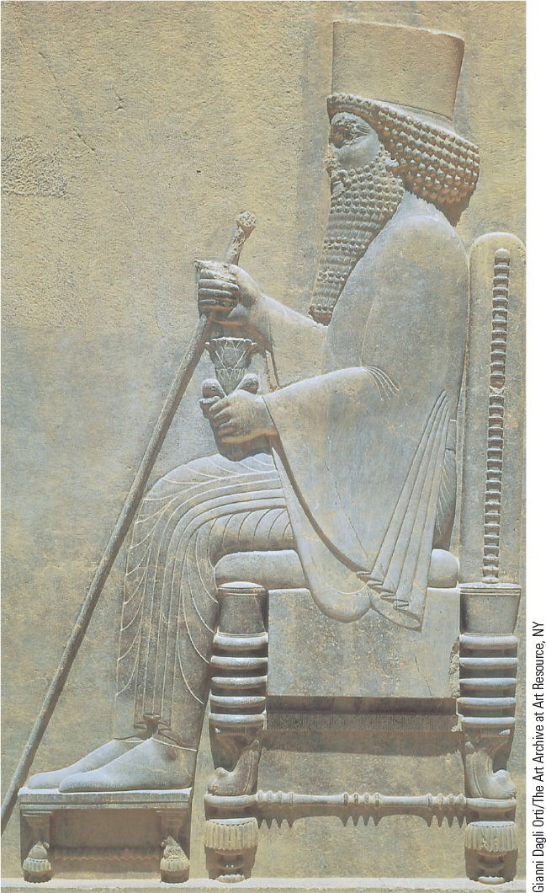
2.6 Darius, the Great King. Darius holds symbols of royal authority while seated on his throne in Persepolis.

Slide 22
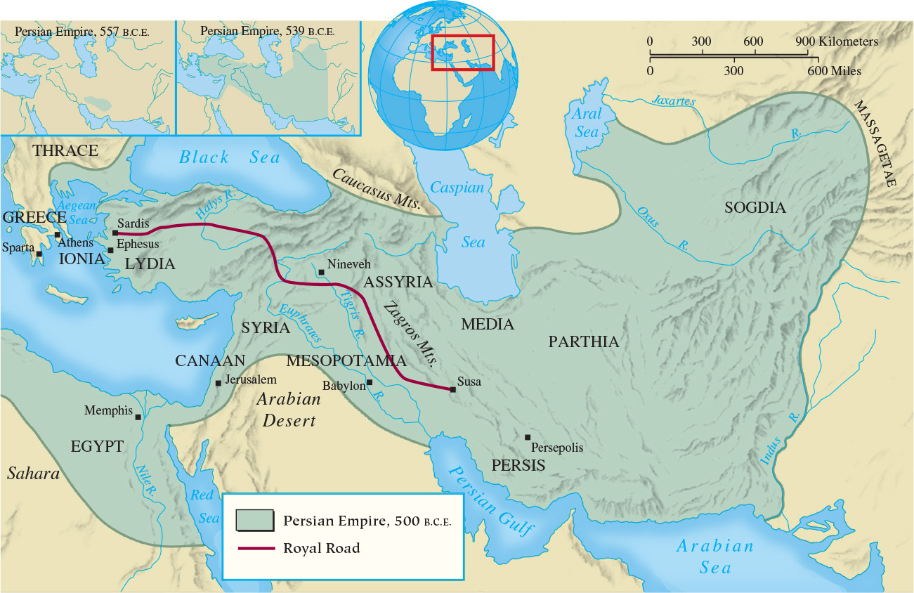
Map 2.4 Persia at the Time of Darius

Slide 23
Chapter 2 Summary
Around 1200 b.c.e., a power vacuum allowed a patchwork of petty kingdoms and city-states to emerge, especially in the area of Syria and Canaan.
Despite its domination by larger empires, Israel left a spiritual legacy of monotheism that influenced much of the later development of Western Civilization.
The Assyrian Empire was built on the effective use of military force and united much of the ancient Near East.
The tolerant Persian Empire created two centuries of peace that facilitated trade.

Slide 24
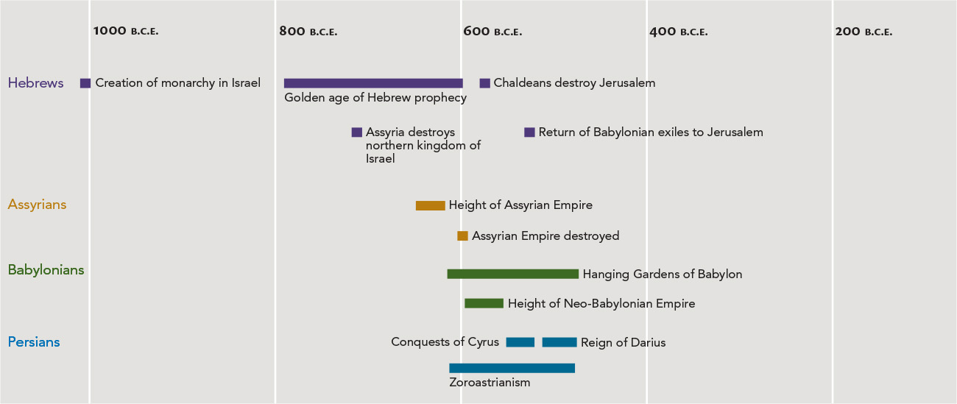
Chapter 2 Timeline

