Slide 1
WESTERN CIVILIZATION: A Brief History
Tenth Edition
CHAPTER 1
The Ancient Near East: The First Civilizations
© 2020 Cengage. All rights reserved.

Slide 2
Chapter 1 OUTLINE
1-1 The First Humans
1-2 The Emergence of Civilization
1-3 Civilization in Mesopotamia
1-4 Egyptian Civilization: “The Gift of the Nile”

Slide 3
1-1 THE FIRST HUMANS (1 OF 2)
Focus Question: How did the Paleolithic and Neolithic Ages differ, and how did the Neolithic Revolution affect the lives of men and women?
Hominids
  Australopithecines (3–4 million years ago)
  Homo Erectus (1.5 million years ago)
The emergence of Homo sapiens (“wise human being”)
  Neanderthals (ca. 100,000–30,000 years ago)
    More advanced stone tools; burial of the dead
  Homo sapiens sapiens (ca. 200,000 b.c.e.–Present): replaced Neanderthals
  The spread of humans: out of Africa or multiregional?

Slide 4
1-1 THE FIRST HUMANS (2 OF 2)
The Hunter-Gatherers of the Old Stone Age
  Small, nomadic bands
  Food, shelter, and tools: adaptability
The Neolithic Revolution (ca. 10,000–4000 b.c.e.)
  Consequences of the shift to systematic agriculture
    Permanent settlement with trade, specialized division of labor, and improved tools
    Emergence of patriarchy
    Domestication of animals
    Development of writing
    Use of metals and the coming of the Bronze Age (ca. 3000 b.c.e. – ca. 1200 b.c.e.)

Slide 5
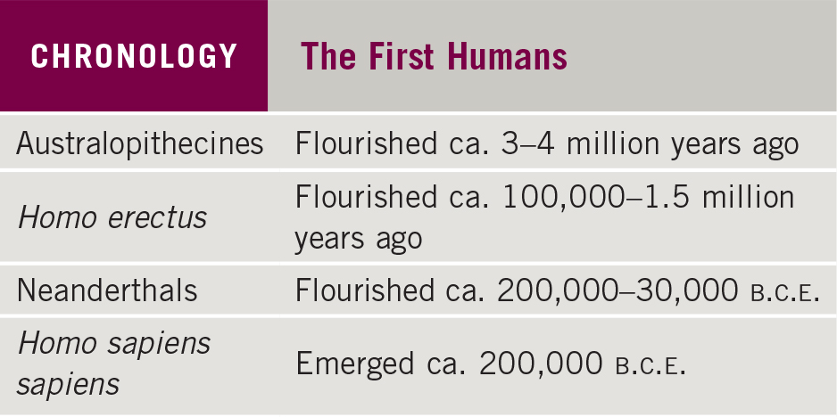
Chronology: The First Humans

Slide 6
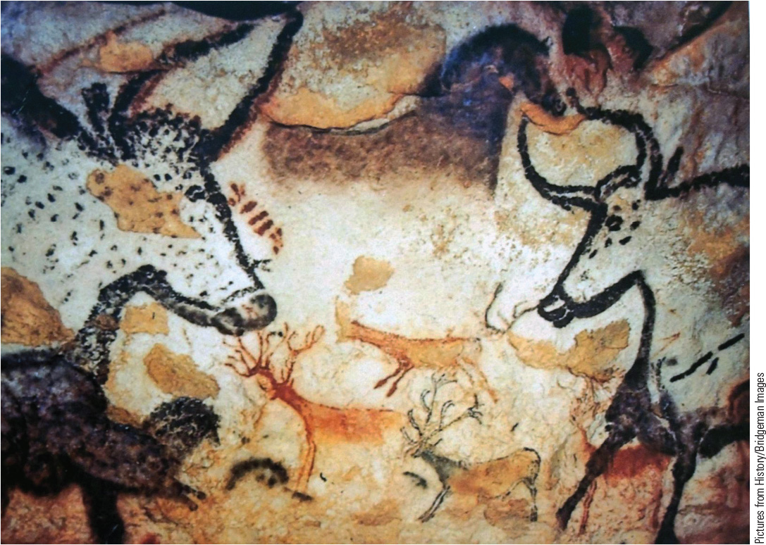
1.2 Paleolithic Cave Painting: The Lascaux Cave. This work, dated around 15,000 B.C.E., demonstrates the creativity of Paleolithic peoples.

Slide 7
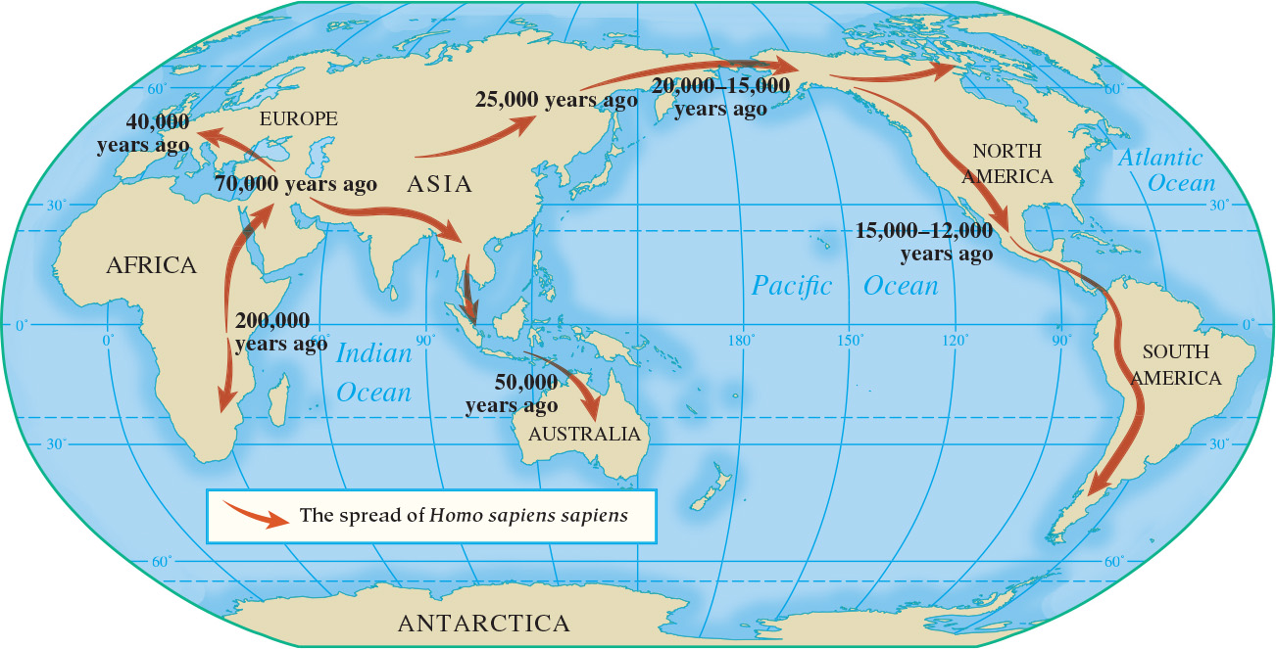
Map 1.1 The Spread of Homo sapiens sapiens

Slide 8
1-2 THE EMERGENCE OF CIVILIZATION (1 OF 2)
Focus Question: What are the characteristics of civilization, and what are some explanations for why early civilizations emerged?
The basic characteristics of civilization
  Urban focus
  Distinct religious structure
  Political and military structures
  Social structure based on economic power
  Development of writing
  Significant artistic and intellectual activity

Slide 9
1-2 THE EMERGENCE OF CIVILIZATION (2 OF 2)
Centers of early civilization beyond Southwest Asia and Egypt
  Indus River Valley in India
  Yellow River Valley in China
  Central Asia
  Supe River Valley in Peru
Why did early civilizations develop?
  The importance of material forces (growth of food surpluses)
  The importance of nonmaterial forces (religious)

Slide 10
1-3 Civilization in Mesopotamia (1 of 2)
Focus Question: How are the chief characteristics of civilization evident in ancient Mesopotamia?
The city-states of ancient Mesopotamia
  Sumerian cities: walled, featuring a temple dedicated to a god/goddess (ziggurat)
  Kingship: divine in origin
  Economy and society: agriculture, trade, social hierarchy
Empires in ancient Mesopotamia
  The Akkadians
  The Babylonians
    The Code of Hammurabi: strict justice based on status

Slide 11
1-3 Civilization in Mesopotamia (2 of 2)
The culture of Mesopotamia
  The importance of religion
    The impact of the physical environment
    Polytheistic religion
    The practice of divination
  Cuneiform writing
    Record keeping and literature

Slide 12
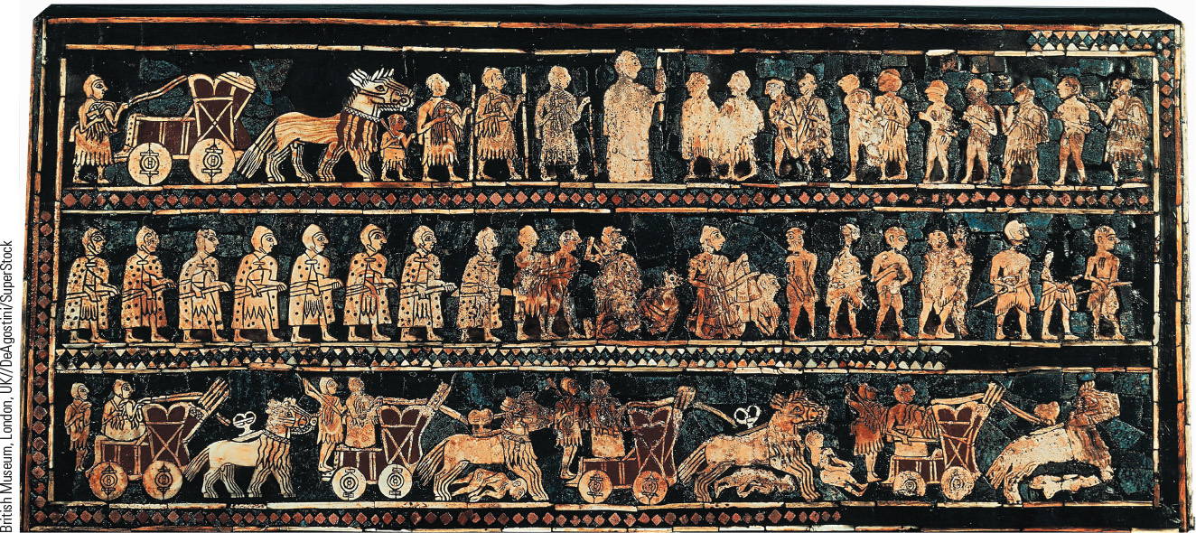
1.3 The ”Royal Standard” of Ur. This image, dated around 2700 B.C.E., was found in a Sumerian royal tomb and demonstrates the king’s military activities.

Slide 13
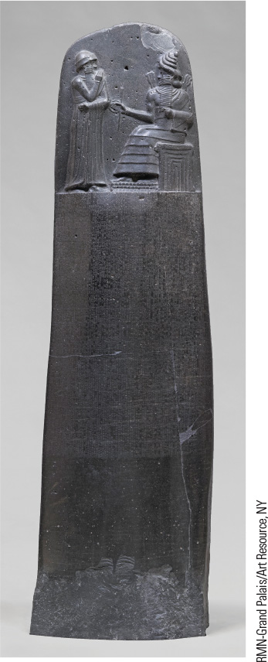
1.4a The Stele of Hammurabi. This image depicts Hammurabi receiving the power to rule from the sun god Shamash.

Slide 14
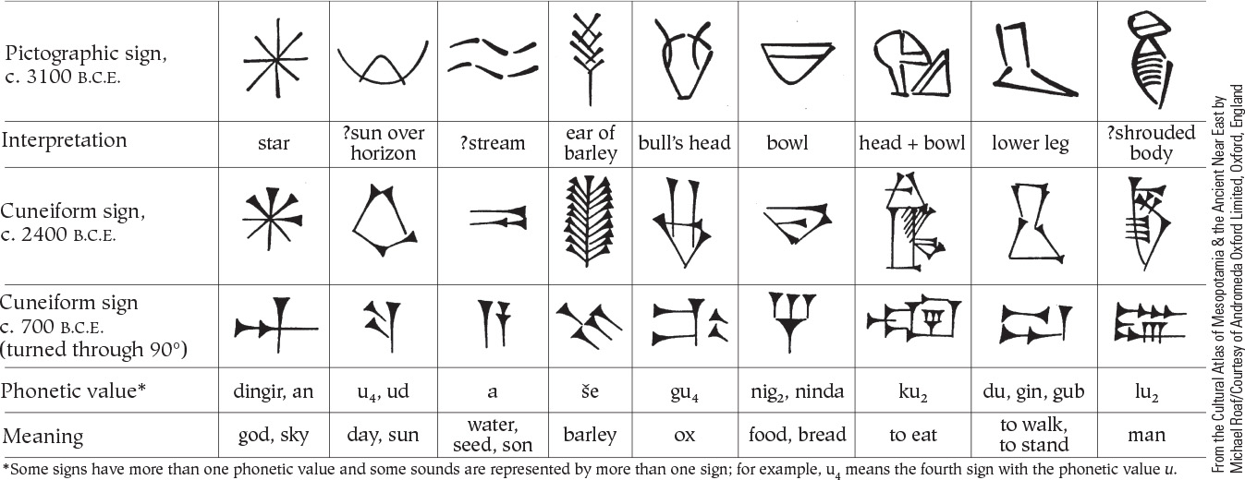
1.5b The Development of Cuneiform Writing. This table shows the development of writing from pictographic signs to cuneiform characters.

Slide 15
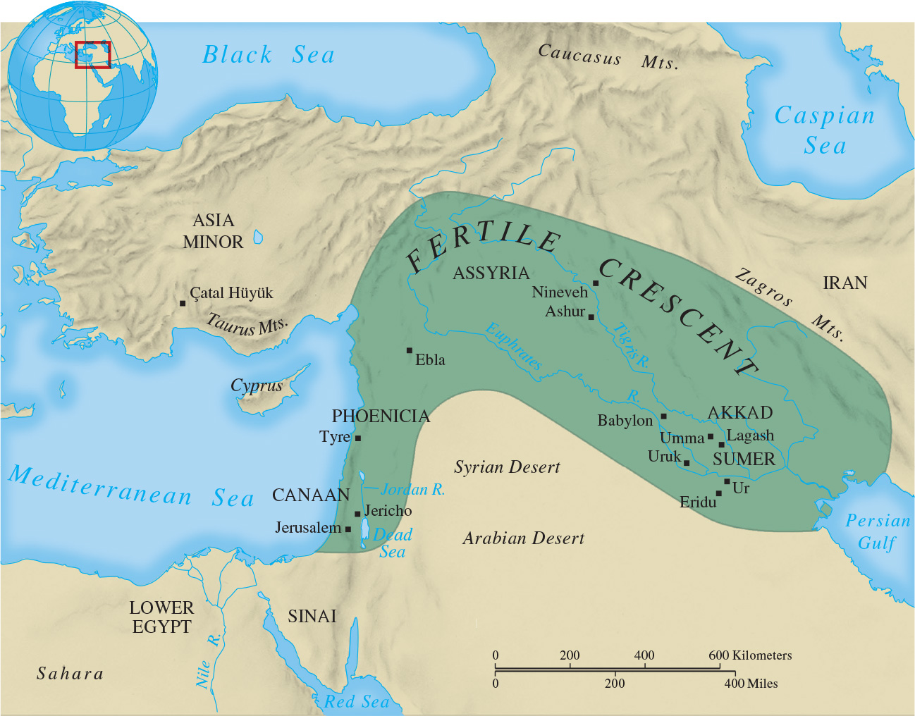
Map 1.6 The Ancient Near East

Slide 16
1-4 Egyptian Civilization: “The Gift of the Nile” (1 of 4)
Focus Questions: What are the basic features of the three major periods of Egyptian history? What elements of continuity are there in the three periods? What are their major differences?
The impact of geography
  The annual flooding of the Nile
  Agricultural prosperity
  Protective natural barriers
The Old and Middle Kingdoms
  Divine kingship during the Old Kingdom (2575–2125 b.c.e.)
  The return of stability during the Middle Kingdom (2010–1630 b.c.e.)

Slide 17
1-4 Egyptian Civilization: “The Gift of the Nile” (2 of 4)
Society and economy in ancient Egypt
  Hierarchical organization
The culture of Egypt
  Spiritual life in Egyptian society
    Worship of sun, river, and land deities
    Emphasis on morality
  The pyramids
  Art and writing
    Hieroglyphics (“priest carvings”)

Slide 18
1-4 Egyptian Civilization: “The Gift of the Nile” (3 of 4)
Disorder and a new order: The New Kingdom
  Disruption of the Hyksos
  Reunification in the New Kingdom (ca. 1539–1069 b.c.e.)
    The rule of Hatshepsut (ca. 1473–1458 b.c.e.), female ruler
    Amenhotep IV (ca. 1364–1347 b.c.e.) and failed religious change
      The worship of Aten
    Ramesses II (ca. 1279–1213 b.c.e.)

Slide 19
1-4 Egyptian Civilization: “The Gift of the Nile” (4 of 4)
Daily Life in Ancient Egypt
  Marriage
    Monogamy as general rule
    Arranged by parents
    Husband as master of the house
    Wife in charge of the household and the education of children
    Adultery strictly prohibited

Slide 20
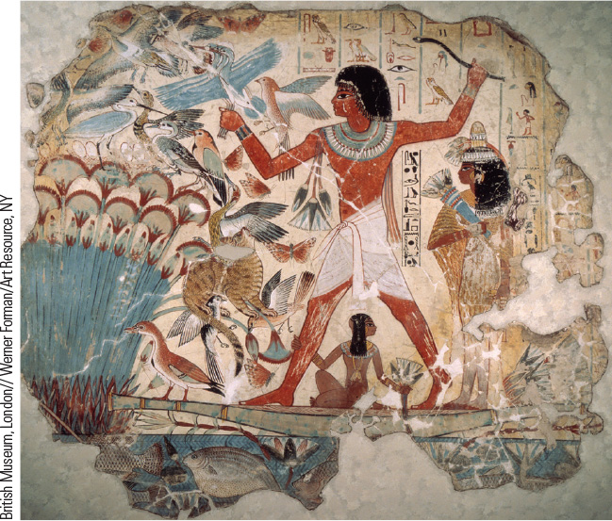
1.7a The Egyptian Diet. The image shows a hunting scene from the Eighteenth-Dynasty tomb of Nebamun in Thebes.

Slide 21
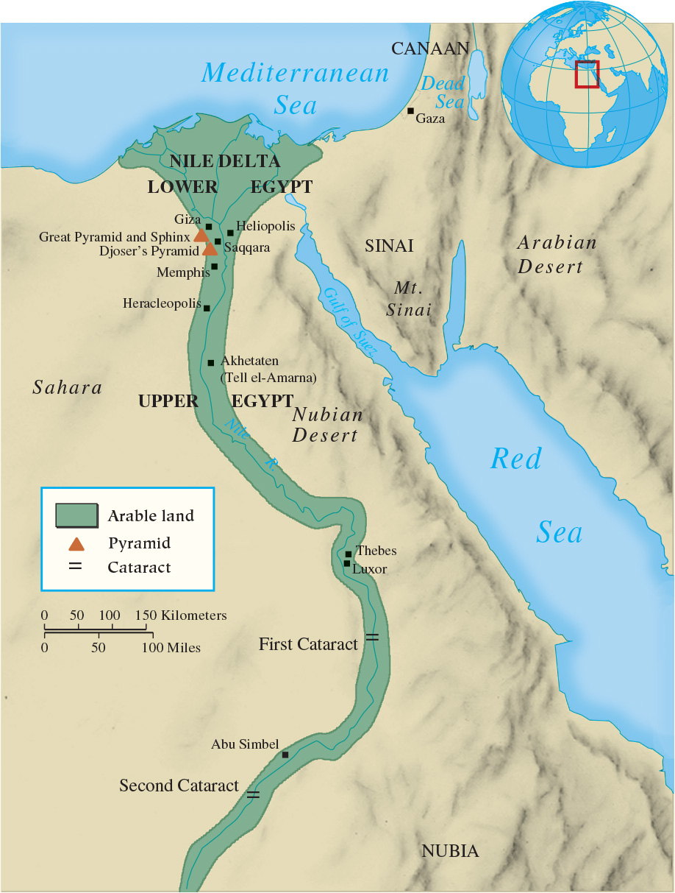
Map 1.7 Ancient Egypt

Slide 22
Chapter 1 Summary
Paleolithic people were nomads who hunted and gathered.
The Neolithic Revolution introduced systematic agriculture and led to permanent settlements.
The first civilizations saw significant growth in population, the rise of cities, and the emergence of governments.
The peoples of Southwest Asia and Egypt laid the foundation of Western civilizations.

Slide 23
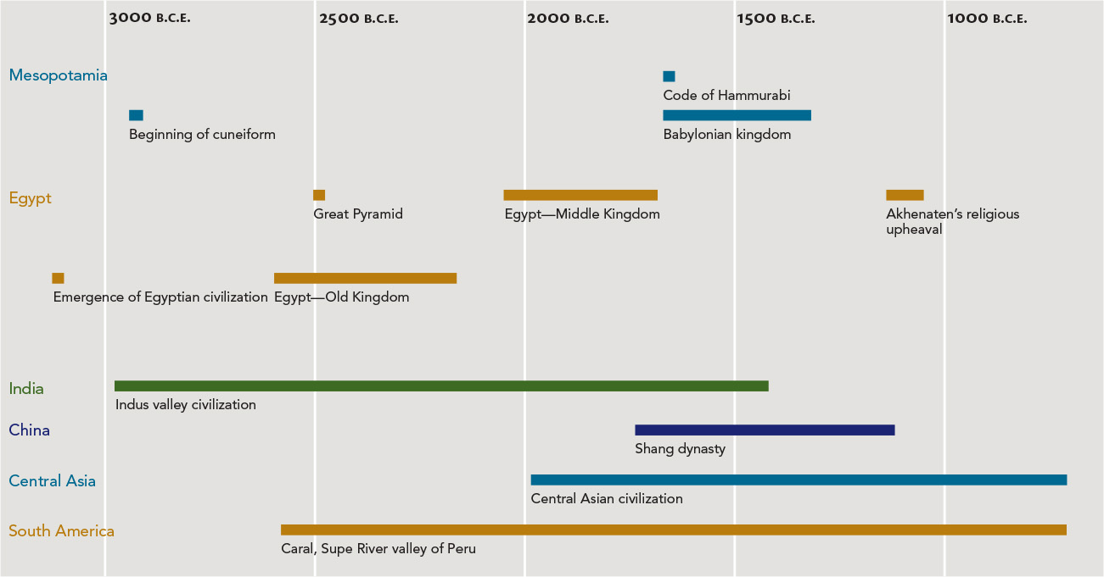
Chapter 1 Timeline

